Slide 1
NetBeans Java Swing Desktop App with CRUD Operations Using MySql

Slide 2
Contents
1
Introduction
4
CRUD
Before starting
Basic CRUD from Mysql
2
BASIC OOP
5
Question and Answer
Class Inheritance, Class Over ridding
Tips tech
3
Java Swing Application
Swings Controls

Slide 3
HELLO “I AM LEONARDO LOUIE ORDONEZ”

Slide 4

WHAT IS JAVA
Java is a computer programming language. It enables programmers to write computer instructions using English-based commands instead of having to write in numeric codes. It’s known as a high-level language because it can be read and written easily by humans.

Slide 5
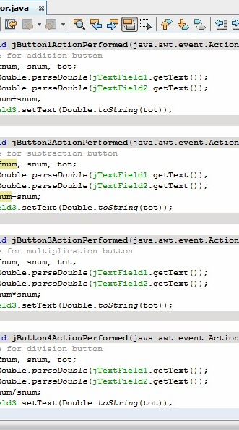
WHAT IS NETBEANS
NetBeans IDE is the official IDE for Java 8. With its editors, code analyzers, and converters, you can quickly and smoothly upgrade your applications to use new Java 8 language constructs functional operations, and method references.

Slide 6
JAVAX SWING
Part of the Java Foundation Classes (JFC)
Provides a rich set of GUI components
Used to create a Java program with a graphical user interface (GUI)
table controls, list controls, tree controls, buttons, and labels, and so on…

Slide 7
What features are available?
GUI components like button, checkbox, and so on…
Java 2D API: images, figures, animation
Pluggable look and feel: use samples or create your own
Data Transfer: cut, copy, paste, drag & drop
Internationalization: supports different input language, right to left reading
Accessibility API: for people with disabilities
Undo Framework API: supports unlimited numbers of actions to undo and redo
Flexible Deployment: run within a browser as an applet or Java Web Start

Slide 8

How does HelloWorld look like?
import javax.swing.*;
public class HelloWorldSwing {
private static void createAndShowGUI() {
//Create and set up the window.
JFrame frame = new JFrame("HelloWorldSwing");
frame.setDefaultCloseOperation(JFrame.EXIT_ON_CLOSE);
//Add the ubiquitous "Hello World" label.
JLabel label = new JLabel("Hello World");
frame.getContentPane().add(label);
//Display the window.
frame.pack();
frame.setVisible(true);
}
public static void main(String[] args) {
//Schedule a job for the event-dispatching thread:
//creating and showing this application's GUI.
javax.swing.SwingUtilities.invokeLater(new Runnable() {
public void run() {
createAndShowGUI();
}
});
}
}

Slide 9
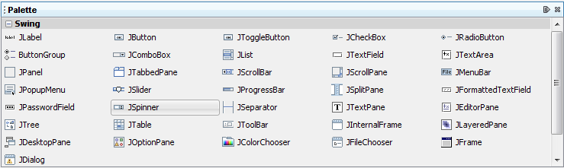
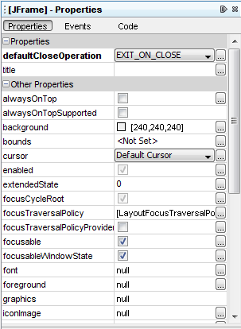
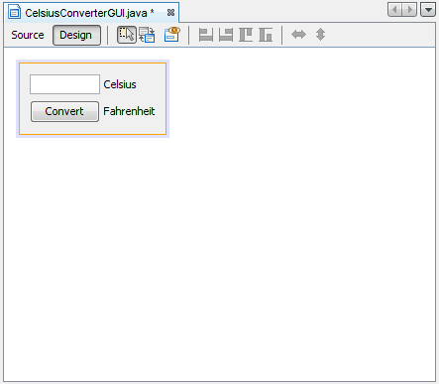
About us

Slide 10
ADVANTAGES
Java Swing is easier to learn than others because it’s Java
You can use any helpful tools out there that are for Java development like eclipse IDE, NetBeans IDE
Lacks live graphical and interactive help while developing
Has unlimited possibilities depending on how you implement your software

Slide 11
JAVA OOP BASICS

Slide 12
CRUD
SETUP IDE
JDBC CONNECTOR
CODE
DEPLOY
DATABASE SETUP
CREATE UI
TEST

Slide 13
TECH STACK
MYSQL
JDBC Connector
NetBeans IDE

Slide 14
CREATING UI USING JAVA SWING

Slide 15
CREATE DATABASE
SYNTAX
CREATE DATABASE NAME
EX.
CREATE DATABASE USER

Slide 16
CREATE TABLE
SYNTAX
CREATE TABLE TABLE_NAME(column_name constraint, type … , ) ;

Slide 17
LIBRARIES
import java.sql.Connection;
import java.sql.DriverManager;
import java.sql.ResultSet;
import java.sql.Statement;
import java.util.ArrayList;
import javax.swing.table.DefaultTableModel;
import java.lang.*;
import javax.swing.JOptionPane;
import javax.swing.table.TableModel;

Slide 18
DATABASE CONNECTION
Code
public Connection getConnection()
{
Connection con;
try {
con = DriverManager.getConnection("jdbc:mysql://localhost:3306/db_handson","root", "root");
return con;
} catch (Exception e) {
e.printStackTrace();
return null;
}
}

Slide 19
SETTING UP ARRAY LIST
CODE
public class User {
private int id, age;
private String firstname;
private String lastname;
public User(int id, String firstname, String lastname, int age)
{
this.id = id;
this.firstname= firstname;
this.lastname= lastname;
this.age = age;
}
public int getId()
{
return id;
}
public String getFirstname()
{
return firstname;
}
public String getLastname()
{
return lastname;
}
public int getAge()
{
return age;
}
}

Slide 20
TRANSFERING DATA FROM DATABASE TO ARRAY LIST USING SELECT DDL STATEMENT
CODE
public ArrayList<User> getUsersList()
{
ArrayList<User> usersList = new ArrayList<User>();
Statement st;
ResultSet rs;
Connection connection = getConnection();
String query= "SELECT * FROM db_handson.user";
try {
st = connection.createStatement();
rs = st.executeQuery(query);
User user;
while(rs.next())
{
user = new User(rs.getInt("id"), rs.getString("firstname"), rs.getString("lastname"), rs.getInt("age"));
usersList.add(user);
}
} catch (Exception e) {
}
return usersList;
}

Slide 21
TRANSEFERING ARRAY LIST TO TABLE
CODE
public void show_user_table()
{
ArrayList<User> list = getUsersList();
DefaultTableModel model = (DefaultTableModel)jTable1.getModel();
Object[] row = new Object[4];
for (int i = 0; i < list.size(); i++) {
row[0] = list.get(i).getId();
row[1] = list.get(i).getFirstname();
row[2] = list.get(i).getLastname();
row[3] = list.get(i).getAge();
model.addRow(row);
}

Slide 22
CLICK EVENT
CODE
int i = jTable1.getSelectedRow();
TableModel model = jTable1.getModel();
txtid.setText(model.getValueAt(i,0).toString());
txtfirstname.setText(model.getValueAt(i,1).toString());
txtlastname.setText(model.getValueAt(i,2).toString());
txtaddress.setText(model.getValueAt(i,3).toString());
txtage.setText(model.getValueAt(i,4).toString());
txtusername.setText(model.getValueAt(i,5).toString());

Slide 23
CRUD FUNCTION
CODE
Connection con = getConnection();
Statement st;
try {
st= con.createStatement();
if((st.executeUpdate(query))==1)
{
JOptionPane.showMessageDialog(null, "Data"+ message+ " Sucessfully");
}
else{
JOptionPane.showMessageDialog(null, "Data Not "+message);
}
} catch (Exception e)
{
}

Slide 24
CALLING FUNCTION
String query= "INSERT INTO user(firstname,lastname,age) values ('"+txtfname.getText()+"','"+txtlname.getText()+"','"+txtage.getText()+"')";
executeQuery(query, "inserted");

Slide 25
QUESTION AND ANSWER

Slide 26
“WAG MAGSETTLE SA PAGE 1 NI GOOGLE”

Slide 27
“PASSION SA GINAGAWA”

Slide 28
“BE HUMBLE NOT HUMBOG”

Slide 29
“TIWALA SA SARILI”

Slide 30
“CODES LANG NG CODES GAGALING DIN TAYO”

Slide 31
“TIWALA LANG KAY LORD”

Slide 32

The future starts today, not tomorrow.

Slide 33
Thank you!
Any questions?

Slide 34

QUESTIONS?
E-mail: Leonardolouie30@gmail.com
facebook.com/leonardolouie30
twitter.com/louieofficial30
Repositories
Github: github.com/leonardolouie30
Heroku :heroku.com/leonardolouie

