Slide 1
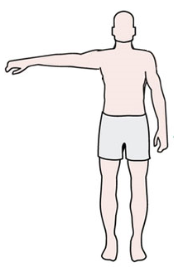

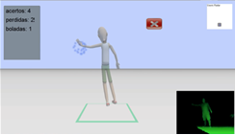







Health Monitoring System
HGM Client
Motion
Control
Game
Rendering
User
Post
Biomechanical Signal
Processing
& Statistical
Analysis
User
Database
HGM Server
Healthcare
Professional

Slide 2
Collect raw data from
MS-Kinect
Identify amplitude of abduction and adduction
movements
Start
Apply noise reduction amplitude filter
Yes
Identified
movement
cycles?
No
Biomechanical Signal Processing
Extract movement cycle
Extract movement features
Feature
Vectors
Select SVM Kernel and Parameters
Split Training and Test Data
Statistical Analysis with SVM
Check classifier performance
End

