Slide 1

S.T.A.R.S.
Student Tracking And PeRformance System
Team Members
Arroyo-Martinez, Refugio
Barunda, Jaime
Obay, Leonardo
Orejel, Edmundo

Slide 2

Introduction
Regular attendance methods are outdated
Professors, teachers, and students waste valuable time on attendance
Take back time that is wasted
Create a uniform attendance system
Revolutionize attendance-taking

Slide 3

Statistics
Normal attendance takes about 5 min a day
Attendance taken twice a week for 15 weeks
End result is 150 minutes a semester
(Time Consuming) 150 minutes is 2.5 hrs

Slide 4


What It’s For
Attendance Taking
Appointment Tracking
Data Analysis
-Budget Improvements
Behavior Improvements
-Discourages Professors
from interacting
-Encourages students to be absent

Slide 5

Our Goals
Simplify Attendance
Streamline record-keeping
Increase operational proficiency
Empower users

Slide 6


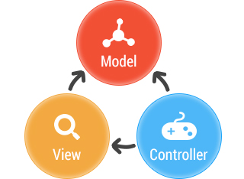
Different Approaches
Net Beans
Java applets & JSP Plugin
(MVC)Model View Controller

Slide 7

Model View Controller
Easier to manage
More modern and more flexibility
more organized
Easier to work with with a strong foundation of knowledge in Java
Controller does heavy lifting while the view helps us determine what gui to display GET RID OF THIS SLIDE

Slide 8


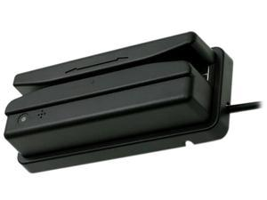

S.T.A.R.S Features
Interface with Universal Card Reader
Harness MVC Architecture
Harness MySQL
Built-in Security
Portable

Slide 9

Features
Main Website Page - GUI
-Swipe Button
-input field
Card Reader
-Populate input field on swipe
-Send input data to main controller
Main Controller
-Parse input data
-Send formatted data to Database(MySql)
DataBase - MySql
-Validate data with roster in Database
-Send back true or false

Slide 10

Features (Contd.)
Settings - For Professor Only
-Set “on-time” deadline
-Add student to roster
-Search feature
-Set course schedule
-Optional grader

Slide 11
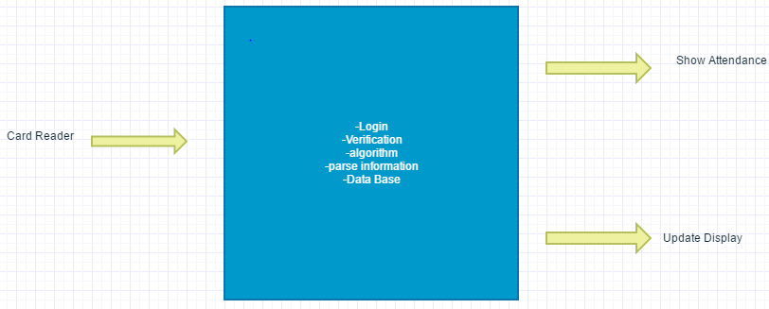
DFD Level 0

Slide 12
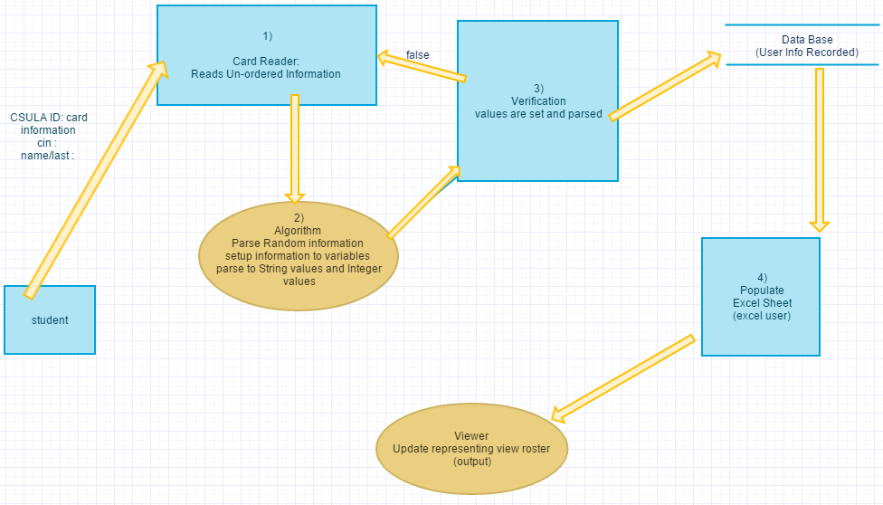
DFD Level 1

Slide 13

Future Goals
Work with wireless components
Set up web application: csns
Implementing School(s)
Lecture Halls
Other Offices

Slide 14
Sources
Teacher Picture Slide 3 https://image.freepik.com/free-photo/happy-teacher-with-students-background_1098-2917.jpg
Teacher and Student Slide 4 https://thumbs.dreamstime.com/t/students-laughing-classes-horizontal-view-43072957.jpg
Bar Graph Slide 3 https://goo.gl/9VwN8a
CSULA Logo Picture Slide 5 https://mir-s3-cdn-cf.behance.net/project_modules/disp/7361fd36850479.5606553087320.jpg
Java Lock Slide 5 https://jaxenter.com/wp-content/uploads/2013/01/lock2.jpg
Card Reader Slide 5 https://images10.newegg.com/ProductImageCompressAll300/1SR-003P-00004-02.jpg

Slide 15
Sources
Java for Android Image Slide 5: http://it-squire.com/wp-content/uploads/2017/01/java-for-android.png
Women Success Image Slide 7: http://www.ad2inc.net/wp-content/uploads/2015/11/up-up-and-away-with-success.jpg
Math Equations Man Board Slide 3: http://bigdatafinance.eu/wp/wp-content/uploads/2015/09/shutterstock_114702799.jpg
Questions People Signs Image Slide 4: http://www.what-matters.com/wp-content/uploads/2013/07/strangers.jpg
Teacher Students Raising Hands Image Slide 1: http://blog.tutor.com/wp-content/uploads/2012/06/teacher-class-K12PDbooth-sm.jpg
Components Puzzle Image Slide 9: http://www.regblog.org/wp-content/uploads/four%20puzzle.jpg

Slide 16
Sources
Software Engineer Image Slide 10: https://i.ytimg.com/vi/vt79JcPfZQA/maxresdefault.jpg
Success People High-Five Image Slide 13: http://ticsoftware.com/blog/wp-content/uploads/2013/06/happy_office_people-resized-600.png
Teacher Students Image Slide 4: https://vaibhavkumarsinha554.files.wordpress.com/2015/03/college-students.jpg
Generic Businessman Image Slide 2: http://www.spiritfountain.com/wp-content/uploads/2012/03/Kozzi-businessman-spinning-a-globe-1688x1243.jpg

