Slide 1
HIGH-LEVEL SYNTHESIS OF QUANTUM CIRCUITS FROM C VIA MLIR AND QUANTUM-AWARE INTERMEDIATE REPRESENTATIONS
Code Transformation and Optimization
AA 2024/2025
Leonardo Ignazio Pagliochini | 10707169
Francesco Rosnati | 10562427

Slide 2
Table of contents
Introduction and goals
Pipeline Description
Performance analysis
Conclusions and future development
MLIR And qMLIR
Translation of C logic

Slide 3

Introduction and goals
This work introduces a compilation pipeline that synthesizes fully reversible quantum circuits directly from classical C programs.
One of the main challenges is to translate the C logic to match the
Fundamental Quantum Constraints
No Cloning
No Deleting
No Signaling
Unitarity and Reversibility
Linearity

Slide 4

Introduction and goals
Challenges of NISQ programming
Together with the quantum constraints, the compiler should take care of the physical constraints of the available quantum architecture:
Resource Efficiency
High-level synthesis and optimization
QFT-Based Operations
Intermediate representations
Classical Optimizations
Quantum Transpiling Optimizations

Slide 5


Introduction and goals
Why is addressing this challenge valuable for quantum technologies?
Because quantum computing is rapidly advancing, making the integration of classical code especially relevant
To reduce hybrid computing and shift classical routines entirely to quantum systems

Slide 6

Pipeline Description
The compilation pipeline is designed as a modular multi-stage process that transforms high-level classical programs into executable quantum circuits. It progresses through a sequence of abstractions that gradually lower the source code while preserving semantic structure and complying with quantum mechanical constraints
C Parsing and AST Generation
AST Normalization to Dataclasses
Classical IR: SSA-Based Representation
Quantum IR: Semantics and Constraint Compliance
Backend Lowering: QASM Generation

Slide 7
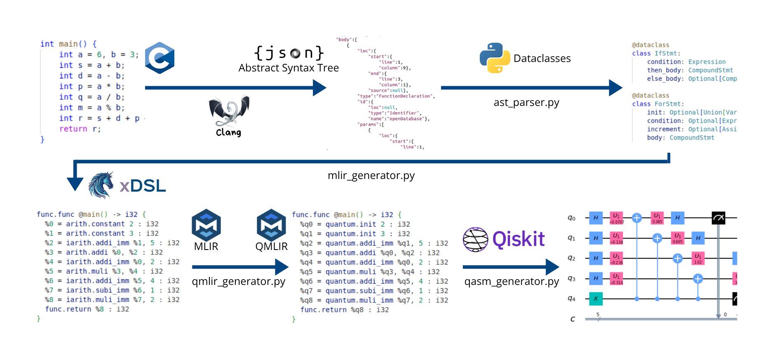
Pipeline Description
Adopted Technologies

Slide 8

Custom MLIR Dialect for C-to-IR
We define a custom MLIR-based dialect to lower a subset of C programs into a structured intermediate representation.
The dialect combines:
Standard MLIR operations (arith, func, cf, builtin)
Custom operations (iarith.*_imm) for arithmetic with constants
IF Statements
Translated using cf.cond_br
Logical && → nested if
Logical || → duplicated if blocks
FOR Loops
Translated by loop unrolling (up to MAX_UNROLL)
Each iteration includes:
condition check
body execution
increment
re-evaluation
Semantic Rules:
Each variable must be declared and initialized before use
No arrays, structs, or pointers (scalar integers only)
SSA form strictly enforced
Type | MLIR Dialect | Example
Arithmetic | arith.addi, subi, muli, divsi | %1 = arith.addi %a, %b
Immediate arith. | iarith.addi_imm, subi_imm, etc. | %1 = iarith.addi_imm %a, 5
Comparison | arith.cmpi | %cmp = cmpi slt %a, %b
Constants | arith.constant | %c = constant 42 : i32
Function | func.func, func.return | func.func @main() -> i32 { ... }
Conditionals | cf.cond_br | cond_br %cond, ^then, ^else

Slide 9
Quantum MLIR Dialect
A custom MLIR dialect for quantum arithmetic and control logic:
Replaces standard arith operations with quantum-safe equivalents
Enforces constraints such as no copying, controlled execution, and SSA integrity
Supports both classical-to-quantum translation and high-level synthesis
Quantum Arithmetic Operations
Immediate Arithmetic
Controlled Arithmetic Operations
Control Flow and Logic
Register Initialization
Operation | MLIR Syntax | Description
quantum.cmpi | %r = quantum.cmpi %a, %b [predicate] : i32 | Comparison between quantum registers (returns i1)
quantum.and | %r = quantum.and %a, %b : i1 | Logical AND on control qubits
quantum.not | %r = quantum.not %a : i1 | Logical NOT
Operation | MLIR Syntax | Description
quantum.c_addi | %r = quantum.c_addi %a, %b, %ctrl : i32 | Addition executed only if ctrl is 1
quantum.c_addi_imm | %r = quantum.c_addi_imm %a, 5, %ctrl : i32 | Immediate addition under control
(same for subi, muli, etc.)
Operation | MLIR Syntax | Description
quantum.init | %r = quantum.init 7 : i32 | Initialize quantum register with value
quantum.c_init | %r = quantum.c_init(%ctrl) 3 : i32 | Controlled initialization with ctrl
Operation | MLIR Syntax | Description
quantum.addi | %r = quantum.addi %a, %b : i32 | Quantum integer addition
quantum.subi | %r = quantum.subi %a, %b : i32 | Quantum subtraction
quantum.muli | %r = quantum.muli %a, %b : i32 | Quantum multiplication
quantum.divsi | %r = quantum.divsi %a, %b : i32 | Signed division
Operation | MLIR Syntax | Description
quantum.addi_imm | %r = quantum.addi_imm %a, 5 : i32 | Add immediate to quantum register
quantum.subi_imm | %r = quantum.subi_imm %a, 3 : i32 | Subtract immediate
quantum.muli_imm | %r = quantum.muli_imm %a, 2 : i32 | Multiply by immediate
quantum.divsi_imm | %r = quantum.divsi_imm %a, 4 : i32 | Divide by immediate

Slide 10

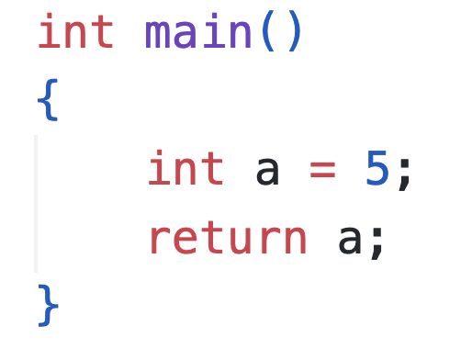
Translation of C logic: Integer Representation
The system allows scalar integer declarations with optional initialization and supports assignments to named variables. Each integer is represented in the quantum computer by a quantum register using two's complement representation. Initialization is performed by applying NOT gates to the qubits that need to be set to one.
1
0
1
0
5 = 000101
0
0

Slide 11
Translation of C logic: Operations
add_in_place : Adds two quantum registers, modifying the first register with the result add : Adds two quantum registers, storing the result in a new register addi_in_place : Adds a classical integer to a quantum register, modifying the input register addi : Adds a classical integer to a quantum register, result stored in a new register sub : Subtracts one quantum register from another, returns a new register with the result subi : Subtracts a classical integer from a quantum register, returns a new register with the result invert : Negates a quantum register in two’s complement form (bitwise NOT + add 1) abs_val : Converts a quantum register to its absolute value in place
mul : Multiplies two quantum registers, result stored in a new register muli : Multiplies a quantum register by a classical constant, result stored in a new register
divu : Performs unsigned division between two quantum registers, returns quotient and remainder divui : Performs unsigned division between a quantum register and a classical divisor, returns quotient and remainder div : Performs signed division between two quantum registers, returns quotient and remainder divi : Performs signed division between a quantum register and a classical divisor, returns quotient and remainder
equal : Compares two quantum registers for equality, returns a qubit storing the result not_equal : Compares two quantum registers for inequality, returns a qubit storing the result less_than : Compares whether one quantum register is less than another, returns a qubit storing the result greater_than : Compares whether one quantum register is greater than another, returns a qubit storing the result less_equal : Compares whether one quantum register is less than or equal to another, returns a qubit storing the result greater_equal : Compares whether one quantum register is greater than or equal to another, returns a qubit storing the result
logical_and : Computes logical AND between two qubits, result stored in a new qubit logical_or : Computes logical OR between two qubits, result stored in a new qubit
initialize_variable : Creates and initializes a quantum register with a classical integer value initialize_bit : Initializes a single qubit to |0⟩ or |1⟩ based on a classical bit measure : Measures a quantum register and stores results in a classical register measure_single : Measures a single qubit and stores the result in a classical bit simulate : Simulates the quantum circuit and interprets measured output in two’s complement form
set_number_of_bits : Sets the global bitwidth used for all arithmetic operations int_to_twos_complement : Converts a classical integer to its two’s complement bit representation pad_register : Pads a quantum register with |0⟩ qubits to reach a target size

Slide 12
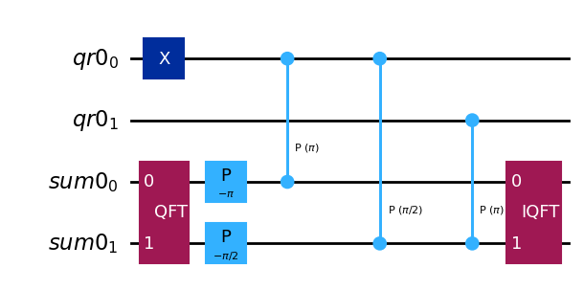
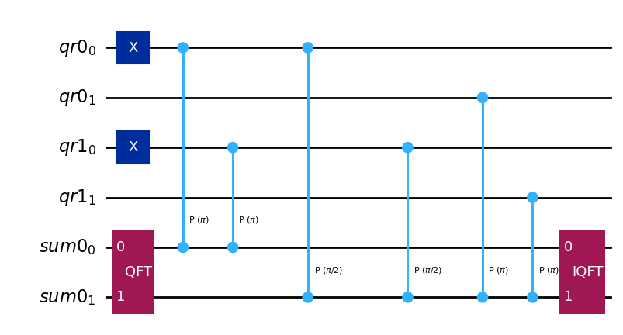
Translation of C logic: Operations
Add_imm operation
Add operation

Slide 13
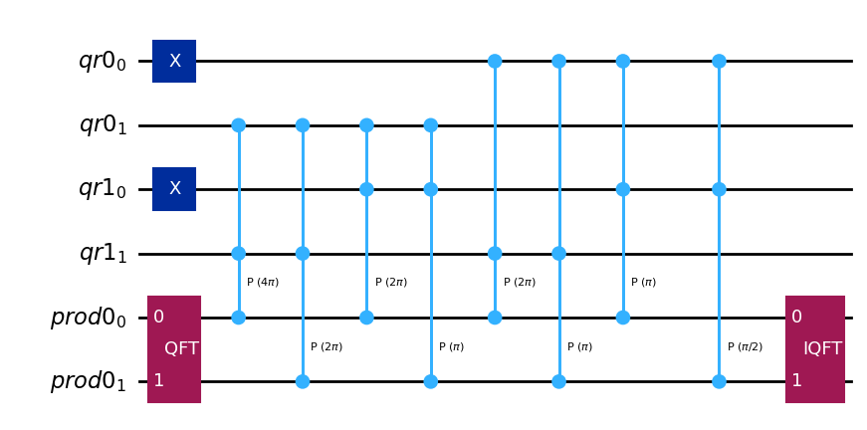
Translation of C logic: Operations
Multiplication

Slide 14
Translation of C logic: Conditional clauses
The implementation of the conditional clause is managed in two different phases of the pipeline:
AST Normalization to Dataclasses
Classical IR: SSA-Based Representation
Quantum IR: Semantics and Constraint Compliance
Definition of conditional branches that involves all the operations in and after the conditional clause
All the operation inside a conditional branch becomes controlled by the qubit that represents the boolean condition
In this way all the conditional branches are executed but the wrong ones measure zero

Slide 15
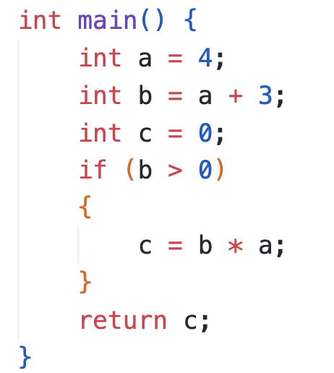
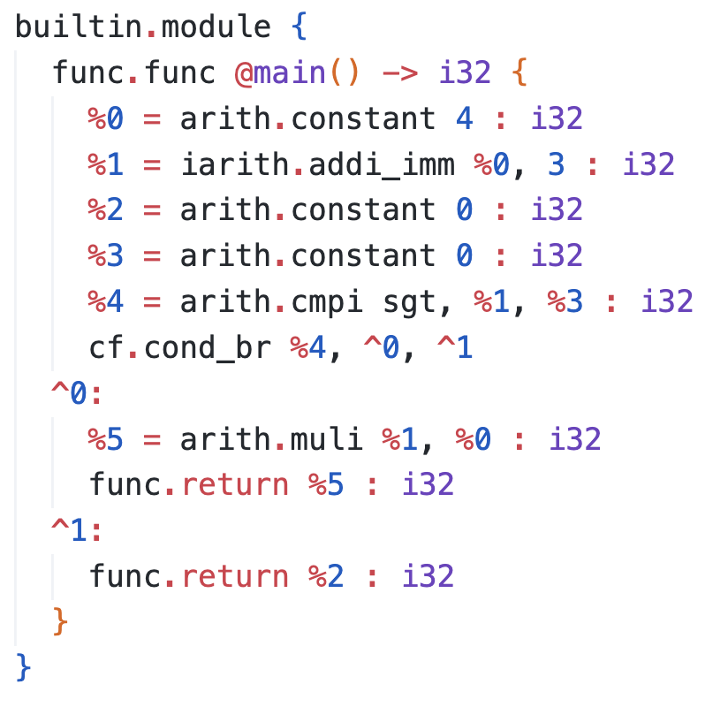
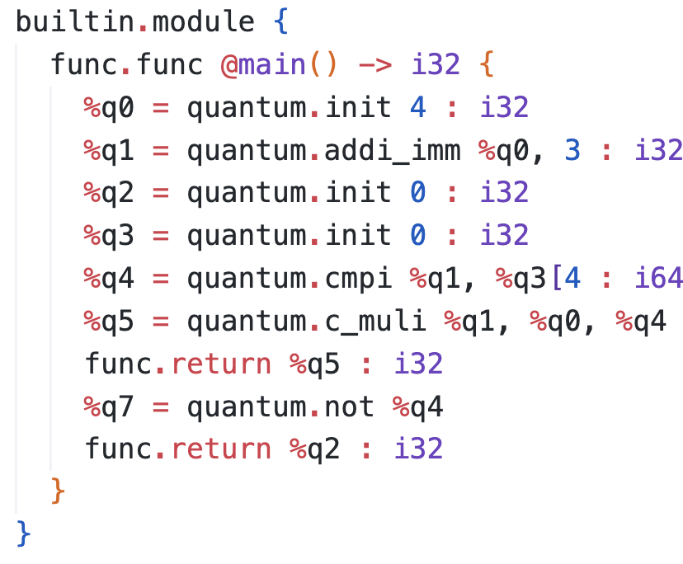
Translation of C logic: Conditional Clauses
C code
Classical IR
Quantum IR

Slide 16
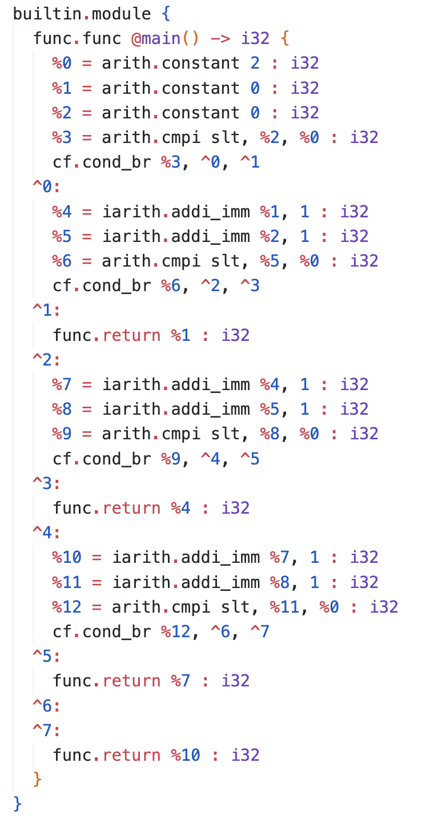
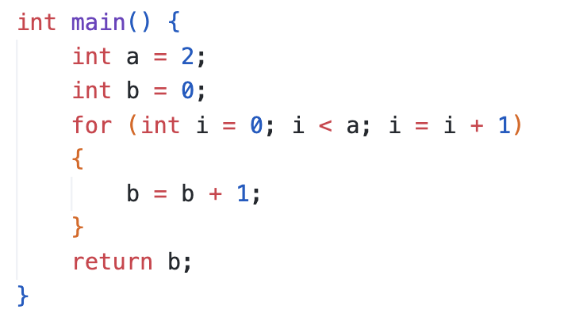
Translation of C logic: Conditional Loops
1
Loops are implemented in the quantum IR by unrolling them up to a maximum number of iterations (max_iter), rewriting them as a series of nested if clauses. This approach supports both loops with statically known and dynamically unknown bounds at compile time.
2
max_iter = 3
3
4
!!!

Slide 17
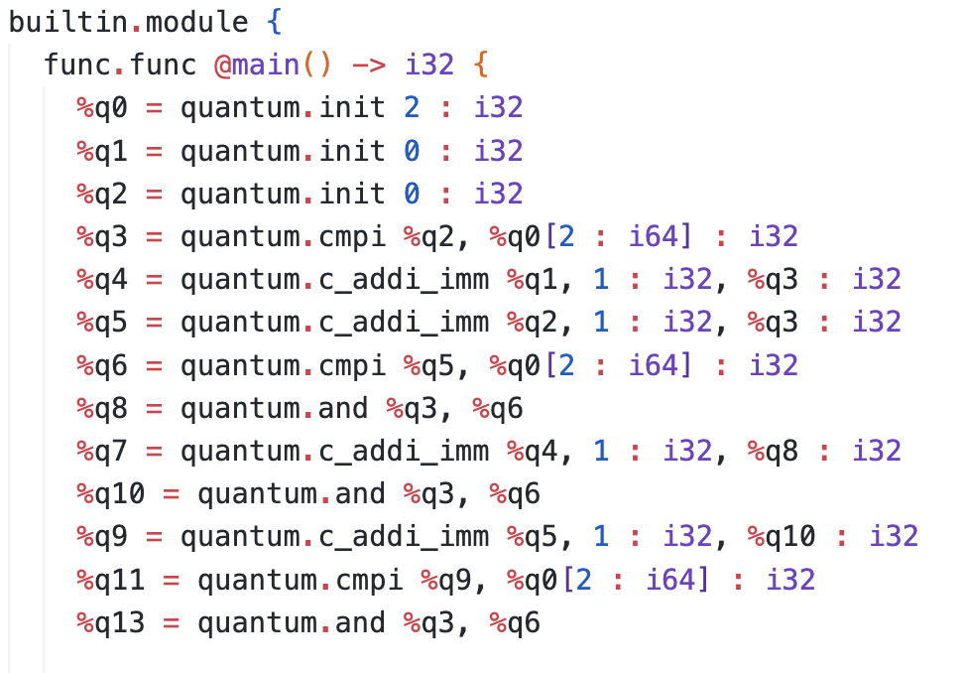
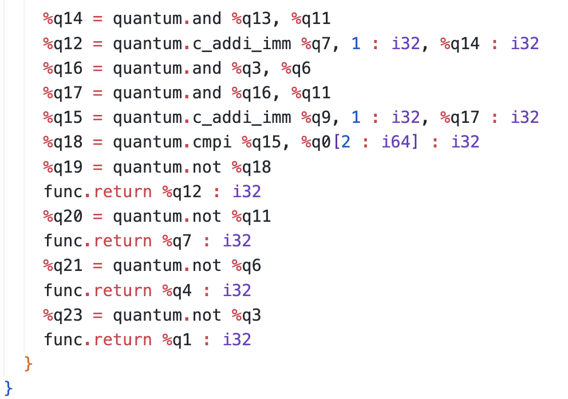
Translation of C logic: Conditional Loops

Slide 18

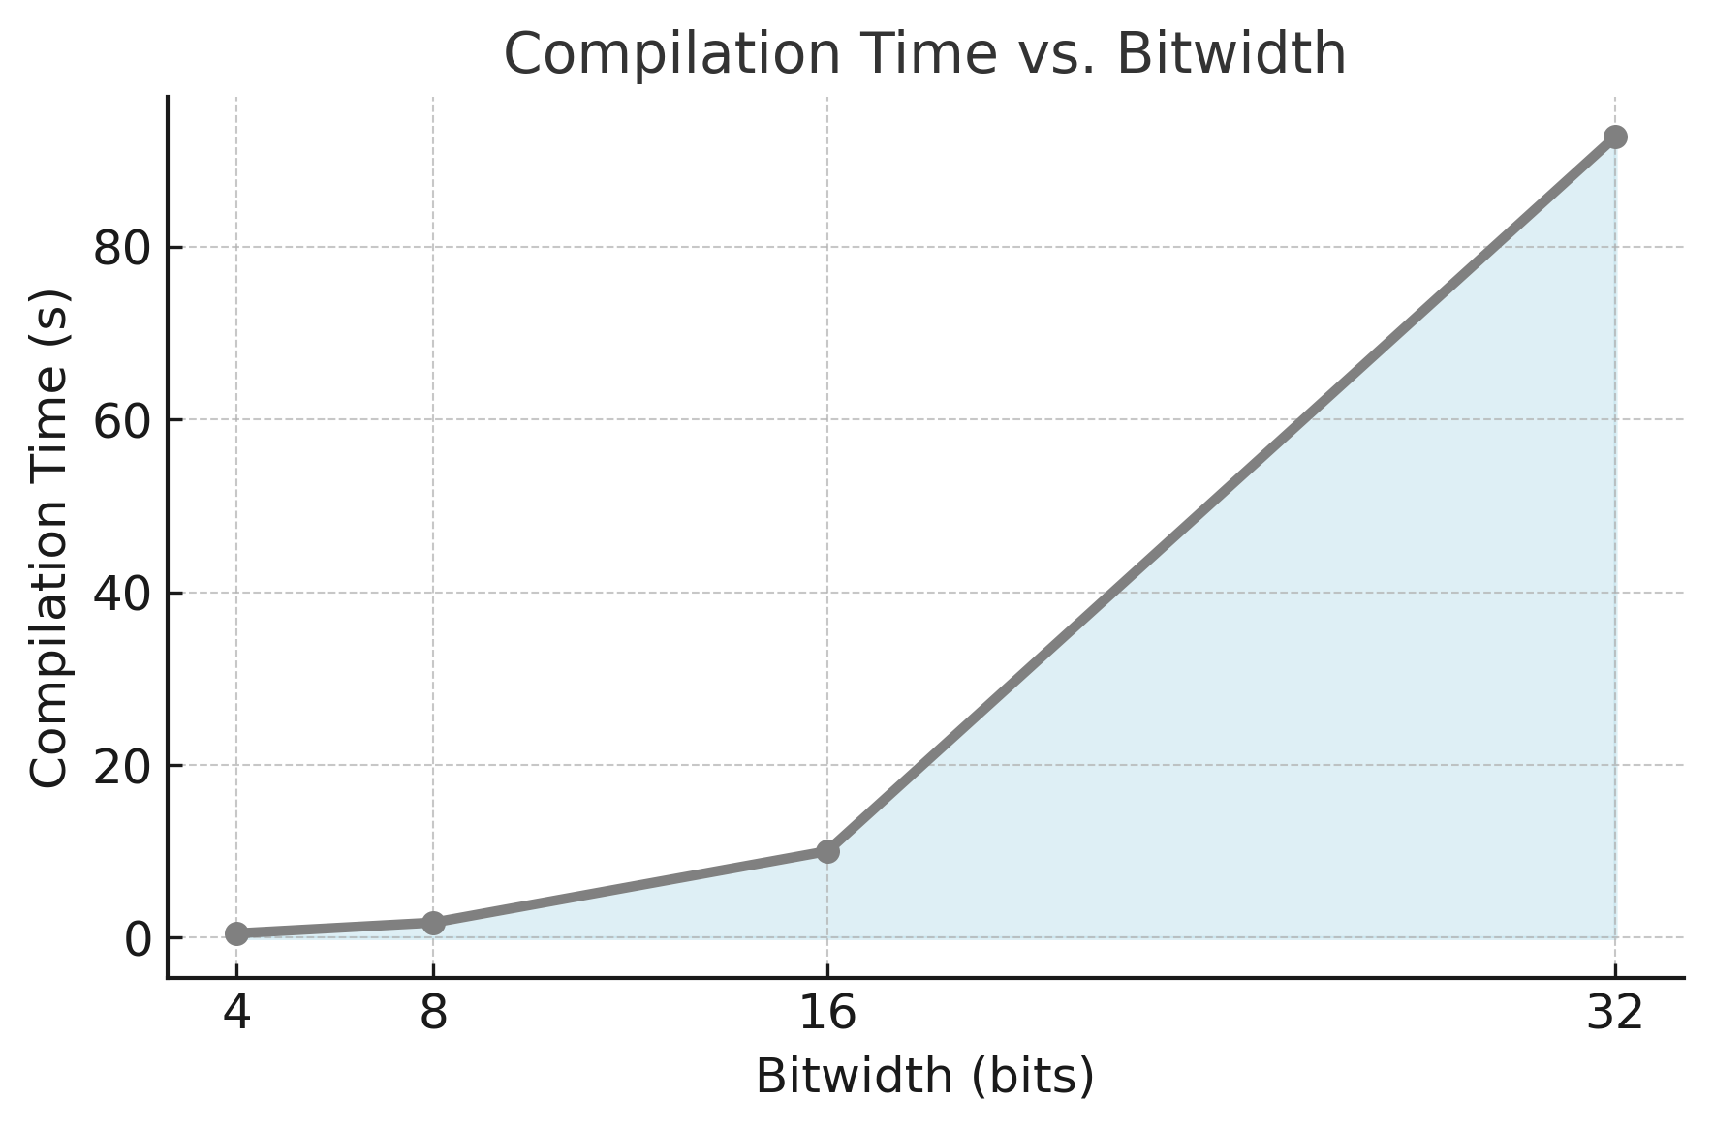
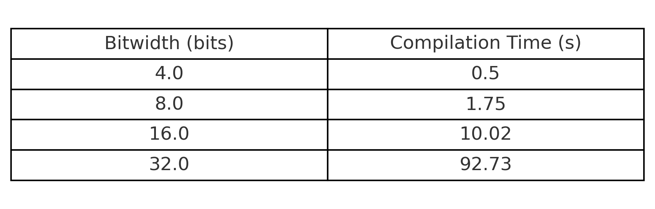
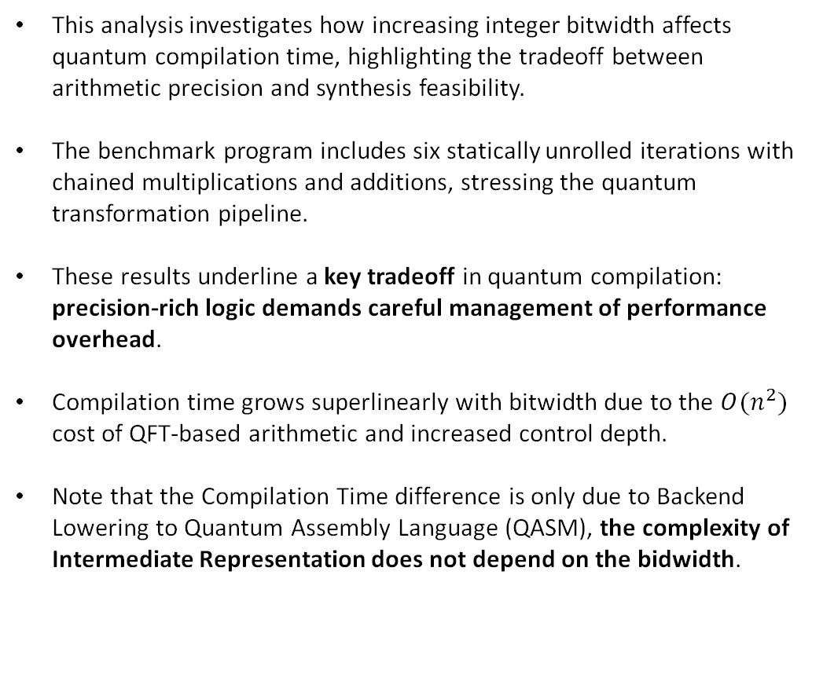
Time Benchmark: Bitwidth vs. Compilation Cost
This analysis investigates how increasing integer bitwidth affects quantum compilation time, highlighting the tradeoff between arithmetic precision and synthesis feasibility.
The benchmark program includes six statically unrolled iterations with chained multiplications and additions, stressing the quantum transformation pipeline.
These results underline a key tradeoff in quantum compilation: precision-rich logic demands careful management of performance overhead.
Compilation time grows superlinearly with bitwidth due to the $O(n^{2})$ cost of QFT-based arithmetic and increased control depth.
Note that the Compilation Time difference is only due to Backend Lowering to Quantum Assembly Language (QASM), the complexity of Intermediate Representation does not depend on the bidwidth.

Slide 19
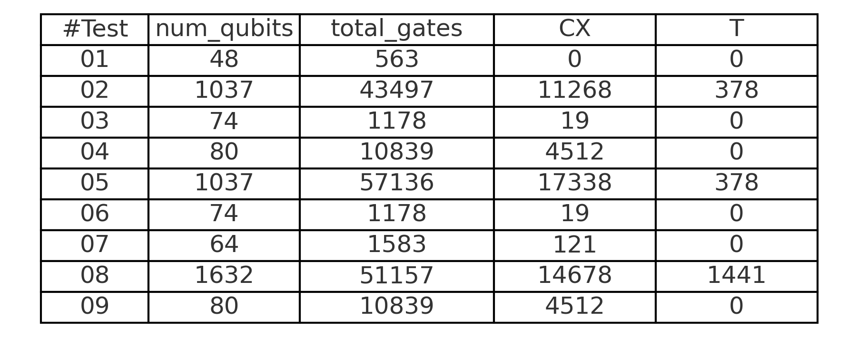
Quantum Complexity
Number of Qubits: Total number of logical qubits used in the final circuit.
Total Gate Count: Overall number of quantum gates in the synthesized circuit.
CX Gates: Number of controlled-NOT (CNOT) gates, which are crucial indicators of circuit depth and error sensitivity on real hardware.
T Gates: Number of T gates, representing the non-Clifford contribution to the overall complexity and a key metric in fault-tolerant quantum computing.
All circuits have been decomposed into the Clifford+T universal gate set to enable backend-independent complexity analysis and fair cost estimation across fault-tolerant platforms.
Due to static single assignment (SSA) and lack of in-place operations, qubit counts grow proportionally with control depth and register duplication across branches.
The complexity trends observed confirm that circuit size correlates not only with program size, but more strongly with arithmetic intensity and register bitwidth, consistent with the previous timing benchmarks.

Slide 20
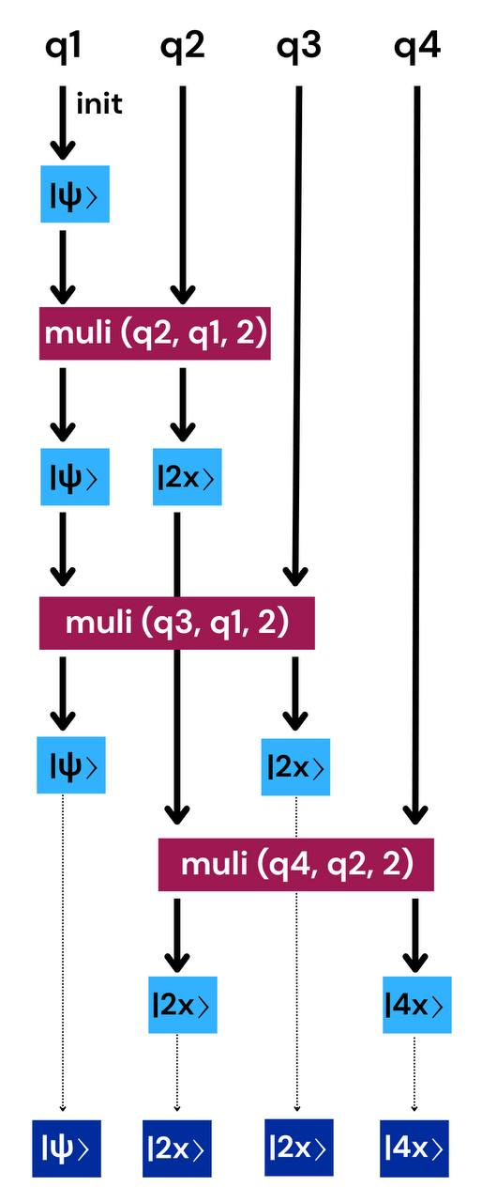
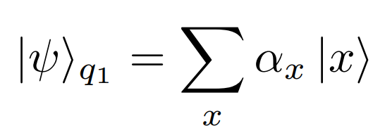
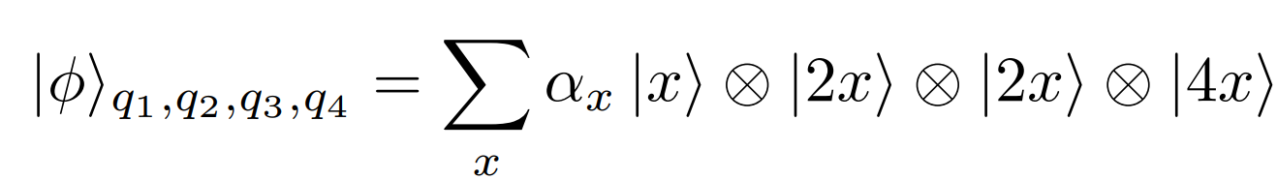
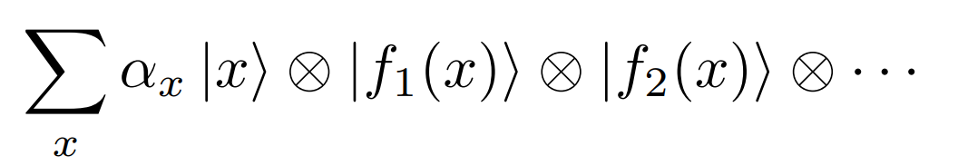
Chained Arithmetic and No-Cloning
From the example:
In general final state has form:

Slide 21
Chained Arithmetic and No-Cloning
Classical Case: No Superposition When qubits encode definite classical values, each output is deterministically derived and no entanglement arises.
Quantum Case: Superposition and Entanglement Applying arithmetic operations to superposed inputs produces entangled outputs; registers are no longer independent.
Collapse on Measurement Measuring one output register collapses all correlated registers due to entanglement, preventing reuse of partial results.
No Advantage from Postselection Even using Grover’s algorithm to amplify a desired input state, the outputs remain tied to the same classical function, with no gain over a classical path.
Core Challenge: Meaningful Superposition Use The difficulty lies not in implementing arithmetic quantumly, but in leveraging superposition for computation that cannot be classically reproduced.

Slide 22

Conclusions
Modular Quantum Compilation
We introduced a modular pipeline for synthesizing quantum circuits from high-level C programs.
The approach is based on intermediate representations (IRs) that preserve semantics and support quantum constraints like unitarity, reversibility, and SSA form.
Key Advantages:
IR-centric architecture enables semantic clarity, structural reuse, and introspection.
No early commitment to fixed transformations: abstraction levels can be revisited.
Facilitates debugging, optimization, and resource-aware synthesis.

Slide 23
Future Developments
Bidirectional and Flexible Workflows
Support for lifting QASM to quantum IR and reverse mapping to classical control logic
Enable round-trip transformations for debugging and IR-level optimization
Integrate alternative frontends (e.g., Verilog) for shared IR reuse
Dialect Interoperability
Align with existing IRs like QIRO, xDSL, and MLIR
Define translation layers between dialects
Contribute toward shared community standards for quantum IRs
Target-Aware Gate Synthesis
Support configurable native gate sets per backend
Allow architecture-specific lowering (e.g., Toffoli, MCRz)
Enable trade-offs between abstraction and performance
IR-Level Benchmarking
Compare multiple optimization stacks on:
Qubit usage
Gate count and depth
Fidelity
Facilitate reproducible experiments across toolchains

Slide 24

Thank you for the attention

Slide 26
Translation of C logic: Operations
The Quantum Fourier Transform (QFT) offers an elegant approach to implementing arithmetic operations on registers while minimizing ancilla usage.
In classical code, variables are often overwritten freely. In quantum programs, this is forbidden: all operations must be reversible, and input states must either be preserved or carefully uncomputed.
All the operations has been implemented also in the immediate form: in this way operations that involves constant does not require to instantiate a new quantum register.
All the operations has been also implemented in a controlled form for the translation of the conditional clauses

