Slide 1

University of Trento
LAP TIMING
Pivetta Leonardo
Piccinin Diego

Slide 2
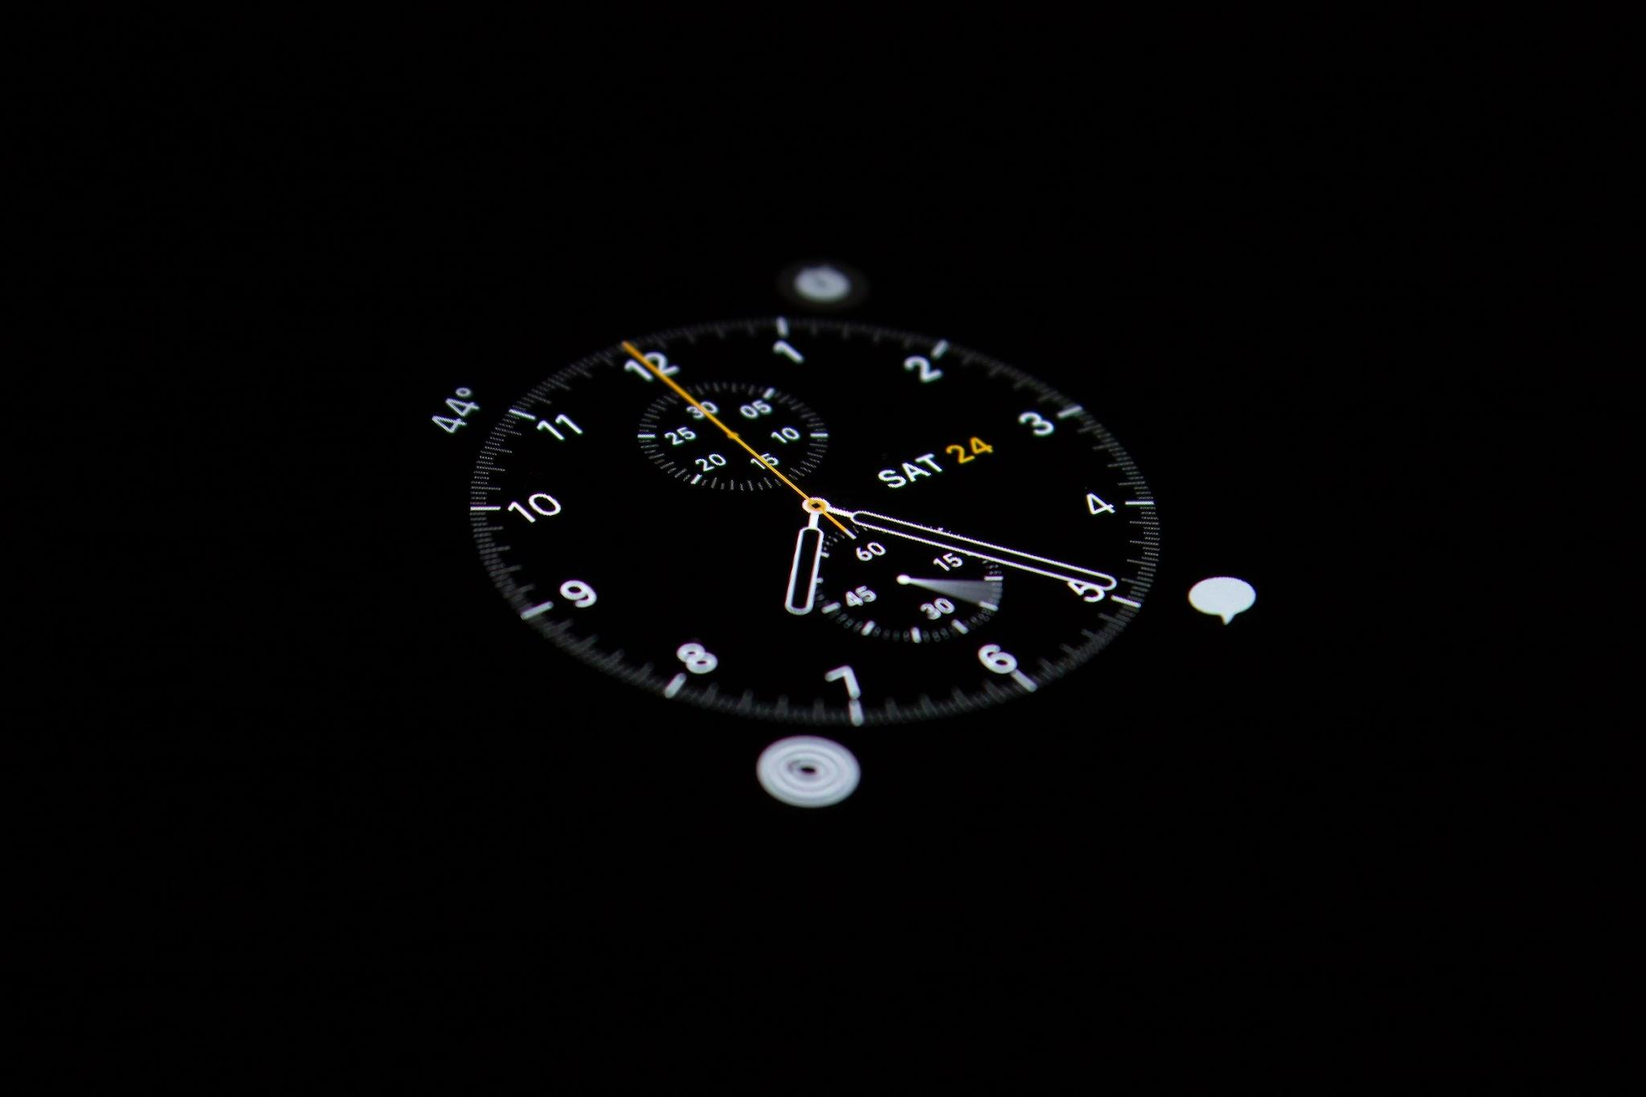
PROBLEM STATEMENT
A simple lap timing IR based solution with pit lane status detection.
Easy to setup
Expandable
Cheap

Slide 3
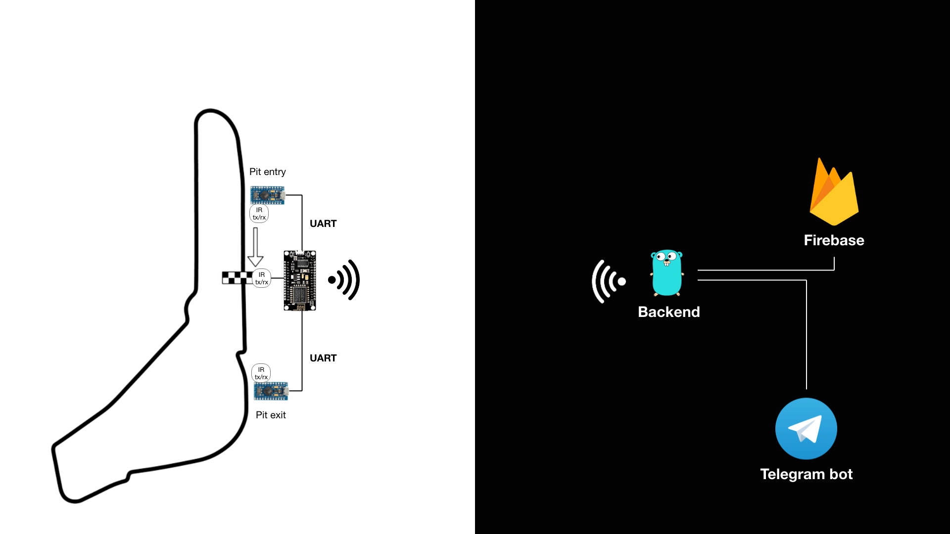

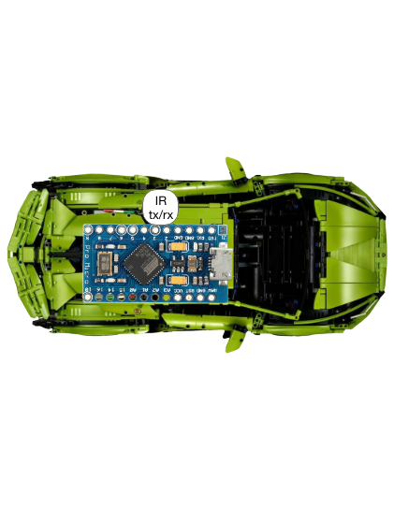
EMBEDDED
BACKEND

Slide 4
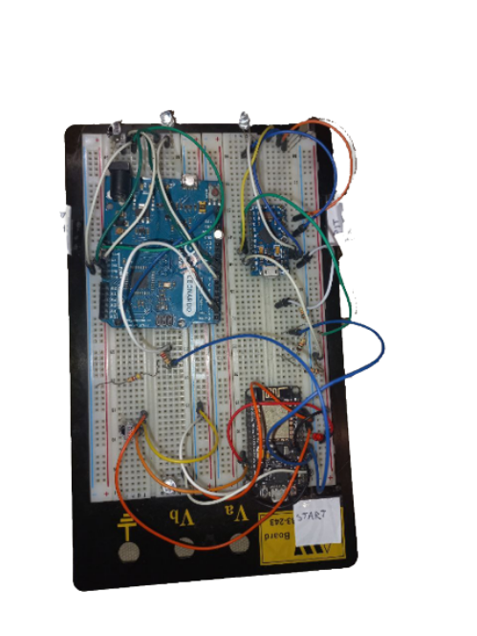
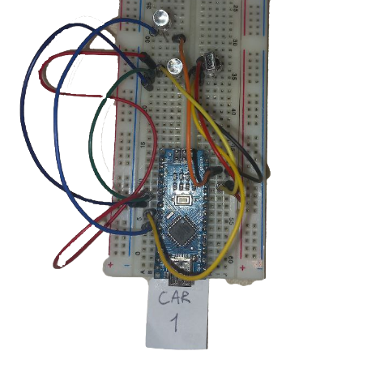
REALITY CHECK
PIT ENTRY
PIT EXIT
START
CAR
this is ugly, but works ;)

Slide 5
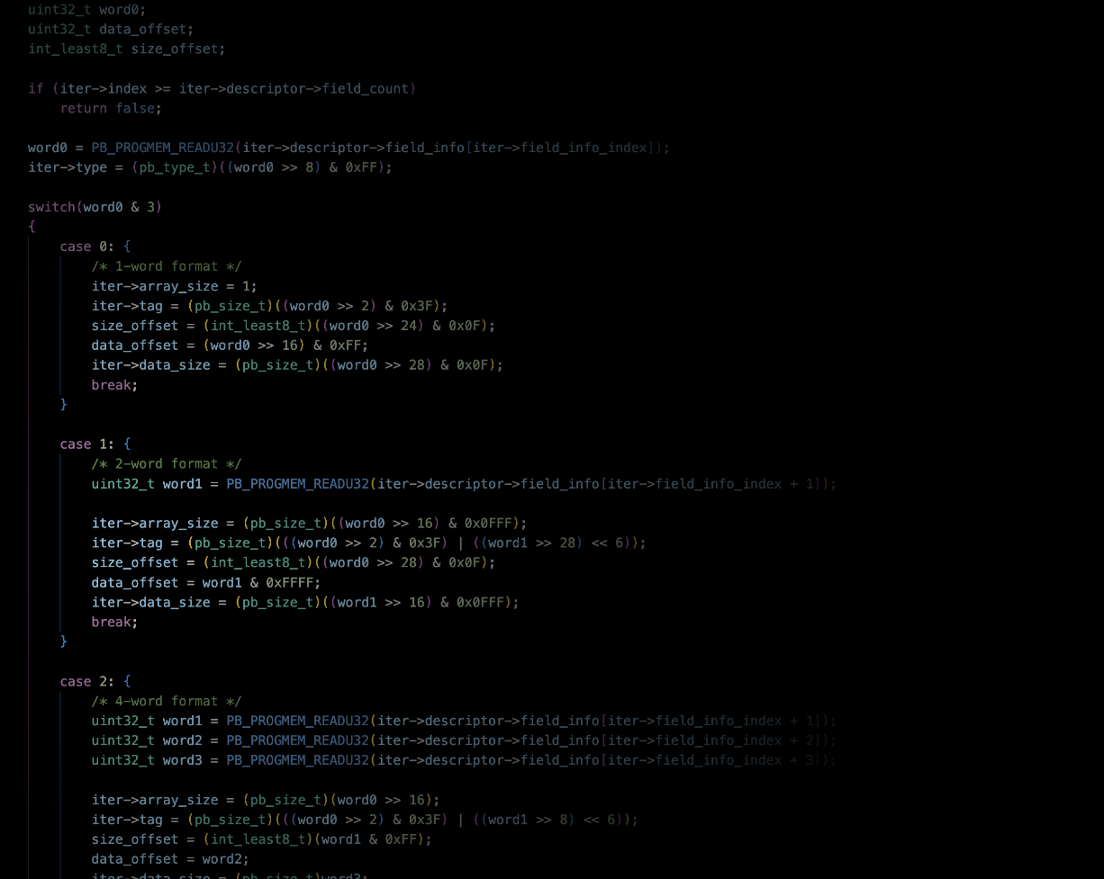
SOFTWARE ARCHITECTURE
Let’s see how data flows in our system
Embedded code
Inter device communication

Slide 6
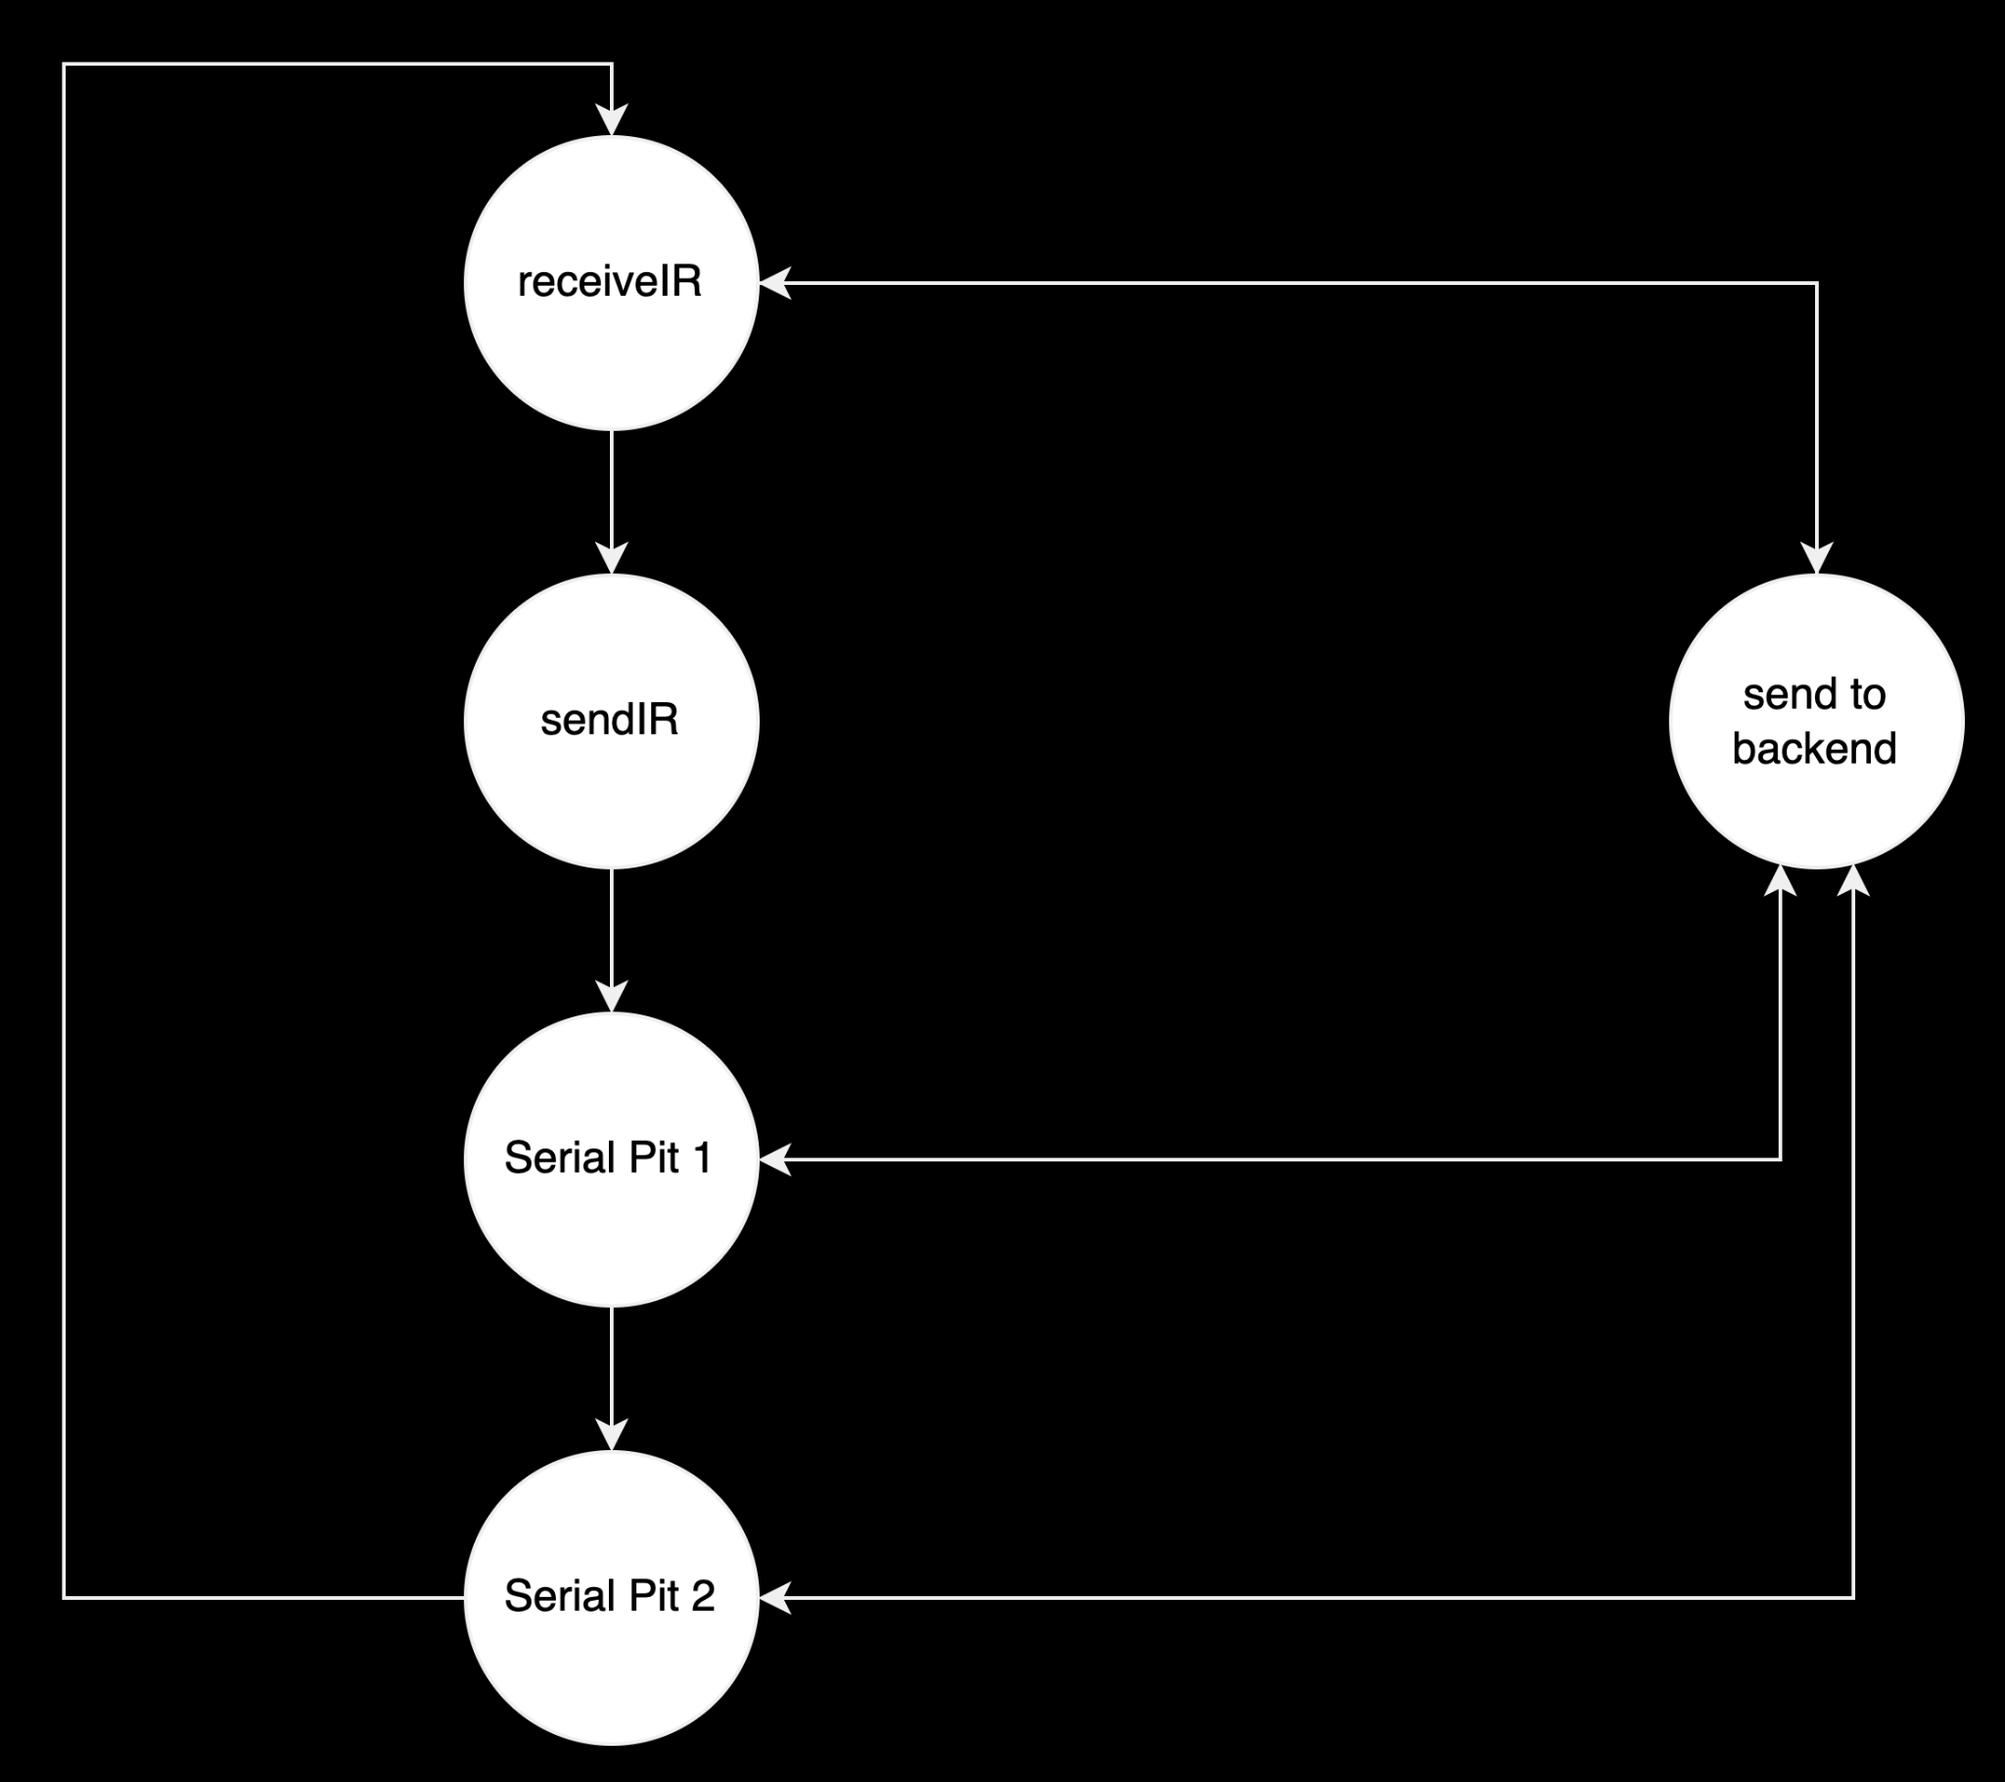
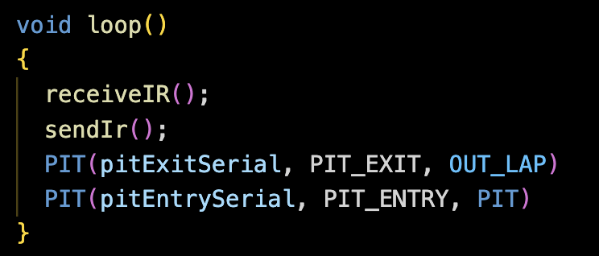
EMBEDDED CODE

Slide 7
THE NO INTERRUPT CHOICE

Slide 8


INTER DEVICE COMMUNICATION
PLAIN TEXT
UART
board to board
HTTP
board to backend

Slide 9
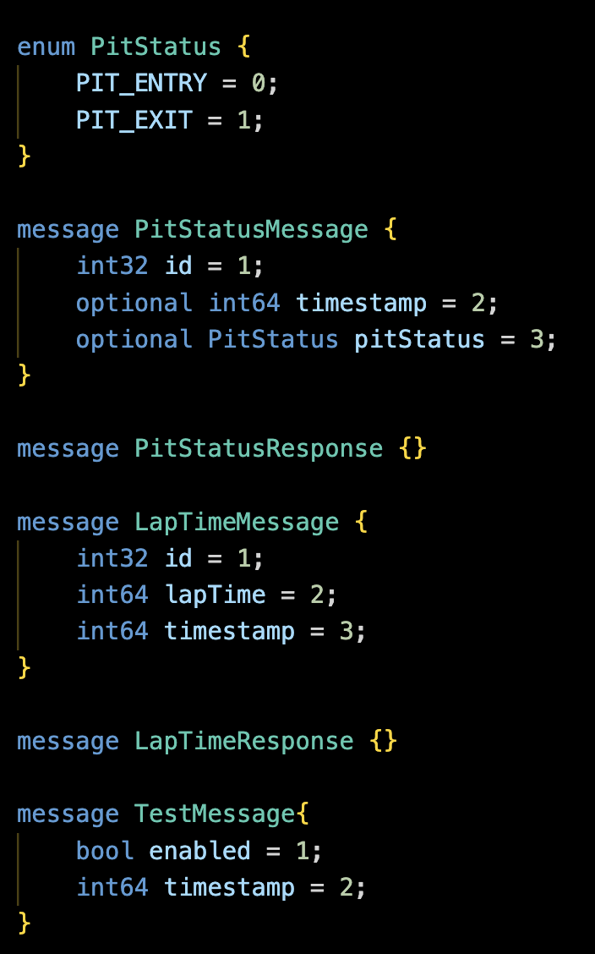
INTER DEVICE COMMUNICATION

Slide 10

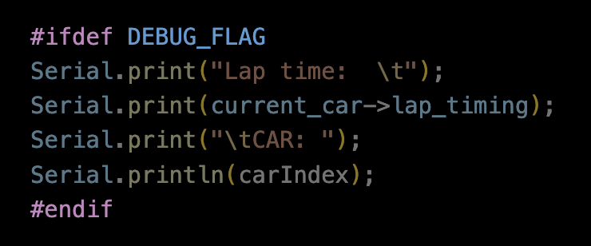
Testing
Hardware Testing
Software
Testing
Multimeter
IR field of view testing
Reflection tests
Protobuf decodes on serial
Serial testing
Time consume testing on functions
IR decoding tests
Backend connection and delays on reconnection

Slide 11
FUTURE IMPLEMENTATIONS
Change the readStringUntil() function with something not blocking
Serial independent boards
Inter time across the circuit
Test the project on real cars
Live time visualization on a website and leaderboard

