Slide 1

Distributed message broker
ADVANCED NETWORK ARCHITECTURES AND WIRELESS SYSTEMS
Leonardo Poggiani
Clarissa Polidori
BRUNO AUGUSTO CASU PEREIRA DE SOUSA

Slide 2
specifications

Slide 3
functionalities

Slide 4
Testing application

Slide 5
Rest interface

Slide 6
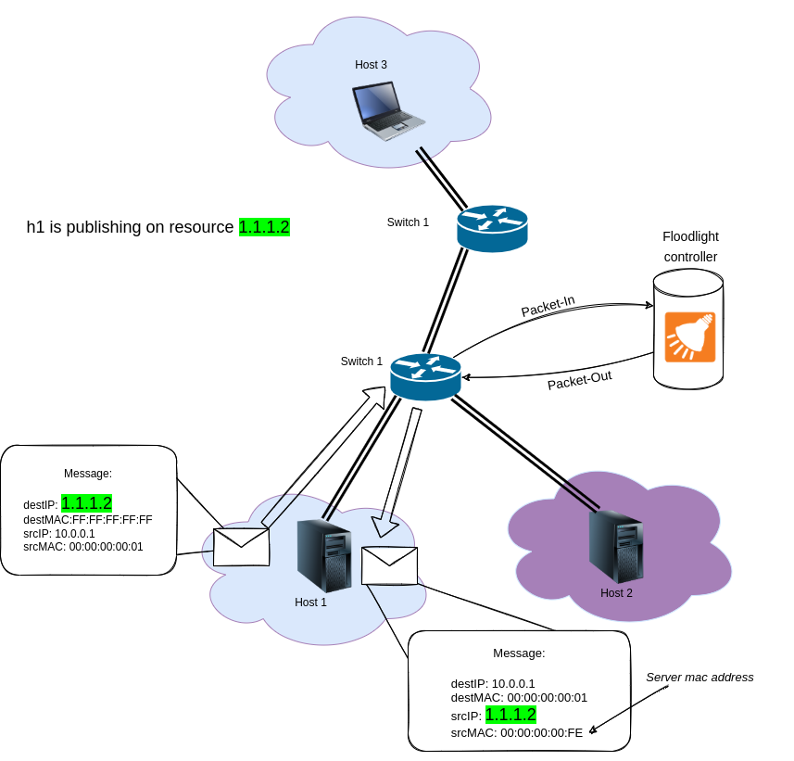
Arp requestS
Example: h1 try to publish a message on resource 1.1.1.2
This originate a packet-in to the Floodlight controller who generates a packet-out containing an ARP REPLY message.
This ARP REPLY contains the source MAC address corresponding to the server mac address and the source IP address equal to the resource address.

Slide 7
ipV4 PACKETS

Slide 8

TESTing

Slide 9
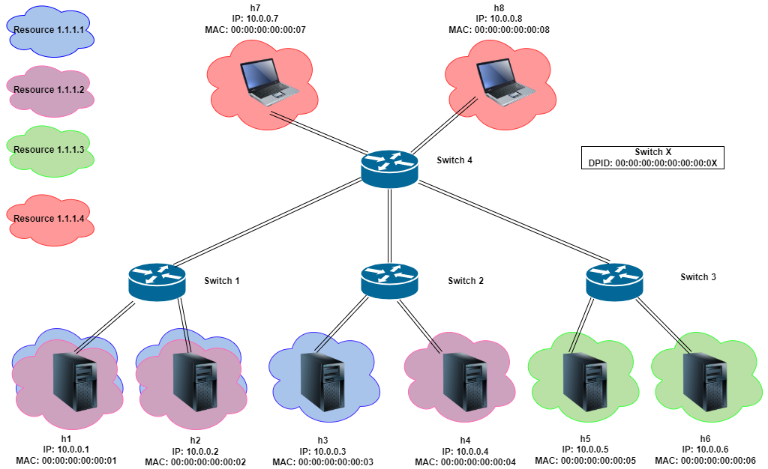
Testing configuration
1) Configure the system through REST API:
Start the controller
Run configuration/creation_resource.py
Run configuration/subscribe_resource.py
2) Create the topology with Mininet
Run the topology/topology.py

Slide 10
Testing objectives
All the subscribers to a resource receive the messages published on it
Non-subscribers do not see message published on the resource
A host can subscribe to multiple resources
A host that unsubscribes no longer receives messages published to that resource
When a resource is deleted, no host is subscriber anymore and receives nothing
A host can not send a message to another host directly
A host cannot publish to a resource to which it is subscribed

Slide 11
Publish a udp message (1)
Run the publisher-subscriber/subscriber.py on the subscriber hosts of the resource we want to test
Run the publisher-subscriber/publisher.py on the host from which you want to do the publish
Publish an UDP message to a resource
Hosts attached to the same switch (1 hop)
Hosts 2 hops away
Hosts 3 hops away
h3> python publisher.py 1.1.1.2
h4> python subscriber.py
h1> python subscriber.py
h7> python publisher.py 1.1.1.4
h5> python subscriber.py
h6> python subscriber.py

Slide 12
Publish a udp message (2)
Unsubscribe a user from a resource
Delete a resource
Repeat all previous tests:
python configuration/delete_unsubscribe.py

Slide 13
Publish a udp message (3)
Publish an UDP message on a resource you are subscribed to
Send an UDP message to a host using its real address
h1> python publisher.py 1.1.1.1
h1> python subscriber.py
h3> python subscriber.py
h1> python publisher.py 10.0.0.2
h2> python subscriber.py

Slide 14
Test plan: expected result
h1: subscribed to both 1.1.1.1 and 1.1.1.2 resources, so it receive two messages. Not receiving the message sent directly from h5.
h2: subscribed to both 1.1.1.1 and 1.1.1.2 resources, so it receive two messages.
h3: subscribed only to 1.1.1.1 resource, so it receive one message.
h4: subscribed only to 1.1.1.2 resource, so it receive one message.
h5: subscribed to 1.1.1.3 resource, so it does not receive any message.
h6: subscribed to 1.1.1.3 resource, so it does not receive any message.
h7: subscribed to 1.1.1.4 resource, so it receive one message.
h8: subscribed to 1.1.1.4 resource, so it receive one message.

Slide 15
Wireshark

Slide 16
Backup slides

