Slide 1

Distributed message broker
ADVANCED NETWORK ARCHITECTURES AND WIRELESS SYSTEMS
Leonardo Poggiani
Clarissa Polidori
BRUNO AUGUSTO CASU PEREIRA DE SOUSA

Slide 2
specifications

Slide 3
functionalities

Slide 4
Testing application

Slide 5
Rest interface

Slide 6
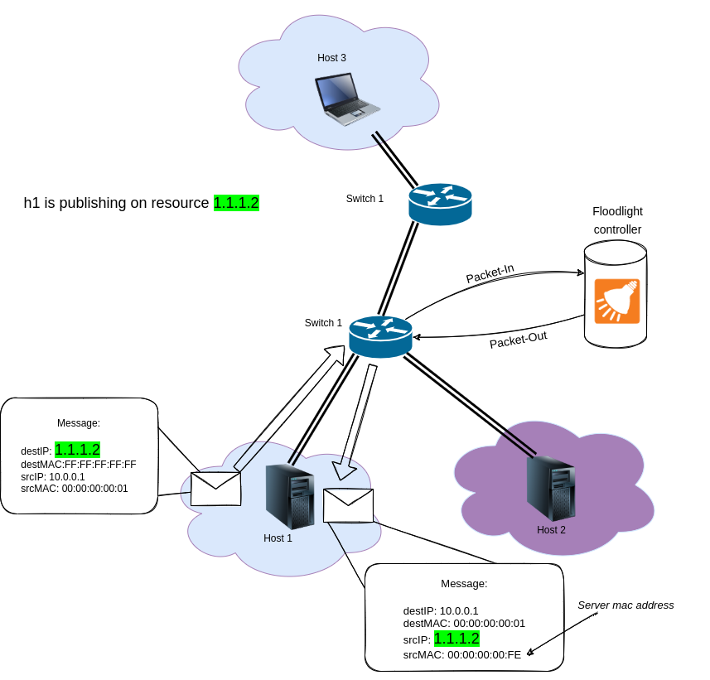
Arp requestS
Example: h1 try to publish a message on resource 1.1.1.2
This originate a packet-in to the Floodlight controller who generates a packet-out containing an ARP REPLY message.
This ARP REPLY contains the source MAC address corresponding to the server mac address and the source IP address equal to the resource address.

Slide 7
ipV4 PACKETS

Slide 8

TEST PLAN

Slide 9
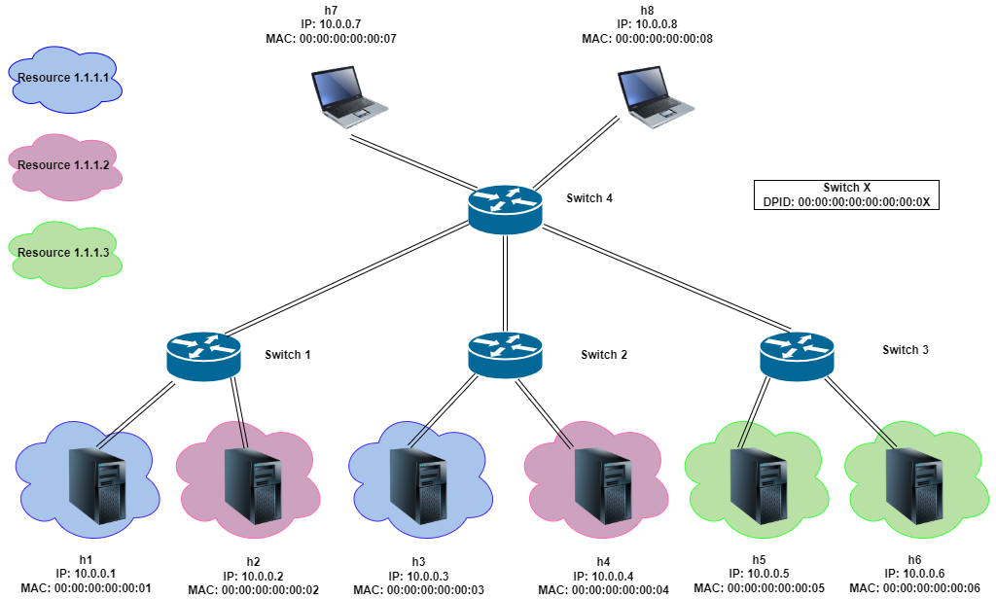
Test plan (1)
First you need to configure the system. After starting the controller you have to execute the configuration/creation_resource.py that permit to create some test resources.

Slide 10
Test plan (2)
Then you can execute the configuration/subscribe_resource.py that allow you to subscribe to some resources to do tests.

Slide 11
Test plan (3)
Now you can run the topology/topology.py to replicate the test topology on mininet.

Slide 12
Test plan (4)
Perform some publish on resources to show that:
Non-subscribers do not see message published on the resource
A host can subscribe to multiple resources
A host can not send a message to another host directly

Slide 13
Test plan (5)
After running the publisher-subscriber/subscriber.py on host h1, h2, h3, h4 run the publisher-subscriber/publisher.py on host h5 and h7.
h5> python publisher.py 1.1.1.1
h7> python publisher.py 1.1.1.2
h5> python publisher.py 10.0.0.1
h5> python publisher.py 1.1.1.4

Slide 14
Test plan: expected result
h1: subscribed to both 1.1.1.1 and 1.1.1.2 resources, so it receive two messages. Not receiving the message sent directly from h5.
h2: subscribed to both 1.1.1.1 and 1.1.1.2 resources, so it receive two messages.
h3: subscribed only to 1.1.1.1 resource, so it receive one message.
h4: subscribed only to 1.1.1.2 resource, so it receive one message.
h5: subscribed to 1.1.1.3 resource, so it does not receive any message.
h6: subscribed to 1.1.1.3 resource, so it does not receive any message.
h7: subscribed to 1.1.1.4 resource, so it receive one message.
h8: subscribed to 1.1.1.4 resource, so it receive one message.

Slide 15
Wireshark

Slide 16
Backup slides

