Slide 1

Security chip on smartphones
Computer Architecture
Gaia Anastasi
Clarissa Polidori
Leonardo Poggiani

Slide 2
Why does the smartphone need a security chip?
Performance improvement
Protection against hardware attacks
Protection against software malwares
Protection of critical data of users such as encryption keys and payment information.
The security of biometric authentication data

Slide 3
What Are biometrics data?
Biometric authentication uses human physical or behavioral characteristics to digitally identify a person. A fingerprint or retinal scan, however, is immutable.
Encryption is not an absolute guarantee of security, of course, if the applications or users authorized to access the data are compromised.
Usability is a very relevant factor.
Another is privacy.
Biometric information is part of your identity.
Notes:
Biometric authentication uses human physical or behavioral characteristics to digitally identify a person to grant access to systems, devices or data (fingerprints, facial patterns, voice or typing cadence).
The security of biometric authentication data is of vital importance, even more than the security of passwords, as passwords can be easily changed if exposed. A fingerprint or retinal scan, however, is immutable.
If a company needs to collect authentication information and keep it on its own servers, security best practices should be applied. This includes encryption for data at rest and data in transit.

Slide 4
What does hardware security mean?
Trusted Execution Environment (TEE)
Secure Booting
Posture Checking
Notes:
Secure Booting
Secure booting traces a path between the hardware and the operating system, and requires all loaded software is digitally signed by an approved author.
Secure booting traces a path between the hardware and the operating system, and requires all loaded software is digitally signed by an approved author. Some versions of this process, such as Samsung Knox, have additional hardware-based protections, like operating system rollback protection and tamper protection.
This method involves knowledge of what relevant digital certificates need to be burned into the hardware. Each startup step is verified, from base hardware to the software. When properly implemented, attackers can’t get “under” the operating system, which is a popular technique for evading operating system protections.
2. Trusted Execution Environment
Since keying and authentication materials need to be protected from exposure, even if the software is completely compromised TEE provide a hardware-separated processor, effectively running a different operating system, that cannot be affected by the main CPU.
It’s also important to consider trusted execution environments (TEEs), since keying and authentication materials need to be protected from exposure, even if the software is completely compromised. These provide a hardware-separated processor, effectively running a different operating system, that cannot be affected by the main CPU.
TEEs can be used to store keying material and take charge of disk encryption and decryption. They may also manage other credential information that can’t be tampered with, such as a burned-in unique system ID. These small applications running inside of the TEE are called trustlets.
3. Posture Checking
It is a protocol inside of the TEE that is constantly confirming that the device has not been compromised through system integrity checking
All of these security advancements make it easier for enterprises to monitor their devices. Hardware-assisted smartphone monitoring, or posture checking, is particularly helpful for this. It is a protocol inside of the TEE that is constantly confirming that the device has not been compromised through system integrity checking.

Slide 5
What is a security smartphone chip?
The security chip will protect the critical data of users such as encryption keys and payment information.
Crypto chips can resist Specter-style attacks
Notes:
Basically, these security chips are microcomputer computers that have microprocessors, native memory and run their own tiny operating systems. They work independently of other devices in the phone
Crypto chips can resist Specter-style attacks that allow the application to read the memory that does not belong to it because the memory chip is completely separate from the system's main memory.

Slide 6
Who are the main actors?
Apple Secure Enclave
ARM TrustZone
Apple Secure Enclave is directly integrated into Apple's A-series SoC.
ARM’s TrustZone is a stand-alone processor integrated directly into the device's main SoC.
Notes:
ARM’s TrustZone is a stand-alone processor integrated directly into the device's main SoC. Although it is not a separate chip, it still has a processor and a separate memory area.

Slide 7
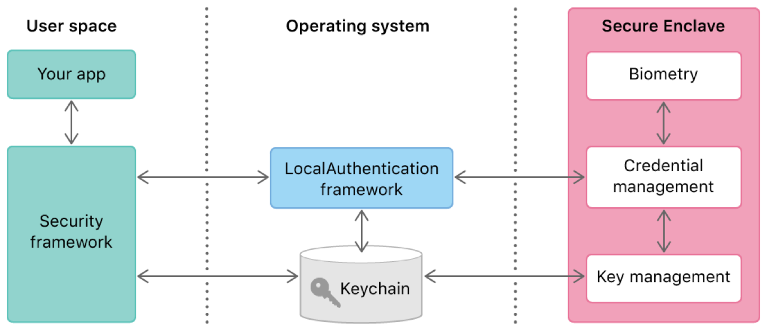
Ios secure enclave
It is isolated with a hardware filter so the AP cannot access it.
Notes:
Secure Enclave:
The Secure Enclave is part of the A7 and newer chips used for data protection, TouchID, and FaceID. The purpose of the Secure Enclave is to handle keys and other info such as biometrics that is sensitive enough to not be handled by the Application Processor (AP).

Slide 8
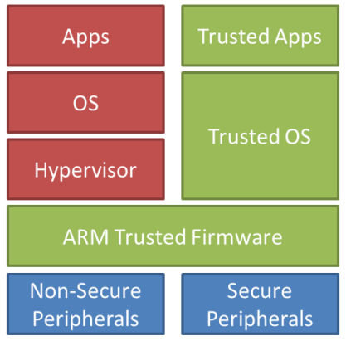
Arm trustzone
Process in the normal world cannot access the secure world.​
Notes:
2. TrustZone:
The main idea of TrustZone is to implement two separate execution modes on the main CPU. All untrusted software is executed in the normal world, while applications that need protection run in a separate execution mode called the secure world.

Slide 9
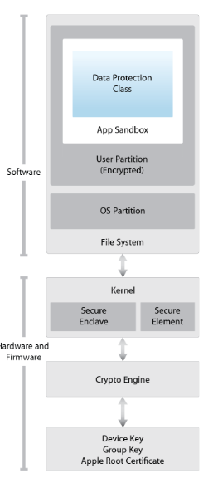
Where Is located a secure enclave?
Secure enclave provide a flexible way to implement various hardware-assisted security services.
Trusted Computing Base (TCB) minimization is one of the most fundamental computer security principles.
Notes:
The idea is to reduce the amount of software and hardware that needs to be trusted for the secure operation of a particular application in order to minimize attack surface.

Slide 10
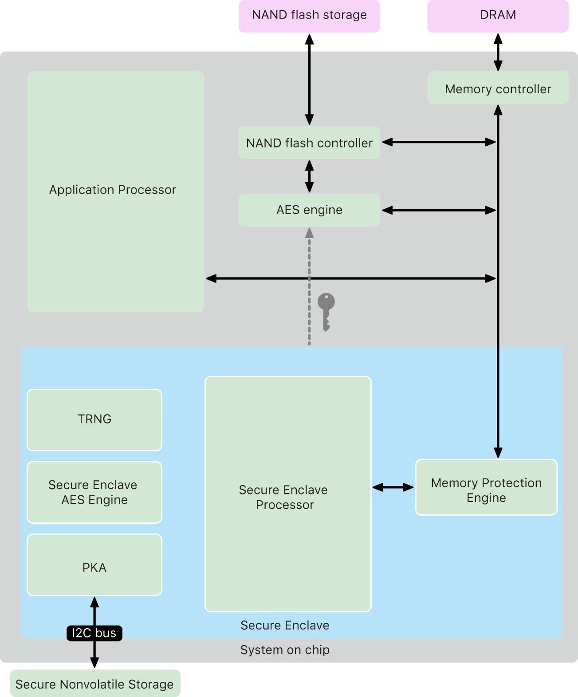
What we have inside a secure enclave?
Notes:
The Secure Enclave itself follows the same principle of design as the SoC does, containing its own discrete boot ROM and AES engine. The Secure Enclave also provides the foundation for the secure generation and storage of the keys necessary for encrypting data at rest.

Slide 11
How secure enclave protects my biometrics data?
The Secure Enclave Processor is dedicated solely for Secure Enclave use.
The Secure Enclave Processor runs an Apple-customized version of the L4 microkernel.
Secure Enclave Processor includes a memory-protected engine and encrypted memory.
Notes:
The Secure Enclave Processor is dedicated solely for Secure Enclave use. This helps prevent side-channel attacks that depend on malicious software sharing the same execution core as the target software under attack.
The Secure Enclave Processor runs an Apple-customized version of the L4 microkernel. It’s designed to operate efficiently at a lower clock speed that helps to protect it against clock and power attacks.
Secure Enclave Processor, starting with the A11 and S4, includes a memory-protected engine and encrypted memory with anti-replay capabilities, secure boot, a dedicated random number generator, and its own AES engine.

Slide 12
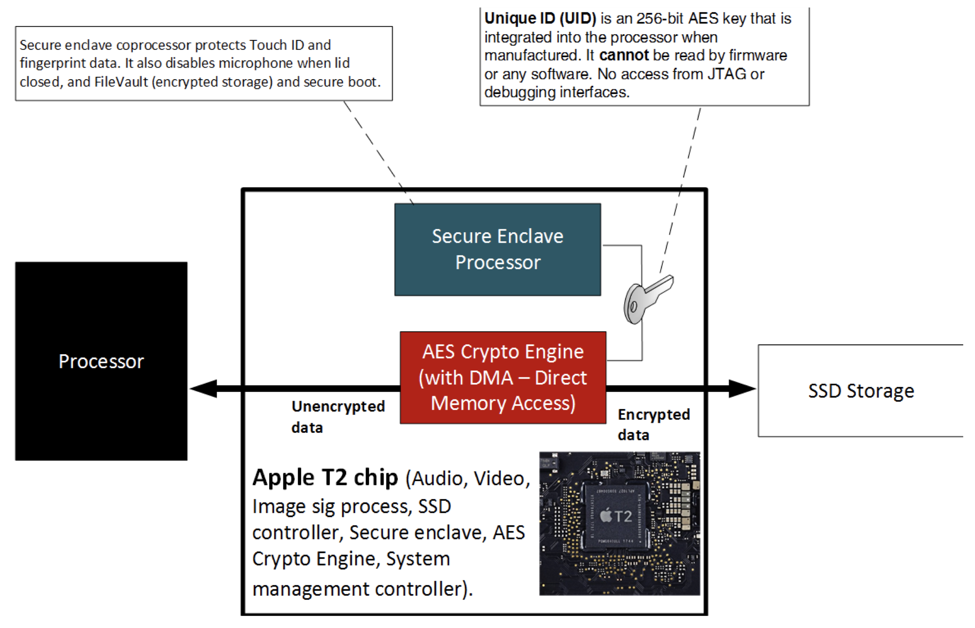
How it works?

Slide 13
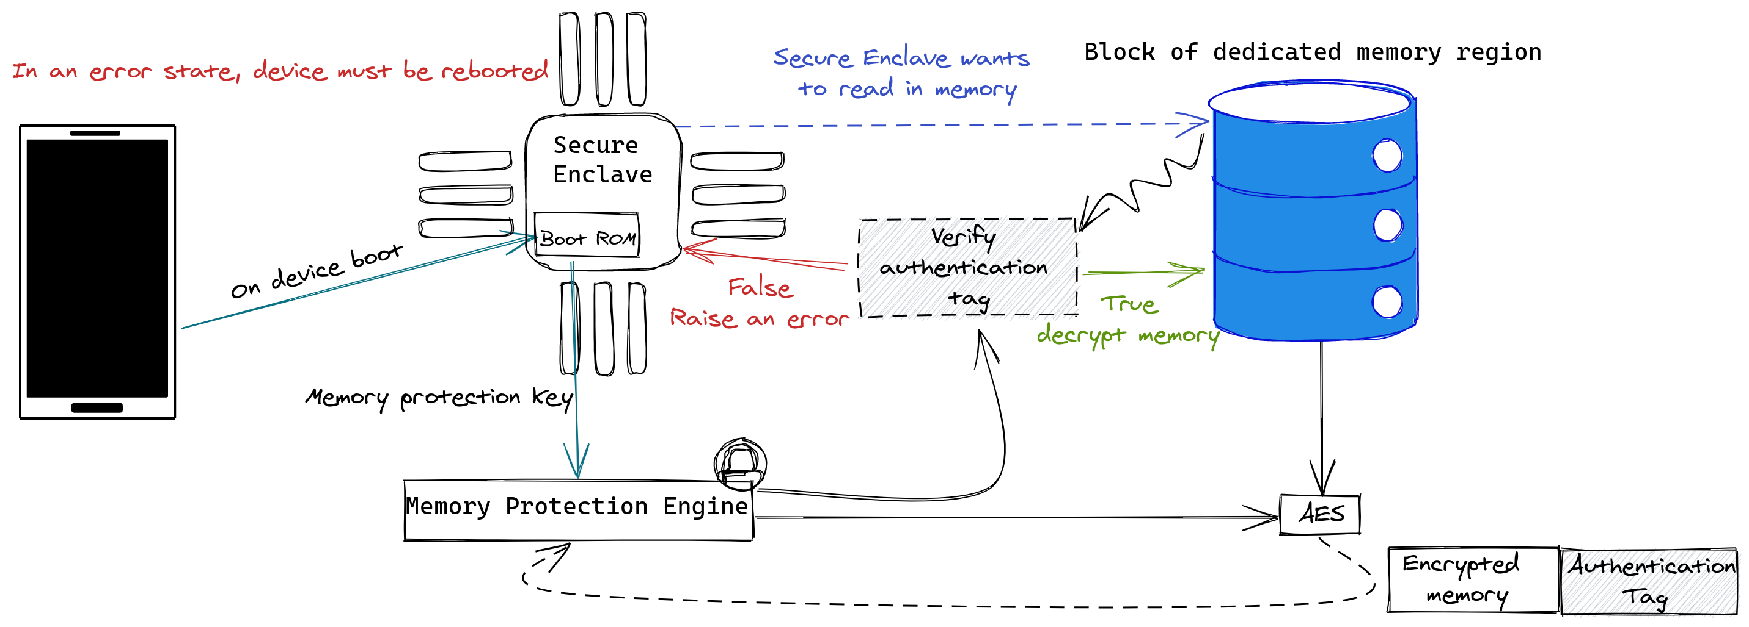
Memory Protection Engine (1)
Secure Enclave reads and writes memory as if it were regular unencrypted DRAM, whereas an observer outside the Secure Enclave sees only the encrypted and authenticated version of the memory.
Notes:
When the device starts up, the Secure Enclave Boot ROM generates a random ephemeral memory protection key for the Memory Protection Engine. Whenever the Secure Enclave writes to its dedicated memory region, the Memory Protection Engine encrypts the block of memory using AES in Mac XEX (xor-encrypt-xor) mode, and calculates a Cipher-based Message Authentication Code (CMAC) authentication tag for the memory. The Memory Protection Engine stores the authentication tag alongside the encrypted memory. When the Secure Enclave reads the memory, the Memory Protection Engine verifies the authentication tag. If the authentication tag matches, the Memory Protection Engine decrypts the block of memory. If the tag doesn’t match, the Memory Protection Engine signals an error to the Secure Enclave. After a memory authentication error, the Secure Enclave stops accepting requests until the system is rebooted.
The Secure Enclave includes a dedicated Secure Enclave Boot ROM. Like the Application Processor Boot ROM, the Secure Enclave Boot ROM is immutable code that establishes the hardware root of trust for the Secure Enclave.
On system startup, iBoot assigns a dedicated region of memory to the Secure Enclave. Before using the memory, the Secure Enclave Boot ROM initializes the Memory Protection Engine to provide cryptographic protection of the Secure Enclave protected memory.
The Application Processor then sends the sepOS image to the Secure Enclave Boot ROM. After copying the sepOS image into the Secure Enclave protected memory, the Secure Enclave Boot ROM checks the cryptographic hash and signature of the image to verify that the sepOS is authorized to run on the device. If the sepOS image is properly signed to run on the device, the Secure Enclave Boot ROM transfers control to sepOS. If the signature isn’t valid, the Secure Enclave Boot ROM prevents any further use of the Secure Enclave until the next chip reset.
On Apple A10 and later SoCs, the Secure Enclave Boot ROM locks a hash of the sepOS into a register dedicated to this purpose. The Public Key Accelerator uses this hash for operating-system-bound (OS-bound) keys.
At system startup, the Secure Enclave Processor’s System Coprocessor Integrity Protection (SCIP) configuration prevents the Secure Enclave Processor from executing any code other than the Secure Enclave Boot ROM. The Boot Monitor prevents the Secure Enclave from modifying the SCIP configuration directly. To make the loaded sepOS executable, the Secure Enclave Boot ROM sends the Boot Monitor a request with the address and size of the loaded sepOS. On receipt of the request, the Boot Monitor resets the Secure Enclave Processor, hashes the loaded sepOS, updates the SCIP settings to allow execution of the loaded sepOS, and starts execution within the newly loaded code. As the system continues booting, this same process is used whenever new code is made executable. Each time, the Boot Monitor updates a running hash of the boot process. The Boot Monitor also includes critical security parameters in the running hash.
When boot completes, the Boot Monitor finalizes the running hash and sends it to the Public Key Accelerator to use for OS-bound keys. This process is designed so that operating system key binding can’t be bypassed even with a vulnerability in the Secure Enclave Boot ROM.
On Apple A14, M1, and later SoCS, the Memory Protection Engine supports two ephemeral memory protection keys. The first is used for data private to the Secure Enclave, and the second is used for data shared with the Secure Neural Engine.

Slide 14
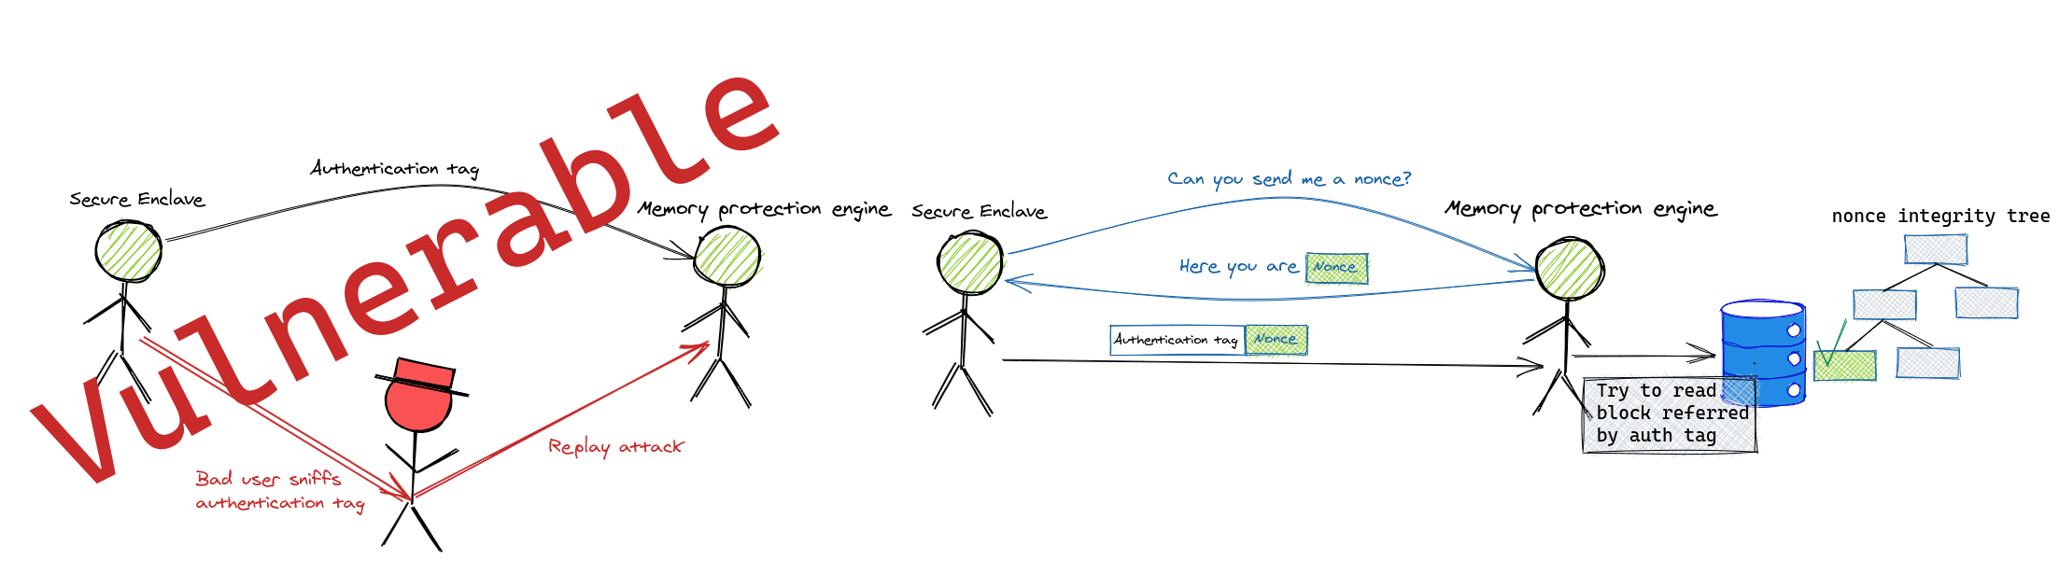
Memory Protection Engine (2)
The Memory Protection Engine adds replay protection for Secure Enclave memory. To prevent replay of security-critical data, the Memory Protection Engine stores a nonce for the block of memory alongside the authentication tag.
Notes:
The Secure Enclave includes a unique ID (UID) root cryptographic key. The UID is unique to each individual device and isn’t related to any other identifier on the device.
A randomly generated UID is fused into the SoC at manufacturing time. Starting with A9 SoCs, the UID is generated by the Secure Enclave TRNG during manufacturing and written to the fuses using a software process that runs entirely in the Secure Enclave. This process protects the UID from being visible outside the device during manufacturing and therefore isn’t available for access or storage by Apple or any of its suppliers.
sepOS uses the UID to protect device-specific secrets. The UID allows data to be cryptographically tied to a particular device. For example, the key hierarchy protecting the file system includes the UID, so if the internal SSD storage is physically moved from one device to another, the files are inaccessible. Other protected device-specific secrets include Touch ID or Face ID data. On a Mac, only fully internal storage linked to the AES engine receives this level of encryption. For example, neither external storage devices connected over USB nor PCIe-based storage added to the 2019 Mac Pro are encrypted in this fashion.
The Secure Enclave also has a device group ID (GID), which is common to all devices that use a given SoC (for example, all devices using the Apple A14 SoC share the same GID).
The UID and GID aren’t available through Joint Test Action Group (JTAG) or other debugging interfaces.
The Secure Enclave AES Engine is a hardware block used to perform symmetric cryptography based on the AES cipher. The AES Engine is designed to resist leaking information by using timing and Static Power Analysis (SPA). Starting with the A9 SoC, the AES Engine also includes Dynamic Power Analysis (DPA) countermeasures.
The AES Engine supports hardware and software keys. Hardware keys are derived from the Secure Enclave UID or GID. These keys stay within the AES Engine and aren’t made visible even to sepOS software. Although software can request encryption and decryption operations with hardware keys, it can’t extract the keys.
On Apple A10 and newer SoCs, the AES Engine includes lockable seed bits that diversify keys derived from the UID or GID. This allows data access to be conditioned on the device’s mode of operation. For example, lockable seed bits are used to deny access to password-protected data when booting from Device Firmware Update (DFU) mode. For more information, see Passcodes and passwords.
Every Apple device with a Secure Enclave also has a dedicated AES256 crypto engine (the “AES Engine”) built into the direct memory access (DMA) path between the NAND (nonvolatile) flash storage and main system memory, making file encryption highly efficient. On A9 or later A-series processors, the flash storage subsystem is on an isolated bus that’s granted access only to memory containing user data through the DMA crypto engine.
At boot time, sepOS generates an ephemeral wrapping key using the TRNG. The Secure Enclave transmits this key to the AES Engine using dedicated wires to prevent it from being accessed by any software outside the Secure Enclave. sepOS can then use the ephemeral wrapping key to wrap file keys for use by the Application Processor file-system driver. When the file-system driver reads or writes a file, it sends the wrapped key to the AES Engine, which unwraps the key. The AES Engine never exposes the unwrapped key to software.
Note: The AES Engine is a separate component from both the Secure Enclave and the Secure Enclave AES Engine, but its operation is closely tied to the Secure Enclave, as shown below.
The nonces for all memory blocks are protected using an integrity tree rooted in dedicated SRAM within the Secure Enclave. For writes, the Memory Protection Engine updates the nonce and each level of the integrity tree up to the SRAM. For reads, the Memory Protection Engine verifies the nonce and each level of the integrity tree up to the SRAM. Nonce mismatches are handled similarly to authentication tag mismatches.

Slide 15
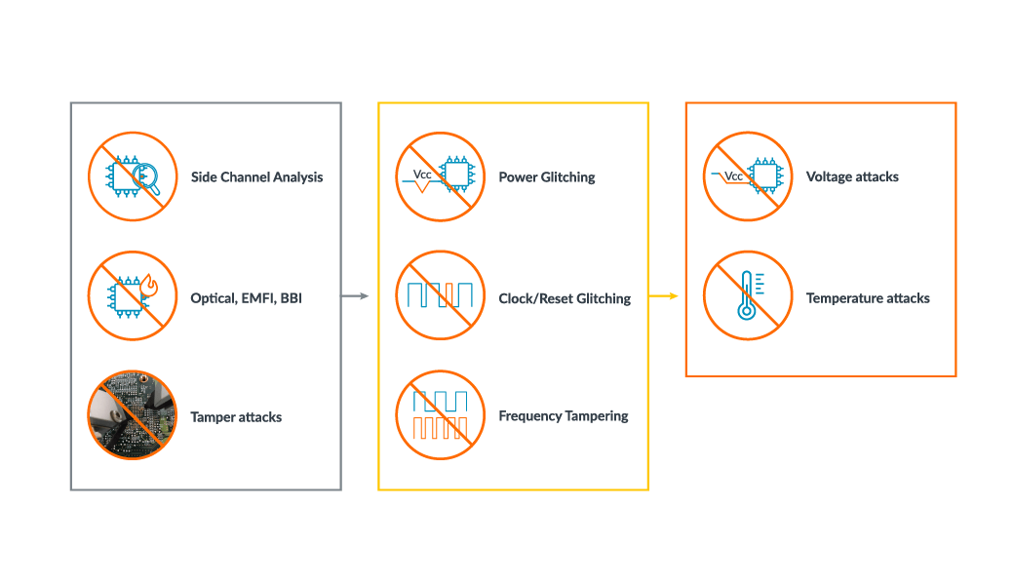
How much secure is secure enclave?
All data inside chips are encrypted with random private keys
Secure Enclave is also responsible for storing the keys that manage sensitive data
Secure Enclave chip is built into the device, it works completely separately from the rest of the system

Slide 16

Possible threats
In 2017, a group of hackers was able to decrypt the Secure Enclave firmware to explore how the component works. However, they were unable to gain access to the private keys, so there wasn’t any risk to users.
Chinese hackers from the Pangu Team have reportedly found an “unpatchable” exploit on Apple’s Secure Enclave chip that could lead to breaking the encryption of private security keys.
Notes:
An unpatchable exploit means that the vulnerability was found in the hardware and not the software, so there’s probably nothing Apple can do to fix it on devices that have already been shipped.
We still don’t have further details on what exactly hackers can do with this specific vulnerability, but having full access to the Security Enclave could also mean having access to passwords, credit cards, and much more. The only thing we know so far is that this vulnerability in Secure Enclave affects all Apple chips between the A7 and A11 Bionic, similar to the checkm8 exploit that allows jailbreak for almost all iOS devices up to iPhone X.
Even though Apple has already fixed this security breach with the A12 and A13 Bionic chips, there are still millions of Apple devices running with the A11 Bionic or older chips that could be affected by this exploit. The impacts that this vulnerability found in the Security Enclave will have on users will likely be known in the coming months.
Keep in mind that exploits like this usually require the hacker to have physical access to the device in order to obtain any data, so it’s unlikely that anyone will be able to access your device remotely. An expected scenario is for government agencies to use this security breach on confiscated devices.
What is known about the error is that it is not a vulnerability of the Secure Enclave Processor itself, according to MOSEC's Weibo account's explanation spotted by YaluJailbreak. Instead, it is a problem with a memory controller that takes control of the TZ0 register memory, which manages the range of the Secure Enclave Processor's memory usage.
By taking control of the TZO register, this can allow an attacker to alter how the memory isolation system of shared memory between the SEP and the main processor functions. In turn, this could feasibly be used to acquire data that would normally be viewed and used by only the Secure Enclave, making it a security risk.
It is claimed that, as the issue involves read-only ROM built into the chip, the vulnerability cannot be plugged via an Apple software update, and is considered a hardware vulnerability.
Despite the permanent nature of the vulnerability, it is quite a difficult one to be abused or to be used for attempted malicious jailbreaks to try and read the stored SEP data.
It is thought that the vulnerability only affects devices that are compatible with the checkra1n jailbreak or the checkm8 exploit. Furthermore, as devices using an A12 or A13 system-on-chip do not currently have a BOOTROM exploit, it is practically impossible to determine if the bug exists, meaning it cannot affect the iPhone XS and iPhone XR generation or later iPhone models.
Security researcher @axi0mX also advises in a Twitter thread that the issue cannot be used in browser-based or app-based jailbreaks, as well as Apple's various hardware and software mitigations further limiting the ways such an attack could be made. Due to the limitations imposed by Apple's security, a successful attack would require physical access to the device and a connection to a host system, effectively ruling out any remote abuse via the vulnerability

Slide 17
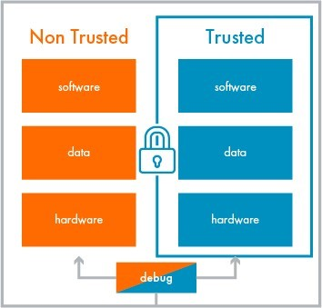
Arm TrustZone: main idea
World switch is done via a special instruction called the Secure Monitor Call (smc)
When the CPU executes the smc instruction, the hardware switches into the secure monitor, which:
Performs a secure context switch into the secure world
Enables sharing data by copying data across worlds.
Notes:
The core of TrustZone’s approach is the concept of secure and non-secure (also called normal) worlds that are hardware separated. Each world has their own user space and kernel space, together with cache, memory and other resources
Because the processor executes in one security mode at a time, to execute software in another security mode the processor must switch worlds.
ARM TrustZone is a processor-based TEE architecture that is commonly used on smart-phones. The main idea of TrustZone is to implement two separate execution modes on the main CPU. All untrusted software, like the OS and third-party apps, are executed in the normal world, while applications that need protection run in a separate execution mode called the secure world. The processor and memory controllers ensure that any process in the normal world cannot access the secure world. TrustZone can enable secure boot [5]. A mobile device can be configured such that when the device is powered up, the main CPU starts executing implicitly trusted code that is loaded from read-only memory in secure world. This code can then verify the normal world boot loader before the CPU starts executing the main boot sequence of the normal world OS. Many smartphone manufacturers implement this approach

Slide 18
architecture features (1)
TEE is isolated from REE
TrustZone is a full-system feature
Depending on the trusted program that runs in the secure world we distinguish 2 types of TEE architectures:
TEE kernel à trusted program implements a basic set of OS functions to manage multiple TEE instances each of them hosting a particular application
TEE service à implement a specific function and do not require any low-level OS logic to manage their own memory and cross-world communication.
Notes:
TrustZone offers several architecture features. First, the TEE is isolated from REE and this ensure secury guarantees without trusting the rich OS and also to protect data even if a malware has taken the control of the rich OS. Second, TrustZone is a full-system feature that can host both user and system logic and can control the peripherals. It can be specified for each peripheral if it has to operate in a way or in another according to the system’s protection state. Depending on the trusted program that runs in the secure world we distinguish 2 types of TEE architectures:
TEE kernel à trusted program implements a basic set of OS functions to manage multiple TEE instances each of them hosting a particular application. The trusted kernel is responsible for: managing memory of secure world, enforcing memory protection for each TEE, handling communication between TEE and the OS providing API. A downside is these systems depends more on larger TCBs(trusted computing bases) which help TEE during the application execution differently to TEE services.
TEE serviceà implement a specific function and do not require any low-level OS logic to manage their own memory and cross-world communication. A downside is that only a TEE service can be deployed on the device to avoid mutual interference differently to TEE kernels where multiple applications can run on an independent instance.

Slide 19

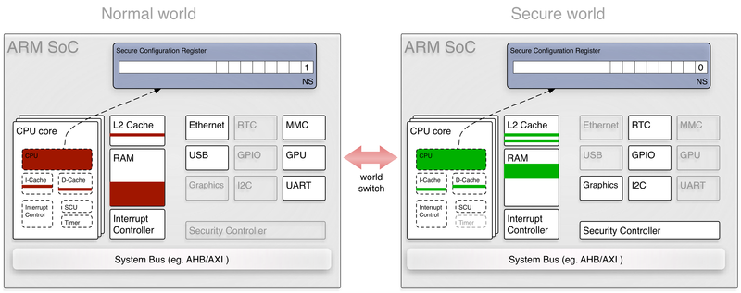
architecture features (2)
Many concepts are the same compared to Secure Enclave, for the sake of brevity we will only report the differences.
Partitioning of DRAM, off-chip ROM and SRAM in different memory regions.
MMU allows for each world to have its own virtual-to-physical memory address translation tables.
At cache level, each lines of the cache contains an extra bit that indicates under which world that cache line access has been performed.
Not K.I.S.S, K.I.I.S.!
Notes:
The world where the processor currently executes is determined by the value of a 33rd processor bit, known as the Non-Secure bit (NS), in the Secure Configuration Register (SCR).
TrustZone also provide a TZPC (TrustZone Protection Controller) that allows for system devices to be restricted to secure or normal world. This component is also optional but its existence is due to the diversity in number and type of TrustZone-aware devices that can be found across hardware platforms.
KISS, that stands for Keep It Simple Stupid. It’s a great design philosophy. Well in Security, we can misspell it KIIS, Keep It ISOLATED Stupid.

Slide 20
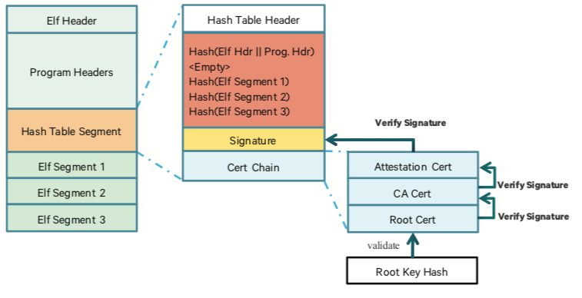
Chain of trust
Each hash represents the hash of a segment of the ELF binary.
This hash table is then signed by the trustlet issuer
This signature can be verified through a certificate chain placed directly after the signature.
This chain of trust can be validated thanks to the root certificate of which a SHA256 is placed in a fuse (QFuse), ensuring its integrity.
Notes:
TrustZone OS provides a more flexible model for adding trusted functionality which are meant to provide additional secure service to the Normal World.
These features are available as signed third-party applications (called trustlet) and are securely loaded and executed in Secure World by the operating system running in TrustZone (the SecureOS).
The trustlet integrity checking process is relatively standard and consists of a hash table.
QFUSE: Microscopic hardware fuse that is integrated into the SoC . Once physically blown, impossible to reset or replace.
In computing, the Executable and Linkable Format^{[citation needed]} (ELF, formerly named Extensible Linking Format), is a common standard file format for executable files, object code, shared libraries, and core dumps. First published in the specification for the application binary interface (ABI) of the Unix operating system version named System V Release 4 (SVR4),^{[2]} and later in the Tool Interface Standard,^{[1]} it was quickly accepted among different vendors of Unix systems. In 1999, it was chosen as the standard binary file format for Unix and Unix-like systems on x86 processors by the 86open project.
By design, the ELF format is flexible, extensible, and cross-platform. For instance it supports different endiannesses and address sizes so it does not exclude any particular central processing unit (CPU) or instruction set architecture. This has allowed it to be adopted by many different operating systems on many different hardware platforms

Slide 21
According to the National Vulnerability Database (NVD) and several security bulletins (e.g., Qualcomm, Huawei, and Samsung), there are more than 130 vulnerabilities regarding TrustZone and TrustZone-based TEE.
Bugs in the TEE kernel and TEE Drivers implementation of some providers:
Lack of input validation
Buffer overflows and over-reads
Race conditions
Boomerang attack
How much secure
Is trustzone?

Slide 22
countermeasures
The current state of the art TEE research still lacks frameworks to verify and/or analyze the secure code
Properly defense mechanisms within the trsuted enviroments
Methods for monitoring and detecting compromised TEEs
Resilient plans to recover and rejuvenate from attacks.
Notes:
According to the National Vulnerability Database (NVD) and several security bulletins (e.g., Qualcomm, Huawei, and Samsung), we found more than 130 vulnerabilities regarding TrustZone and TrustZone-based TEE. Most of these vulnerabilities are related to existing bugs in the TEE kernel and TEE drivers implementation of some providers. Such vulnerabilities include the lack of input validation, buffer overflows and over-reads, uninitialized variables, and race conditions and at Black Hat 2014 Rosenberg described how this vulnerabilities affected a wide range of TrustZone-enabled mobile devices, including the Samsung Galaxy Note 3, Samsung Galaxy S4, LG Nexus 4 and 5, Moto X, LG G2, and HTC One series. At Black Hat 2015 Di Shen described how to exploit the TEE implementation of Huawei devices (HiSilicon SoC), to gain kernel-level privileges in the normal world (privilege escalation) and also execute arbitrary code in the secure world. It is also demonstrated that TEE are vulnerable to BOOMERANG, an attack where the malicious application can send specific inputs to a trusted application, which are not properly checked, and then lead the trusted application to manipulate memory locations, which shall not be accessible to the malicious software. although the security design of TEEs might be correct the code running inside the TEE may contain vulnerabilities that can be exploited by attackers to corrupt the TEE and compromise the trust state of the entire

Slide 23
hardware-related vulnerabilities
The reported vulnerabilities affect different hardware parts of the platform, in particular:
Root of trust
Caches → CacheKit attack
Power management mechanism → CLKSCREW software attack
Notes:
HARDWARE VULNERABILITIES:
Several hardware-related vulnerabilities has also been uncovered over the last few years. The
reported vulnerabilities affect different hardware parts of the platform, in particular:
root of trust → While Intel and AMD specify the TPM as the root of trust for their systems, TrustZone, per se, does not specify where keys for authentication and decryption shall be stored. Several TrustZone-based systems and services consider the existence of a unique device key, which is used to serve as the root of trust. However, such hardware modules do not always exist in mobile devices, which can result in a lack of guarantees in providing a way to establish trust in the runtime environment
caches → On TrustZone-enabled processors, the cache architecture is modified to include an additional bit that tags the security state of the memory transaction (see Section 2). Even though the secure cache lines are not accessible by the non-secure world, both worlds are equal when competing for the use of cache lines. So, during a world switch, cache lines do not need to be flushed, because a secure cache line fill can evict a non-secure cache line, and vice versa. This design improves system performance by eliminating the need to perform cache flushes during world switches; however, it also enables cache contention between the two worlds. To minimize cache pollution, many Arm processors implement a cache-locking feature, which basically prevents cache lines from being evicted. Caches have associated a serious challenge to formal verify programs, because the cache access pattern of security-critical services can lead to secret information leakage. An example of cache attack is ChacheKit which is an attack that can bypass memory introspection mechanisms by exploiting existing TrustZone cache incoherences.
power management mechanisms → à Security is rarely a consideration in the design of such mechanisms due to the complexity of hardware-software needs and the pressure of cost and time-to-market. An example of power management attack is CLKSCREW software attack can be used to break TrustZone-enabled devices by extracting secret cryptographic keys and loading signed applications on commodity mobiles.
IoT devices are being deployed in massive numbers, and the success of this new wave of the Internet is heavily dependent upon the trust and security built into these billions of different connected devices. Nowadays ARM is investing strongly on low-end secure devices in terms of specification and standardization and has recently announced the Platform Security Architecture (PSA) and an accompanying open-source software project, named Trusted Firmware-M. The PSA provides a recipe to build a secure system without having to develop all of the elements. While the PSA is architecture agnostic, which means it can be implemented on Cortex-M, Cortex-R, and Cortex-A-based devices,
it was mainly designed to secure low-cost IoT devices, where a full TEE would not be appropriate.
TrustZone-M provides a reliable and easy method to better implement PSA-defined rules. With PSA, Arm provides an architectural specification, and different partners can provide alternative implementations.

Slide 24
Performance evaluation
The benchmarks used during the study will use different CPU governors:
Powersave
Performance
Ondemand
Secure boot and hardware separation of memory and peripherals haven’t not been evaluated.
Notes:
(Dire cosa è un governor)
The results shown in the next slides have been obtained using a Raspberry Pi 3B, a popular yet representative single-board device, equipped with Broadcom BCM2837 System-On-Chip (1GB of RAM, ARM Cortex A53 quad core running at 1.2GHz) using some benchmarks. The benchmarks used during the study will use different CPU governors. CPU governors are used to adjust the frequency of each core depending on its load and temperature. Several options exist:
Powersave and performance for minimum and maximum operating frequency
Ondemand toggles between the previous two
Secure boot and hardware separation of memory and peripherals haven’t not been evaluated.
Some measurements have been also compared the hardware experiments against a modified version of the Qemu emulator that uses the Cortex A53 emulation profile on an Ubuntu host residing on a VMWare ESXi machine equipped with an i7 6820HQ running at 2.7GHz. Raspberry Pi 3B lacks support for secure boot and hardware separation of memory and peripherals, hence these aspects of the TRUSTZONE ecosystem could not be evaluated.

Slide 25
POWER CONSUMPTION:
The power consumption is the measure of the idle and under-stress (burn) power consumption of the hardware unit:
Notes:
[GRAPH 1]
Measure of the idle and under-stress (burn) power consumption of our hardware unit for three different CPU governors (ondemand, performance, and powersave). The idle measurements use the standard REE kernel, without any user-intensive applications nor trusted application running. Burn measurements run a single-threaded trusted application which computes the first 20000 prime numbers before exiting. We can observe higher power consumption using the performance governor even in idle. Overall, the board’s power consumption is very low, in particular below 1W in idle mode. We can observe higher power consumption using the performance governor even in idle.

Slide 26
LOAD & UNLOAD TRUSTED APPLICATION:
The load and unload trusted application is the measure of the time required to load and unload a trusted application inside the TrustZone.
Notes:
Measure of the time required to load and unload a trusted application inside the TrustZone. The left graph shows the results obtained with 2 different trusted applications, one of a small size and one of a large size. The experiments show no significant difference between TAs of different sizes.

Slide 27
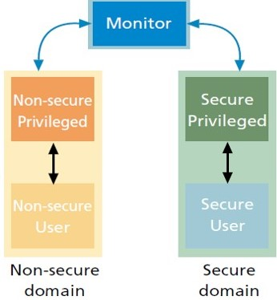
CONTEXT SWITCHING (1):
Time needed to switch from a TrustZone world to the other.
It’s here reported 3 important factors:
Execution time
Instrumentation delay
Energy for calling an empty function.
The empty function only contains time-measuring code and are made to record the time taken to switch between TEE and REE and vice versa. ​
Notes:
Instrumentation delay → difference between 2 consecutive calls to the time measurement functions.

Slide 28
CONTEXT SWITCHING (2):
In the graphics here were also reported the results obtained for all the calls following the first one to evaluate possible caching effects
Notes:
In term of execution time it is more time-consuming to switch from the REE to the TEE.
For instrumentation delay, delay is higher in the TEE compared to the REE, due to the additional world switch.
In terms of energy, it was also evaluated the energy spent for calling an empty TA function from the REE. The timer starts and stops when leaving and re-entering the REE, respectively.
The ondemand governor is the most energy-eager, while powersave is the most energy efficient.

Slide 29
SECURE STORAGE (1):
Performance of the system for operation. operations like creating, writing, reading and closing objects inside the secure storage area, for two different object sizes (100KB and 1MB).
It’s here report some factors:
Duration of a simple operation and an iteration
Execution time
Energy
Notes:
Here we will present performance of the system for operations like creating, writing, reading and closing objects inside the secure storage area, for two different object sizes (100KB and 1MB).

Slide 30
SECURE STORAGE (2):
Duration of each operation:
Notes:
Here we will present performance of the system for operations like creating, writing, reading and closing objects inside the secure storage area, for two different object sizes (100KB and 1MB).
[GRAPH 1]
The graph (one at left) shows that closing and deleting objects are fast operations while opening and writing are the slowest ones. Iterating over objects in the secure storage (e.g., the execution of a find operation) is slow, up to a few hours in the worst case (the right graph). Adding more objects in secure storage degrade the results even more.

Slide 31
SECURE STORAGE (3):
Impact of each operation on the execution time:
Notes:
These functions are atomic and are surrounded by a monitor (mutex) which adds a considerable delay (but it wasn’t shown in the graph for semplicity)
From the graph we can notice how opening the file and setting the filename are the most expensive ones.

Slide 32
SECURE STORAGE (4):
Energy impact of each operation on the whole system:
Notes:
[GRAPH 1]
In particular the graph shows how creating a new object is the most energy-demanding one, irrelevant of the size of the object, while the second one shows the energy requiremements to iterate over a single stored object during enumeration of all stored objects in secure storage or ranme a single object.

Slide 33
SECURE STORAGE (5):
Energy required to iterate over a single object
Notes:
The energy required to iterate over a single object depends on the number of objects stored whereas the size of the object is irrelevant.
[GRAPH 2]
We can observe from the graph that the energy required to iterate over a single object depends on the number of objects stored whereas the size of the object is irrelevant.

