Slide 1
Large-Scale and Multi-Structured Databases Project Design
BoardGameNet
Gaia Anastasi
Clarissa Polidori
Leonardo Poggiani

Slide 2
Application Highlights
BoardGameNet is designed to create a community of people who are passionate about board games. It is organized as a social network where you can learn about new games or discuss your favorite ones with your friends.
Main features are:
Users can browse board games provided by the admin
Users can review and rate board games
Users interact each other through a network of friendships
Users can create discussion groups to talk about a specific game with their friends
Users follow special users who writes articles about games
Users can comment and like or dislike articles

Slide 3
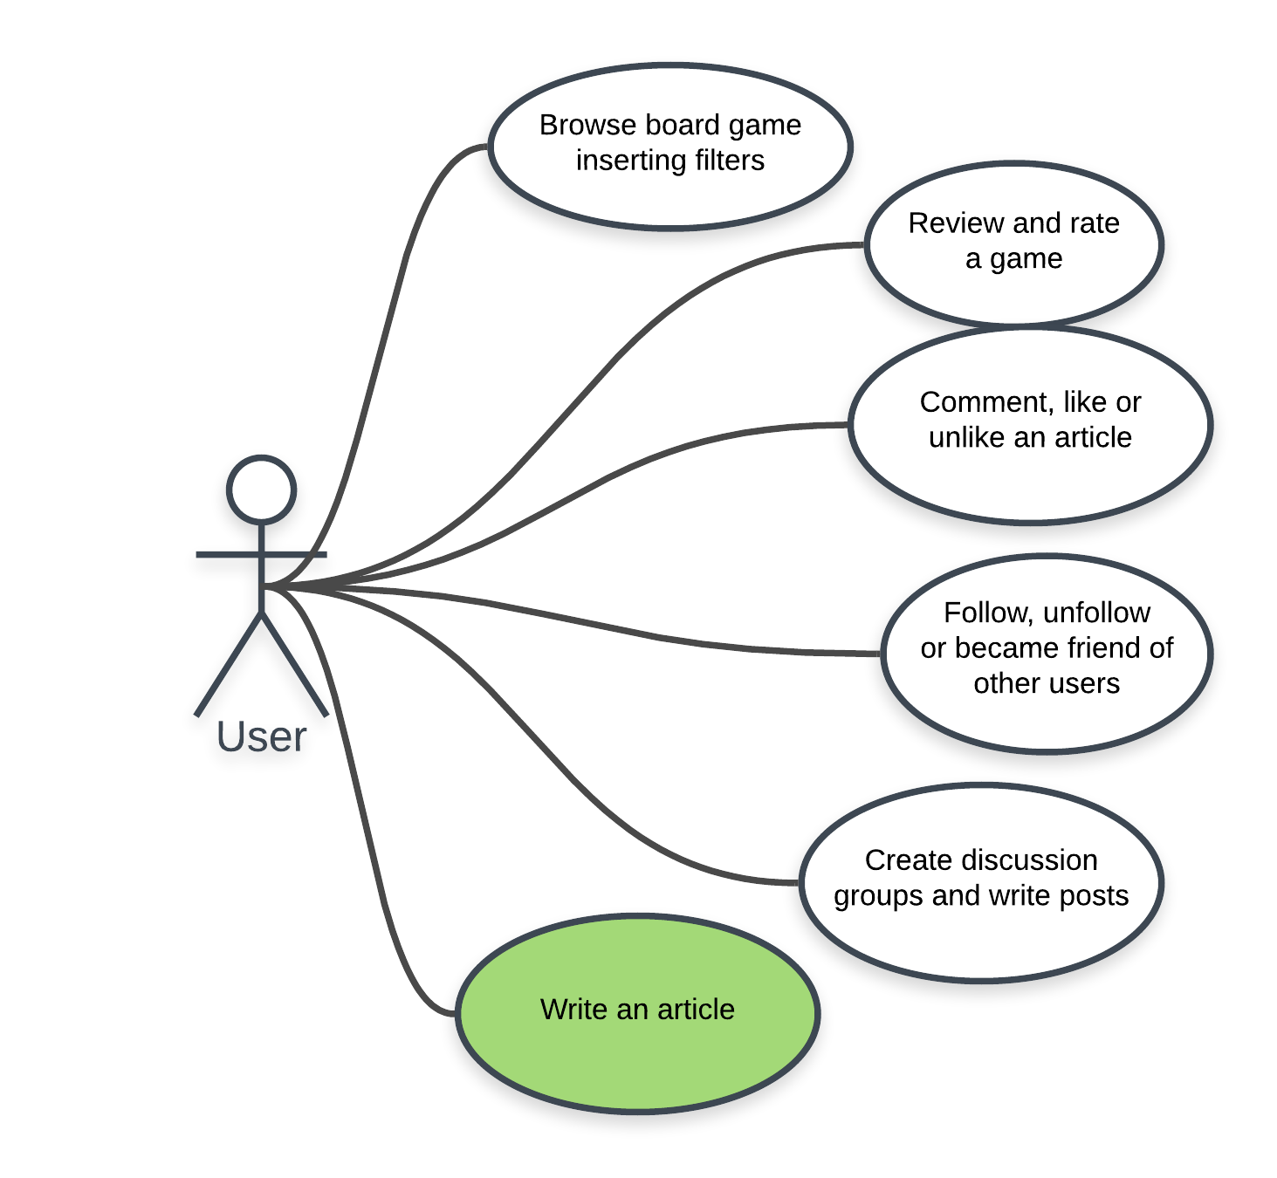
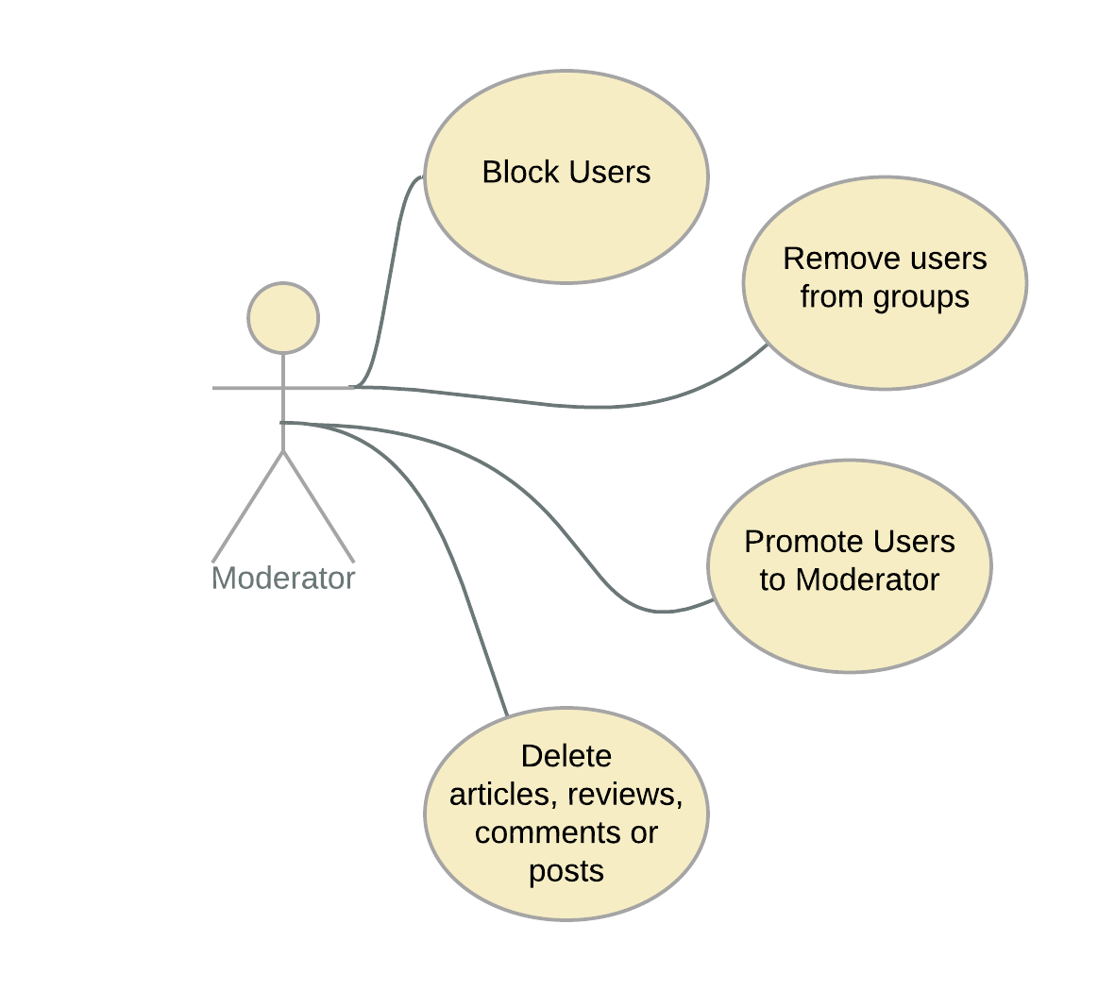
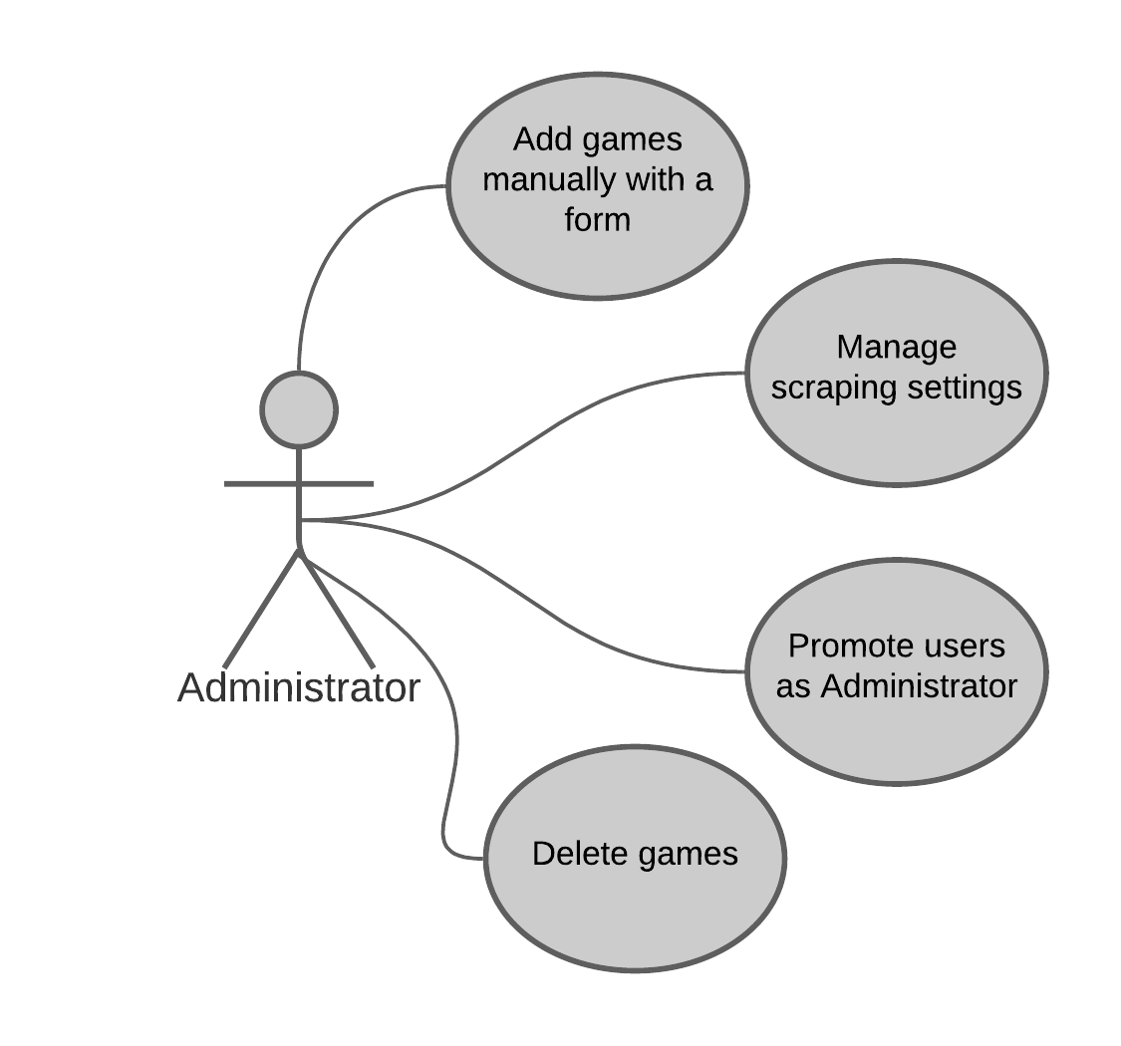
Actors and main supported functionalities
performed by an Influecer, a user who can writes articles about one or more games.
This is a simplified use case

Slide 4
Dataset Description
Source: https://boardgamegeek.com, https://luding.org, https://www.wikidata.org/wiki/Wikidata:Main_Page
Description: Forum and website scraped with https://github.com/recommend-games/board-game-scraper , adapted for our purpose.
Volume: ~100 MB
Variety: Various format and sources, we formatted the data with some Python scripts.
Velocity/Variability: Administrator can choose the sources and the interval for the scraping and this can also be suggested by analytics functions for the activity time of users.

Slide 5
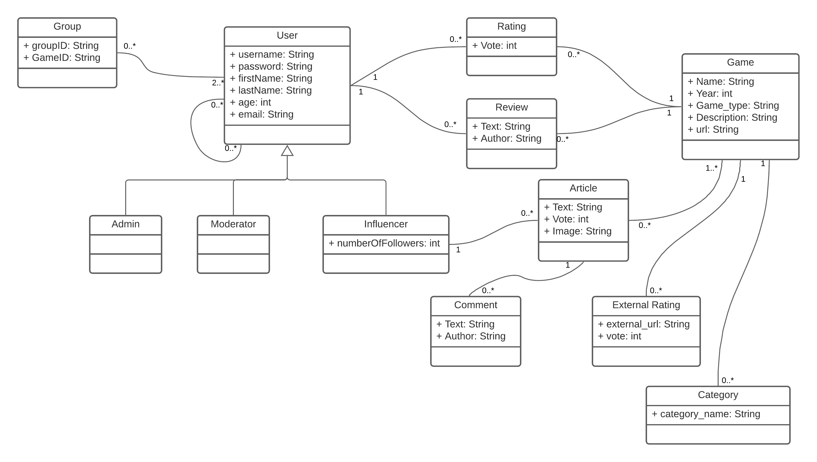
Preliminary UML Class Diagram
A user can also be an Unregistered User or a Registered User. An influencer is a Registered User that has many good reviews and then she/he can be promoted by a Moderator.

Slide 6

Requirements and Entities handled by Document DB
Three collections that hold these entities:
Game
Category
External_rating
User
Article
Group
High level query:
Show suggested games based on favorite categories specified at subscription
Show suggested users to make friends with based on favorite categories
Search a games setting parameters and use filters, for instance:
Set category
Set # of players
Order by external rating

Slide 7
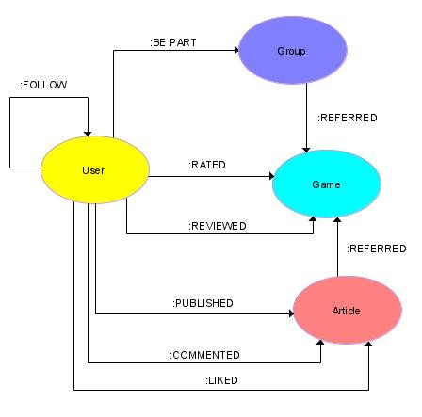
Requirements and Entities handled by Graph DB
Entities:
Game → Id, Name, Category
User → Id, Name, Age
Review → Id, Timestamp, Text
Rating → Vote, Timestamp
Article → Id
Group → Id, Name
Comment → Id, Timestamp, Text
High level query:
Domain-specific | Graph-Centric
The top-3 rated games in a given period | The 3 games with the highest number of ":Reviewed" incoming edges.
Most popular influencers among users in a given age range | Select an age range and count the number of ":Follow" incoming edges from users within this range
The user who reviewed the largest number of different game categories | The user who has the hieghst number of ":Reviewed" outgoing edges to a different game category

Slide 8




Software Architecture Preliminary Idea
Programming Language:
Java
Frontend Framework:
JavaFX
DBMS:
MongoDB and Neo4J
Other frameworks and libraries:
Guava
Mockito
Junit
Gson
Log4J

