Slide 1
Kubernetes
design principles and pod migration concepts

Slide 2
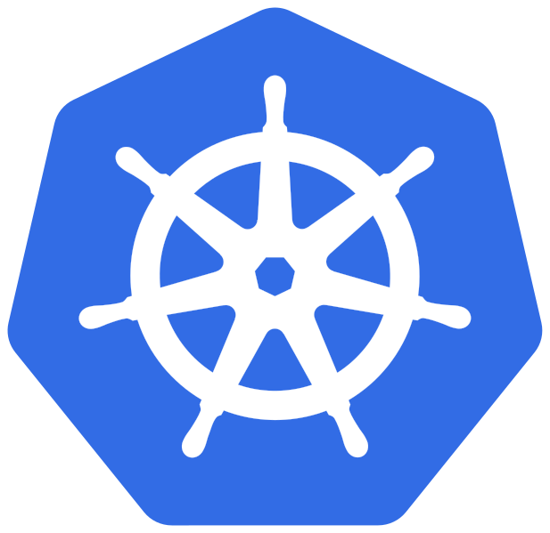
Kubernetes
Container orchestrator
Provides:
Service discovery and load balancing
Storage orchestration
Self-healing
Automated rollouts and rollbacks
..and much more!

Slide 3
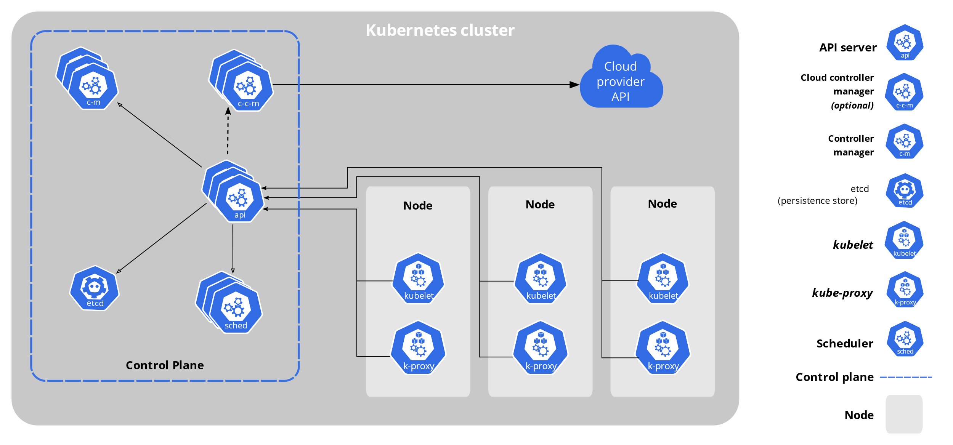
Kubernetes
Reference architecture:
Source: https://kubernetes.io/docs/concepts/overview/components/
Notes:
A Kubernetes cluster consists of a set of worker machines, called nodes, that run containerized applications. Every cluster has at least one worker node.
The worker node(s) host the Pods that are the components of the application workload.
The control plane manages the worker nodes and the Pods in the cluster.
In production environments, the control plane usually runs across multiple computers and a cluster usually runs multiple nodes, providing fault-tolerance and high availability.

Slide 4
Kubernetes
Control plane components:
kube-apiserver
etcd
kube-scheduler
kube-controller-manager
Notes:
The control plane is actually made up of several components:
kube-apiserver This is the frontend server for the control plane, handling API requests.
etcd This is the database where Kubernetes stores all its information: what nodes exist, what resources exist on the cluster, and so on.
kube-scheduler This decides where to run newly created Pods.
kube-controller-manager This is responsible for running resource controllers, such as Deployments.
cloud-controller-manager This interacts with the cloud provider (in cloud-based clusters), managing resources such as load balancers and disk volumes.
The control-plane components in a production cluster typically run on multiple servers to ensure high availability.

Slide 5
Kubernetes
Node components:
kubelet
kube-proxy
container-runtime
Notes:
kubelet This is responsible for driving the container runtime to start workloads that are scheduled on the node, and monitoring their status.
kube-proxy This does the networking magic that routes requests between Pods on different nodes, and between Pods and the internet.
Container runtime This actually starts and stops containers and handles their communications.
Historically the most popular option has been Docker, but Kubernetes supports other container runtimes as well, such as containerd and CRI-O.

Slide 6
Kubernetes
Node components:
kubelet
kube-proxy
container-runtime
Software that is responsible for
running containers

Slide 7
Container-runtime
CRI (Container Runtime Interface)
containerd
cri-o
OCI (Open Container Initiative) runtimes
Native runtimes
Sandboxed and virtualized runtimes
Notes:
Docker has been instrumental in popularizing containers and has historically been the most popular container runtime for Kubernetes environments. But Kubernetes recently announced that it will deprecate Dockershim—the underlying module that enables compatibility between Docker and Kubernetes—as part of the v1.24 release. This means that organizations will have to migrate from Docker to either containerd or CRI-O, which are the two runtimes that are compatible with the Kubernetes container runtime interface (CRI).

Slide 8
Container-runtime
CRI (Container Runtime Interface)
containerd
cri-o
OCI (Open Container Initiative) runtimes
Native runtimes
Sandboxed and virtualized runtimes

Slide 9

Container-runtime
OCI runtimes:
Native runtimes:
runC
Railcar
Crun
rkt
Sandboxed and virtualized runtimes:
gviso
nabla-containers
runV
clearcontainers
kata-containers

Slide 10
Docker vs Kubernetes
Docker
Kubernetes
CRI
containerd
cri-o
OCI
runc
container
container

Slide 11
Docker vs Kubernetes
Docker
Tools to execute containers
Kubernetes
CRI
containerd
cri-o
OCI
runc
container
container

Slide 12
Docker vs Kubernetes
Docker
Kubernetes
Kubernetes API, define how k8s interacts with container runtime
CRI
containerd
cri-o
OCI
runc
container
container

Slide 13
Docker vs Kubernetes
Docker
Kubernetes
CRI
containerd
container runtimes
cri-o
OCI
runc
container
container

Slide 14
Docker vs Kubernetes
Docker
Kubernetes
CRI
containerd
cri-o
Specification about how execute container images
OCI
runc
container
container

Slide 15
Docker vs Kubernetes
Docker
Kubernetes
CRI
containerd
cri-o
OCI
OCI-compliant tool to create and execute containers
runc
container
container

Slide 16
Pods
Kubernetes objects express the desired state of the cluster.
Each object is represented by a .yaml file:
manifest.yaml
apiVersion: v1
kind: Pod
metadata:
name: nginx
spec:
containers:
- name: nginx
image: nginx:1.14.2
ports:
- containerPort: 80
A pod is just a resource with kind equal to «Pod»
Notes:
Pods are NON-PERMANENT resources, they are destroyed and re-created continously to match the desired state of the cluster

Slide 17
Pods
Sets of running containers in a cluster
Properties of pods:
unique IP address
may be composed of more than one container
containers inside the same pod share volumes, IP namespace and port space

Slide 18
Deployments
apiVersion: apps/v1
kind: Deployment
metadata:
name: nginx-deployment
spec:
selector:
matchLabels:
app: nginx
replicas: 2
template:
metadata:
labels:
app: nginx
spec:
containers:
- name: nginx
image: nginx:1.14.2
ports:
- containerPort: 80
Resource of kind «Deployment»
Set the «desired state» to 2 replicas, so deployment need to run 2 pods
Notes:
Working together with the Deployment resource is a kind of Kubernetes component called a controller.
Controllers are basically pieces of code that run continuously in a loop, and watch the resources that they’re responsible for, making sure they’re present and working.
If a given Deployment isn’t running enough replicas, for whatever reason, the controller will create some new ones. (If there were too many replicas for some reason, the controller would shut down the excess ones.
Either way, the controller makes sure that the real state matches the desired state.)
Actually, a Deployment doesn’t manage replicas directly: instead, it automatically creates an associated object called a ReplicaSet, which handles that.
Why doesn’t a Deployment just manage an individual container directly?
The answer is that sometimes a set of containers needs to be scheduled together, running on the same node, and communicating locally, perhaps sharing storage.
This is where Kubernetes starts to grow beyond simply running containers directly on a host using something like Docker.
It manages entire combinations of containers, their configuration, and storage, etc. across a cluster of nodes.

Slide 19
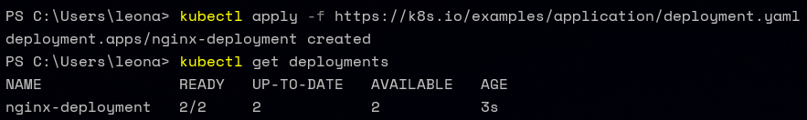
Deployments
Notes:
The kubectl create deployment command didn’t actually create the Pod directly. Instead it created a Deployment, and then the Deployment created a ReplicaSet, which created the Pod.

Slide 20
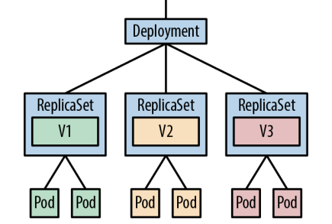
ReplicaSets
A ReplicaSet is responsible for a group of identical Pods, or replicas.
Source: «Cloud Native DevOps with Kubernetes», O’Reilly, Justin Domingous & John Arundel
Notes:
A ReplicaSet is responsible for a group of identical Pods, or replicas.
If there are too few (or too many) Pods, compared to the specification, the ReplicaSet controller will start (or stop) some Pods to rectify the situation.
Deployments, in turn, manage ReplicaSets, and control how the replicas behave when you update them

Slide 21
DaemonSets
apiVersion: apps/v1
kind: DaemonSet
metadata:
name: fluentd-eAlasticsearch
...
spec:
...
template:
...
spec:
containers:
- name: fluentd-elasticsearch
Notes:
Use a DaemonSet when you need to run one copy of a Pod on each of the nodes in your cluster.
If you’re running an application where maintaining a given number of replicas is more important than exactly which node the Pods run on, use a Deployment instead

Slide 22
StatefulSets
Adds the ability to start and stop Pods in a specific sequence.
Notes:
With a Deployment, for example, all your Pods are started and stopped in a random order. This is fine for stateless services, where every replica is identical and does the same job
Each replica in a StatefulSet must be running and ready before Kubernetes starts the next one, and similarly when the StatefulSet is terminated, the replicas will be shut down in reverse order, waiting for each Pod to finish before moving on to the next.
To be able to address each of the Pods by a predictable DNS name, such as redis-1, you also need to create a Service with a clusterIP type of None (known as a headless service)
With a nonheadless Service, you get a single DNS entry (such as redis) that loadbalances across all the backend Pods. With a headless service, you still get that single Pod Controllers | 167 service DNS name, but you also get individual DNS entries for each numbered Pod, like redis-0, redis-1, redis-2, and so on.

Slide 23
Jobs & CronJobs
apiVersion: batch/v1
kind: Job
metadata:
name: queue-worker
spec:
completions: 10
template:
metadata:
name: queue-worker
spec:
containers:
...
apiVersion: batch/v1
kind: CronJob
metadata:
name: demo-cron
spec:
schedule: "*/1 * * * *"
jobTemplate:
spec:
containers:
...
Notes:
Another useful type of Pod controller in Kubernetes is the Job. Whereas a Deploy‐ ment runs a specified number of Pods and restarts them continually, a Job only runs a Pod for a specified number of times. After that, it is considered completed.
There are two fields that control Job execution: completions and parallelism. The first, completions, determines the number of times the specified Pod needs to run successfully before the Job is considered complete. The default value is 1, meaning the Pod will run once.
The parallelism field specifies how many Pods should run at once. Again, the default value is 1, meaning that only one Pod will run at a time.
If it crashes, fails, or exits in any nonsuccessful way, the Job will restart it, just like a Deployment does. Only successful exits count toward the required number of completions.
In Unix environments, scheduled jobs are run by the cron daemon.
The two important fields to look at in the CronJob manifest are spec.schedule and spec.jobTemplate. The schedule field specifies when the job will run, using the same format as the Unix cron utility.

Slide 24
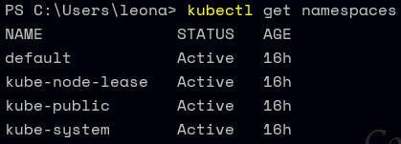
Managing resources
A Kubernetes namespace is a way of partitioning your cluster into separate subdivisions, for whatever purpose you like.
Notes:
For example, you might have different namespaces for testing out different versions of an application, or a separate namespace per team.
As the term namespace suggests, names in one namespace are not visible from a different namespace.
This means that you could have a service called demo in the prod namespace, and a different service called demo in the test namespace, and there won’t be any conflict.
If you don’t specify a namespace when running a kubectl command, such as kubectl run, your command will operate on the default namespace.
If you’re wondering what the kube-system namespace is, that’s where the Kubernetes internal system components run so that they’re segregated from your own applications.
If, instead, you specify a namespace with the --namespace flag (or -n for short), your command will use that namespace.
For example, to get a list of Pods in the prod namespace, run: kubectl get pods --namespace prod
namespaces are logically isolated from one another, they can still communicate with Services in other namespaces.

Slide 25
Networking

Slide 26
Requirements
Containers can communicate with all other containers without NAT.
Nodes can communicate with all containers (and vice versa) without NAT.
The IP a container sees itself is the same IP as others see it.

Slide 27
Networking model
container-to-container
pod-to-pod
pod-to-service
external-to-service
Notes:
Intra-pod: All containers within a pod share a network namespace and see each other on localhost.
Inter-pod networking Two types of east–west traffic are supported: pods can directly communicate with other pods or, preferably, pods can leverage services to communicate with other pods.
Ingress and egress Ingress refers to routing traffic from external users or apps to pods, and egress refers to calling external APIs from pods.

Slide 28
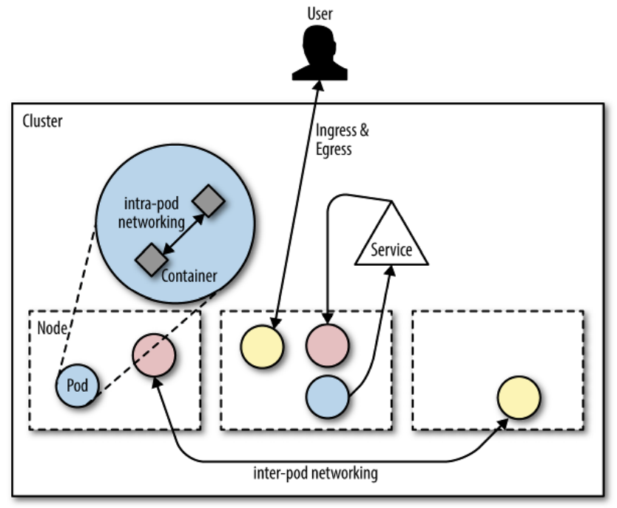
Networking model
Source: «Container Networking», O’Reilly, Michael Hausenblas
Notes:
Kubernetes requires each pod to have an IP in a flat networking name‐ space with full connectivity to other nodes and pods across the network. This IP-per-pod model yields a backward-compatible way for you to treat a pod almost identically to a VM or a physical host, in the context of naming, service discovery, or port allocations. The model allows for a smoother transition from non–cloud native apps and environments.
In Kubernetes, each pod has a routable IP, allowing pods to communicate across cluster nodes without NAT and no need to manage port allocations.
Because every pod gets a real (that is, not machine-local) IP address, pods can communicate without proxies or translations (such as NAT). The pod can use well-known ports and can avoid the use of higher-level service discovery mechanisms.
We distinguish between two types of inter-pod communication, sometimes also called East-West traffic:
• Pods can directly communicate with other pods; in this case the caller pod needs to find out the IP address of the callee and risks repeating this operation since pods come and go (cattle behaviour).
• Preferably, pods use services to communicate with other pods. In this case, the service provides a stable (virtual) IP address that can be discovered, for example, via DNS.
While in the case of Ingress we’re interested in routing traffic from outside the cluster to a service, in the case of Egress we are dealing with the opposite: how does an app in a pod call out to (cluster-)external APIs? One may want to control which pods are allowed to have a communication path to outside services and on top of that impose other policies. Note that by default all containers in a pod can perform Egress. These policies can be enforced using network policies

Slide 29
Services
An abstract way to expose an application running on a set of Pods as a network service.
Single, unchanging IP address or DNS name that will be automatically routed to any matching Pod
Notes:
Suppose you want to make a network connection to a Pod (such as our example application).
How do you do that? You could find out the Pod’s IP address and connect directly to that address and the app’s port number.
But the IP address may change when the Pod is restarted, so you’ll have to keep looking it up to make sure it’s up-to-date.
Worse, there may be multiple replicas of the Pod, each with different addresses.
Every other application that needs to contact the Pod would have to maintain a list of those addresses, which doesn’t sound like a great idea.

Slide 30
Services
apiVersion: v1
kind: Service
metadata:
name: demo
labels:
app: demo
spec:
ports:
- port: 8888
protocol: TCP
targetPort: 8888
selector:
app: demo
type: ClusterIP
How to route requests to particular Pods
ClusterIP
NodePort
LoadBalancer
Notes:
A selector is an expression that matches a label (or set of labels). It’s a way of specifying a group of resources by their labels.
Labels are key/value pairs that are attached to objects, such as pods.
Labels are intended to be used to specify identifying attributes of objects that are meaningful and relevant to users, but do not directly imply semantics to the core system.
If you set the type field to NodePort, the Kubernetes control plane allocates a port from a range specified by --service-node-port-range flag (default: 30000-32767). Each node proxies that port (the same port number on every Node) into your Service.

Slide 31

Services
apiVersion: v1
kind: Service
metadata:
name: demo
labels:
app: demo
spec:
ports:
- port: 8888
protocol: TCP
targetPort: 8888
selector:
app: demo
type: ClusterIP
How to route requests to particular Pods
ClusterIP
NodePort
LoadBalancer
Notes:
Kube-proxy uses iptables where random selection is the native method for the load-balancing.
Ingress uses a controller.

Slide 32
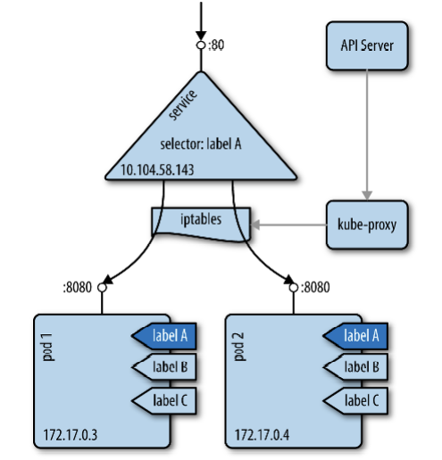
Services
Source: «Container Networking», O’Reilly, Michael Hausenblas
Notes:
A service provides a stable virtual IP (VIP) address for a set of pods.
While pods may come and go, services allow clients to reliably discover and connect to the containers running in the pods by using the VIP.
The “virtual” in VIP means it’s not an actual IP address connected to a network interface; its purpose is purely to act as the stable front to forward traffic to one or more pods, with IP addresses that may come and go.
You specify the set of pods you want a service to target via a label selector, for example, for spec.selector.app=someapp
Kubernetes would create a service that targets all pods with a label app=someapp.
Note that if such a selector exists, then for each of the targeted pods a sub-resource of type Endpoint will be created, and if no selector exists then no endpoints are created.
Keeping the mapping between the VIP and the pods up-to-date is the job of kube-proxy.
In iptables mode, kube-proxy creates iptables rules for kubernetes services which ensure that the request to the service gets routed (and load balanced) to the appropriate pods.
These iptables rules also help answer the second question mentioned above. As long as these iptables rules exist, requests to services will get routed to the appropriate pods even if kube-proxy process dies on the node. Endpoints for new services won’t work from this node, however, since kube-proxy process won’t create the iptables rules for it.
As outlined in this flow chart, there are rules in the PREROUTING chain of the nat table for kubernetes services. As per iptables rules evaluation order, rules in the PREROUTING chain are the first ones to be consulted as a packet enters the linux kernel’s networking stack.
Rules created by kube-proxy in the PREROUTING chain help determine if the packet is meant for a local socket on the node or if it should be forwarded to a pod. It is these rules that ensure that the request to <kubernetes-node-ip>:<NodePort> continue to get routed to pods even if the NodePort is in use by another process.
As a part of the v1.25 release, SIG Network made this declaration explicit: that (with one exception), the iptables chains that Kubernetes creates are intended only for Kubernetes’s own internal use, and third-party components should not assume that Kubernetes will create any specific iptables chains, or that those chains will contain any specific rules if they do exist

Slide 33
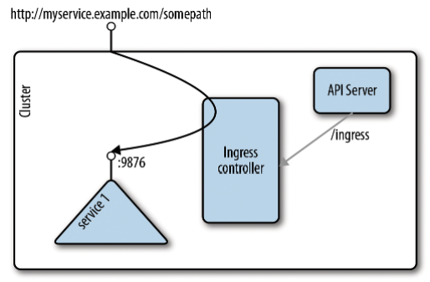
Services
Source: «Container Networking», O’Reilly, Michael Hausenblas
Notes:
conceptually, it is split up into two main pieces, an Ingress resource, which defines the routing to the back‐ ing services, and the Ingress controller, which listens to the /ingresses endpoint of the API server, learning about services being created or removed. On service status changes, the Ingress controller configures the routes so that external traffic lands at a specific (cluster-internal) service

Slide 34
Services
Service DNS names always follow this pattern:
SERVICE.NAMESPACE.svc.cluster.local
Notes:
The .svc.cluster.local part is optional, and so is the namespace.
Even if you have a dozen different Services called demo, each in its own namespace, you can add the namespace to the DNS name for the Service to specify exactly which one you mean.
It’s easy, if you have the DNS cluster add-on installed and enabled. This DNS server watches on the Kubernetes API for services being created or removed. It creates a set of DNS records for each service it observes.

Slide 35
Networking
CNI (Container Network Interface)
cilium
flannel
calico
Weave Net
antrea
..and many more!

Slide 36
Networking
What a CNI does:
Create interfaces.
Create veth pairs.
Set up the namespace networking.
Set up static routes.
Configure an ethernet bridge.
Assign IP addresses.
Create NAT rules.
..and counting!

Slide 37

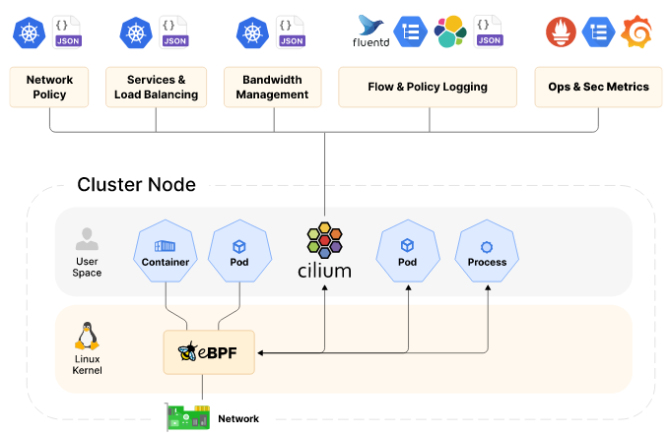
Cilium
Source: https://cilium.io/get-started/
Notes:
Cilium is another CNI solution, based on eBPF, and is designed to be run at large scale. Whilst Cilium implements the standard NetworkPolicies, it is able to utilise the full packet introspection of eBPF, enabling it to have first class support for Layer 7 policy for a number of protocols, custom extensions using Envoy, large options for endpoint selection, as well as rich network monitoring introspection. For these reasons, Cilium becomes a very favourable choice for running Kubernetes at scale, with complex network policy requirements.
Kubernetes doesn't come with an implementation of Load Balancing. This is usually left as an exercise for your cloud provider or in private cloud environments an exercise for your networking team. Cilium can attract this traffic with BGP and accelerate leveraging XDP and eBPF. Together these technologies provide a very robust and secure implementation of Load Balancing.
Cilium and eBPF operate at the kernel layer. With this level of context we can make intelligent decisions about how to connect different workloads whether on the same node or between clusters. With eBPF and XDP Cilium enables significant improvements in latency and performance and eliminates the need for kube-proxy entirely.
Cilium’s control and data plane has been built from the ground up for large-scale and highly dynamic cloud native environments where 100s and even 1000s of containers are created and destroyed within seconds. Cilium’s control plane is highly optimized, running in Kubernetes clusters of up to 5K nodes and 100K pods. Cilium’s data plane uses eBPF for efficient load-balancing and incremental updates, avoiding the pitfalls of large iptables rulesets. Cilium is fully IPv6-aware.
With standard Kubernetes networking each cluster is an island, requiring proxies to connect workloads across clusters for the purposes of migration, disaster-recovery, or geographic locality. Cilium Cluster Mesh creates a single zone of connectivity for load-balancing, observability and security between nodes across multiple clusters, enabling simple, high-performance cross-cluster connectivity.

Slide 38

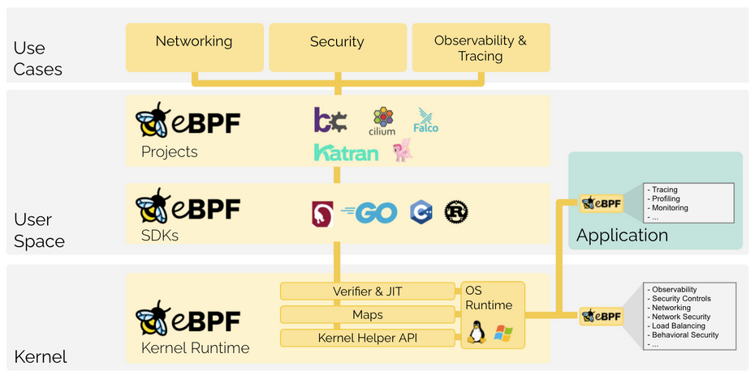
eBPF
Source: https://ebpf.io/
Notes:
eBPF is a revolutionary technology with origins in the Linux kernel that can run sandboxed programs in an operating system kernel. It is used to safely and efficiently extend the capabilities of the kernel without requiring to change kernel source code or load kernel modules.
Historically, the operating system has always been an ideal place to implement observability, security, and networking functionality due to the kernel’s privileged ability to oversee and control the entire system. At the same time, an operating system kernel is hard to evolve due to its central role and high requirement towards stability and security. The rate of innovation at the operating system level has thus traditionally been lower compared to functionality implemented outside of the operating system.
eBPF changes this formula fundamentally. By allowing to run sandboxed programs within the operating system, application developers can run eBPF programs to add additional capabilities to the operating system at runtime. The operating system then guarantees safety and execution efficiency as if natively compiled with the aid of a Just-In-Time (JIT) compiler and verification engine. This has led to a wave of eBPF-based projects covering a wide array of use cases, including next-generation networking, observability, and security functionality.
Today, eBPF is used extensively to drive a wide variety of use cases: Providing high-performance networking and load-balancing in modern data centers and cloud native environments, extracting fine-grained security observability data at low overhead, helping application developers trace applications, providing insights for performance troubleshooting, preventive application and container runtime security enforcement, and much more. The possibilities are endless, and the innovation that eBPF is unlocked has only just begun.
NETWORKING:
The combination of programmability and efficiency makes eBPF a natural fit for all packet processing requirements of networking solutions. The programmability of eBPF enables adding additional protocol parsers and easily program any forwarding logic to meet changing requirements without ever leaving the packet processing context of the Linux kernel. The efficiency provided by the JIT compiler provides execution performance close to that of natively compiled in-kernel code.

Slide 39
eBPF
eBPF is a mechanism for Linux applications to execute code in Linux kernel space.
eBPF can run sandboxed programs in the Linux kernel without changing kernel source code or loading kernel modules.

Slide 40

flannel
Flannel runs a small, single binary agent called flanneld on each host
Allocate a subnet lease to each host out of a larger, preconfigured address space.
Notes:
Flannel manages an IPv4 network between multiple nodes in a cluster. It does not control how containers are networked to the host, only how the traffic is transported between hosts.
Flannel runs a small, single binary agent called flanneld on each host, and is responsible for allocating a subnet lease to each host out of a larger, preconfigured address space. Flannel uses either the Kubernetes API or etcd directly to store the network configuration, the allocated subnets, and any auxiliary data (such as the host's public IP). Packets are forwarded using one of several backend mechanisms including VXLAN and various cloud integrations.
Platforms like Kubernetes assume that each container (pod) has a unique, routable IP inside the cluster. The advantage of this model is that it removes the port mapping complexities that come from sharing a single host IP.
Flannel is responsible for providing a layer 3 IPv4 network between multiple nodes in a cluster. Flannel does not control how containers are networked to the host, only how the traffic is transported between hosts. However, flannel does provide a CNI plugin for Kubernetes and a guidance on integrating with Docker.
Flannel is focused on networking. For network policy, other projects such as Calico can be used.
Flannel may be paired with several different backends. Once set, the backend should not be changed at runtime.
VXLAN is the recommended choice. host-gw is recommended for more experienced users who want the performance improvement and whose infrastructure support it (typically it can't be used in cloud environments). UDP is suggested for debugging only or for very old kernels that don't support VXLAN.
For more information on configuration options for Tencent see TencentCloud VPC Backend for Flannel

Slide 41

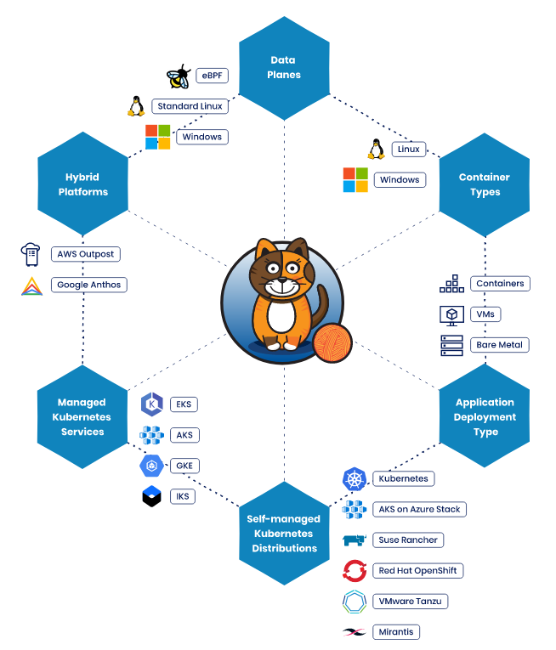
calico
Source: Kubernetes (tigera.io)
Notes:
Calico is a widely adopted, battle-tested open source networking and network security solution for Kubernetes, virtual machines, and bare-metal workloads. Calico provides two major services for Cloud Native applications:
Network connectivity between workloads.
Network security policy enforcement between workloads.
Calico’s flexible architecture supports a wide range of deployment options, using modular components and technologies, including:
Choice of data plane technology, whether it be eBPF, standard Linux, Windows HNS or VPP
Enforcement of the full set of Kubernetes network policy features, plus for those needing a richer set of policy features, Calico network policies.
An optimized Kubernetes Service implementation using eBPF.
Kubernetes apiserver integration, for managing Calico configuration and Calico network policies.
Both non-overlay and overlay (via IPIP or VXLAN) networking options in either public cloud or on-prem deployments.
CNI plugins for Kubernetes to provide highly efficient pod networking and IP Address Management (IPAM).
A Neutron ML2 plugin to provide VM networking for OpenStack.
A BGP routing stack that can advertise routes for workload and service IP addresses to physical network infrastructure.

Slide 42
Pod migration
Notes:
Placing certain services in close proximity to the consumers has great benefits, including low-latency response, bandwidth consumption savings, and data locality. However, there are also multiple challenges. One of the key challenges with the Kubernetes deployment model is the placement of the Kubernetes control plane that manages the workers that comprise the resource pools consumed by the applications and services. The two main options for control plane placement are:
Deploying full-fledged cluster(s), complete with control nodes and worker nodes, everywhere you need your applications to be accessible
Deploying worker nodes at the edge and connecting them to the central location hosting the control plane
You can simplify option one (the full-cluster model shown above) with innovative deployment models:
A compact high availability (HA) cluster with a minimum of three nodes accommodating both control plane and worker node roles
An all-in-one, single-node standalone cluster
Option two (the remote worker approach shown below) eliminates the overhead of having a dedicated control plane at each location. Still, it may not be feasible if there is a significant latency, intermittent connectivity, or a lack of sufficient bandwidth for the cluster's internal services or operations between the Kubernetes control plane and the worker locations to function correctly.

Slide 43
Checkpoint-restore (C/R)
CRIU (Checkpoint and Restore In User-space):
Freeze the process
Persist the state to disk
Transfer the state
Restore the state
Resume the process

Slide 44
Migration Strategies
Full checkpointing
Pre-copy
Post-copy
Hybrid
Notes:
Full checkpointing: Minimize the net utilization and have the minimun failure risk but the downtime is equal to the duration of the migration.
Pre-copy: the memory data are transfered while the checkpoint is still running. The memory is copied on the target node using iterations while the process keeps running
Post-copy: Inverting the pre-copy we have that the process is freezed and the only the necessary things to keep the process running are migrated, to re-run the process with the minimun downtime.

Slide 45
MigratingPod library
Developed by J. Schrettenbrunner
Main drawbacks:
No full network trasparency
Full checkpointing
No migration of local volumes and container fyle systems
Source: «Migrating Pods in Kubernetes» Jakob Schrettenbrunner

Slide 46
Enough with the boring stuff, some more interesting use cases..

Slide 47
Deploying microservices applications
Notes:
Placing certain services in close proximity to the consumers has great benefits, including low-latency response, bandwidth consumption savings, and data locality. However, there are also multiple challenges. One of the key challenges with the Kubernetes deployment model is the placement of the Kubernetes control plane that manages the workers that comprise the resource pools consumed by the applications and services. The two main options for control plane placement are:
Deploying full-fledged cluster(s), complete with control nodes and worker nodes, everywhere you need your applications to be accessible
Deploying worker nodes at the edge and connecting them to the central location hosting the control plane
You can simplify option one (the full-cluster model shown above) with innovative deployment models:
A compact high availability (HA) cluster with a minimum of three nodes accommodating both control plane and worker node roles
An all-in-one, single-node standalone cluster
Option two (the remote worker approach shown below) eliminates the overhead of having a dedicated control plane at each location. Still, it may not be feasible if there is a significant latency, intermittent connectivity, or a lack of sufficient bandwidth for the cluster's internal services or operations between the Kubernetes control plane and the worker locations to function correctly.

Slide 48
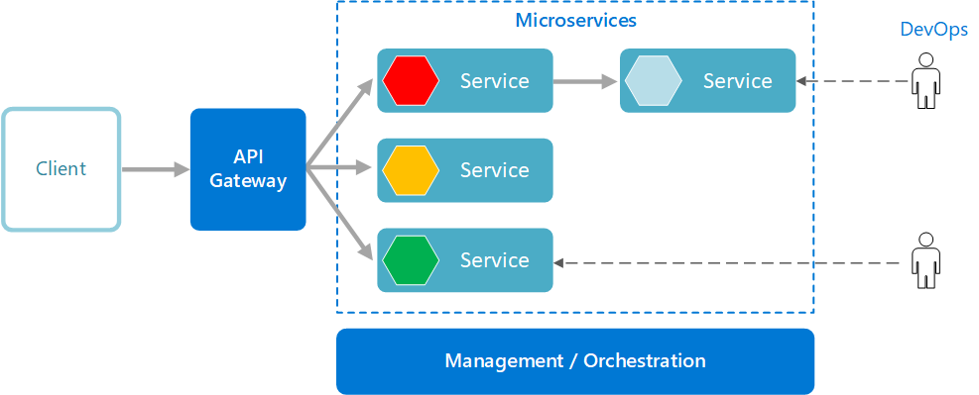
Microservices
Source: https://learn.microsoft.com/en-us/azure/architecture/guide/architecture-styles/microservices
Notes:
A microservices architecture consists of a collection of small, autonomous services. Each service is self-contained and should implement a single business capability within a bounded context. A bounded context is a natural division within a business and provides an explicit boundary within which a domain model exists.
What are microservices?
Microservices are small, independent, and loosely coupled. A single small team of developers can write and maintain a service.
Each service is a separate codebase, which can be managed by a small development team.
Services can be deployed independently. A team can update an existing service without rebuilding and redeploying the entire application.
Services are responsible for persisting their own data or external state. This differs from the traditional model, where a separate data layer handles data persistence.
Services communicate with each other by using well-defined APIs. Internal implementation details of each service are hidden from other services.
Supports polyglot programming. For example, services don't need to share the same technology stack, libraries, or frameworks.
Besides for the services themselves, some other components appear in a typical microservices architecture:
Management/orchestration. This component is responsible for placing services on nodes, identifying failures, rebalancing services across nodes, and so forth. Typically this component is an off-the-shelf technology such as Kubernetes, rather than something custom built.
API Gateway. The API gateway is the entry point for clients. Instead of calling services directly, clients call the API gateway, which forwards the call to the appropriate services on the back end.
Advantages of using an API gateway include:
It decouples clients from services. Services can be versioned or refactored without needing to update all of the clients.
Services can use messaging protocols that are not web friendly, such as AMQP.
The API Gateway can perform other cross-cutting functions such as authentication, logging, SSL termination, and load balancing.
Out-of-the-box policies, like for throttling, caching, transformation, or validation.
Benefits
Agility. Because microservices are deployed independently, it's easier to manage bug fixes and feature releases. You can update a service without redeploying the entire application, and roll back an update if something goes wrong. In many traditional applications, if a bug is found in one part of the application, it can block the entire release process. New features may be held up waiting for a bug fix to be integrated, tested, and published.
Small, focused teams. A microservice should be small enough that a single feature team can build, test, and deploy it. Small team sizes promote greater agility. Large teams tend be less productive, because communication is slower, management overhead goes up, and agility diminishes.
Small code base. In a monolithic application, there is a tendency over time for code dependencies to become tangled. Adding a new feature requires touching code in a lot of places. By not sharing code or data stores, a microservices architecture minimizes dependencies, and that makes it easier to add new features.
Mix of technologies. Teams can pick the technology that best fits their service, using a mix of technology stacks as appropriate.
Fault isolation. If an individual microservice becomes unavailable, it won't disrupt the entire application, as long as any upstream microservices are designed to handle faults correctly (for example, by implementing circuit breaking).
Scalability. Services can be scaled independently, letting you scale out subsystems that require more resources, without scaling out the entire application. Using an orchestrator such as Kubernetes or Service Fabric, you can pack a higher density of services onto a single host, which allows for more efficient utilization of resources.
Data isolation. It is much easier to perform schema updates, because only a single microservice is affected. In a monolithic application, schema updates can become very challenging, because different parts of the application may all touch the same data, making any alterations to the schema risky.
Challenges
The benefits of microservices don't come for free. Here are some of the challenges to consider before embarking on a microservices architecture.
Complexity. A microservices application has more moving parts than the equivalent monolithic application. Each service is simpler, but the entire system as a whole is more complex.
Development and testing. Writing a small service that relies on other dependent services requires a different approach than a writing a traditional monolithic or layered application. Existing tools are not always designed to work with service dependencies. Refactoring across service boundaries can be difficult. It is also challenging to test service dependencies, especially when the application is evolving quickly.
Lack of governance. The decentralized approach to building microservices has advantages, but it can also lead to problems. You may end up with so many different languages and frameworks that the application becomes hard to maintain. It may be useful to put some project-wide standards in place, without overly restricting teams' flexibility. This especially applies to cross-cutting functionality such as logging.
Network congestion and latency. The use of many small, granular services can result in more interservice communication. Also, if the chain of service dependencies gets too long (service A calls B, which calls C...), the additional latency can become a problem. You will need to design APIs carefully. Avoid overly chatty APIs, think about serialization formats, and look for places to use asynchronous communication patterns like queue-based load leveling.
Data integrity. With each microservice responsible for its own data persistence. As a result, data consistency can be a challenge. Embrace eventual consistency where possible.
Management. To be successful with microservices requires a mature DevOps culture. Correlated logging across services can be challenging. Typically, logging must correlate multiple service calls for a single user operation.
Versioning. Updates to a service must not break services that depend on it. Multiple services could be updated at any given time, so without careful design, you might have problems with backward or forward compatibility.
Skill set. Microservices are highly distributed systems. Carefully evaluate whether the team has the skills and experience to be successful.
Best practices
Model services around the business domain.
Decentralize everything. Individual teams are responsible for designing and building services. Avoid sharing code or data schemas.
Data storage should be private to the service that owns the data. Use the best storage for each service and data type.
Services communicate through well-designed APIs. Avoid leaking implementation details. APIs should model the domain, not the internal implementation of the service.
Avoid coupling between services. Causes of coupling include shared database schemas and rigid communication protocols.
Offload cross-cutting concerns, such as authentication and SSL termination, to the gateway.
Keep domain knowledge out of the gateway. The gateway should handle and route client requests without any knowledge of the business rules or domain logic. Otherwise, the gateway becomes a dependency and can cause coupling between services.
Services should have loose coupling and high functional cohesion. Functions that are likely to change together should be packaged and deployed together. If they reside in separate services, those services end up being tightly coupled, because a change in one service will require updating the other service. Overly chatty communication between two services may be a symptom of tight coupling and low cohesion.
Isolate failures. Use resiliency strategies to prevent failures within a service from cascading.

Slide 49
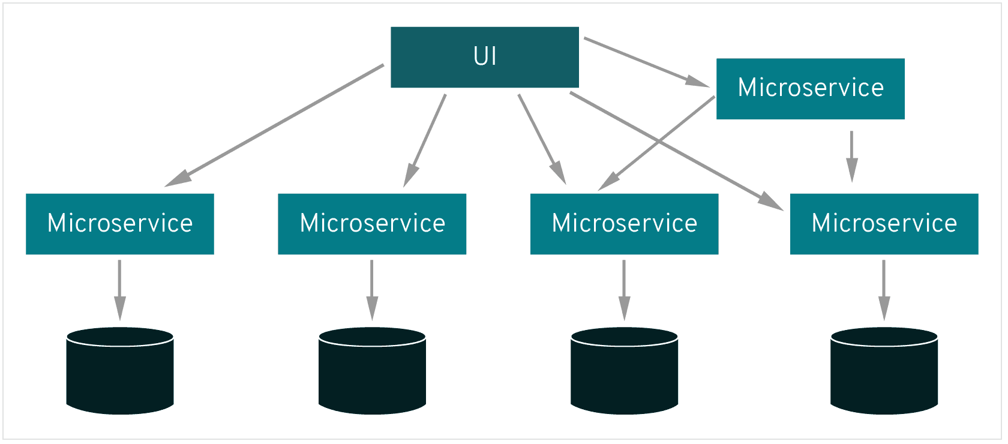
Service mesh
Source: What's a service mesh? (redhat.com)
Notes:
A service mesh, like the open source project Istio, is a way to control how different parts of an application share data with one another. Unlike other systems for managing this communication, a service mesh is a dedicated infrastructure layer built right into an app. This visible infrastructure layer can document how well (or not) different parts of an app interact, so it becomes easier to optimize communication and avoid downtime as an app grows.
Each part of an app, called a "service," relies on other services to give users what they want. If a user of an online retail app wants to buy something, they need to know if the item is in stock. So, the service that communicates with the company's inventory database needs to communicate with the product webpage, which itself needs to communicate with the user’s online shopping cart. To add business value, this retailer might eventually build a service that gives users in-app product recommendations. This new service will communicate with a database of product tags to make recommendations, but it also needs to communicate with the same inventory database that the product page needed—it’s a lot of reusable, moving parts.
Modern applications are often broken down in this way, as a network of services each performing a specific business function. In order to execute its function, one service might need to request data from several other services. But what if some services get overloaded with requests, like the retailer’s inventory database? This is where a service mesh comes in—it routes requests from one service to the next, optimizing how all the moving parts work together.
A microservices architecture lets developers make changes to an app’s services without the need for a full redeploy. Unlike app development in other architectures, individual microservices are built by small teams with the flexibility to choose their own tools and coding languages. Basically, microservices are built independently, communicate with each other, and can individually fail without escalating into an application-wide outage.
Service-to-service communication is what makes microservices possible. The logic governing communication can be coded into each service without a service mesh layer—but as communication gets more complex, a service mesh becomes more valuable. For cloud-native apps built in a microservices architecture, a service mesh is a way to comprise a large number of discrete services into a functional application.

Slide 50
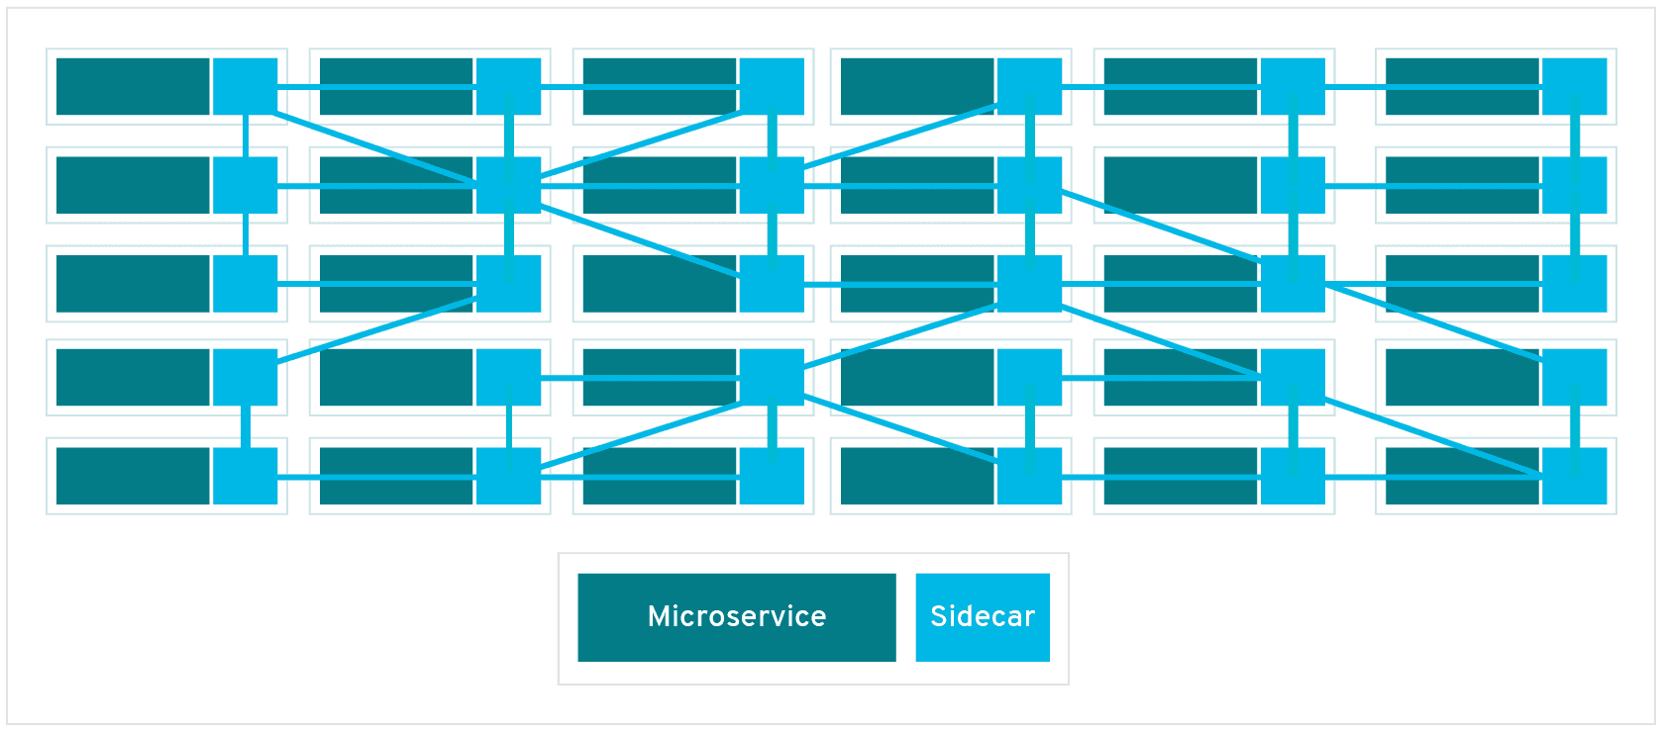
Service mesh
Source: What's a service mesh? (redhat.com)
Notes:
Deploying application’s components in separate processes or containers to entrust isolation and encapsulation.
Sidecar can be attached to the parent application and provide support features to the application.
Dataplane is implemented as an array of proxies (e.g. Envoy) deployed as sidecars.
Each pod contains a proxy istance to manage the communication between microservices.
The control plane manage and configure proxies to route the traffic.
Without a service mesh, each microservice needs to be coded with logic to govern service-to-service communication, which means developers are less focused on business goals. It also means communication failures are harder to diagnose because the logic that governs interservice communication is hidden within each service.
Every new service added to an app, or new instance of an existing service running in a container, complicates the communication environment and introduces new points of possible failure. Within a complex microservices architecture, it can become nearly impossible to locate where problems have occurred without a service mesh.
That’s because a service mesh also captures every aspect of service-to-service communication as performance metrics. Over time, data made visible by the service mesh can be applied to the rules for interservice communication, resulting in more efficient and reliable service requests.
For example, If a given service fails, a service mesh can collect data on how long it took before a retry succeeded. As data on failure times for a given service aggregates, rules can be written to determine the optimal wait time before retrying that service, ensuring that the system does not become overburdened by unnecessary retries.

Slide 51

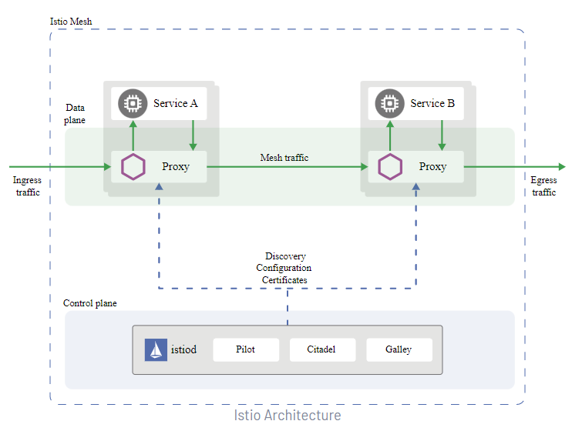
Istio
Source: Istio / Architecture
Notes:
Virtual services, along with destination rules, are the key building blocks of Istio’s traffic routing functionality. A virtual service lets you configure how requests are routed to a service within an Istio service mesh, building on the basic connectivity and discovery provided by Istio and your platform. Each virtual service consists of a set of routing rules that are evaluated in order, letting Istio match each given request to the virtual service to a specific real destination within the mesh. Your mesh can require multiple virtual services or none depending on your use case.
Why use virtual services?
Virtual services play a key role in making Istio’s traffic management flexible and powerful. They do this by strongly decoupling where clients send their requests from the destination workloads that actually implement them. Virtual services also provide a rich way of specifying different traffic routing rules for sending traffic to those workloads.
Why is this so useful? Without virtual services, Envoy distributes traffic using round-robin load balancing between all service instances, as described in the introduction. You can improve this behavior with what you know about the workloads. For example, some might represent a different version. This can be useful in A/B testing, where you might want to configure traffic routes based on percentages across different service versions, or to direct traffic from your internal users to a particular set of instances.
With a virtual service, you can specify traffic behavior for one or more hostnames. You use routing rules in the virtual service that tell Envoy how to send the virtual service’s traffic to appropriate destinations. Route destinations can be versions of the same service or entirely different services.
A typical use case is to send traffic to different versions of a service, specified as service subsets. Clients send requests to the virtual service host as if it was a single entity, and Envoy then routes the traffic to the different versions depending on the virtual service rules: for example, “20% of calls go to the new version” or “calls from these users go to version 2”. This allows you to, for instance, create a canary rollout where you gradually increase the percentage of traffic that’s sent to a new service version. The traffic routing is completely separate from the instance deployment, meaning that the number of instances implementing the new service version can scale up and down based on traffic load without referring to traffic routing at all. By contrast, container orchestration platforms like Kubernetes only support traffic distribution based on instance scaling, which quickly becomes complex. You can read more about how virtual services help with canary deployments in Canary Deployments using Istio.
Virtual services also let you:
Address multiple application services through a single virtual service. If your mesh uses Kubernetes, for example, you can configure a virtual service to handle all services in a specific namespace. Mapping a single virtual service to multiple “real” services is particularly useful in facilitating turning a monolithic application into a composite service built out of distinct microservices without requiring the consumers of the service to adapt to the transition. Your routing rules can specify “calls to these URIs of monolith.com go to microservice A”, and so on. You can see how this works in one of our examples below.
Configure traffic rules in combination with gateways to control ingress and egress traffic.
In some cases you also need to configure destination rules to use these features, as these are where you specify your service subsets. Specifying service subsets and other destination-specific policies in a separate object lets you reuse these cleanly between virtual services. You can find out more about destination rules in the next section.
In addition to capturing application traffic, Istio can also capture DNS requests to improve the performance and usability of your mesh. When proxying DNS, all DNS requests from an application will be redirected to the sidecar, which stores a local mapping of domain names to IP addresses. If the request can be handled by the sidecar, it will directly return a response to the application, avoiding a roundtrip to the upstream DNS server. Otherwise, the request is forwarded upstream following the standard /etc/resolv.conf DNS configuration.
While Kubernetes provides DNS resolution for Kubernetes Services out of the box, any custom ServiceEntrys will not be recognized. With this feature, ServiceEntry addresses can be resolved without requiring custom configuration of a DNS server. For Kubernetes Services, the DNS response will be the same, but with reduced load on kube-dns and increased performance.
This functionality is also available for services running outside of Kubernetes. This means that all internal services can be resolved without clunky workarounds to expose Kubernetes DNS entries outside of the cluster.
Address auto allocation
In the above example, you had a predefined IP address for the service to which you sent the request. However, it’s common to access external services that do not have stable addresses, and instead rely on DNS. In this case, the DNS proxy will not have enough information to return a response, and will need to forward DNS requests upstream.
This is especially problematic with TCP traffic. Unlike HTTP requests, which are routed based on Host headers, TCP carries much less information; you can only route on the destination IP and port number. Because you don’t have a stable IP for the backend, you cannot route based on that either, leaving only port number, which leads to conflicts when multiple ServiceEntrys for TCP services share the same port.
To work around these issues, the DNS proxy additionally supports automatically allocating addresses for ServiceEntrys that do not explicitly define one. This is configured by the ISTIO_META_DNS_AUTO_ALLOCATE option.
When this feature is enabled, the DNS response will include a distinct and automatically assigned address for each ServiceEntry. The proxy is then configured to match requests to this IP address, and forward the request to the corresponding ServiceEntry.

Slide 52
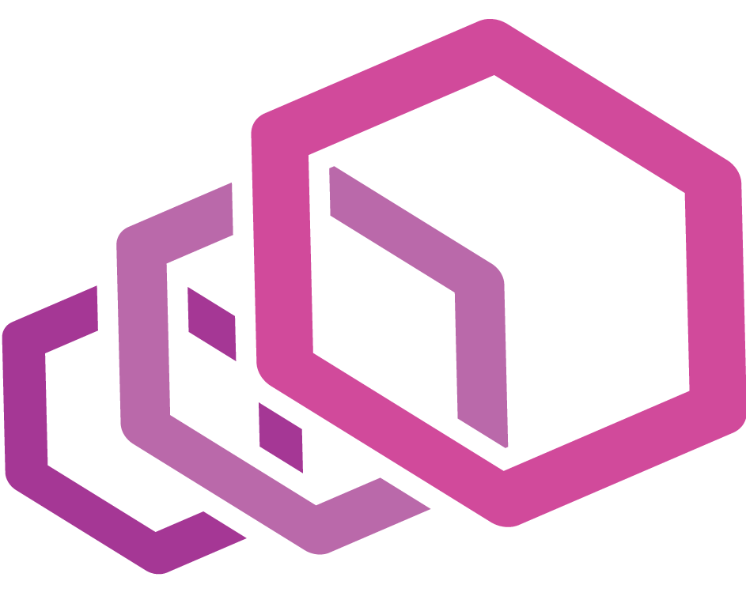
Envoy
Envoy is an L7 proxy and communication bus designed for large modern service-oriented architectures.
Source: What is Envoy — envoy 1.5.0-tag-v1.5.0 documentation (envoyproxy.io)
Notes:
Out of process architecture: Envoy is a self contained process that is designed to run alongside every application server. All of the Envoys form a transparent communication mesh in which each application sends and receives messages to and from localhost and is unaware of the network topology. The out of process architecture has two substantial benefits over the traditional library approach to service to service communication:
Envoy works with any application language. A single Envoy deployment can form a mesh between Java, C++, Go, PHP, Python, etc. It is becoming increasingly common for service oriented architectures to use multiple application frameworks and languages. Envoy transparently bridges the gap.
As anyone that has worked with a large service oriented architecture knows, deploying library upgrades can be incredibly painful. Envoy can be deployed and upgraded quickly across an entire infrastructure transparently.
Modern C++11 code base: Envoy is written in C++11. Native code was chosen because we believe that an architectural component such as Envoy should get out of the way as much as possible. Modern application developers already deal with tail latencies that are difficult to reason about due to deployments in shared cloud environments and the use of very productive but not particularly well performing languages such as PHP, Python, Ruby, Scala, etc. Native code provides generally excellent latency properties that don’t add additional confusion to an already confusing situation. Unlike other native code proxy solutions written in C, C++11 provides both excellent developer productivity and performance.
L3/L4 filter architecture: At its core, Envoy is an L3/L4 network proxy. A pluggable filter chain mechanism allows filters to be written to perform different TCP proxy tasks and inserted into the main server. Filters have already been written to support various tasks such as raw TCP proxy, HTTP proxy, TLS client certificate authentication, etc.
HTTP L7 filter architecture: HTTP is such a critical component of modern application architectures that Envoy supports an additional HTTP L7 filter layer. HTTP filters can be plugged into the HTTP connection management subsystem that perform different tasks such as buffering, rate limiting, routing/forwarding, sniffing Amazon’s DynamoDB, etc.
First class HTTP/2 support: When operating in HTTP mode, Envoy supports both HTTP/1.1 and HTTP/2. Envoy can operate as a transparent HTTP/1.1 to HTTP/2 proxy in both directions. This means that any combination of HTTP/1.1 and HTTP/2 clients and target servers can be bridged. The recommended service to service configuration uses HTTP/2 between all Envoys to create a mesh of persistent connections that requests and responses can be multiplexed over. Envoy does not support SPDY as the protocol is being phased out.
HTTP L7 routing: When operating in HTTP mode, Envoy supports a routing subsystem that is capable of routing and redirecting requests based on path, authority, content type, runtime values, etc. This functionality is most useful when using Envoy as a front/edge proxy but is also leveraged when building a service to service mesh.
gRPC support: gRPC is an RPC framework from Google that uses HTTP/2 as the underlying multiplexed transport. Envoy supports all of the HTTP/2 features required to be used as the routing and load balancing substrate for gRPC requests and responses. The two systems are very complementary.
MongoDB L7 support: MongoDB is a popular database used in modern web applications. Envoy supports L7 sniffing, statistics production, and logging for MongoDB connections.
DynamoDB L7 support: DynamoDB is Amazon’s hosted key/value NOSQL datastore. Envoy supports L7 sniffing and statistics production for DynamoDB connections.
Service discovery: Service discovery is a critical component of service oriented architectures. Envoy supports multiple service discovery methods including asynchronous DNS resolution and REST based lookup via a service discovery service.
Health checking: The recommended way of building an Envoy mesh is to treat service discovery as an eventually consistent process. Envoy includes a health checking subsystem which can optionally perform active health checking of upstream service clusters. Envoy then uses the union of service discovery and health checking information to determine healthy load balancing targets. Envoy also supports passive health checking via an outlier detection subsystem.
Advanced load balancing: Load balancing among different components in a distributed system is a complex problem. Because Envoy is a self contained proxy instead of a library, it is able to implement advanced load balancing techniques in a single place and have them be accessible to any application. Currently Envoy includes support for automatic retries, circuit breaking, global rate limiting via an external rate limiting service, request shadowing, and outlier detection. Future support is planned for request racing.
Front/edge proxy support: Although Envoy is primarily designed as a service to service communication system, there is benefit in using the same software at the edge (observability, management, identical service discovery and load balancing algorithms, etc.). Envoy includes enough features to make it usable as an edge proxy for most modern web application use cases. This includes TLS termination, HTTP/1.1 and HTTP/2 support, as well as HTTP L7 routing.
Best in class observability: As stated above, the primary goal of Envoy is to make the network transparent. However, problems occur both at the network level and at the application level. Envoy includes robust statistics support for all subsystems. statsd (and compatible providers) is the currently supported statistics sink, though plugging in a different one would not be difficult. Statistics are also viewable via the administration port. Envoy also supports distributed tracing via thirdparty providers.
Dynamic configuration: Envoy optionally consumes a layered set of dynamic configuration APIs. Implementors can use these APIs to build complex centrally managed deployments if desired.

Slide 53
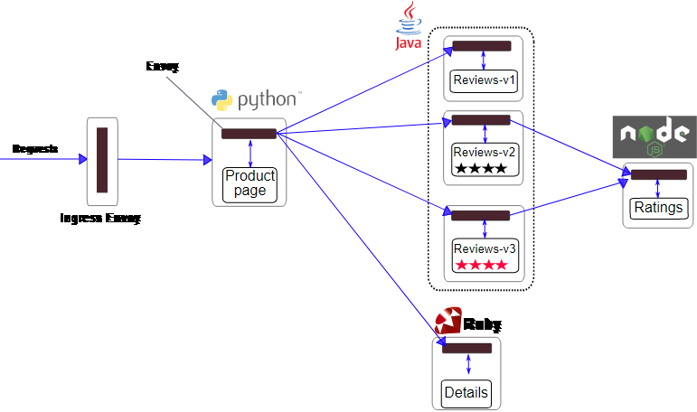
Example of a microservices application
Envoy
requests
Ingress Envoy
Source: Istio / Bookinfo Application
Notes:
The application displays information about a book, similar to a single catalog entry of an online book store. Displayed on the page is a description of the book, book details (ISBN, number of pages, and so on), and a few book reviews.
The Bookinfo application is broken into four separate microservices:
productpage. The productpage microservice calls the details and reviews microservices to populate the page.
details. The details microservice contains book information.
reviews. The reviews microservice contains book reviews. It also calls the ratings microservice.
ratings. The ratings microservice contains book ranking information that accompanies a book review.
There are 3 versions of the reviews microservice:
Version v1 doesn’t call the ratings service.
Version v2 calls the ratings service, and displays each rating as 1 to 5 black stars.
Version v3 calls the ratings service, and displays each rating as 1 to 5 red stars.
The end-to-end architecture of the application is shown below.

Slide 54
Mobility in edge computing
Notes:
Placing certain services in close proximity to the consumers has great benefits, including low-latency response, bandwidth consumption savings, and data locality. However, there are also multiple challenges. One of the key challenges with the Kubernetes deployment model is the placement of the Kubernetes control plane that manages the workers that comprise the resource pools consumed by the applications and services. The two main options for control plane placement are:
Deploying full-fledged cluster(s), complete with control nodes and worker nodes, everywhere you need your applications to be accessible
Deploying worker nodes at the edge and connecting them to the central location hosting the control plane
You can simplify option one (the full-cluster model shown above) with innovative deployment models:
A compact high availability (HA) cluster with a minimum of three nodes accommodating both control plane and worker node roles
An all-in-one, single-node standalone cluster
Option two (the remote worker approach shown below) eliminates the overhead of having a dedicated control plane at each location. Still, it may not be feasible if there is a significant latency, intermittent connectivity, or a lack of sufficient bandwidth for the cluster's internal services or operations between the Kubernetes control plane and the worker locations to function correctly.

Slide 55
Master node 1
API server
Worker node 1
Worker node 2
Kubelet
Kube-proxy
Kubelet
Kube-proxy
POD A
IPTables
IPTables
Notes:
Example with kube-proxy running on default mode with ip tables.

Slide 56

Master node 1
API server
Worker node 1
Worker node 2
Kubelet
Kube-proxy
Kubelet
Kube-proxy
POD A
IPTables
IPTables

Slide 57


Master node 1
API server
Worker node 1
Worker node 2
Kubelet
Kube-proxy
Kubelet
Kube-proxy
POD A
IPTables
IPTables

Slide 58

Master node 1
API server
Worker node 1
Worker node 2
Kubelet
Kube-proxy
Kubelet
Kube-proxy
POD A
IPTables
IPTables
POD A

Slide 59
But also..
Notes:
Placing certain services in close proximity to the consumers has great benefits, including low-latency response, bandwidth consumption savings, and data locality. However, there are also multiple challenges. One of the key challenges with the Kubernetes deployment model is the placement of the Kubernetes control plane that manages the workers that comprise the resource pools consumed by the applications and services. The two main options for control plane placement are:
Deploying full-fledged cluster(s), complete with control nodes and worker nodes, everywhere you need your applications to be accessible
Deploying worker nodes at the edge and connecting them to the central location hosting the control plane
You can simplify option one (the full-cluster model shown above) with innovative deployment models:
A compact high availability (HA) cluster with a minimum of three nodes accommodating both control plane and worker node roles
An all-in-one, single-node standalone cluster
Option two (the remote worker approach shown below) eliminates the overhead of having a dedicated control plane at each location. Still, it may not be feasible if there is a significant latency, intermittent connectivity, or a lack of sufficient bandwidth for the cluster's internal services or operations between the Kubernetes control plane and the worker locations to function correctly.

Slide 60
Master node 1
API server
Worker node 1
Worker node 2
Kubelet
Kube-proxy
Kubelet
Kube-proxy
POD A
IPTables
IPTables

Slide 61

Master node 1
API server
Worker node 1
Worker node 2
Kubelet
Kube-proxy
Kubelet
Kube-proxy
POD A
IPTables
IPTables

Slide 62
Master node 1
API server
Worker node 1
Worker node 2
Kubelet
Kube-proxy
Kubelet
Kube-proxy
POD A
IPTables
IPTables
POD A

Slide 63
Mobility in edge computing
In the last scenario:
Multiple clients served by the same pod
Clients can move across nodes
We don’t want to just migrate the existing pod, we also want the old pod functioning
Notes:
Impossible to migrate the IP so that the new pod and the old pod have the same IP? Each node has his own subnet (according to what cni do you use) so maybe is still possible. But the new IP must be free at the target destination.
We have just to migrate the necessary state and the necessary connections

Slide 64
Challenges
Network trasparency
Some pods are stateful, others are stateless
We can have multiple clients served by a pod

Slide 65
Challenges
Network trasparency
Some pods are stateful, others are stateless
We can have multiple clients served by a pod

Slide 66
Challenges
Network trasparency
Some pods are stateful, others are stateless
We can have multiple clients served by a pod

Slide 67
Challenges
Network trasparency
Some pods are stateful, others are stateless
We can have multiple clients served by a pod

Slide 68
That’s all! Questions?
Notes:
Placing certain services in close proximity to the consumers has great benefits, including low-latency response, bandwidth consumption savings, and data locality. However, there are also multiple challenges. One of the key challenges with the Kubernetes deployment model is the placement of the Kubernetes control plane that manages the workers that comprise the resource pools consumed by the applications and services. The two main options for control plane placement are:
Deploying full-fledged cluster(s), complete with control nodes and worker nodes, everywhere you need your applications to be accessible
Deploying worker nodes at the edge and connecting them to the central location hosting the control plane
You can simplify option one (the full-cluster model shown above) with innovative deployment models:
A compact high availability (HA) cluster with a minimum of three nodes accommodating both control plane and worker node roles
An all-in-one, single-node standalone cluster
Option two (the remote worker approach shown below) eliminates the overhead of having a dedicated control plane at each location. Still, it may not be feasible if there is a significant latency, intermittent connectivity, or a lack of sufficient bandwidth for the cluster's internal services or operations between the Kubernetes control plane and the worker locations to function correctly.

Slide 69
Sources
Kubernetes official documentation: https://kubernetes.io/docs
«Cloud Native DevOps with Kubernetes», O’Reilly, Justin Domingous & John Arundel
«Container Networking», O’Reilly, Michael Hausenblas
eBPF official site: https://ebpf.io/
cilium official site: https://cilium.io/get-started/
calico official site: Kubernetes (tigera.io)
Red Hat: What's a service mesh? (redhat.com)
Istio official site: Istio / Architecture
«Migrating Pods in Kubernetes», Jakob Schrettenbrunner
Envoy official site What is Envoy — envoy 1.5.0-tag-v1.5.0 documentation (envoyproxy.io)
Microsoft Learn site: https://learn.microsoft.com/en-us/azure/architecture/guide/architecture-styles/microservices

