Slide 1

Programação para dispositivos Móveis Aula 4
Curso de Especialização em Internet das Coisas
Prof. Leonardo Faix Pordeus
leonardopordeus@gmail.com
2019

Slide 2
CoAP (Constrained Application Protocol)
Cliente/Servidor;
UDP;
REST:
HTTP:
GET, POST, PUT, DELETE;
Discovery/Observe;
RFC 7252:
https://tools.ietf.org/html/rfc7252#page-64

Slide 3
CoAP + Java/Kotlin
Californium;
https://github.com/eclipse/paho.mqtt.android
Ncoap
https://github.com/okleine/nCoAP
https://github.com/okleine/spitfirefox

Slide 4
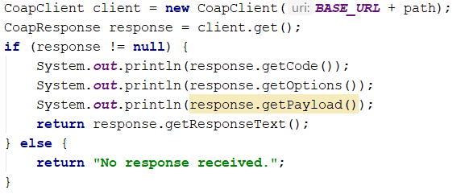
GET, POST, PUT, DELETE
CoapClient
Get(...)
Post(...)
Put(...)
Delete(...)

Slide 5
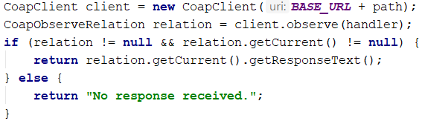
Observe
CoapClient
Observe(...)
CoapObserveRelation

Slide 6
Discovery
CoapClient
Discovery(...)
WebLink

Slide 7
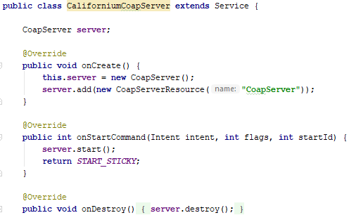
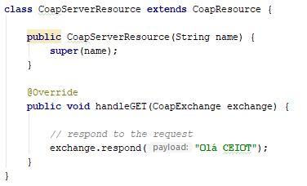
Service
extends Service:
IntentService:
startService;
stopService.
CoapServer;
CoapResource;

Slide 8
Exemplo
Nativo:
Java/Kotlin
Coap.docx/pdf
Ionic
JavaScript (node.js)
Outros exemplos:
https://coap.technology/impls.html

Slide 9
Obrigado

