Slide 1
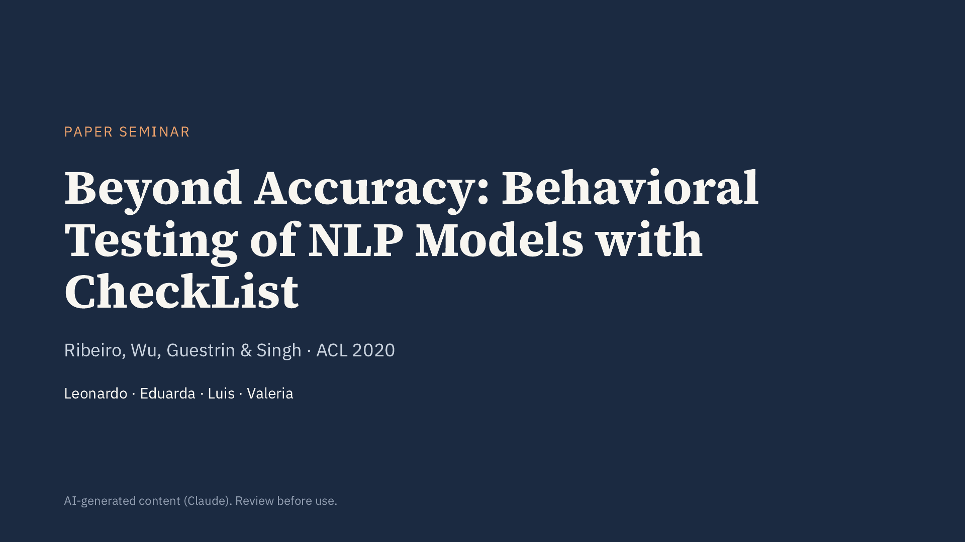
Notes:
Opening: Good morning. Today we will present “Beyond Accuracy: Behavioral Testing of NLP Models with CheckList”, by Ribeiro, Wu, Guestrin and Singh, published at ACL 2020. The paper argues that held-out accuracy is not sufficient to evaluate NLP models and proposes a behavioral testing methodology borrowed from software engineering. We have split the talk into four parts.

Slide 2
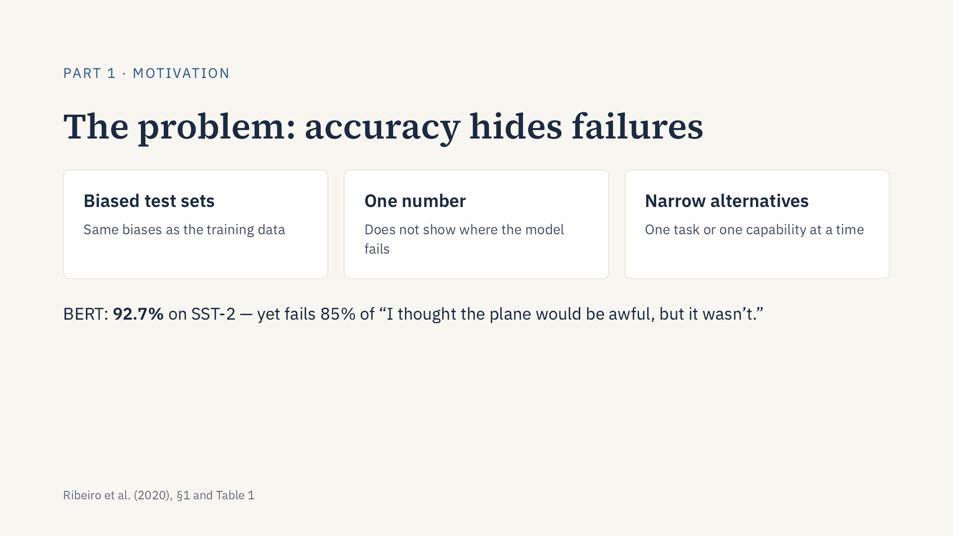
Notes:
Part 1: Let me start with the problem that motivated the paper. NLP models are usually evaluated by their accuracy on a held-out test set, often on public leaderboards. The authors point out three weaknesses. First, test sets share the biases of the training data, so real-world performance can be much lower than reported. Second, a single number does not tell us where the model fails or how to fix it. Third, the alternative evaluations that existed, such as robustness or fairness tests, each focus on one task or one capability. Here is a concrete example from the paper: BERT reaches 92.7% accuracy on the SST-2 sentiment benchmark, yet it fails 85% of simple sentences where the negation comes at the end, like “I thought the plane would be awful, but it wasn’t”. The authors’ answer is to test NLP models the way we test software.

Slide 3
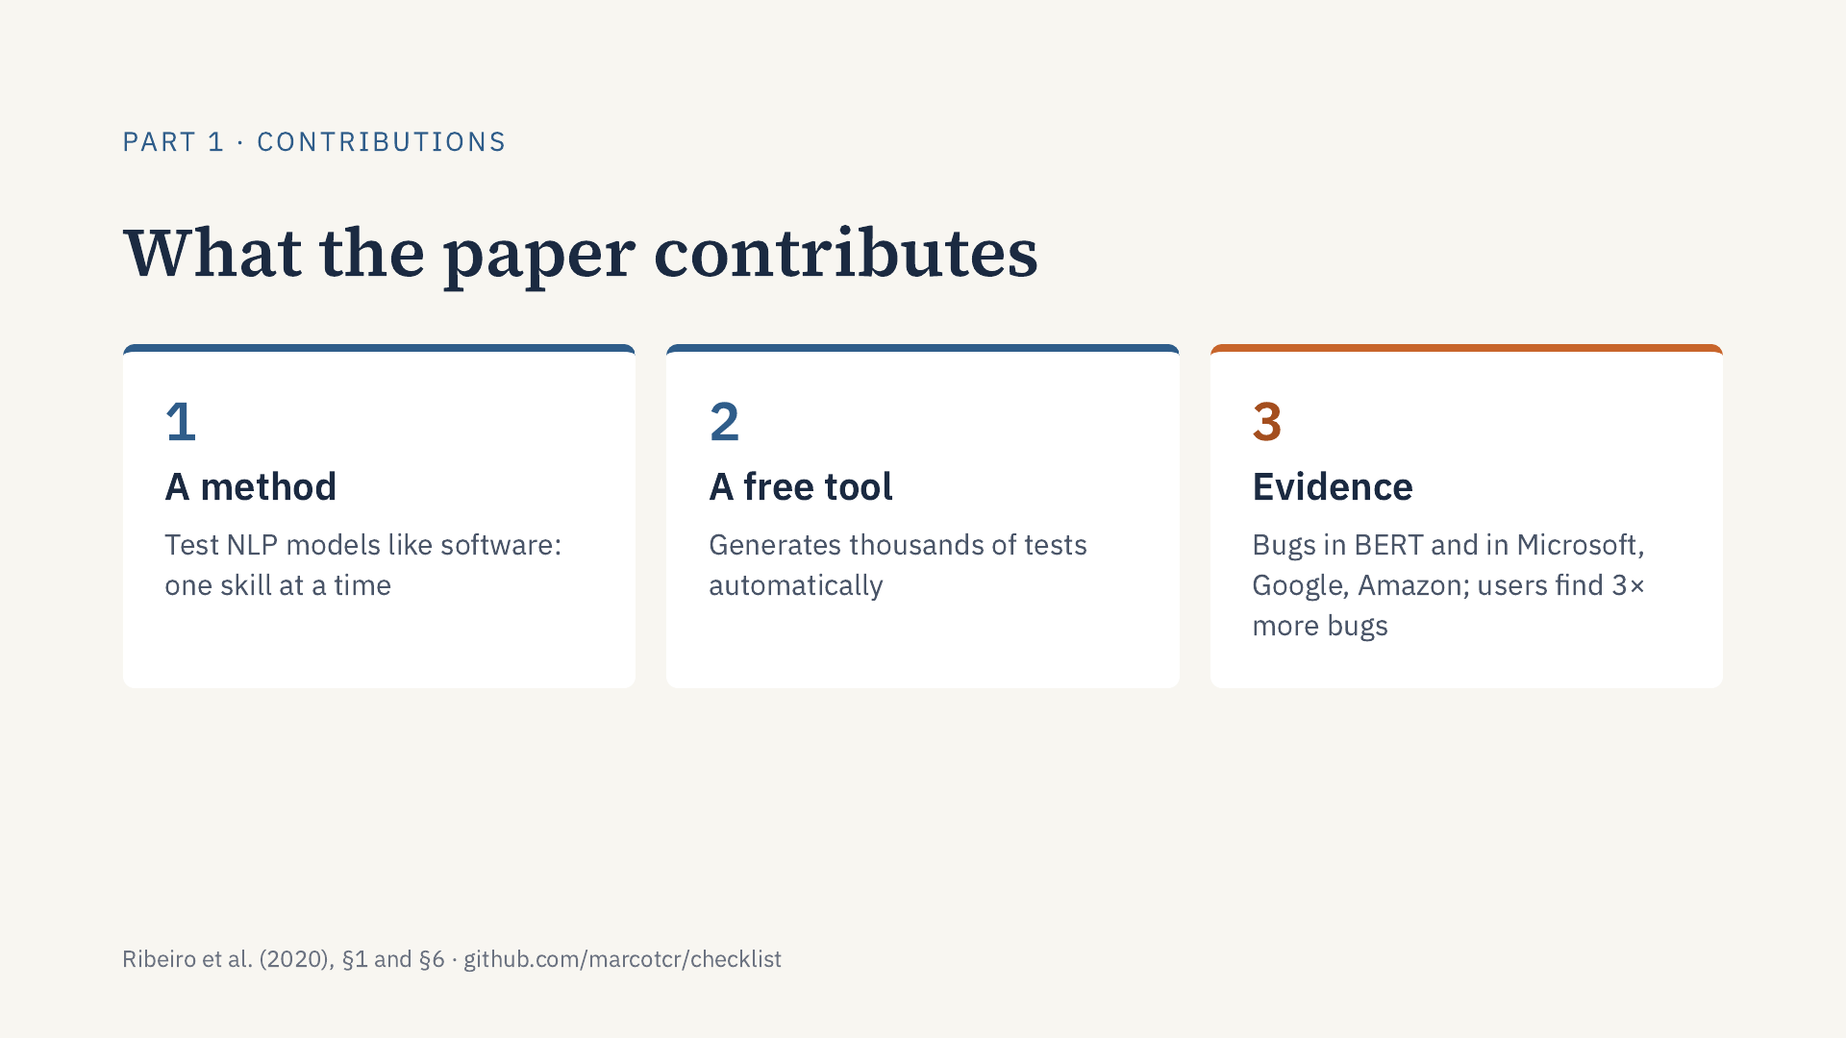
Notes:
Part 1: So what does the paper propose? Three things. First, a method: test language models the way we test software, checking one skill at a time, such as negation or names, instead of looking at one overall score. It works for any task and any model. Second, a free, open-source tool that generates thousands of test cases automatically, so this kind of testing is cheap. Third, evidence that it works: with CheckList, the authors found serious bugs both in research models like BERT and in commercial products from Microsoft, Google and Amazon; and people who used CheckList found about three times as many bugs as people who did not. Now, how does this compare with previous work?

Slide 4
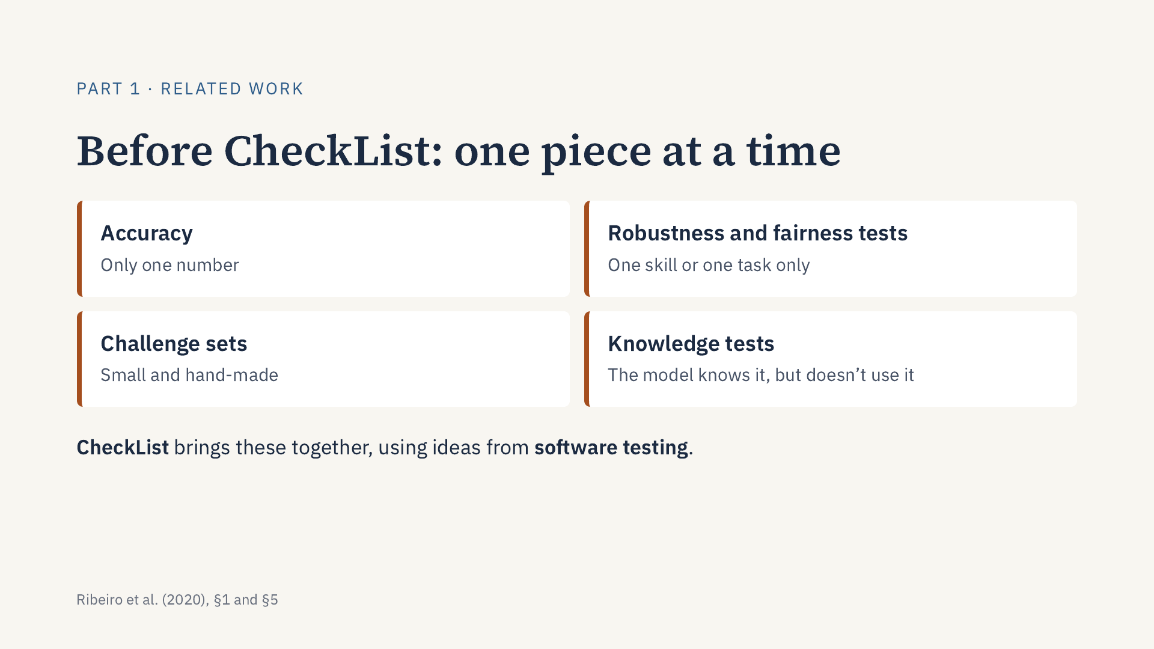
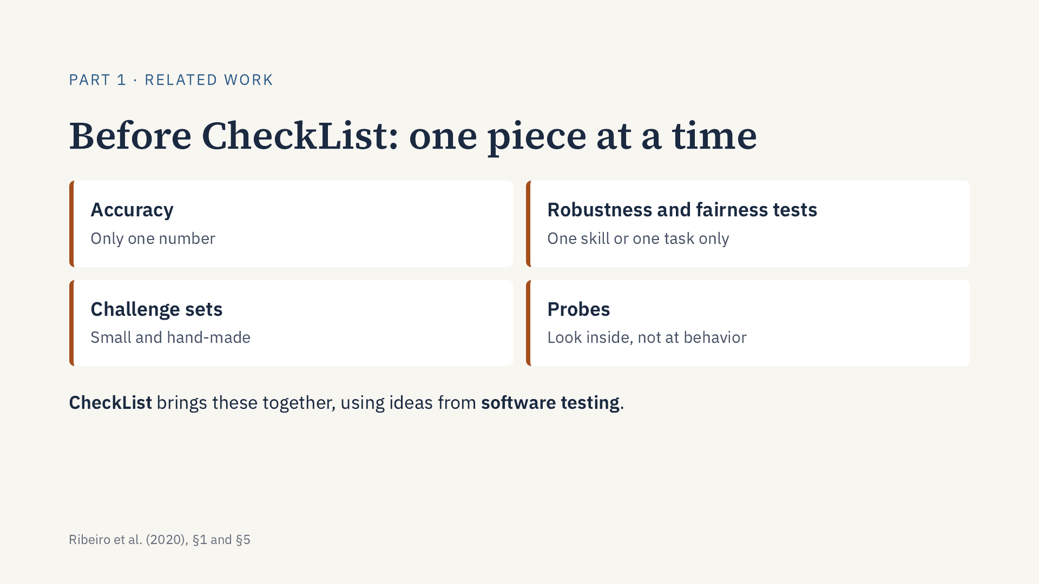
Notes:
Part 1: How does CheckList compare with previous work? Before CheckList, each approach covered only one piece of the problem. Accuracy on benchmarks gives only one number, so it doesn’t show where the model fails. Robustness and fairness tests, like adding typos or swapping names, look at one skill or one task at a time. Challenge sets are small and made by hand. And knowledge tests, also called probes, check what the model has learned internally. They show the model knows something, but not that it uses it. For example, a knowledge test shows BERT recognizes names with 96.7% accuracy, yet BERT fine-tuned on a real task still fails simple tests with names. CheckList brings these ideas together in one method, using ideas from software testing: unit tests and metamorphic tests. Now, to understand how it works, we need some key concepts.

Slide 5
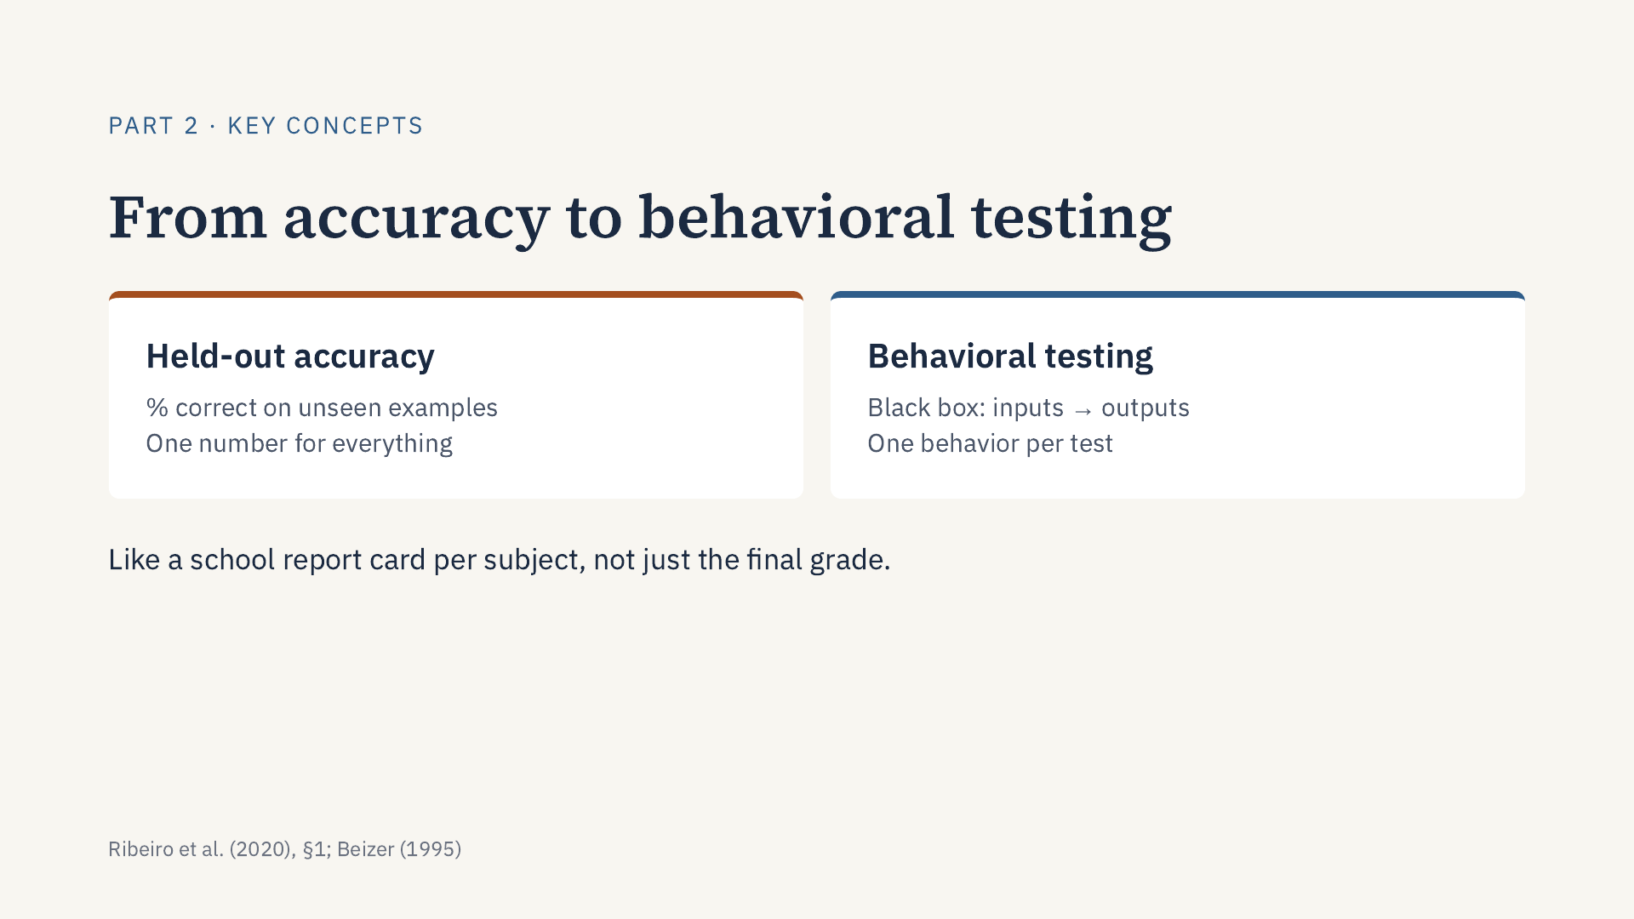
Notes:
Part 2: Thank you. To follow the paper we need a few concepts. The first is held-out accuracy: the percentage of correct predictions on examples the model did not see during training. It is the standard metric, but it summarizes everything in one number; BERT, for example, reaches 92.7% on the SST-2 sentiment benchmark. The second is behavioral testing, also called black-box testing, from software engineering: we test a system only through its inputs and outputs, without looking at its code or weights, and each test checks one behavior. A useful analogy: accuracy is the final grade, while behavioral testing is the report card per subject, which shows that a student with a good average may still fail one subject entirely.

Slide 6
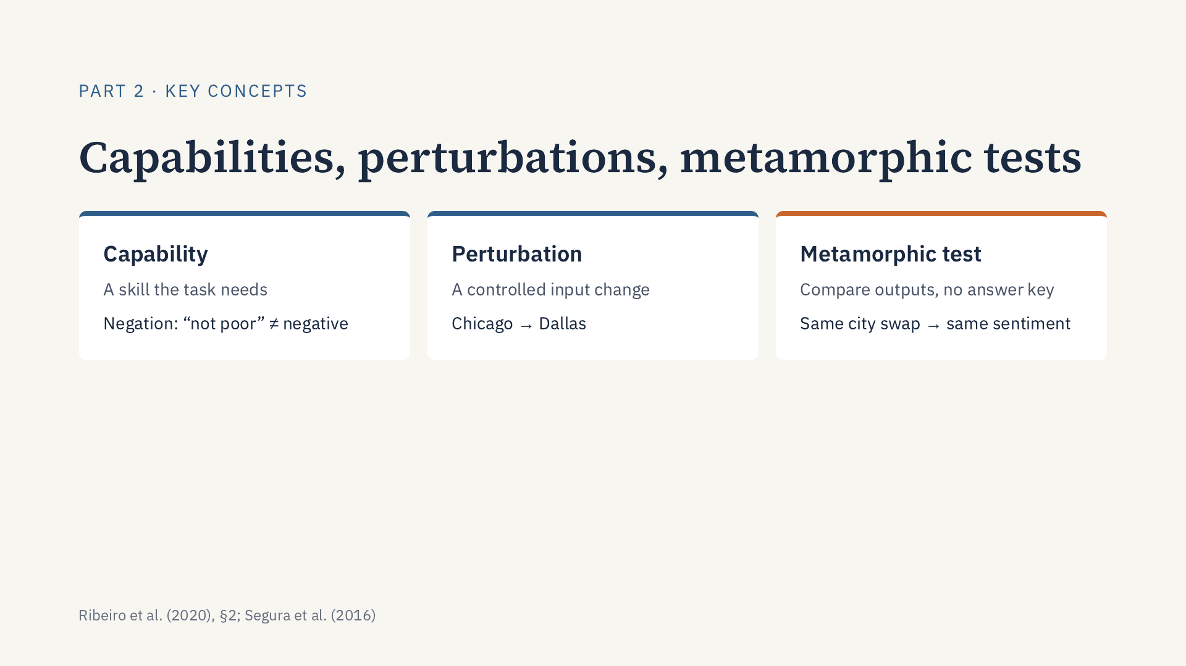
Notes:
Part 2: Three more concepts. A linguistic capability is a skill the task requires, for example understanding negation, named entities, the order of events, or who did what to whom. A perturbation is a controlled change to the input, such as replacing “Chicago” with “Dallas” in a tweet or introducing a typo. A metamorphic test, a technique from software testing, checks a relation between the outputs of related inputs instead of comparing each output with a correct answer. If I only change the city name, the sentiment must stay the same, even if I do not know what the correct sentiment is. This is what allows testing on unlabeled data.

Slide 7
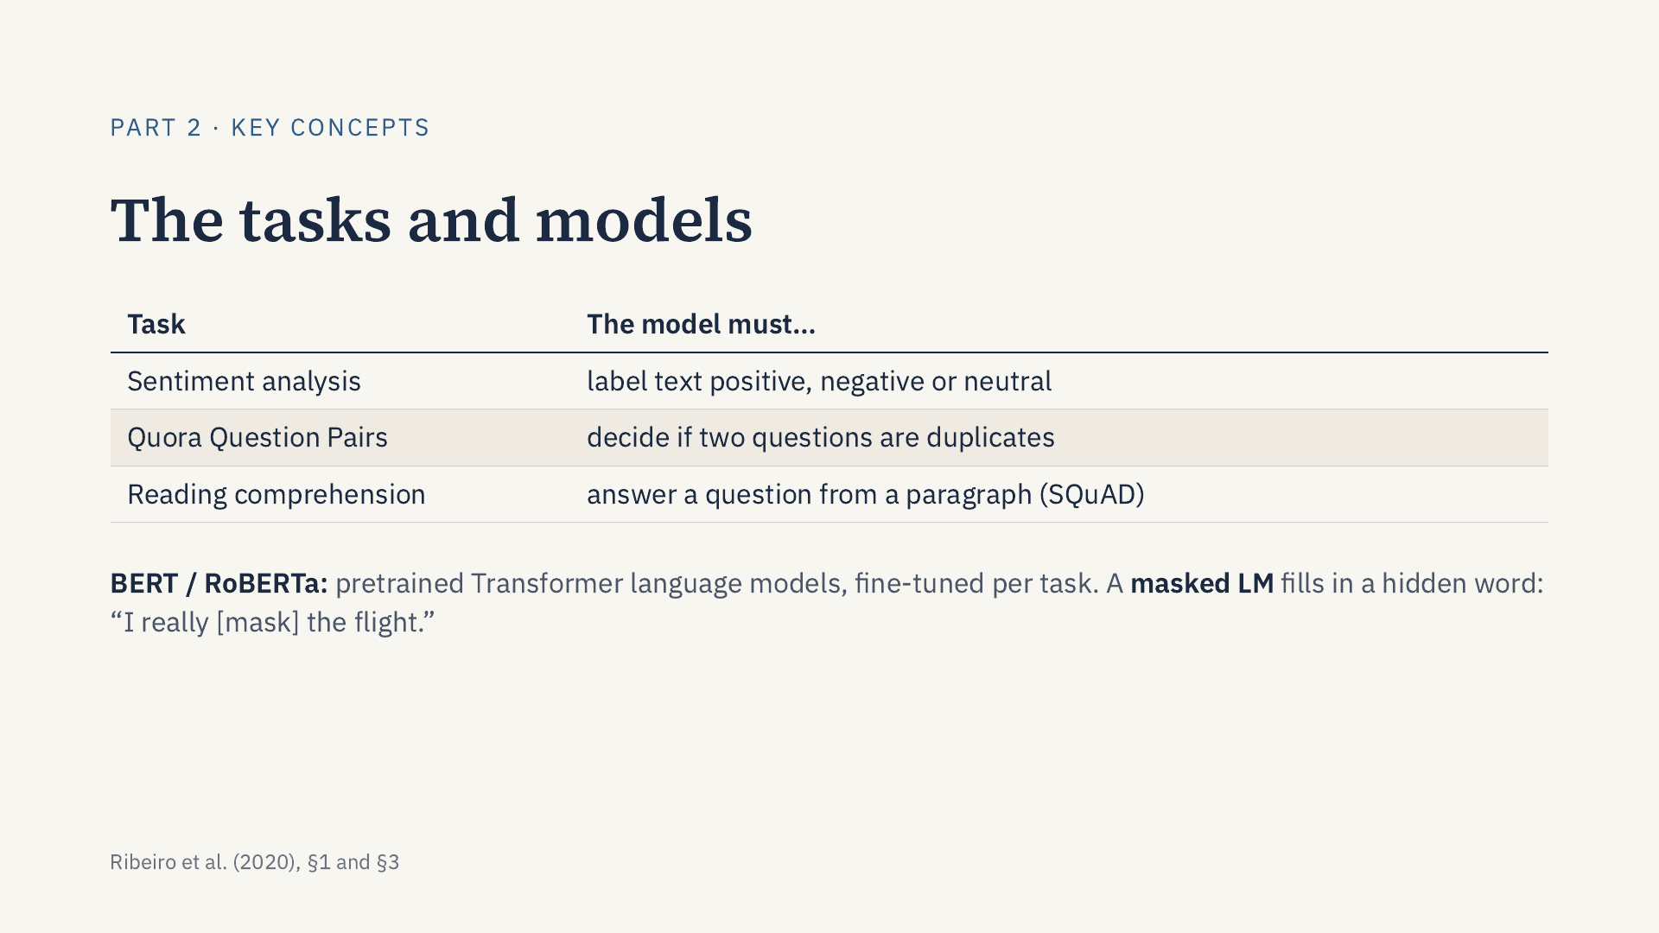
Notes:
Part 2: Finally, the tasks and models. Sentiment analysis labels a text as positive, negative or neutral. Quora Question Pairs asks whether two questions are duplicates, that is, ask the same thing. Reading comprehension, on the SQuAD dataset, asks the model to answer a question using a paragraph. The models tested include BERT and RoBERTa: Transformer language models pretrained on large text corpora and then fine-tuned for each task. RoBERTa also appears as a tool: as a masked language model it predicts a hidden word, which CheckList uses to suggest words for its templates. With these concepts in place, the next part explains the methodology.

Slide 8
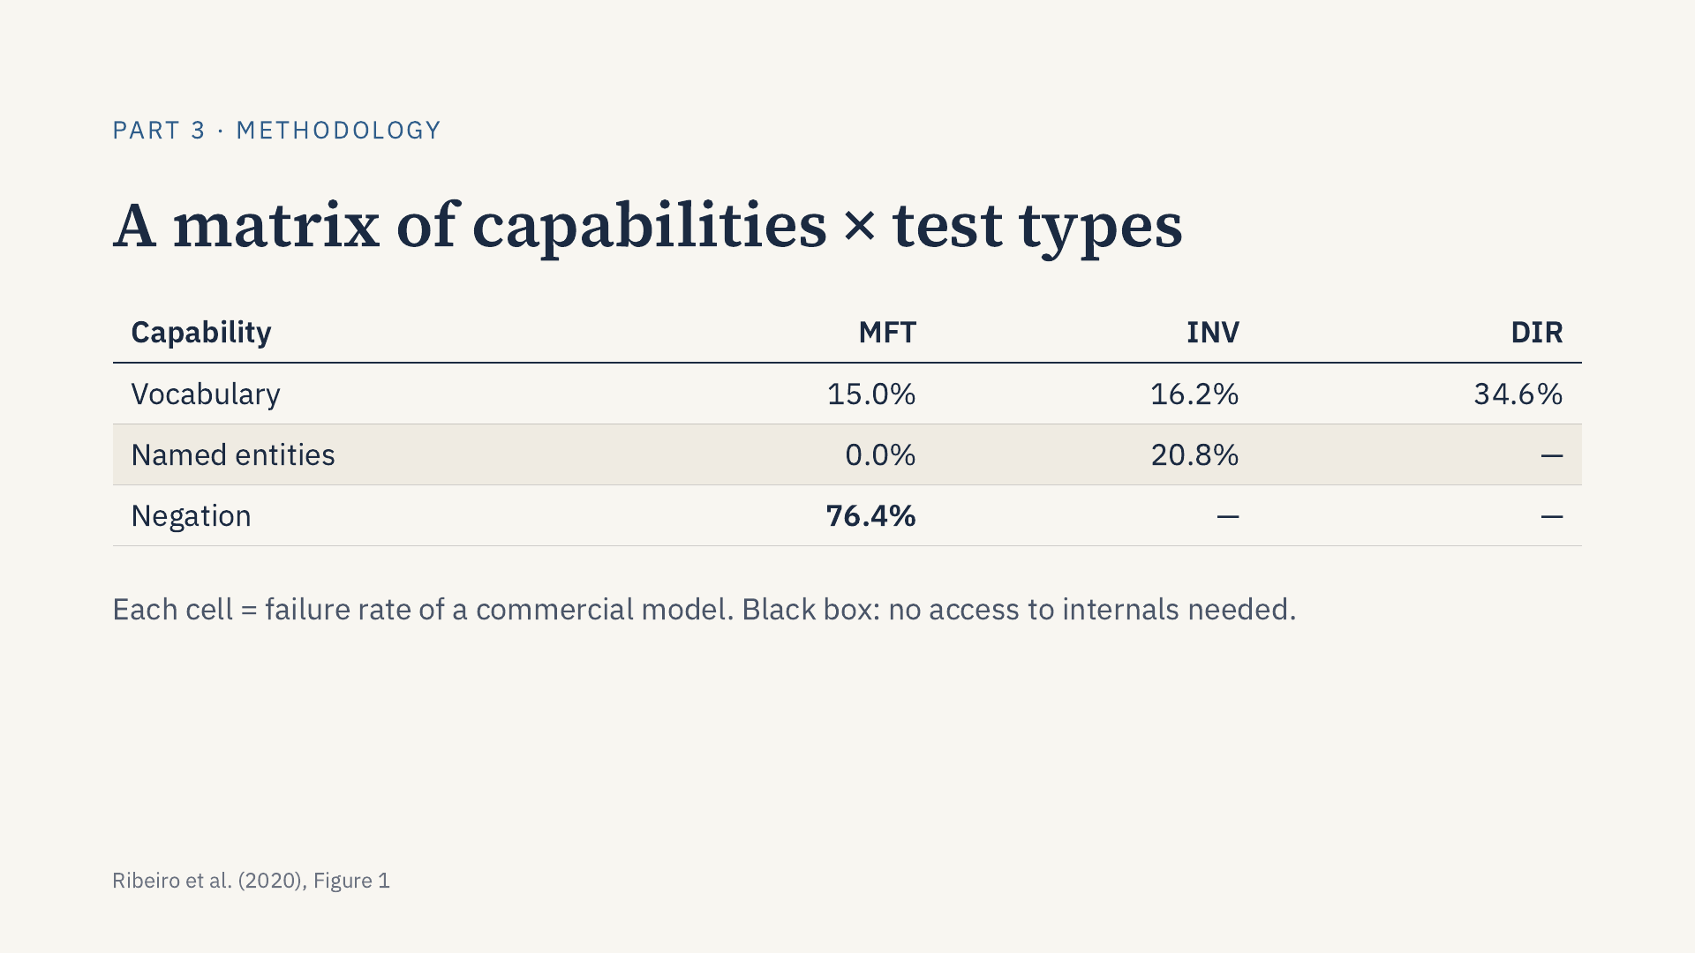
Notes:
Conceptually, users “CheckList” a model by filling in a matrix. Rows are linguistic capabilities, such as vocabulary, named entities or negation; the paper also suggests taxonomy, robustness, fairness, temporal reasoning, coreference, semantic roles and logic. Columns are three test types, explained next. Each cell reports a failure rate. In this example from Figure 1, a commercial sentiment model fails 76.4% of a simple negation test. Because the model is treated as a black box, research and commercial systems can be compared directly.

Slide 9
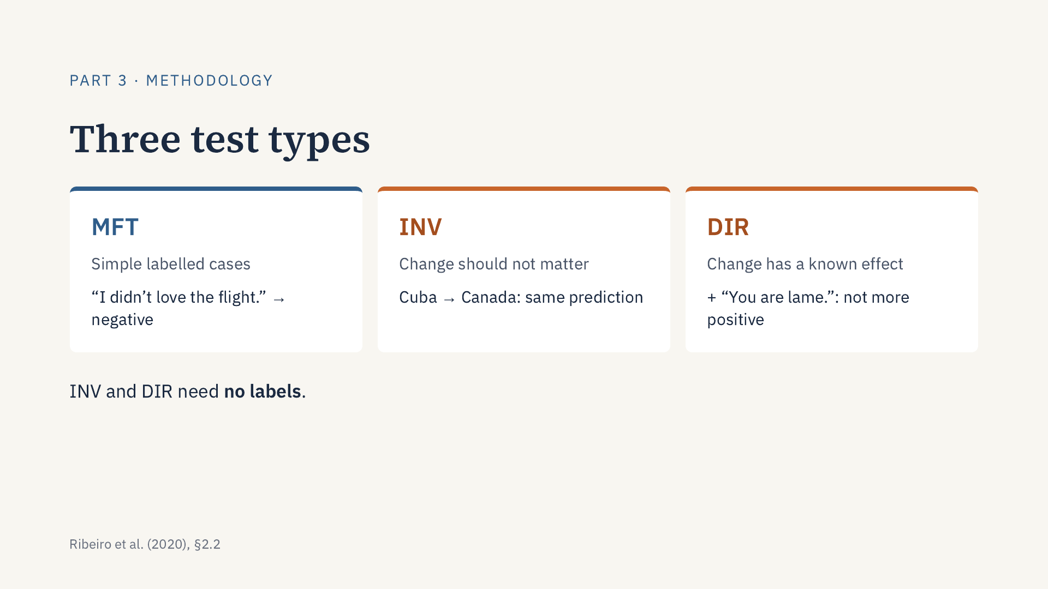
Notes:
The columns of the matrix are three test types. A Minimum Functionality Test, or MFT, is like a unit test: simple examples with labels that check one behavior. An Invariance test applies a change that should not alter the label, such as replacing a location, and checks that the prediction stays the same. A Directional Expectation test applies a change with a known effect, such as appending a negative sentence, and checks that the prediction moves only in the allowed direction. INV and DIR are metamorphic tests, after Segura et al. (2016): they compare predictions before and after the change, so they work on unlabeled data.

Slide 10
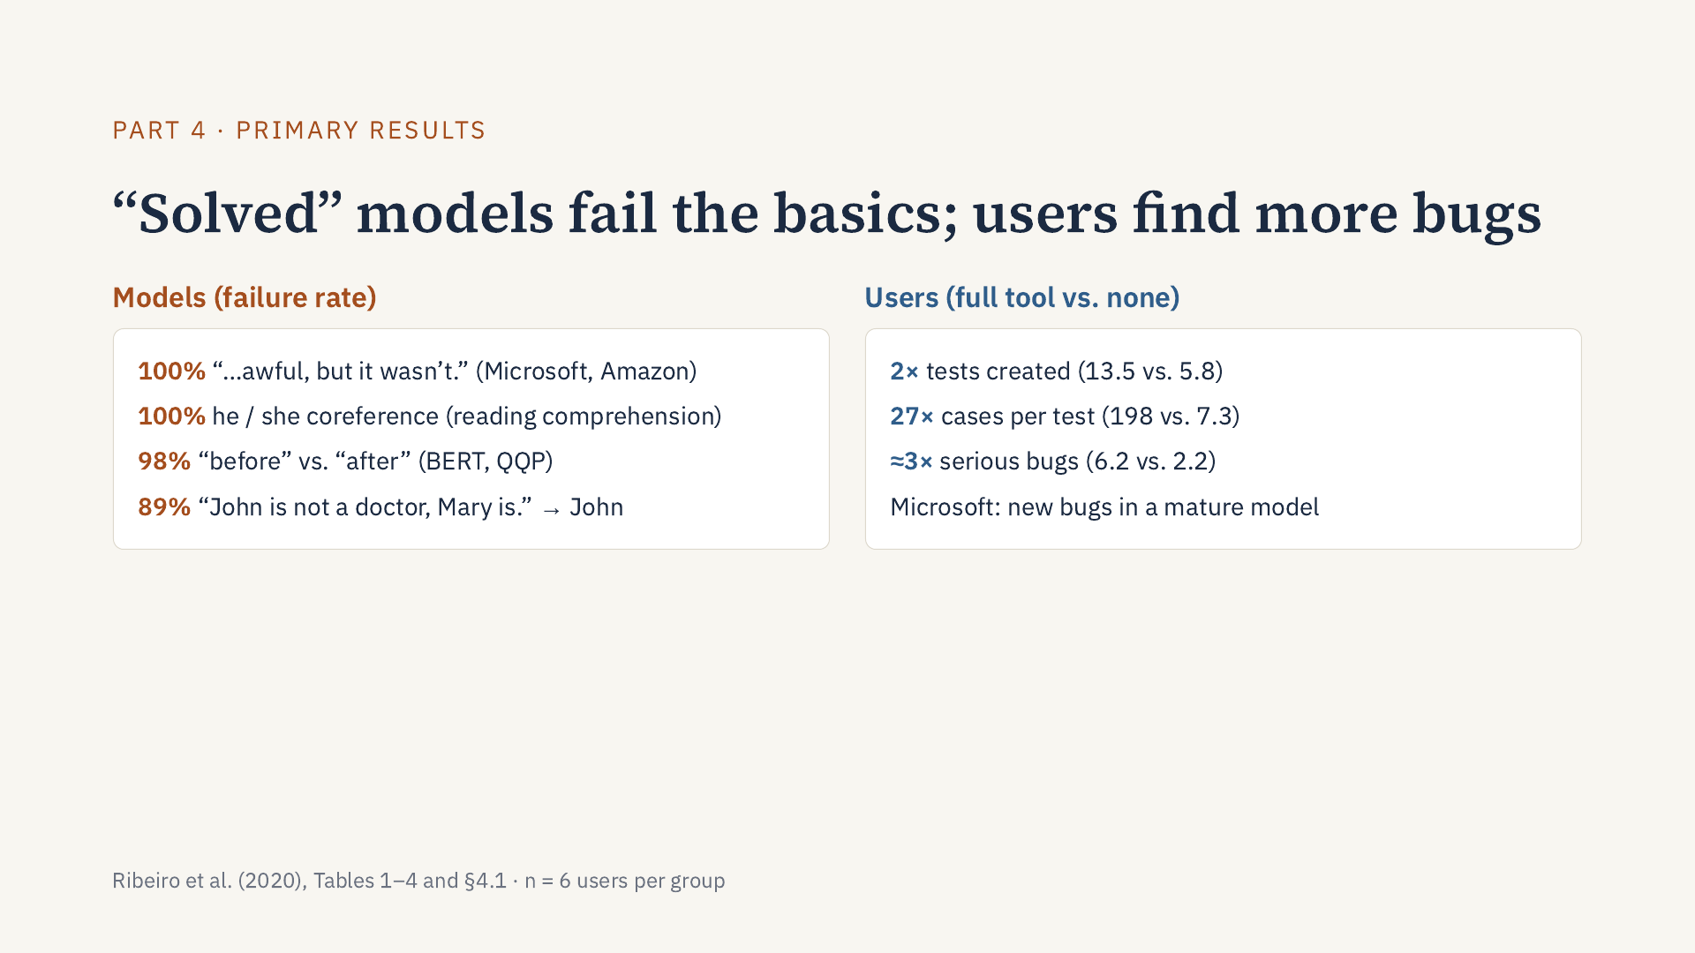
Notes:
Part 4: Thank you. There are two main results. On the left, the models: models considered solved on benchmarks fail very basic things. When the negation comes at the end of the sentence, as in “I thought the plane would be awful, but it wasn’t”, Microsoft’s and Amazon’s models fail every case. In reading comprehension, the model fails every simple he/she coreference test. On Quora Question Pairs, where BERT beats human accuracy on the benchmark, it confuses “before” and “after” 98% of the time. And given “John is not a doctor, Mary is”, the model says John is the doctor 89% of the time, but only 3% when the names are swapped, a clear gender bias. Surprisingly, research models did better than commercial ones on most tests, and the authors attribute these failures to shortcuts. On the right, the users: compared with the group without help, users with the full tool created twice as many tests, had 27 times more cases per test thanks to templates, and found about three times as many serious bugs. Microsoft’s team also found new bugs in a mature model. One caveat: each group had only six people, so this is a strong indication, not statistical proof.

Slide 11
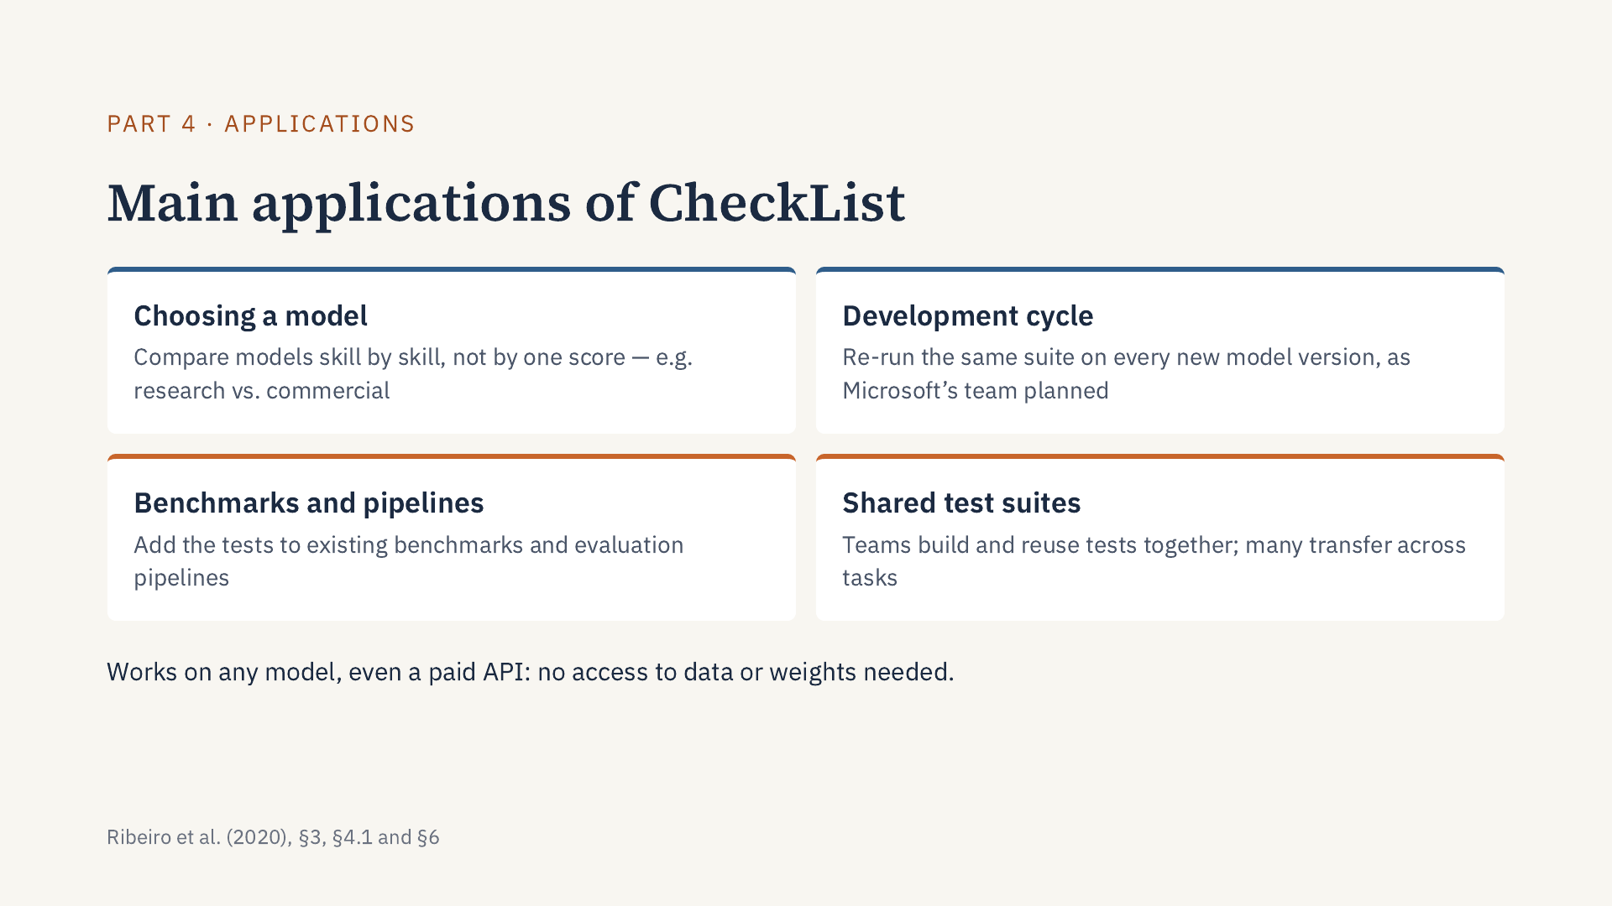
Notes:
Part 4: Where can CheckList be used in practice? The paper points to four main applications. First, choosing a model: because tests are applied capability by capability, we can compare models in detail instead of by a single score; the authors did exactly this when they compared research models with the commercial services of Microsoft, Google and Amazon. Second, the development cycle: the same test suite can be re-run on every new version of a model; Microsoft’s team said they would incorporate CheckList into their development cycle and fix the bugs they found in the next model iteration. Third, benchmarks and evaluation pipelines: the authors state that tests created with CheckList can be applied to any model and easily incorporated into current benchmarks or evaluation pipelines. Fourth, shared test suites: since many tests transfer across tasks as they are, like typos, or with small changes, like names, the authors expect teams to create test suites collaboratively. And all of this works on any model, even a paid API, because CheckList is a black-box method: it needs no access to the training data or to the model’s weights.

Slide 12
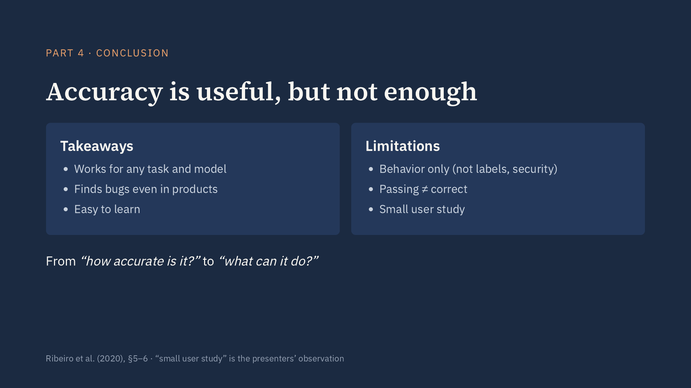
Notes:
Part 4: To conclude: benchmark accuracy is useful but not sufficient. A behavioral methodology, independent of model and task, revealed critical bugs both in research models that have “solved” benchmarks and in commercial products, and the user studies indicate that it is easy to learn. The authors acknowledge that CheckList does not address non-behavioral problems such as labeling errors, data versioning, worst-case security or interpretability, and that passing a test does not prove a capability. We would add that the user study is small. In one sentence: CheckList replaces the question “how accurate is the model?” with “what can the model actually do?”. Thank you; we are happy to take questions.

Slide 13
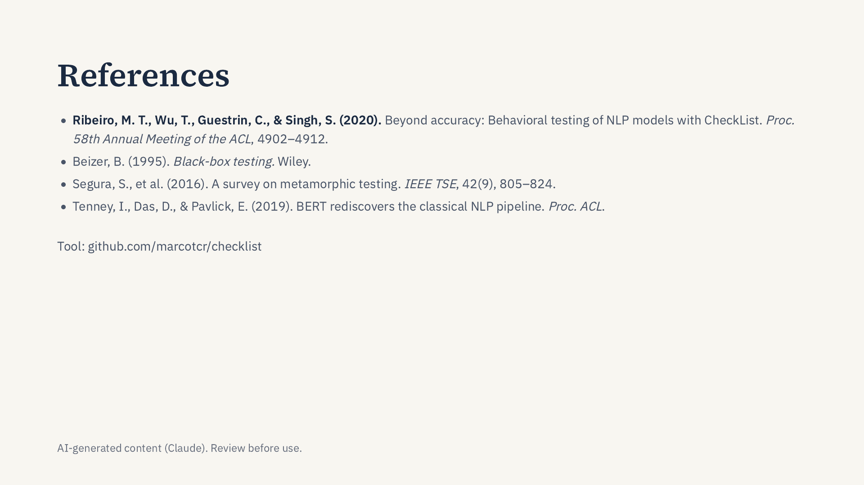
Notes:
The main reference is the paper itself. The other three are works it cites that I mention in the notes: Beizer for behavioral testing, Segura et al. for metamorphic testing, and Tenney et al. for probing.

