Slide 1


Slide 2
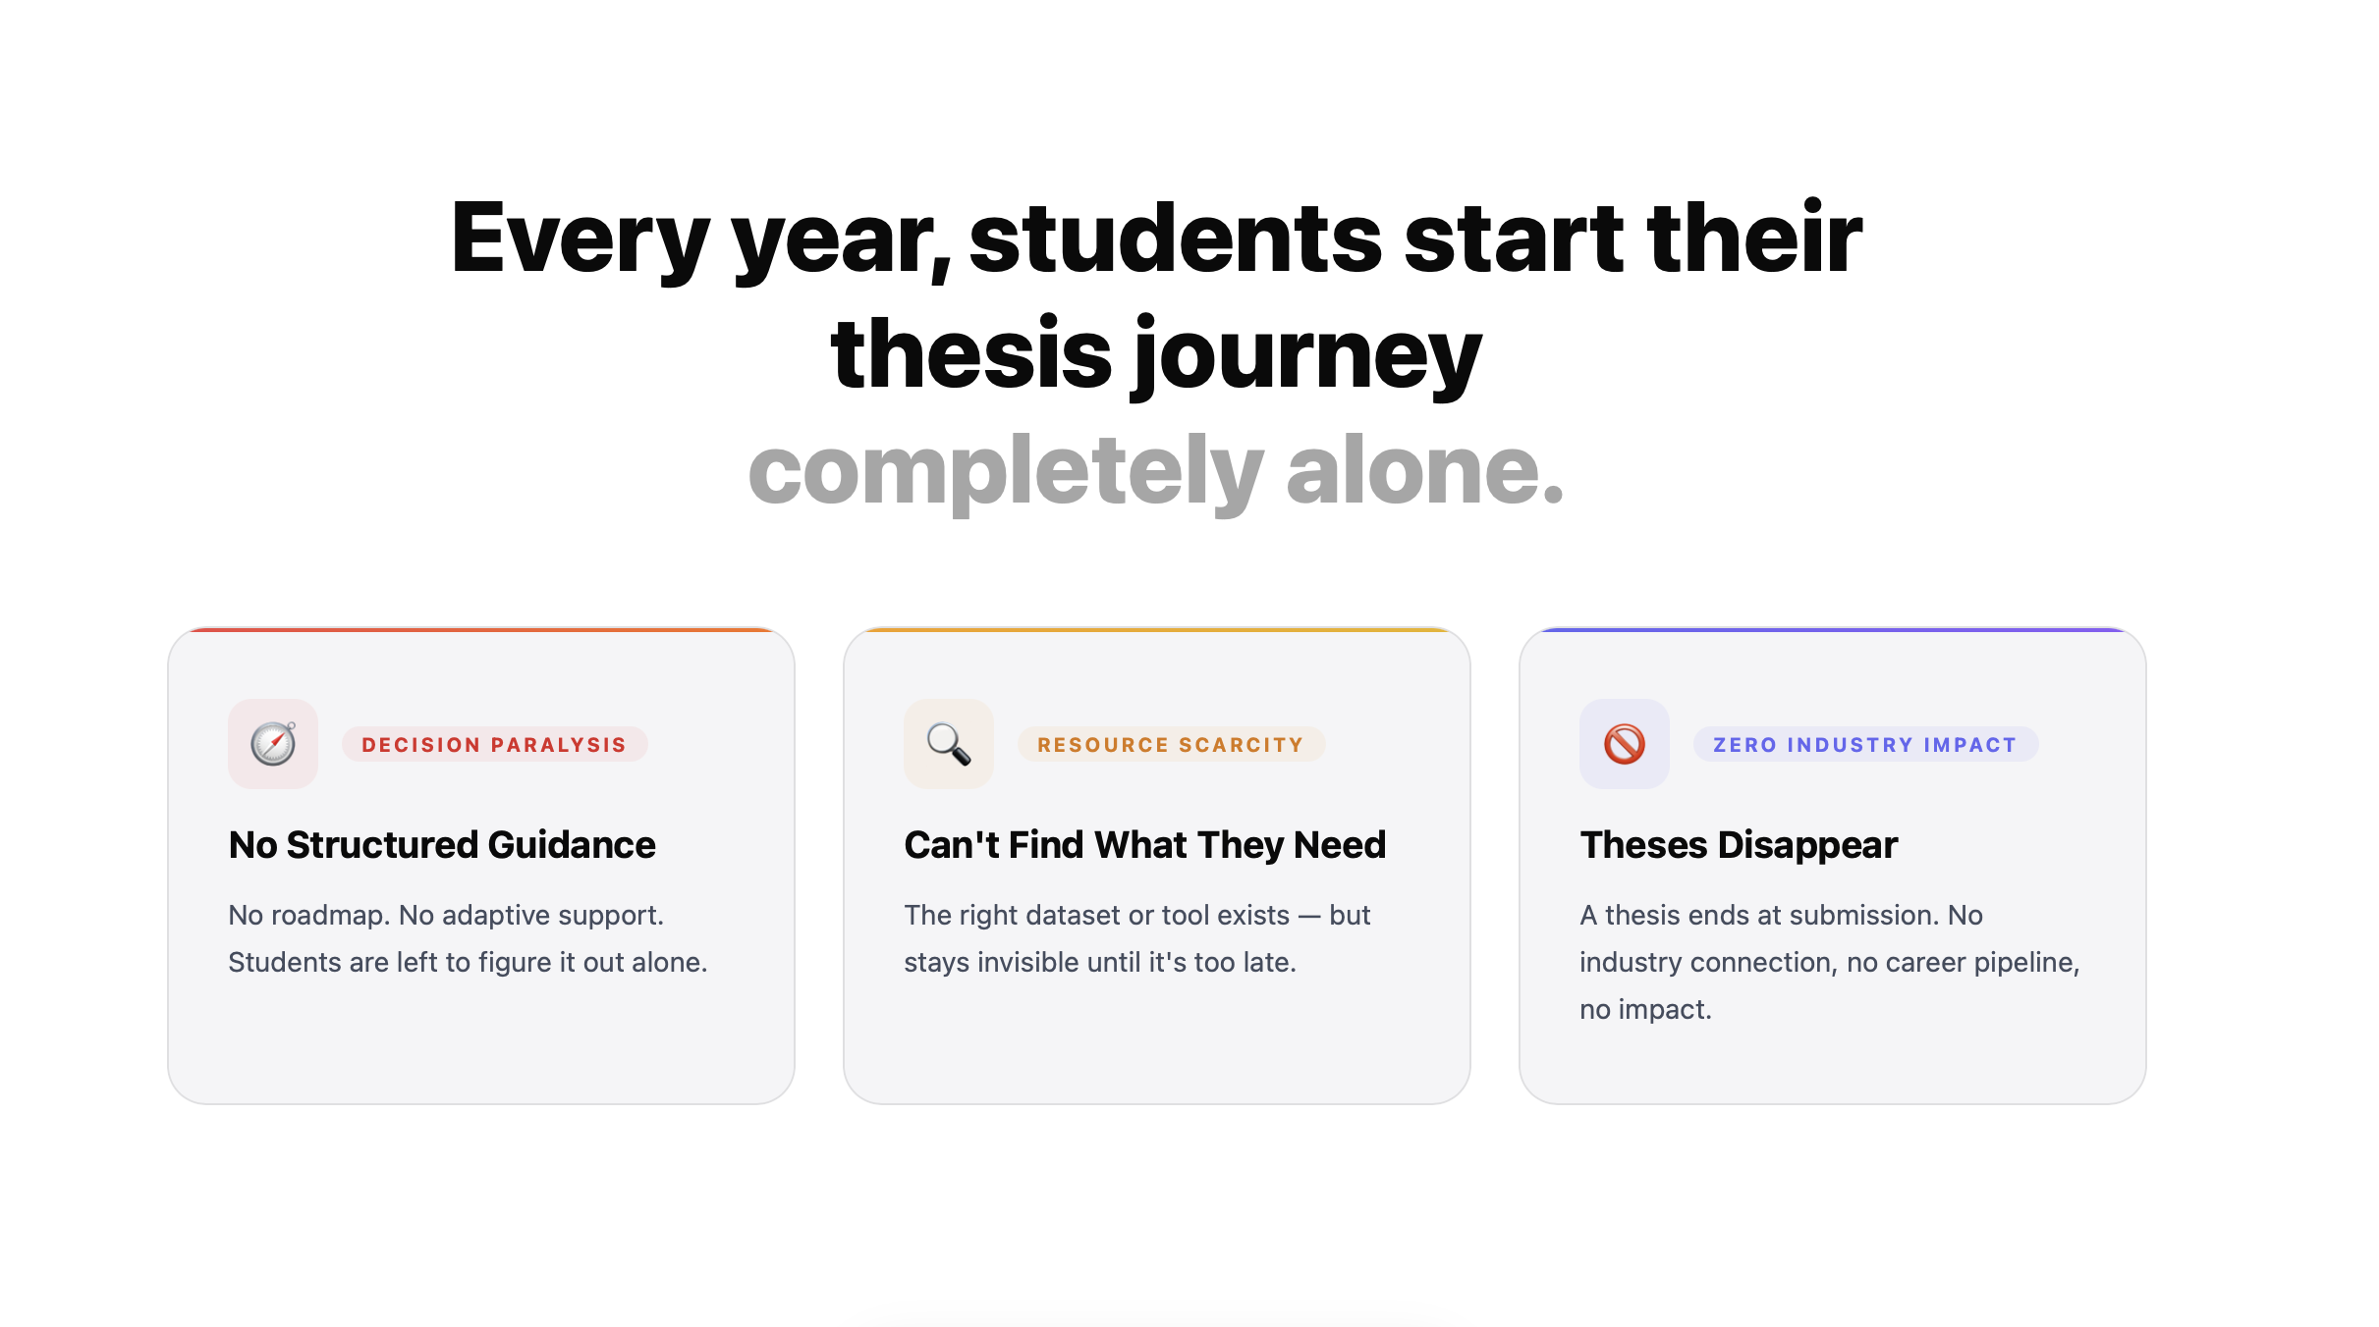

Slide 3
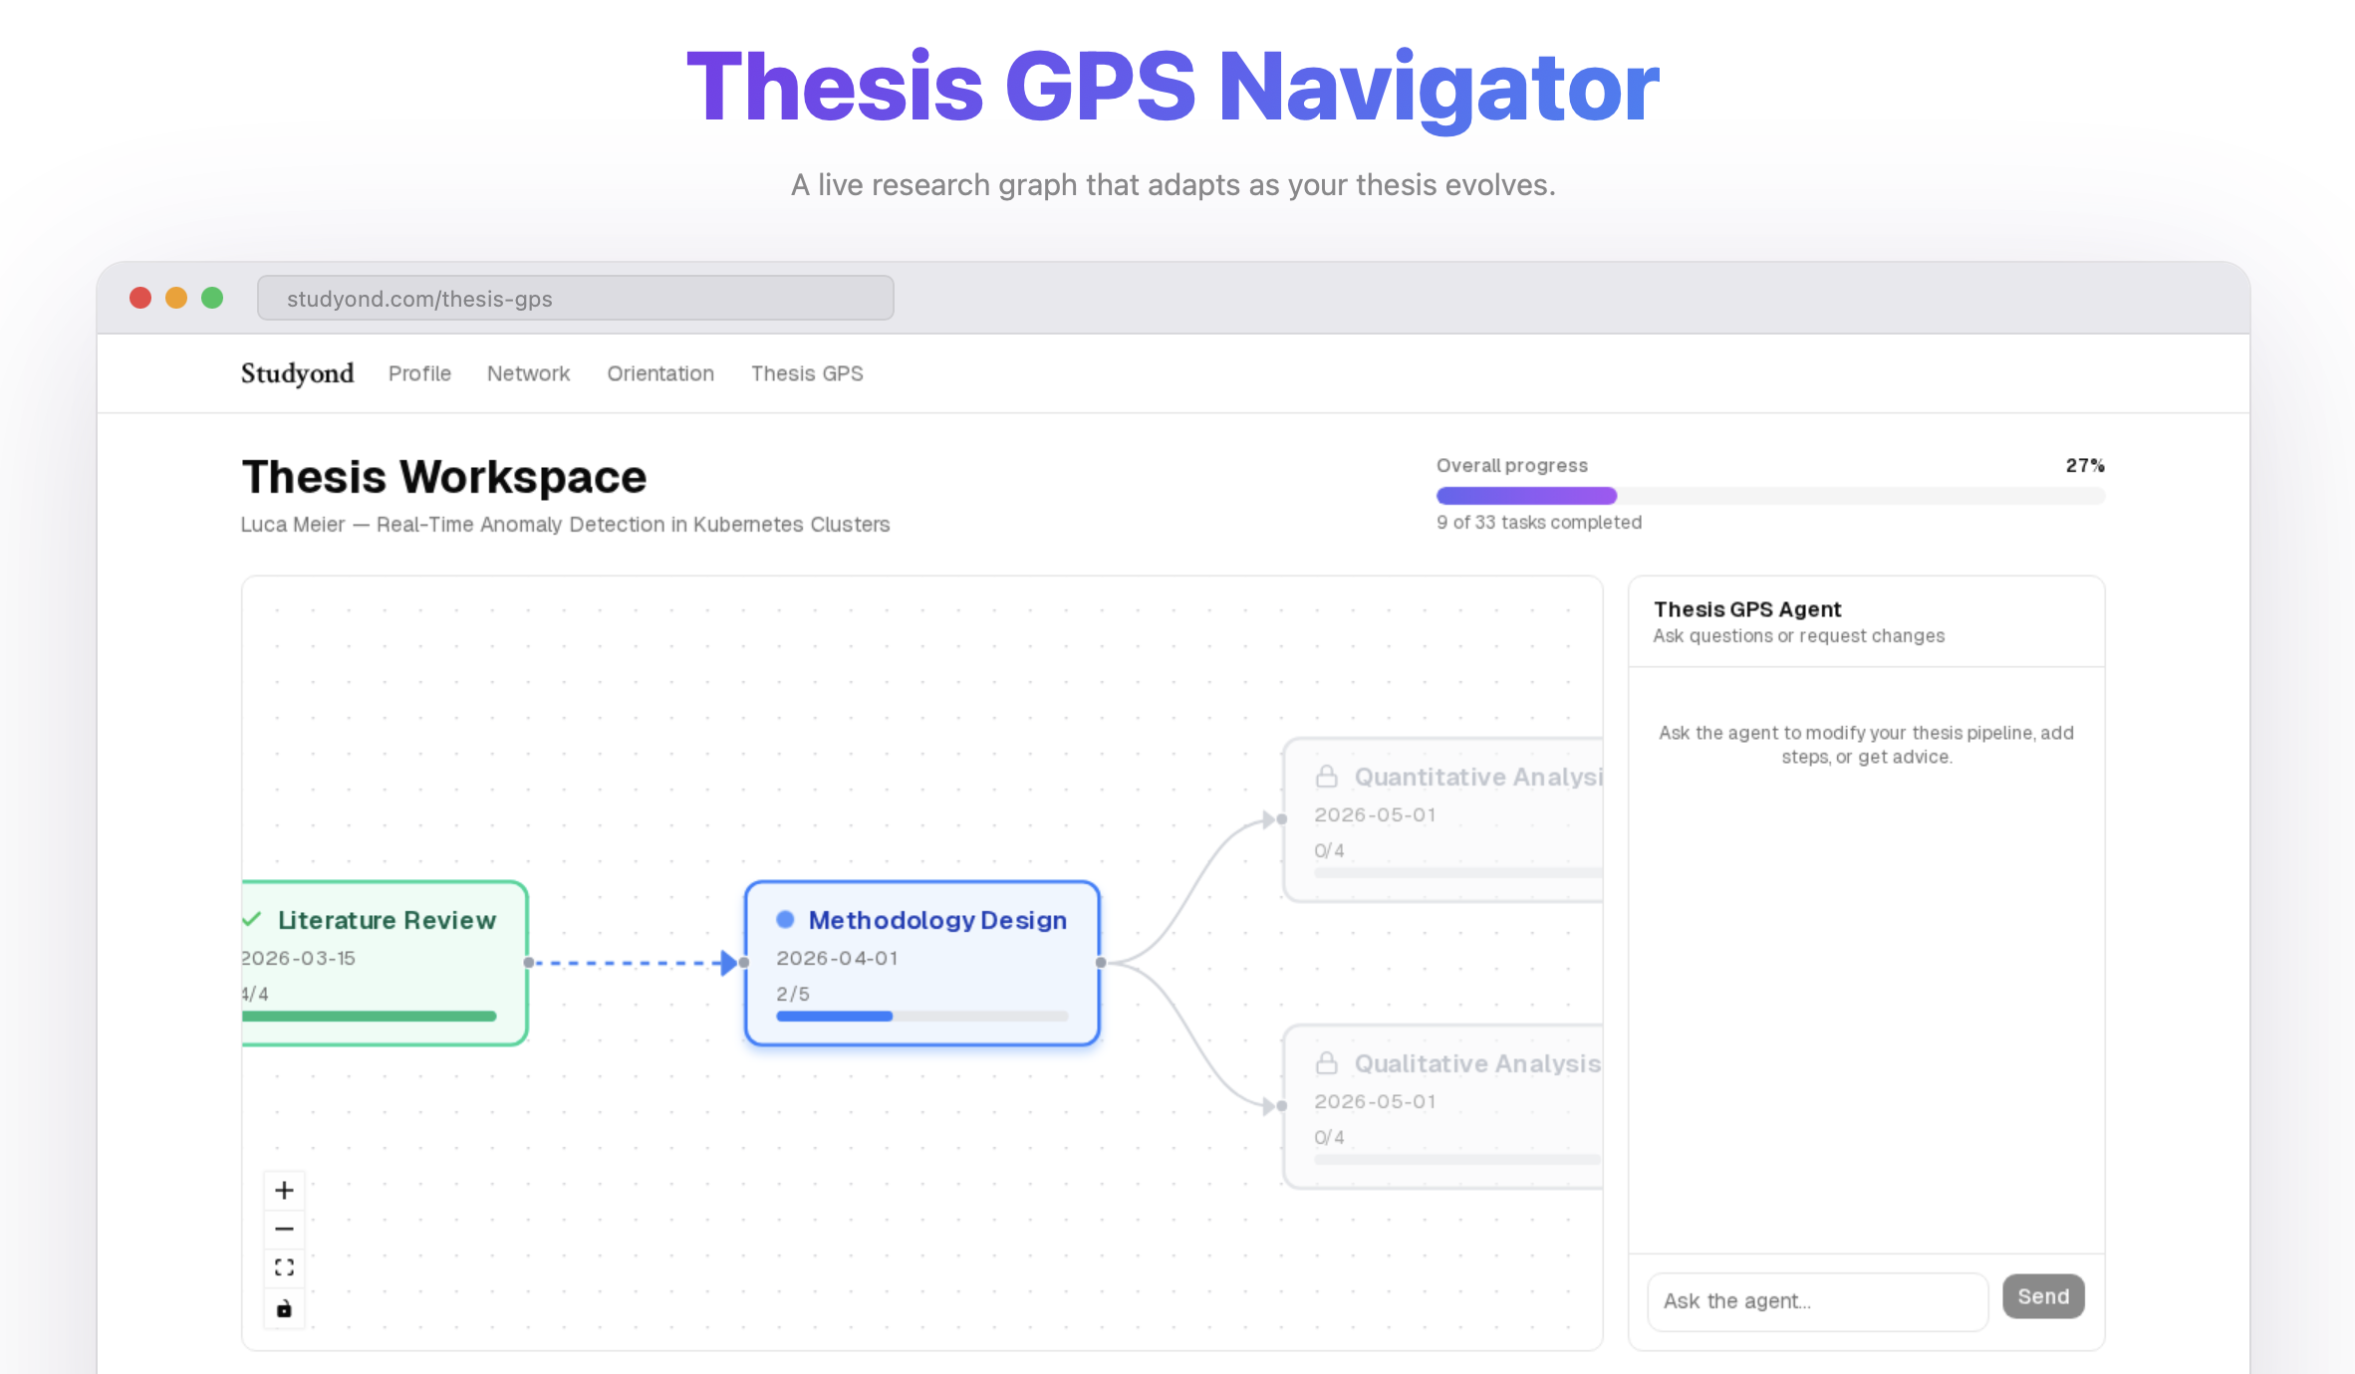

Slide 4
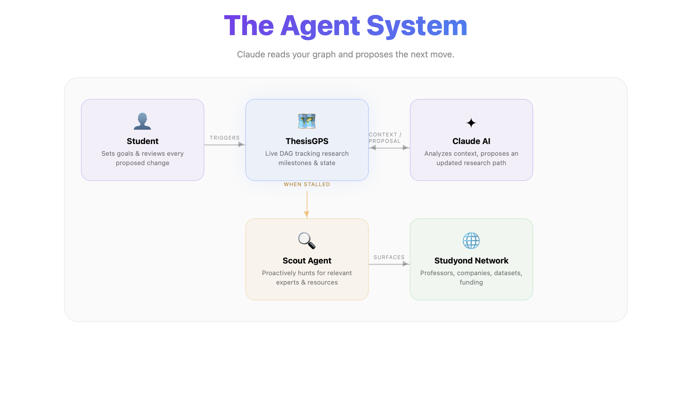

Slide 5


Slide 6

Thank you for your attention!
Q&A

