Slide 1
FROM FIRST VISIT TO FIRST PURCHASE
DAILY CONVERSION TIME ANALYSIS
LEONARDO VALOPPI

Slide 2
INTRODUCTION

Slide 3
Context
Understanding the time it takes for users to complete their first purchase is a key aspect of analyzing user behavior and optimizing conversion flows.

Slide 4
Context
Understanding the time it takes for users to complete their first purchase is a key aspect of analyzing user behavior and optimizing conversion flows.
This type of analysis helps identify points of friction, decision-making delays, or high-intent behavior, and is commonly used in product analytics to improve onboarding, checkout experience, and campaign targeting.

Slide 5
Context
Understanding the time it takes for users to complete their first purchase is a key aspect of analyzing user behavior and optimizing conversion flows.
This type of analysis helps identify points of friction, decision-making delays, or high-intent behavior, and is commonly used in product analytics to improve onboarding, checkout experience, and campaign targeting.
In this case, we focus specifically on purchases made within the same day as the user’s first recorded visit.

Slide 6
Context
Understanding the time it takes for users to complete their first purchase is a key aspect of analyzing user behavior and optimizing conversion flows.
This type of analysis helps identify points of friction, decision-making delays, or high-intent behavior, and is commonly used in product analytics to improve onboarding, checkout experience, and campaign targeting.
In this case, we focus specifically on purchases made within the same day as the user’s first recorded visit.
Goal
Measure how long it takes each user to make their first purchase after landing on the website, considering only activity that happens within the same calendar day.

Slide 7
Methodology
The analysis is based on raw clickstream data from the turing_data_analytics.raw_events table, covering a 3-month period from November 2020 to January 2021.

Slide 8
Methodology
The analysis is based on raw clickstream data from the turing_data_analytics.raw_events table, covering a 3-month period from November 2020 to January 2021.
Data was cleaned and processed using SQL in BigQuery and structured to identify, for each user and each day:
the first recorded event (first visit),
the first purchase event (on that same day),
and the difference between the two timestamps, calculated in seconds.

Slide 9
Methodology
The analysis is based on raw clickstream data from the turing_data_analytics.raw_events table, covering a 3-month period from November 2020 to January 2021.
Data was cleaned and processed using SQL in BigQuery and structured to identify, for each user and each day:
the first recorded event (first visit),
the first purchase event (on that same day),
and the difference between the two timestamps, calculated in seconds.
The final dataset contains one row per user per day with time-to-purchase and relevant metadata about the user’s device, browser, country, and event details, ready to be visualized and segmented in Tableau.

Slide 10
Methodology
The analysis is based on raw clickstream data from the turing_data_analytics.raw_events table, covering a 3-month period from November 2020 to January 2021.
Data was cleaned and processed using SQL in BigQuery and structured to identify, for each user and each day:
the first recorded event (first visit),
the first purchase event (on that same day),
and the difference between the two timestamps, calculated in seconds.
The final dataset contains one row per user per day with time-to-purchase and relevant metadata about the user’s device, browser, country, and event details, ready to be visualized and segmented in Tableau.
Additional columns were created to support the analysis:
is_outlier – a binary flag indicating whether a data point exceeds the upper or lower bounds defined by the IQR method.
is_gift – identifies users who completed a purchase event with no associated revenue, suggesting the purchase may have been a gift.

Slide 11
Summary statistics of Minutes To Purchase (entire 3 months period)

Slide 12
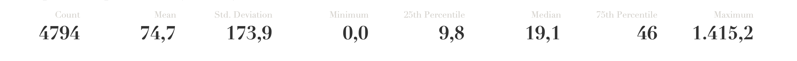
Summary statistics of Minutes To Purchase (entire 3 months period)

Slide 13
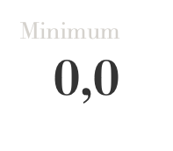
Summary statistics of Minutes To Purchase (entire 3 months period)
What?
seconds

Slide 14
Summary statistics of Minutes To Purchase (entire 3 months period)
What?
seconds
2 entries with 0 seconds of MTP

Slide 15
Summary statistics of Minutes To Purchase (entire 3 months period)
What?
seconds
Possible reasons:
Direct landing on a product or checkout page;
High-intent external campaign;
Returning customer already familiar with the product;
Previous session not tracked;
Autofill or 1-click checkout experience.

Slide 16
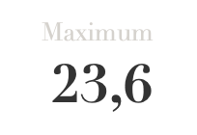
Summary statistics of Minutes To Purchase (entire 3 months period)
Almost a day!
seconds
hours

Slide 17
Summary statistics of Minutes To Purchase (entire 3 months period)
seconds
hours
Mean is above 75th percentile = Presence of extreme values (outliers)

Slide 18
Why do some users take so long to make a purchase?
Long session left open

Slide 19
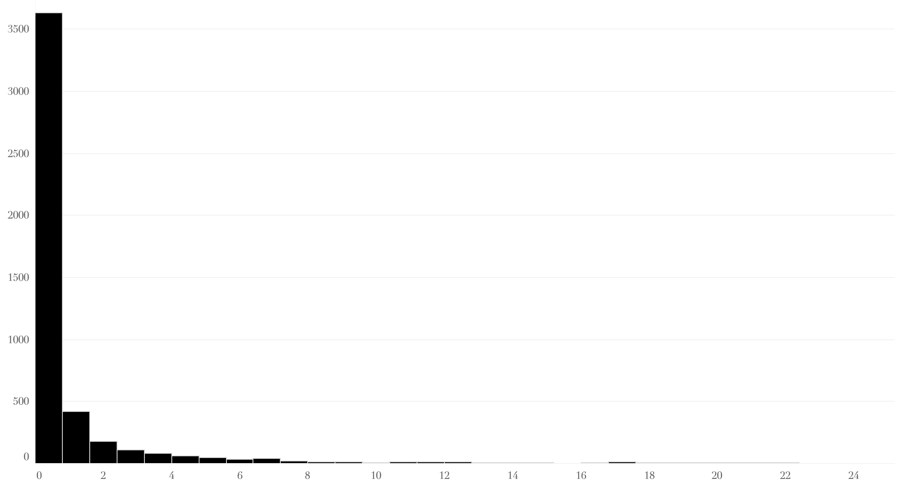
Why do some users take so long to make a purchase?
Distribution of HTP (entire 3 months period)
Long session left open

Slide 20
Why do some users take so long to make a purchase?
Distribution of HTP (entire 3 months period)
Long session left open
478 puchases (9,97%)
After more than 3 hours

Slide 21
Why do some users take so long to make a purchase?
Distribution of HTP (entire 3 months period)
Long session left open
478 puchases (9,97%)
After more than 3 hours
244 purchases (5,09%)
After more than 6 hours

Slide 22
Why do some users take so long to make a purchase?
Distribution of HTP (entire 3 months period)
Long session left open
478 puchases (9,97%)
After more than 3 hours
244 purchases (5,09%)
After more than 6 hours
137 purchases (2,86%)
After more than 10 hours

Slide 23
Why do some users take so long to make a purchase?
Distribution of HTP (entire 3 months period)
Long session left open
Possible reasons:
Long session left open;
Exploratory or indecisive behavior;
Planned purchase later the same day;
Interrupted and resumed purchase flow;
Technical issues or checkout friction.
478 puchases (9,97%)
After more than 3 hours
244 purchases (5,09%)
After more than 6 hours
137 purchases (2,86%)
After more than 10 hours

Slide 24
Long session left open
NEXT PART:
CATEGORY SPLIT AND OVER-TIME ANALYSIS
ON TABLEAU

Slide 25
Long session left open
CONCLUSION

Slide 26
Analysis Limits

Slide 27
Analysis Limits
The type of product and complexity of the website are unknown, making it hard to assess whether the measured time-to-purchase is concerning or acceptable. This context would be essential to align the metric with product goals or OKRs.

Slide 28
Analysis Limits
The type of product and complexity of the website are unknown, making it hard to assess whether the measured time-to-purchase is concerning or acceptable. This context would be essential to align the metric with product goals or OKRs.
Time-to-purchase is calculated based on calendar day rather than actual session duration, which limits precision in identifying true user behavior.

Slide 29
Analysis Limits
The type of product and complexity of the website are unknown, making it hard to assess whether the measured time-to-purchase is concerning or acceptable. This context would be essential to align the metric with product goals or OKRs.
Time-to-purchase is calculated based on calendar day rather than actual session duration, which limits precision in identifying true user behavior.
Session tracking is inconsistent: the session_start event is not always the first recorded action, leading to potential inaccuracies, especially for outliers with very long or very short purchase times.

Slide 30
What did we find out today?
Long session left open

Slide 31
What did we find out today?
After removing outliers (14.8% of all purchases), the overall average time to purchase dropped by 70%.
Long session left open

Slide 32
What did we find out today?
After removing outliers (14.8% of all purchases), the overall average time to purchase dropped by 70%;
The mean, median, minimum, and maximum values of time to purchase all show significant fluctuations throughout the period.
Long session left open

Slide 33
What did we find out today?
After removing outliers (14.8% of all purchases), the overall average time to purchase dropped by 70%;
The mean, median, minimum, and maximum values of time to purchase all show significant fluctuations throughout the period;
In the second half of December, the average time to purchase fell by more than 50%, even though the average amount spent in USD remained stable. It then increased again, reaching the highest daily peak on January 20th, 2021.
Long session left open

Slide 34
What did we find out today?
After removing outliers (14.8% of all purchases), the overall average time to purchase dropped by 70%;
The mean, median, minimum, and maximum values of time to purchase all show significant fluctuations throughout the period;
In the second half of December, the average time to purchase fell by more than 50%, even though the average amount spent in USD remained stable. It then increased again, reaching the highest daily peak on January 20th, 2021;
There is no observable correlation between the average time to purchase and the amount spent in USD, suggesting that longer decision time does not necessarily imply higher-value purchases.
Long session left open

Slide 35
What did we find out today?
After removing outliers (14.8% of all purchases), the overall average time to purchase dropped by 70%;
The mean, median, minimum, and maximum values of time to purchase all show significant fluctuations throughout the period;
In the second half of December, the average time to purchase fell by more than 50%, even though the average amount spent in USD remained stable. It then increased again, reaching the highest daily peak on January 20th, 2021;
There is no observable correlation between the average time to purchase and the amount spent in USD, suggesting that longer decision time does not necessarily imply higher-value purchases;
A group of 8 tablet users took 625% longer to complete a purchase compared to the average of other tablet users, and 554% longer than the overall user average; observed across six different days.
Long session left open

Slide 36
What did we find out today?
After removing outliers (14.8% of all purchases), the overall average time to purchase dropped by 70%;
The mean, median, minimum, and maximum values of time to purchase all show significant fluctuations throughout the period;
In the second half of December, the average time to purchase fell by more than 50%, even though the average amount spent in USD remained stable. It then increased again, reaching the highest daily peak on January 20th, 2021;
There is no observable correlation between the average time to purchase and the amount spent in USD, suggesting that longer decision time does not necessarily imply higher-value purchases;
A group of 8 tablet users took 625% longer to complete a purchase compared to the average of other tablet users, and 554% longer than the overall user average; observed across six different days;
Users purchasing in the late evening (21:00–00:00) tended to take twice as long to complete a purchase compared to other time slots, suggesting longer decision times during nighttime activity.
Long session left open

Slide 37
What did we find out today?
After removing outliers (14.8% of all purchases), the overall average time to purchase dropped by 70%;
The mean, median, minimum, and maximum values of time to purchase all show significant fluctuations throughout the period;
In the second half of December, the average time to purchase fell by more than 50%, even though the average amount spent in USD remained stable. It then increased again, reaching the highest daily peak on January 20th, 2021;
There is no observable correlation between the average time to purchase and the amount spent in USD, suggesting that longer decision time does not necessarily imply higher-value purchases;
A group of 8 tablet users took 625% longer to complete a purchase compared to the average of other tablet users, and 554% longer than the overall user average; observed across six different days;
Users purchasing in the late evening (21:00–00:00) tended to take twice as long to complete a purchase compared to other time slots, suggesting longer decision times during nighttime activity;
In the last two weeks of November, users who claimed a gift spent 1.97× more time purchasing than regular users. Interestingly, in the following three weeks, their average time to purchase was 23% lower than that of normal purchasers.
Over the entire period, gift claimers showed a steady decrease in time to purchase, eventually falling below the baseline.
Long session left open

Slide 38
What did we find out today?
After removing outliers (14.8% of all purchases), the overall average time to purchase dropped by 70%;
The mean, median, minimum, and maximum values of time to purchase all show significant fluctuations throughout the period;
In the second half of December, the average time to purchase fell by more than 50%, even though the average amount spent in USD remained stable. It then increased again, reaching the highest daily peak on January 20th, 2021;
There is no observable correlation between the average time to purchase and the amount spent in USD, suggesting that longer decision time does not necessarily imply higher-value purchases;
A group of 8 tablet users took 625% longer to complete a purchase compared to the average of other tablet users, and 554% longer than the overall user average; observed across six different days;
Users purchasing in the late evening (21:00–00:00) tended to take twice as long to complete a purchase compared to other time slots, suggesting longer decision times during nighttime activity;
In the last two weeks of November, users who claimed a gift spent 1.97× more time purchasing than regular users. Interestingly, in the following three weeks, their average time to purchase was 23% lower than that of normal purchasers.
Over the entire period, gift claimers showed a steady decrease in time to purchase, eventually falling below the baseline;
Other outliers displayed very diverse characteristics, making it difficult to detect specific patterns. Many of them were isolated single purchases, likely influenced by varied and untracked user dynamics or external factors.
Long session left open

Slide 39
Recommendations
Long session left open

Slide 40
Recommendations
Investigate tablet experience more closely
→ Tablet users show extreme delays in conversion time. Consider reviewing the UX and technical performance on tablet devices to identify possible usability issues.
Long session left open

Slide 41
Recommendations
Investigate tablet experience more closely
→ Tablet users show extreme delays in conversion time. Consider reviewing the UX and technical performance on tablet devices to identify possible usability issues.
Explore user behavior during late evening hours
→ Users purchasing between 21:00 and midnight take significantly more time to convert. Test whether simplified flows, reminders, or reassurance messages during these hours could reduce hesitation.
Long session left open

Slide 42
Recommendations
Investigate tablet experience more closely
→ Tablet users show extreme delays in conversion time. Consider reviewing the UX and technical performance on tablet devices to identify possible usability issues.
Explore user behavior during late evening hours
→ Users purchasing between 21:00 and midnight take significantly more time to convert. Test whether simplified flows, reminders, or reassurance messages during these hours could reduce hesitation.
Re-evaluate the gift claiming process
→ Gift claimers initially take longer to convert, but eventually become faster than normal users. Consider optimizing the onboarding or confirmation flow for gift-based purchases to support early conversion.
Long session left open

Slide 43
Recommendations
Investigate tablet experience more closely
→ Tablet users show extreme delays in conversion time. Consider reviewing the UX and technical performance on tablet devices to identify possible usability issues.
Explore user behavior during late evening hours
→ Users purchasing between 21:00 and midnight take significantly more time to convert. Test whether simplified flows, reminders, or reassurance messages during these hours could reduce hesitation.
Re-evaluate the gift claiming process
→ Gift claimers initially take longer to convert, but eventually become faster than normal users. Consider optimizing the onboarding or confirmation flow for gift-based purchases to support early conversion.
Ignore time-to-purchase as a predictor of spend
→ Since no correlation was found between time and amount spent, avoid assuming that longer consideration leads to higher-value transactions.
Long session left open

Slide 44
Recommendations
Investigate tablet experience more closely
→ Tablet users show extreme delays in conversion time. Consider reviewing the UX and technical performance on tablet devices to identify possible usability issues.
Explore user behavior during late evening hours
→ Users purchasing between 21:00 and midnight take significantly more time to convert. Test whether simplified flows, reminders, or reassurance messages during these hours could reduce hesitation.
Re-evaluate the gift claiming process
→ Gift claimers initially take longer to convert, but eventually become faster than normal users. Consider optimizing the onboarding or confirmation flow for gift-based purchases to support early conversion.
Ignore time-to-purchase as a predictor of spend
→ Since no correlation was found between time and amount spent, avoid assuming that longer consideration leads to higher-value transactions.
Use outlier detection to flag specific cases, not trends
→ Outliers vary too widely to define a pattern but could be used to flag cases for qualitative follow-up (e.g. extreme delay, friction, technical failure).
Long session left open

Slide 45
Recommendations
Investigate tablet experience more closely
→ Tablet users show extreme delays in conversion time. Consider reviewing the UX and technical performance on tablet devices to identify possible usability issues.
Explore user behavior during late evening hours
→ Users purchasing between 21:00 and midnight take significantly more time to convert. Test whether simplified flows, reminders, or reassurance messages during these hours could reduce hesitation.
Re-evaluate the gift claiming process
→ Gift claimers initially take longer to convert, but eventually become faster than normal users. Consider optimizing the onboarding or confirmation flow for gift-based purchases to support early conversion.
Ignore time-to-purchase as a predictor of spend
→ Since no correlation was found between time and amount spent, avoid assuming that longer consideration leads to higher-value transactions.
Use outlier detection to flag specific cases, not trends
→ Outliers vary too widely to define a pattern but could be used to flag cases for qualitative follow-up (e.g. extreme delay, friction, technical failure).
Complement this analysis with session-based metrics
→ If possible, improve tracking to measure active session duration. This would provide a more accurate view of user effort and help refine funnel performance indicators.
Long session left open

Slide 46
What Could Improve This Analysis
Long session left open
More reliable and consistent session tracking.

Slide 47
What Could Improve This Analysis
Long session left open
More reliable and consistent session tracking;
Clearer definitions of user activity duration (e.g. active time on site vs. passive time).

Slide 48
What Could Improve This Analysis
Long session left open
More reliable and consistent session tracking;
Clearer definitions of user activity duration (e.g. active time on site vs. passive time);
Contextual information about the product or service being sold.

Slide 49
What Could Improve This Analysis
Long session left open
More reliable and consistent session tracking;
Clearer definitions of user activity duration (e.g. active time on site vs. passive time);
Contextual information about the product or service being sold;
Better understanding of the user journey and site complexity.

Slide 50
What Could Improve This Analysis
Long session left open
More reliable and consistent session tracking;
Clearer definitions of user activity duration (e.g. active time on site vs. passive time);
Contextual information about the product or service being sold;
Better understanding of the user journey and site complexity;
Alignment of the time-to-purchase metric with product team OKRs and business goals.

Slide 51
Long session left open
THANK YOU

