Slide 1
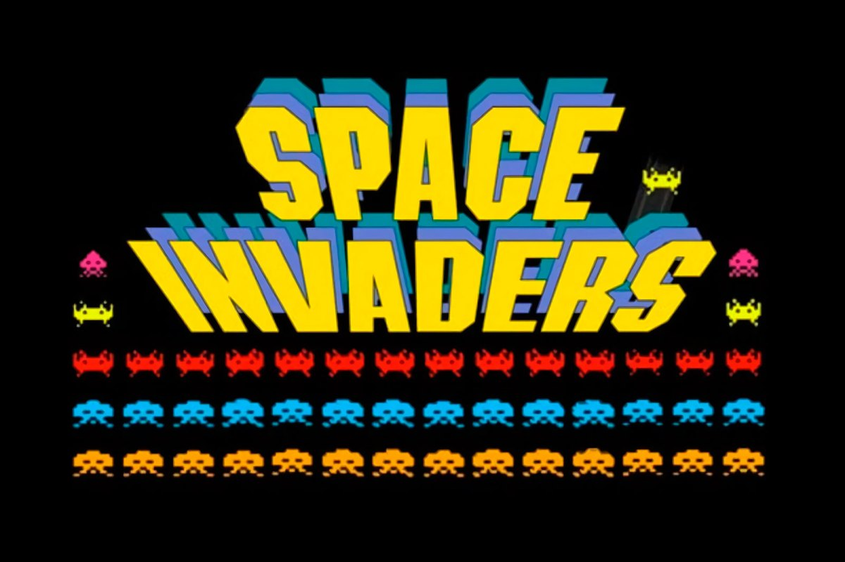
USB Edition

Slide 2

USB Edition
USB Edition
USB EDITION

Slide 3
Leonardo Ward
USB Edition
Mauricio Marcano
USB EDITION

