Slide 1
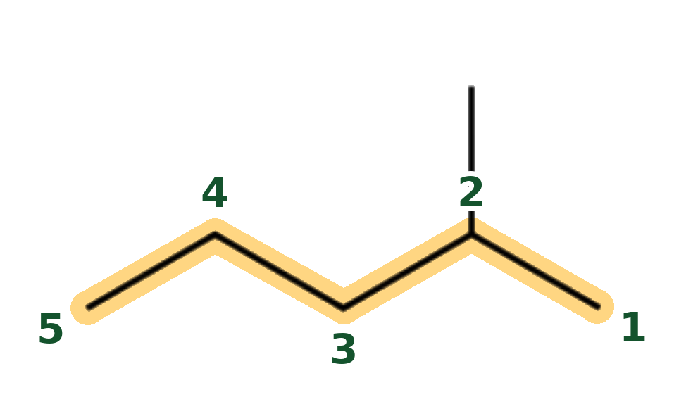
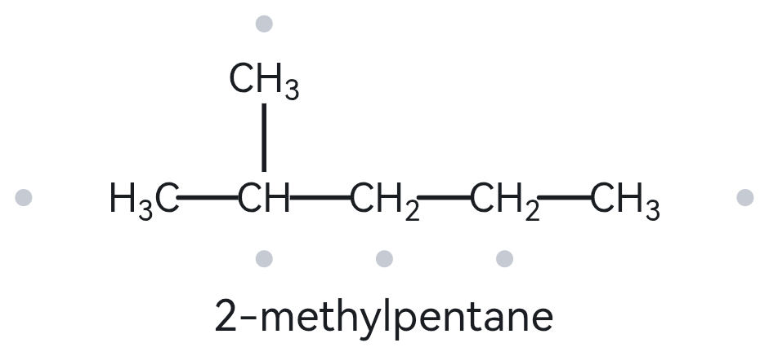
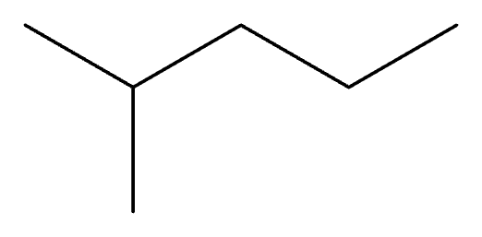
A01 FOUNDATION
Molecular formula (counted): C6H14
(6 C, open chain: CₙH₂ₙ₊₂)
Structure → Name
1 · NUMBERED PARENT
2 · NAMING TRAIL
Parent: 5 C → pentane (chain). (Other paths of the same length: 5 C, using the top methyl branch instead of the rightmost carbon as a chain end.)
Numbering: right → left gives the substituent C2; left → right gives C4. Winner: right → left. (2 is lower than 4.)
Substituents (A→Z): methyl on C2.
(Parent highlighted; carbons numbered from the end that gives the lowest locants)
3 · MY NAME (TYPED BEFORE OPENING THE TOOL)
4 · THE ALKANE CHECK (RETURNED NAME)
2-methylpentane
Tool: The Alkane
Returned name: 2-methylpentane
Verdict: [✓] Match [ ] Mismatch
[✓] longest chain/ring confirmed [✓] lowest locants [✓] alphabetical order [✓] punctuation [✓] formula counted

Slide 2
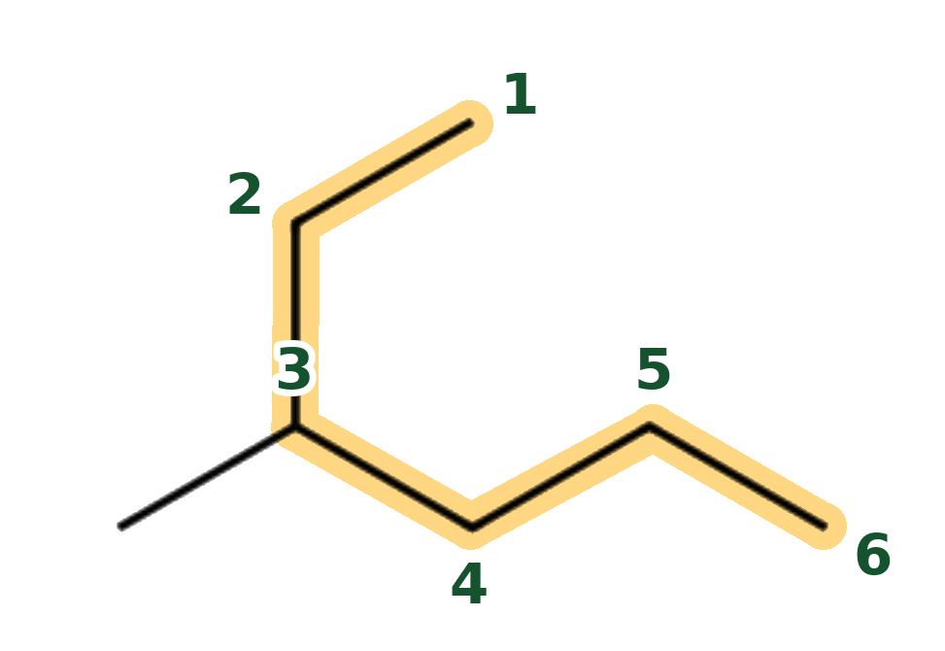
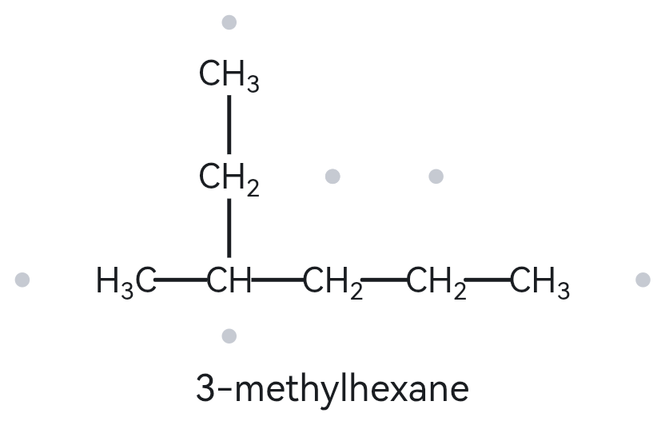
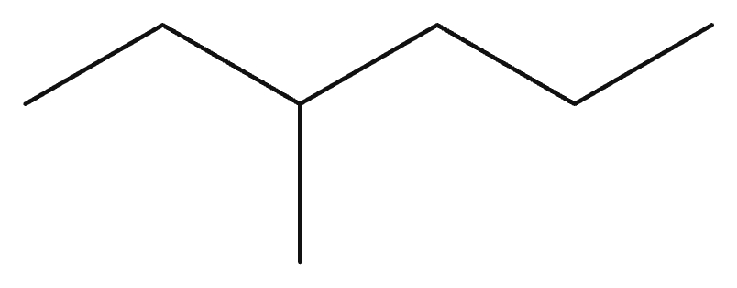
A02 FOUNDATION
Molecular formula (counted): C7H16
(7 C, open chain: CₙH₂ₙ₊₂)
Structure → Name
1 · NUMBERED PARENT
2 · NAMING TRAIL
Parent: 6 C → hexane (chain). (The longest chain is not the horizontal one; it bends through the branch carbon. Other paths of the same length: none, the others give 4 C or 5 C.)
Numbering: from the top-right end down to the bottom-right end gives the branch C3; the other direction gives C4. Winner: C3.
Substituents (A→Z): methyl on C3.
(Parent highlighted; carbons numbered from the end that gives the lowest locants)
3 · MY NAME (TYPED BEFORE OPENING THE TOOL)
4 · THE ALKANE CHECK (RETURNED NAME)
3-methylhexane
Tool: The Alkane
Returned name: 3-methylhexane
Verdict: [✓] Match [ ] Mismatch
[✓] longest chain/ring confirmed [✓] lowest locants [✓] alphabetical order [✓] punctuation [✓] formula counted

Slide 3
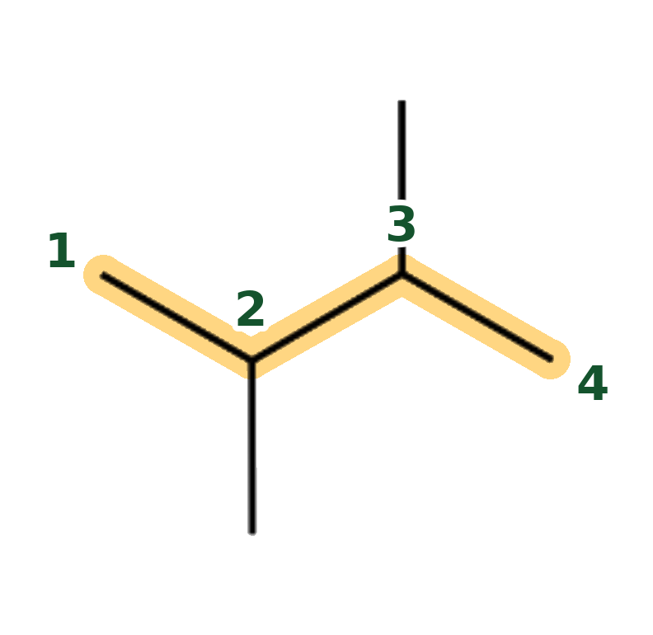
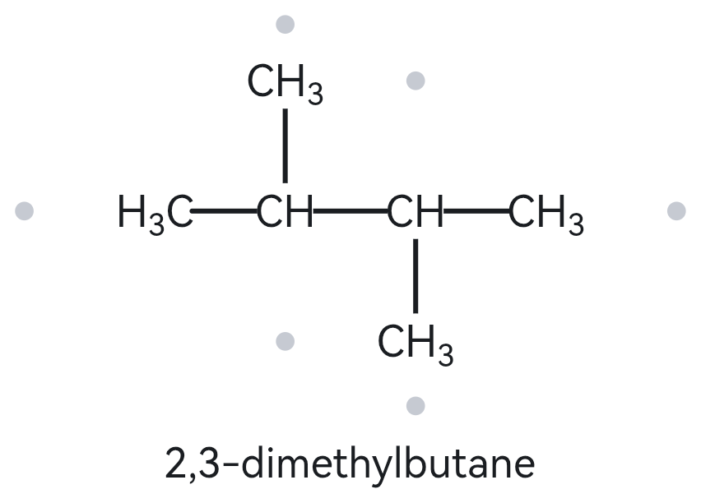
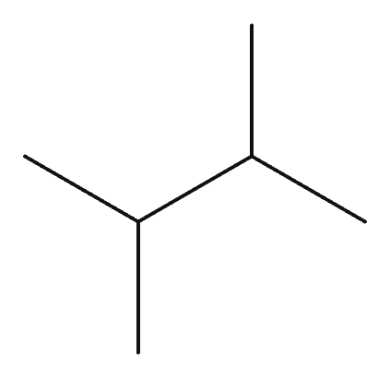
A03 FOUNDATION
Molecular formula (counted): C6H14
(6 C, open chain: CₙH₂ₙ₊₂)
Structure → Name
1 · NUMBERED PARENT
2 · NAMING TRAIL
Parent: 4 C → butane (chain). (Other paths of the same length: 4 C, using either vertical methyl branch as a chain end.)
Numbering: left → right or right → left: the molecule is symmetrical, so the locants are 2 and 3 either way.
Substituents (A→Z): methyl on C2, methyl on C3. (Identical groups, so they are combined with the prefix di-.)
(Parent highlighted; carbons numbered from the end that gives the lowest locants)
3 · MY NAME (TYPED BEFORE OPENING THE TOOL)
4 · THE ALKANE CHECK (RETURNED NAME)
2,3-dimethylbutane
Tool: The Alkane
Returned name: 2,3-dimethylbutane
Verdict: [✓] Match [ ] Mismatch
[✓] longest chain/ring confirmed [✓] lowest locants [✓] alphabetical order [✓] punctuation [✓] formula counted

Slide 4
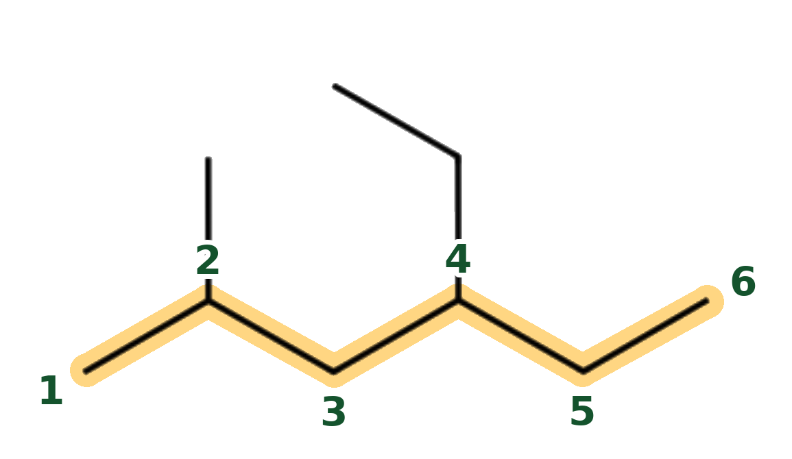
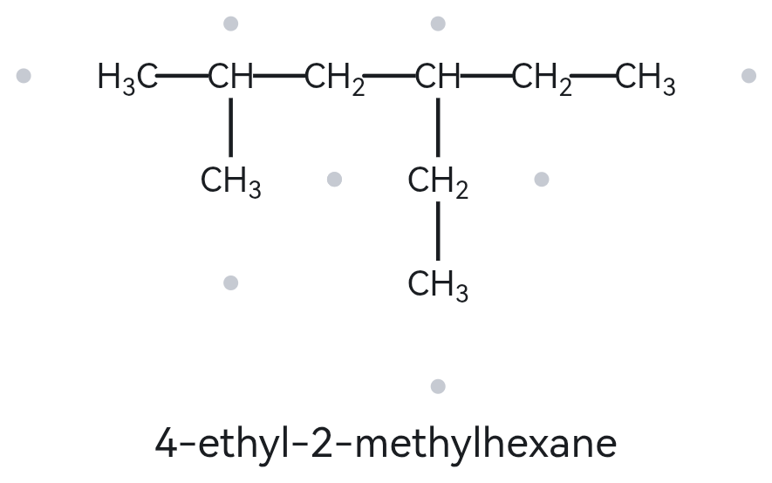
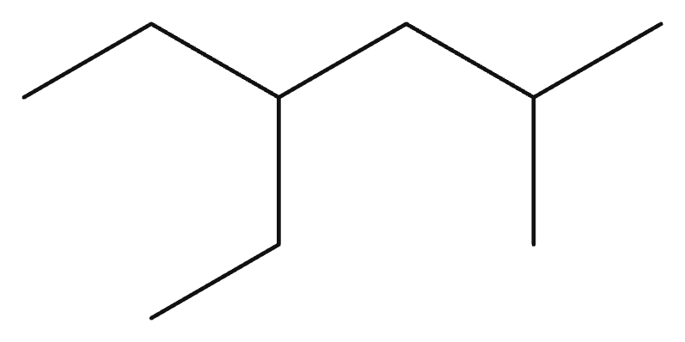
A04 DEVELOPING
Molecular formula (counted): C9H20
(9 C, open chain: CₙH₂ₙ₊₂)
Structure → Name
1 · NUMBERED PARENT
2 · NAMING TRAIL
Parent: 6 C → hexane (chain). (Other paths of the same length: 6 C, tracing up through the ethyl branch instead of continuing to the rightmost tip.)
Numbering: left → right gives 2,4; right → left gives 3,5. Winner: left → right. (First point of difference: 2 is lower than 3.)
Substituents (A→Z): ethyl on C4, methyl on C2. (Ethyl is cited first because "e" comes before "m" alphabetically.)
(Parent highlighted; carbons numbered from the end that gives the lowest locants)
3 · MY NAME (TYPED BEFORE OPENING THE TOOL)
4 · THE ALKANE CHECK (RETURNED NAME)
4-ethyl-2-methylhexane
Tool: The Alkane
Returned name: 4-ethyl-2-methylhexane
Verdict: [✓] Match [ ] Mismatch
[✓] longest chain/ring confirmed [✓] lowest locants [✓] alphabetical order [✓] punctuation [✓] formula counted

Slide 5
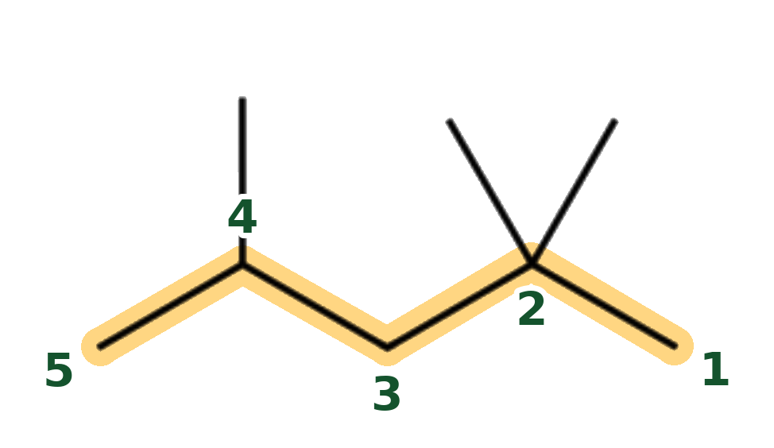
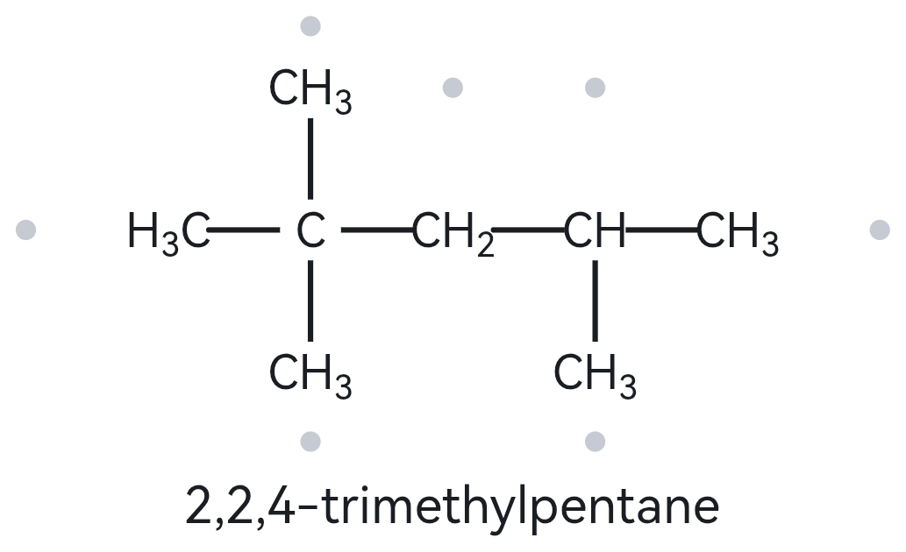
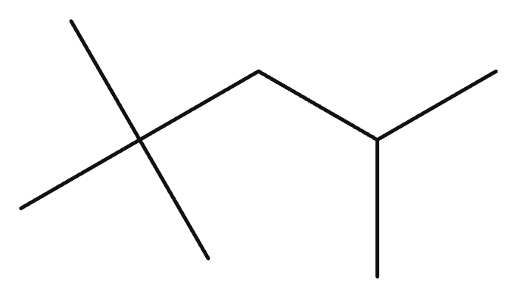
A05 DEVELOPING
Molecular formula (counted): C8H18
(8 C, open chain: CₙH₂ₙ₊₂)
Structure → Name
1 · NUMBERED PARENT
2 · NAMING TRAIL
Parent: 5 C → pentane (chain). (Other paths of the same length: 5 C, using any of the branching terminal methyl groups as chain ends.)
Numbering: right → left gives 2,2,4; left → right gives 2,4,4. Winner: right → left. (First point of difference: 2 is lower than 4.)
Substituents (A→Z): methyl on C2, methyl on C2, methyl on C4.
(Parent highlighted; carbons numbered from the end that gives the lowest locants)
3 · MY NAME (TYPED BEFORE OPENING THE TOOL)
4 · THE ALKANE CHECK (RETURNED NAME)
2,2,4-trimethylpentane
Tool: The Alkane
Returned name: 2,2,4-trimethylpentane
Verdict: [✓] Match [ ] Mismatch (Isooctane is the common name of this compound.)
(commonly known as isooctane)
[✓] longest chain/ring confirmed [✓] lowest locants [✓] alphabetical order [✓] punctuation [✓] formula counted

Slide 6
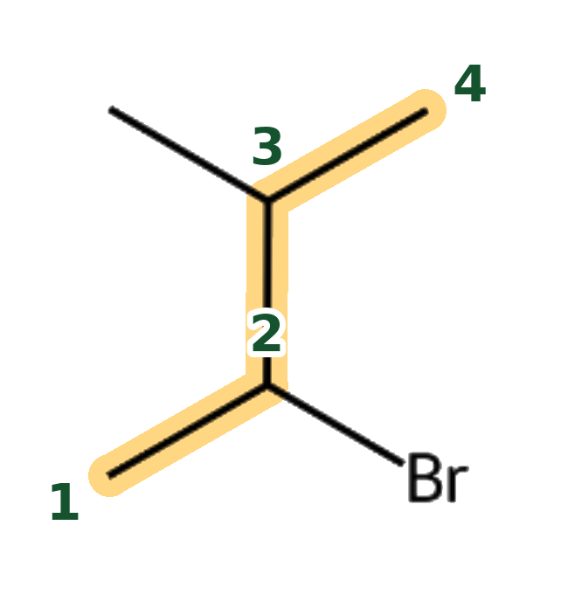
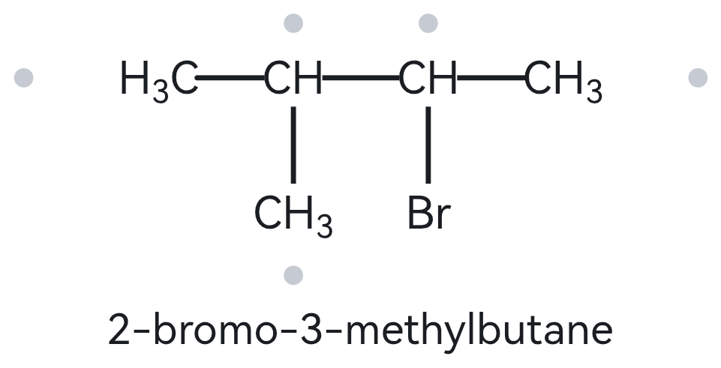
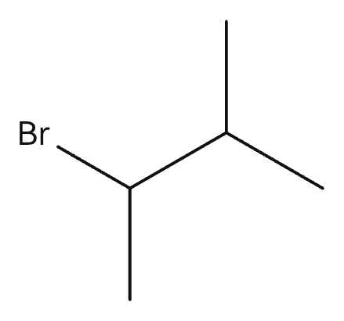
A06 DEVELOPING
Molecular formula (counted): C5H11Br
(5 C chain C₅H₁₂, one H replaced by Br)
Structure → Name
1 · NUMBERED PARENT
2 · NAMING TRAIL
Parent: 4 C → butane (chain). (Other paths of the same length: 4 C, using either top methyl group as the chain start.)
Numbering: bottom-left → top-left gives bromo C2, methyl C3; the other direction gives methyl C2, bromo C3. Both sets are 2,3 (a tie). (Alphabetical tie-break: bromo comes before methyl, so bromo gets the lower number C2.)
Substituents (A→Z): bromo on C2, methyl on C3.
(Parent highlighted; carbons numbered from the end that gives the lowest locants)
3 · MY NAME (TYPED BEFORE OPENING THE TOOL)
4 · THE ALKANE CHECK (RETURNED NAME)
2-bromo-3-methylbutane
Tool: The Alkane
Returned name: 2-bromo-3-methylbutane
Verdict: [✓] Match [ ] Mismatch
[✓] longest chain/ring confirmed [✓] lowest locants [✓] alphabetical order [✓] punctuation [✓] formula counted

Slide 7
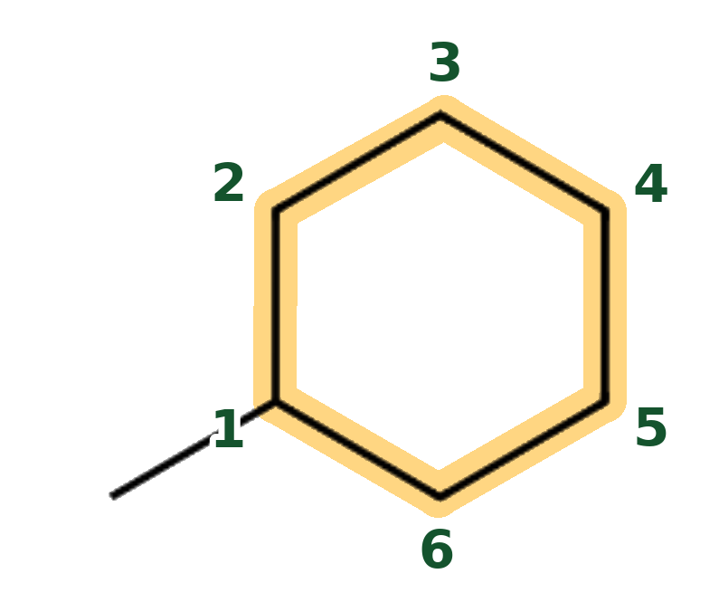
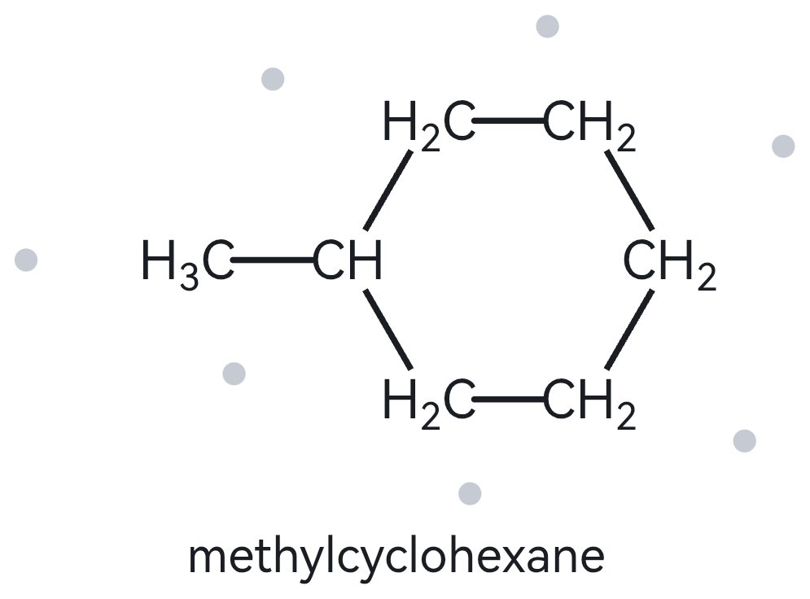
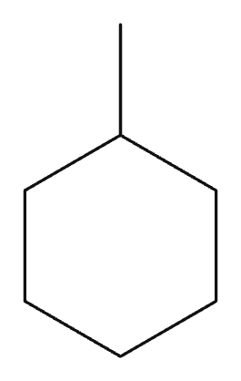
A07 DEVELOPING
Molecular formula (counted): C7H14
(7 C, one ring: CₙH₂ₙ)
Structure → Name
1 · NUMBERED PARENT
2 · NAMING TRAIL
Parent: 6 C → cyclohexane (ring). (Other paths of the same length: none.)
Numbering: no locant is needed. (A single substituent on a ring is automatically assigned position C1.)
Substituents (A→Z): methyl on C1.
(Parent highlighted; carbons numbered from the end that gives the lowest locants)
3 · MY NAME (TYPED BEFORE OPENING THE TOOL)
4 · THE ALKANE CHECK (RETURNED NAME)
methylcyclohexane
Tool: The Alkane
Returned name: methylcyclohexane
Verdict: [✓] Match [ ] Mismatch
[✓] longest chain/ring confirmed [✓] lowest locants [✓] alphabetical order [✓] punctuation [✓] formula counted

Slide 8
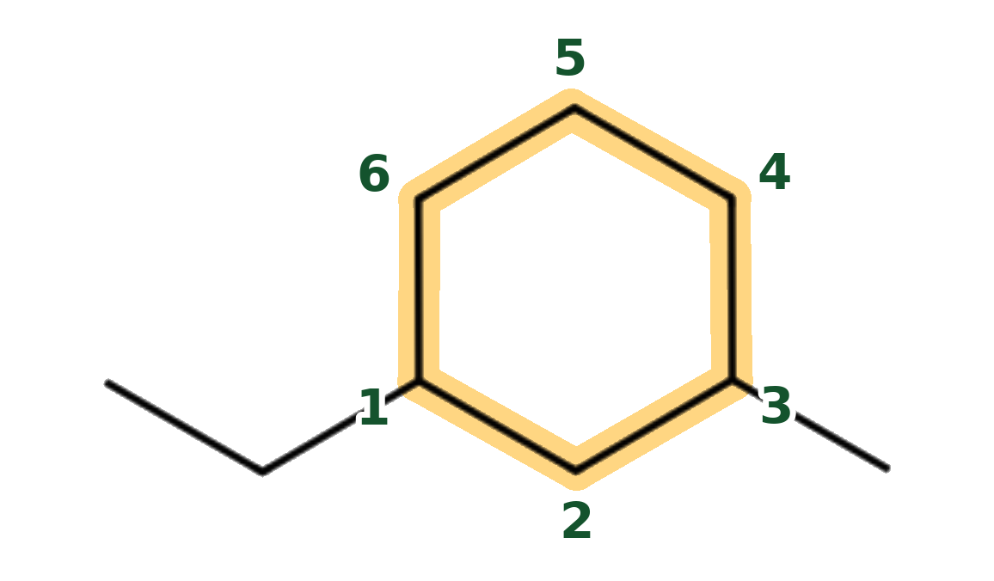
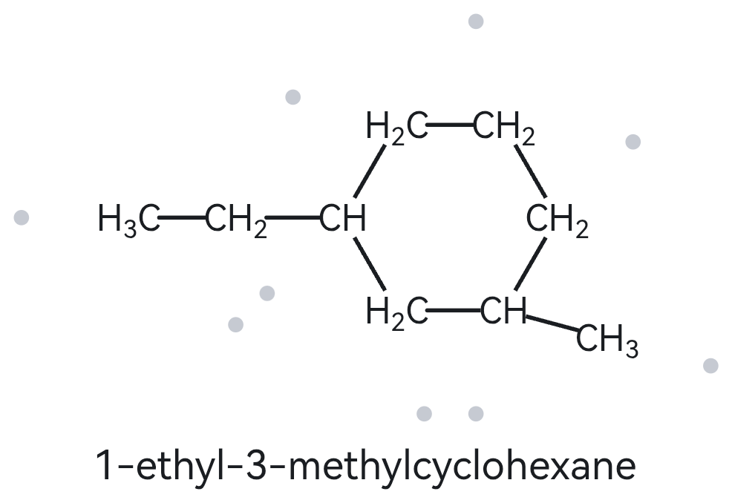
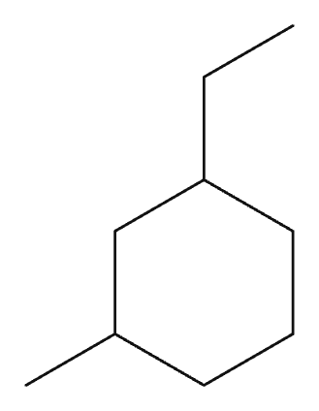
A08 CHALLENGE
Molecular formula (counted): C9H18
(9 C, one ring: CₙH₂ₙ)
Structure → Name
1 · NUMBERED PARENT
2 · NAMING TRAIL
Parent: 6 C → cyclohexane (ring). (Other paths of the same length: none.)
Numbering: counter-clockwise from the ethyl group to the methyl group gives {1,3}; the other way round also gives {1,3}. (Alphabetical tie-break: ethyl comes before methyl, so ethyl gets C1.)
Substituents (A→Z): ethyl on C1, methyl on C3.
(Parent highlighted; carbons numbered from the end that gives the lowest locants)
3 · MY NAME (TYPED BEFORE OPENING THE TOOL)
4 · THE ALKANE CHECK (RETURNED NAME)
1-ethyl-3-methylcyclohexane
Tool: The Alkane
Returned name: 1-ethyl-3-methylcyclohexane
Verdict: [✓] Match [ ] Mismatch
[✓] longest chain/ring confirmed [✓] lowest locants [✓] alphabetical order [✓] punctuation [✓] formula counted

Slide 9
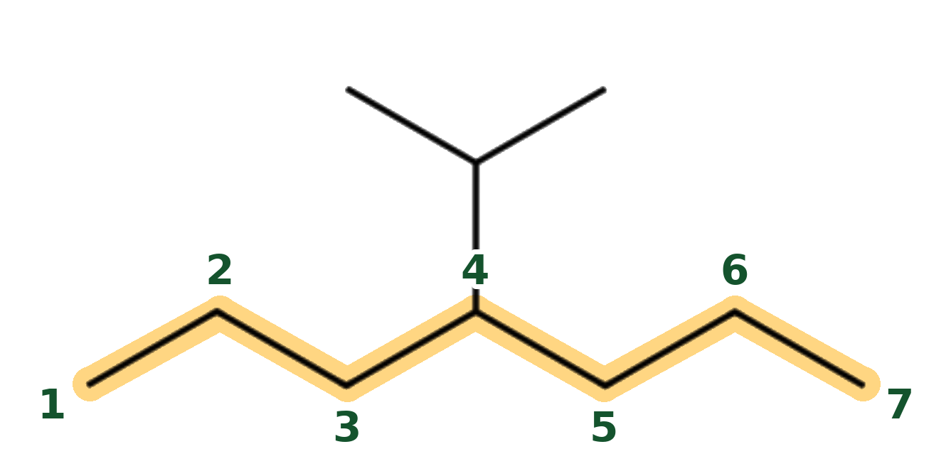
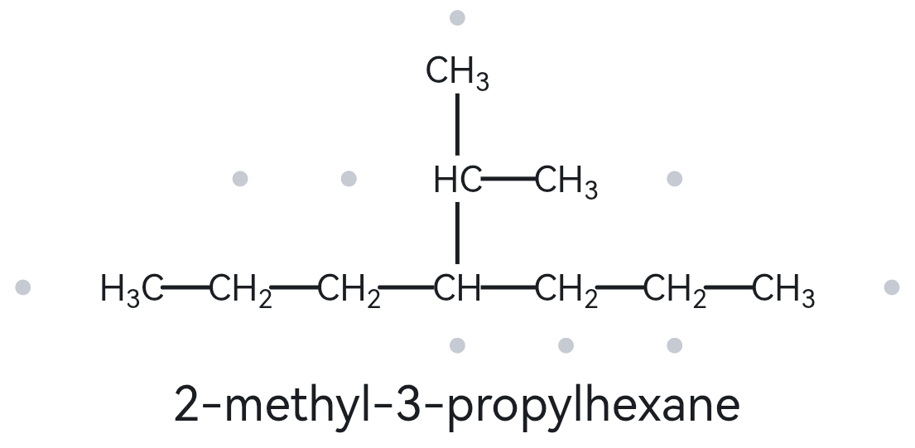
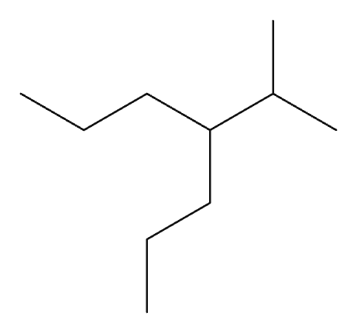
A09 CHALLENGE
Molecular formula (counted): C10H22
(7 + 3 = 10 C, open chain: CₙH₂ₙ₊₂)
Structure → Name
1 · NUMBERED PARENT
2 · NAMING TRAIL
Parent: 7 C → heptane (chain). (Other paths: 6 C, tracing from an end into the branched substituent, so the 7 C chain is the longest.)
Numbering: left → right or right → left: the chain is symmetrical, so the substituent is at C4 either way.
Substituents (A→Z): isopropyl on C4. (Isopropyl = 1-methylethyl = propan-2-yl; all are the same group.)
(Parent highlighted; carbons numbered from the end that gives the lowest locants)
3 · MY NAME (TYPED BEFORE OPENING THE TOOL)
4 · THE ALKANE CHECK (RETURNED NAME)
4-isopropylheptane
Tool: The Alkane
Returned name: 2-methyl-3-propylhexane
Verdict: [ ] Match [✓] Mismatch
Correct name: 4-isopropylheptane
Rule: parent = longest chain (7 C, not 6 C)
or 4-(1-methylethyl)heptane
[✓] longest chain/ring confirmed [✓] lowest locants [✓] alphabetical order [✓] punctuation [✓] formula counted

Slide 10
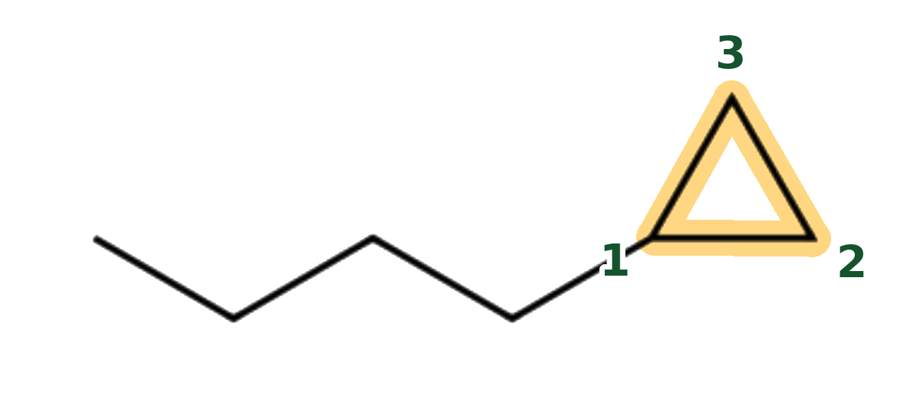
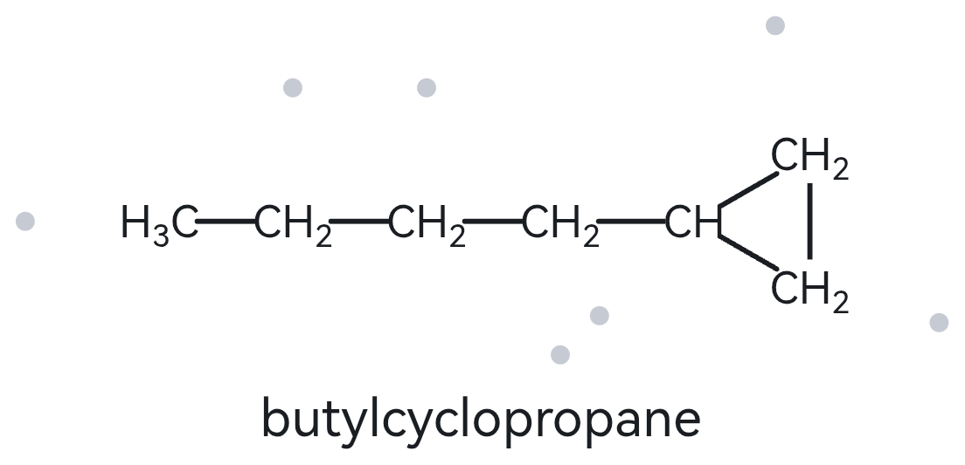
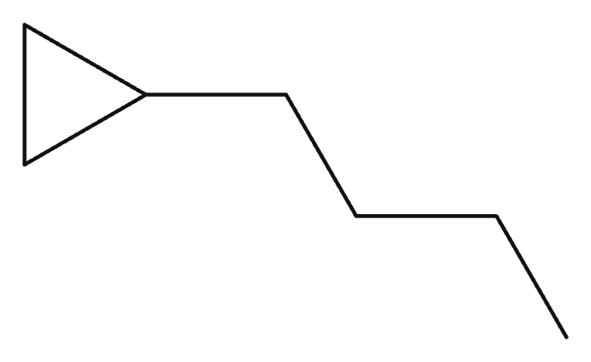
A10 CHALLENGE
Molecular formula (counted): C7H14
(3 + 4 = 7 C, one ring: CₙH₂ₙ)
Structure → Name
1 · NUMBERED PARENT
2 · NAMING TRAIL
Parent: 3 C → cyclopropane (ring). (The ring is the parent in this activity, even though the open chain has more carbons than the ring. Other paths of the same length: none.)
Numbering: no locant is needed. (A single substituent on a ring is automatically assigned position C1.)
Substituents (A→Z): butyl on C1 (the 4-carbon chain).
(Parent highlighted; carbons numbered from the end that gives the lowest locants)
3 · MY NAME (TYPED BEFORE OPENING THE TOOL)
4 · THE ALKANE CHECK (RETURNED NAME)
butylcyclopropane
Tool: The Alkane
Returned name: butylcyclopropane
Verdict: [✓] Match [ ] Mismatch
[✓] longest chain/ring confirmed [✓] lowest locants [✓] alphabetical order [✓] punctuation [✓] formula counted

Slide 11
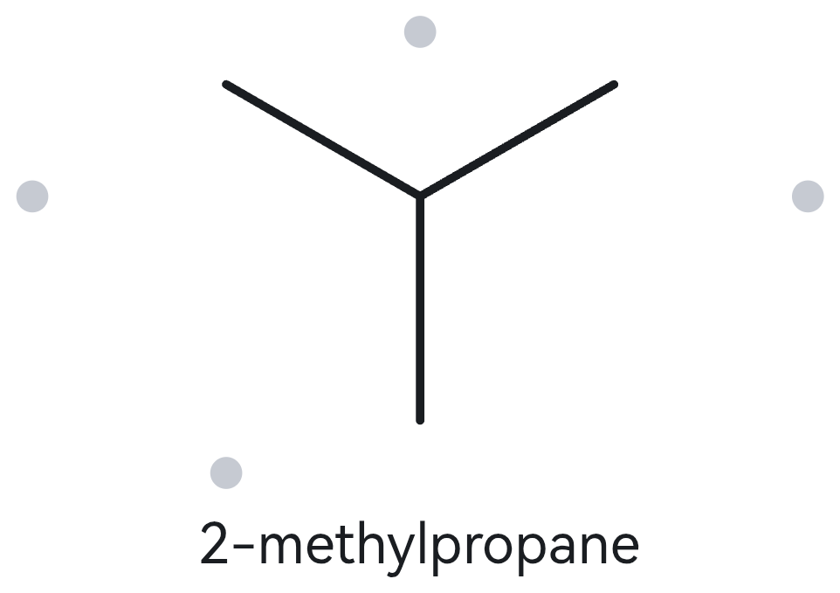
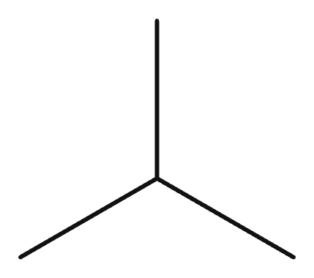
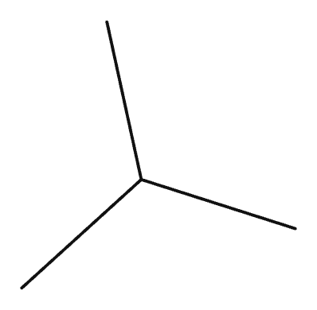
B01 FOUNDATION
Given name:
2-methylpropane
Name → Structure
1 · NAME DECODED
2 · BOND-LINE STRUCTURE (MY DRAWING IN THE ALKANE)
Parent: root = propane → 3 C; chain
Substituents: methyl on C2
Expected formula: total C = 4; C4H10
3 · FORMULA CHECK
4 · BACK-CHECK (THE ALKANE)
Counted from drawing: C4H10
General formula: chain, n = 4: CₙH₂ₙ₊₂ = C4H10
Agrees with expected formula: [✓] Yes
Returned by The Alkane: 2-methylpropane (same parent, branches and positions as the given name)
Verdict: [✓] Same as given [ ] Different
[✓] parent length matches [✓] substituent positions match [✓] formula agrees [✓] back-check recorded

Slide 12
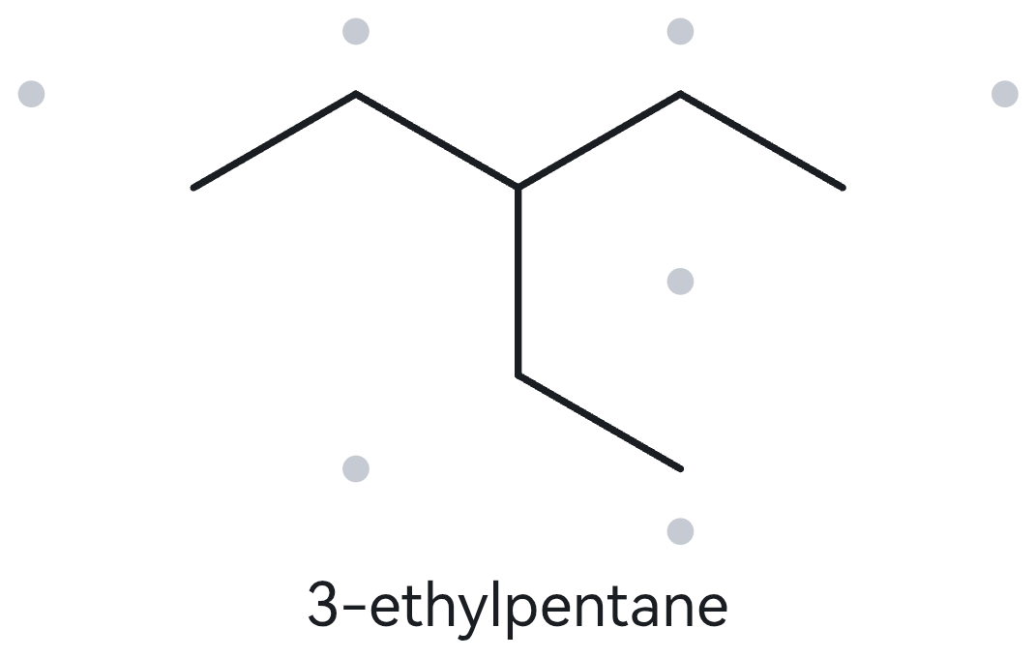
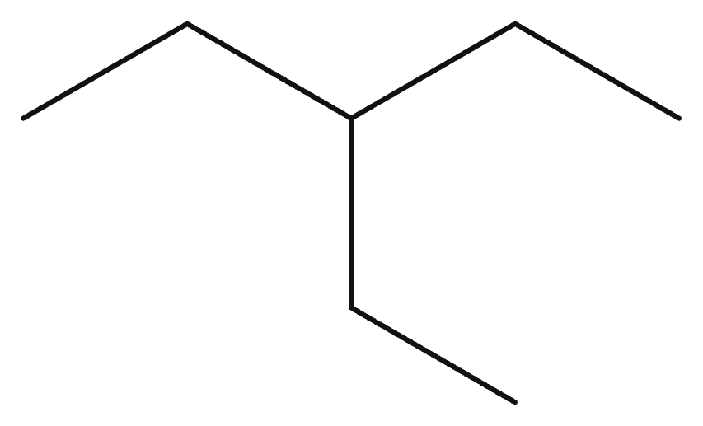
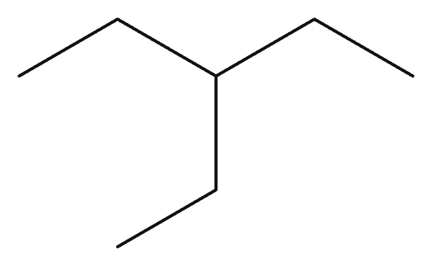
B02 FOUNDATION
Given name:
3-ethylpentane
Name → Structure
1 · NAME DECODED
2 · BOND-LINE STRUCTURE (MY DRAWING IN THE ALKANE)
Parent: root = pentane → 5 C; chain
Substituents: ethyl on C3
Expected formula: total C = 7; C7H16
3 · FORMULA CHECK
4 · BACK-CHECK (THE ALKANE)
Counted from drawing: C7H16
General formula: chain, n = 7: CₙH₂ₙ₊₂ = C7H16
Agrees with expected formula: [✓] Yes
Returned by The Alkane: 3-ethylpentane (same parent, branches and positions as the given name)
Verdict: [✓] Same as given [ ] Different
[✓] parent length matches [✓] substituent positions match [✓] formula agrees [✓] back-check recorded

Slide 13
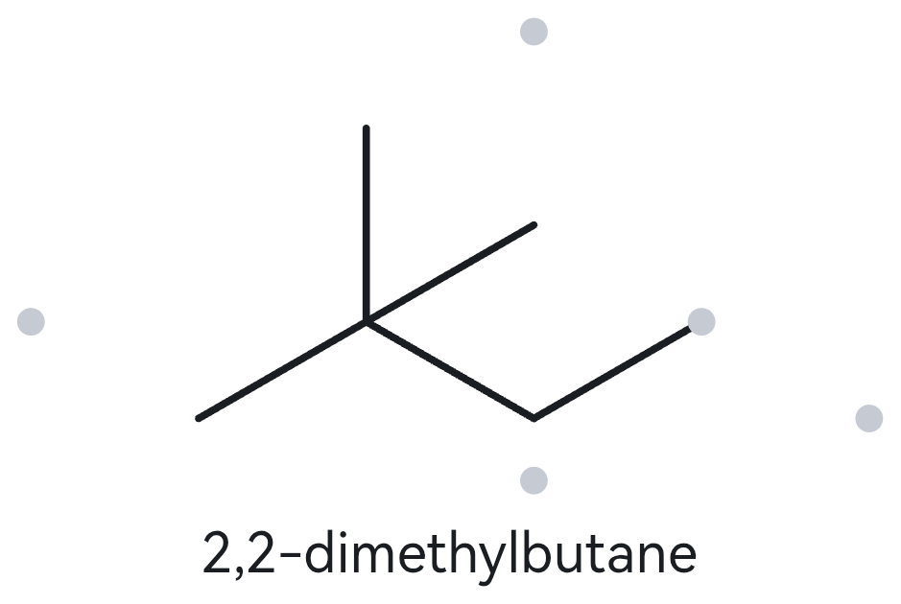
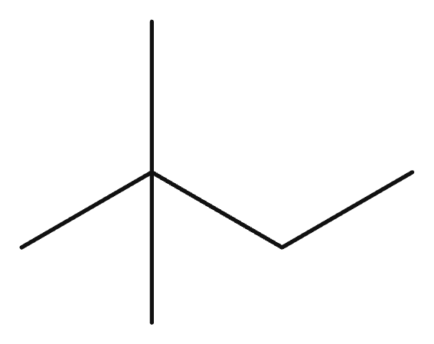
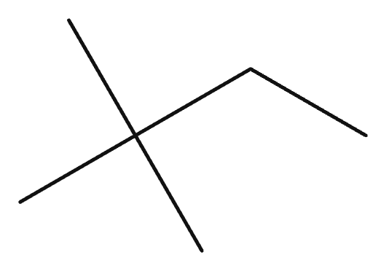
B03 FOUNDATION
Given name:
2,2-dimethylbutane
Name → Structure
1 · NAME DECODED
2 · BOND-LINE STRUCTURE (MY DRAWING IN THE ALKANE)
Parent: root = butane → 4 C; chain
Substituents: methyl on C2, methyl on C2
Expected formula: total C = 6; C6H14
3 · FORMULA CHECK
4 · BACK-CHECK (THE ALKANE)
Counted from drawing: C6H14
General formula: chain, n = 6: CₙH₂ₙ₊₂ = C6H14
Agrees with expected formula: [✓] Yes
Returned by The Alkane: 2,2-dimethylbutane (same parent, branches and positions as the given name)
Verdict: [✓] Same as given [ ] Different
[✓] parent length matches [✓] substituent positions match [✓] formula agrees [✓] back-check recorded

Slide 14
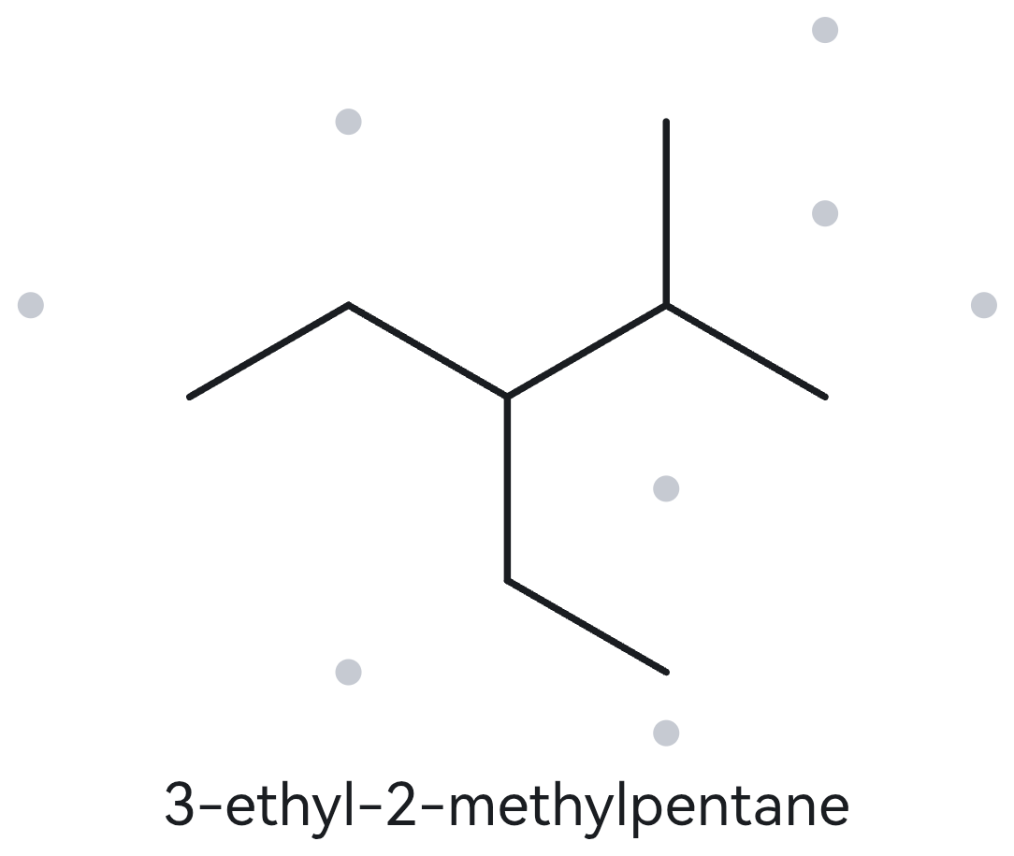
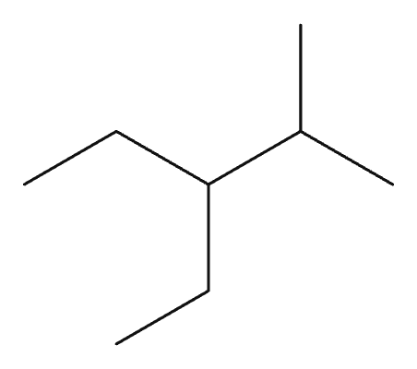
B04 DEVELOPING
Given name:
3-ethyl-2-methylpentane
Name → Structure
1 · NAME DECODED
2 · BOND-LINE STRUCTURE (MY DRAWING IN THE ALKANE)
Parent: root = pentane → 5 C; chain
Substituents: methyl on C2, ethyl on C3
Expected formula: total C = 8; C8H18
3 · FORMULA CHECK
4 · BACK-CHECK (THE ALKANE)
Counted from drawing: C8H18
General formula: chain, n = 8: CₙH₂ₙ₊₂ = C8H18
Agrees with expected formula: [✓] Yes
Returned by The Alkane: 3-ethyl-2-methylpentane (same parent, branches and positions as the given name)
Verdict: [✓] Same as given [ ] Different
[✓] parent length matches [✓] substituent positions match [✓] formula agrees [✓] back-check recorded

Slide 15
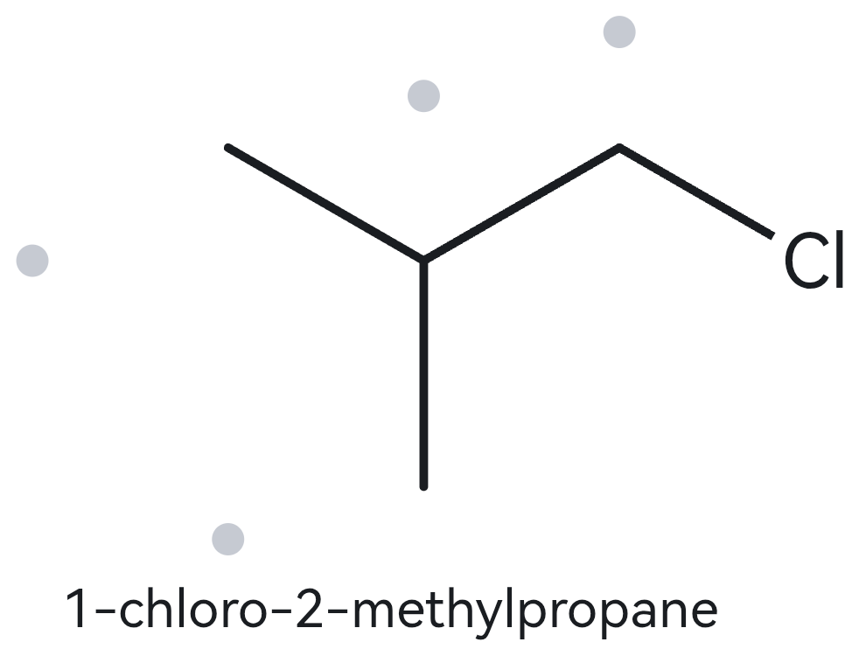
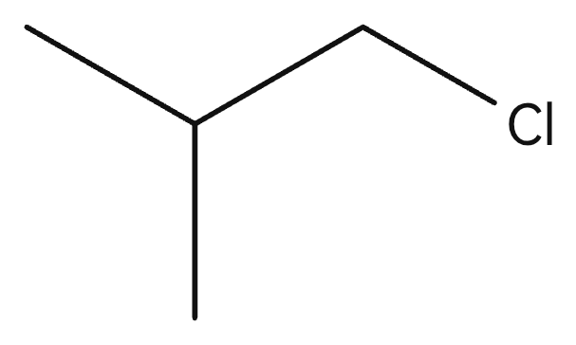
B05 DEVELOPING
Given name:
1-chloro-2-methylpropane
Name → Structure
1 · NAME DECODED
2 · BOND-LINE STRUCTURE (MY DRAWING IN THE ALKANE)
Parent: root = propane → 3 C; chain
Substituents: chloro on C1, methyl on C2
Expected formula: total C = 4; C4H9Cl (C4H10 with one H replaced by Cl.)
3 · FORMULA CHECK
4 · BACK-CHECK (THE ALKANE)
Counted from drawing: C4H9Cl
General formula: chain, n = 4: C4H10; one H replaced by Cl = C4H9Cl
Agrees with expected formula: [✓] Yes
Returned by The Alkane: 1-chloro-2-methylpropane (same parent, branches and positions as the given name)
Verdict: [✓] Same as given [ ] Different
[✓] parent length matches [✓] substituent positions match [✓] formula agrees [✓] back-check recorded

Slide 16
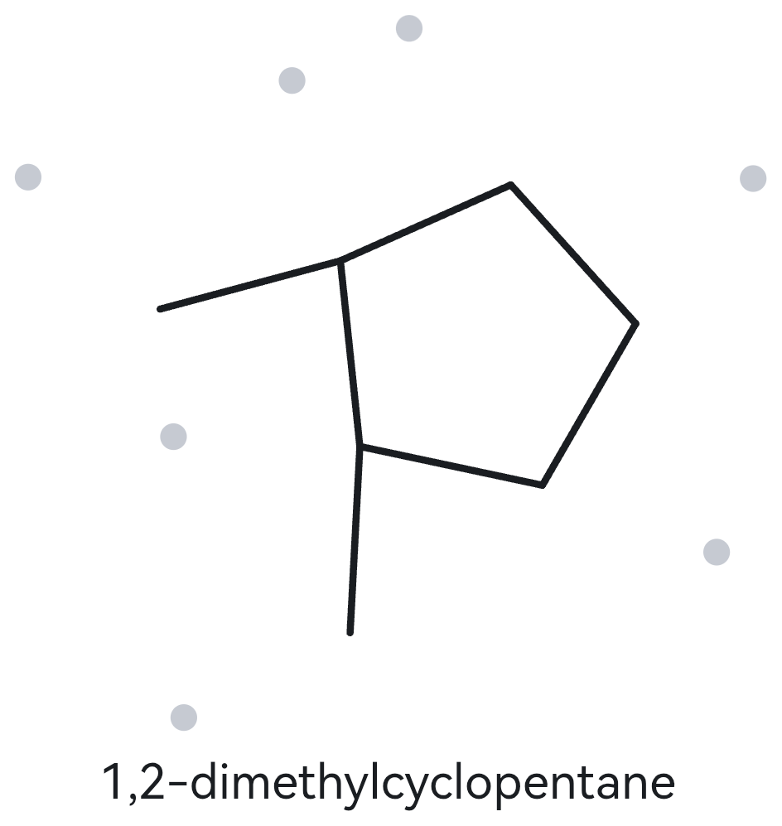
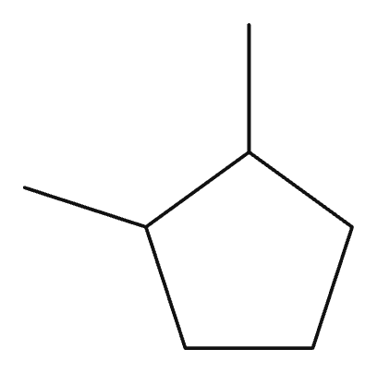

B06 DEVELOPING
Given name:
1,2-dimethylcyclopentane
Name → Structure
1 · NAME DECODED
2 · BOND-LINE STRUCTURE (MY DRAWING IN THE ALKANE)
Parent: root = cyclopentane → 5 C; ring
Substituents: methyl on C1, methyl on C2
Expected formula: total C = 7; C7H14 (The two methyls are on neighbouring ring carbons.)
3 · FORMULA CHECK
4 · BACK-CHECK (THE ALKANE)
Counted from drawing: C7H14
General formula: one ring, n = 7: CₙH₂ₙ = C7H14
Agrees with expected formula: [✓] Yes
Returned by The Alkane: 1,2-dimethylcyclopentane (same parent, branches and positions as the given name)
Verdict: [✓] Same as given [ ] Different
[✓] parent length matches [✓] substituent positions match [✓] formula agrees [✓] back-check recorded

Slide 17
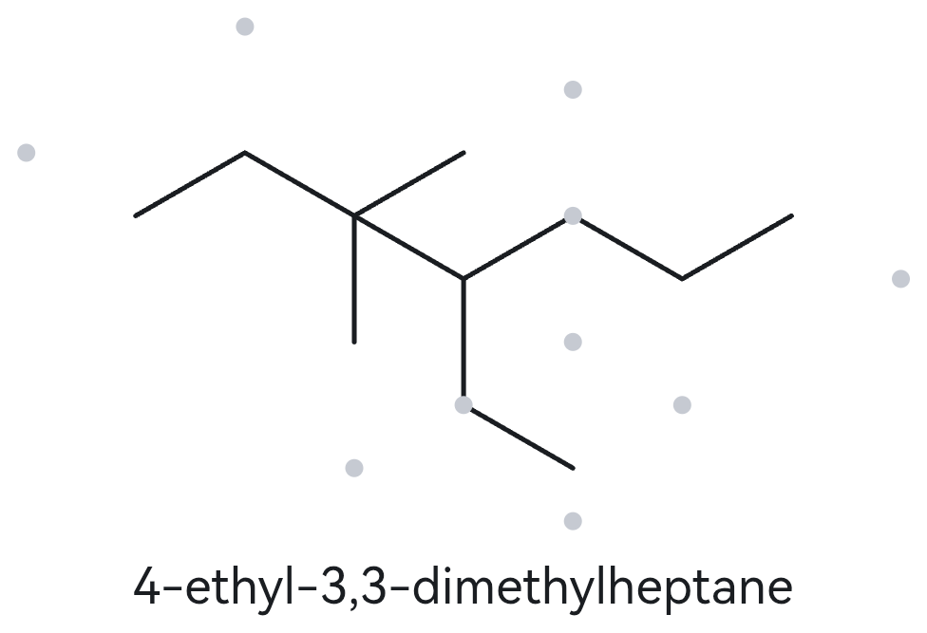
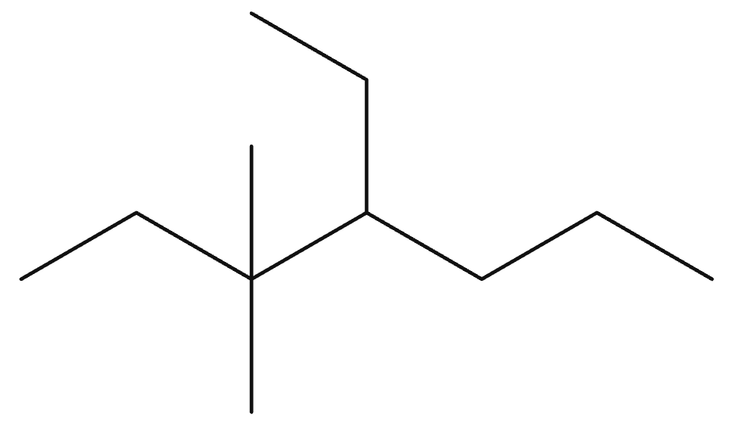
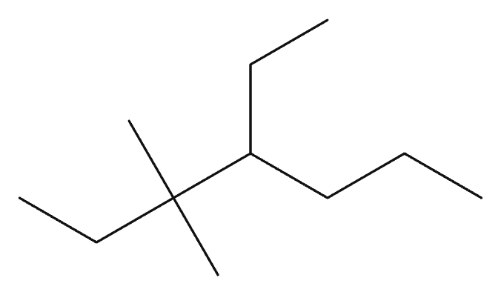
B07 DEVELOPING
Given name:
4-ethyl-3,3-dimethylheptane
Name → Structure
1 · NAME DECODED
2 · BOND-LINE STRUCTURE (MY DRAWING IN THE ALKANE)
Parent: root = heptane → 7 C; chain
Substituents: methyl on C3, methyl on C3, ethyl on C4
Expected formula: total C = 11; C11H24
3 · FORMULA CHECK
4 · BACK-CHECK (THE ALKANE)
Counted from drawing: C11H24
General formula: chain, n = 11: CₙH₂ₙ₊₂ = C11H24
Agrees with expected formula: [✓] Yes
Returned by The Alkane: 4-ethyl-3,3-dimethylheptane (same parent, branches and positions as the given name)
Verdict: [✓] Same as given [ ] Different
[✓] parent length matches [✓] substituent positions match [✓] formula agrees [✓] back-check recorded

Slide 18
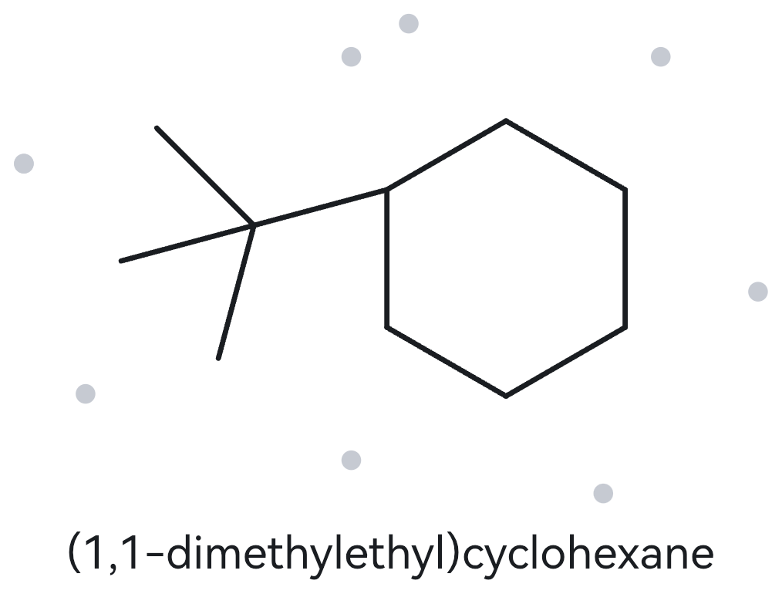
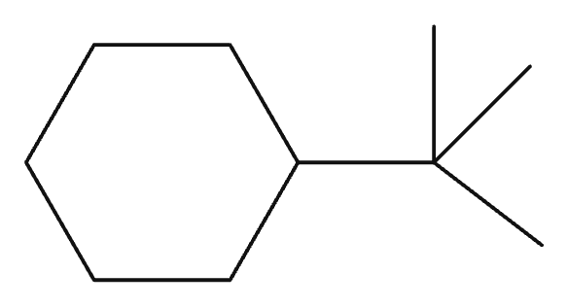

B08 CHALLENGE
Given name:
tert-butylcyclohexane
Name → Structure
1 · NAME DECODED
2 · BOND-LINE STRUCTURE (MY DRAWING IN THE ALKANE)
Parent: root = cyclohexane → 6 C; ring
Substituents: tert-butyl on C1
Expected formula: total C = 10; C10H20 (tert-butyl is a 4-carbon group: a carbon bearing three methyls. Systematic forms: (1,1-dimethylethyl) or 2-methylpropan-2-yl.)
3 · FORMULA CHECK
4 · BACK-CHECK (THE ALKANE)
Counted from drawing: C10H20
General formula: one ring, n = 10: CₙH₂ₙ = C10H20
Agrees with expected formula: [✓] Yes
Returned by The Alkane: (1,1-dimethylethyl)cyclohexane (same compound: tert-butyl is written (1,1-dimethylethyl), an accepted equivalent form, Appendix B.3)
Verdict: [ ] Same as given [✓] Different wording, same compound
[✓] parent length matches [✓] substituent positions match [✓] formula agrees [✓] back-check recorded

Slide 19



B09 CHALLENGE
Given name:
3-ethyl-1,1-dimethylcyclohexane
Name → Structure
1 · NAME DECODED
2 · BOND-LINE STRUCTURE (MY DRAWING IN THE ALKANE)
Parent: root = cyclohexane → 6 C; ring
Substituents: methyl on C1, methyl on C1, ethyl on C3
Expected formula: total C = 10; C10H20 (Both methyls are on the same ring carbon, C1.)
3 · FORMULA CHECK
4 · BACK-CHECK (THE ALKANE)
Counted from drawing: C10H20
General formula: one ring, n = 10: CₙH₂ₙ = C10H20
Agrees with expected formula: [✓] Yes
Returned by The Alkane: 3-ethyl-1,1-dimethylcyclohexane (same parent, branches and positions as the given name)
Verdict: [✓] Same as given [ ] Different
[✓] parent length matches [✓] substituent positions match [✓] formula agrees [✓] back-check recorded

Slide 20



B10 CHALLENGE
Given name:
2-ethylbutane
Name → Structure (deliberately incorrect name)
1 · NAME DECODED
2 · BOND-LINE STRUCTURE (MY DRAWING IN THE ALKANE)
Parent: root = butane → 4 C; chain
Substituents: ethyl on C2
Expected formula: total C = 6; C6H14 (Deliberately incorrect name: drawing it as written reveals that the true longest parent chain is 5 C.)
3 · FORMULA CHECK
4 · BACK-CHECK (THE ALKANE)
Counted from drawing: C6H14
General formula: chain, n = 6: CₙH₂ₙ₊₂ = C6H14
Agrees with expected formula: [✓] Yes
Returned by The Alkane: 3-methylpentane (the same compound as my drawing).
Verdict: [ ] Same as given [✓] Different
Correct name: 3-methylpentane.
Rule broken: the parent must be the longest continuous chain (5 C, not 4 C).
[✓] parent length matches [✓] substituent positions match [✓] formula agrees [✓] back-check recorded

