Slide 1
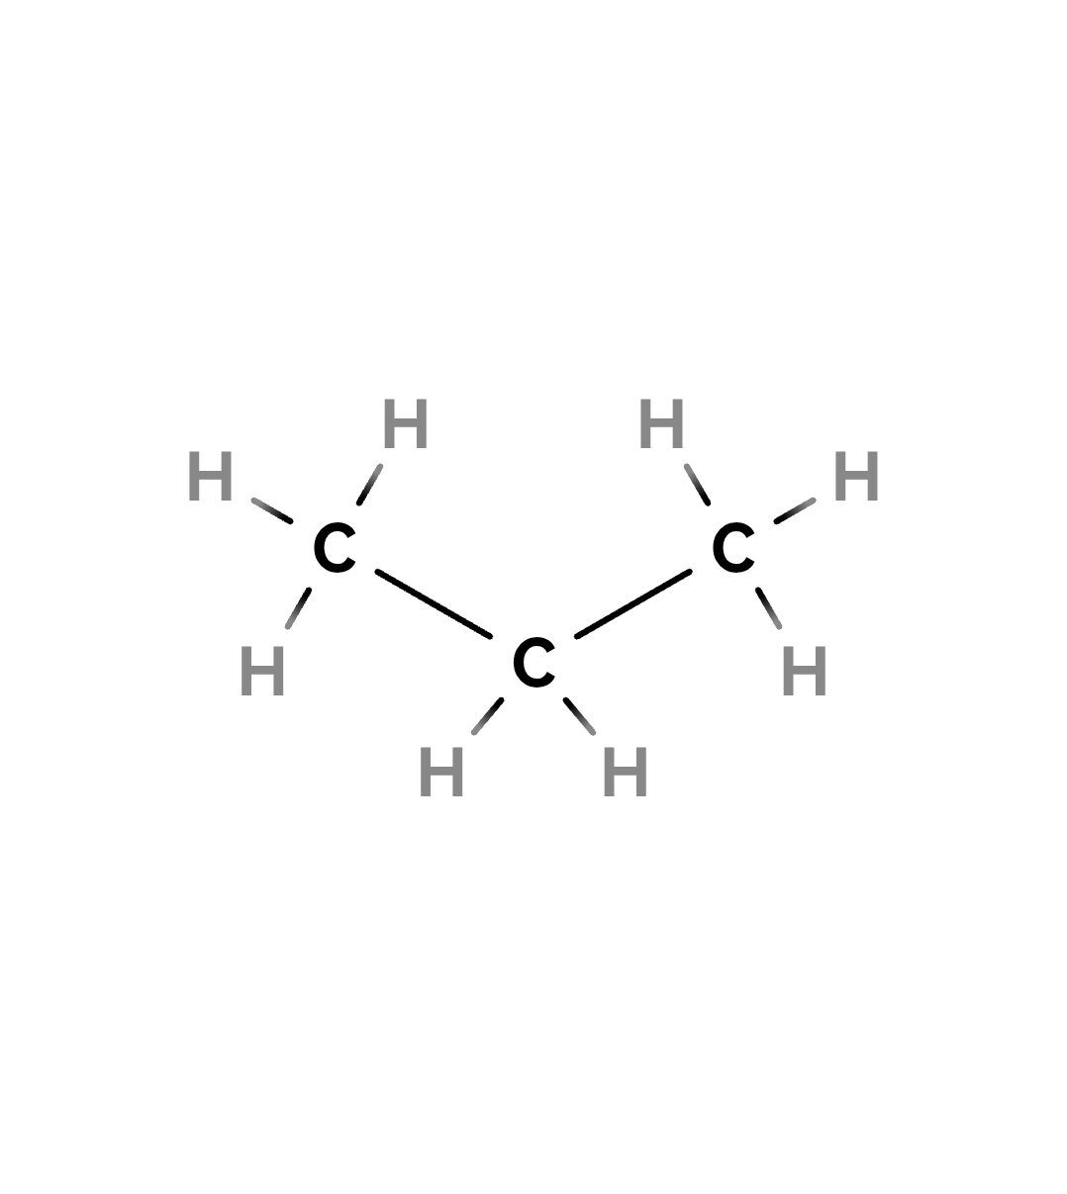

Propane
01
IUPAC: propane
C₃H₈
CH₃CH₂CH₃
C 3 | H 8
11 atoms
ChE connection: LPG and fuel processing

Slide 2
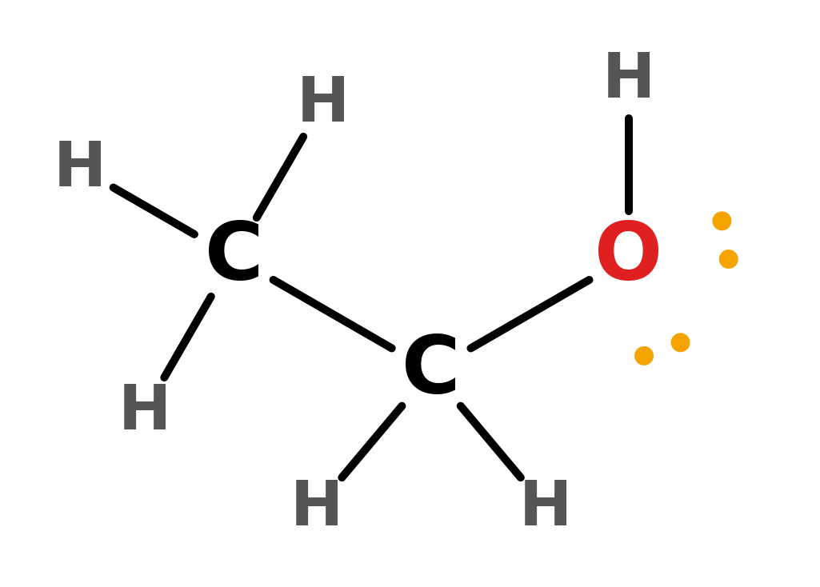
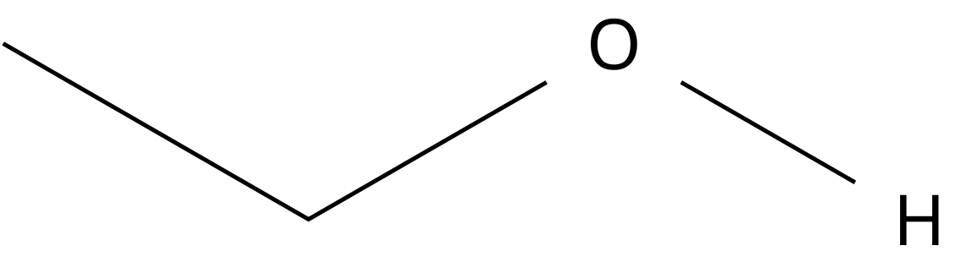
Ethanol
02
IUPAC: ethanol
C₂H₆O
CH₃CH₂OH
C 2 | H 6 | O 1
9 atoms
ChE connection: Fermentation, distillation, solvents, biofuels

Slide 3
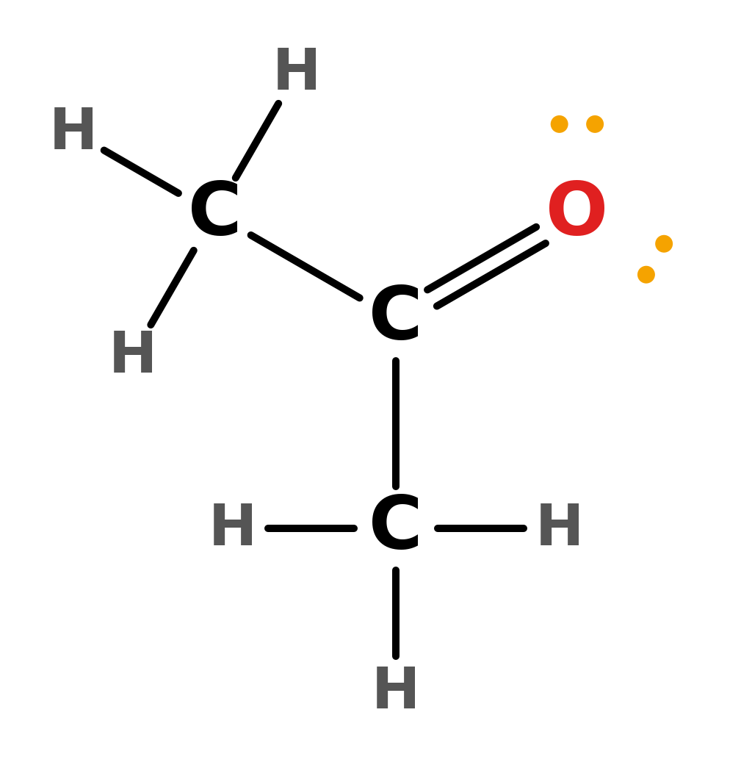
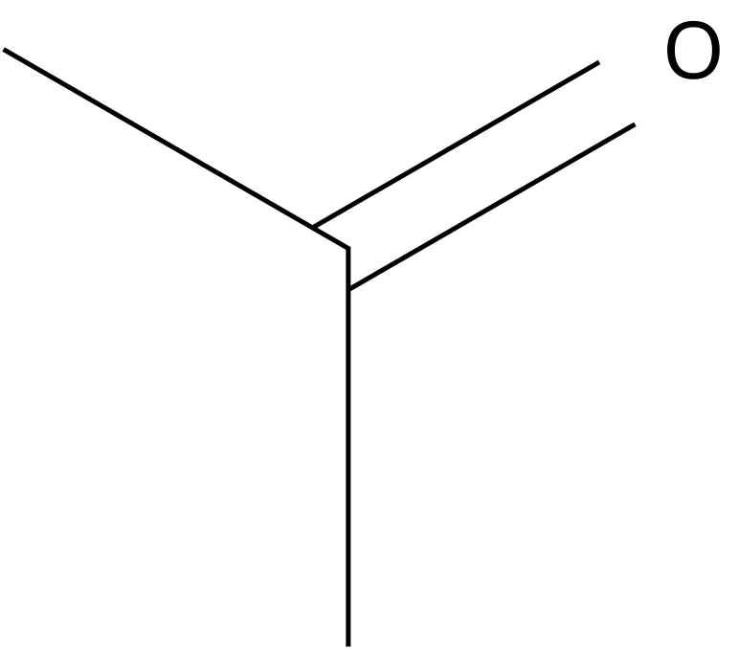
Acetone
03
IUPAC: propan-2-one
C₃H₆O
CH₃C(=O)CH₃
Also written CH₃COCH₃
C 3 | H 6 | O 1
10 atoms
ChE connection: Industrial solvent and solvent recovery

Slide 4
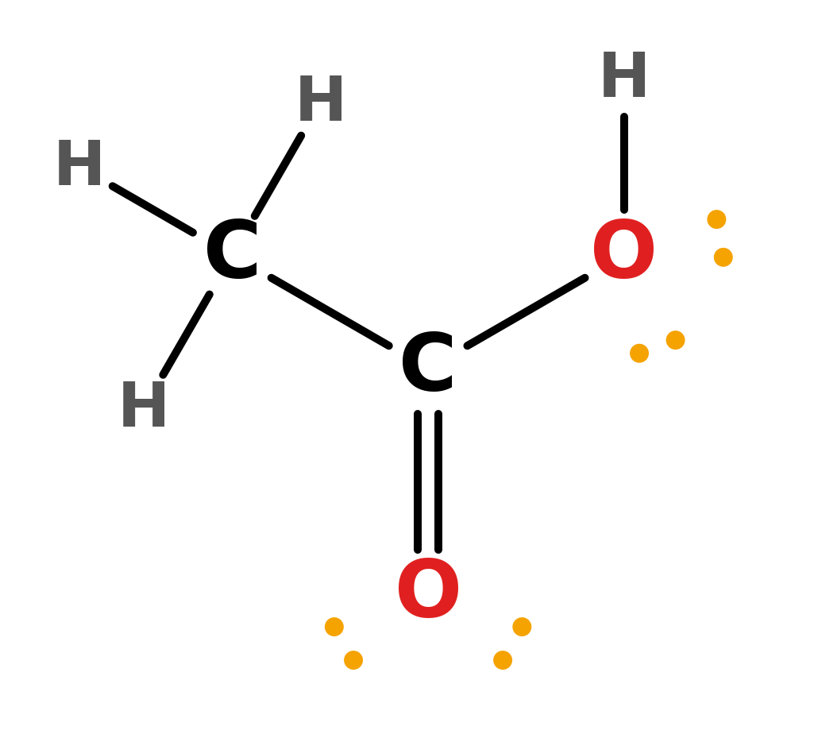
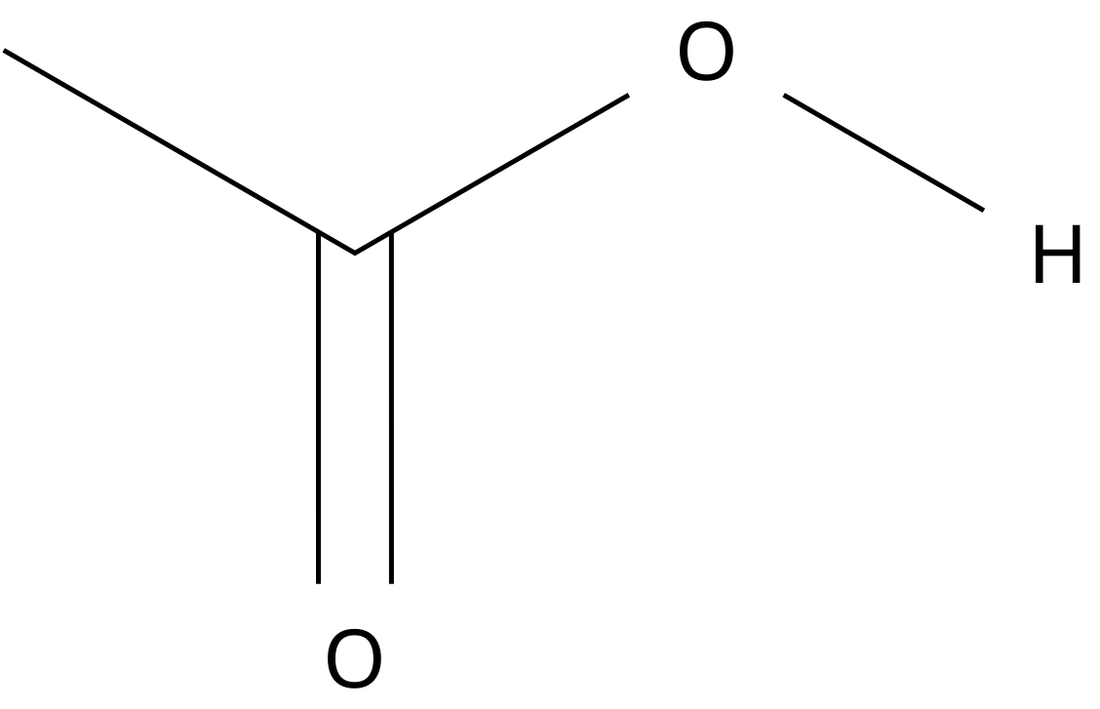
Acetic acid
04
Systematic name: ethanoic acid
C₂H₄O₂
CH₃C(=O)OH
Also written CH₃COOH
C 2 | H 4 | O 2
8 atoms
ChE connection: Chemical manufacture and acid processing

Slide 5
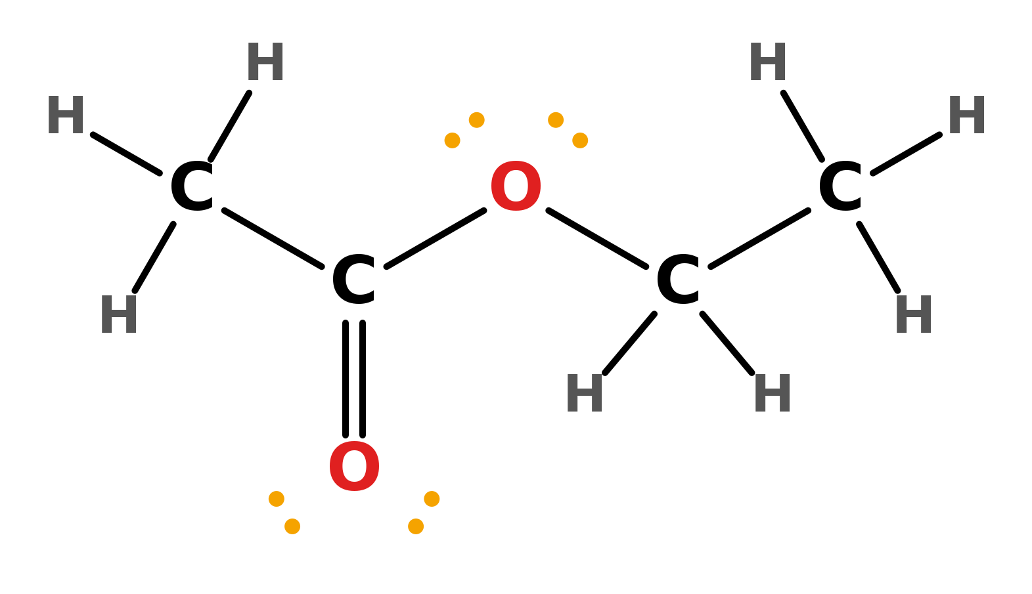
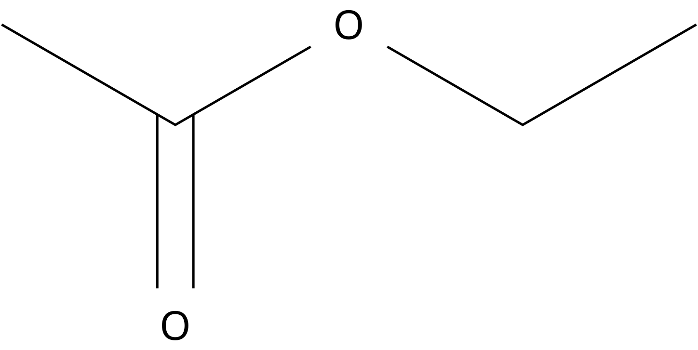
Ethyl acetate
05
Systematic name: ethyl ethanoate
C₄H₈O₂
CH₃C(=O)OCH₂CH₃
Acetyl group joined through O to the ethyl group
C 4 | H 8 | O 2
14 atoms
ChE connection: Esterification, solvents, extraction

Slide 6
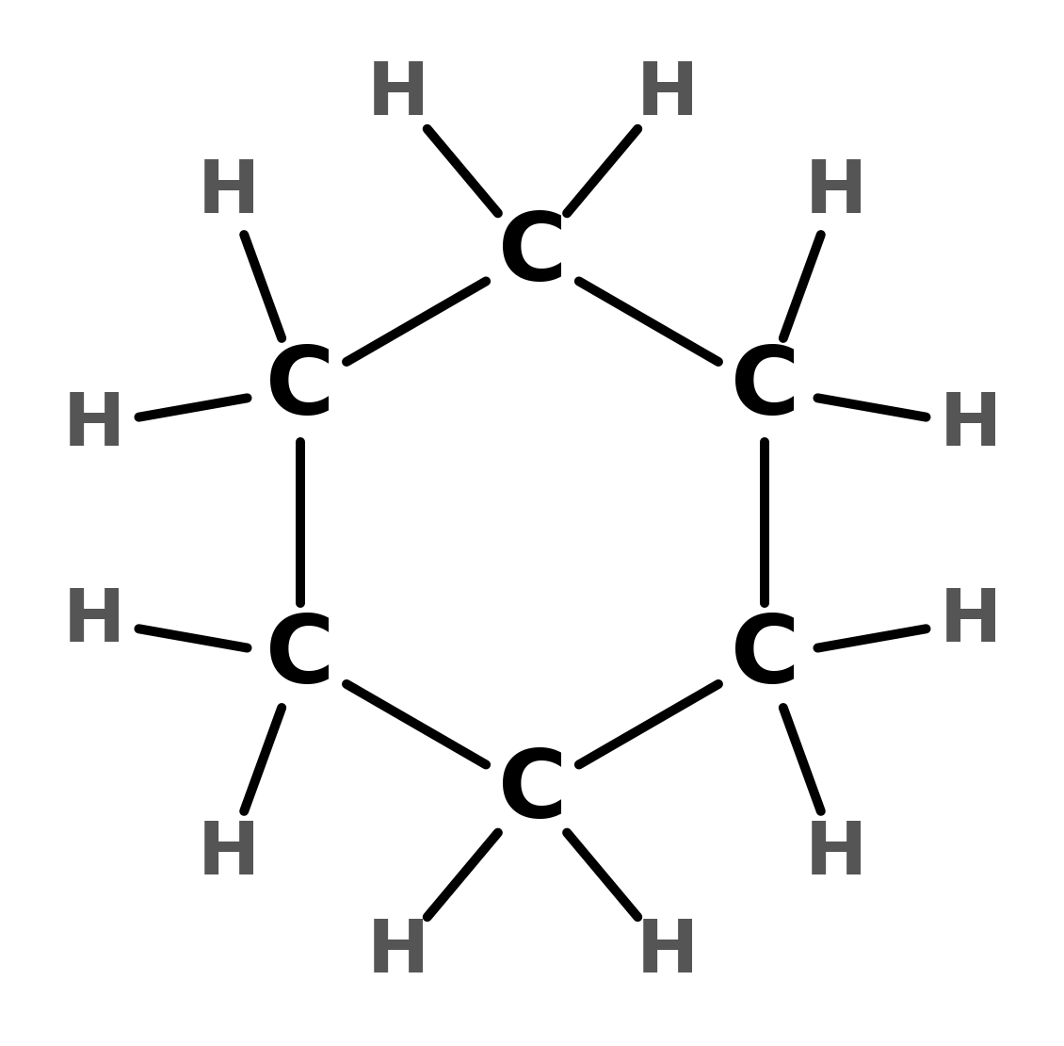

Cyclohexane
06
IUPAC: cyclohexane
C₆H₁₂
cyclo-(CH₂)₆
Cyclic: six CH₂ units joined in a ring
C 6 | H 12
18 atoms
ChE connection: Petrochemical intermediate

Slide 7
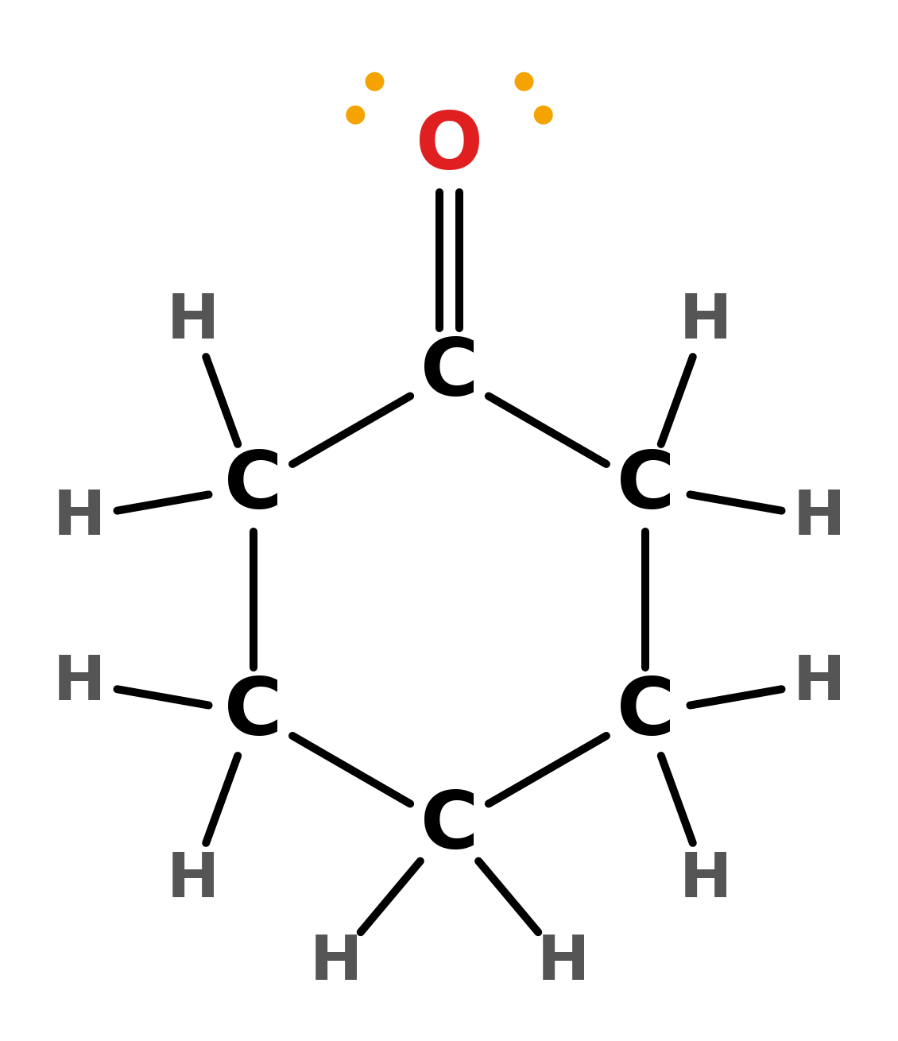
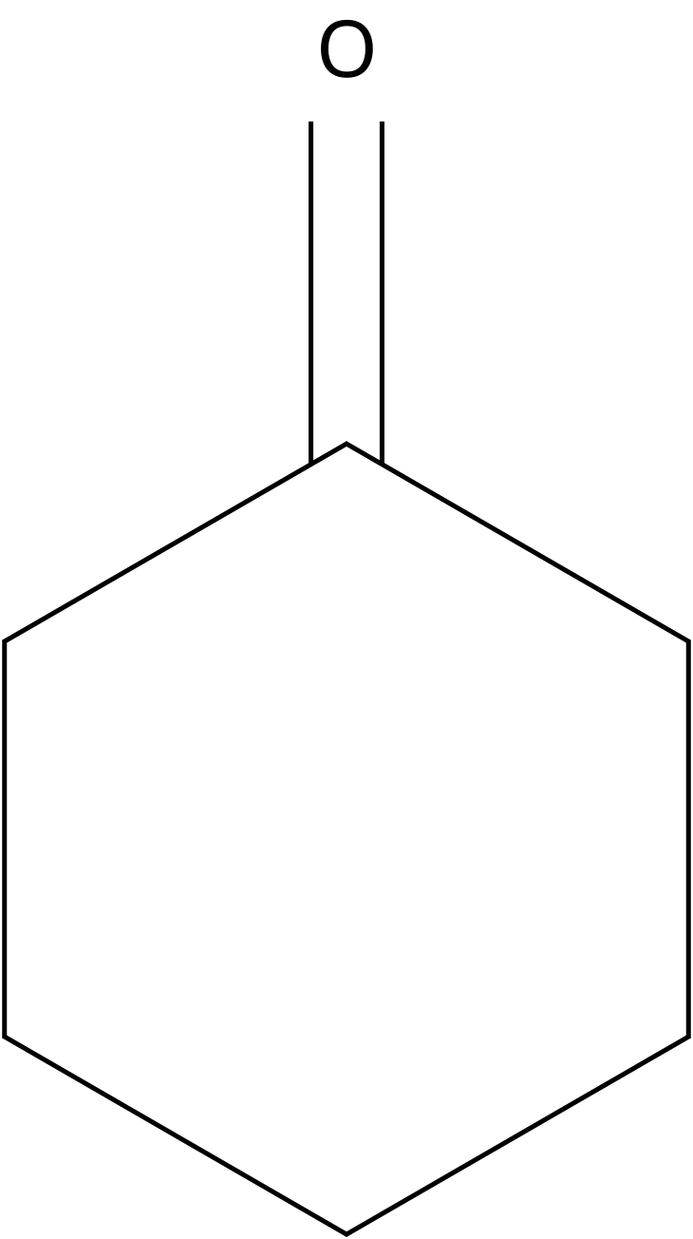
Cyclohexanone
07
IUPAC: cyclohexanone
C₆H₁₀O
cyclo-C(=O)(CH₂)₅
Cyclic: one C=O carbon and five CH₂ units in a ring
C 6 | H 10 | O 1
17 atoms
ChE connection: Intermediate in nylon-related manufacturing

Slide 8
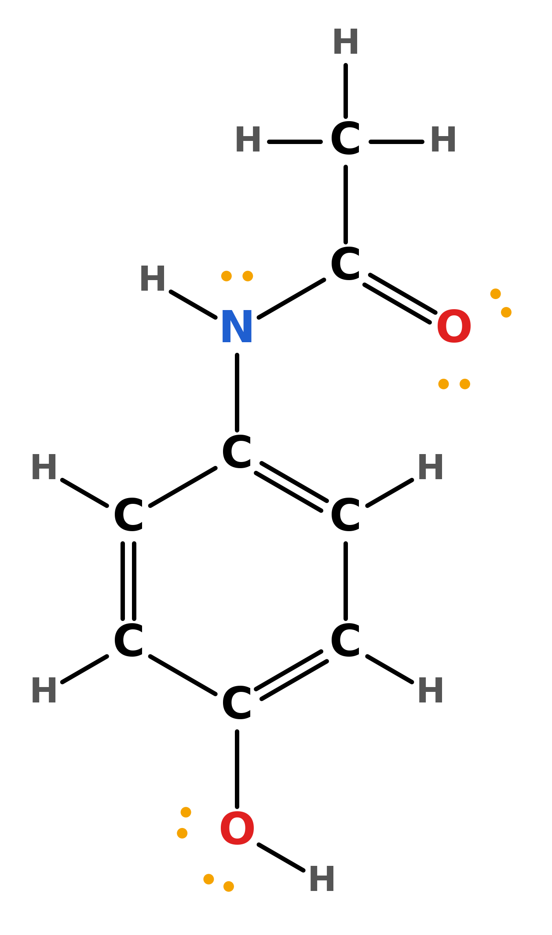
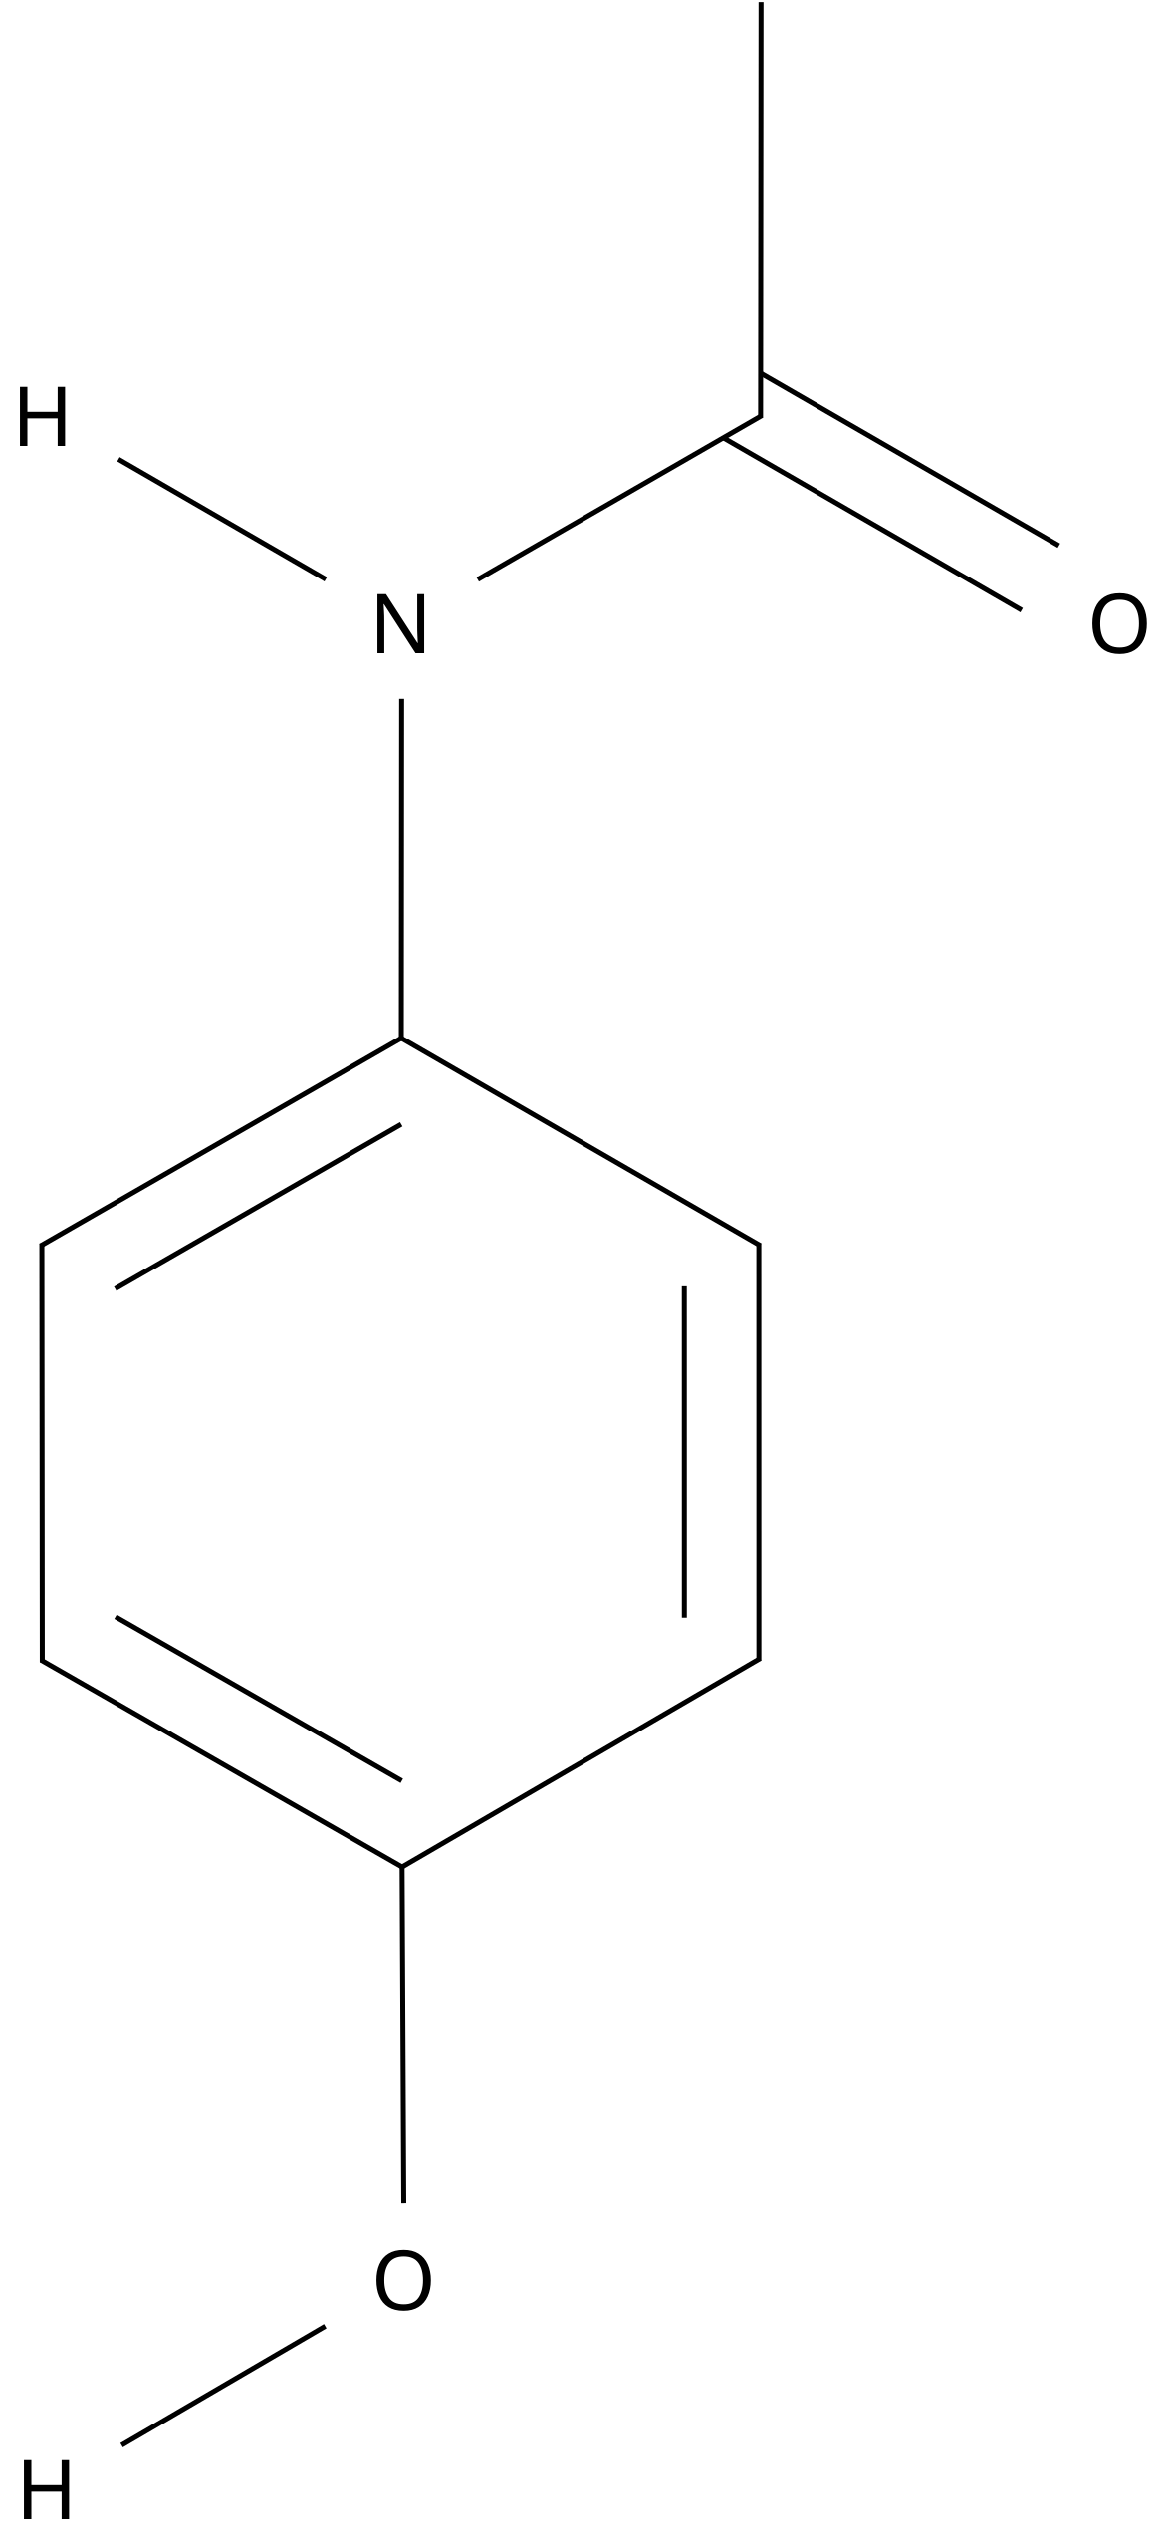
Acetaminophen (paracetamol)
08
IUPAC: N-(4-hydroxyphenyl)acetamide
C₈H₉NO₂
CH₃C(=O)NH–C₆H₄–OH
Ring substituents are para (1,4)
C 8 | H 9 | N 1 | O 2
20 atoms
ChE connection: Pharmaceutical synthesis and purification

Slide 9
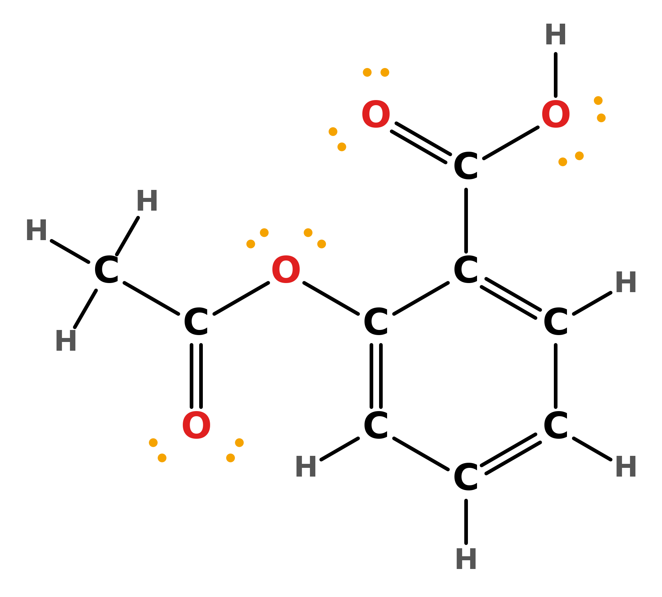
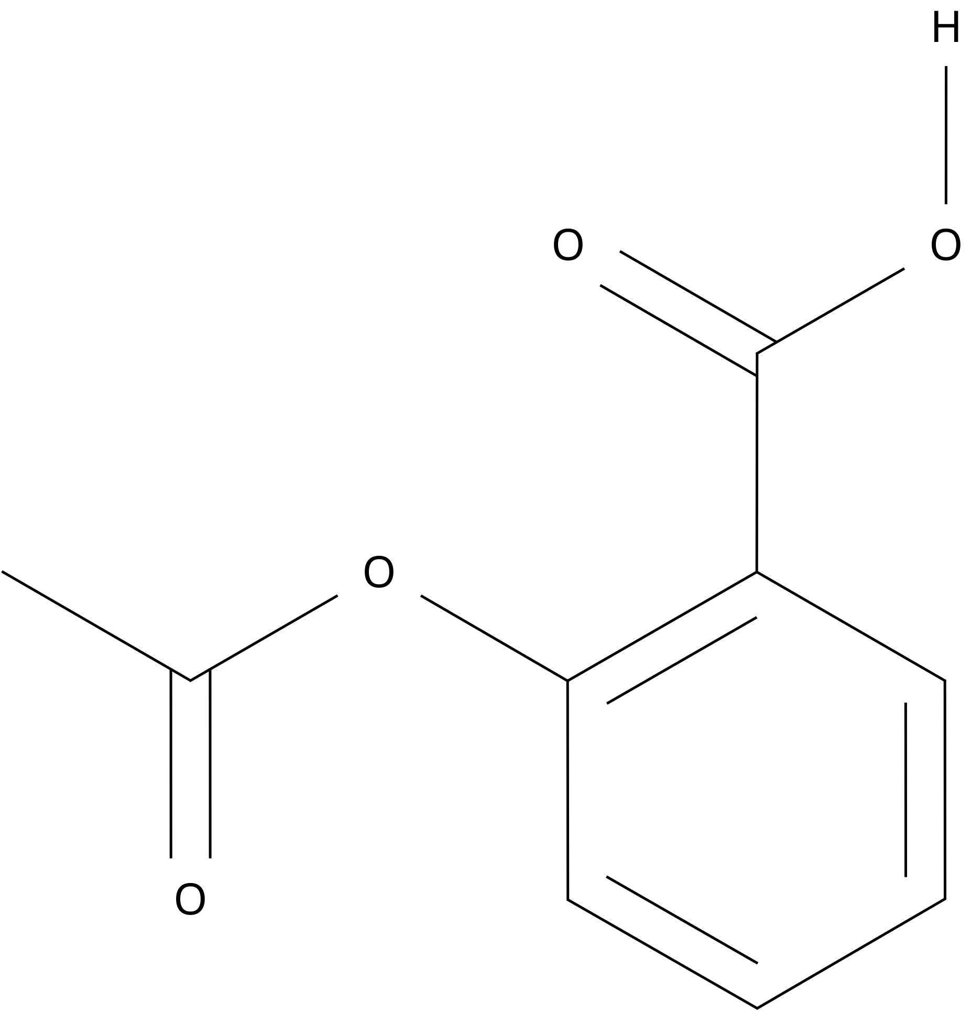
Aspirin (acetylsalicylic acid)
09
IUPAC: 2-acetyloxybenzoic acid
C₉H₈O₄
CH₃C(=O)O–C₆H₄–C(=O)OH
Ring substituents are ortho (1,2)
C 9 | H 8 | O 4
21 atoms
ChE connection: Pharmaceutical reaction and crystallization

Slide 10
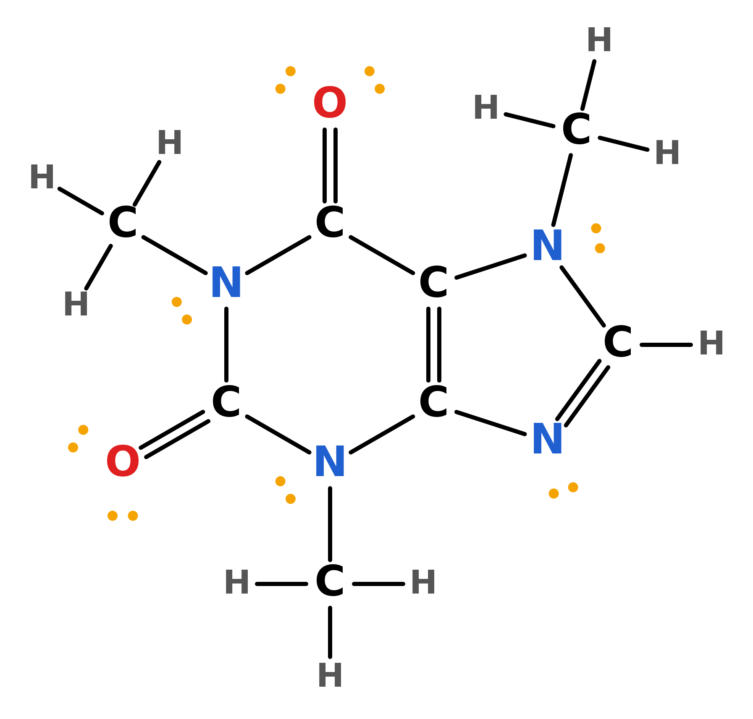
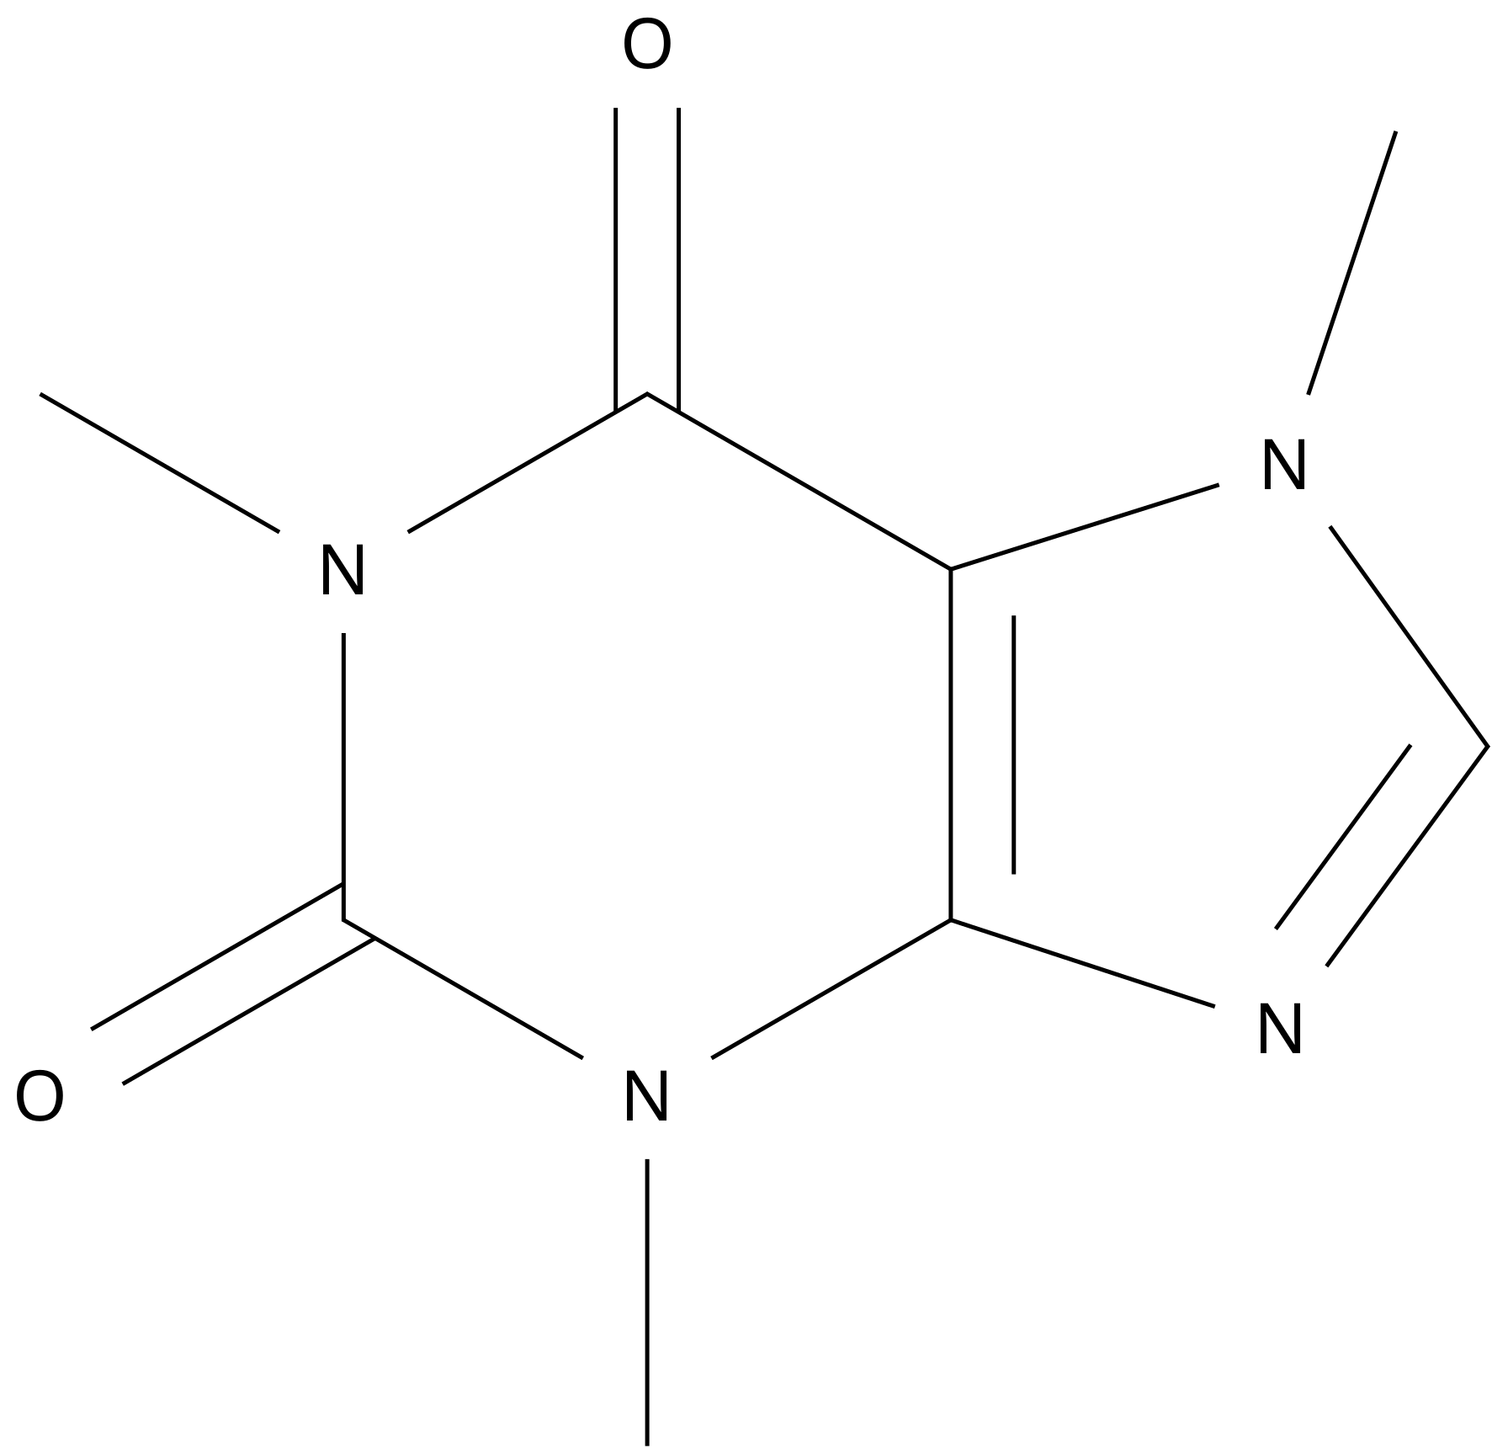
Caffeine
10
IUPAC: 1,3,7-trimethylpurine-2,6-dione
C₈H₁₀N₄O₂
CH₃N1C=NC2=C1C(=O)N(CH₃)C(=O)N2CH₃
Fused rings, so written as a connectivity string. N–CH₃ at N1, N3, N7; C=O at C2 and C6
C 8 | H 10 | N 4 | O 2
24 atoms
ChE connection: Extraction, separations, food/pharma processing

