Slide 1



Artifact: Cassandra Source Code, Feature Description across 27 versions, with Starting and Ending Version Trace Matrices
Mona Rahimi and Jane Cleland-Huang

Slide 2
Motivation
Traceability, an essential element of software development
Safety Critical Systems and rigorous Safety Analysis
Maintaining trace links is arduous, error-prone and costly
More towards adoption of agile and the big freeze problem
Ongoing analysis of the traceability coverage
Reuse the existing traceability information as the software evolves

Slide 3
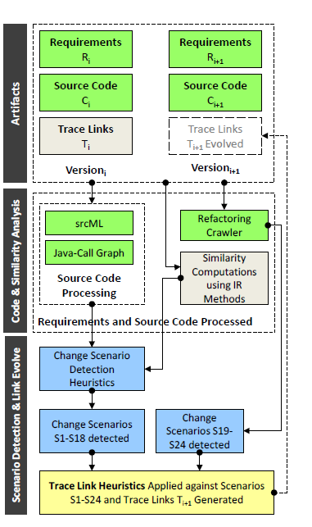
Trace Link Evolver
Trace Link Evolver(TLE): A solution to automatically evolve requirements-to-code trace links.
Detect change scenarios using 3 open source tools(srcML, java-callgraph and Refactoring Crawler), Information Retrieval techniques and finally our written scripts in Java.
Each change scenario corresponds to a set of trace link evolution heuristics.

Slide 4
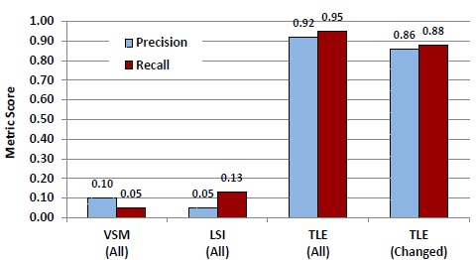
Evaluation- Open Source Project
Dataset: Apache Cassandra database system (27 sequential versions):
version 1.0.0-beta1(Sep-2011): 488 classes (86,852 LOC)
TO
version 1.2.1(Jan-2013): 702 classes (132,111 LOC)
Baseline: VSM and LSI
Metrics: Recall, Precision
Results:
Correctness: 0.88
Completeness: 0.86

Slide 5
Cassandra- 27 Version Feature-To-Code
A Detailed Explanation
Readme file
Source Code:
27 Versions:
V-start: Version 1.0.0-beta1 (Sep 2011) → 488 Classes
V-final: Version1.2.1 (Jan 2013) → 702 Classes
Also:
A Static Call Graph
Inheritance relationship
List of classes and methods
Feature Descriptions:
Manually extracted from initial- and released documentation
48 features in V-start
594 in V-final
Deltas between Versions
Added, Deleted and modified classes
Trace Links
%93 were identified directly through references to classes found in the documentation
%7 through evaluating candidate links automatically generated using the Vector Space Model

Slide 6
Scorecard
Insightful: Provides needed data to evaluate trace link evolution algorithms
Useful: To fill the need for data sets that provide multiple versions of requirements, source code and trace matrices.
Usable: Data is stored in a parsable format.

Slide 7

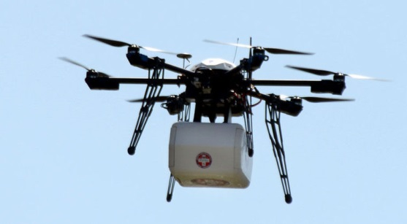
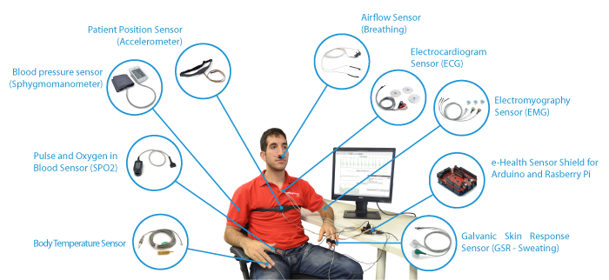
Future Direction
6
Data Collection: The Greatest Challenge!
Change Patterns: To address RQ1
Co-evolution Patterns: To address RQ2 and RQ3
Tool building: To address RQ4
Industrial Extension: Current collaborators include Siemens Positive Train Control,
Tata Consultancy Services, and the USA Food and Drug Administration.

