Slide 1



Introduction to Web Development
Chapter 4:
Logic With JavaScript and React
By Leonard Tng

Slide 2


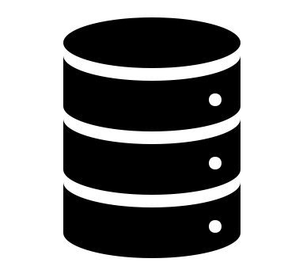
Just a Quickie on Web Development
Frontend
Backend
Database

Slide 3

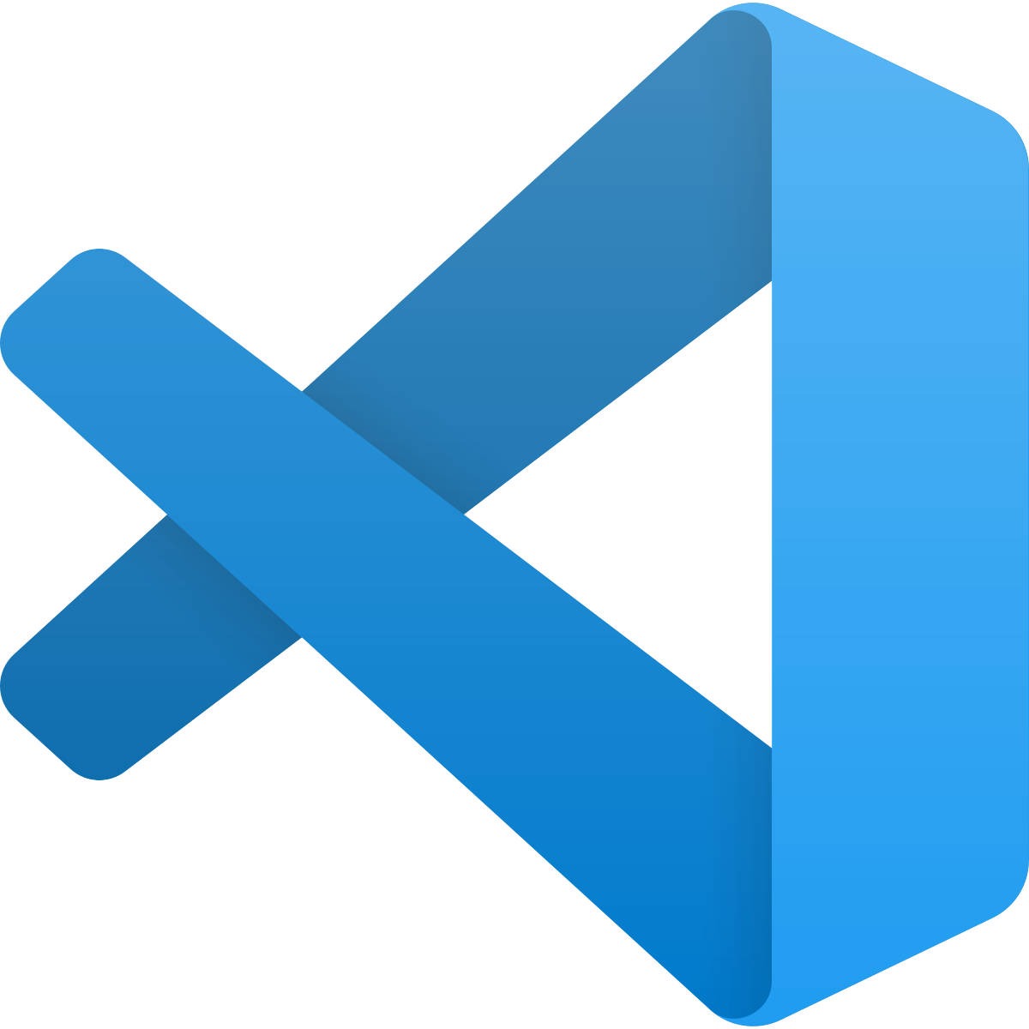
Setting Up The Development Environment
Check if you have these installed!
Node.js Version 12.18.0 and above
VScode is recommended but you may use your favorite text editor if you wish

Slide 4
What in the World is Node.js???
In technical terms, Node.js is a JavaScript runtime environment
It provides an engine to run JavaScript code
In non-technical terms, it’s a JavaScript backend

Slide 5
A little bit about JavaScript
JavaScript used to be only able to run in the browser (Frontend)
With Node.js, JavaScript can now run on your local machine as a standalone application (frontend + Backend)

Slide 6
Wait, But isn’t React for Frontend Development?

Slide 7
Node.js and React
You don’t ACTUALLY need Node.js to start a React website.
BUT Node.js makes it so much easier.

Slide 8

Node Package Manager (NPM)
Comes bundled with Node.js
Helps manage all your JavaScript packages, such as Create-React-App, a package that allows you to start React projects easily

Slide 9
In a nutshell
We need Node.js because NPM makes it easier to develop a React application
When we develop applications, we want the process to be as streamlined as possible

Slide 10
Functions in JavaScript
Functions are units of code that can be run over and over again by calling them
Let’s write our first Hello World function!

Slide 11
Why React?
Component-based
Bits of code can be reused again and again throughout the application
Development becomes really fast

Slide 12
Functional Components in React
Similarly, in React, functional components are components which can be reused over and over again!
Let’s start our React App and try it out!

Slide 13

Navigating the Command Line Interface (CLI)
cd: Changes the working directory
mkdir: Creates a new directory
ls: Lists all available paths in current directory

Slide 14
Starting a React App
Navigate to the directory which you want to store your React App
Run:

Slide 15
What Happened?
The Create-React-App Package that comes with Node.js created a template for you to build you React app on.
Open the directory in VScode and take a look!

Slide 16

Document Object Model (DOM)
The document object represents your webpage
JavaScript can alter the code here to change what is displayed in the browser

Slide 17
Hello World!

Slide 18
React Hooks
Hooks are functions that let you “hook into” React state and lifecycle features from function components.
We would be experimenting with the useState hook

Slide 19
Let’s Build!
Imagine you’re standing at the doorway to the dining hall and you have nothing better to do
You decide to be a good member of the community and keep track of the number of people going in and out of the dining hall
Because you only have 10 fingers and you’re a master at React, you decide to build a website that can help you count!

Slide 20
Counter Website!

Slide 21
Demo Code
https://github.com/leonardtng/react-workshop-demo-1

Slide 22
Challenge!
Can you implement a basic calculator with React or pure JavaScript?

