Slide 1


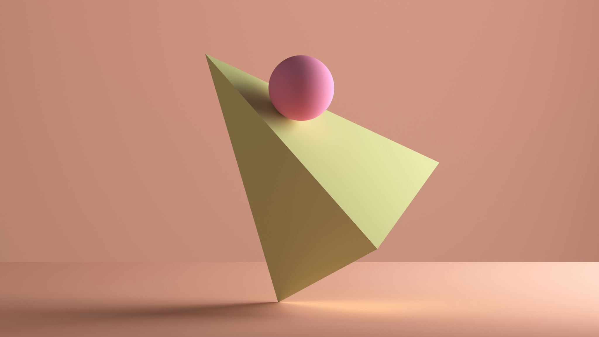
Introduction to Web Development
Chapter 5:
Component-Based Development
By Leonard Tng

Slide 2


Recap
Setting up the development environment
JavaScript Functions
React Functional Components
useState hook

Slide 3
Today’s Agenda
JavaScript Objects
React Component Props

Slide 4
JavaScript Objects
JavaScript Objects are great ways to store data
They are similar to Python Dictionaries

Slide 5
Let’s try it out in a JS script!

Slide 6
Component Props
Props are short for ”properties”, which can be information such as variables, functions, or data
Parent components pass props down to children components

