Slide 1

Project Title
Aloïs Mattei and Léonard Vaney
Systèmes Embarqués Microprogrammés
Notes:
<numéro>

Slide 2
NDS features: checklist (1/2)
ARM Processors
ARM9 is used for the keys and the two screens
ARM7 is used for the sound (activated via ARM9) and the touchscreen
Timers / Interrupts
Timer0 for the waiting time between games (FREQ_1024(1))
Timer1 for the mini-game time restriction (FREQ_1024(100))
Graphics
The main and sub engine are swapped (access to more banks)
Main screen: mode 0 with backgrounds 2 and 3 (tiled mode)
Sub screen: mode 0 with backgrounds 2 and 3 (tiled mode)
Keypad
The A button is used for the start of the game and the directional keys are used for the movement of the sprite of one mini-game (by polling)
Notes:
<numéro>

Slide 3
NDS features: checklist (2/2)
Touchscreen
One mini-game use the touch screen to keep what positions have already been pressed (by polling)
Sound
One global music that loop forever
One sound for a mini-game success and one sound for a mini-game failure
Sprites (optional)
One sprite (the balloon) that can move around with the directional keys is used for a mini-game
Notes:
<numéro>

Slide 4
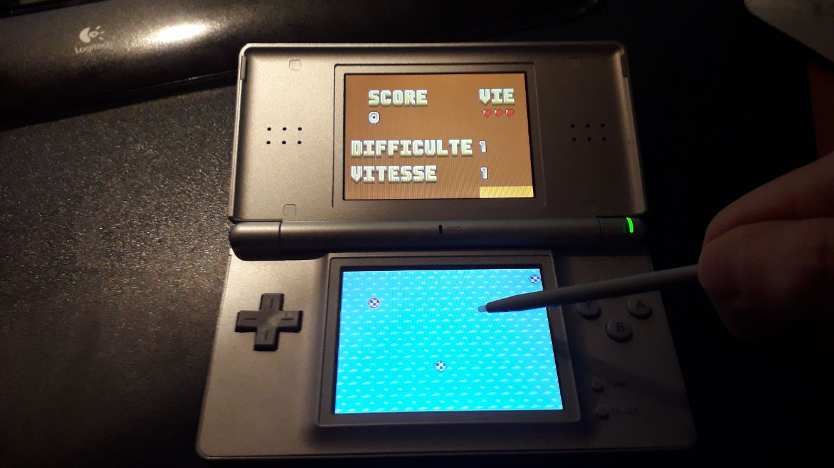
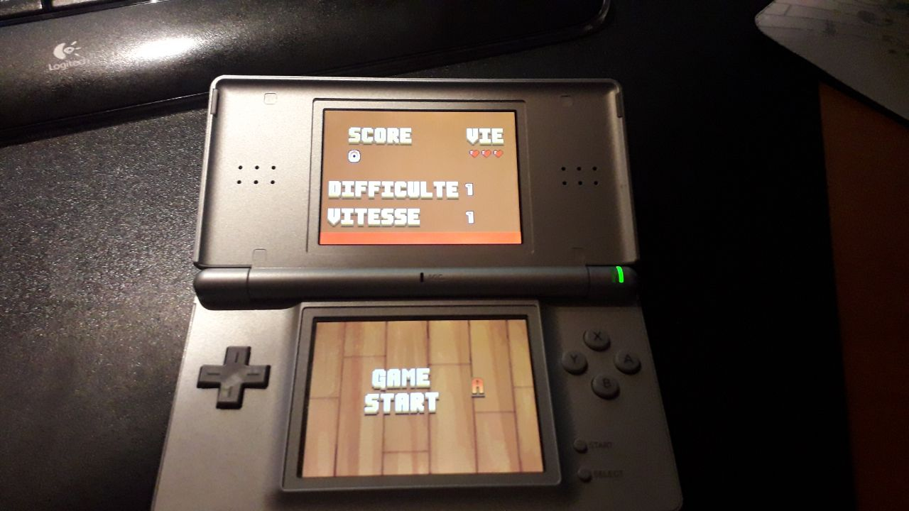
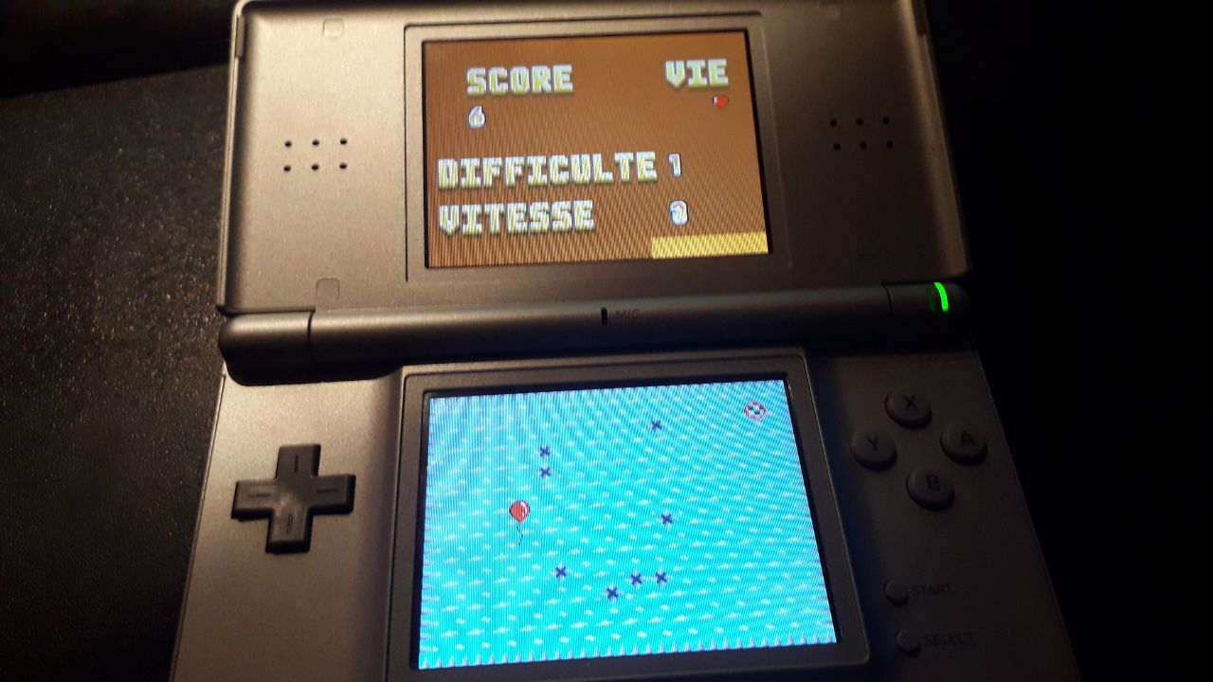
NDS project screenshot
Notes:
<numéro>

