Slide 1

VLSI Systems Design Project EECS 392
Dr. David Zaretsky
david.zaretsky@northwestern.edu

Slide 2
Design Proposals
Pretend I am your client. Sell me on your business.
Proposal requirements include:
Team Name
Team members
Project title
Project description / overview
System architecture, including IO, peripherals, memory, etc.
Block diagrams
Tasks / Gantt Chart
Members Responsibilities
Development plan
Deliverables
Project costs (man hours) – Hr Rates: $250 Grad / $200 Sr / $150 Jr

Slide 3
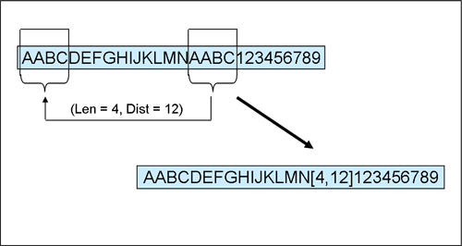
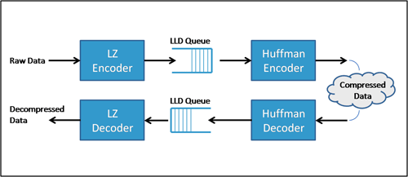
ZLIB Algorithm
ZLIB is a lossless data compression algorithm based on the LZ77 algorithm
ZLIB block consists of two parts:
A pair of Huffman code trees
The compressed data
Replaces subsequent occurrences of string pairs with pointers to the first occurrence using
Literal Length/Distance lookup table
32k window
Applications
PDF
Disk backups
Web server load balancing
Routers
FPGA Implementation
Exploit parallelism in computations
Streaming architecture
Higher throughput

Slide 4
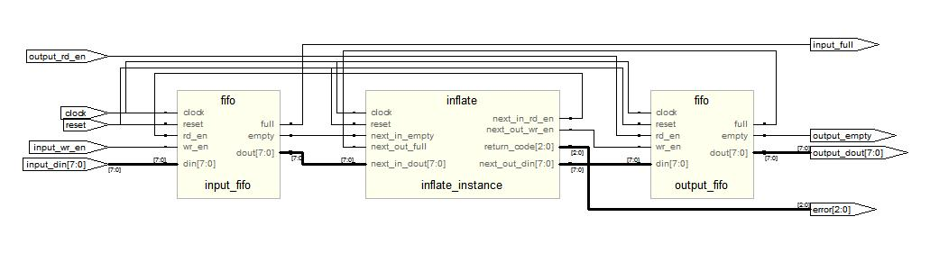
ZLIB Architecture
Software redesigned into Architecture-C model
Remove extraneous or inefficient code segments
Remove GZIP references
Eliminate all data structures
Identify inputs / outputs to functions
Variable scopes were redefined as local or static
I/O data access modified to resembled FIFO buffer

Slide 5
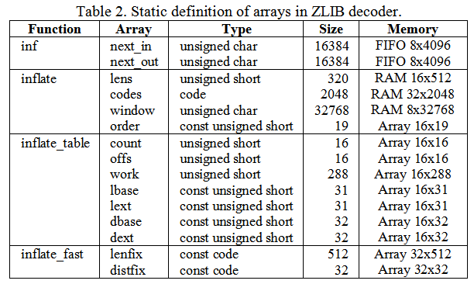
ZLIB Memory/Array Optimizations
Redesigned Window cache, implemented as 32K circular buffer
Identify input/output stream buffers
Statically redefine dynamically allocated arrays

Slide 6
Logic Synthesis Tools
Logic synthesis tools are smart... But not that smart.
They are unpredictable.
They don’t support every operation
They can’t optimize every structure
Whenever possible, build “synthesizable” structures to improve overall performance
The following are some techniques for building synthesizable VHDL.

Slide 7
Finite State Machines
In clocked processes, only asynchronous reset and clock signals should be included in the sensitivity list.
Never assign to a signal outside of the control of the rising_edge(clk) statement (or reset statement if an asynchronous reset exists)
sync_process : process( reset, clock )
begin
if ( reset = '1' ) then
state <= 0;
done <= '0';
x <= 0;
y <= 0;
z <= 0;
elsif ( rising_edge(clock) ) then
state <= next_state;
done <= done_c;
x <= x_c;
y <= y_c;
z <= z_c;
end if;
end process fir_reg_process;

Slide 8
Finite State Machines
Within a combinatorial process, all signals that are read (which can change) must be in the sensitivity list.
For a combinatorial process, never assign to a signal and read from the same signal in the same process.
Always include reset, init, and OTHERS states.
ansync_process : process(x,y,z)
begin
next_state <= state;
case ( state ) is
when 0 =>
if ( start = '1' ) then
done_c <= '0';
next_state <= 1;
else
next_state <= 0;
end if;
when 1 =>
z_c <= x + y + z;
done_c <= '1';
next_state <= 0;
when OTHERS =>
done_c <= 'X';
next_state <= 0;
end case;
end process ansync_process;

Slide 9
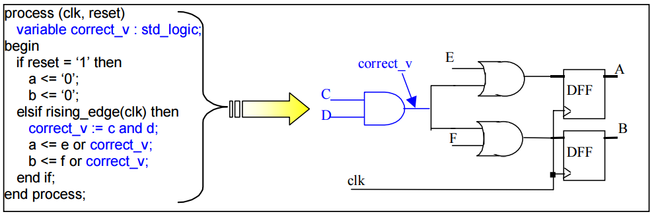
Using VHDL Variables
Variables are treated like wires
They carry combinatorial signals within a combinatorial or clocked process
In simulations, variables are updated instantaneously

Slide 10
Critical Paths
The critical path (or critical delay) affects performance
Multipliers = 5 ns
Adders = 2 ns
Critical delay = 5 ns
Multipliers = 5 ns
Adders = 2 ns
Critical delay = 14 ns

Slide 11
Software Pipelining
Overlap loop iterations to reduce the body of the loop from 3 cycles to 1 cycle.
Original Schedule
Software Pipelined Schedule
1
A
1
A
Prologue
2
B
2
B
A
3
C
3
C
B
A
4
A
4
C
B
:
Loop Body
5
B
5
C
:
:
Loop Body
:
C
:
:
:
A
n-1
A
n-1
:
B
A
n-2
B
n-2
C
B
Epilogue
n
C
n
C

Slide 12
Hardware Pipelining
Used in combination with Software Pipelining.
Pipelining multipliers will allow you to reach 250MHz+ frequencies.
a
b
*
type regbank6x64 is array(PIPE-1 downto 0) of std_logic_vector(63 downto 0);
signal prod: regbank6x64;
prod(0) <= a * b;
regbank: for i in 1 to PIPE generate begin
process (clk) begin
if (rising_edge(clk)) then
prod(i) <= prod(i-1);
end if;
end process;
end generate;
mult_out <= prod(PIPE)
Prod(1)
Prod(2)
Prod(3)
Prod(4)

Slide 13
Loop Unrolling
Using loop structures will replicate operations within the same cycle.
for i in 0 to 2 loop
y(i+1) := x(i) * y(i);
end loop;
X(0)
Y(0)
for i in 0 to 255 loop
z(i) := x(i) * y(i);
end loop;
X(1)
*
Y(1)
X(0)
Y(0)
X(1)
Y(1)
X(255)
Y(255)
*
Y(2)
X(2)
*
Z(0)
*
Z(1)
*
Z(255)
*
Y(3)

Slide 14
Building Block RAMs
Distributed block RAMs allow for better partitioning and layout of memory elements across the FPGA.
Use the GENERATE loop to build block structures.
Din[0-7]
Din[8-15]
Din[16-23]
Din[24-31]
wr_en clk
wr_en clk
wr_en clk
wr_en clk
Dout[0-7]
Dout[8-15]
Dout[16-23]
Dout[24-31]

Slide 15
Building Block RAMs
entity sramb is
generic (
constant SIZE : integer := 1024;
constant AWIDTH : integer := 10;
constant DWIDTH : integer := 32
);
port (
signal clock : in std_logic;
signal rd_addr : in std_logic_vector ((AWIDTH - 1) downto 0);
signal wr_addr : in std_logic_vector ((AWIDTH - 1) downto 0);
signal wr_en : in std_logic;
signal dout : out std_logic_vector ((DWIDTH - 1) downto 0);
signal din : in std_logic_vector ((DWIDTH - 1) downto 0)
);
end entity sramb;
architecture behavior of sramb is
type ARRAY_SLV_DWIDTH is array ( natural range <> ) of std_logic_vector ((DWIDTH - 1) downto 0);
signal mem : ARRAY_SLV_DWIDTH (0 to (SIZE - 1));
signal read_addr : std_logic_vector ((AWIDTH - 1) downto 0) := std_logic_vector(resize(to_unsigned(0, 2), AWIDTH));
begin
sramb_write_process : process (clock)
begin
if ( rising_edge(clock) ) then
if ( wr_en = '1' ) then
mem(to_integer(to_01(unsigned(wr_addr)))) <= std_logic_vector(to_01(unsigned(din)));
end if;
read_addr <= rd_addr;
end if;
end process sramb_write_process;
dout <= std_logic_vector(to_01(unsigned( mem(to_integer(to_01(unsigned(rd_addr)))))));
end architecture behavior;

Slide 16
Building Block RAMs
entity sram is
generic (
constant SIZE : integer := 1024;
constant DWIDTH : integer := 32;
constant AWIDTH : integer := 10
);
port (
signal clock : in std_logic;
signal rd_addr : in std_logic_vector ((AWIDTH - 1) downto 0);
signal wr_addr : in std_logic_vector ((AWIDTH - 1) downto 0);
signal wr_en : in std_logic_vector (((DWIDTH / 8) - 1) downto 0);
signal dout : out std_logic_vector ((DWIDTH - 1) downto 0);
signal din : in std_logic_vector ((DWIDTH - 1) downto 0)
);
end entity sram;
architecture behavior of sram is
begin
sram_block : for i in 0 to (NUM_BYTES - 1) generate
sramb_instance : component sramb
generic map (
SRAMB_BUFFER_SIZE => SRAMB_BUFFER_SIZE,
SRAMB_ADDR_WIDTH => SRAMB_ADDR_WIDTH,
SRAMB_DATA_WIDTH => 8
)
port map (
clock => clock,
din => din(((8 * (i + 1)) - 1) downto (8 * i)),
rd_addr => rd_addr((AWIDTH - 1) downto (AWIDTH - SRAMB_ADDR_WIDTH)),
wr_addr => wr_addr((AWIDTH - 1) downto (AWIDTH - SRAMB_ADDR_WIDTH)),
wr_en => wr_en(i),
dout => dout(((8 * (i + 1)) - 1) downto (8 * i))
);
end generate sram_block;
end architecture behavior;

Slide 17
FIFO Architectures
FIFOs provide the glue-logic for streaming architectures
Allow data to pass between different time domains
Single-cycle read/write – data is instantaneously available
If not built correctly, timing issues may emerge
entity fifo is
generic (
constant DATA_WIDTH : integer := 32;
constant BUFFER_SIZE : integer := 32
);
port (
signal rd_clk : in std_logic;
signal wr_clk : in std_logic;
signal reset : in std_logic;
signal rd_en : in std_logic;
signal wr_en : in std_logic;
signal din : in std_logic_vector ((DATA_WIDTH - 1) downto 0);
signal dout : out std_logic_vector ((DATA_WIDTH - 1) downto 0);
signal full : out std_logic;
signal empty : out std_logic
);
end entity fifo;
when 1 =>
if ( full = '0' ) then
wr_en <= '1';
din <= data_in;
next_state <= 2;
end if;
when 2 =>
if ( empty = '0' ) then
rd_en <= '1';
data_out <= dout;
next_state <= 3;
end if;
wr_clk
wr_en
din
full
rd_clk
rd_en
dout
empty
FIFO

Slide 18
FIFO Write
p_write_buffer : process (wr_clk) begin
if ( rising_edge(wr_clk) ) then
if ( (wr_en = '1') and (full_t = '0') ) then
fifo_buf(to_integer(unsigned(write_addr((ADDR_SIZE - 2) downto 0)))) <= din;
end if;
end if;
end process p_write_buffer;
p_write_addr : process(wr_clk, reset) begin
if ( reset = '1' ) then
write_addr <= std_logic_vector(resize(to_unsigned(0, 2), ADDR_SIZE));
elsif ( rising_edge(wr_clk) ) then
write_addr <= write_addr_t;
end if;
end process p_write_addr;
full_t <= if_cond((unsigned(write_addr((ADDR_SIZE - 2) downto 0)) = unsigned(read_addr((ADDR_SIZE - 2) downto 0))) and (write_addr(ADDR_SIZE - 1) /= read_addr(ADDR_SIZE - 1)), '1', '0');
write_addr_t <= if_cond((wr_en = '1') and (full_t = '0'), std_logic_vector(unsigned(write_addr) + resize(to_unsigned(1, 2), ADDR_SIZE)), write_addr);

Slide 19
FIFO Read
p_read_buffer : process( rd_clk) begin
if ( rising_edge(rd_clk) ) then
dout <= to01(fifo_buf(to_integer(unsigned(read_addr_t((ADDR_SIZE - 2) downto 0)))));
end if;
end process p_read_buffer;
p_read_addr : process ( rd_clk, reset ) begin
if ( reset = '1' ) then
read_addr <= std_logic_vector(resize(to_unsigned(0, 2), ADDR_SIZE));
elsif ( rising_edge(rd_clk) ) then
read_addr <= read_addr_t;
end if;
end process p_read_addr;
p_empty : process ( rd_clk, reset) begin
if ( reset = '1' ) then
empty <= '1';
elsif ( rising_edge(rd_clk) ) then
empty <= if_cond(unsigned(write_addr) = unsigned(read_addr_t), '1', '0');
end if;
end process p_empty;
empty_t <= if_cond(unsigned(write_addr) = unsigned(read_addr), '1', '0');
read_addr_t <= if_cond((rd_en = '1') and (empty_t = '0'), std_logic_vector(unsigned(read_addr) + resize(to_unsigned(1, 2), ADDR_SIZE)), read_addr);

Slide 20
Reminders
Build your team
Split into groups of 3-4
Create your group on Canvas
Select a project
I have posted some architecture-C models on Canvas
Make sure you feel confident you can finish the project on time
Begin preparing your proposal
Gantt chart
Who is doing what work
System / Functional design architecture
Submit your proposals by next Tue.

