Slide 1
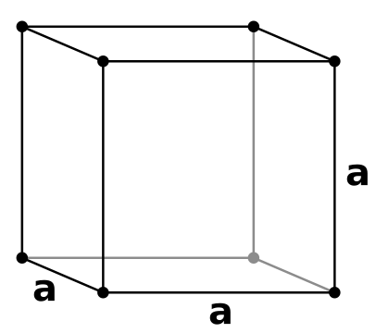
CUBIC
Qian HE (Steve)
CS 577 – Prof. Bob Kinicki

Slide 2
Agenda
Brief Introduction of CUBIC
Prehistory of CUBIC
Standard TCP
BIC
CUBIC
Conclusion

Slide 3
Brief Introduction
CUBIC is a less aggressive and more systematic derivative of BIC, in which the window is a cubic function of time since the last congestion event, with the inflection point set to the window prior to the event.

Slide 4
Why do we need CUBIC-TCP?
Compares to:
Standard TCP
BIC-TCP

Slide 5
Standard TCP
Underutilization of the bandwidth in High-Speed Network
Cannot fully utilize the huge capacity of high-speed networks!
NS-2 Simulation (100 sec)
Link Capacity = 155Mbps, 622Mbps, 2.5Gbps, 5Gbps, 10Gbps,
Drop-Tail Routers, 0.1BDP Buffer
5 TCP Connections, 100ms RTT, 1000-Byte Packet Size
Presentation: "Congestion Control on High-Speed Networks”, Injong Rhee, Lisong Xu, Slide 6

Slide 6
Standard TCP
Low window size resilience to packet loss in High-Speed Network
1.4 hours
1.4 hours
1.4 hours
Packet loss
Packet loss
Packet loss
Packet loss
TCP
cwnd
100,000
10Gbps
50,000
Slow Increase
cwnd = cwnd + 1
Fast Decrease
cwnd = cwnd * 0.5
5Gbps
Slow start
Congestion avoidance
Time (RTT)
Presentation: "Congestion Control on High-Speed Networks”, Injong Rhee, Lisong Xu, Slide 7

Slide 7
Why BIC?
Existing schemes have a severe RTT unfairness problem
RTT unfairness for high-speed networks occurs distinctly with drop tail routers for flows with large congestion windows where packet loss can be highly synchronized.

Slide 8
BIC
“Binary Increase Congestion Control (BIC) for Fast Long-Distance Networks”, Lisong Xu, Khaled Harfoush, and Injong Rhee, IEEE INFOCOM 2004

Slide 9
Goals of BIC
Scalability: BIC can scale its bandwidth share to 10 Gbps around 3.5e-8 loss rates (comparable to HSTCP which reaches 10Gbps at 1e-7).
RTT fairness: for large windows, BIC’s RTT unfairness is proportional to the inverse square of the RTT ratio as in AIMD.
TCP friendliness: BIC achieves bounded TCP fairness for all window sizes. Around high loss rates where TCP performs well, its TCP friendliness is comparable to STCP’s.
Fairness and convergence: compared to HSTCP and STCP, BIC achieves better bandwidth fairness over both short and long time scales, and faster convergence to a fair bandwidth share.

Slide 10
BIC Algorithm
If cwnd < low_window, normal TCP:
ACK received
cwnd = cwnd + 1
Enter recovery
cwnd = cwnd * 0.5
Else, BIC

Slide 11
BIC Algorithm
ACK received
If cwnd < Wmax
cwnd += (Wmax – cwnd) / 2
Else
cwnd += cwnd - Wmax
Recovery
If cwnd < Wmax
Wmax = cwnd * (1 – ß / 2)
Else
Wmax = cwnd
cwnd *= 1 - ß
Smin <= cwnd
&&
cwnd <=Smax

Slide 12
BIC with no lost
Smin
Smax

Slide 13
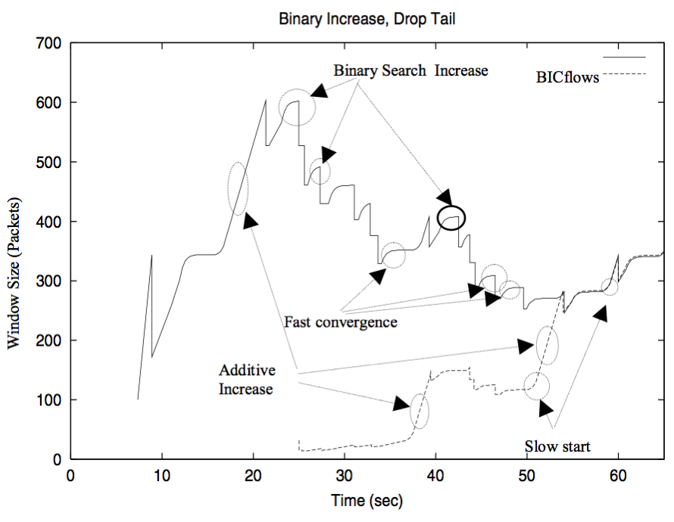
"Binary Increase Congestion Control (BIC) for Fast Long-Distance Networks", Lisong Xu, Khaled Harfoush, and Injong Rhee

Slide 14
Why CUBIC?
Window control of BIC is so complex!
BIC’s growth function can still be too aggressive for TCP, especially under short RTT or low speed networks.
BIC still has room for improving TCP-friendliness and RTT-fairness!

Slide 15
CUBIC Algorithm
ACK received
C is a scaling factor
t is the elapsed time from the last window reduction
Wmax is the window size just before the last window reduction
K is updated at the time of last lost event
Recovery
Update K with:
Update Wmax with:
β is a constant multiplication decrease factor
cwnd cannot be less than
as to keep the growth rate the same as standard TCP in short RTT networks.

Slide 16
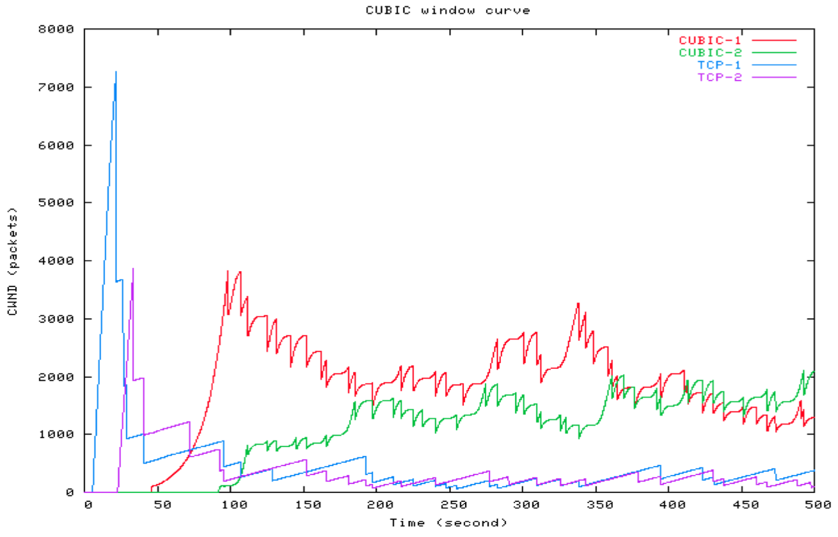
CUBIC window curves with competing flows (NS simulation in a network with 500Mbps and 100ms RTT), C = 0.4, β = 0.8.

Slide 17
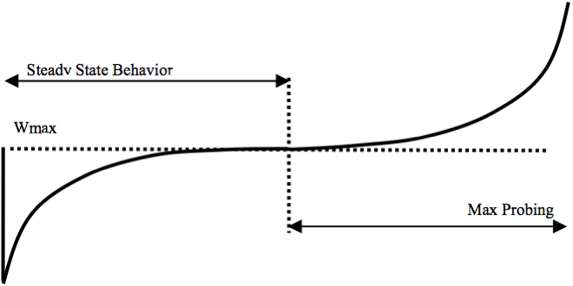
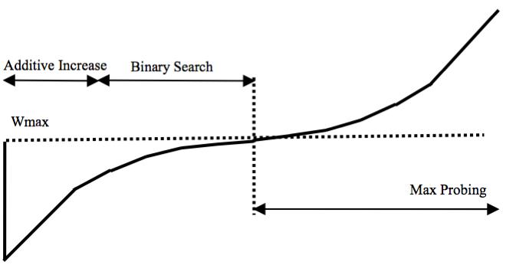
Window Growth Function
CUBIC
BIC
"CUBIC: A New TCP-Friendly High-Speed TCP Variant", Injong Rhee, and Lisong Xu

Slide 18
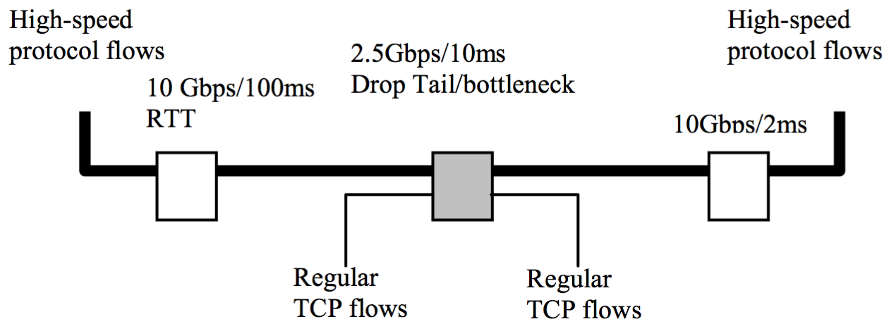
Stability
4 flows of a high-speed TCP variant over a long-RTT network path (~220ms)
4 flows of long-term TCP-SACK flows over a short-RTT path (~20ms)
"CUBIC: A New TCP-Friendly High-Speed TCP Variant", Injong Rhee, and Lisong Xu

Slide 19
Coefficient of Variation (CoV)
“There is no well-defined metric of stability.”
“Often the CoV of transmission rates are used to depict stability.”
“For a less satisfactory measure, we plotted the CoV of throughput.”
"CUBIC: A New TCP-Friendly High-Speed TCP Variant", Injong Rhee, and Lisong Xu

Slide 20
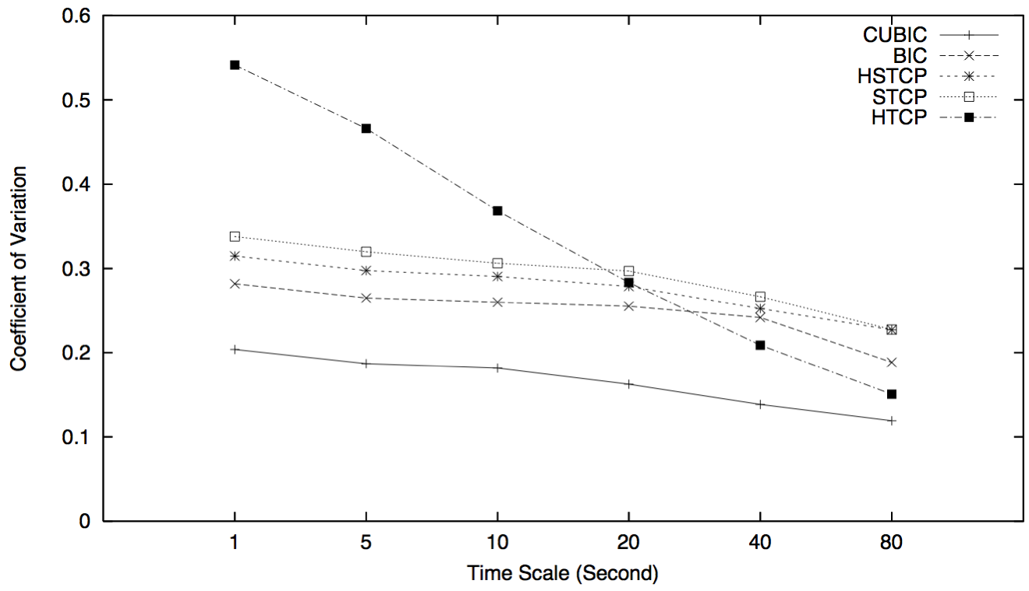
CoV - 20% BDP
"CUBIC: A New TCP-Friendly High-Speed TCP Variant", Injong Rhee, and Lisong Xu

Slide 21
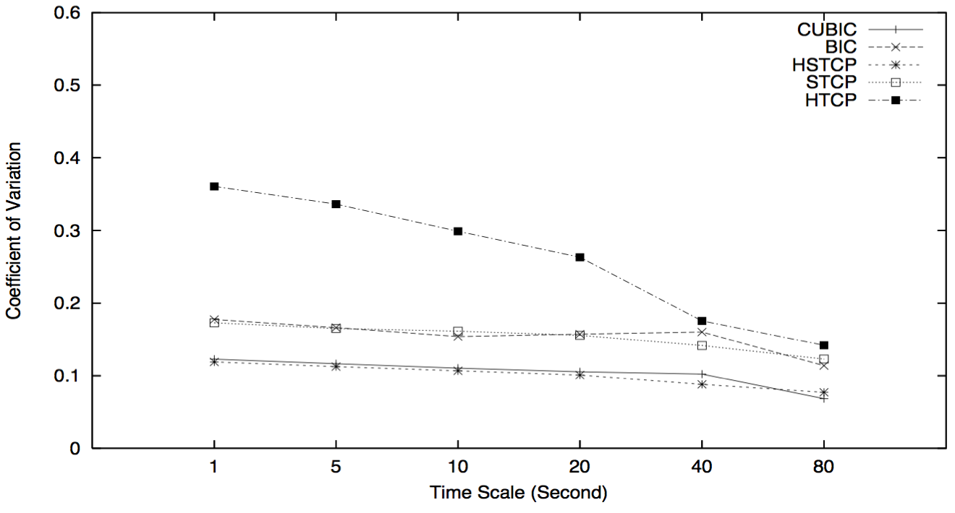
CoV - 200% BDP
"CUBIC: A New TCP-Friendly High-Speed TCP Variant", Injong Rhee, and Lisong Xu

Slide 22
Thanks

