Slide 1
POCKET CHANGE PRO
What can Tech do to break the cycle of poverty and empower communities through financial literacy

Slide 3
Why?
Based on Pew research:
Huge opportunity:
Form good habits early
Move up in society
Self-empowerment
Improve community
20 Million Millennials aged 16-24 are entering the workforce at a critical teachable moment where their first experience and first paychecks are potential income streams and mobility streams.

Slide 4
Impact/Lessons Learned
Mission 1: Prove you are Credit Worthy.
Mission 2: Financial Planning and Budgeting
Mission 3: Building the Future & Touching the Community
MicroActions

Slide 5
Mission 1
Creditworthiness
what’s credit
mastering savings
responsible payments

Slide 6
Mission 2
Mastering your budget
Dealing with large loans
Basic interest

Slide 7
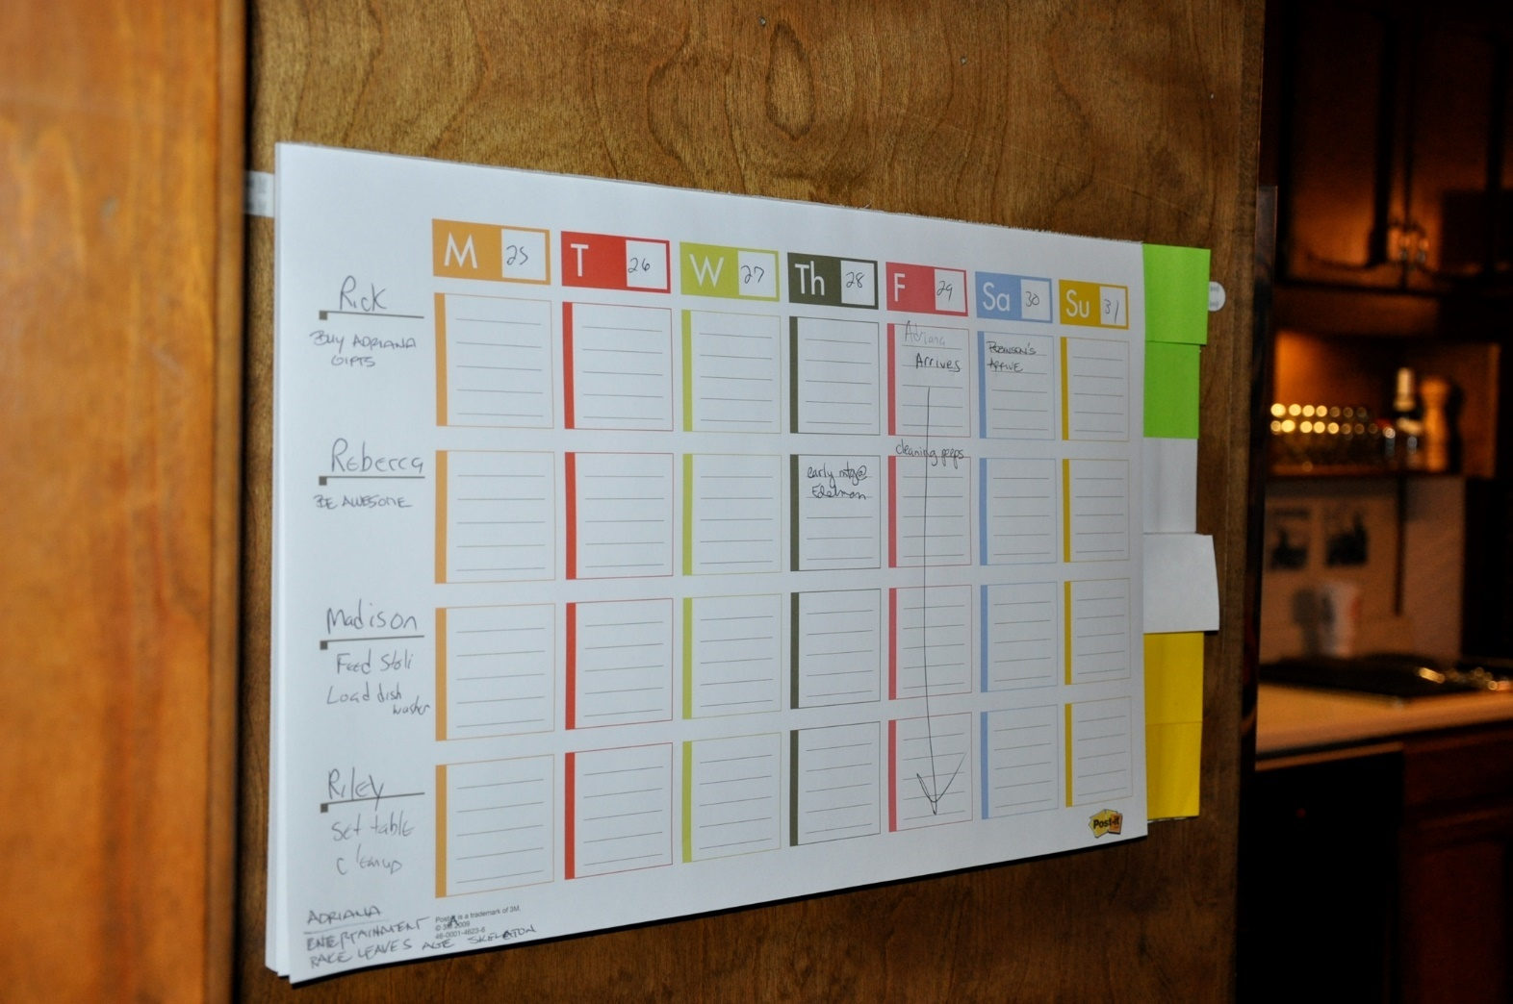
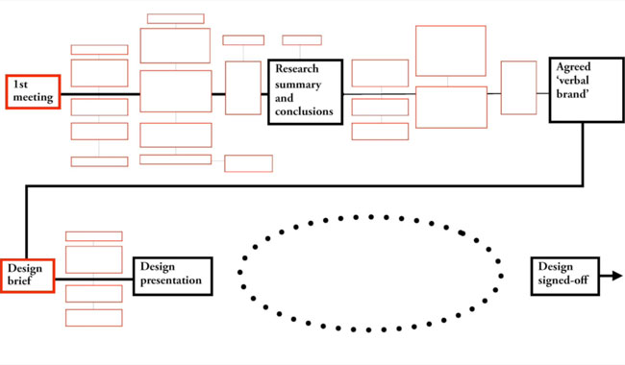

Slide 8
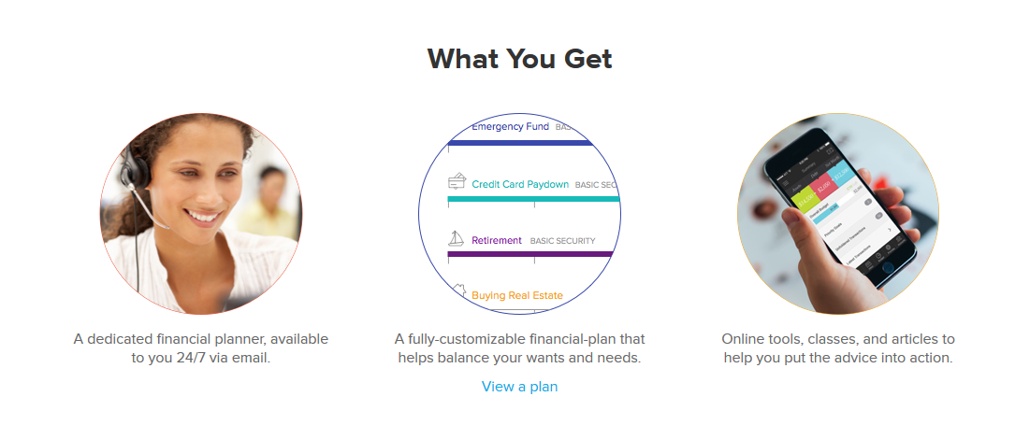


Slide 9
Mission 3 & Future
School involvement
Compound interest
Community involvement
Repetition! Daily Practice
Start a business
Get steady employment

Slide 10
Community Opportunities
Here’s where sponsors, monetization, and engagement activists come in
Purchase the app 1, 2, 3, 5 + Monthly 1, 2, 3, subrx
Business sponsors microactions
Community Building Better Buying
MicroLoans to friend
Connect with mentoring programs who have already built relationships of people who care IM Day
Economists against humanity -- know your enemy cards
How to start a business seminars
Get a quarterly credit report
Call Quorum for Townhall

Slide 11
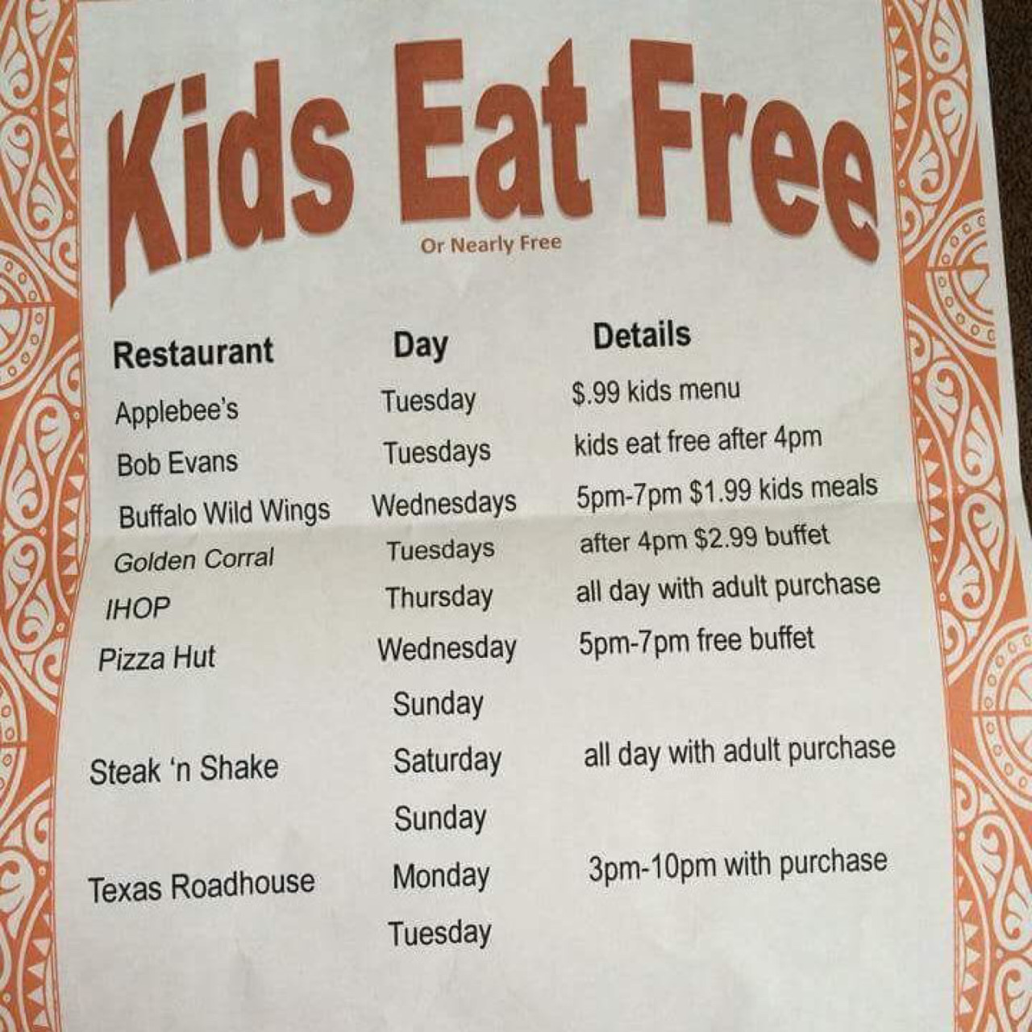

Slide 12
Wrap up
The mission of the collaborative team is to empower community participation with idea machines, developers, entrepreneurs, and student activists working together to stimulate financial literacy, citizenship, safer communities, and economic engagement.

Slide 13
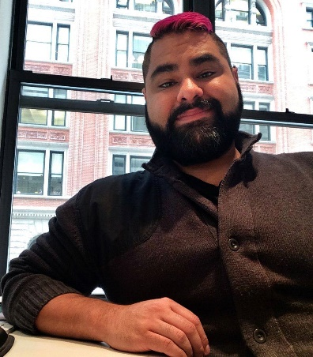

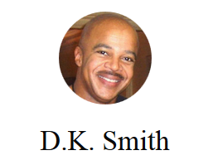
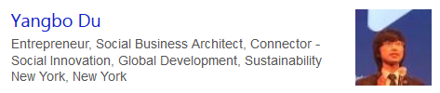
THANK YOU!!!
Andy Saldaña
Georgie-Ann Getton

Slide 15
How much do you want to pay back?
Minimum balance (-score)
Balance due (++score)
Fill in (=score delta, less than half, more minimum)
(+

Slide 16
First Successful Payment MILESTONE
You’re qualified for a horse!
Save up for it (+score)
Buy on credit (-score)

Slide 17
NEW MISSION #2 (financial planning)
Interest Rate
Interest rates hike if you carry a balance fwd
Update for having so much money saved
Bonus baker’s dozen = free drink!

Slide 18
MISSION #3 Join the Community
Use the horse to mercenary ride thru the towns and make money
Samurai for hire
Remove greedy water blocker
Drive out bandits/robbers/terrorists
Income increases with each happy freetown

Slide 19
VICTORY SCREEN
Start a business
Get steady employment
Get a scholarship to Xyz.edu

Slide 20
Intro & Purpose
Empower the local economy
Teach financial literacy
Build positive habits
Pocket Change Pro courtesy of Hackathon Hack the System, is a dynamic, immersive, augmented reality app that turns personal finance education, consumer empowerment, and everyday entrepreneurship into a web- and mobile-based game that stimulates financial literacy, citizen activism, safer communities, and economic engagement.
The mission of the collaborative team of idea machines, developers, entrepreneurs, and student activists is to empower power people to take control of their personal lives, play an active role, and improve their lives in every way possible. The simple tasks like keeping track of their spending habits will help them get a clear sense of how and where they are voting with their dollars.

