Slide 1
WoS NN on Poisson
Feb. 21th 2024

Slide 2
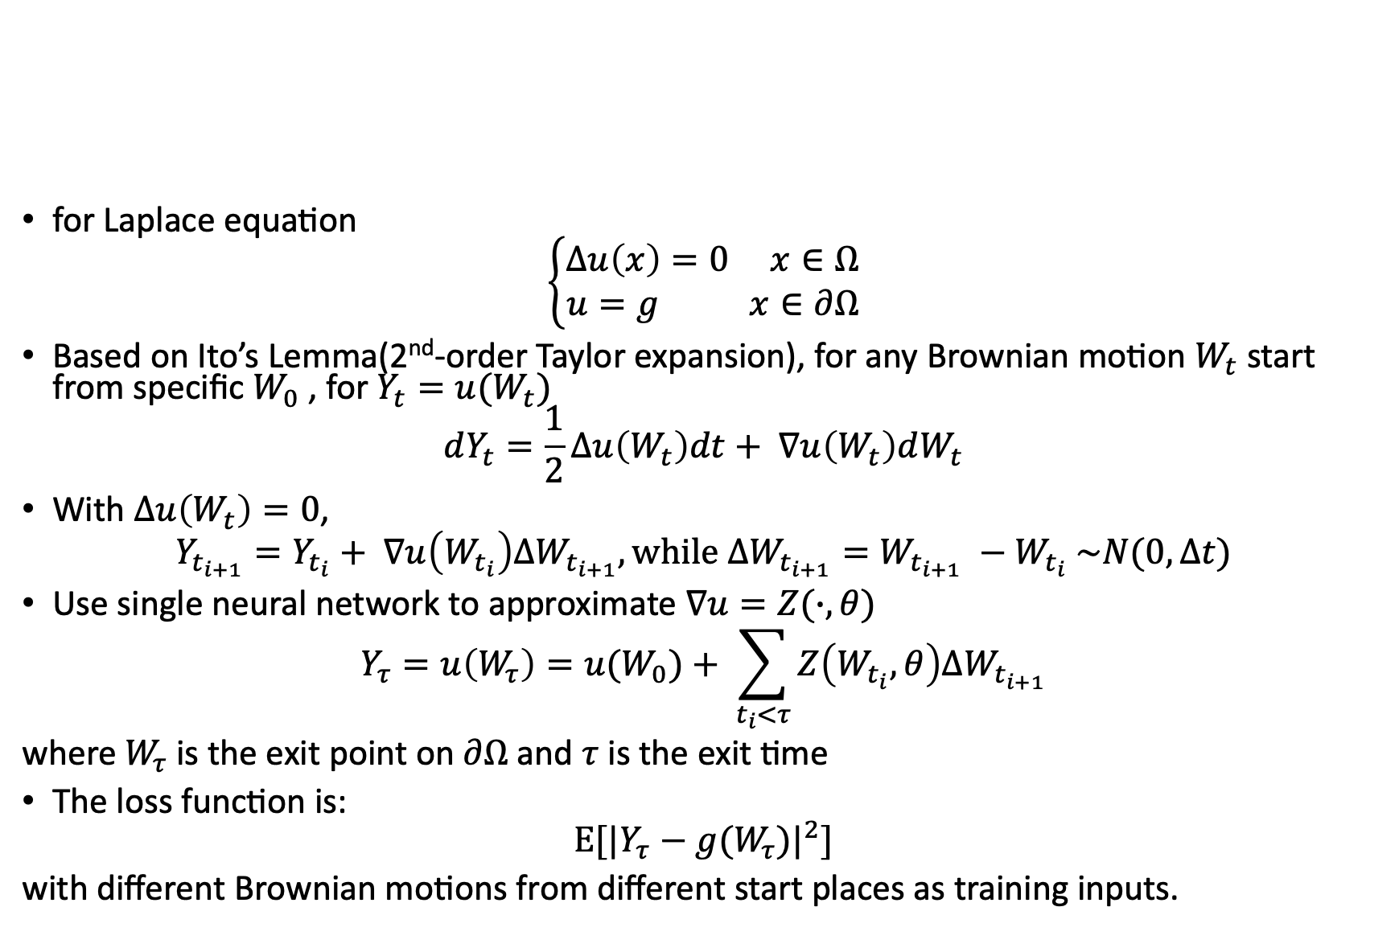
Background
for Laplace equation
$$\left\{\begin{aligned}Δu\left(x\right)=0 x∈Ω \\ u=g x∈∂Ω\end{aligned}\right.$$
Based on Ito’s Lemma(2nd-order Taylor expansion), for any Brownian motion $W_{t}$ start from specific $W_{0}$ , for $Y_{t}=u(W_{t})$
$$dY_{t}=\frac{1}{2}Δu\left(W_{t}\right)dt+ ∇u\left(W_{t}\right)dW_{t}$$
With $Δu\left(W_{t}\right)=0$,
$$Y_{t_{i+1}}=Y_{t_{i}}+ ∇u\left(W_{t_{i}}\right)ΔW_{t_{i+1}}, while ΔW_{t_{i+1}}=W_{t_{i+1}} −W_{t_{i}} \sim N(0, Δt)$$
Use single neural network to approximate $∇u=Z(∙, θ)$
$$Y_{τ}=u\left(W_{τ}\right)=u(W_{0})+ \sum_{t_{i}<τ}{Z\left(W_{t_{i}}, θ\right)ΔW_{t_{i+1}}}$$
where $W_{τ}$ is the exit point on $∂Ω$ and $τ$ is the exit time
The loss function is:
$$Ε[{|Y_{τ}−g(W_{τ})|}^{2}]$$
with different Brownian motions from different start places as training inputs.

Slide 3
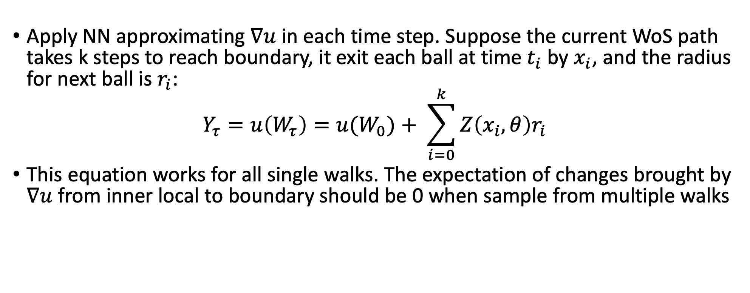
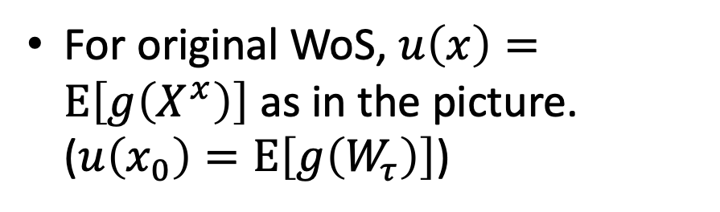
Original WoS
For original WoS, $u\left(x\right)=Ε\left[g\left(X^{x}\right)\right]$ as in the picture. ($u\left(x_{0}\right)=Ε\left[g\left(W_{τ}\right)\right]$)
Apply NN approximating $∇u$ in each time step. Suppose the current WoS path takes k steps to reach boundary, it exit each ball at time $t_{i}$by $x_{i}$, and the radius for next ball is $r_{i}$:
$$Y_{τ}=u\left(W_{τ}\right)=u(W_{0})+ \sum_{i=0}^{k}{Z\left(x_{i}, θ\right)r_{i}}$$
This equation works for all single walks. The expectation of changes brought by $∇u$ from inner local to boundary should be 0 when sample from multiple walks

Slide 4
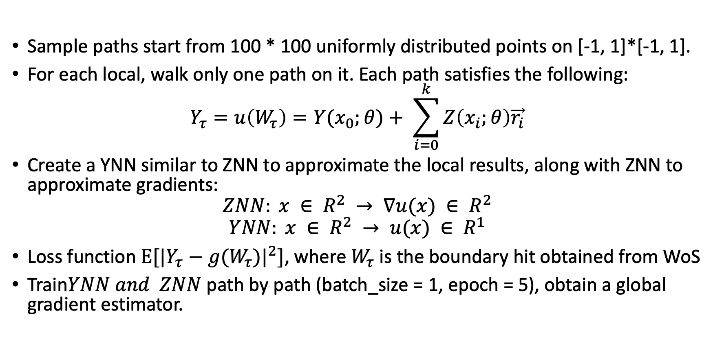
2. Multiple start places with 1 path for each (Start Y is approximated by YNN)
Sample paths start from 100 * 100 uniformly distributed points on [-1, 1]*[-1, 1].
For each local, walk only one path on it. Each path satisfies the following:
$$Y_{τ}=u\left(W_{τ}\right)=Y(x_{0};θ)+ \sum_{i=0}^{k}{Z\left(x_{i};θ\right)\vec{r_{i}}}$$
Create a YNN similar to ZNN to approximate the local results, along with ZNN to approximate gradients:
$$ZNN: x ∈ R^{2} → ∇u(x) ∈ R^{2}$$
$$YNN: x ∈ R^{2} → u(x) ∈ R^{1}$$
Loss function $Ε[{|Y_{τ}−g(W_{τ})|}^{2}]$, where $W_{τ}$ is the boundary hit obtained from WoS
Train$YNN and ZNN$ path by path (batch_size = 1, epoch = 5), obtain a global gradient estimator.

Slide 5

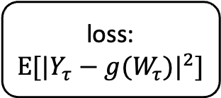
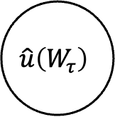

Network Structure
accumulate
accumulate
$$\hat{u}\left(W_{τ}\right)$$
loss:$Ε[{|Y_{τ}−g(W_{τ})|}^{2}]$
YNN
ZNN
$$X_{0}$$
$$X_{i}$$
back propagate

Slide 6
The left problem: Batch utilize
Vectorize varying length paths -> a constant path length
extend short paths by stay at the boundary hit points repeatedly
Unbalanced training:
not obvious for single sample training situation (batch size = 1), because most of the paths are having small lengths
when paths long enough, ZNN for gradient estimation will be trained multiple times while YNN will be trained only for once for each batch.
The unbalanced training will result in the ignore of one of the networks during optimization
the training 0 out YNN every time -> a local minimum for the network

Slide 7
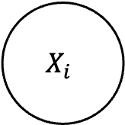
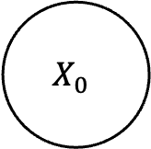
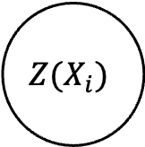
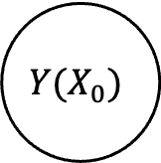
New Network Structure
Instead of letting the NNs to capture the inner relationship between local solutions and gradients, using a single inner-connected NN to give solutions and gradients simultaneously -> instruct the NN to capture the relationship, should be more efficient
However, the problem of unbalanced training is still not completely solved.
$$X_{0}$$
YZNN
$${Y(X}_{0})$$
$$X_{i}$$
$${Z(X}_{i})$$

Slide 8
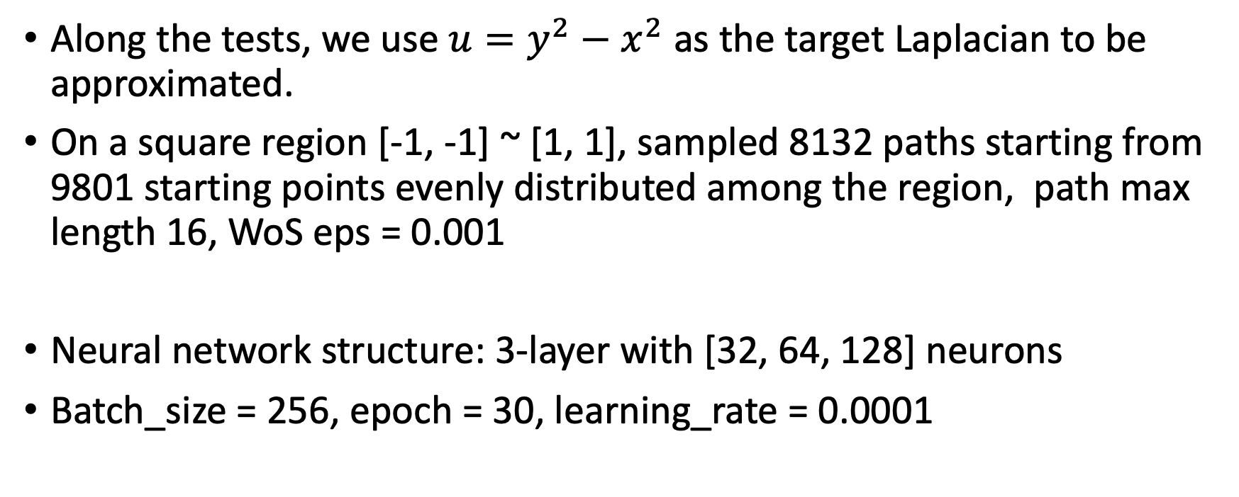
Settings
Along the tests, we use $u=y^{2}−x^{2}$ as the target Laplacian to be approximated.
On a square region [-1, -1] ~ [1, 1], sampled 8132 paths starting from 9801 starting points evenly distributed among the region, path max length 16, WoS eps = 0.001
Neural network structure: 3-layer with [32, 64, 128] neurons
Batch_size = 256, epoch = 30, learning_rate = 0.0001

Slide 9
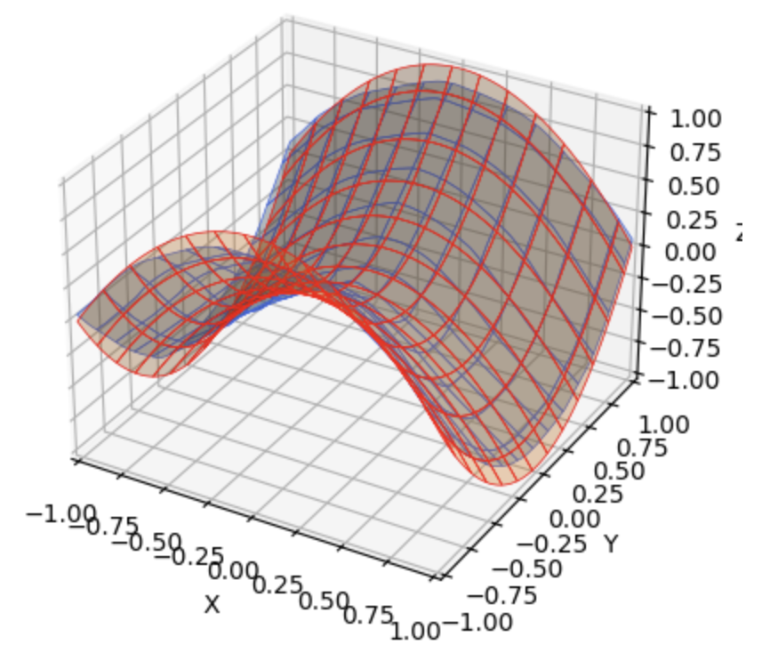
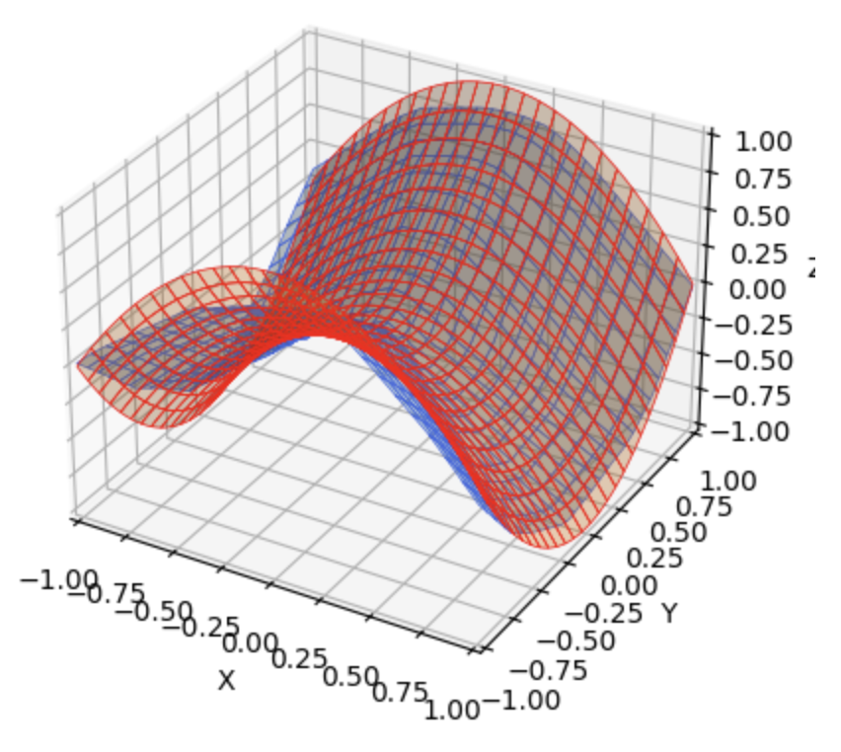
Test Results and comparison – local solutions
batch utilized
batch size = 1

Slide 10
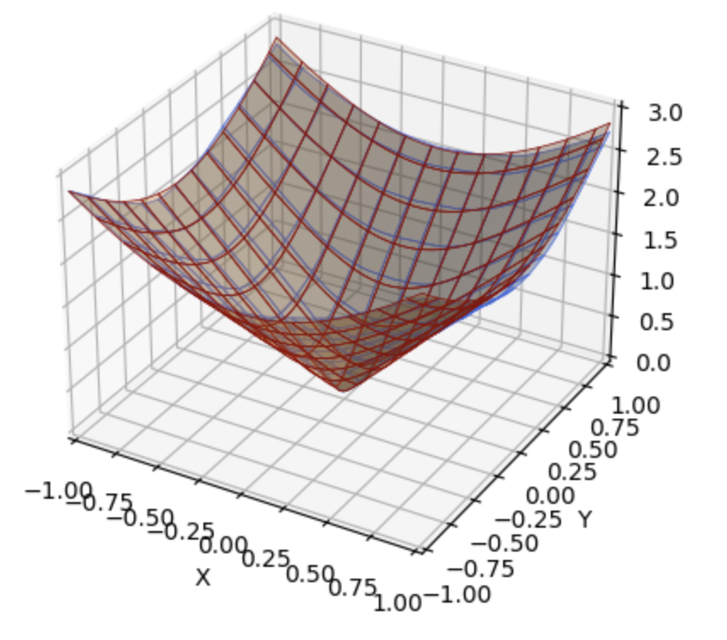
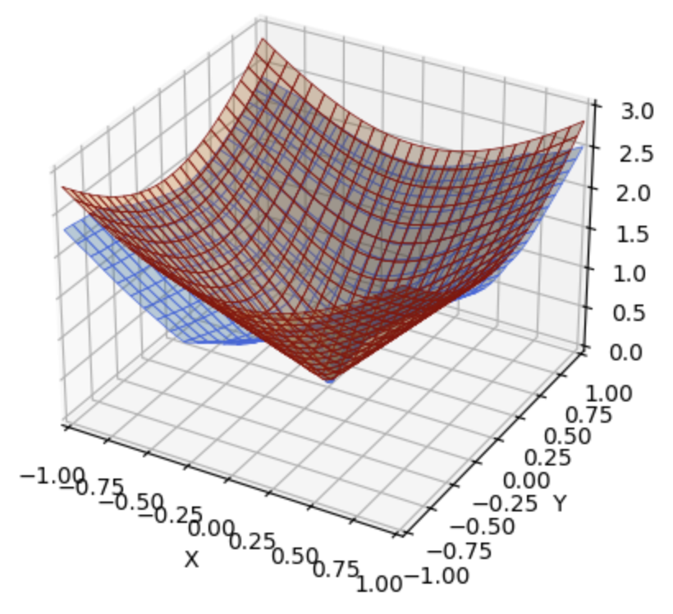
Test Results and comparison – gradient norm
batch utilized
batch size = 1

Slide 11
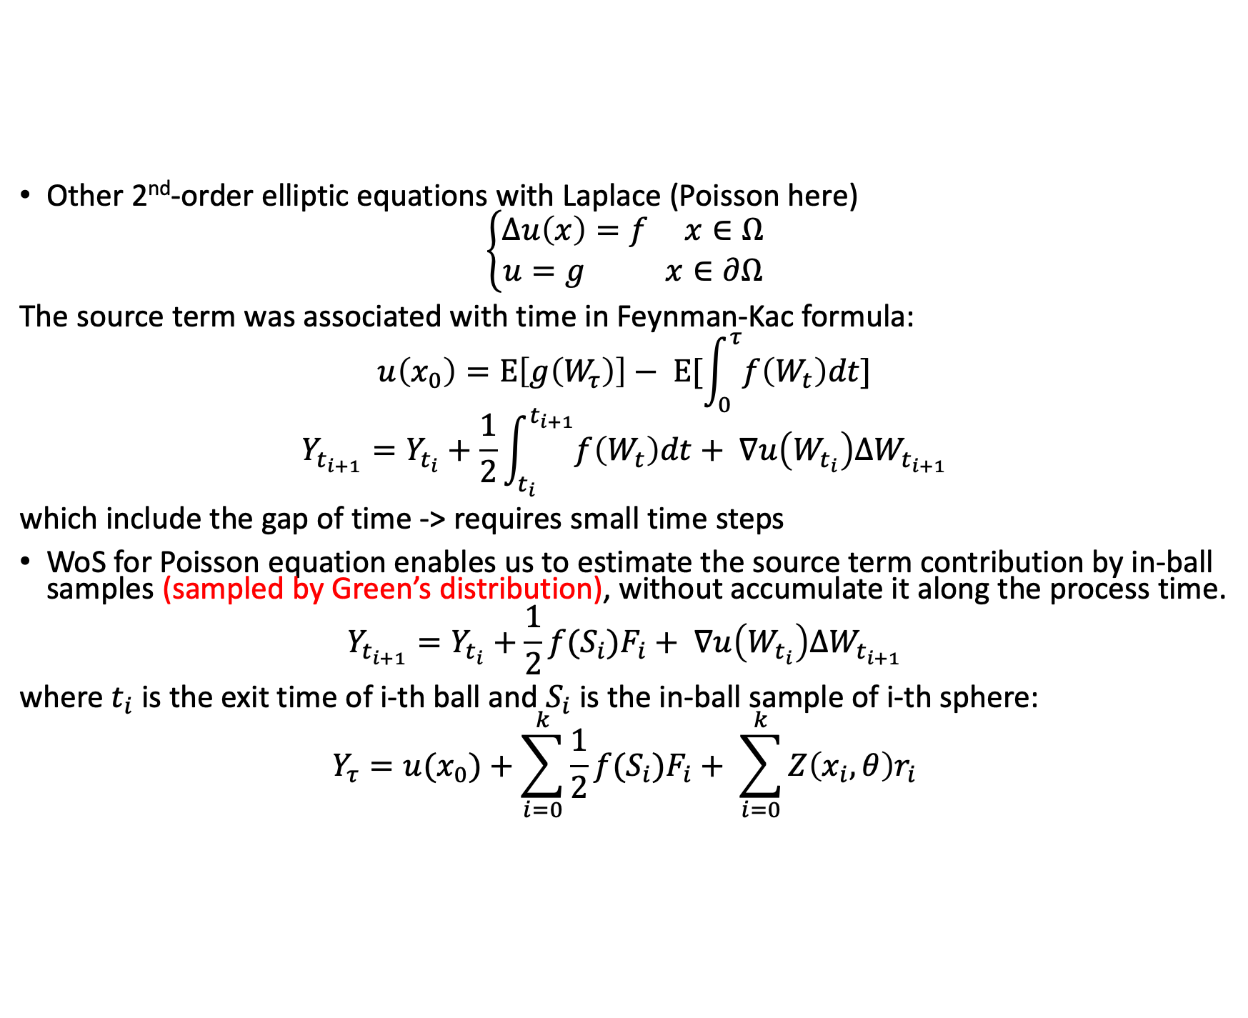
Source term contribution
Other 2nd-order elliptic equations with Laplace (Poisson here)
$$\left\{\begin{aligned}Δu\left(x\right)=f x∈Ω \\ u=g x∈∂Ω\end{aligned}\right.$$
The source term was associated with time in Feynman-Kac formula:
$$u\left(x_{0}\right)=Ε\left[g\left(W_{τ}\right)\right]− Ε[\int_{0}^{τ}{f\left(W_{t}\right)dt}]$$
$$Y_{t_{i+1}}=Y_{t_{i}}+\frac{1}{2}\int_{t_{i}}^{t_{i+1}}{f\left(W_{t}\right)dt}+ ∇u\left(W_{t_{i}}\right)ΔW_{t_{i+1}}$$
which include the gap of time -> requires small time steps
WoS for Poisson equation enables us to estimate the source term contribution by in-ball samples (sampled by Green’s distribution), without accumulate it along the process time.
$$Y_{t_{i+1}}=Y_{t_{i}}+\frac{1}{2}f(S_{i})F_{i}+ ∇u\left(W_{t_{i}}\right)ΔW_{t_{i+1}}$$
where $t_{i}$ is the exit time of i-th ball and $S_{i}$ is the in-ball sample of i-th sphere:
$$Y_{τ}=u(x_{0})+\sum_{i=0}^{k}{\frac{1}{2}f(S_{i})F_{i}}+ \sum_{i=0}^{k}{Z\left(x_{i}, θ\right)r_{i}}$$

Slide 12
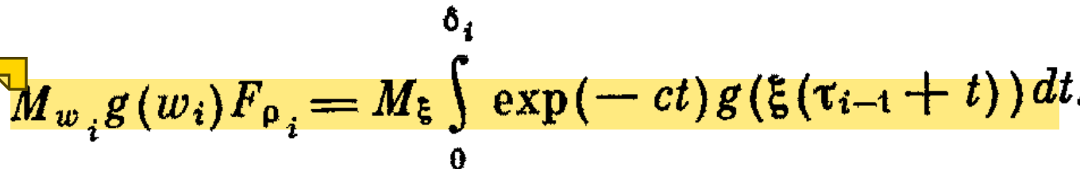
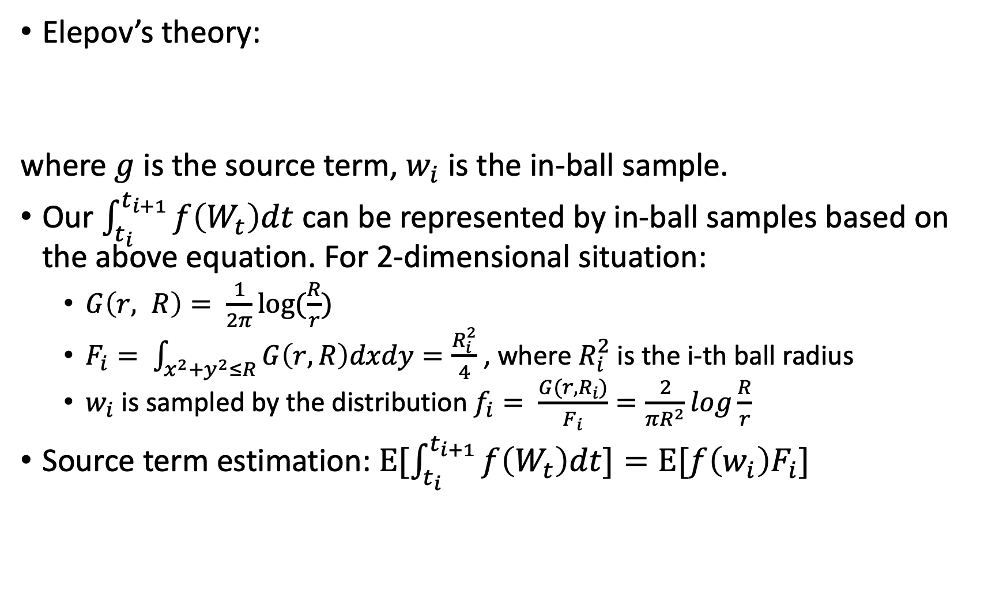
Solving Poisson Equations
Elepov’s theory:
where $g$ is the source term, $w_{i}$ is the in-ball sample.
Our $\int_{t_{i}}^{t_{i+1}}{f\left(W_{t}\right)dt}$ can be represented by in-ball samples based on the above equation. For 2-dimensional situation:
$G\left(r, R\right)= \frac{1}{2π}log⁡(\frac{R}{r})$
$F_{i}= \int_{x^{2}+y^{2}≤R}{G\left(r, R\right)dxdy}=\frac{R_{i}^{2}}{4}$, where $R_{i}^{2}$ is the i-th ball radius
$w_{i}$ is sampled by the distribution $f_{i}= \frac{G(r, R_{i})}{F_{i}}=\frac{2}{πR^{2}}log\frac{R}{r}$
Source term estimation: $E[\int_{t_{i}}^{t_{i+1}}{f\left(W_{t}\right)dt}]=Ε[f\left(w_{i}\right)F_{i}]$

Slide 13
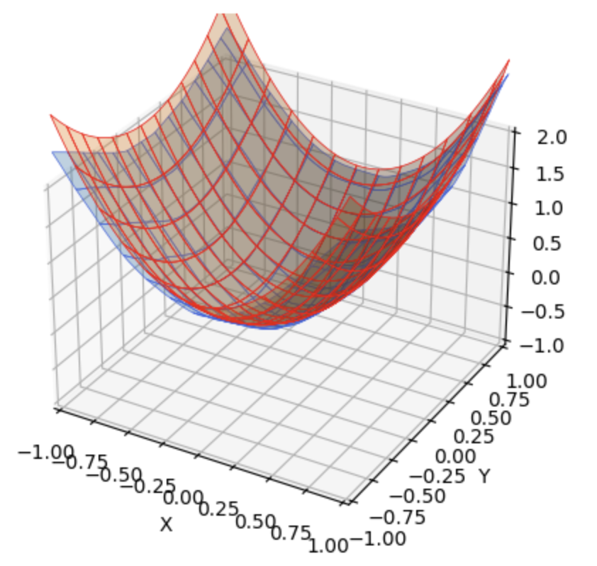
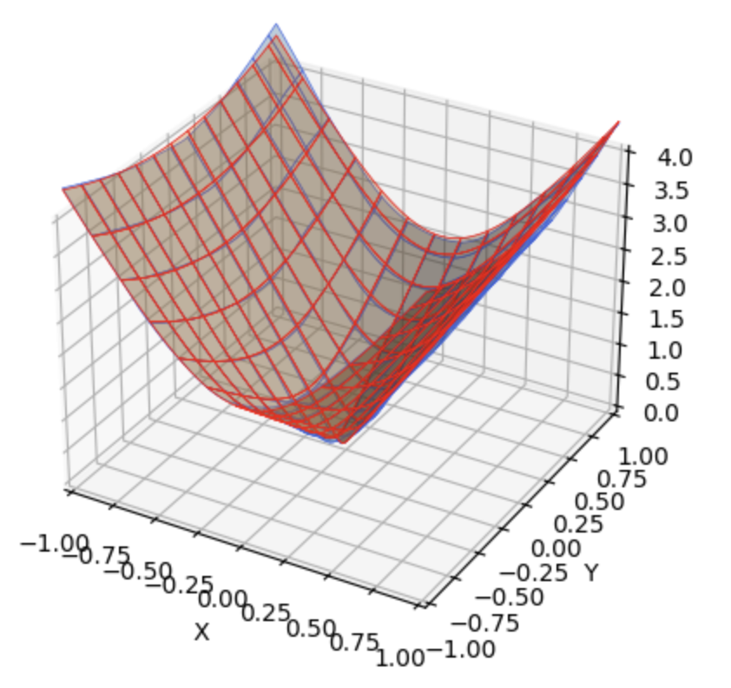

Test Results for Constant Source $$f=6, u=2x^{2}+y^{2}$$
local solution
gradient estimation (norm of gradient)

Slide 14
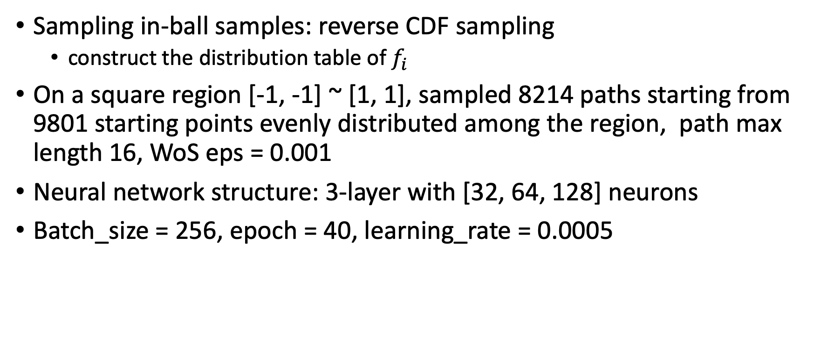
Solving Poisson Equations
Sampling in-ball samples: reverse CDF sampling
construct the distribution table of $f_{i}$
On a square region [-1, -1] ~ [1, 1], sampled 8214 paths starting from 9801 starting points evenly distributed among the region, path max length 16, WoS eps = 0.001
Neural network structure: 3-layer with [32, 64, 128] neurons
Batch_size = 256, epoch = 40, learning_rate = 0.0005

Slide 15
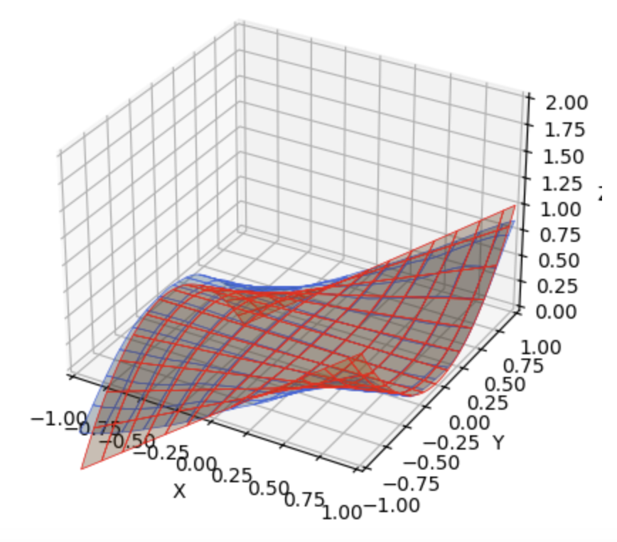
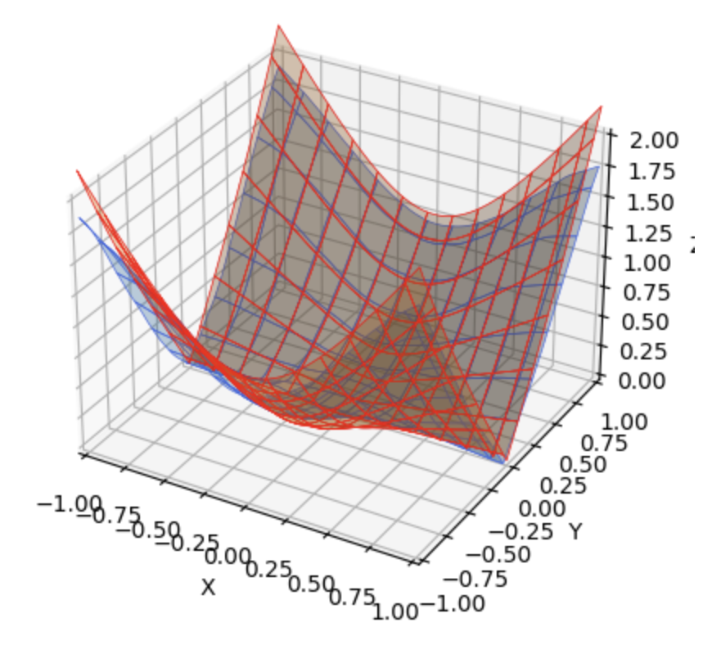
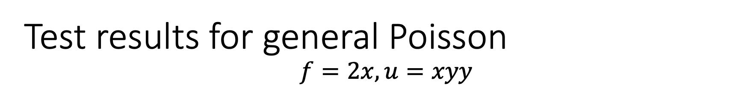
Test results for general Poisson $$f=2x, u=xyy$$
local solution
gradient estimation (norm of gradient)

Slide 16
Next step to do
Currently doing:
3-dimensional Laplacian example: 3-d projection and sample among the sphere, working with polygon soup
integrated PDE solver: include the path sampling process into the solver (flexible batch)
3-dimensional Poisson: different green’s function sampling
Absorption: Poisson-Boltzmann equation solving
Different boundary conditions and experiments, comparison.
different NN structure and hyper parameters.

