Slide 1
Non-deterministic PDE Solver with Machine Learning
future schedule and potential projects
Silei Song

Slide 2
Reading List – for WoS
Walk on Spheres basic:
Mervin E. Muller. “Some Continuous Monte Carlo Methods for the Dirichlet Problem”.
Original Walk on Sphere, learn the algorithm process
B.S. Elepov and G.A. Mikhailov. “Solution of the dirichlet problem for the equation ∆u − cu = q by a model of "walks on spheres"”.
Sample inside to solve the source term, for Poisson equation
Walk on Spheres implementation: Rohan & Keenan’s work
Rohan Sawhney and Keenan Crane. “Monte Carlo geometry processing: a grid-free approach to PDE-based methods on volumetric domains”.
A simple implementation of WoS in geometry processing.
Code: https://www.cs.cmu.edu/~kmcrane/Projects/MonteCarloGeometryProcessing/index.html
Rohan Sawhney et al. Grid-Free Monte Carlo for PDEs with Spatially Varying Coefficients.
With more complete implementation codes, including adaptive sampling and more examples and details.
Code: https://cs.dartmouth.edu/~wjarosz/publications/sawhneyseyb22gridfree.html

Slide 3
Reading List – for NN in time discretization
PDE – BSDE:
Shizuo Kakutani. “Two-dimensional Brownian motion and harmonic functions”.
Feynman Kac formula and Ito’s process
E. Pardoux and S.G. Peng. “Adapted solution of a backward stochastic differential equation”
PDE – BSDE, definition of BSDE
fully non-linear parabolic PDE – 2BSDE
Single Stacked Neural Network:
Jiequn Han, Arnulf Jentzen, and Weinan E. “Solving high-dimensional partial differential equations using deep learning”.
semi-linear PDE to BSDE and time discretization
Dynamic Programming Deep Learning
Come Hure, Huyen Pham, and Xavier Warin. “Deep backward schemes for high-dimensional nonlinear PDEs”
backward propagation of time discretization
Maximilien Germain, Huyen Pham, and Xavier Warin. “Approximation error analysis of some deep backward schemes for nonlinear PDEs”.
multi-step idea

Slide 4
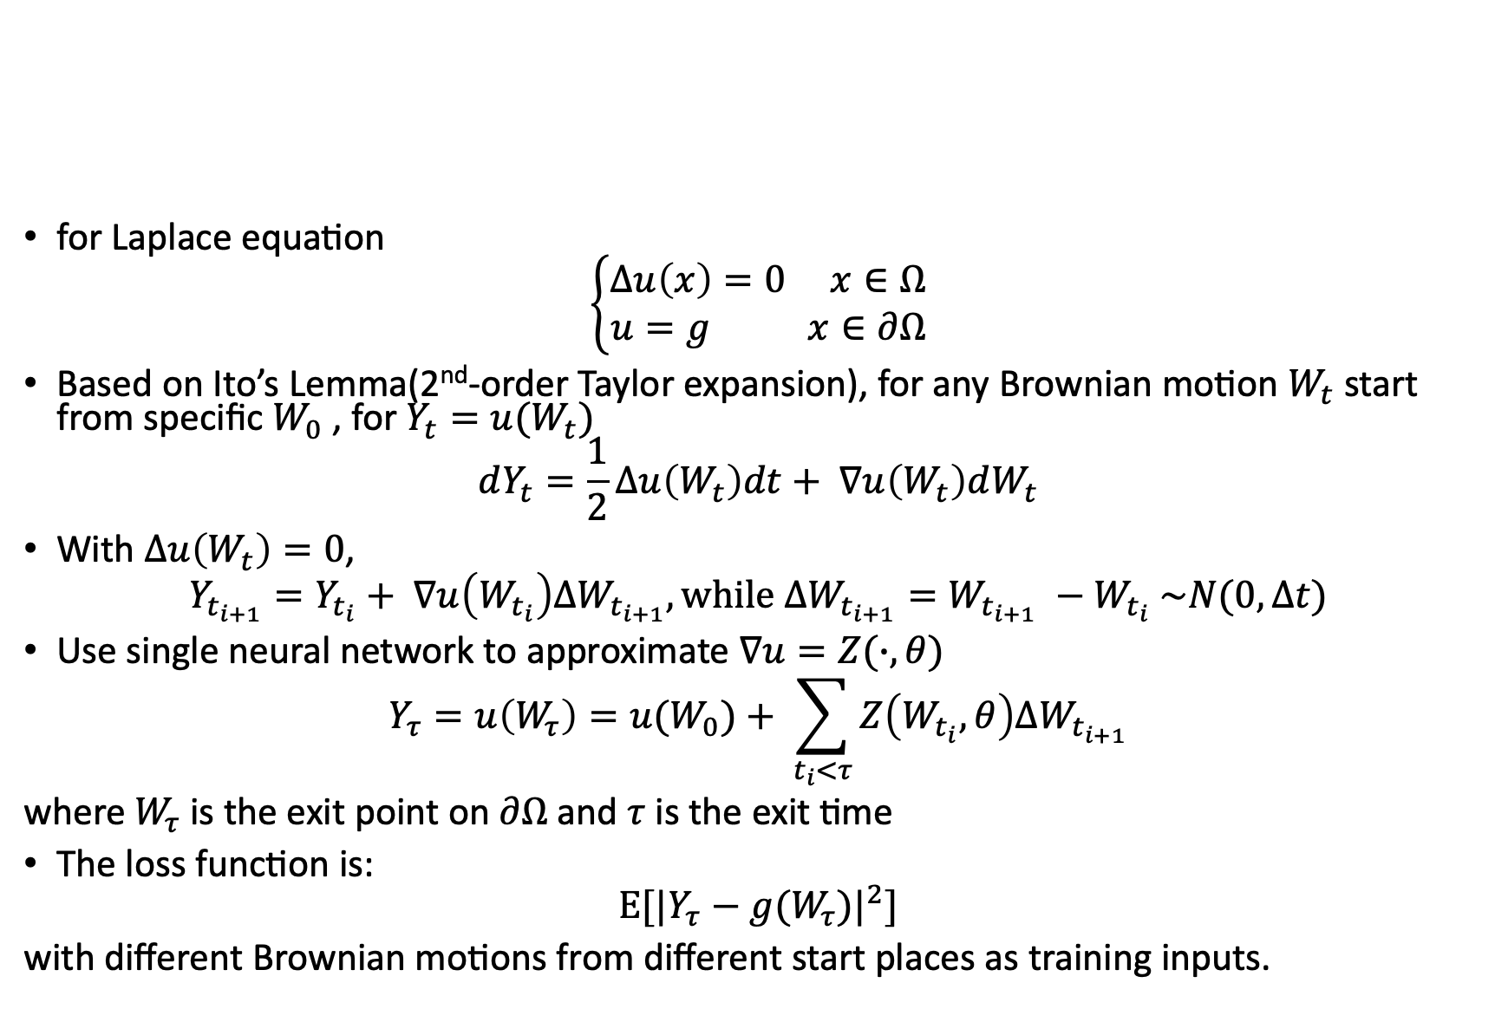
Project 1: WoS with NN
for Laplace equation
$$\left\{\begin{aligned}Δu\left(x\right)=0 x∈Ω \\ u=g x∈∂Ω\end{aligned}\right.$$
Based on Ito’s Lemma(2nd-order Taylor expansion), for any Brownian motion $W_{t}$ start from specific $W_{0}$ , for $Y_{t}=u(W_{t})$
$$dY_{t}=\frac{1}{2}Δu\left(W_{t}\right)dt+ ∇u\left(W_{t}\right)dW_{t}$$
With $Δu\left(W_{t}\right)=0$,
$$Y_{t_{i+1}}=Y_{t_{i}}+ ∇u\left(W_{t_{i}}\right)ΔW_{t_{i+1}}, while ΔW_{t_{i+1}}=W_{t_{i+1}} −W_{t_{i}} \sim N(0, Δt)$$
Use single neural network to approximate $∇u=Z(∙, θ)$
$$Y_{τ}=u\left(W_{τ}\right)=u(W_{0})+ \sum_{t_{i}<τ}{Z\left(W_{t_{i}}, θ\right)ΔW_{t_{i+1}}}$$
where $W_{τ}$ is the exit point on $∂Ω$ and $τ$ is the exit time
The loss function is:
$$Ε[{|Y_{τ}−g(W_{τ})|}^{2}]$$
with different Brownian motions from different start places as training inputs.

Slide 5
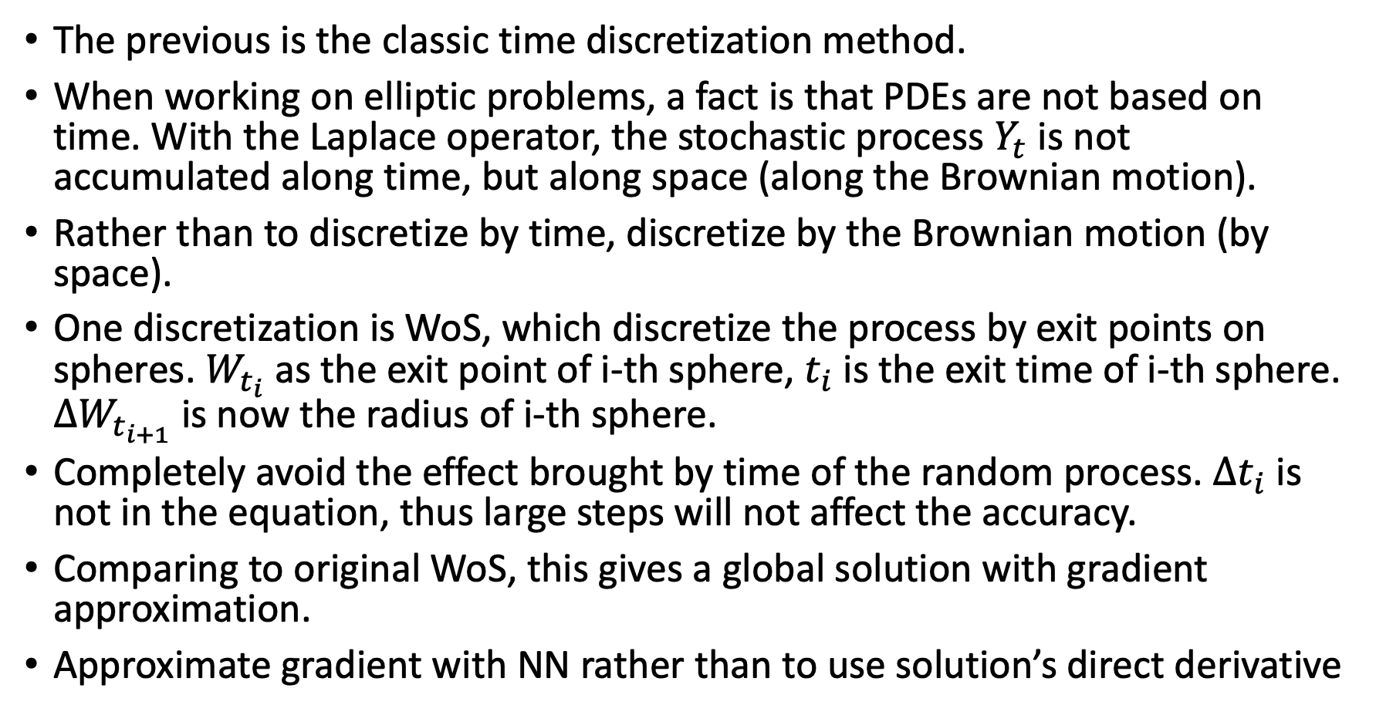
Project 1: WoS with NN
The previous is the classic time discretization method.
When working on elliptic problems, a fact is that PDEs are not based on time. With the Laplace operator, the stochastic process $Y_{t}$ is not accumulated along time, but along space (along the Brownian motion).
Rather than to discretize by time, discretize by the Brownian motion (by space).
One discretization is WoS, which discretize the process by exit points on spheres. $W_{t_{i}}$ as the exit point of i-th sphere, $t_{i}$ is the exit time of i-th sphere. $ΔW_{t_{i+1}}$ is now the radius of i-th sphere.
Completely avoid the effect brought by time of the random process. $Δt_{i}$ is not in the equation, thus large steps will not affect the accuracy.
Comparing to original WoS, this gives a global solution with gradient approximation.
Approximate gradient with NN rather than to use solution’s direct derivative

Slide 6
Project 1: WoS with NN

Slide 7
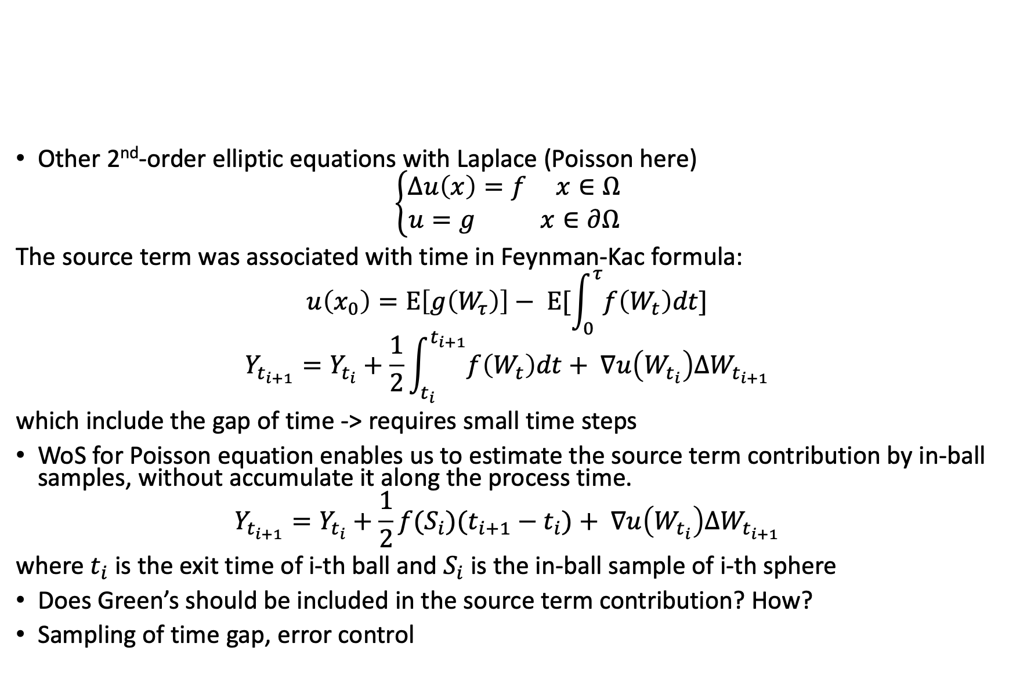
Project 1: WoS with NN
Other 2nd-order elliptic equations with Laplace (Poisson here)
$$\left\{\begin{aligned}Δu\left(x\right)=f x∈Ω \\ u=g x∈∂Ω\end{aligned}\right.$$
The source term was associated with time in Feynman-Kac formula:
$$u\left(x_{0}\right)=Ε\left[g\left(W_{τ}\right)\right]− Ε[\int_{0}^{τ}{f\left(W_{t}\right)dt}]$$
$$Y_{t_{i+1}}=Y_{t_{i}}+\frac{1}{2}\int_{t_{i}}^{t_{i+1}}{f\left(W_{t}\right)dt}+ ∇u\left(W_{t_{i}}\right)ΔW_{t_{i+1}}$$
which include the gap of time -> requires small time steps
WoS for Poisson equation enables us to estimate the source term contribution by in-ball samples, without accumulate it along the process time.
$$Y_{t_{i+1}}=Y_{t_{i}}+\frac{1}{2}f(S_{i})(t_{i+1}−t_{i})+ ∇u\left(W_{t_{i}}\right)ΔW_{t_{i+1}}$$
where $t_{i}$ is the exit time of i-th ball and $S_{i}$ is the in-ball sample of i-th sphere
Does Green’s should be included in the source term contribution? How?
Sampling of time gap, error control

Slide 8
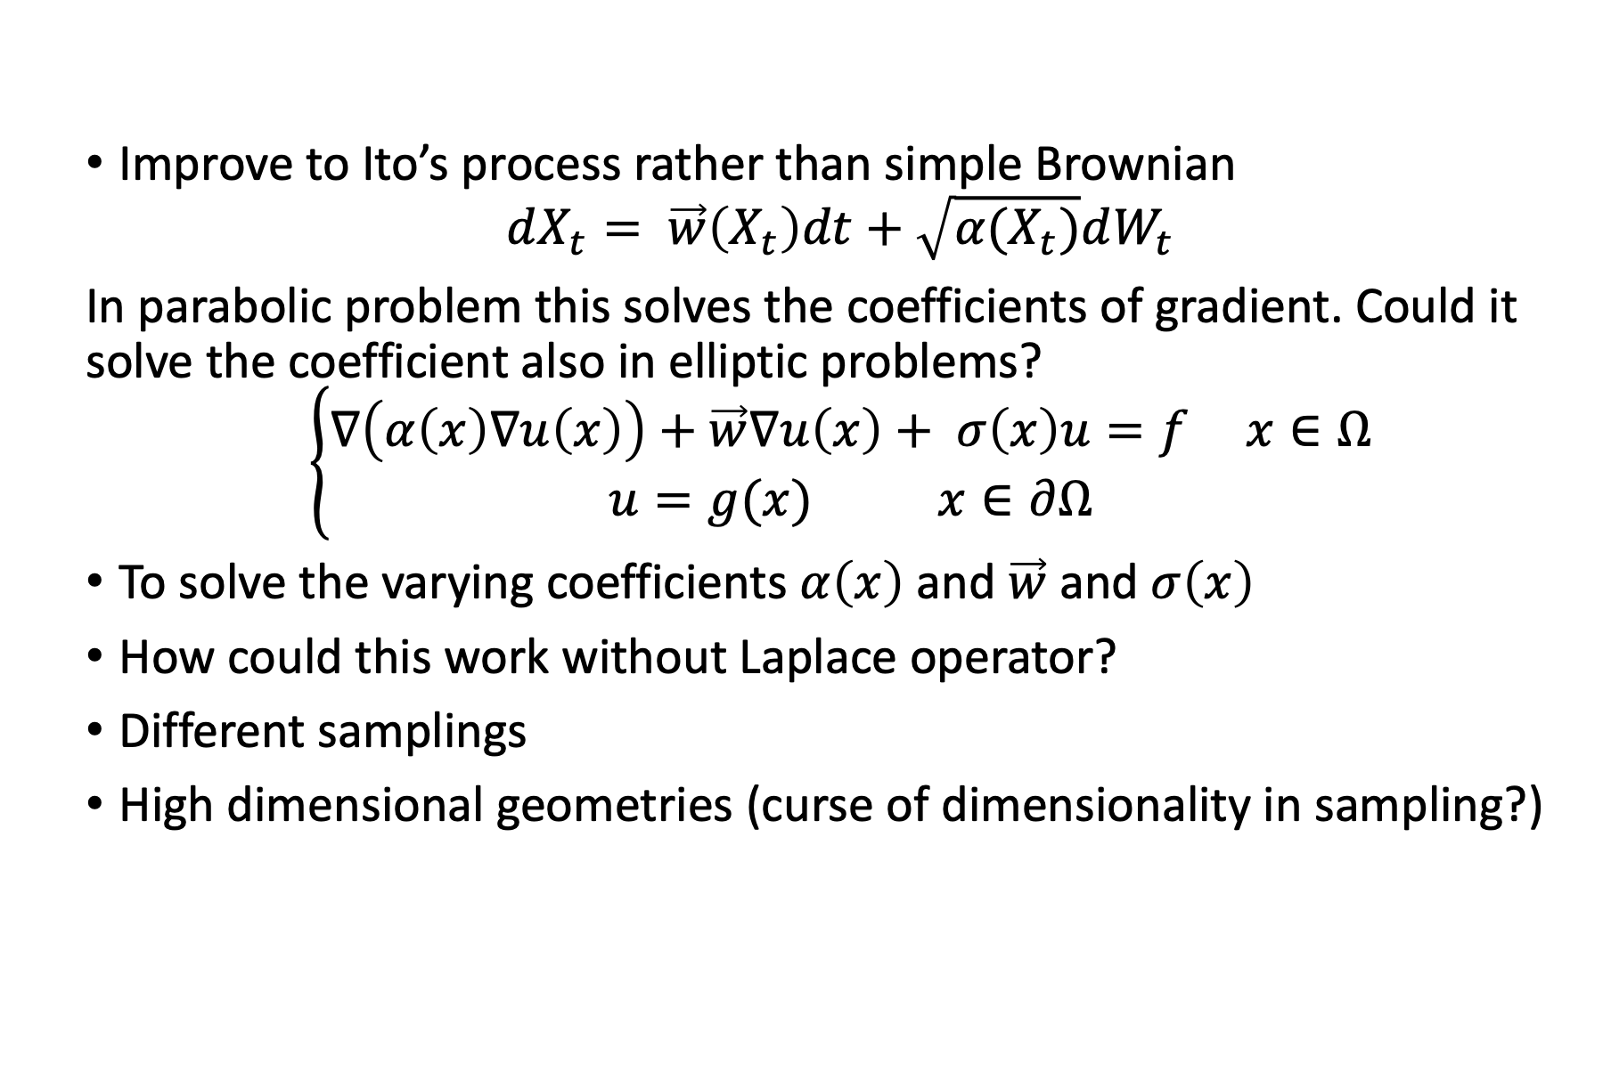
Project 1: WoS with NN
Improve to Ito’s process rather than simple Brownian
$$dX_{t}= \vec{w}\left(X_{t}\right)dt+\sqrt{α(X_{t})}dW_{t}$$
In parabolic problem this solves the coefficients of gradient. Could it solve the coefficient also in elliptic problems?
$$\left\{\begin{aligned}∇\left(α\left(x\right)∇u\left(x\right)\right)+\vec{w}∇u\left(x\right)+ σ\left(x\right)u=f x∈Ω \\ u=g(x) x∈∂Ω\end{aligned}\right.$$
To solve the varying coefficients $α\left(x\right)$ and $\vec{w}$ and $σ\left(x\right)$
How could this work without Laplace operator?
Different samplings
High dimensional geometries (curse of dimensionality in sampling?)

Slide 9
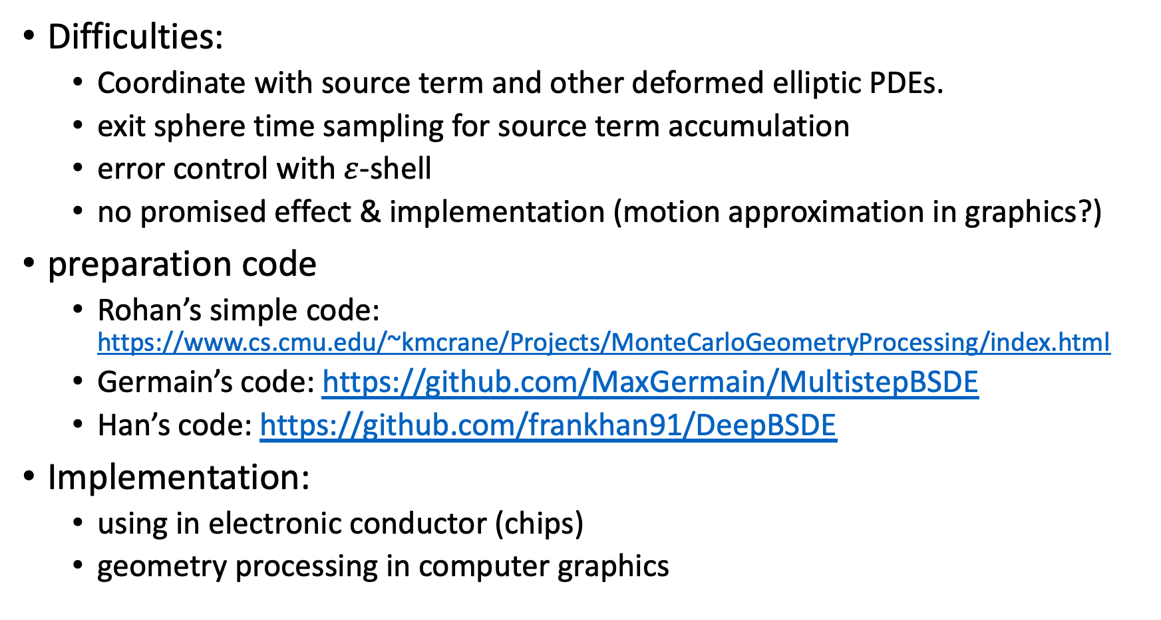
Project 1: WoS with NN
Difficulties:
Coordinate with source term and other deformed elliptic PDEs.
exit sphere time sampling for source term accumulation
error control with $ε$-shell
no promised effect & implementation (motion approximation in graphics?)
preparation code
Rohan’s simple code: https://www.cs.cmu.edu/~kmcrane/Projects/MonteCarloGeometryProcessing/index.html
Germain’s code: https://github.com/MaxGermain/MultistepBSDE
Han’s code: https://github.com/frankhan91/DeepBSDE
Implementation:
using in electronic conductor (chips)
geometry processing in computer graphics

Slide 10
Timeline and Things to do
math process details
the approximation with gradient for Laplace, Poisson, and Poisson Boltzman, do a table (original, expectation Feynman-Kac, Ito’s stochastic version, and approximation)
how to involve in-ball samplings with Green’s function?
coding:
read & understand the NN codes (how to construct NN with random process input simulating PDEs) (long short time memory)
code this process on simple Rohan’s code for Laplace (different programming language? final C++? )
improve to harder 2nd-order elliptic with source terms
Test & comparing to original WoS
Move to harder elliptic problems with absorption, gradient, varying coefficients (Ito’s process instead of Brownian motion?)
Math proving and writing

Slide 11
Project 2: WoS library for Graphics
figure out the PDE needs in graphics
figure out how to write a library in C++
implement simple Laplace, Poisson, Poisson-Boltzman calculator in library for graphics, with polygon soup
Test library
Improvements on library
parallel sampling & local calculation
WoS v.s. FRW on other shapes, implemented on GPU
reuse previous samples on WoS paths with certain distribution
WoSt
varying coefficients
fcwp & BVH work with WoS
high dimensional problems
WoS + NN

Slide 12
Other interesting topics
sticky Brownian motion solving Robin B.C.
Helmholtz equation
Kelvin transform solving external WoS
larger steps exit boundary WoS with the WoSt’s BIE
WoSt method to solve walk on boundary
PINN
Different PDE cross region
ML sampling for Green’s

