Slide 1
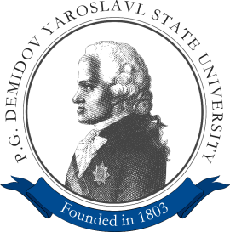


Detection and Tracking of Sport Players on Videodata Using Deep Learning Methods
Leonid Ivanovsky
Vladimir Khryashchev
Dmitry Matveev
Alexander Semenov

Slide 2
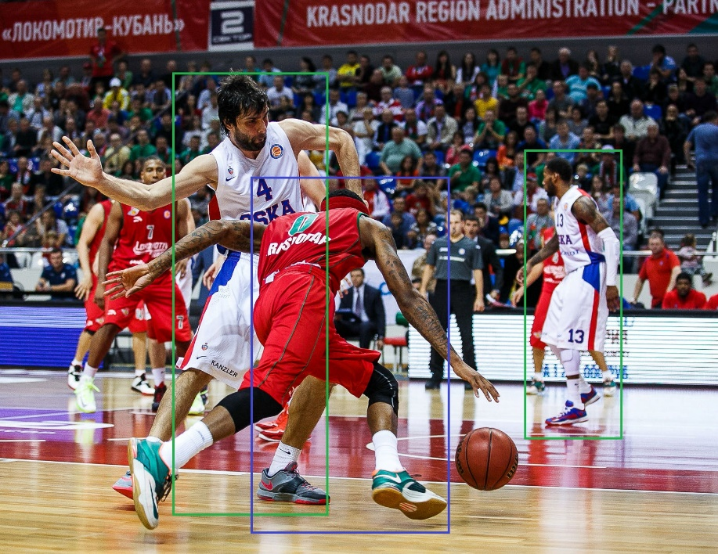
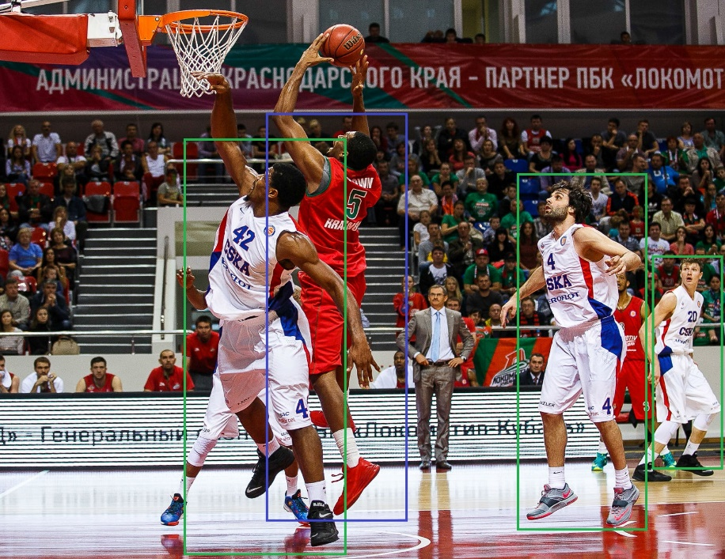
Purpose
Develop an effective algorithm for detection and tracking of athletes on videos using brand-new deep learning methods
2

Slide 3

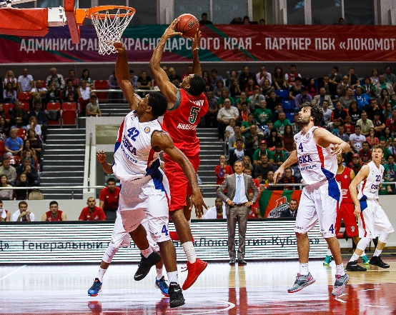
Complexity
Dynamics of sport events: high speed of players’ movements
Athletes’ interaction on the field: players can be very close to each
Optical obstacles on video frames (shadows, distortions, flares, blur…)
2
2
3
3
3
1
3

Slide 4
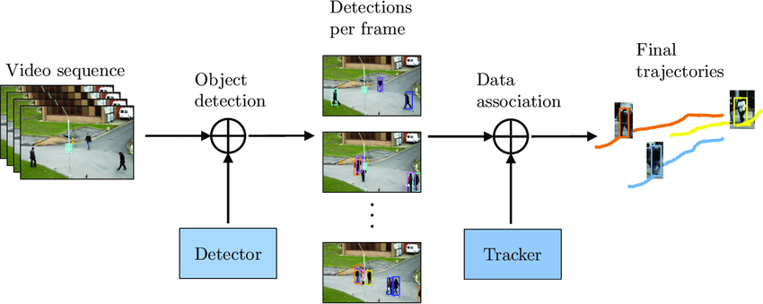
Tracking-by-detection paradigm
Detection stage:
Highlight bounding boxes that determine localizations of target objects
Data association (embedding) stage:
Detected objects are reidentified with the motion trajectories obtained earlier
4

Slide 5
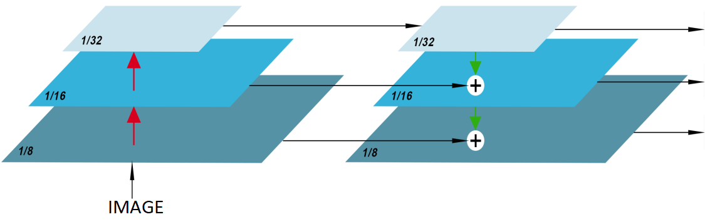
JDE model
JDE (Joint Detection and Embedding) algorithm combines 2 steps of the tracking-by-detection paradigm into a common model
FPN (Feature Pyramid Network)
PREDICTION HEAD
PREDICTION HEAD
PREDICTION HEAD
5

Slide 6
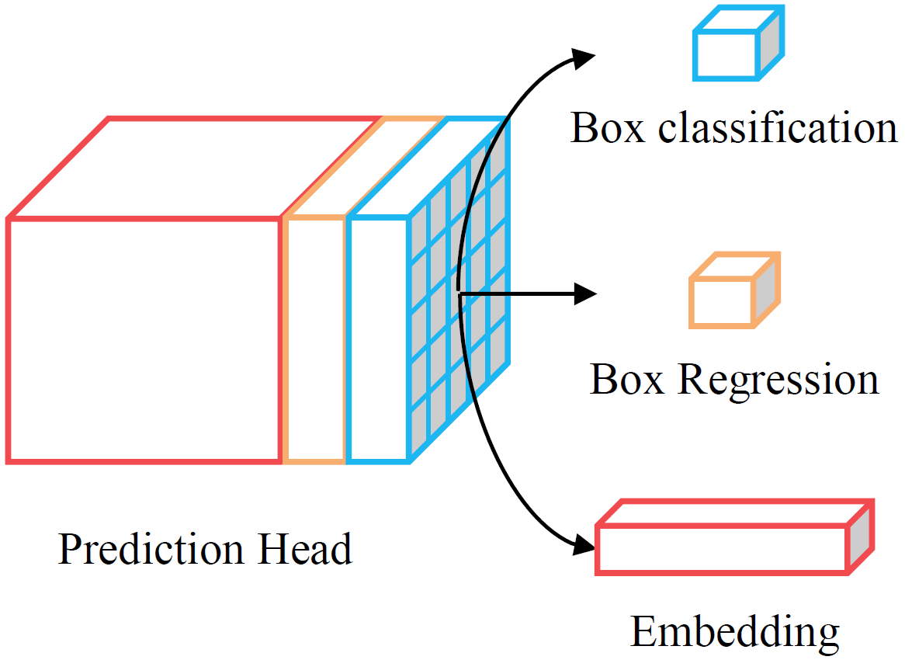
JDE model: prediction head
Output: tensor with a size of (6A+D)×H×W:
box classification results (2A×H×W; to classify detected objects)
box regression coefficients (4A×H×W; to adjust bounding boxes)
dense embedding map (D×H×W; for embedding stage)
A=4 – # anchor templates assigned to certain width (from 11 to 512),
All anchors were set to aspect ratio 1:3
D – dimension of embedding
6

Slide 7
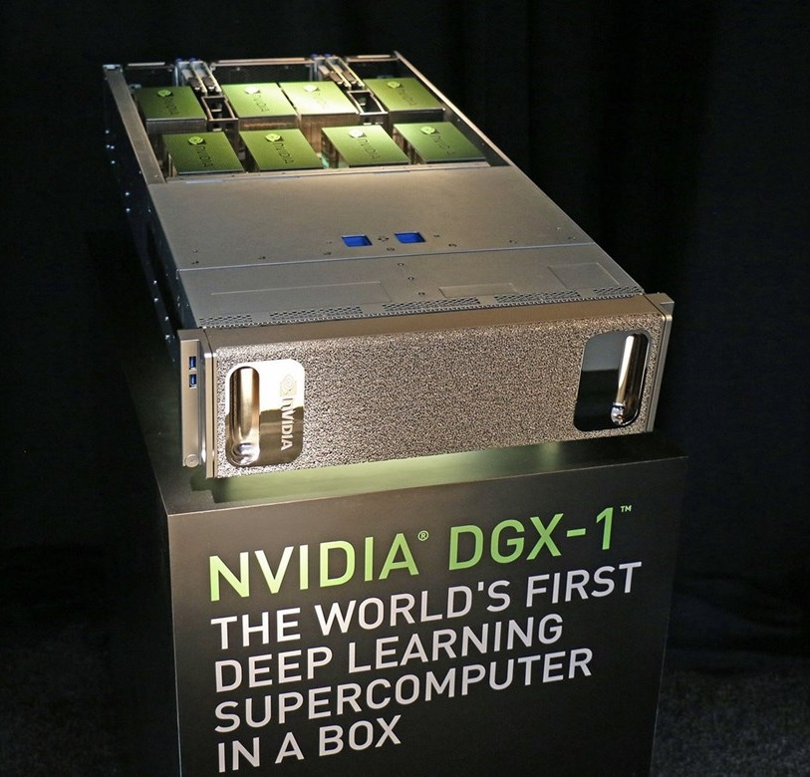

Training and testing
Optimizer: SGD
Learning rate: 0.01
(decreased 10 times on 15th and 23th epochs)
Epochs: 30
7

Slide 8
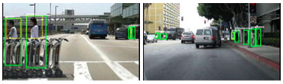
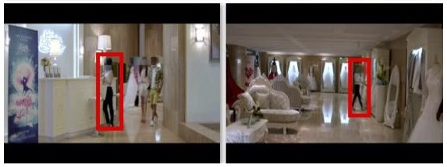
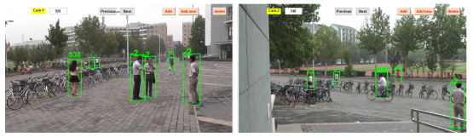
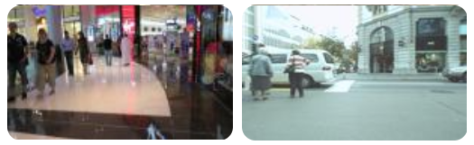
Training and testing: data
Training datasets:
CalTech Pedestrian
CUHK-SYSU
PRW
MOT-16 Challenge (train sample)
Testing:
MOT-16 Challenge (test sample)
8

Slide 9
Data augmentation
Random rotation
Random scale
Color jittering
Resize to 1088×608 (if it is needed)
9

Slide 10
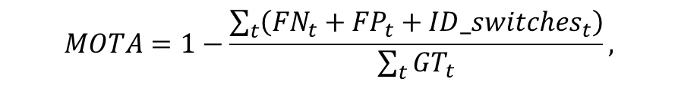
Numerical results
Model | Metrics of quality
 | MOTA | FPS
DeepSort_2 + WRN [1] | 61.4% | 8
CNNMTT + 5-layer CNN [2] | 65.2% | 6
JDE | 62.6 % | 18
$$MOTA=1−\frac{\sum_{t}{\left({FN}_{t}+{FP}_{t}+{ID_switches}_{t}\right)}}{\sum_{t}{{GT}_{t}}},$$
[1] S. Zagoruyko, N. Komodakis, “Wide Residual Networks”, Web: https://arxiv.org/pdf/1605.07146.pdf.
[2] N. Mahmoudi, S. M. Ahadi, M. Rahmati, “Multi-target tracking using CNN-based features: CNNMTT”, Multimedia Tools and Applications, vol. 78, No. 6, pp. 7077-7096, 2019.
10

Slide 11
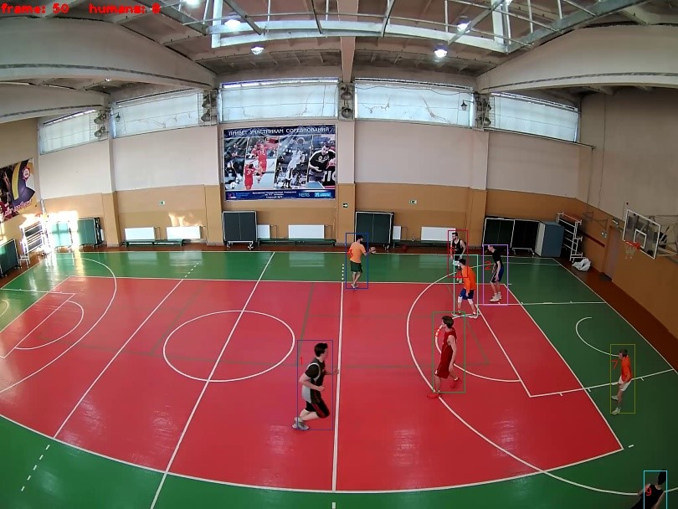
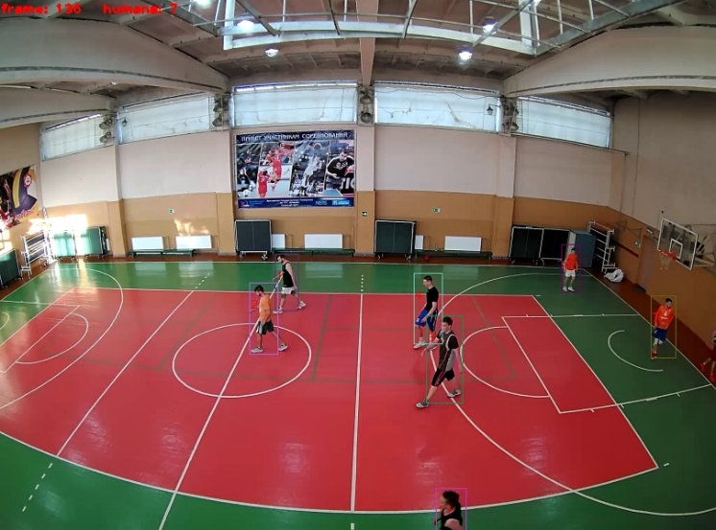
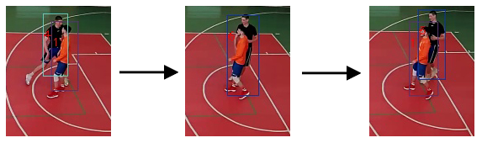
Visual results
ID switches:
11

Slide 12
Conclusions
Researched JDE algorithm for detection and tracking people (in particular athletes, on videos in real time)
Trained on supercomputer NVIDIA DGX-1
Tested on video frames extracted from video files of the MOT-16 Challenge dataset, using MOTA metric
Evaluated on collected video recordings of basketball matches, filmed on the dome camera, located in the sports hall of P.G. Demidov YarSU
Future plans: improve the quality of the JDE algorithm by training it on video frames of sports events
12

Slide 13

Acknowledgements
The authors are grateful to the support from the federal academic leadership program Priority 2030 of P.G. Demidov Yaroslavl State University and project “Development of fundamental basis and scientific and methodological support for the management of creating new competences for modern Russian corporation of the machine-building industry and the formation of requests for competencies”, funded by the Russian Foundation for Basic Research (project number 20-010-00572 A)
13

Slide 14
Detection and Tracking of Sport Players on Videodata Using Deep Learning Methods
Leonid Ivanovsky
Vladimir Khryashchev
Dmitry Matveev
Alexander Semenov

