Slide 1

Presentation On
Development
of
Automatic Timetable Generation System For Universities
Guided BY:
By:
Go-Groups Interns:
EWANG CLARKSON
AND
LEONEL DJATIO
Go-Groups Software Engineer:
DENGUN DIEUDONNE

Slide 2

Presentation Overview
Brief History of the Project
Introduction to the Timetable Generation System
Project Status & Learnings
Next Steps?

Slide 3
Brief History of the Project
In recent years two main approaches seem to have been successful.
  The first approach is based on
  Local Search Procedures
  The second approach is based on
  Constraint Programming (CP)

Slide 4
The Local Search Procedures
The local search procedures such as Simulated Annealing, Tabu Search and Genetic Algorithms.
These methods express constraints as some cost functions, which are minimized by a Heuristic Search of better solutions in a neighborhood of some initial feasible solution.
The main disadvantages of this approach are :
1. The difficulty of taking into account hard constraints
2. The need to determine their parameters through experimentation. Although they are good for optimizing the initial feasible solution, they have problems with finding it.

Slide 5
The Constraint Programming (CP)
The constraints are handled through a system of constraint propagation, which reduces domains of variables, coupled with backtracking search.
The main disadvantages of this approach are :
1. The difficulties with expressing soft constraints
2. The possible problems with improving the initial feasible solution, which - as a rule - may be determined without difficulties.
The ability to express complex constraints in a simple, declarative way is crucial for introducing the requirements of the colleges and university timetabling problem into the program and is crucial for their successful solution.

Slide 6

Introduction to the
Timetable Generation System
What is a Timetable Generation System?
Flow of The Project
Approach Used
Flow of Data Within The Project
Design of Database

Slide 7

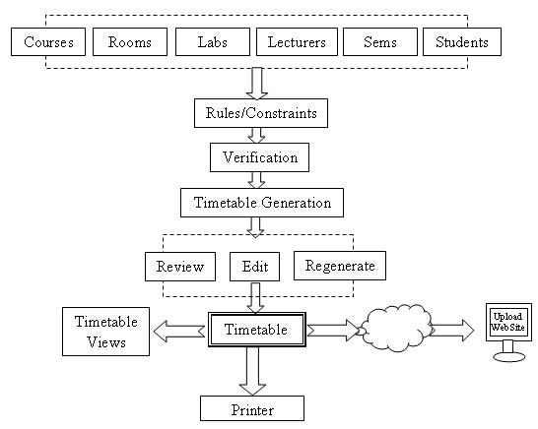
Flow of Project
Get the data
Input the constraints
Verify all entries
Generate timetable
Finalize timetable
View timetable
Print/Download
timetable

Slide 8
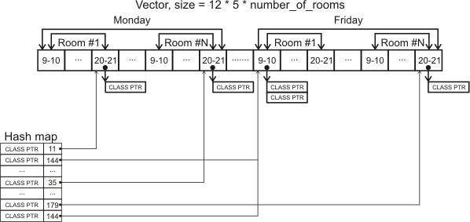
Our Approach
Genetic Algorithm
Chromosome Represention
Matrix Mapping Techniques
Database Population/Allocations
View timetable
Print/Download
timetable

Slide 9
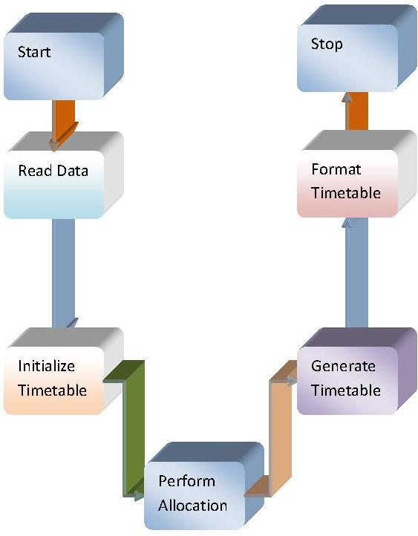
Flow of Data Within Project
Collect data from database
Initialize Timetable
Perform Allocation
Generation of Timetable
Formatting of Timetable

Slide 10

Project Status & Learning

Slide 11
Status of Project
Project Stage-1
  Analysis of Project
  Requirements of Projects (S/W and H/W)
  Planning
  Documentation

Slide 12



It Consist Of Scheduling Of Lectures And Rooms
Based On Strong Constraints and Weak Constraints in given Time Slots
Strong Constraint
A classroom is not assigned to more than one lecture at the same time.
Weak Constraint
There should be break after 2 hrs
A teacher can take maximum 3 lectures a day

Slide 13







Teachers List
Course List
Rooms List
ARS
SSC
SRP
SMV
SHB
CEF ...
SM ...
EFF …
COT ...
CLRBLK ...
U-BLK ...
AMPHI …
RESTAUX ...
Time Slots List
Years List
Days List
7:00-9:00
.
.
2:00-3:00
.
.
4:30-5:30
.
.
.
2018
Mon
Tue
Wed
Thu
Fri
Sat

Slide 14






Constraints Matrix
Teachers List
Courses List
Class Rooms List
ARS
SSC
SRP
SMV
SHB
COT...
CEF ...
SM...
EEF...
CLRBLK…
U-BLK...
AMPHI...
RESTAUX...
Time Slots List
Years List
Days List
7:00-9:00
.
.
2:00-3:00
.
.
6:00-7:00
.
.
.
2018
Mon
Tue
Wed
Thu
Fri
Sat

Slide 15

Next Steps?

Slide 16

Next Steps?
Actual Implementation
  Interface design
  Code
  Test for some e.g.
  Feedback
  Prepare Final Product
  THE ABOVE IS STILL TO BE DONE

Slide 17
References
An algorithm for constructing University timetables
By Mary Almond s
Google Web Toolkit.
https://google.com
http://laravel.com
http://stackoverflow.com
http://laracast.com Etc.

Slide 18
Timetable Generation System
Timetabling The Stress Free Way !
Thank You !
CLARKSON AND LEONEL
University Of Buea,Cameroon

