Slide 1
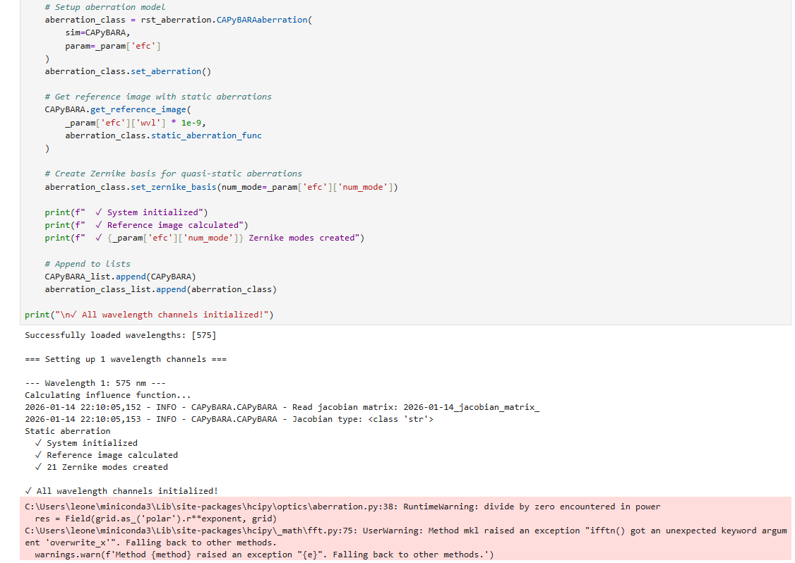
I was getting an error in the very first line with the aberration_class variable. Typically, you would see another message printed out at the bottom, and the code would not run at all in this text. This is where I went back to aberration.py to make some changes. There was a custom_basis variable that was not properly defined in one of the classes, according to the error. I basically went back and prematurely set it to None just so the code would at least run. However, I do not think that was the right thing to do since from the code, custom_basis seemed to mean something, and I am unsure what that is. It was just never defined but still used.

Slide 2
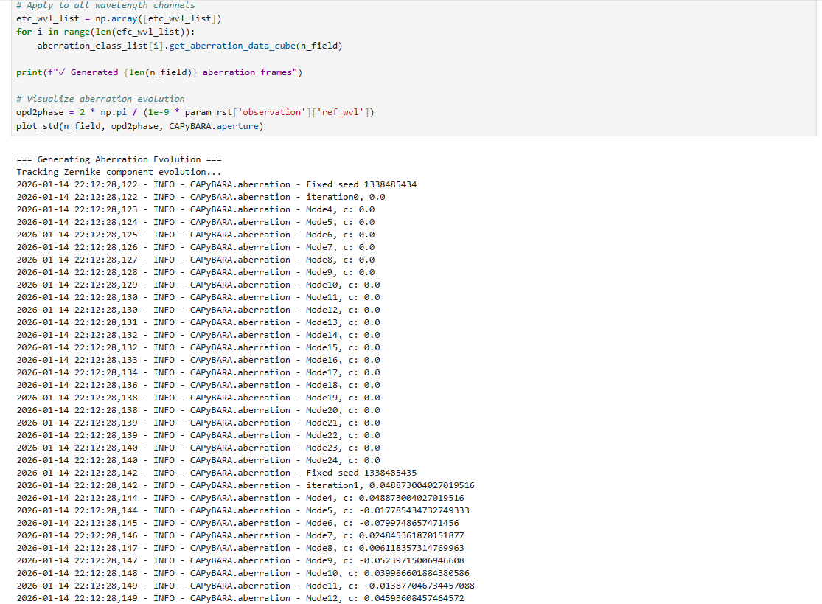
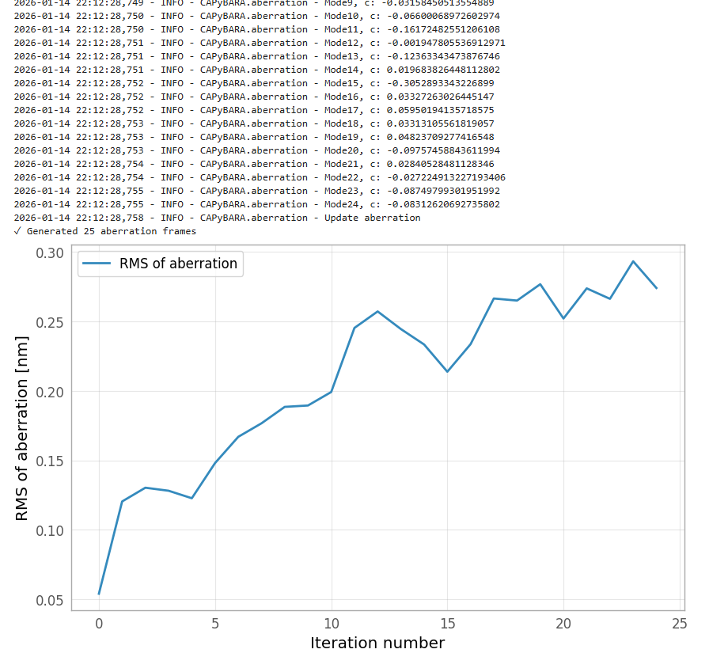

Slide 3
As a result of applying the changes to the aberration stuff, I got the results above. I do not want to make much speculation on what these mean since I am not sure exactly what I am looking at nor how the changes I made would even affect if this is right or wrong.

Slide 4
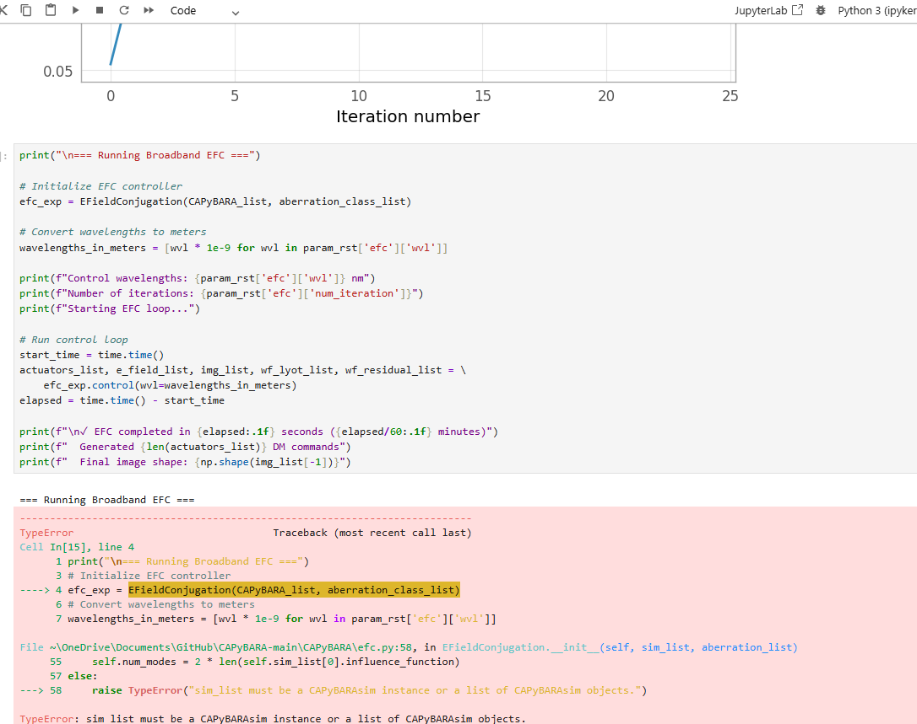

Slide 5
The slide above shows the next code block. This is the first cell that ran with actual errors. After this, I did not proceed to make any more changes to the code. This seemed like it was one of those variable of function definition issues I was talking about.

