Slide 1
Vue
Components

Slide 2
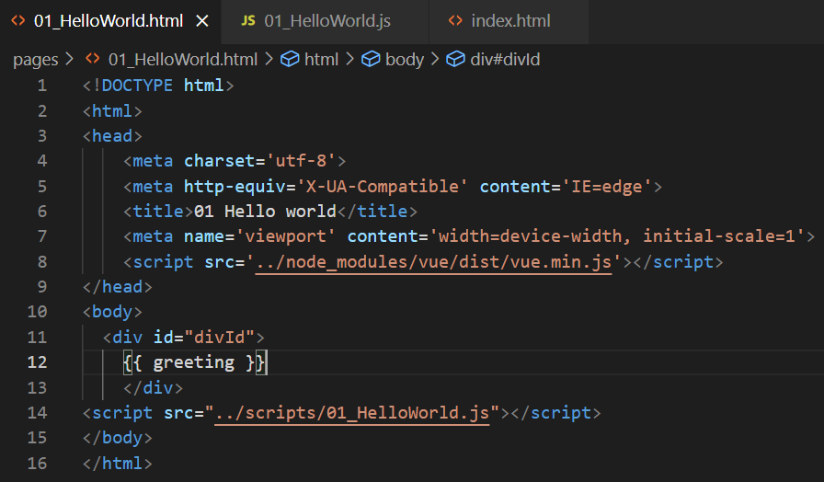
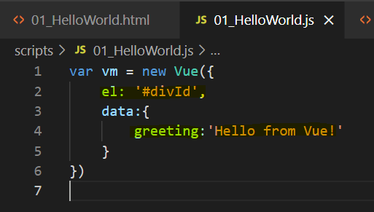
Vue attach to id
1. Create Vue view model
2. Define element on witch one view model will be attached
3. Fill and use view model data

Slide 3
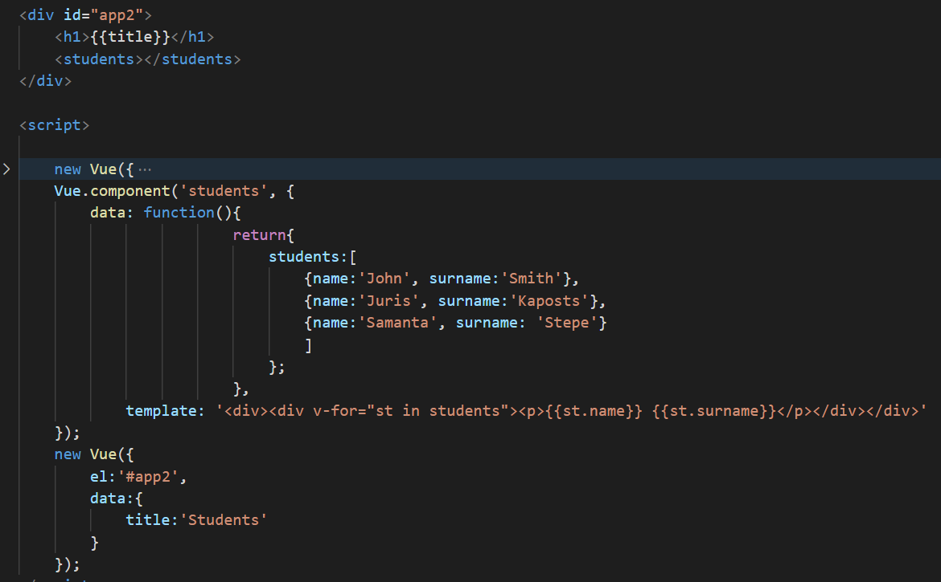
Componenets

Slide 4
Vue/webpack
Open cmd or terminal as administrator in folder where should be your project. Execute commands:
npm install -g vue-cli
npm - g @vue/cli-init
vue init webpack-simple vue-webpack
cd vue-webpack
npm install
Npm run build
Npm run dev

Slide 5
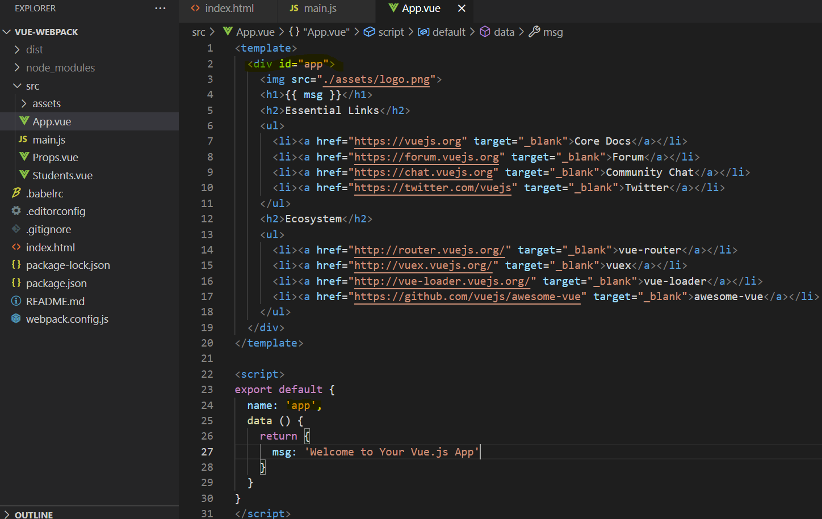
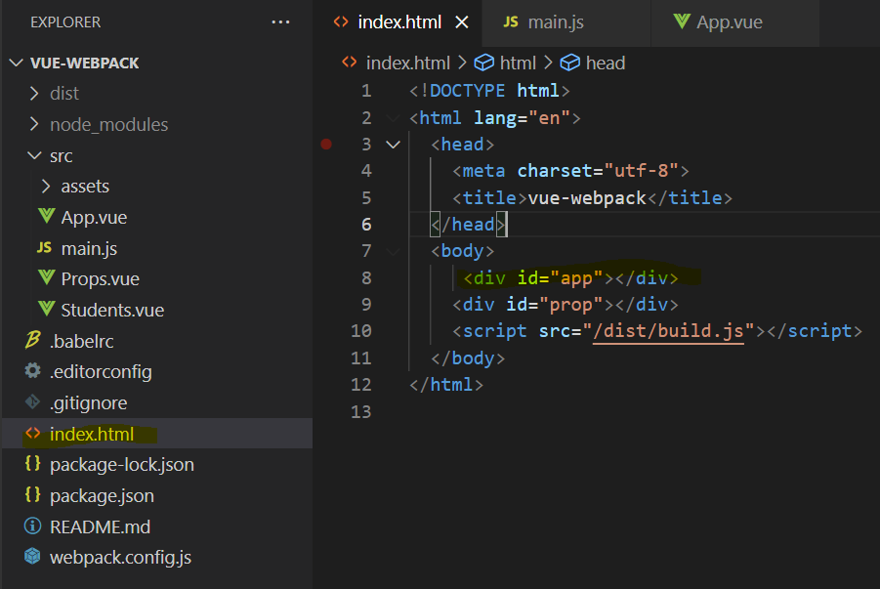
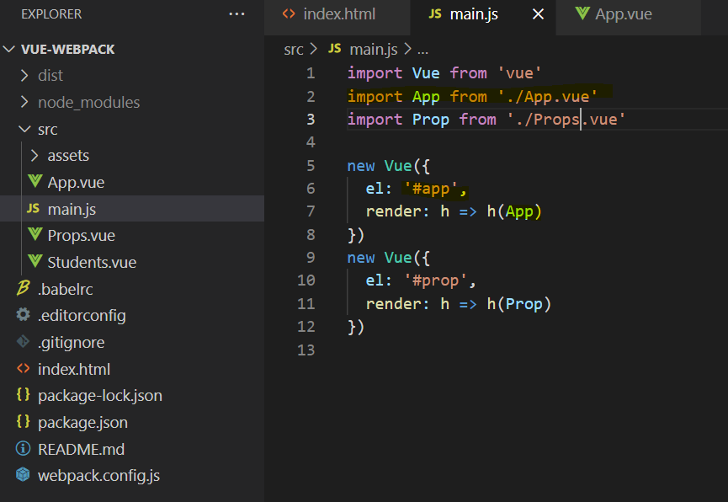
Replace existing content against Vue content

