Slide 1
CS 621 Data Analytics
Dashboard

Slide 2
A dashBoard
A dashboard is a visual interface that summarizes important information for data.
Combines key metrics and visualizations in one view.
Uses charts, tables, gauges, and maps to present data clearly.
Can be a local or cloud application.
Provides interactive Features.
Helps decision makers quickly identify patterns.

Slide 3
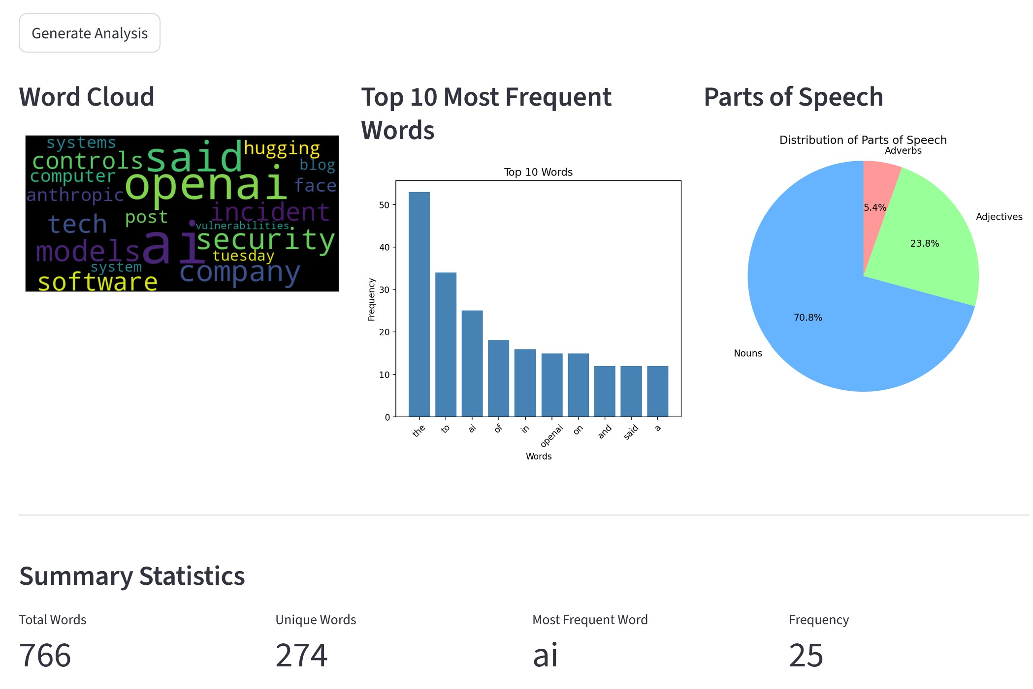
AN Example

Slide 4
Components Needed
A web-based application
NLTK
Wordcloud
Matplotlib
Steamlit

Slide 5
STREMLIT
Check https://streamlit.io/ for details.
Open-source Python framework for creating interactive web applications.
Only uses only Python, without HTML, CSS, or JavaScript.
Converts Python scripts into web-based dashboards.
Installation: pip install streamlit
Run: steamlit run dashboard_demo.py

Slide 6
THE PROCESS FLOW
Create a TextArea for the user to input text data.
Provide a clickable button to start the analysis.
Clean the text data based on our previous examples.
Create a word cloud based on our previous examples.
Create a bar chart based on our previous examples.
Create a pie chart based on our previous examples.
Compute basic statistics based on our previous examples.
Launch the application locally with Python and Streamlit.

