Slide 1

Web Attack Strategies and Mitigation Techniques
Protecting Your Web Applications from Common Threats
Notes:
Good morning/afternoon everyone. Today's presentation focuses on crucial web attack strategies and the effective mitigation techniques to counter them. We'll delve into the mechanics of each attack and discuss practical steps to safeguard your web applications.

Slide 2


The Ever-Present Threat of Web Attacks
Web applications are increasingly targeted by malicious actors.
Exploiting vulnerabilities can lead to data breaches, financial loss, reputational damage, and service disruption.
Understanding the attack vectors is the first step in protecting your digital assets.
Recommend strategies to mitigate attacks
Notes:
The digital landscape is becoming increasingly complex, and with that complexity comes increased vulnerability. Web attacks are a constant threat, impacting businesses of all sizes. The consequences can be devastating, affecting not only financial stability but also brand reputation and customer trust.

Slide 3
Web Attack Strategies in Focus
This presentation will cover the following attack strategies:
Cross-Site Scripting (XSS)
Cross-Site Request Forgery (CSRF)
SQL Injection
Command Injection
Cookie Poisoning
Buffer Overflow
Zero-Day Attack
Directory Traversal
Notes:
We'll be examining a range of common and potentially devastating web attack strategies, from well-established methods like XSS and SQL Injection to emerging threats like zero-day exploits.

Slide 4
Cross-Site Scripting (XSS)
Injecting malicious scripts into websites viewed by other users.
Mitigation:
Input Validation: Sanitize all user inputs.
Output Encoding: Encode data before displaying it on the page.
Content Security Policy (CSP): Define allowed sources of content.
“Researchers have shifted their focus from traditional XSS attack detection techniques to machine learning-based detection techniques because ML techniques have several advantages over conventional mechanisms such as detecting malicious patterns automatically and higher accuracy scores” ( Kaur et. al., 2023).
Notes:
XSS attacks exploit vulnerabilities in web applications to inject malicious code. Effective mitigation strategies involve carefully validating and encoding data, as well as using Content Security Policy to restrict the sources of executable scripts. New techniques are using machine learning to assign probabilities of malicious activity and send alerts based on AI models. (Kaur et. al., 2023)

Slide 5
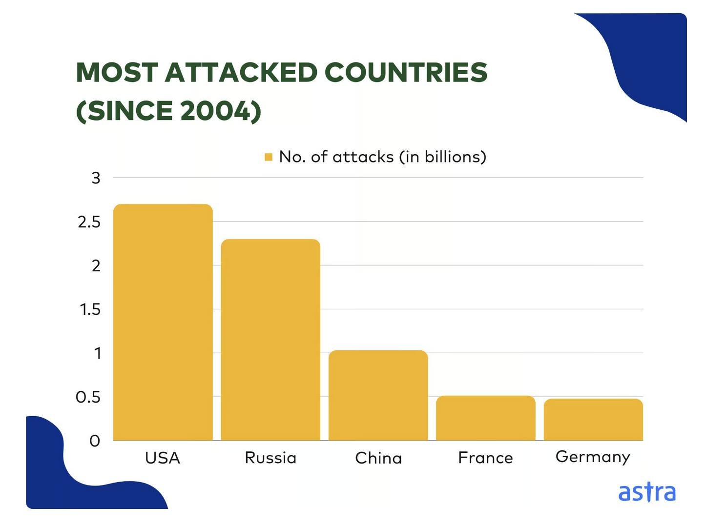
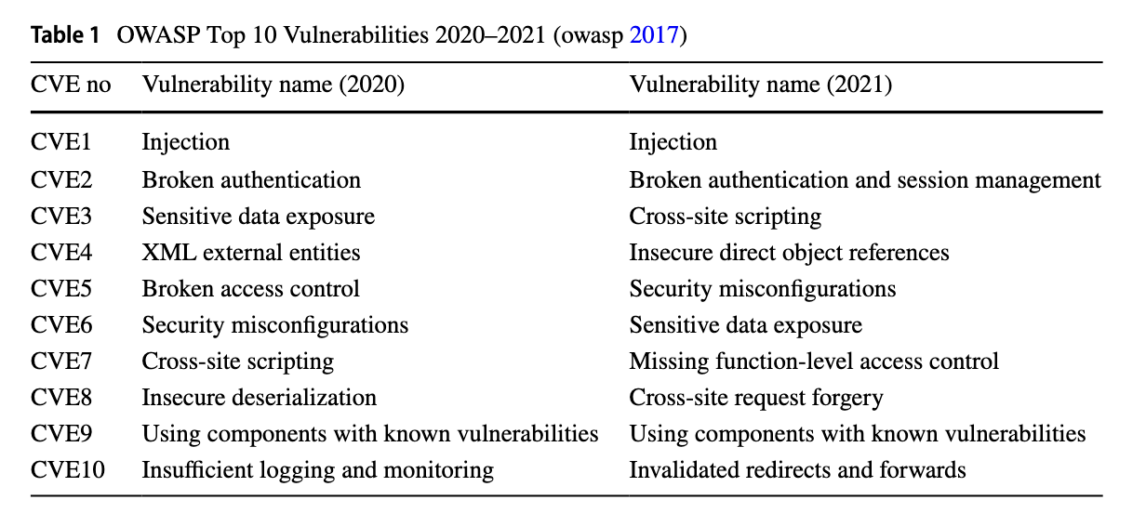
Statistics
A recent security audit from Astra Security states that a web application faces a cyber-attack every 39 seconds (Nivedita J., 2023).
At the time of writing, 28778 new vulnerabilities have been discovered in 2023 alone, dwarfing 2022’s total vulnerabilities by nearly 3700. In fact, at the current rate of 14.8%, 2024 will have 33K+ CVEs (Nivedita J., 2023).
“…the most prominent internet threat among web applications is cross-site scripting (XSS) attack and thus needs the utmost attention of researchers”(owasp, 2017).
“…the universal cost of threat activities executed by hackers on online platforms crossed $6 trillion at the end of 2021” (G, Nick, 2021).
Notes:
Let's break down these figures. A cyberattack every 39 seconds highlights the relentless nature of these threats. This constant barrage of attacks requires organizations to adopt a proactive and vigilant security posture. The dramatic increase in discovered vulnerabilities year over year indicates that attackers are constantly finding new ways to exploit weaknesses in software. This emphasizes the importance of staying up-to-date with security patches and implementing robust vulnerability management programs.
The fact that Cross-Site Scripting (XSS) remains a prominent threat, even with increased awareness and mitigation efforts, demonstrates the persistent nature of this vulnerability and the ongoing need for developers to prioritize secure coding practices. The astronomical cost of cyberattacks, exceeding $6 trillion globally in 2021, signifies the devastating financial impact these attacks can have on businesses and individuals. This includes not only direct financial losses but also the costs associated with incident response, reputational damage, and legal liabilities.

Slide 6
Cross-Site Request Forgery (CSRF)
Tricking a user into executing unwanted actions on a website in which they're currently authenticated.
Mitigation:
Anti-CSRF Tokens: Generate unique, unpredictable tokens for each user session and include them in forms.
SameSite Cookie Attribute: Restrict cookies to the same site to prevent them from being sent with cross-site requests.
Double Submit Cookie: Include a hidden field with a value derived from a cookie; the server verifies the match.
Verify Origin Header: Check the Origin header of requests to ensure they originate from the expected domain.
Notes:
Cross-Site Request Forgery (CSRF), also known as XSRF or one-click attack, is a web vulnerability that tricks a user into executing unwanted actions on a website in which they're currently authenticated. It exploits the trust a website has in a user's browser. Unlike other attacks that aim to steal user data, CSRF attacks aim to perform actions on behalf of the user without their knowledge or consent.
Here's how it works: Imagine a user is logged into their online banking portal. An attacker could craft a malicious webpage containing a hidden form that automatically submits a request to the banking website to transfer funds. If the user visits this malicious webpage while still logged in to their bank, their browser will automatically include their authentication cookies with the request, allowing the attacker to perform the fraudulent transaction. The user doesn't even have to click anything; simply visiting the malicious page is enough to trigger the attack.

Slide 7
SQL Injection
Manipulating database queries to gain unauthorized access or modify data.
Mitigation:
Parameterized Queries: Use prepared statements to prevent direct injection.
Input Validation: Strictly validate user inputs to prevent malicious code.
Least Privilege Principle: Grant database users only necessary permissions.
Notes:
SQL Injection is a prevalent and dangerous web vulnerability that allows attackers to manipulate database queries to gain unauthorized access to data or modify the database itself. It occurs when an application directly incorporates user-supplied input into SQL queries without proper sanitization. The consequences of successful SQL injection attacks can be severe, including data breaches, data manipulation, and even complete control over the database server. Sensitive data such as customer information, financial records, and intellectual property can be compromised.

Slide 8
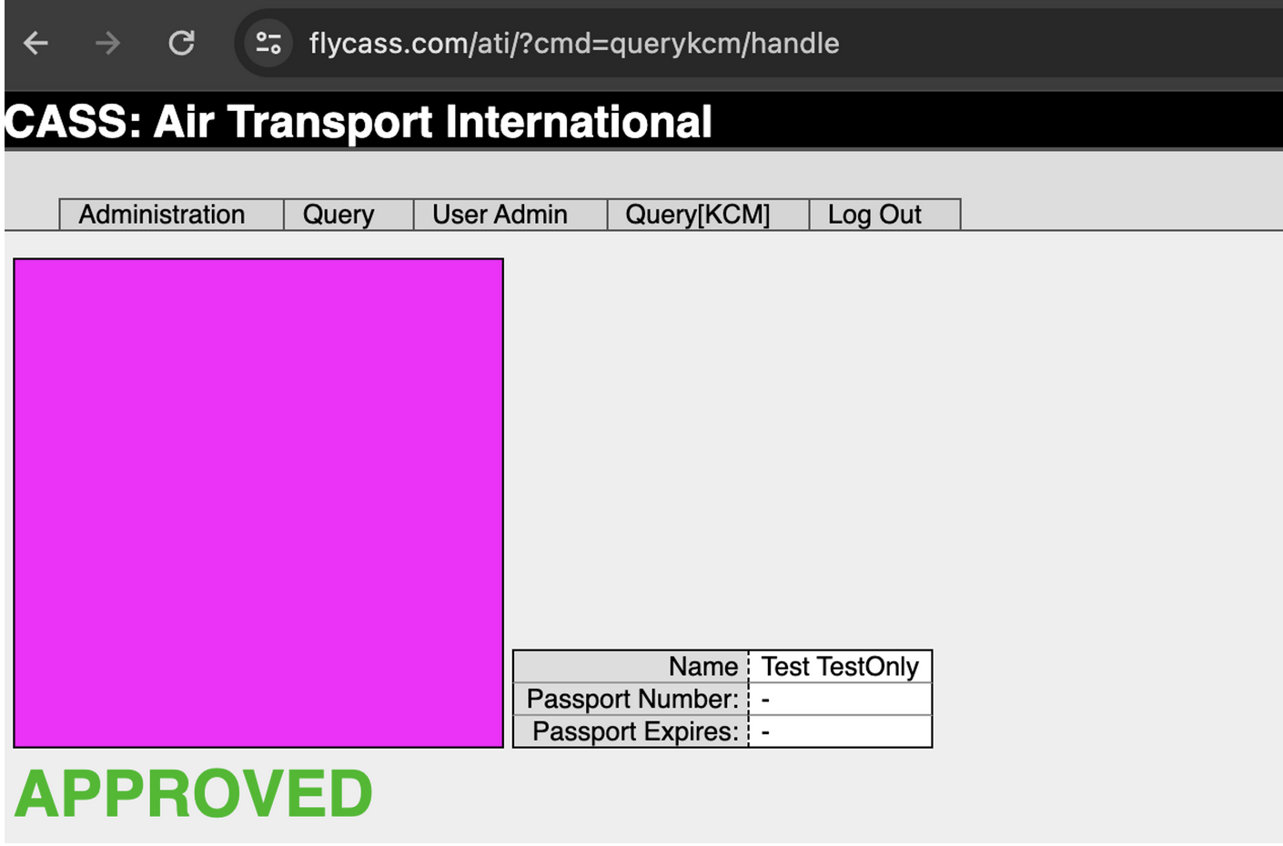
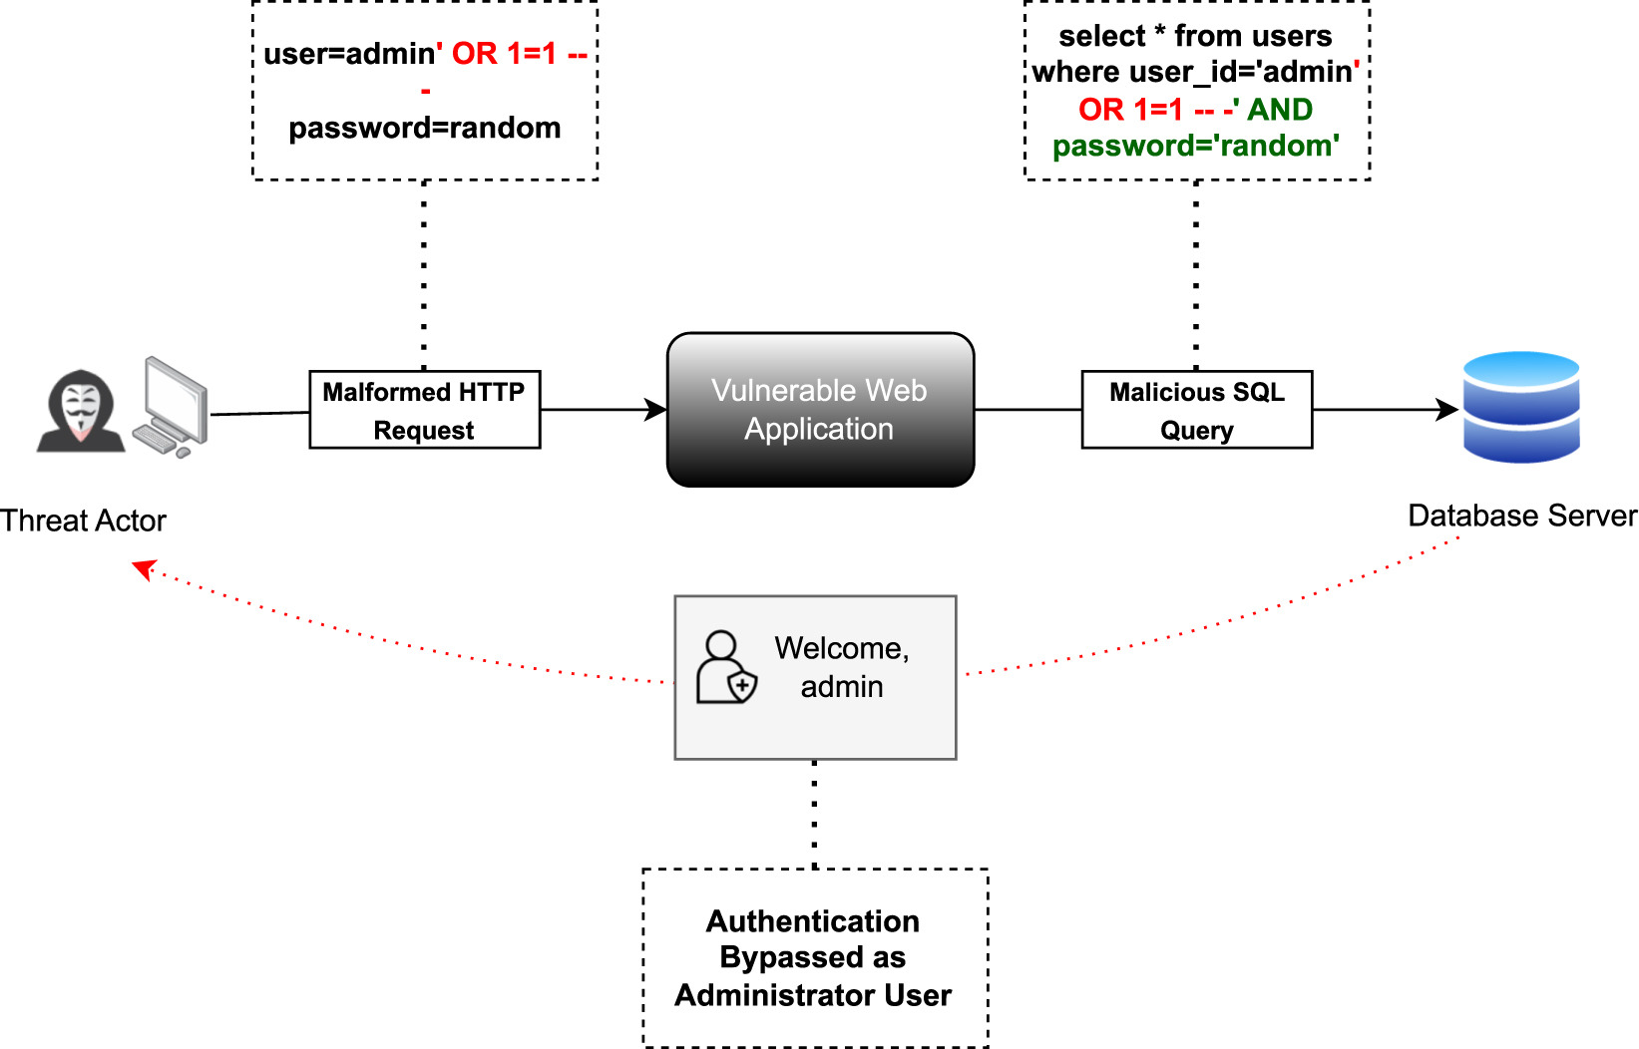
Case Study: Flycass.com
TSA program that allows pilots and flight attendants to bypass security screening, even when flying on domestic personal trips.
the employee uses the dedicated lane and presents their KCM barcode or provides the TSA agent their employee number and airline.
A similar system also exists for cockpit access, called the Cockpit Access Security System (CASS).
“It turns out that FlyCASS also operates both KCM and CASS for its participating airlines. Now that we are an administrator of Air Transport International, we are able to manage the list of pilots and flight attendants associated with them. Surprisingly, there is no further check or authentication to add a new employee to the airline. As the administrator of the airline, we were able to add anyone as an authorized user for KCM and CASS”(Carroll, 2024).
“An example usage of SQLi attack to bypass authentication is demonstrated in Fig. 1, which displays the threat actor injecting the SQLi payload “admin’OR 1=1 – -” into a “user” field of a login page using any arbitrary password. The malicious input, “admin’OR 1=1 – -”, which always evaluates to true, is then directly concatenated to the prefixed SQL statement with the “– -” commenting out the remainder of the SQL bypassing password verification and successfully authenticating the threat actor to the web application” (Paul et. al., 2024).
Carrol, 2024
Paul et. al, 2024
Notes:
Here is an example of a security vulnerability discovered in the Known Crewmember (KCM) and Cockpit Access Security System (CASS) used by the Transportation Security Administration (TSA) to allow airline employees to bypass airport security screening. The researchers found that the FlyCASS.com website, which operates the authorization systems for some smaller airlines, had a SQL injection vulnerability that allowed them to log in as an administrator and add any person they wanted to the authorized list for KCM and CASS access. This would have allowed anyone to bypass security screening and gain access to aircraft cockpits. The researchers attempted to disclose the issue to the Department of Homeland Security, but the TSA issued incorrect statements denying the vulnerability. The vulnerability was eventually addressed, but the researchers were frustrated by the lack of cooperation from the authorities.

Slide 9
Command Injection
Injecting operating system commands into an application through user input.
Mitigation:
Input Validation: Strictly sanitize and validate all user inputs, especially those used in shell commands.
Avoid System Calls: Use safer alternatives when possible, such as dedicated libraries for file system operations.
Least Privilege Principle: Run applications with the minimum necessary privileges.
Escape Special Characters: Properly escape or encode special characters used in command construction.
Notes:
The key difference between Command Injection and SQL Injection lies in the target. SQL Injection targets the database, aiming to manipulate database queries to retrieve or modify data, or even control the database server. Command Injection, on the other hand, targets the underlying operating system, allowing attackers to execute system commands. While both exploit insufficient input validation, the impact and scope of Command Injection can be broader, as it potentially grants access to the entire server, not just the database.

Slide 10

Cookie Poisoning
Modifying cookie values to gain unauthorized access or manipulate user sessions.
Mitigation:
Encrypting Cookies: Encrypt sensitive cookie data, such as user IDs and authentication tokens.
Setting HttpOnly Flag: Prevent client-side scripts from accessing cookies.
Setting Secure Flag: Ensure cookies are only transmitted over HTTPS.
Short Cookie Expiration Times: Limit the window of vulnerability by setting shorter expiration times.
Notes:
Cookie poisoning is a web attack where an attacker modifies the content of a user's cookies to gain unauthorized access to a web application or to manipulate the user's session. Cookies store various pieces of information about a user's interaction with a website, including session IDs, user preferences, and shopping cart contents. If an attacker can modify these cookies, they can potentially hijack a user's session, gain access to sensitive information, or perform actions on behalf of the user without their consent.

Slide 11
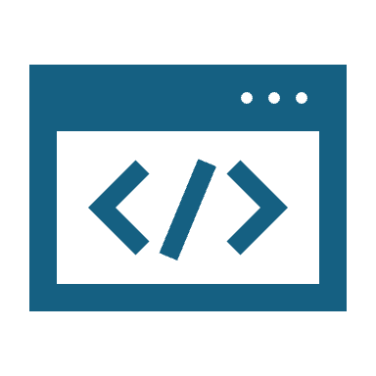
Buffer Overflow
Writing data beyond the allocated buffer size, potentially overwriting adjacent memory regions.
Mitigation:
Input Validation: Check the length of input data before writing it to a buffer.
Safe String Handling Functions: Use functions that prevent buffer overflows, such as strncpy() instead of strcpy().
Compiler-Level Protections: Enable compiler features like stack canaries and Address Space Layout Randomization (ASLR).
Regular Security Audits and Code Reviews: Identify and fix potential buffer overflow vulnerabilities.
Fuzzy Logic and Machine learning can be applied to static analysis of code to find overflow points (Cruzes, 2018).
Notes:
A buffer overflow is a classic and dangerous software vulnerability that occurs when a program attempts to write data beyond the allocated buffer size. This can lead to overwriting adjacent memory regions, potentially corrupting other data, crashing the program, or even allowing attackers to execute arbitrary code. Think of a buffer like a container designed to hold a specific amount of data. If you try to pour more into it than it can hold, it overflows, and the excess spills out, potentially messing up things around it.

Slide 12
Case Study: CVE-2023-4863 and CVE-2023-5217
Two high-heap overflow vulnerabilities were discovered in the libwebp and libvpx libraries
The libwebp library encodes and decodes images in the WebP format. It’s used extensively in various applications such as web browsers and image processing tools.
“That being said, bad actors generally have a low probability of successfully exploiting heap overflow vulnerabilities via RCE due to the heap's unpredictable nature and the absence of return addresses” (Sharon, et. al., 2023)
Patched relatively quickly by Google for Chrome web browser on September 11, 2023.
Notes:
CVE-2023-5217 is an exploit of the VP8 codec within the libvpx library. This exploit relies on memory corruption and heap buffer overflow. By utilizing a crafted HTML page, an attacker can exploit the library to inject malware, gain remote elevated access privileges, and execute other exploits. While first detected by Google within its Chrome software, this vulnerability affects numerous different software packages that depend upon the libvpx library. This includes all Chromium-based browsers, Firefox, and hundreds of Ubuntu and Debian packages. In this exploit, it is likely an attacker utilizes a vulnerability within the VP8 codec allowing for a video stream to send more data than the memory buffer can keep up with. This then allows for out-of-bounds write and for the attacker to perform a code injection gaining more access. From here, an attacker would likely pivot through the system and deploy a remote access trojan (RAT) to gain persistent access.

Slide 13

Zero-Day Attack
Exploiting vulnerabilities unknown to the software vendor or security community.
Mitigation:
Threat Intelligence: Stay informed about emerging threats and vulnerabilities.
Intrusion Detection/Prevention Systems (IDS/IPS): Implement systems to detect and block suspicious activity.
Security Hardening: Configure systems and applications with strong security settings.
Vulnerability Management Program: Establish a process for identifying, assessing, and patching vulnerabilities.
Researches have used zero shot Machine Learning models to detect shellcode exploits with up to 97% accuracy.(Sarhan et. al., 2023)
Notes:
A zero-day attack exploits a software vulnerability that is unknown to the software vendor or the security community. This means that no patch is available to fix the vulnerability, making these attacks particularly dangerous. Because the vulnerability is unknown, traditional signature-based security solutions are often ineffective against zero-day attacks. They are called "zero-day" because the developers have zero days of awareness to address the flaw. Once the vulnerability becomes public knowledge, it's no longer a zero-day exploit, but the impact can already be significant.

Slide 14
Case Study: CVE-2021-44228 Log4Shell
According to Wiz and EY, 93% of all cloud environments were at risk when Log4Shell was discovered (Wiz.io, 2024).
“By 9 December 2021, proof-of-concept code on how to use Log4Shell was posted on GitHub, and hackers were mounting attacks”(IBM, 2024).
“At the peak of Log4Shell activity, Check Point observed more than 100 attacks every minute, affecting more than 40% of all business networks globally” (Checkpoint, 2021).
Notes:
The Log4Shell vulnerability (CVE-2021-44228) is a critical remote code execution (RCE) flaw affecting Apache Log4j 2 versions 2.14.1 and earlier. This vulnerability stems from how these older versions handle Java Naming and Directory Interface (JNDI) lookups. Because Log4j 2 improperly processes JNDI lookups – which are commands fetching external resources – it executes any code received from these lookups. Log4j 2 versions 2.15 and later, and all versions of Log4j 1, are not affected.

Slide 15

Directory Traversal
Accessing files and directories outside the intended webroot through manipulated file paths.
Mitigation:
Input Validation: Strictly validate user-supplied file paths to prevent traversal sequences (../).
Canonicalize File Paths: Resolve all symbolic links and relative paths to their absolute form before accessing files.
Configure web server to restrict access to sensitive files and directories via ACLs and chmod.
Use Dedicated Libraries: Leverage libraries or functions designed to safely handle file paths.
Notes:
Directory traversal attacks can expose sensitive information. Input validation, canonicalization, proper web server configuration, and using secure file handling techniques are critical for preventing unauthorized access to the file system. Here's a breakdown of how it works: The ../ sequence represents the parent directory. By repeating this sequence, the attacker can traverse up the directory tree and potentially access sensitive files or directories outside the web server's document root. This could include configuration files, system files, or even files from other users on the same server.

Slide 16
Recommended Course of Action – Proactive Defense
Implement a Web Application Firewall (WAF).
01
Conduct regular security assessments and penetration testing.
02
Stay updated with security patches and best practices.
03
Implement robust incident response plans.
04
Notes:
A proactive security posture is crucial. WAFs provide an initial line of defense, while regular security testing helps identify and address vulnerabilities before they are exploited. Keeping software up to date and having a well-defined incident response plan are essential for minimizing the impact of successful attacks.

Slide 17
Recommended Course of Action – Continuous Monitoring and Improvement
Implement security information and event management (SIEM) systems.
01
Regularly review security logs and alerts.
02
Foster a security-conscious culture within the organization.
03
Engage in ongoing security training for developers and staff.
04
Notes:
Security is an ongoing process, not a one-time event. Continuous monitoring and improvement are vital. SIEM systems help analyze security-related data, while regular log reviews can reveal suspicious activity. Promoting a security-focused culture and providing ongoing training empowers everyone to contribute to a stronger security posture.

Slide 18
References
G. Nick. (2021). The Most Telling Cyber Security Statistics in 2021. Cyber Security Stats— Infographic. https://techjury.net/blog/cyber-security-statistics/
owasp. (2017). OWASP Top Ten. OWASP. https://owasp.org/
Kaur, J., Garg, U., & Bathla, G. (2023). Detection of cross-site scripting (XSS) attacks using machine learning techniques: a review. Artificial Intelligence Review, 56(11), 12725–12769. doi:10.1007/s10462-023-10433-3
Nivedita J. (2023).160 Cybersecurity Statistics 2023 [Updated]. Astra IT. https://www.getastra.com/blog/security-audit/cyber-security-statistics/.
Carroll, I. (2024, August 29). Bypassing airport security via SQL injection. Bypassing Airport Security via SQL injection. https://ian.sh/tsa
Paul, A., Sharma, V., & Olukoya, O. (2024). SQL injection attack: Detection, prioritization & prevention. Journal of Information Security and Applications, 85(103871), 103871. doi:10.1016/j.jisa.2024.103871

Slide 19
References
Sharon Ben Zeev, Zand, T., & Artur Oleyarsh. (2023). High-Severity Vulnerabilities Discovered in WebM Project’s Libraries. Palo Alto Networks Blog. https://www.paloaltonetworks.com/blog/prisma-cloud/high-severity-vulnerabilities-webm-project-libraries/
Cruzes, D., Chaim, M., & Santos, D. (2018). What Do We Know About Buffer Overflow Detection?: A Survey on Techniques to Detect A Persistent Vulnerability. International Journal of Systems and Software Security and Protection, 9(3), 1-33. https://doi.org/10.4018/IJSSSP.2018070101
Wiz.io. (2024). Log4Shell 10 days later: Enterprises halfway through patching. https://www.wiz.io/blog/10-days-later-enterprises-halfway-through-patching-log4shell
IBM. (2024). What is the Log4j vulnerability?. Www.ibm.com. https://www.ibm.com/topics/log4j
Checkpoint. (2021). The Numbers Behind Log4j CVE-2021-44228. Check Point Blog. https://blog.checkpoint.com/security/the-numbers-behind-a-cyber-pandemic-detailed-dive/‌
Sarhan, M., Layeghy, S., Gallagher, M., & Portmann, M. (2023). From zero-shot machine learning to zero-day attack detection. International Journal of Information Security, 22(4), 947-959. https://doi.org/10.1007/s10207-023-00676-0

