Slide 1
Lecture 3 Pt. 1
Classes and Class Diagrams

Slide 2
Classes and Class Diagrams
The most popular UML diagram is the class diagram.
A system’s structure is made up of a collection of pieces often referred to as objects.
Classes describe the different types of objects that your system can have, and class diagrams show these classes and their relationships.

Slide 3
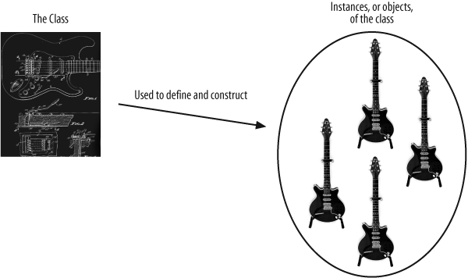
The relationship between classes and objects

Slide 4
Abstraction
This is the process of discarding irrelevant details in the context of the system you are modelling [Abstraction the verb]
An abstraction [noun] is a representation of an entity in the real world without details that are not relevant to the model being considered
A model itself is an abstraction – it is like the real thing but only the details relative to what must be represented in the model are presented

Slide 5
Abstraction
“Getting the right level of abstraction for your model, or even just for a class, is often a real challenge. Focus on the information that your system needs to know rather than becoming bogged down with details that may be irrelevant to your system. You will then have a good starting point when designing your system’s classes” (Russ & Miles)

Slide 6
Encapsulation
Encapsulation is important to allow a class to change the way it works internally without those changes being visible to the rest of the system, those changes will have no effect on how the class is interacted with.
If we have a good design of classes and their interfaces and relationships - changes to how those classes work internally shouldn’t cause your system to break.

Slide 7
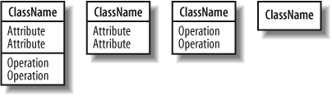
Class Notation

Slide 8

Classes
A class’s name establishes a type for the objects that will be instantiated based on it
Some classes that could be identified from the Content Management System Discussed last week:

Slide 9
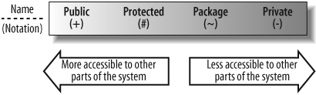
Visibility
Important for encapsulation
The means by which a class selectively reveals its operations and data to other classes
Control access to attributes, operations, and even entire classes to effectively enforce encapsulation
UML provides four levels of visibility
Notes:
Having imparted a package you only have access to classes that are either public or package/namepacse or module visibility

Slide 10
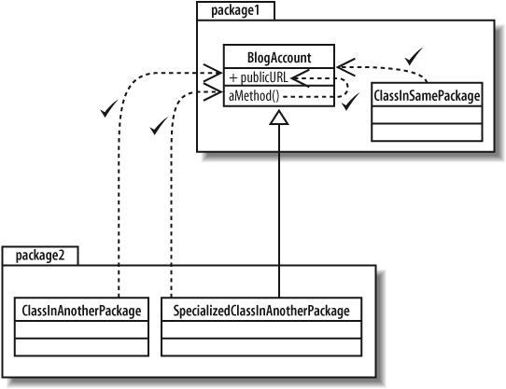
Public Visibility
public visibility is specified using the plus (+) symbol before the associated attribute or operation
Declare an attribute or operation public if you want it to be accessible directly by any other class.

Slide 11
Public visibility contd.
The public interface of a class consists of the attributes and operations that can be accessed and used by other classes.
This means the public interface is the part of your class that other classes will depend on the most.
It is important that the public interface to your classes changes as little as possible to prevent unnecessary changes wherever your class is used.

Slide 12
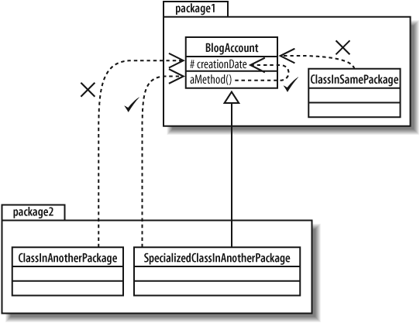
Protected visibility
Protected visibility is specified using the hash (#) symbol and are more visible to the rest of your system than private attributes and operations, but are less visible than public.
Declared protected elements on classes can be accessed by methods that are part of your class and also by methods that are declared on any class that inherits from your class.

Slide 13
Protected visibility contd.
Protected elements cannot be accessed by a class that does not inherit from your class whether it’s in the same package or not
Protected visibility is crucial if you want allow specialized classes to access an attribute or operation in the base class without opening that attribute or operation to the entire system.

Slide 14
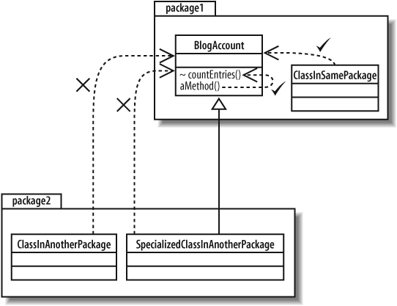
Package visibility contd.
Package visibility, specified with a tilde (~), when applied to attributes and operations, sits in between protected and private
packages are the key factor in determining which classes can see an attribute or operation that is declared with package visibility .
Notes:
Although the two classes in package 2 import package 1 they have no access to the method countEntries() because it has package visibility in package 1. Note though that the classes within the same package even if in a different class will have access to the method.

Slide 15
Package visibility Contd.
If you add an attribute or operation that is declared with package visibility to your class, then any class in the same package can directly access that attribute or operation
Classes outside the package cannot access protected attributes or operations even if it’s an inheriting class.
In practice, package visibility is most useful when you want to declare a collection of methods and attributes across your classes that can only be used within your package.
In Java – called package private achieved by not explicitly stating any visibility – note that this is different than private as this is achieved by the use of the keyword private – and means that the element is not visible to anyone outside the class (including other classes in the same package) while package private is less restrictive and means visible to any class in package but not outside of package.

Slide 16
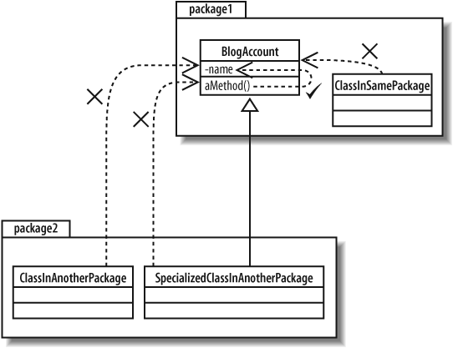
Private Visibility
Private visibility is the most tightly constrained type of visibility classification, and it is shown by adding a minus (-) symbol before the attribute or operation.
Only the class that contains the private element can see or work with the data stored in a private attribute or make a call to a private operation

Slide 17
Private Visibility contd.
Private visibility is most useful if you have an attribute or operation that you want no other part of the system to depend on.
This might be the case if you intend to change an attribute or operation at a later time but don’t want other classes with access to that element to be changed.
Attributes should always be private and only in extreme cases opened to direct access by using something more visible.
The exception to this rule is when you need to share your class’s attribute with classes that inherit from your class.
In this case, it is common to use protected. In well-designed OO systems, attributes are usually private or protected, but very rarely public.

Slide 18
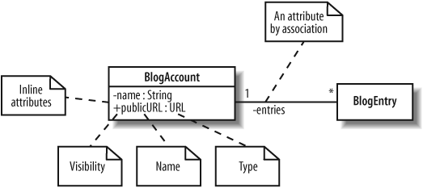
Attributes
A class’s attributes are the pieces of information that represent the state of an object. These attributes can be represented on a class diagram either by placing them inside the section of the class box—known as inline attributes —or by association with another class

Slide 19
Attributes
Discussed previously!!!
Visibility
Name
Type
Can be any set of characters, but no two attributes in the same class can have the same name
make sure that the name accurately describes what is being named
the name should meet the conventions of the target language
The type of attribute can vary depending on how the class will be implemented in your system but it is usually either a class, such as String, or a primitive type, such as an int in Java

Slide 20
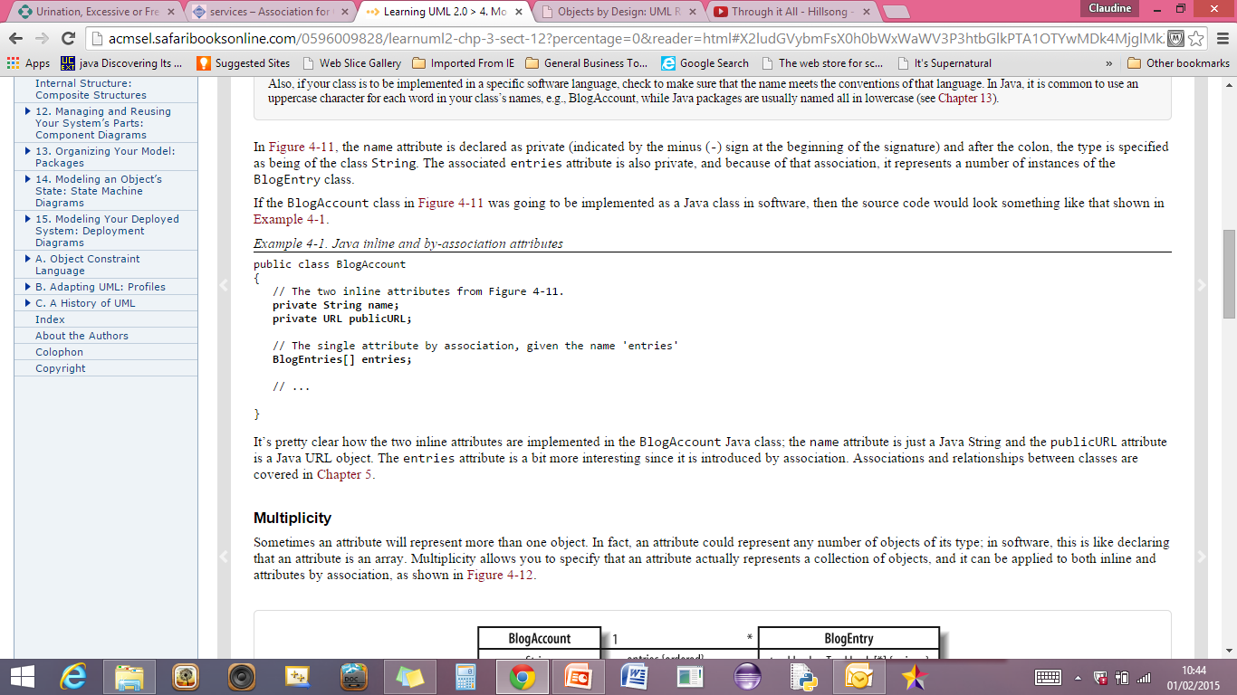
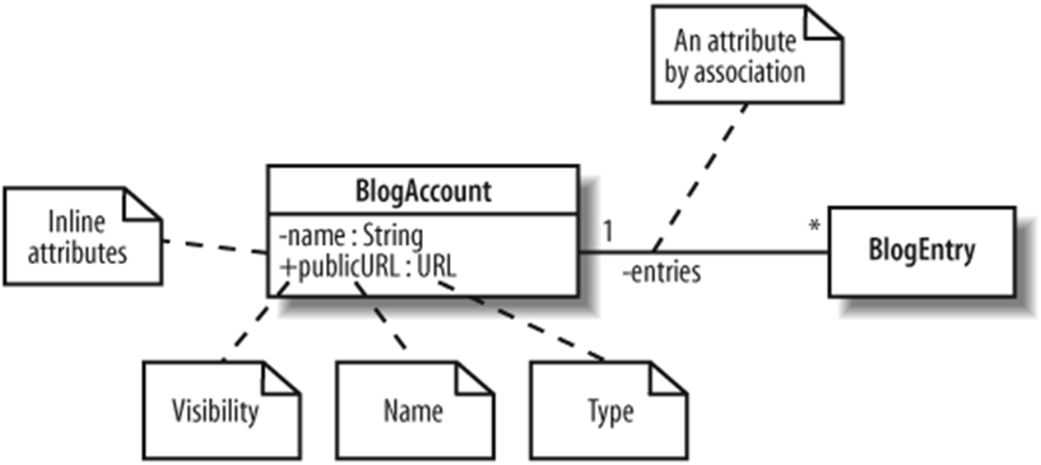
Example – Blog Account
BlogEntry[ ] entries;
We commonly use association (or other relationship to show attributes that are of the type of one of the classes in your system). In line classes usually reflect those attributes that are Java/UML types (existing independent of your system definition)

Slide 21

Multiplicity
an attribute could represent any number of objects of its type
this is like declaring that an attribute is an array
Multiplicity allows you to specify that an attribute actually represents a collection of objects, and it can be applied to both inline and attributes by association
Note that any given Blog Account can have any number of BlogEntry objects stored in the entries attribute (attribute by association). On the other hand, shown at the BlogEntry end of the relationship Any given Blog entry will be associated with only 1 Blog Account.
Notes:
A trackback is an acknowledgment. This acknowledgment is sent via a network signal (ping) from the originating site to the receiving site. The receptor often publishes a link back to the originator indicating its worthiness. Trackback requires both sites to be trackback-enabled in order to establish this communication.
Trackbacks are used primarily to facilitate communication between blogs; if a blogger writes a new entry commenting on, or referring to, an entry found at another blog, and bothblogging tools support the TrackBack protocol, then the commenting blogger can notify the other blog with a "TrackBack ping"; the receiving blog will typically display summaries of, and links to, all the commenting entries below the original entry. This allows for conversations spanning several blogs that readers can easily follow.

Slide 22

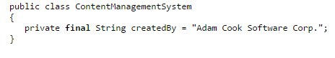
Indicating a read only Attribute
The main exception to the rule that attributes should be private is in the case of read only attributes where the attribute will be visible anywhere the class is visible. Usually this is some constant value that is important for use to all other classes.

Slide 23
Behaviours
A class’s operations describe what a class can do but not necessarily how it is going to do it.
Operations in UML are specified on a class diagram with a signature that is at minimum made up of a:
visibility property
a name
a pair of parentheses in which any parameters that are needed for the operation to do its job can be supplied
and a return type

Slide 24
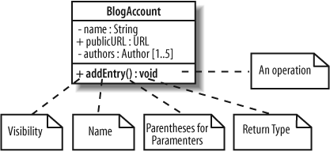
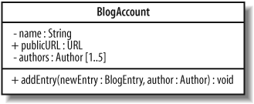
Behaviours contd.
Parameters

Slide 25
Behaviours Contd.
A return type is specified after a colon at the end of an operation’s signature and specifies the type of object that will be returned by the operation
There is one exception where you don’t need to specify a return type: when you are declaring a class’s constructor

Slide 26
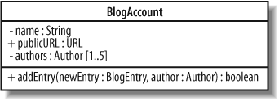
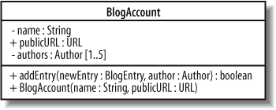
Behaviours

Slide 27
Static Class Members
Sometimes you want all of the objects in a particular class to share the same copy of an attribute or operation.
In this case the class’s attributes and operations are associated with the class itself and have a lifetime beyond that of the any objects that are instantiated from the class.
This is where static attributes and operations become useful.

Slide 28
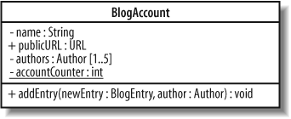
Static Class Member
if we wanted to keep a count of all the BlogAccount objects currently alive in the system, then this counter would be a good candidate for being a static class attribute.
Rather than the counter attribute being associated with any one object, it is associated with the BlogAccount class and is therefore a static attribute

Slide 29
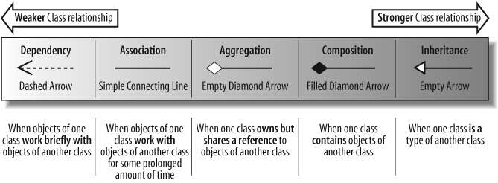
Relationships between Classes

Slide 30
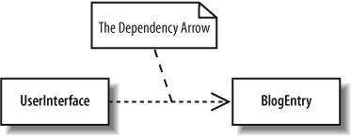
Dependency
a Dependency is a relationship that shows that an element, or set of elements, requires other model elements for their specification or implementation
dependency is called a supplier - client relationship, where supplier provides something to the client, and thus the client is in some sense incomplete while semantically or structurally dependent on the the supplier element(s).
Modification of the supplier may impact the client elements.

Slide 31
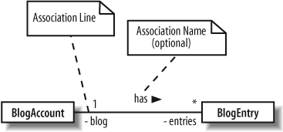
Association
association means that a class will actually contain a reference to an object, or objects, of the other class in the form of an attribute
In association a class works with an object of another class – It is not just a dependency
Association is shown using a simple line connecting two classes

Slide 32
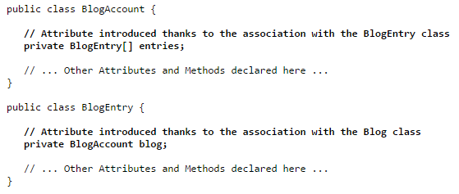
Association contd. (no navigation)

Slide 33
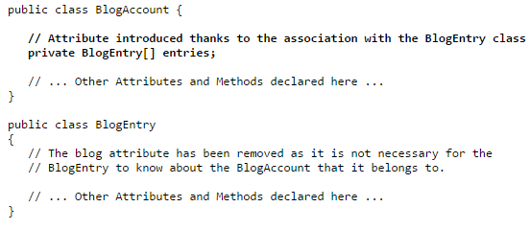
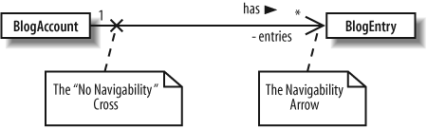
Association contd. (with navigation)

Slide 34
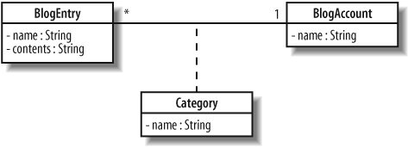
Association Classes
Sometimes an association itself introduces new classes.
Association classes are particularly useful in when you want to show that a class is related to two classes because those two classes have a relationship with each other
depending on the categories that the account contains, the blog entry is also associated with any number of categories.
The association relationship between a blog account and a blog entry results in an association relationship with a set of categories

Slide 35
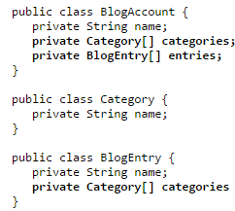
Example method of implementing the association class

Slide 36
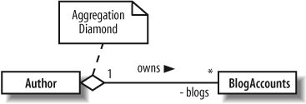
Aggregation
Aggregation is really just a stronger version of association and is used to indicate that a class actually owns but may share objects of another class.
Usually in a language like java this can be implemented using an object reference as an attribute in the class

Slide 37
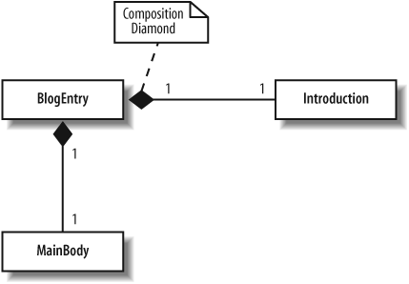
Composition
Moving one step further down the class relationship line, composition is an even stronger relationship than aggregation, although they work in very similar ways.
Composition is shown using a closed, or filled, diamond arrowhead
Owns but does not share
We could implement this by including the actual object as an attribute

Slide 38
Aggregation vs. Composition in code
Not always easy to distinguish in code in a programming language
Most times at the design level we can work with the weaker form and make a final decision at coding time
public class MyClass
{
private AnotherClass ac;
private SomeOtherClass sc;
MyClass(AnotherClass ac)
{
this.ac=ac; //reference - aggregation
this.sc=new SomeOtherClass(); //value – composition
}
…
…
}

Slide 39
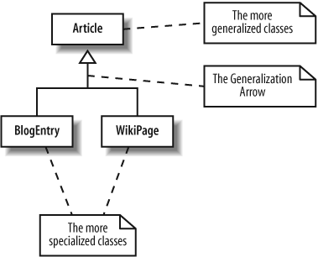
Generalisation / Inheritance
Generalization and inheritance are used to describe a class that is a type of another class.
The terms has a and is a type of have become an accepted way of deciding whether a relationship between two classes is aggregation or generalization for many years now.
Makes sense in only one direction (is a)

Slide 40
WARNING!!!
If you are thinking of using generalization just so you can reuse some behaviour in a particular class, then you probably need to think again.
Since a child class can see most of the internals of its parent, it becomes tightly coupled to its parent’s implementation.
use generalization only when a class really is a more specialized type of another class and not just as a convenience to support reuse.
If you still want to reuse a class’s behavior in another class, think about using delegation .

Slide 41
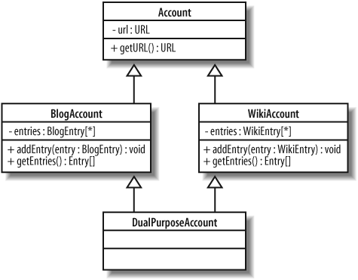
Multiple Inheritance? Trouble?

Slide 42
Constraints using the OCL
Sometimes we wish to constrain the ways in which a class can operate. We can do this using OCL
There are three types of constraint that can be applied to class members using OCL:
An invariant is a constraint that must always be true; otherwise the system is in an invalid state. Invariants are defined on class attributes.
A precondition is a constraint that is defined on a method and is checked before the method executes. Preconditions are frequently used to validate input parameters to a method.
A postcondition is also defined on a method and is checked after the method executes. Postconditions are frequently used to describe how values were changed by a method.

Slide 43
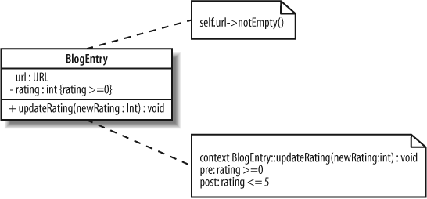
Example of Constraints

Slide 44
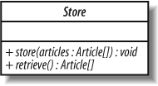
Abstract Classes
We do not create instances of abstract classes but rather the instances are of the subclasses
Some or all of the methods may be un-implemented

Slide 45
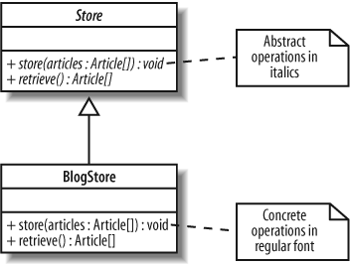
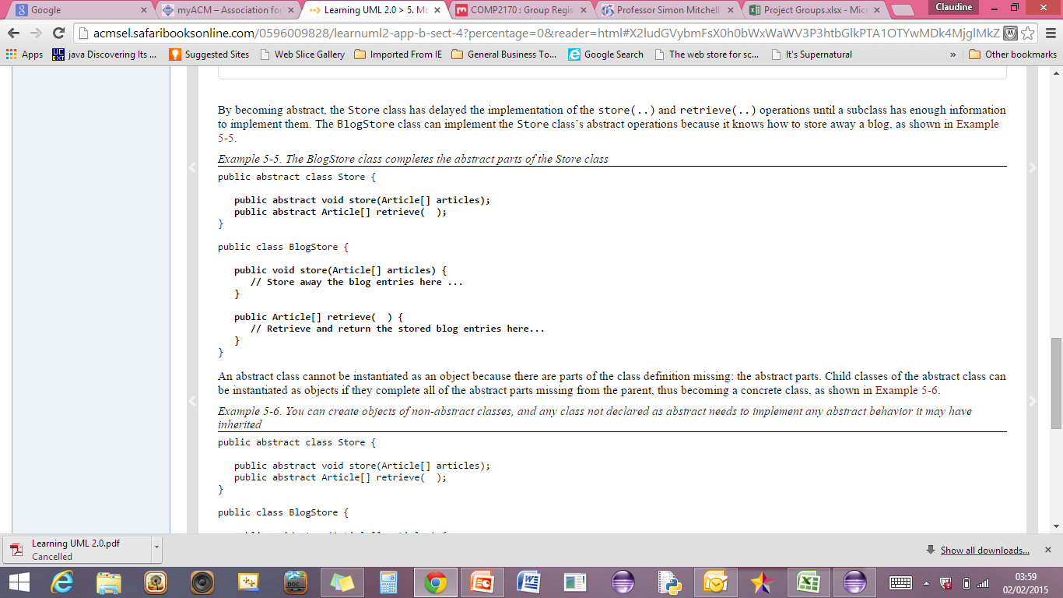
Abstract Classes contd.

Slide 46
Interfaces
An interface is a collection of operations that have no corresponding method implementations
Sometimes an interface will contain attributes as well, but in those cases, the attributes are usually static and are often constants.

Slide 47
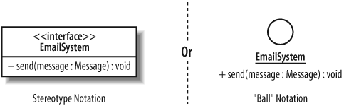
Interfaces contd
public interface EmailSystem
{
public void send(Message message);
}

Slide 48
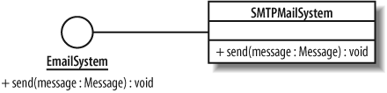
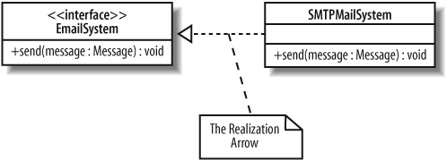
Realising an Interface
//define interface
public interface EmailSystem
{
public void send(Message message));
}
public class SMTPMailSystem implements EmailSystem
{
public void send(Message message)
{
// Implement the interactions with an SMTP server to send the message
}
….
}
OR

Slide 49
Note on Interfaces and Abstract Classes
If a class realizes an interface but does not implement all of the operations that the interface specifies, then that class needs to be declared abstract
Interfaces are great at completely separating the behaviour that is required of a class from exactly how it is implemented. When a class implements an interface, objects of that class can be referred to using the interface’s name rather than the class name itself. This means that other classes can be dependent on interfaces rather than classes. This is generally a good thing since it ensures that your classes are as loosely coupled as possible. If your classes are loosely coupled, then when a class implementation changes other classes should not break (because they are dependent on the interface, not on the class itself).

Slide 50
Reference
Learning UML 2.0
By: Russ Miles; Kim Hamilton
Publisher: O'Reilly Media, Inc.
Chapter 4 & 5

