Slide 1
Database Relationships
Generated on 2025-04-25 12:32:05

Slide 2
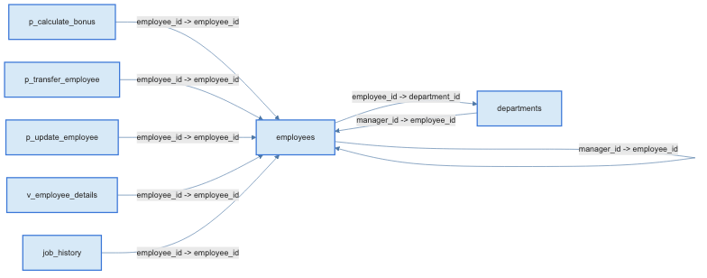
Table Relationships Diagram

Slide 3
Relationship Details
Content | Description | Created At | Score | Source
表 p_calculate_bonus 通过字段 employee_id 关联到表 employees 的字段 employee_id | employee_id -> employee_id | 2025-04-25T09:38:38.168917 | 1 | neo4j
表 p_transfer_employee 通过字段 employee_id 关联到表 employees 的字段 employee_id | employee_id -> employee_id | 2025-04-25T09:38:38.145799 | 1 | neo4j
表 p_update_employee 通过字段 employee_id 关联到表 employees 的字段 employee_id | employee_id -> employee_id | 2025-04-25T09:38:38.134757 | 1 | neo4j
表 v_employee_details 通过字段 employee_id 关联到表 employees 的字段 employee_id | employee_id -> employee_id | 2025-04-25T09:38:38.079859 | 1 | neo4j
表 job_history 通过字段 employee_id 关联到表 employees 的字段 employee_id | employee_id -> employee_id | 2025-04-25T09:38:37.789278 | 1 | neo4j
表 departments 通过字段 manager_id 关联到表 employees 的字段 employee_id | manager_id -> employee_id | 2025-04-25T09:38:37.775931 | 1 | neo4j
表 employees 通过字段 manager_id 关联到表 employees 的字段 employee_id | manager_id -> employee_id | 2025-04-25T09:38:37.647334 | 1 | neo4j
表 employees 通过字段 employee_id 关联到表 departments 的字段 department_id | employee_id -> department_id | 2025-04-25T09:38:37.428489 | 1 | neo4j

Slide 4
Opensearch Results
Procedure 'p_UpdateEmployeeSalary':
--- p_UpdateEmployeeSalary
--- 更新员工的工资，并将变更记录插入到 employees_history 表中
--- 结合了 employees 表和 employees_history 表
CREATE OR REPLACE FUNCTION p_p_UpdateEmployeeSalary(
emp_id INT,
new_salary DECIMAL(10, 2),
changed_by INT
) RETURNS VOID AS $$
DECLARE
old_salary DECIMAL(10, 2);
BEGIN
-- 获取当前工资
SELECT salary INTO old_salary FROM employees WHERE employee_id = emp_id;
-- 更新员工工资
UPDATE employees SET salary = new_salary WHERE employee_id = emp_id;
-- 插入历史记录
INSERT INTO employees_history (
employee_id,
old_salary,
new_salary,
changed_by
) VALUES (
emp_id,
old_salary,
new_salary,
changed_by
);
END;
$$ LANGUAGE plpgsql;
与employees相关的procedure是：--- p_UpdateEmployeeSalary
--- 更新员工的工资，并将变更记录插入到 employees_history 表中
--- 结合了 employees 表和 employees_history 表
CREATE OR REPLACE FUNCTION p_p_UpdateEmployeeSalary(
emp_id INT,
new_salary DECIMAL(10, 2),
changed_by INT
) RETURNS VOID AS $$
DECLARE
old_salary DECIMAL(10, 2);
BEGIN
-- 获取当前工资
SELECT salary INTO old_salary FROM employees WHERE employee_id = emp_id;
-- 更新员工工资
UPDATE employees SET salary = new_salary WHERE employee_id = emp_id;
-- 插入历史记录
INSERT INTO employees_history (
employee_id,
old_salary,
new_salary,
changed_by
) VALUES (
emp_id,
old_salary,
new_salary,
changed_by
);
END;
$$ LANGUAGE plpgsql;
相关表: ['employees', 'employees_history']

Slide 5
Opensearch Results
Procedure 'Procedure':
--- Procedure
--- p_GetEmployeeDetails
--- 根据员工 ID 获取员工的详细信息，包括姓名、职位、部门名称和工资
--- 结合了 employees 表和 v_employee_details 视图
CREATE OR REPLACE FUNCTION p_GetEmployeeDetails(emp_id INT)
RETURNS TABLE (
employee_id INT,
full_name TEXT,
job_title VARCHAR(50),
department_name VARCHAR(100),
salary DECIMAL(10, 2)
) AS $$
BEGIN
RETURN QUERY
SELECT
ed.employee_id,
ed.full_name,
ed.job_title,
ed.department_name,
ed.salary
FROM
v_employee_details ed
WHERE
ed.employee_id = p_GetEmployeeDetails.emp_id; -- 明确指定参数来源
END;
$$ LANGUAGE plpgsql;
与employees相关的procedure是：--- Procedure
--- p_GetEmployeeDetails
--- 根据员工 ID 获取员工的详细信息，包括姓名、职位、部门名称和工资
--- 结合了 employees 表和 v_employee_details 视图
CREATE OR REPLACE FUNCTION p_GetEmployeeDetails(emp_id INT)
RETURNS TABLE (
employee_id INT,
full_name TEXT,
job_title VARCHAR(50),
department_name VARCHAR(100),
salary DECIMAL(10, 2)
) AS $$
BEGIN
RETURN QUERY
SELECT
ed.employee_id,
ed.full_name,
ed.job_title,
ed.department_name,
ed.salary
FROM
v_employee_details ed
WHERE
ed.employee_id = p_GetEmployeeDetails.emp_id; -- 明确指定参数来源
END;
$$ LANGUAGE plpgsql;
相关表: ['v_employee_details']

Slide 6
Postgresql Results
employeesテーブルの全フィールド情報は以下の通りです。
| テーブル物理名 | テーブル論理名 | カラム名 | カラム日本語名 |
|----------------|----------------|-------------------|------------------|
| employees | 従業員 | employee_id | 従業員ID |
| employees | 従業員 | first_name | 名 |
| employees | 従業員 | last_name | 姓 |
| employees | 従業員 | email | メール |
| employees | 従業員 | phone_number | 電話番号 |
| employees | 従業員 | hire_date | 入社日 |
| employees | 従業員 | job_title | 職位 |
| employees | 従業員 | department_id | 部門ID |
| employees | 従業員 | salary | 給与 |
| employees | 従業員 | manager_id | マネージャーID |
ご希望のカラムをこの一覧から選択し、具体的な変更内容をお知らせいただければ、さらに詳しいSQLや影響範囲もご案内できます。

