Slide 1
Database Relationships
Generated on 2025-03-10 14:06:08

Slide 2
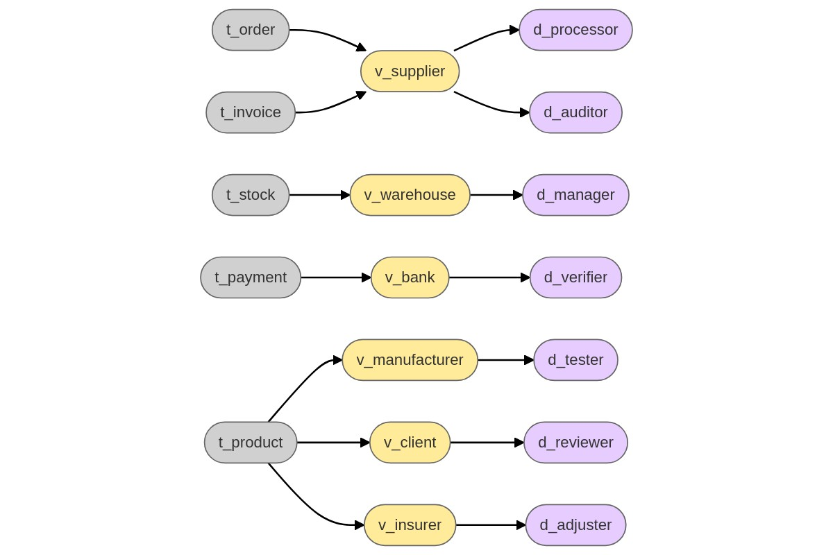
Table Relationships Diagram

Slide 3
Relationship Details
Table | First Relationship | View | Second Relationship | Dataset
t_order | BELONGS_TO | v_supplier | BELONGS_TO | d_processor
t_invoice | BELONGS_TO | v_supplier | BELONGS_TO | d_auditor
t_stock | BELONGS_TO | v_warehouse | BELONGS_TO | d_manager
t_payment | BELONGS_TO | v_bank | BELONGS_TO | d_verifier
t_product | BELONGS_TO | v_manufacturer | BELONGS_TO | d_tester
t_product | BELONGS_TO | v_client | BELONGS_TO | d_reviewer
t_product | BELONGS_TO | v_insurer | BELONGS_TO | d_adjuster

