Slide 1
Single-cell enrichment analysis
Charles
16.05.19

Slide 2
Method
For each cell type (49 cell types in total), we obtain the number of genes with enrichment scores greater than 2, out of the 15092 matched human homolog genes in the aging gene expression data:
We take the directionality of the aging effect into account, and perform the analysis separately for genes up-regulated (N=5331) and down-regulated (N=6241) with age.
*Note: we require the two brain regions to have the same directionality (in this case, N_total = 11572)
> sapply(enriched_genes,length)
[1] 1276 809 786 912 1115 952 939 1007 951 778 866 617 744
[14] 810 954 898 707 707 828 786 1394 813 1044 1160 3965 966
[27] 1036 2198 907 758 841 626 1034 873 776 953 693 734 1153
[40] 1015 740 887 2148 2817 1907 1454 2312 2140 2626

Slide 3
Method ctd.
2. Then we plot the –log10(AW-qvalue) (from the meta-analysis of the aging data from the two brain regions) distribution of those selected genes (with enrichment score >= 2) vs the background genes , for each cell type.
- See the two files “Density_log10qaw_BA11_47_concord_upregulated.pdf/downregulated.pdf”, as you can see, the –log10(AW-qvalue) distribution usually has two peaks on two ends (left end corresponds to very non-significant genes, while right end is from very significant genes, restricted by the permutation numbers), and the distribution of the selected genes has higher relative abundance on the right end for quite a few cell types, especially for down-regulated part.

Slide 4
Method ctd.
3. Lastly, we perform the GSEA test (weighted by –log10(aw-qvalue) ) to see whether the aging-related significance of those enriched genes is different from that of the background genes, separately for up-regulated and down-regulated pools (I also reported the GSEA p-value by combining up and down).
See the csv file “p_GSEA_out.csv”
To increase the precision of the permutation test, I already borrowed the information across the 49 different cell types so the precision was increased by 50 times

Slide 5
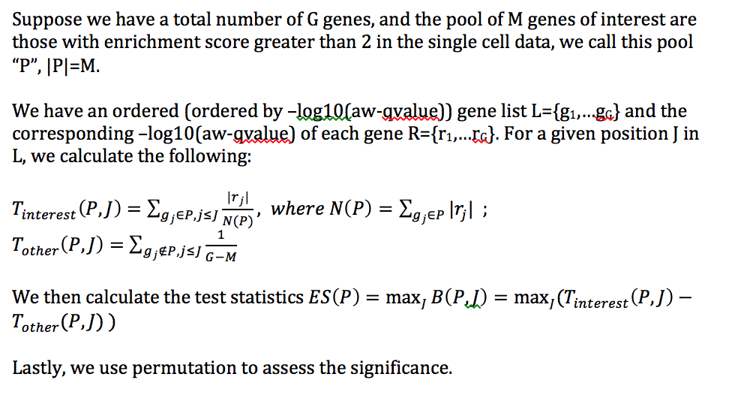
GSEA formula details

Slide 6
Summary of GSEA test
 | GSEA p-values
 | p<0.001 | p<0.01 | p<0.05 | p<0.15
Up-regulated | 4 | 6 | 11 | 14
Down-regulated | 22 | 29 | 33 | 35
Up + Down | 23 | 30 | 37 | 40

Slide 7
Based on the GSEA results (p-value obtained by permutation, here we permute for B=1000 times)
There are more cell types with significant p_gsea in the down-regulated part;
The significance for up-regulated and down-regulated part are mostly complementary (i.e. some cell types only significant in up, while others only significant in down).

