Slide 1
Cell type analyses

Slide 2
Cell type method
All genes ranked from most significant down-regulated to most significant up-regulated gene (same as before)
In cell type data:
for each gene, compute its log(1+RPKM value)
Average these values across cell types
Compute z-score across the cell types
Select genes with z-score > 2 to create gene lists
Create a list that has abs(z-score) < 2 for all cell types
Test for enrichment using area under receiver operating curve (AUROC)
Generate p-value by shuffling cell types of the Tasic single cell data (controls for number of cells)

Slide 3
Differences from previous setup
Haven’t used GSEA
Did not filter genes based on consistent effects in both brain regions
Used AW fisher weights to decide direction
Added CelltypeNonSpecific gene list
Genes with stable expression across cell types
Used Tasic cell type names from the paper

Slide 4
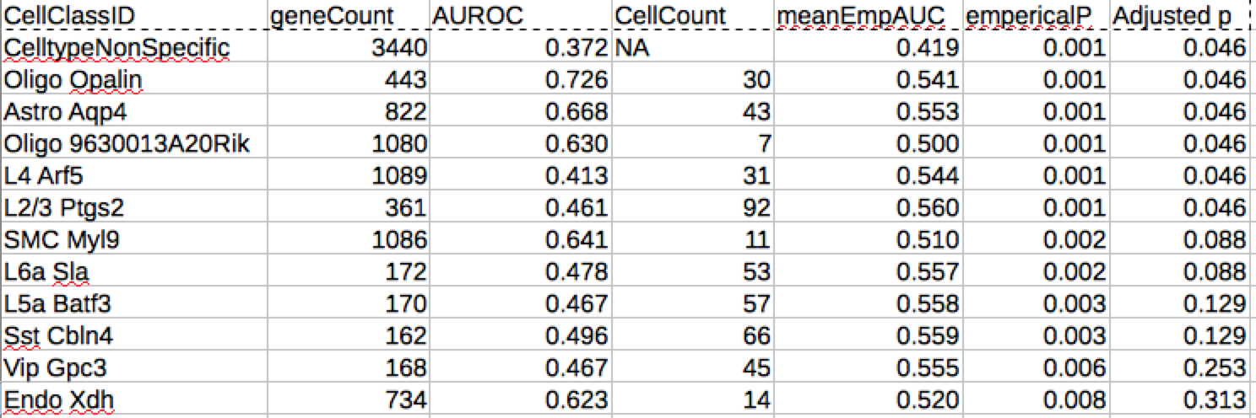
Results – 49 cell types

Slide 5
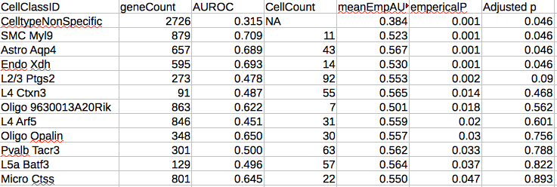
Results, alternate aging list (Mistry and Pavlidis)

Slide 6
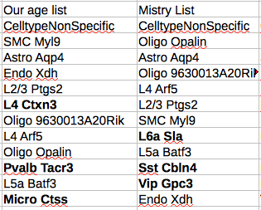
Comparison

Slide 7
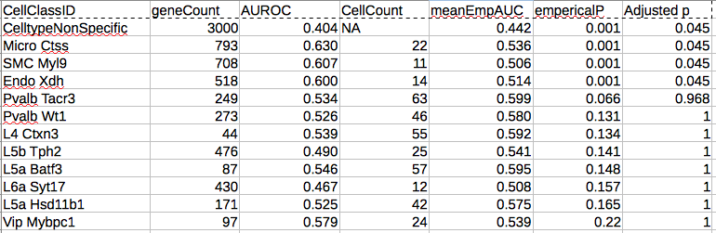
Blood aging list The transcriptional landscape of age in human peripheral blood, Peters et al., 2015
No oligodendrocyte signal

Slide 8
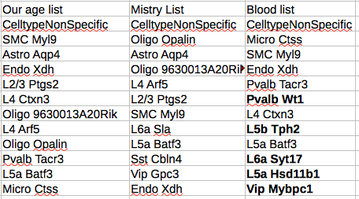
Comparison

Slide 9
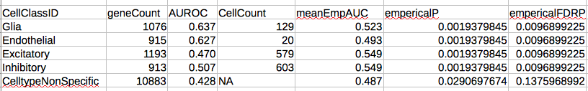
Main cell classes (500 iterations) 1.4x enrichment z-score threshold
-has not been ran on the two other aging lists yet

Slide 10
Result points
Genes with stable expression across cell types are down regulated with age in brain and blood (matches results for a housekeeping gene list)
Might represent broad neuron/glia genes
After correction three cell types are enriched in our aging list – oligos(2) and astrocytes. They are up-regulated with age. Only astrocytes appears in the other brain aging results.

Slide 11
Updates – July 22
Tested effect of removing genes with discordant directions across brain regions
Not much difference
Noticed that 4 of the 49 cell types were missing
Fixed bug in data cleaning step
Re-ran analyses in the 3 aging lists
Similar results
Ran GO on cell type subsets

Slide 12
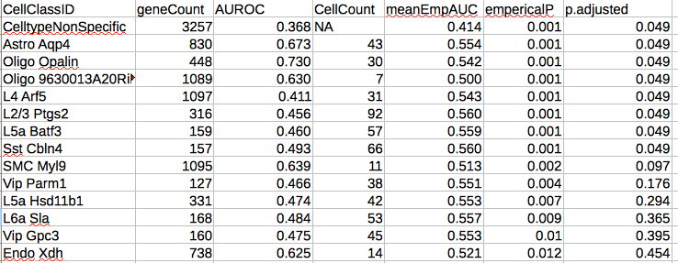
Results – 49 cell types

Slide 13
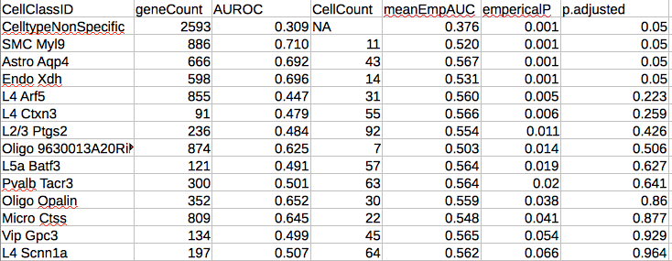
Results, alternate aging list (Mistry and Pavlidis)

Slide 14
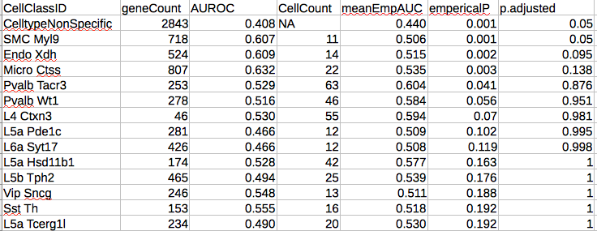
Blood aging list The transcriptional landscape of age in human peripheral blood, Peters et al., 2015
No oligodendrocyte signal

Slide 15
GO subset analysis
When restricted to genes expressed in a specific cell type, are a certain set up or down-regulated in age?
For a given cell type
Subset aging list to genes enriched in that cell type 123-1097 genes
Rank genes by aging direction*p-value
Test for enrichment of GO groups
Size between 10-200 genes
38056 Tests (cell types * GO groups)
No emperical p-values involved

Slide 16
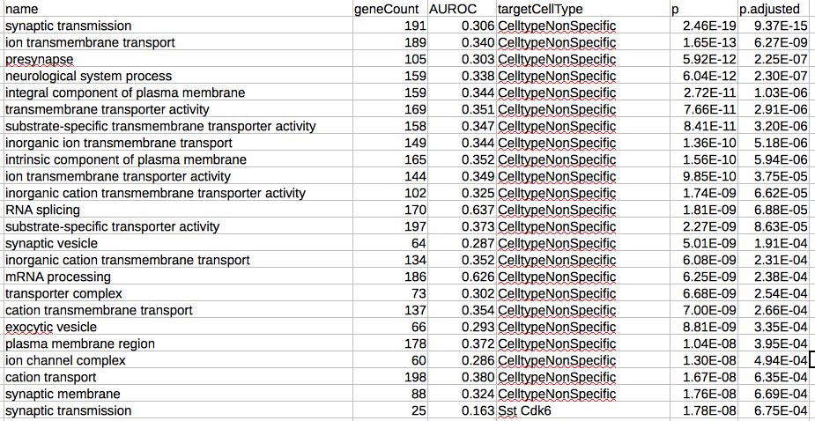
Synaptic transmission in all cell types is downregulated

Slide 17
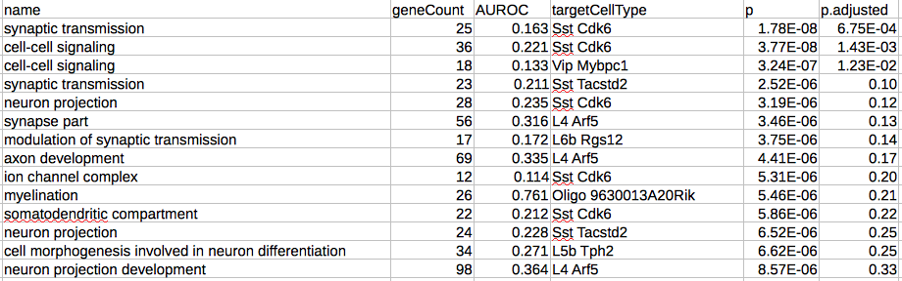
After filtering nonspecific gene set tests
Possible due to their being many more genes in the nonspec group
than a cell type specific group (3250 vrs 1100)

Slide 18
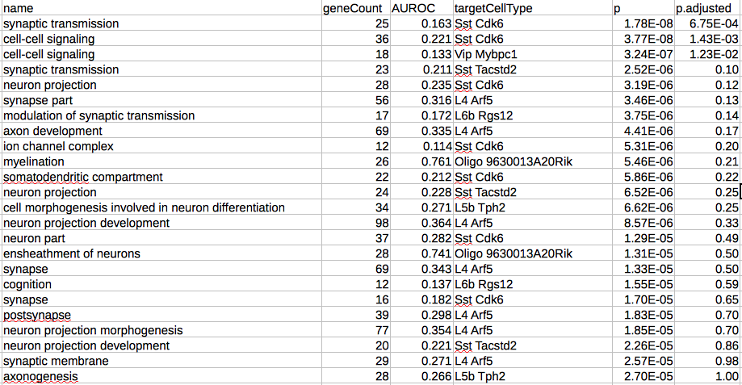

Slide 19
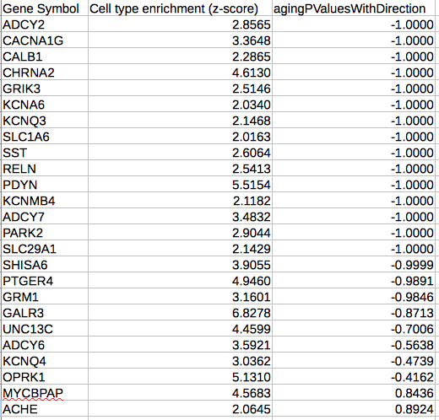
Synaptic transmission genes enriched in SST Cdk6 cells are downregulated with age
For comparison, Cdk6 logExpZ is 6.58 and it’s upregulated with age (0.998)

Slide 20
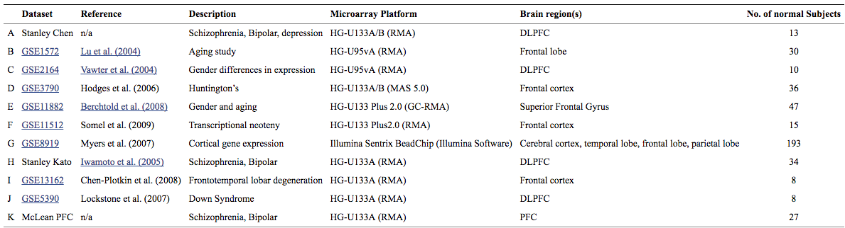
Updates Aug 1, 2016
Mistry and Pavlidis dataset sources:

Slide 21
Updates
10,000 iteration results
Zeisel dataset loaded

Slide 22
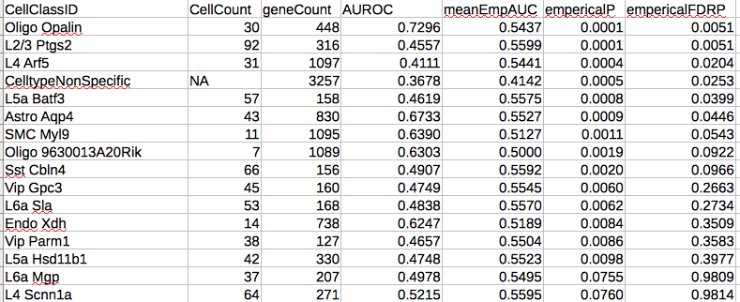
Results – 49 cell types

Slide 23
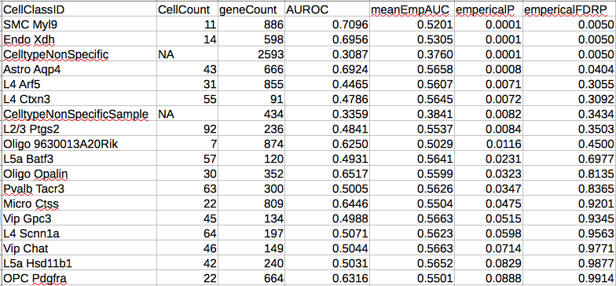
Results, alternate aging list (Mistry and Pavlidis)

Slide 24
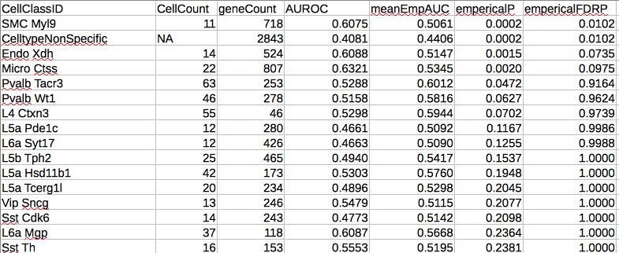
Blood aging list The transcriptional landscape of age in human peripheral blood, Peters et al., 2015

Slide 25
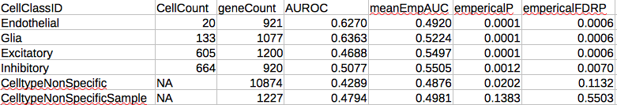
Results – 4 cell types

Slide 26
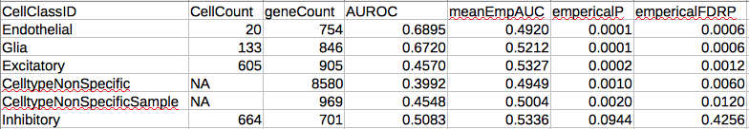
Results, alternate aging list (Mistry and Pavlidis)

Slide 27
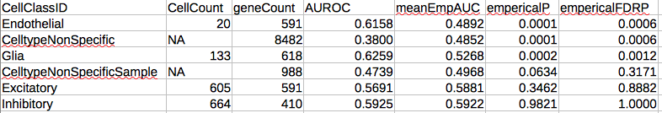
Blood aging list The transcriptional landscape of age in human peripheral blood, Peters et al., 2015

Slide 28
Zeisel single cell sequencing

Slide 29
Cell types in the mouse cortex and hippocampus revealed by single-cell RNA-seq
Published Feb 2015 in Science
Zeisel, Muñoz-Manchado, et al. (Stockholm, Sweden)
used single-cell RNA sequencing (RNA-seq) to classify cells in the mouse brain

Slide 30
Mouse brain details
Mice between postnatal 21 and 31 days of both sexes
Regions: hippocampal CA1 and somatosensory cortex
3005 single-cell transcriptomes
9 main clusters, 47 subclasses

Slide 31
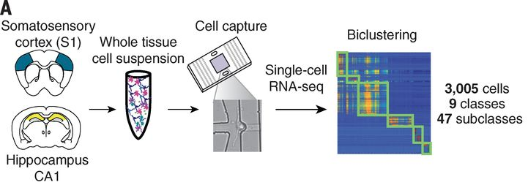

Slide 32
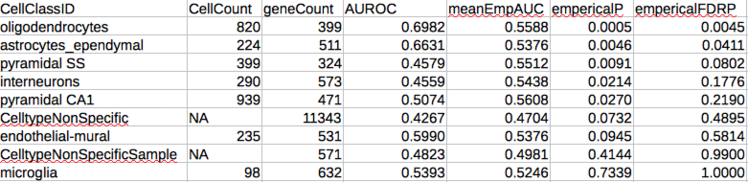
Zeisel main cell types – our aging list

Slide 33
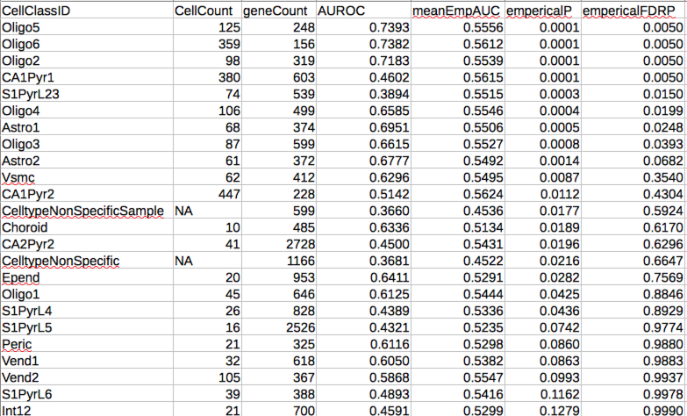
Zeisel all cell types, our aging list

Slide 34
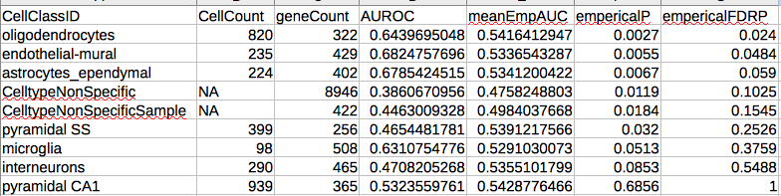
Results, alternate aging list (Mistry and Pavlidis)

Slide 35
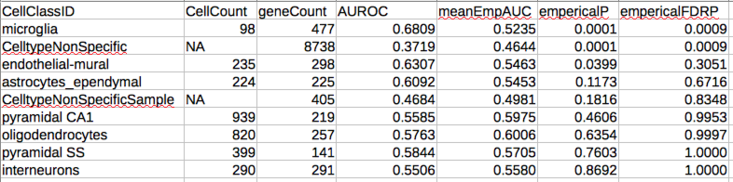
Blood aging list The transcriptional landscape of age in human peripheral blood, Peters et al., 2015

Slide 36
Summary
Enrichment for:
Astrocytes
Oligodenrocytes
Subsets of excitatory neurons (layer 2/3)
Weak to no enrichment for inhibitory neuron specific genes
Mistry list has enrichment for endothelia-mural expressed genes

Slide 37
Todo list
Reconcile with past results
GSEA method and visualization
Create and send tables for review

