Slide 1
CHAPTER 2
Taxonomy of Software Maintenance

Slide 2
Key characteristics of maintenance activities
keeping an eye on the software's day-to-day operations
keeping software changes under control.
improve the software's current functions
threats to security are identified, and security flaws are fixed.
preventing software performance from deteriorating to unacceptable levels
Source : http://swebokwiki.org/Chapter_5:_Software_Maintenance

Slide 3
Characteristics of Software Maintenance
Constraints of an existing system.
On an operational system, maintenance is carried out. As a result, all changes must be compatible with the existing software architecture, design, and code limitations.
Shorter time frame.
Maintenance activities might last anywhere from a few hours to many months, but software creation can take up to a year.

Slide 4
Characteristics of Software Maintenance
Available test data.
Test cases are created from scratch during software development, however software maintenance can choose a portion of these test cases and run the mas regression tests. As a result, selecting acceptable test cases from the existing test suite is a hurdle. To effectively test the code changes, in addition to the regression test cases, new test cases must be written.

Slide 5
Intention-based classification
According to ISO/IEC 14764, the categories of software maintenance are:
Corrective
Adaptive
Perfective
Preventive
Source : http://swebokwiki.org/Chapter_5:_Software_Maintenance

Slide 6
Intention-based classification
Corrective maintenance.
React to problems that are uncovered. Unplanned (unscheduled) software maintenance is also required to allow the software to function.
Source : http://swebokwiki.org/Chapter_5:_Software_Maintenance

Slide 7
Intention-based classification
Adaptive maintenance.
Maintain software usability in an ever-changing environment. For example, software modifications may be required as a result of an operating system upgrade.
Source : http://swebokwiki.org/Chapter_5:_Software_Maintenance

Slide 8
Intention-based classification
Perfective Maintenance
The goal is to increase user experience, processing efficiency, and maintainability, among other things.
For a better user experience, the programme outputs can be made more understandable; the programme can be updated to make it faster, hence enhancing processing efficiency.
Source : http://swebokwiki.org/Chapter_5:_Software_Maintenance
Notes:
Re-Engineering

Slide 9
Intention-based classification
Preventive maintenance
After-sales modification of a software product to uncover and remedy fundamental flaws before they become operational flaws.
For example, with good programming styles, impact of change is reduced, thereby reducing the number of failures.
Source : http://swebokwiki.org/Chapter_5:_Software_Maintenance
Notes:
Software Rejuvenation

Slide 10
Activity-Based Classification
The intention of an activity depends upon the reason for the change.
Two categories: corrections and enhancements.
Corrections
The activities in this category are intended to correct system flaws, which are defined as a difference between the expected and actual behaviour of the system.
 | Enhancement | Correction
Proactive | Perfective | Preventive
Reactive | Adaptive | Corrective
Source from:
Tripathy, P., Naik K. (2014). Software Evolution and Maintenance – A Practitioner’s Approach. John Wiley and Son. Springer Vieweg.

Slide 11
Activity-Based Classification
Enhancements
Do not necessarily modify the system’s behavior.
Categorised into three subcategories as follows:
– enhancement activities that modify existing requirements (some) implemented by the system
– enhancement activities that add new system requirements; and
– enhancement activities that change the implementation without modifying the existing requirements of the system.
 | Enhancement | Correction
Proactive | Perfective | Preventive
Reactive | Adaptive | Corrective
Source from:
Tripathy, P., Naik K. (2014). Software Evolution and Maintenance – A Practitioner’s Approach. John Wiley and Son. Springer Vieweg.

Slide 12
Evidence-Based Classification
Objectives:
based on objective evidence, which may be measured by observations and comparisons of software before and after alterations
select the classification coarseness to reflect a true representative mix of observed activities
Hardware, operating system (OS), organisational processes, design methodology, implementation language, and employees involved in maintenance should all be classified independently of the execution and development environments.
Source from:
Tripathy, P., Naik K. (2014). Software Evolution and Maintenance – A Practitioner’s Approach. John Wiley and Son. Springer Vieweg.

Slide 13
Evidence-Based Classification
The types of maintenance activities are clustered based on modifications made, detected, or observed on four elements of the system being maintained:
the entire software
the external documentation
the properties of the program code
the experience of customer on system functionality.
Source from:
Tripathy, P., Naik K. (2014). Software Evolution and Maintenance – A Practitioner’s Approach. John Wiley and Son. Springer Vieweg.

Slide 14
Support Interface
Training, this refers to informing the stakeholders about the system's implementation.
Consultive In this type, maintenance work is estimated in terms of cost and time, personnel staff a help desk, clients are assisted in preparing maintenance work requests, and personnel share expert knowledge of available resources and the system with others in the company to improve efficiency.
Evaluative Reviewing the program code and documentations, assessing the ripple effect of a proposed modification, writing and performing tests, examining the programming support offered by the operating system, and discovering and debugging the required data are all common actions in this kind.
Source from:
Tripathy, P., Naik K. (2014). Software Evolution and Maintenance – A Practitioner’s Approach. John Wiley and Son. Springer Vieweg.

Slide 15
Documentation
Reformative Ordinary actions of this sort include improving the readability of the documentation, aligning it with other system modifications, creating training materials, and adding entries to a data dictionary.
Updative Typical tasks include replacing out-of-date documentation with current documentation, creating semi-formal documentation, such as in UML, to document current programme code, and updating the documentation with test plans.
Source from:
Tripathy, P., Naik K. (2014). Software Evolution and Maintenance – A Practitioner’s Approach. John Wiley and Son. Springer Vieweg.

Slide 16
Software Properties
Groomative Substituting more efficient and simpler components and algorithms, updating data naming standards, changing access authorizations, compiling source code, and performing backups are all common actions in this category.
Ordinary preventive efforts of this type make improvements to improve maintainability and lay the groundwork for a future transition to an emerging technology.
Performance activities provide results that have an influence on the user. These operations increase system uptime by replacing slower components and algorithms.
Ordinary Adaptive actions of this sort migrate software to a new execution platform and increase the use of COTS components.
Source from:
Tripathy, P., Naik K. (2014). Software Evolution and Maintenance – A Practitioner’s Approach. John Wiley and Son. Springer Vieweg.

Slide 17
Business Rules
Reductive Ordinary operations of this sort reduce the amount of data input to the system and reduce the amount of data created by the system.
Corrective Correcting detected flaws, implementing defensive programming strategies, and changing the way exceptions are handled are all common actions in this category.
Enhancive Adding and changing business rules to improve the system's functionality available to the client, as well as adding new data flows into or out of the software, are typical tasks in this category.
Source from:
Tripathy, P., Naik K. (2014). Software Evolution and Maintenance – A Practitioner’s Approach. John Wiley and Son. Springer Vieweg.

Slide 18
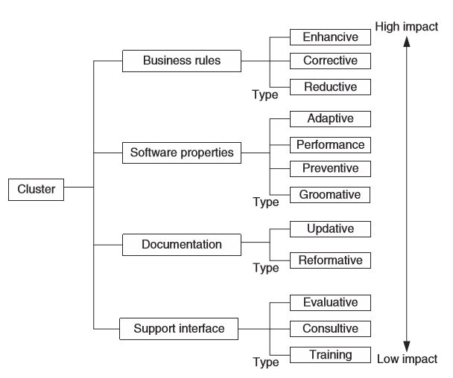
Evidence based maintenance activities
Source from:
Tripathy, P., Naik K. (2014). Software Evolution and Maintenance – A Practitioner’s Approach. John Wiley and Son. Springer Vieweg.

Slide 19
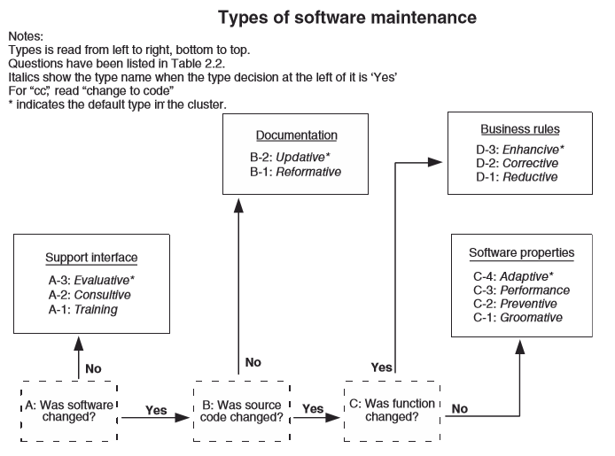
Evidence-Based Classification
Decision Tree-Based Criteria
Source from:
Tripathy, P., Naik K. (2014). Software Evolution and Maintenance – A Practitioner’s Approach. John Wiley and Son. Springer Vieweg.

Slide 20
Categories of Domain Concepts that Influence S/W maintenance
the product to be maintained;
the types of maintenance to be performed;
the maintenance organization processes to be followed; and
the people ware involved, that is, the people in the maintenance organization and in the customer/client organization.
Source from:
Tripathy, P., Naik K. (2014). Software Evolution and Maintenance – A Practitioner’s Approach. John Wiley and Son. Springer Vieweg.

Slide 21
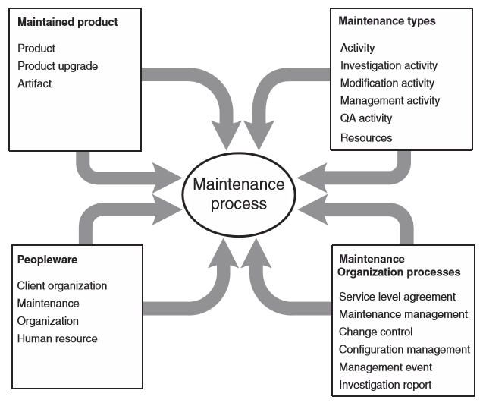
CATEGORIES OF DOMAIN CONCEPTS
Overview of concept categories affecting software maintenance
Source from:
Tripathy, P., Naik K. (2014). Software Evolution and Maintenance – A Practitioner’s Approach. John Wiley and Son. Springer Vieweg.

Slide 22
Maintained Product
Product
A cohesive collection of multiple diverse artefacts is referred to as a product. Source code, print manuals, and online help are examples.
Product upgrade
Upgrade the product. A baseline is a collection of connected items that together form a software setup. Upgrade can result in the creation of a new version of the system under maintenance, a patch code for an item, or even a notice describing a limitation on the system's use.
Artefacts
A number of distinct artefacts are utilised in the design of a software product, and a number of artefacts exist alongside a software product at the same time.
Source from:
Tripathy, P., Naik K. (2014). Software Evolution and Maintenance – A Practitioner’s Approach. John Wiley and Son. Springer Vieweg.

Slide 23
Maintenance Types
Activity. Investigation, modification, management, and quality assurance are all examples of software maintenance activities. Investigations are being conducted. Analyze the consequences of making a certain system modification.
Modification is a process. Change the way the system is implemented.
Management is a type of activity. pertain to the administration of the maintenance process or the configuration control of the maintained system.
This is a quality control activity. Ascertain that system modifications do not jeopardies the system's integrity.
Source from:
Tripathy, P., Naik K. (2014). Software Evolution and Maintenance – A Practitioner’s Approach. John Wiley and Son. Springer Vieweg.

Slide 24
Maintenance Organization Processes
Two different levels of maintenance processes :
Individual-level maintenance processes
followed by maintenance personnel to implement a specific CR(Change Request)
Organization-level process
manage the change requests
Is referred to as the maintenance organization process.
Source from:
Tripathy, P., Naik K. (2014). Software Evolution and Maintenance – A Practitioner’s Approach. John Wiley and Son. Springer Vieweg.

Slide 25
Peopleware
Refers to the human factors that influence software maintenance.
Eg. An experience programmer may find new bugs in the software program.
Eg. Separation on development staff and maintenance staff may impact maintenance process.
Eg. Customer and users’ size, variability and common goals also influence maintenance process.
Source from:
Tripathy, P., Naik K. (2014). Software Evolution and Maintenance – A Practitioner’s Approach. John Wiley and Son. Springer Vieweg.

Slide 26
References
1. Blokdyk. G. ((2020). Maintenance of software : a complete guide : practical tools for self-assessment. Art of Service.
2. Blokdyk. G.. (2020). Software change management : a complete guide : practical tools for self-assessment. Art of Service.
3. Maxim. B. R., Pressman. R. S. (2020) Software Engineering: A Practitioner's Approach. 9th Edn. McGraw-Hill Education
Other references
1. E. Varga. (2017). Unraveling software maintenance and evolution : thinking outside the box. Springer.
2. F. Tsui. O. Karam. B. Bernal. (2018). Essentials of Software Engineering. 4th Edition. Jones & Bartlett Learning.
3. Tripathy, P., Naik K. (2014). Software Evolution and Maintenance – A Practitioner’s Approach. John Wiley and Son. Springer Vieweg.

