Slide 1
Trading Strategies
Using Machine Learning
By Harrison, Darren, Khushboo, Leon, Liam

Slide 2
TABLE OF CONTENTS
01
02
ML MODELS
DATA PREP & TECHNICAL INDICATORS
03
04
ML RESULTS
FURTHER CONSIDERATION

Slide 3
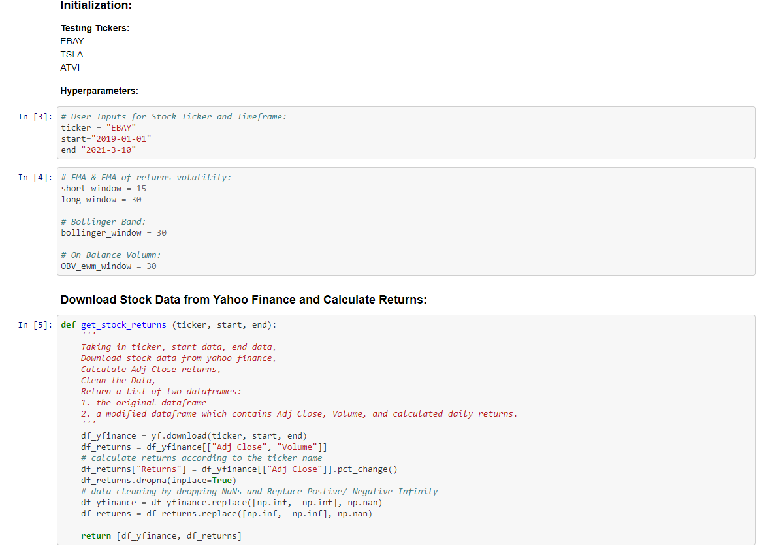
DATA PREPERATION, SELECTION & CLEANING USING YAHOO FINANCE

Slide 4
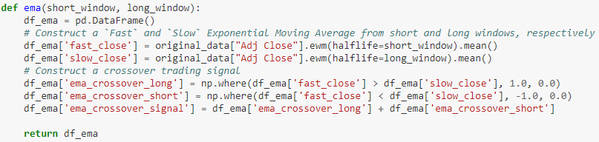
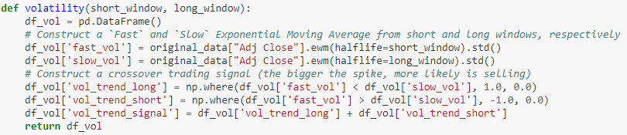
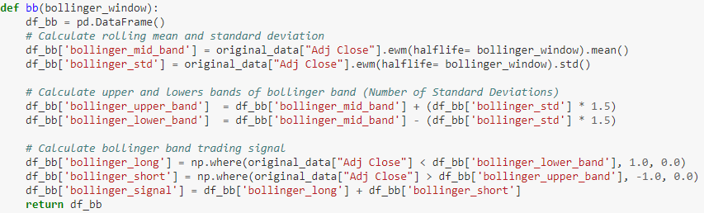
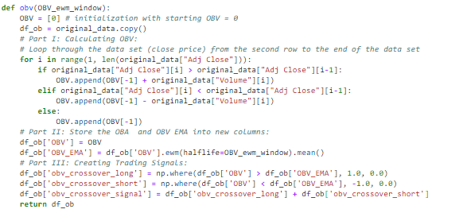
TECHNICAL INDICATORS OVERVIEW
EMA Cross Strat.
EMA of Daily Return Volatility
Bollinger Bands
On Balance Volume

Slide 5
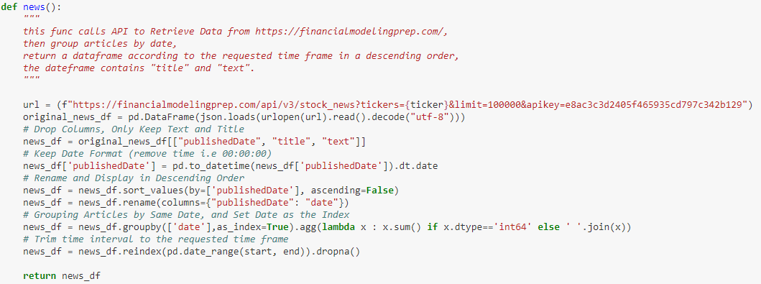
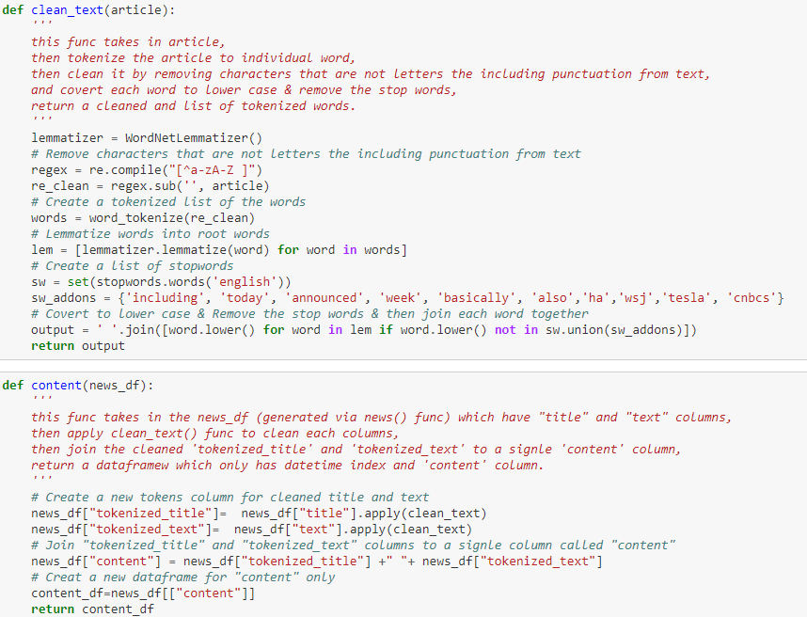
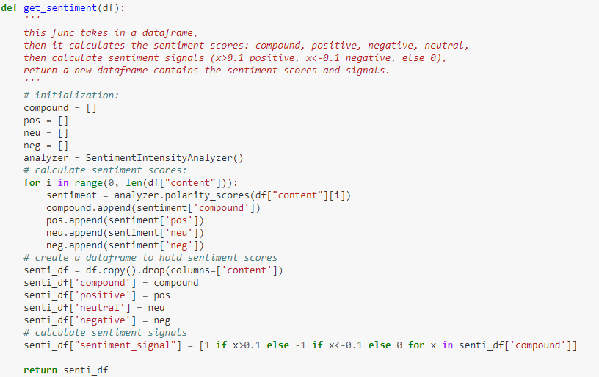
SCORING SENTIMENT USING VADAR
STEP 1: GET NEWS DATA
- if the compound score is greater than or equal to 0.1, the news will be positive
- if the compound score is below -0.1, the news will be negative.
STEP 2: PREPARE NEWS DATA
STEP 3: SENTIMENT ANALYSIS

Slide 6
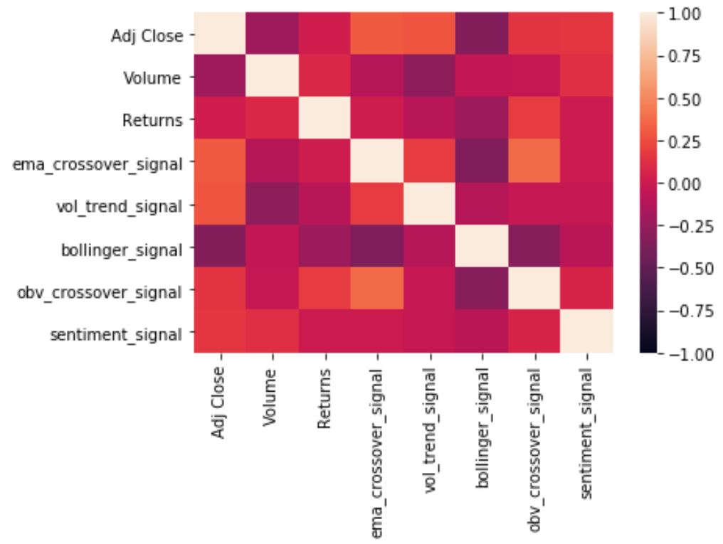
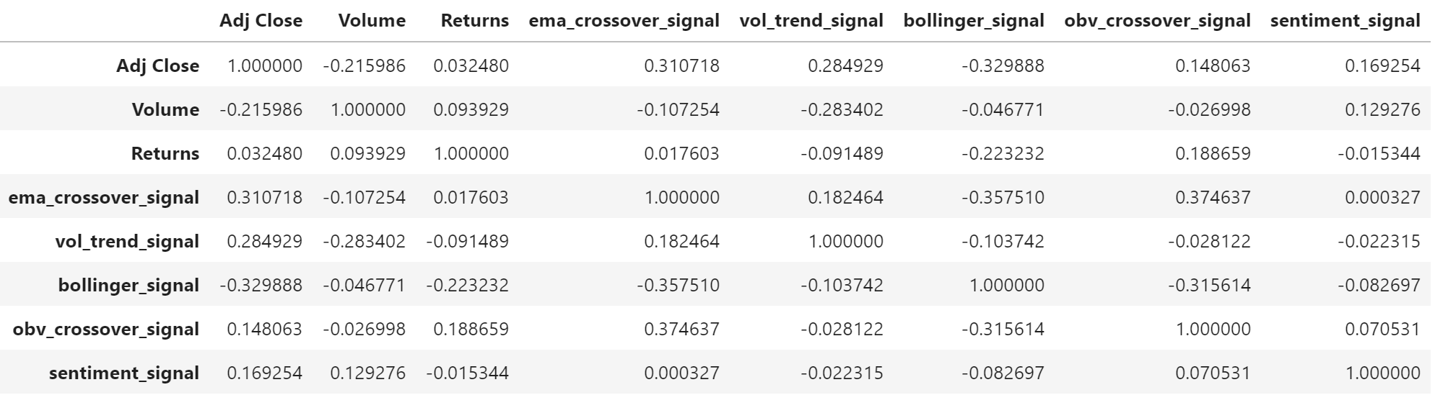
TECHNICAL INDICATORS CORRELATIONS

Slide 7
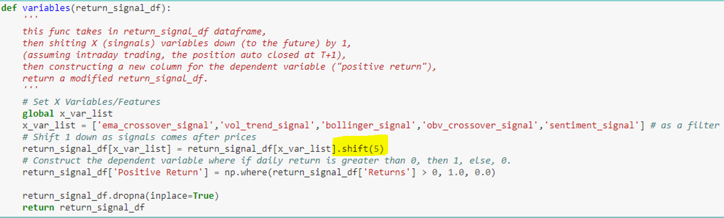
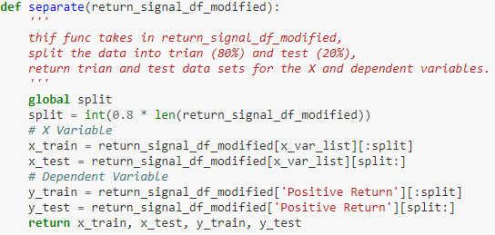
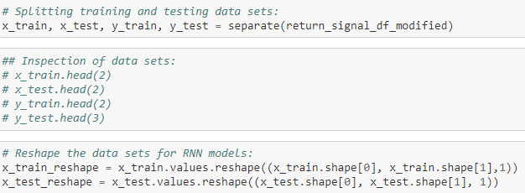
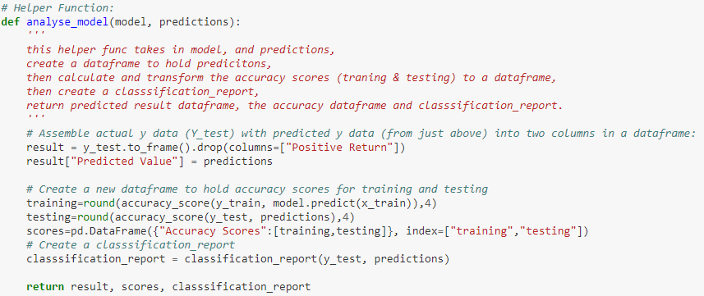
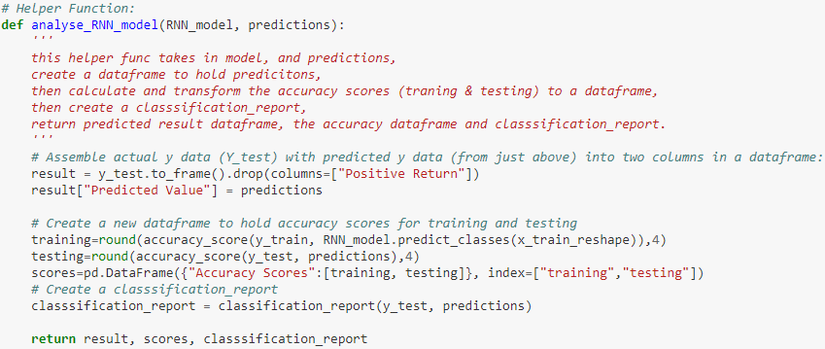
MACHINE LEARNING STRATEGY
FIRST STEPS:
- Creating X and Dependent Variables
- Separate X and Y Training & Testing Datasets
- Machine Learning Models Training

Slide 8
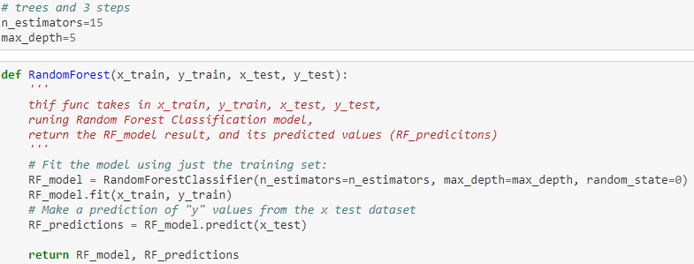
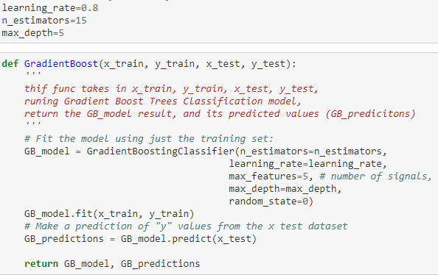
MACHINE LEARNING STRATEGIES
RANDOM FOREST
GRADIENT BOOSTING
Random forest is a combination of decision trees that can be modelled for prediction.
Uses a modified decision tree techniques, used to reduce overfitting effects, eliminating the degradation by ensuring the fitting procedure is constrained.

Slide 9
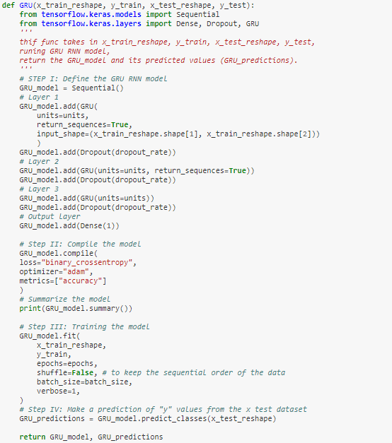
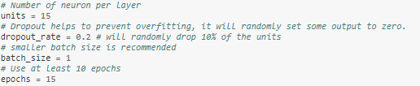
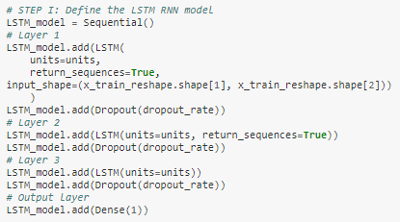
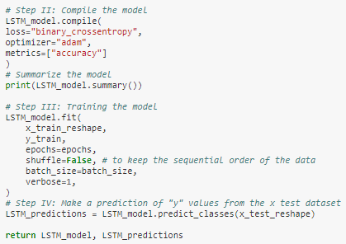

LSTM RNN
NEW GRU RNN
- A neural network model.
- RNNs is a generalised feedforward network, can use internal state (memory) to process sequences of inputs
- LSTM trains the model by using back-propagation to remember past data
Uses a modified decision tree techniques, used to reduce overfitting effects, eliminating the degradation by ensuring the fitting procedure is constrained.

Slide 10
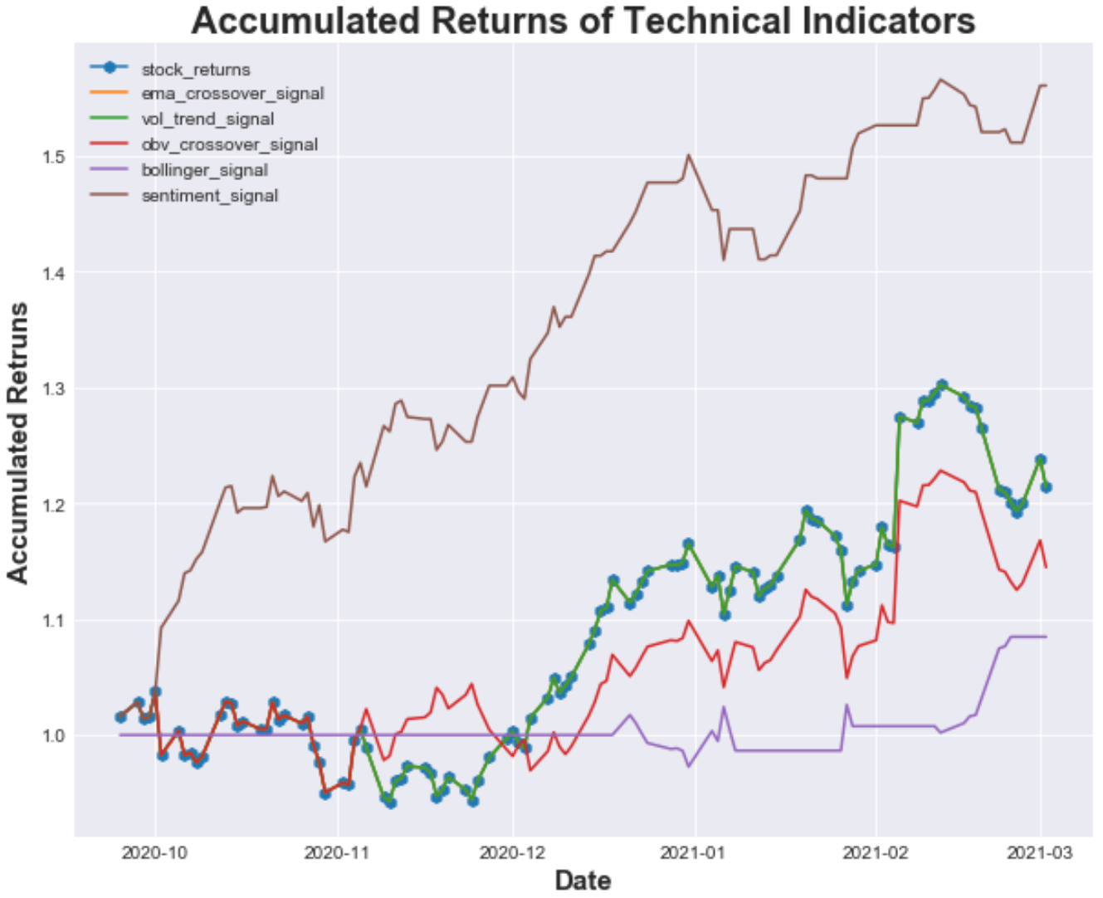
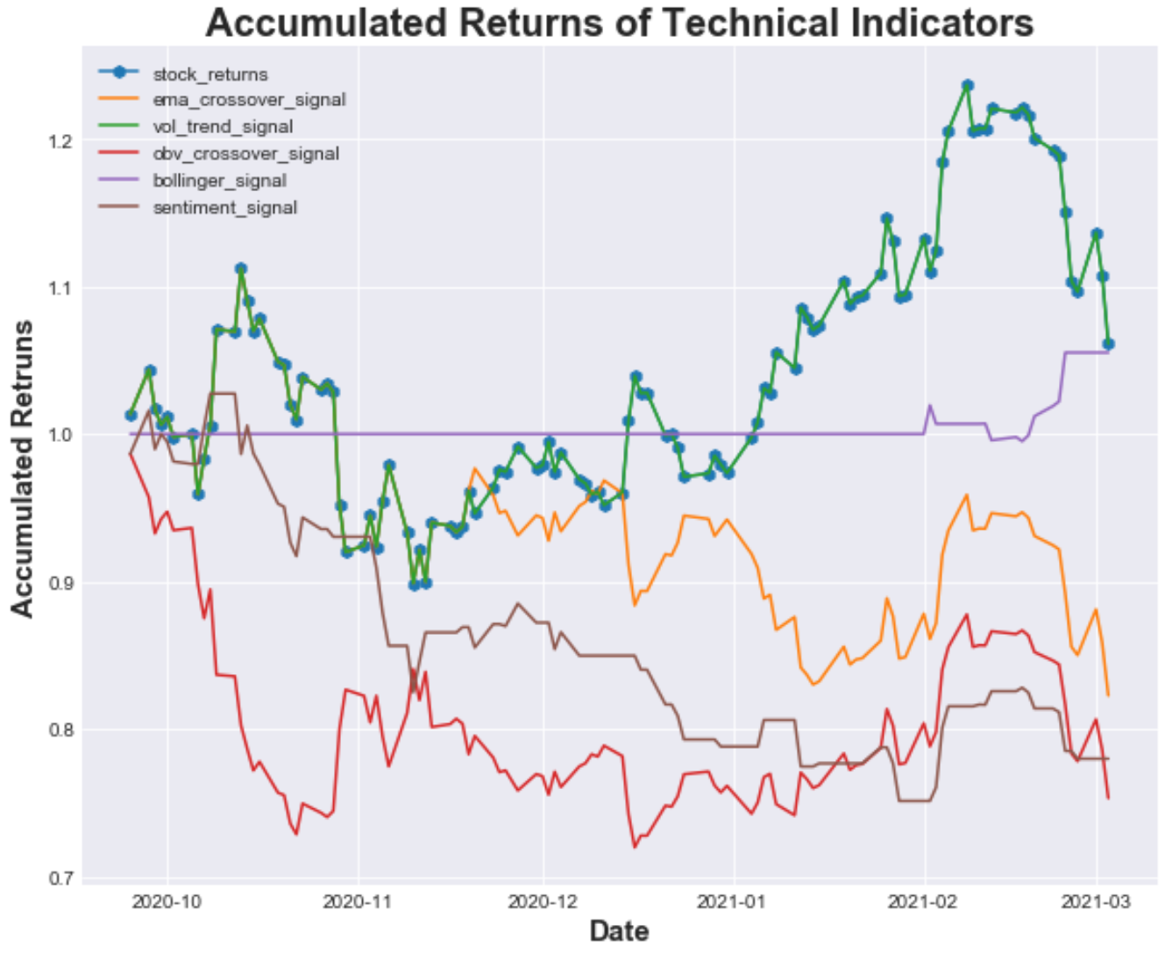
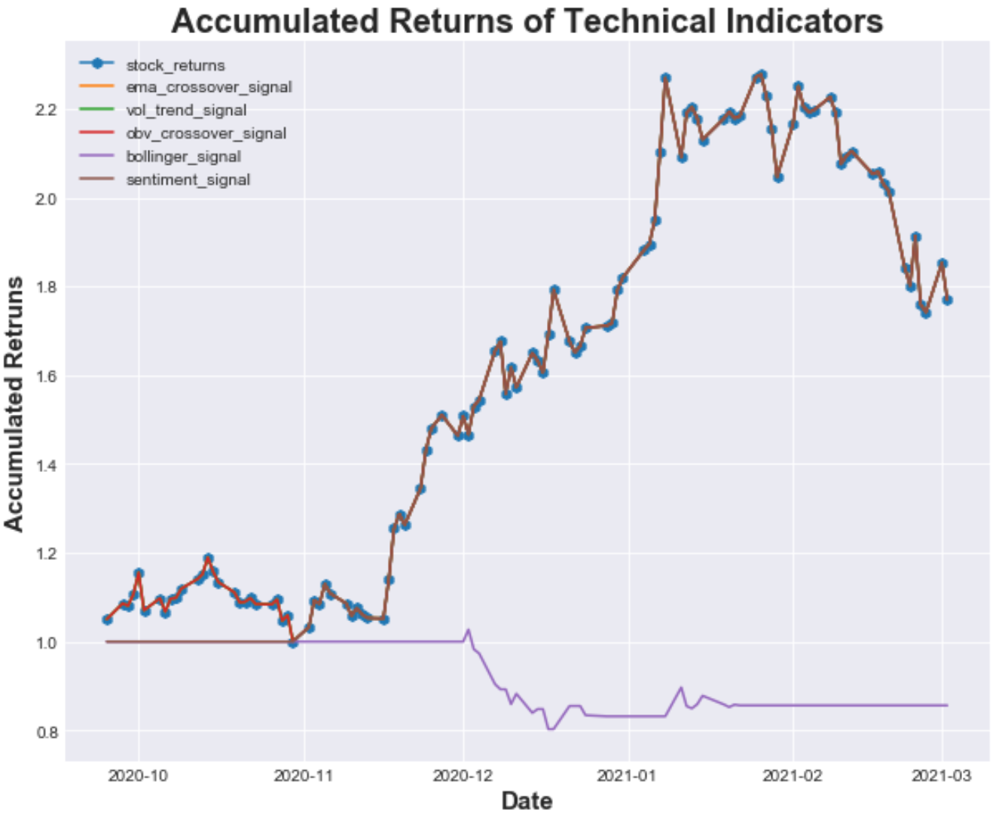
TECHNICAL STRATEGY RESULTS
EBAY
ATVI
TSLA

Slide 11
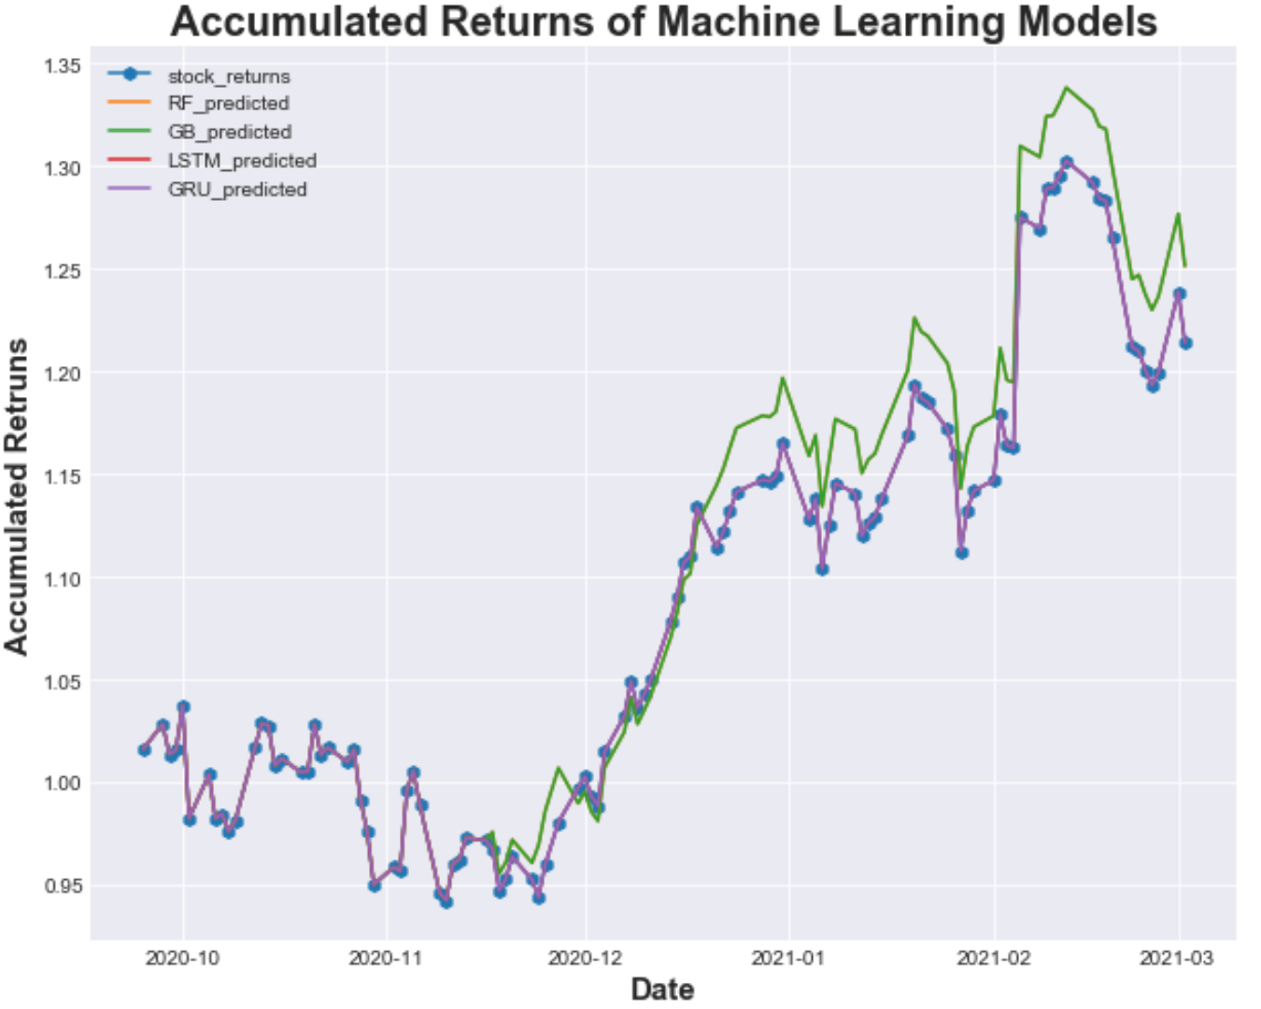
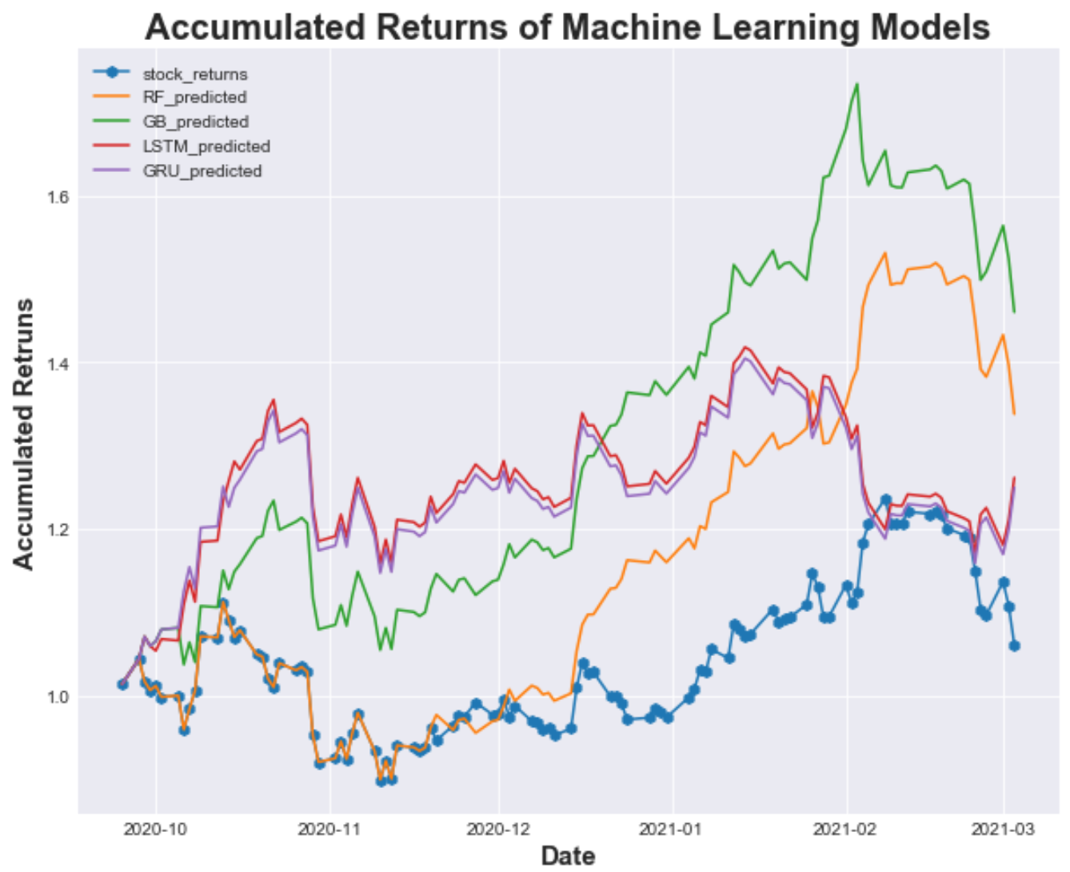
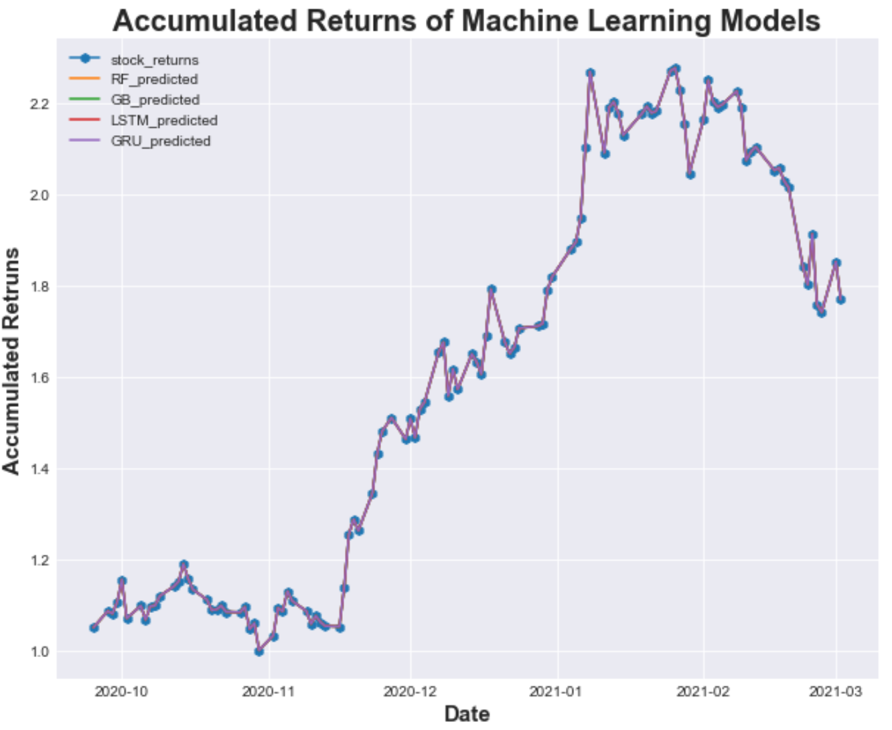
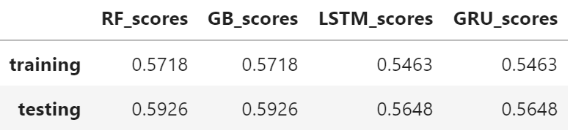
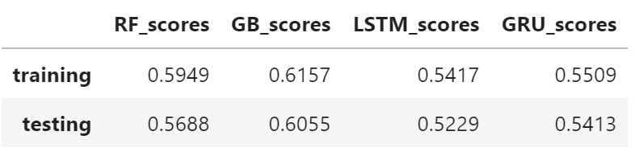
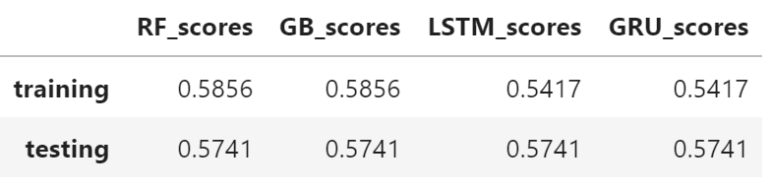
MACHINE LEARNING RESULTS
ATVI
TSLA
EBAY

Slide 12
FUTURE CONSIDERATIONS
More Technical Inidicators
Fundamental Ratios
Test a Conjunction of Indicators

