Slide 1

NFL Audience Analysis
Leon Chan
Notes:
Good afternoon, this presentation will be based on findings and insights from the analysis of the BBCs NFL audience.

Slide 2
Content
Introduction
Key figures
Demographic
Audience behaviors

Slide 3
Introduction
This presentation provide insights on the BBC’s NFL audience in the UK. Analysis is performed to investigate the digital behavior of this group of audience.
This presentation will offer insights on
Demographic (e.g age range, gender, geographic information)
User behavior and preferences regarding devices app types
Interests in other parts of the BBC such as BBC Homepage, BBC News, iPlayer and Sounds.
Notes:
__________. Analysis is performed to gain an insight into the digital behavior of this group of audience.
___
___
2. Interests and engagement of these users with other parts of the BBC. Such as the BBC Homepage, ………..

Slide 4
Key Figures
The dataset consists of 535369 users with unique user IDs, and 589819 total entries.
54450 users use more than one app type or device type to access content.
Content accessed from 103 countries. However, over 99% of the audience access from the UK.
Vast majority of the accounts were from England (82.5%). Followed by Scotland (7.8%).
Notes:
2. 54450 users have a duplicated user id in the dataset, and this is due to them using more than one device or app type.
3. The NFL audience accessed the content from over 100 countries. However, over 99% of the audience access the content from the UK.
4. Vast majority of the users had an account registered with England, making up 82.5% of the total users. 7.8% of the accounts were linked to Scotland, which is the second most popular group.

Slide 5
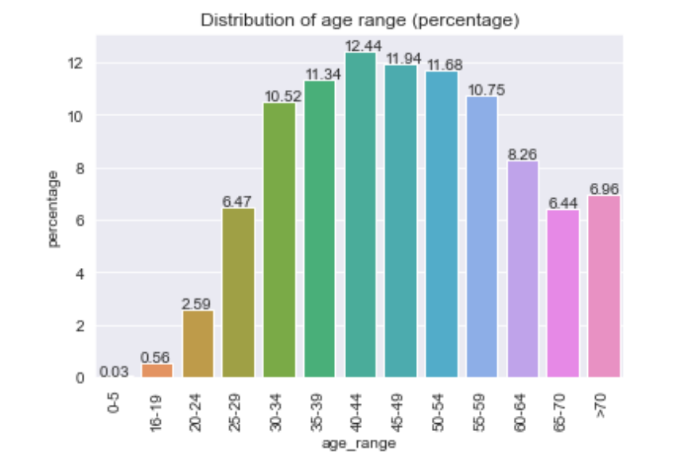
Distribution of age range
Null values for age range (18.0%) and gender (21.9%).
Re-send forms to collect information for those users.
40 – 44 age range had highest percentage of users (12.4%) followed by 45 – 49 age range (11.9%).
The 16 - 19 and 20 - 24 age range are amongst the lowest with 0.6% and 2.6% respectively. These age ranges have a lower percentage than the >70 age range (7.0%).
Notes:
Age range and gender are the two columns with the most null values. 18% and 21.9% of the rows are null values for age range and gender respectively.
1. Since this makes up a significant portion of the total audience, it is recommended to re-send form to collect this information to get a more accurate analysis.
Each range consisted of 5 years (excluding >70 range). The core age demographic are 30 – 60 age groups, peaking at 40 – 44 age range, making up 12.4% of the total audience, followed by the 45 – 49 age range with 11.9%. Each of the other age groups in this 30 – 60 range had above 10%.

Slide 6
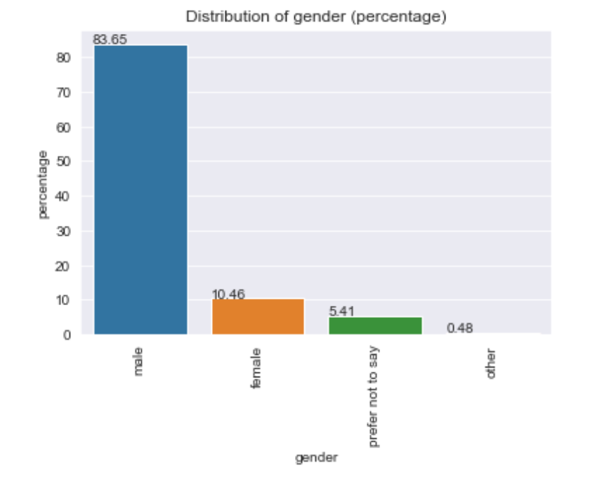
Distribution of gender
Males make up a overwhelming majority of the audience with 83.7%.
Females make up 10.5%of the audience.

Slide 7
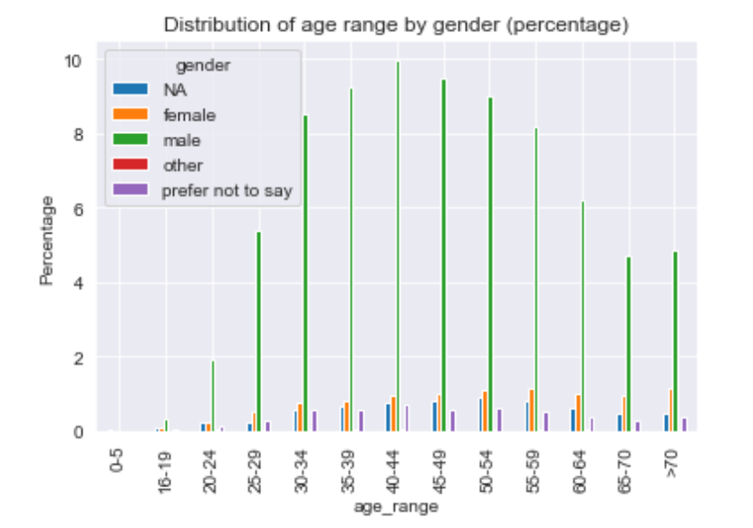
Distribution of age by gender
As predicted, there is a much larger male audience across every age group by a significant margin.
The most popular demographic are males in the 40 – 44 age range (10.0%).
Followed by males in the 45 – 49 age range (9.5%).

Slide 8
Distribution of age by gender
Females: more popular in the older age groups.
Highest percentage in 55 – 59 age range (1.18%) followed by >70 (1.15%).
Although male dominated, less difference in older age groups.

Slide 9
ACCESS BEHAVIOUR OF THE AUDIENCE
Insight on the app and device types used by the audience to access content.
Identify preferences in ways to access content using different app and device types.
Notes:
2. Identify preferences in apps or device types across age groups.

Slide 10
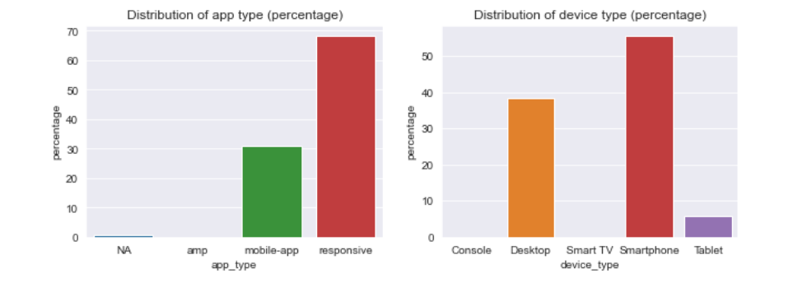
Distribution of app type
Negligible number of users are accessing the site using amp. A small minority have an unknown app type.
Responsive app types are the most popular (68.4%) using this app to access content.
Mobile app users make up 30.1% of the total.

Slide 11
Distribution of device type
Majority of the users access content using either smartphones (55.7%).
Desktop users make up 38.5% of the total.
Minority use tablets (5.7%).
Less than 0.2% of the users use Smart TV or Console to access content.

Slide 12
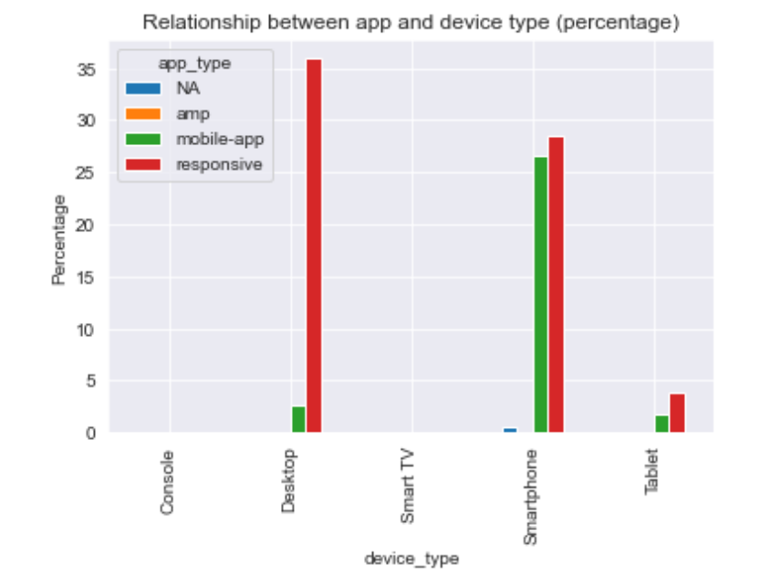
Distribution of app and device type
Responsive app more widely used across all devices.
Most popular combination is responsive app on desktop (36.0%).
Relatively evenly distributed for smartphone users.
28.5% of the total use responsive app on smartphones.
26.6% of the total use mobile app on smartphones.

Slide 13
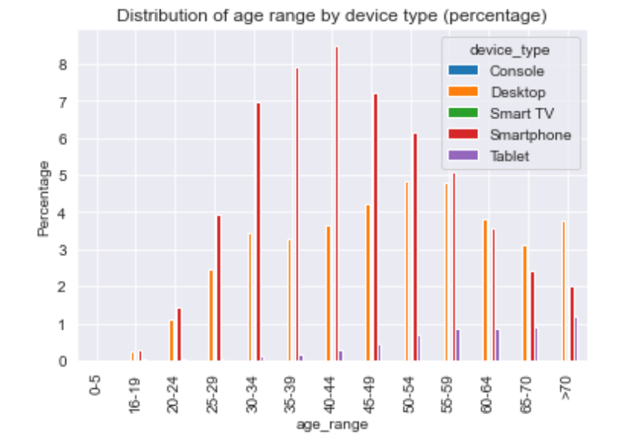
Distribution of age range by device type
Clear preference and trend for device types used across age ranges.
Smartphones are more widely used for all age groups below 60.
Clear preference for smartphones for the younger age groups.
Desktop becomes more widely used for older age groups.
Tablets more popular for older age groups.
Smartphones users in the 40 – 44 age range have the highest percentage out of total users (8.5%).

Slide 14
How app and device types are used
Insight on the app type and number of:
Visits to sports
Sport page views
Sport articles read
Sport clips watched

Slide 15
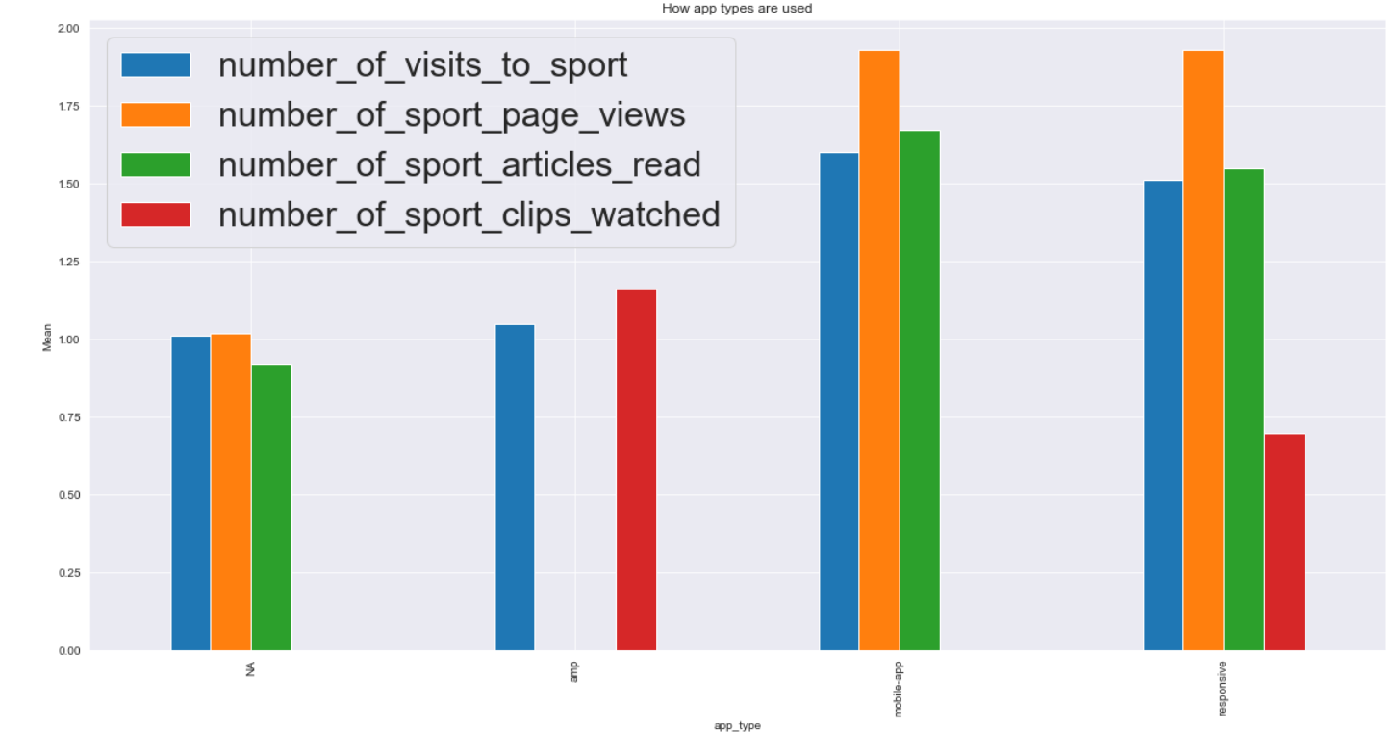
App type vs number of *
Mobile apps and responsive app types relatively similar usage numbers.
Mobile users are slightly more engaged with sport page.
1.60 visits for mobile app users compared with 1.51.
1.67 sport articles read for mobile app users compared with 1.55 for responsive.
AMPs were most active for sport clips watched with 1.16 compared with 0.70 for responsive and close to 0 for mobile apps.

Slide 16
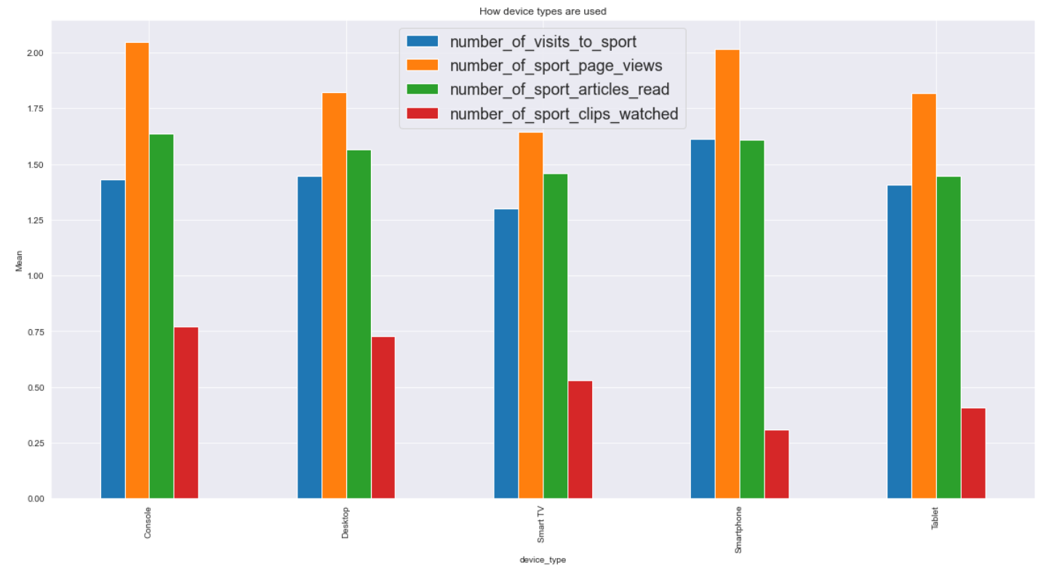
Device type vs number of *
Smartphone users are one of the more groups.
However, less active for sport clips.
Console and desktop users consume the highest average of sport clips.
The data suggests that smartphones are most widely used, and users are more active than other groups such as desktop or tablet users.
Data on AMP suggests low usage for sport clips using smartphones potentially due to speed of loading. Recommended to improve AMP or promote the usage to increase smartphone users (core demographic) engagement with sport clips.

Slide 17
Cross service usage
Investigate the usage of BBC’s other service amongst the NFL audience. Other services include:
BBC Homepage
BBC News
BBC iPlayer
BBC Sounds

Slide 18
Cross service usage
BBC News is the most popular amongst the NFL audience, 85.9% reported to have accessed content from BBC News.
BBC iPlayer is the second most popular (47.3%) and is used across all age ranges.
BBC Homepage is visited by 41.7% of the NFL audience. Most popular amongst the core age groups, with a slight drop off for older age groups.
BBC Sounds is least popular (29.5%). Slightly more popular amongst the age groups above 50.
Recommended to focus efforts on including NFL content on BBC News for the core age demographic to stay informed.
Notes:
85.9% of the NFL audience have accessed BBC News, this is the most widely used BBC service amongst the NFL audience.
BBC iPlayer comes in second with 47.3%. BBC iPlayer is used across all age ranges with a relatively even distribution.
41.7% of the NFL audience have accessed the BBC Homepage. More popular amongst the core age groups, lower portion of the older age groups use the Homepage.
4. Only 29.5% of the users have accessed BBC Sounds. A higher percentage of the age groups above 50 access BBC Sounds.
5.

Slide 19
Thank you

