Slide 1

NFL Audience Analysis
Leon Chan

Slide 2
Content
Introduction
Key summary and figures
Demographic
Audience behaviours

Slide 3
Introduction
This presentation provides insight on the NFL audience in the UK. Analysis is performed to investigate the digital behavior of this group of audience.
The dataset consists of _____ users with unique user IDs, and _____ total entries.
There are______ users with unique user IDs.
This presentation will offer insights on
Demographic (e.g age range, gender, geographic information)
User behavior and preferences regarding devices
Interests in other parts of the BBC such as BBC News, BBC Homepage, iPlayer and Sounds.

Slide 4
Key Summary and Figures

Slide 5
Demographic and Geographic Information
Distribution of age.
Distribution of gender.
Distribution of geographic location.
Distribution of nation and region.
Distribution of age range by device type.

Slide 8
Content
Key summary and figures
Introduction
Demographic

Slide 9
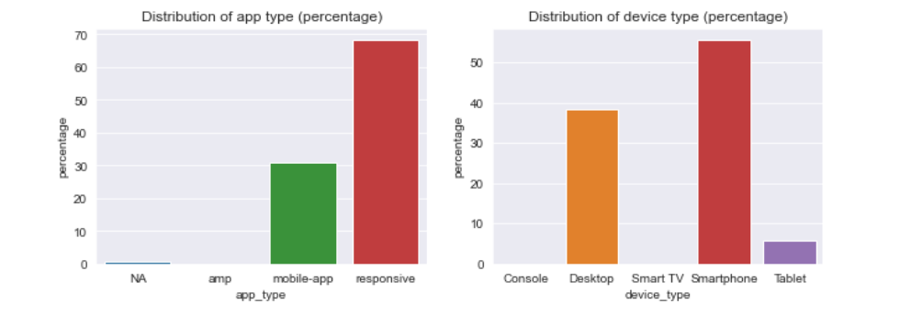
Bcvbvcbcvbcv

