Slide 1

Inverse Kinematics (part 2)
CSE169: Computer Animation
Instructor: Steve Rotenberg
UCSD, Winter 2005

Slide 2
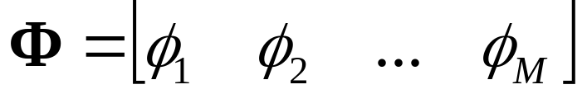
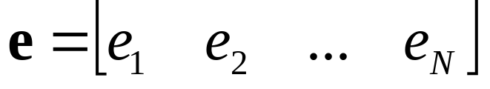
Forward Kinematics
We will use the vector:
to represent the array of M joint DOF values
We will also use the vector:
to represent an array of N DOFs that describe the end effector in world space. For example, if our end effector is a full joint with orientation, e would contain 6 DOFs: 3 translations and 3 rotations. If we were only concerned with the end effector position, e would just contain the 3 translations.

Slide 3
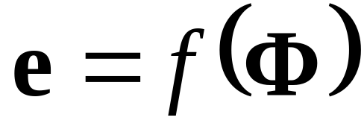
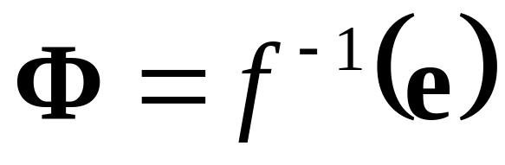
Forward & Inverse Kinematics
The forward kinematic function computes the world space end effector DOFs from the joint DOFs:
The goal of inverse kinematics is to compute the vector of joint DOFs that will cause the end effector to reach some desired goal state

Slide 4
Gradient Descent
We want to find the value of x that causes f(x) to equal some goal value g
We will start at some value x₀ and keep taking small steps:
x_{i+1} = x_{i} + Δx
until we find a value x_{N} that satisfies f(x_{N})=g
For each step, we try to choose a value of Δx that will bring us closer to our goal
We can use the derivative to approximate the function nearby, and use this information to move ‘downhill’ towards the goal

Slide 5
Gradient Descent for f(x)=g
df/dx
f(x_{i})
f-axis
g
x_{i+1}
x_{i}
x-axis

Slide 6
Minimization
If f(x_{i})-g is not 0, the value of f(x_{i})-g can be thought of as an error. The goal of gradient descent is to minimize this error, and so we can refer to it as a minimization algorithm
Each step Δx we take results in the function changing its value. We will call this change Δf.
Ideally, we could have Δf = g-f(x_{i}). In other words, we want to take a step Δx that causes Δf to cancel out the error
More realistically, we will just hope that each step will bring us closer, and we can eventually stop when we get ‘close enough’
This iterative process involving approximations is consistent with many numerical algorithms

Slide 7
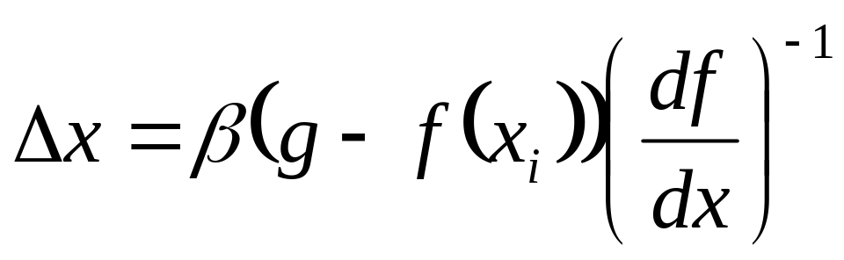
Taking Safe Steps
Sometimes, we are dealing with non-smooth functions with varying derivatives
Therefore, our simple linear approximation is not very reliable for large values of Δx
There are many approaches to choosing a more appropriate (smaller) step size
One simple modification is to add a parameter β to scale our step (0≤ β ≤1)

Slide 8
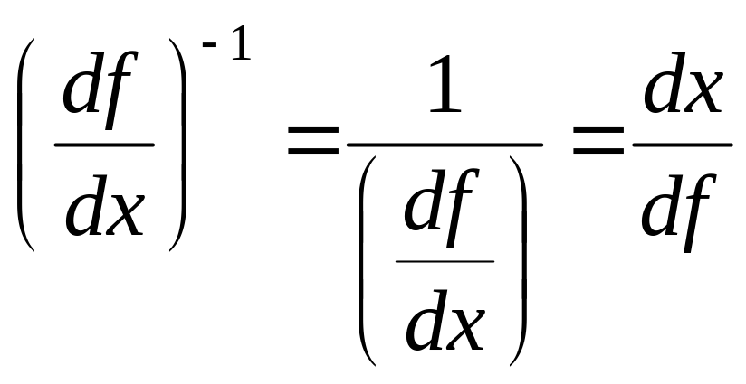
Inverse of the Derivative
By the way, for scalar derivatives:

Slide 9
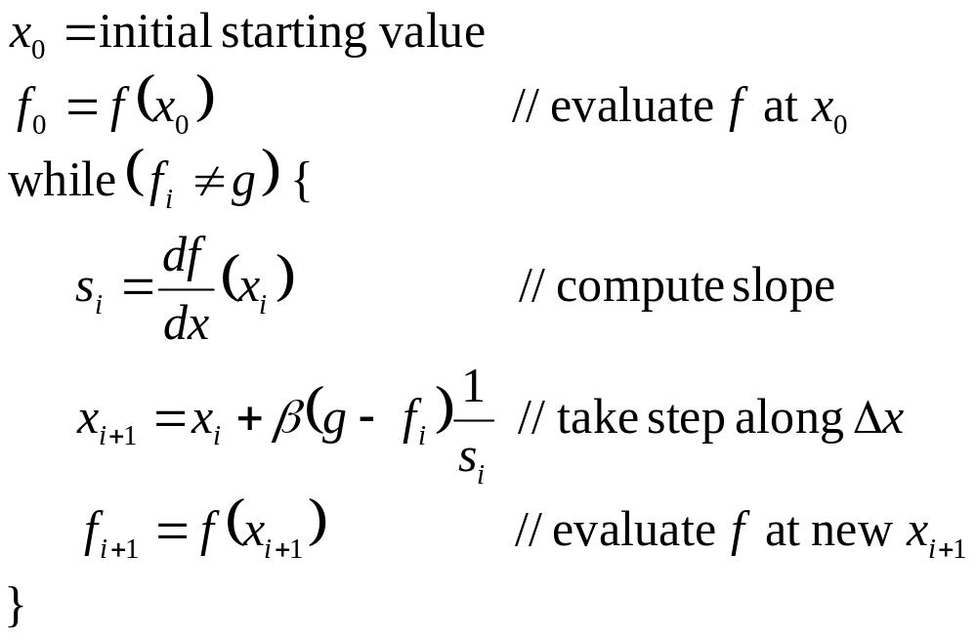
Gradient Descent Algorithm

Slide 10
Jacobians
A Jacobian is a vector derivative with respect to another vector
If we have a vector valued function of a vector of variables f(x), the Jacobian is a matrix of partial derivatives- one partial derivative for each combination of components of the vectors
The Jacobian matrix contains all of the information necessary to relate a change in any component of x to a change in any component of f
The Jacobian is usually written as J(f,x), but you can really just think of it as df/dx

Slide 11
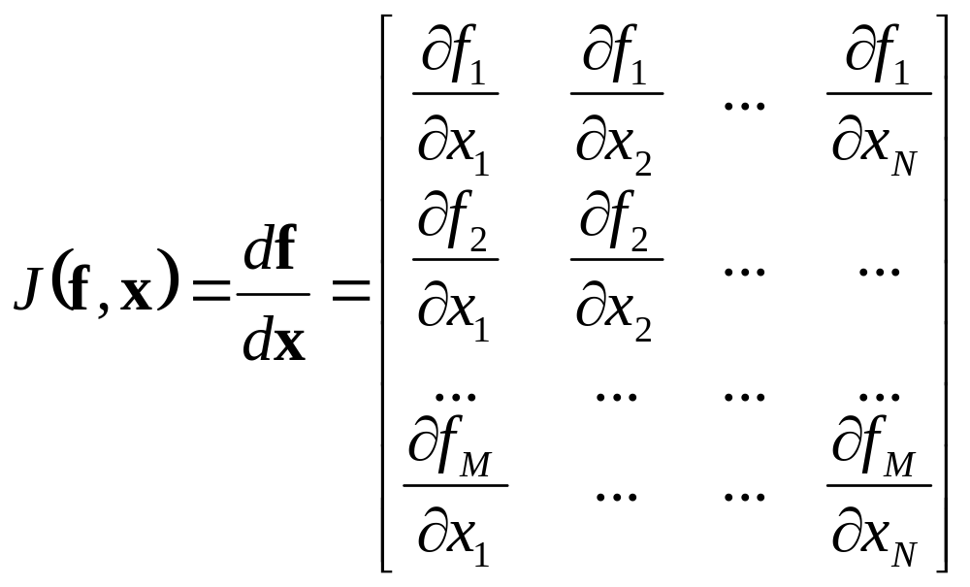
Jacobians

Slide 12
Jacobian Inverse Kinematics

Slide 13
Jacobians
Let’s say we have a simple 2D robot arm with two 1-DOF rotational joints:
• e=[e_{x} e_{y}]
φ₂
φ₁

Slide 14
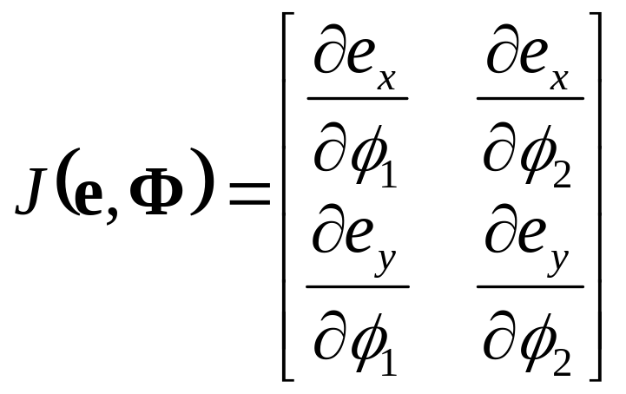
Jacobians
The Jacobian matrix J(e,Φ) shows how each component of e varies with respect to each joint angle

Slide 15
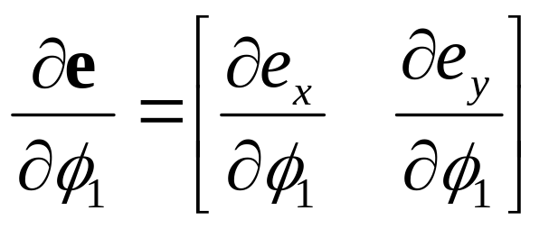
Jacobians
Consider what would happen if we increased φ₁ by a small amount. What would happen to e ?
•
φ₁

Slide 16
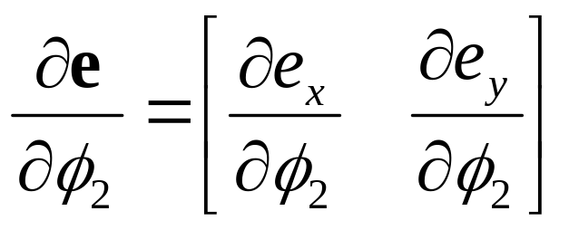
Jacobians
What if we increased φ₂ by a small amount?
•
φ₂

Slide 17
Jacobian for a 2D Robot Arm
•
φ₂
φ₁

Slide 18
Jacobian Matrices
Just as a scalar derivative df/dx of a function f(x) can vary over the domain of possible values for x, the Jacobian matrix J(e,Φ) varies over the domain of all possible poses for Φ
For any given joint pose vector Φ, we can explicitly compute the individual components of the Jacobian matrix

Slide 19
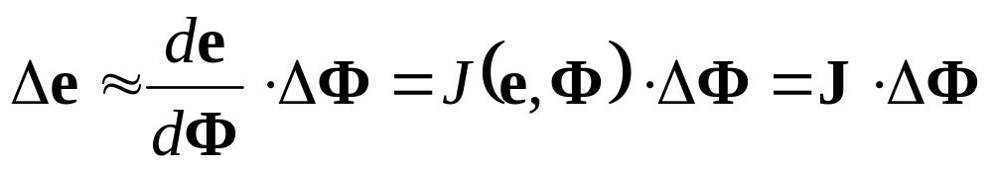
Incremental Change in Pose
Lets say we have a vector ΔΦ that represents a small change in joint DOF values
We can approximate what the resulting change in e would be:

Slide 20
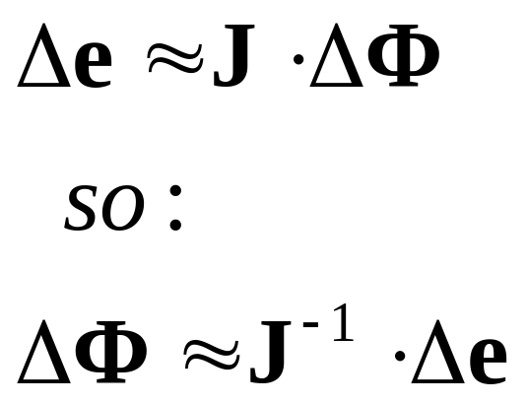
Incremental Change in Effector
What if we wanted to move the end effector by a small amount Δe. What small change ΔΦ will achieve this?

Slide 21
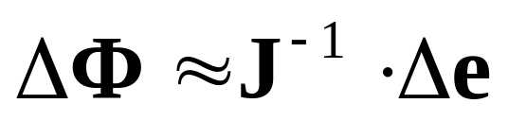
Incremental Change in e
Given some desired incremental change in end effector configuration Δe, we can compute an appropriate incremental change in joint DOFs ΔΦ
Δe
•
φ₂
φ₁

Slide 22
Incremental Changes
Remember that forward kinematics is a nonlinear function (as it involves sin’s and cos’s of the input variables)
This implies that we can only use the Jacobian as an approximation that is valid near the current configuration
Therefore, we must repeat the process of computing a Jacobian and then taking a small step towards the goal until we get to where we want to be

Slide 23
Choosing Δe
We want to choose a value for Δe that will move e closer to g. A reasonable place to start is with
Δe = g - e
We would hope then, that the corresponding value of ΔΦ would bring the end effector exactly to the goal
Unfortunately, the nonlinearity prevents this from happening, but it should get us closer
Also, for safety, we will take smaller steps:
Δe = β(g - e)
where 0≤ β ≤1

Slide 24
Basic Jacobian IK Technique
while (e is too far from g) {
Compute J(e,Φ) for the current pose Φ
Compute J⁻¹ // invert the Jacobian matrix
Δe = β(g - e) // pick approximate step to take
ΔΦ = J⁻¹ · Δe // compute change in joint DOFs
Φ = Φ + ΔΦ // apply change to DOFs
Compute new e vector // apply forward
// kinematics to see
// where we ended up
}

Slide 25
Inverting the Jacobian Matrix

Slide 26
Inverting the Jacobian
If the Jacobian is square (number of joint DOFs equals the number of DOFs in the end effector), then we might be able to invert the matrix
Most likely, it won’t be square, and even if it is, it’s definitely possible that it will be singular and non-invertable
Even if it is invertable, as the pose vector changes, the properties of the matrix will change and may become singular or near-singular in certain configurations
The bottom line is that just relying on inverting the matrix is not going to work

Slide 27
Underconstrained Systems
If the system has more degrees of freedom in the joints than in the end effector, then it is likely that there will be a continuum of redundant solutions (i.e., an infinite number of solutions)
In this situation, it is said to be underconstrained or redundant
These should still be solvable, and might not even be too hard to find a solution, but it may be tricky to find a ‘best’ solution

Slide 28
Overconstrained Systems
If there are more degrees of freedom in the end effector than in the joints, then the system is said to be overconstrained, and it is likely that there will not be any possible solution
In these situations, we might still want to get as close as possible
However, in practice, overconstrained systems are not as common, as they are not a very useful way to build an animal or robot (they might still show up in some special cases though)

Slide 29
Well-Constrained Systems
If the number of DOFs in the end effector equals the number of DOFs in the joints, the system could be well constrained and invertable
In practice, this will require the joints to be arranged in a way so their axes are not redundant
This property may vary as the pose changes, and even well-constrained systems may have trouble

Slide 30
Pseudo-Inverse
If we have a non-square matrix arising from an overconstrained or underconstrained system, we can try using the pseudoinverse:
J*=(J^{T}J)⁻¹J^{T}
This is a method for finding a matrix that effectively inverts a non-square matrix

Slide 31
Degenerate Cases
Occasionally, we will get into a configuration that suffers from degeneracy
If the derivative vectors line up, they lose their linear independence
•

Slide 32
Single Value Decomposition
The SVD is an algorithm that decomposes a matrix into a form whose properties can be analyzed easily
It allows us to identify when the matrix is singular, near singular, or well formed
It also tells us about what regions of the multidimensional space are not adequately covered in the singular or near singular configurations
The bottom line is that it is a more sophisticated, but expensive technique that can be useful both for analyzing the matrix and inverting it

Slide 33
Jacobian Transpose
Another technique is to simply take the transpose of the Jacobian matrix!
Surprisingly, this technique actually works pretty well
It is much faster than computing the inverse or pseudo-inverse
Also, it has the effect of localizing the computations. To compute Δφ_{i} for joint i, we compute the column in the Jacobian matrix J_{i} as before, and then just use:
Δφ_{i} = J_{i}^{T} · Δe

Slide 34
Jacobian Transpose
With the Jacobian transpose (JT) method, we can just loop through each DOF and compute the change to that DOF directly
With the inverse (JI) or pseudo-inverse (JP) methods, we must first loop through the DOFs, compute and store the Jacobian, invert (or pseudo-invert) it, then compute the change in DOFs, and then apply the change
The JT method is far friendlier on memory access & caching, as well as computations
However, if one prefers quality over performance, the JP method might be better…

Slide 35
Iterating to the Solution

Slide 36
Iteration
Whether we use the JI, JP, or JT method, we must address the issue of iteration towards the solution
We should consider how to choose an appropriate step size β and how to decide when the iteration should stop

Slide 37
When to Stop
There are three main stopping conditions we should account for
  Finding a successful solution (or close enough)
  Getting stuck in a condition where we can’t improve (local minimum)
  Taking too long (for interactive systems)
All three of these are fairly easy to identify by monitoring the progress of Φ
These rules are just coded into the while() statement for the controlling loop

Slide 38
Finding a Successful Solution
We really just want to get close enough within some tolerance
If we’re not in a big hurry, we can just iterate until we get within some floating point error range
Alternately, we could choose to stop when we get within some tolerance measurable in pixels
For example, we could position an end effector to 0.1 pixel accuracy
This gives us a scheme that should look good and automatically adapt to spend more time when we are looking at the end effector up close (level-of-detail)

Slide 39
Local Minima
If we get stuck in a local minimum, we have several options
  Don’t worry about it and just accept it as the best we can do
  Switch to a different algorithm (CCD…)
  Randomize the pose vector slightly (or a lot) and try again
  Send an error to whatever is controlling the end effector and tell it to try something else
Basically, there are few options that are truly appealing, as they are likely to cause either an error in the solution or a possible discontinuity in the motion

Slide 40
Taking Too Long
In a time critical situation, we might just limit the iteration to a maximum number of steps
Alternately, we could use internal timers to limit it to an actual time in seconds

Slide 41
Iteration Stepping
Step size
Stability
Performance

Slide 42
Other IK Issues

Slide 43
Joint Limits
A simple and reasonably effective way to handle joint limits is to simply clamp the pose vector as a final step in each iteration
One can’t compute a proper derivative at the limits, as the function is effectively discontinuous at the boundary
The derivative going towards the limit will be 0, but coming away from the limit will be non-zero. This leads to an inequality condition, which can’t be handled in a continuous manner
We could just choose whether to set the derivative to 0 or non-zero based on a reasonable guess as to which way the joint would go. This is easy in the JT method, but can potentially cause trouble in JI or JP

Slide 44
Higher Order Approximation
The first derivative gives us a linear approximation to the function
We can also take higher order derivatives and construct higher order approximations to the function
This is analogous to approximating a function with a Taylor series

Slide 45
Repeatability
If a given goal vector g always generates the same pose vector Φ, then the system is said to be repeatable
This is not likely to be the case for redundant systems unless we specifically try to enforce it
If we always compute the new pose by starting from the last pose, the system will probably not be repeatable
If, however, we always reset it to a ‘comfortable’ default pose, then the solution should be repeatable
One potential problem with this approach however is that it may introduce sharp discontinuities in the solution

Slide 46
Multiple End Effectors
Remember, that the Jacobian matrix relates each DOF in the skeleton to each scalar value in the e vector
The components of the matrix are based on quantities that are all expressed in world space, and the matrix itself does not contain any actual information about the connectivity of the skeleton
Therefore, we extend the IK approach to handle tree structures and multiple end effectors without much difficulty
We simply add more DOFs to the end effector vector to represent the other quantities that we want to constrain
However, the issue of scaling the derivatives becomes more important as more joints are considered

Slide 47
Multiple Chains
Another approach to handling tree structures and multiple end effectors is to simply treat it as several individual chains
This works for characters often, as we can animate the body with a forward kinematic approach, and then animate each limb with IK by positioning the hand/foot as the end effector goal
This can be faster and simpler, and actually offer a nicer way to control the character

Slide 48
Geometric Constraints
One can also add more abstract geometric constraints to the system
  Constrain distances, angles within the skeleton
  Prevent bones from intersecting each other or the environment
  Apply different weights to the constraints to signify their importance
  Have additional controls that try to maximize the ‘comfort’ of a solution
  Etc.
Welman talks about this in section 5

Slide 49
Other IK Techniques
Cyclic Coordinate Descent
  This technique is more of a trigonometric approach and is more heuristic. It does, however, tend to converge in fewer iterations than the Jacobian methods, even though each iteration is a bit more expensive. Welman talks about this method in section 4.2
Analytical Methods
  For simple chains, one can directly invert the forward kinematic equations to obtain an exact solution. This method can be very fast, very predictable, and precisely controllable. With some finesse, one can even formulate good analytical solvers for more complex chains with multiple DOFs and redundancy
Other Numerical Methods
  There are lots of other general purpose numerical methods for solving problems that can be cast into f(x)=g format

Slide 50
Jacobian Method as a Black Box
The Jacobian methods were not invented for solving IK. They are a far more general purpose technique for solving systems of non-linear equations
The Jacobian solver itself is a black box that is designed to solve systems that can be expressed as f(x)=g ( e(Φ)=g )
All we need is a method of evaluating f and J for a given value of x to plug it into the solver
If we design it this way, we could conceivably swap in different numerical solvers (JI, JP, JT, damped least-squares, conjugate gradient…)

Slide 51
Computing the Jacobian

Slide 52
Computing the Jacobian Matrix
We can take a geometric approach to computing the Jacobian matrix
Rather than look at it in 2D, let’s just go straight to 3D
Let’s say we are just concerned with the end effector position for now. Therefore, e is just a 3D vector representing the end effector position in world space. This also implies that the Jacobian will be an 3xN matrix where N is the number of DOFs
For each joint DOF, we analyze how e would change if the DOF changed

Slide 53
1-DOF Rotational Joints
We will first consider DOFs that represents a rotation around a single axis (1-DOF hinge joint)
We want to know how the world space position e will change if we rotate around the axis. Therefore, we will need to find the axis and the pivot point in world space
Let’s say φ_{i} represents a rotational DOF of a joint. We also have the offset r_{i} of that joint relative to it’s parent and we have the rotation axis a_{i} relative to the parent as well
We can find the world space offset and axis by transforming them by their parent joint’s world matrix

Slide 54
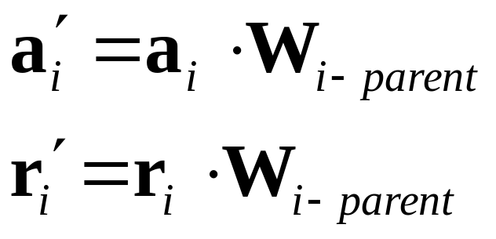
1-DOF Rotational Joints
To find the pivot point and axis in world space:
Remember these transform as homogeneous vectors. r transforms as a position [r_{x} r_{y} r_{z} 1] and a transforms as a direction [a_{x} a_{y} a_{z} 0]

Slide 55
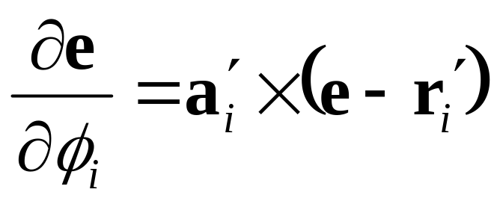
Rotational DOFs
Now that we have the axis and pivot point of the joint in world space, we can use them to find how e would change if we rotated around that axis
This gives us a column in the Jacobian matrix

Slide 56
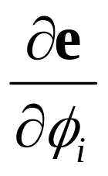

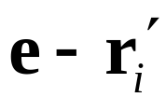


Rotational DOFs
•
a’_{i}: unit length rotation axis in world space
r’_{i}: position of joint pivot in world space
e: end effector position in world space
•

Slide 57
3-DOF Rotational Joints
For a 2-DOF or 3-DOF joint, it is actually a little trickier to get the world space axis
Consider how we would find the world space x-axis of a 3-DOF ball joint
Not only do we need to consider the parent’s world matrix, but we need to include the rotation around the next two axes (y and z-axis) as well
This is because those following rotations will rotate the first axis itself

Slide 58
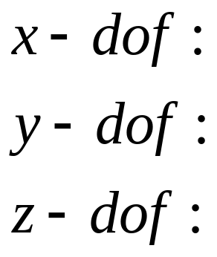
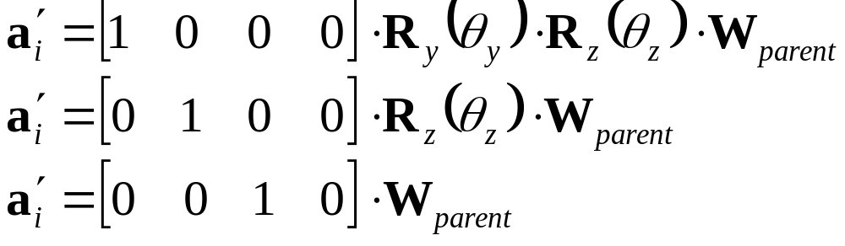
3-DOF Rotational Joints
For example, assuming we have a 3-DOF ball joint that rotates in XYZ order:
Where R_{y}(θ_{y}) and R_{z}(θ_{z}) are y and z rotation matrices

Slide 59
3-DOF Rotational Joints
Remember that a 3-DOF XYZ ball joint’s local matrix will look something like this:
Where R_{x}(θ_{x}), R_{y}(θ_{y}), and R_{z}(θ_{z}) are x, y, and z rotation matrices, and T(r) is a translation by the (constant) joint offset
So it’s world matrix looks like this:

Slide 60
3-DOF Rotational Joints
Once we have each axis in world space, each one will get a column in the Jacobian matrix
At this point, it is essentially handled as three 1-DOF joints, so we can use the same formula for computing the derivative as we did earlier:
We repeat this for each of the three axes

Slide 61
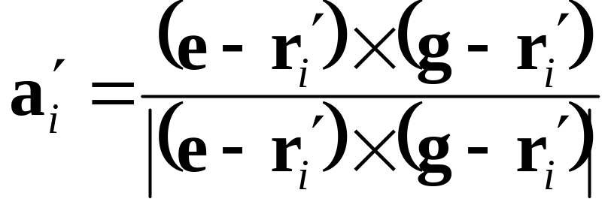
Quaternion Joints
What about a quaternion joint? How do we incorporate them into our IK formulation?
We will assume that a quaternion joint is capable of rotating around any axis
However, since we are trying to find a way to move e towards g, we should pick the best possible axis for achieving this

Slide 62

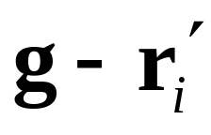
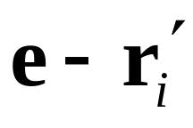
Quaternion Joints
•
•
•

Slide 63
Quaternion Joints
We compute a_{i}’ directly in world space, so we don’t need to transform it
Now that we have a_{i}’, we can just compute the derivative the same way we would do with any other rotational axis
We must remember what axis we use, so that later, when we’ve computed Δφ_{i}, we know how to update the quaternion

Slide 64
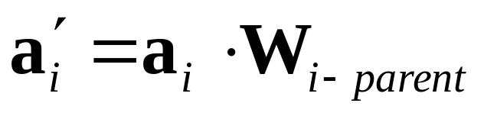
Translational DOFs
For translational DOFs, we start in the same way, namely by finding the translation axis in world space
If we had a prismatic joint (1-DOF translation) that could translate along an arbitrary axis a_{i} defined in the parent’s space, we can use:

Slide 65
Translational DOFs
For a more general 3-DOF translational joint that just translates along the local x, y, and z-axes, we don’t need to do the same thing that we did for rotation
The reason is that for translations, a change in one axis doesn’t affect the other axes at all, so we can just use the same formula and plug in the x, y, and z axes [1 0 0 0], [0 1 0 0], [0 0 1 0] to get the 3 world space axes
Note: this will just return the a, b, and c axes of the parent’s world space matrix, and so we don’t actually have to compute them!

Slide 66
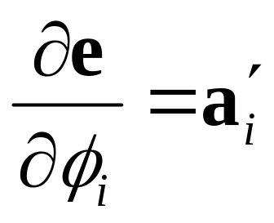
Translational DOFs
As with rotation, each translational DOF is still treated separately and gets its own column in the Jacobian matrix
A change in the DOF value results in a simple translation along the world space axis, making the computation trivial:

Slide 67
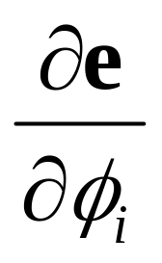
Translational DOFs
•
•

Slide 68
Building the Jacobian
To build the entire Jacobian matrix, we just loop through each DOF and compute a corresponding column in the matrix
If we wanted, we could use more elaborate joint types (scaling, translation along a path, shearing…) and still compute an appropriate derivative
If absolutely necessary, we could always resort to computing a numerical approximation to the derivative

Slide 69
Units & Scaling
What about units?
Rotational DOFs use radians and translational DOFs use meters (or some other measure of distance)
How can we combine their derivatives into the same matrix?
Well, it’s really a bit of a hack, but we just combine them anyway
If desired, we can scale any column to adjust how much the IK will favor using that DOF

Slide 70
Units & Scaling
For example, we could scale all rotations by some constant that causes the IK to behave how we would like
Also, we could use this as an additional way to get control over the behavior of the IK
We can store an additional parameter for each DOF that defines how ‘stiff’ it should behave
If we scale the derivative larger (but preserve direction), the solution will compensate with a smaller value for Δφi, therefore making it act stiff
There are several proposed methods for automatically setting the stiffness to a reasonable default value. They generally work based on some function of the length of the actual bone. The Welman paper talks about this.

Slide 71
End Effector Orientation

Slide 72
End Effector Orientation
We’ve examined how to form the columns of a Jacobian matrix for a position end effector with 3 DOFs
How do we incorporate orientation of the end effector?
We will add more DOFs to the end effector vector e
Which method should we use to represent the orientation? (Euler angles? Quaternions?…)
Actually, a popular method is to use the 3 DOF scaled axis representation!

Slide 73
Scaled Rotation Axis
We learned that any orientation can be represented as a single rotation around some axis
Therefore, we can store an orientation as an 3D vector
  The direction of the vector is the rotation axis
  The length of the vector is the angle to rotate in radians
This method has some properties that work well with the Jacobian approach
  Continuous and consistent
  No redundancy or extra constraints
  It’s also a nice method to store incremental changes in rotation

Slide 74
6-DOF End Effector
If we are concerned about both the position and orientation of the end effector, then our e vector should contain 6 numbers
But remember, we don’t actually need the e vector, we really just need the Δe vector
To generate Δe, we compare the current end effector position/orientation (matrix E) to the goal position/orientation (matrix G)
The first 3 components of Δe represent the desired change in position: β(G.d - E.d)
The next 3 represent a desired change in orientation, which we will express as a scaled axis vector

Slide 75
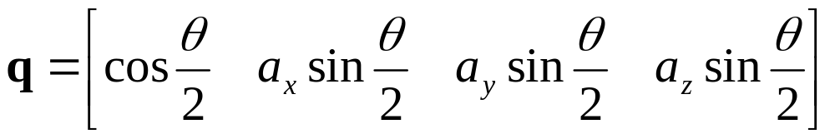
Desired Change in Orientation
We want to choose a rotation axis that rotates E in to G
We can compute this using some quaternions:
M=E⁻¹·G
q.FromMatrix(M);
This gives us a quaternion that represents a rotation from E to G
To extract out the rotation axis and angle, we just remember that:
We can then scale the final axis by β

Slide 76
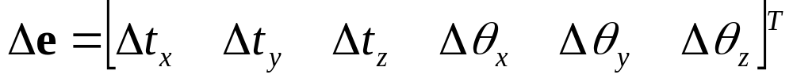
End Effector
So we now can define our goal with a matrix and come up with some desired change in end effector values that will bring us closer to that goal:
We must now compute a Nx6 Jacobian matrix, where each column represents how a particular DOF will affect both the position and orientation of the end effector

Slide 77
Rotational DOFs
We need to compute additional derivatives that show how the end effector orientation changes with respect to an incremental change in each DOF
We will use the scaled axis to represent the incremental change
For a rotational DOF, we first find the rotation axis in world space (as we did earlier)
Then- we’re done! That axis already represents the incremental rotation caused by that DOF
By default, the length of the axis should be 1, indicating that a change of 1 in the DOF value results in a rotation of 1 radian around the axis. We can scale this by a stiffness value if desired

Slide 78
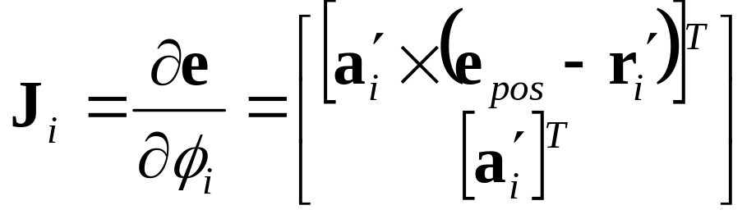
Rotational DOFs
The column in the Nx6 Jacobian matrix corresponding to a rotational DOF is:
a’ is the rotation axis in world space
r’ is the pivot point in world space
e_{pos} is the position of the end effector in world space

Slide 79
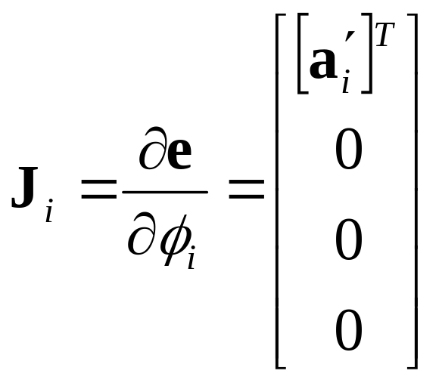
Translational DOFs
Translational DOFs don’t affect the end effector orientation, so their contribution to the derivative of orientation will be [0 0 0]

