Slide 1
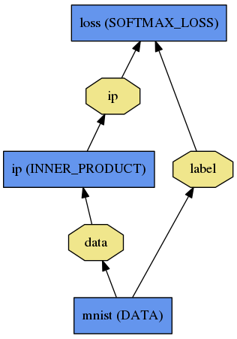
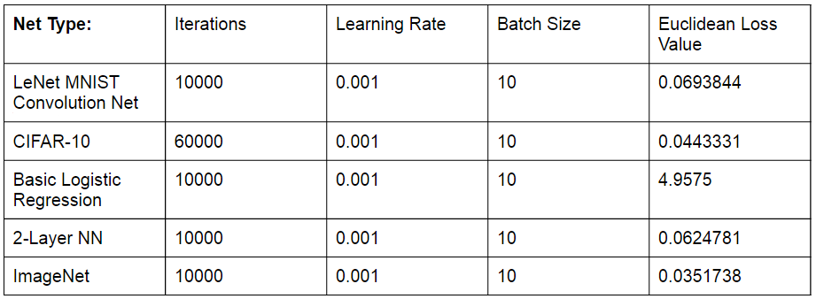
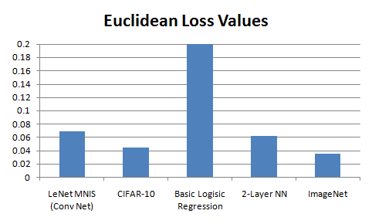
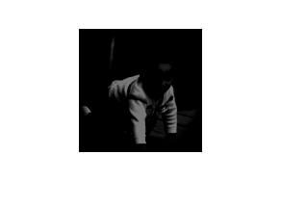
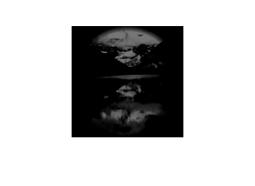

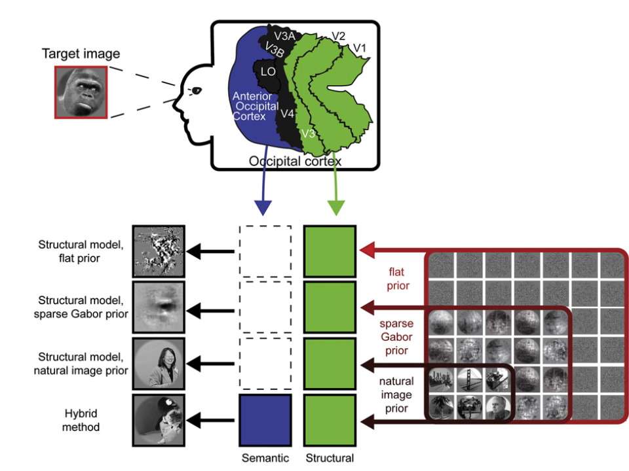
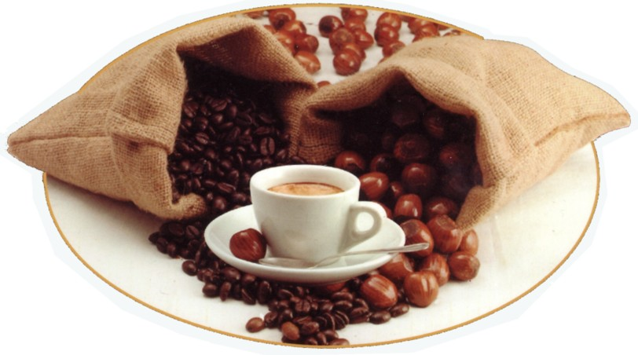
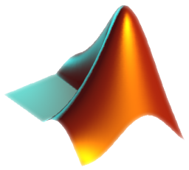

Caffe: Deep Learning Network on Predicting Brain Response
About Caffe
Caffe is a Deep Learning framework for images developed and maintained by BVLC.
http://caffe.berkeleyvision.org/
Caffe allows end users to easily create neural nets to train a model. Nets are created through an abstraction of layers. Complex nets and models are available on the Caffe website. An example net is the logistic regression net.
Zachary Hargreaves, Yew Hung Leong, Ali Kayes
Computer Science Division
University of California, Berkeley
Group 3
How the Brain Responds to Images
Patients were given natural images to look at. While these patients were examining the images, an fMRI machine scanned the visual cortex of the brains of the test subjects. FMRI machines measure blood oxygen levels of organic tissue and measuring higher oxygen levels in specific regions of a brain would imply that there is more activity in that region.
Preprocessing of the fMRI data along with their corresponding visual stimuli is done through Matlab.
The preprocessed data is funnelled through different combinations of the layers of Caffe. At the end, a loss function is used as a quality metric.
Many loss functions such as Softmax, Hinge, Sigmoid Cross Entropy, and Infogain work for various types of datasets and layer combinations. We used Euclidean loss for this particular dataset.
Methods
Here’s a list of learning methods we used in caffe. They are all directed acyclic graphs where each node in the graph represents a layer in caffe.
Basic Logistic Regression: This method uses three total layers and one computational layer. The computational layer computer and inner product.
Basic Two Layer Neural Net: An expansion from basic logistic regression, this neural net computes an inner product and then passes that information to a convolution layer.
LeNet Convolution Net: This neural net is known for its accuracy in classifying digits. The Sigmoid activation layer had been replaced with a Rectified Linear Unit layer so that neurons could be handled. Moreover, its computational layers consist of a convolution layer then a pooling layer then another convolution layer and pooling layer. Then the inner product is computed and passed to the Rectifies Linear Unit which then passes the information to another inner product.
CIFAR-10: This is another convolutional neural net. Like LeNet, it uses a convolution layer followed by a pooling layer. But unlike LeNet, it then uses a Rectified Linear Unit and a normalizing layer for the pooling layer. The normalized data is passed to another convolution layer which then is pooled and and passes through a rectified linear unit. This same process is repeated once more and in the end, an inner product is computed.
ImageNet: This is a heavily layered model. The method was proposed by Krizhevsky, Sutskever, and Hinton in their NIPS 2012 paper. It has 24 layers and a SoftMax loss function that we replaced with an Euclidean loss.
Results
As a baseline we ran a basic logistic regression composed of an inner product and a softmax loss function, this ran as expected. From here different configurations and fine tuning were exercised. After two computational layers were introduced(i.e. convolution, inner product), results became dramatically better. The LeNet MNIST convolution net (from class) performed well and very similar to most other 2-Layer NN that utilized convolution and pooling. The imageNet, as its name indicates, is designed for processing pixels and abstracting features/correlations from images. The complexity of this net made it very difficult to analyse which layers were responsible for the results. Small augmentations to imageNet were tried but none of them were able to outperform the example net provided by caffe
Data Preparation
The data provided was composed of raw volumetric fMRI data and corresponding simulation images.
For a given simulation image, the brain data was separated into different “region of interest” (ROI) for each respective image.
The ROIs served as our labels for running out neural network code.
Example Stimuli Images:
Tools
*The Basic Logistic Regression
continues off the chart*
Matlab:
Converts original raw data into HDF5 files. The format of our data indexed into 2D matrices from the original 4D matrices which allowed easier access and proper processing room for Caffe and Numpy.
Data exploration of stimuli images.
Numpy
Preprocessing of brain response data.
Average compression of ~25k labels to 8 labels (ROI)
Separation of training and validation sets.
Caffe:
Contains the framework for implementing deep learning neural nets that process our data.
Amazon EC2:
Handles the thousands of parameters in our dataset.
Enables GPU processing
Basis for ROI abstraction:
With the data provided specific voxel regions associated with vision in the brain were labelled which aided in our analysis/processing
We were able to compress the data through these regions and reduce out runtime significantly while developing our neural layers.
The results when having a label for every voxel still needs to be assessed.
When developing new neural networks the compressed ROI dataset was more agile and had a much faster runtime (>10x)
Lessons Learned
Caffe is still in developmental stages and the “accuracy layer” (common in neural networks) does not support multiple labels and in turn was the source of major delays when starting out ETL and data processing.
There was severe lack of documentation with regards to how the different types of layers worked respectively. Caffe assumed prior experience with how neural layers work.
Much focus was given to our loss layer/s because we were not confident in how to correctly assess our outcomes. In retrospect, many of the loss layers performed similar to one another and a lot of unnecessary energy was put into code that was already working.

