Slide 1
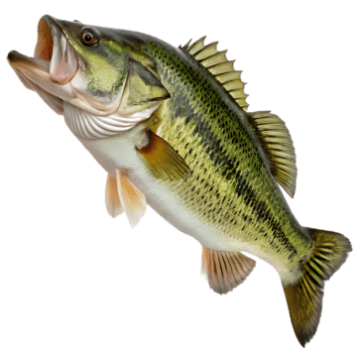

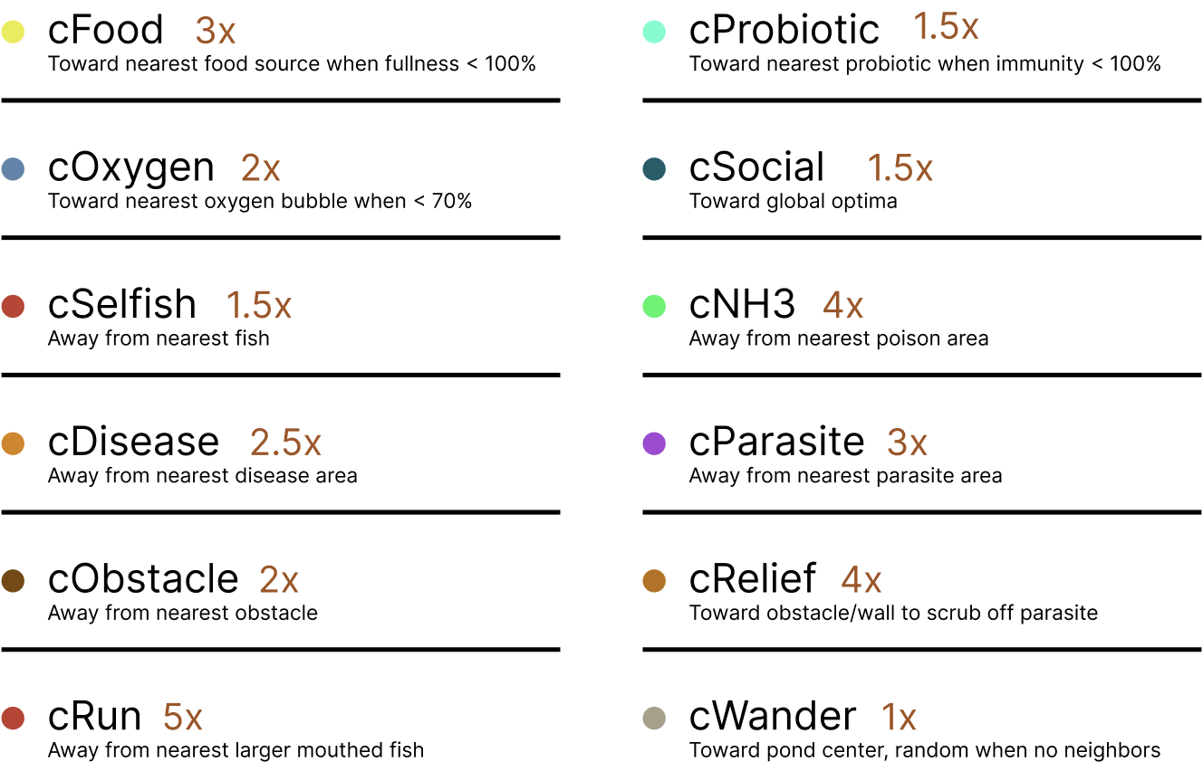
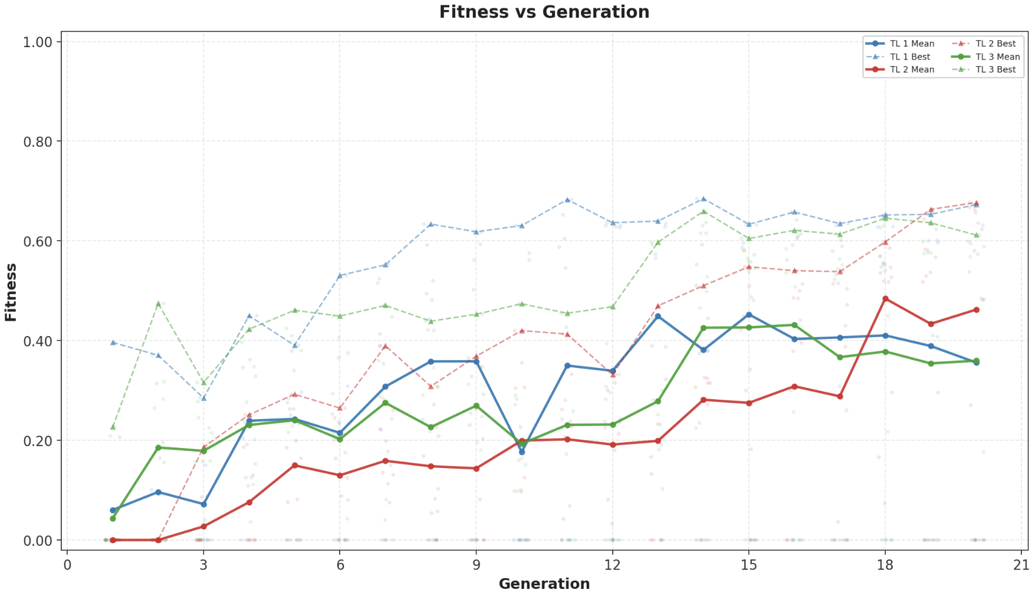
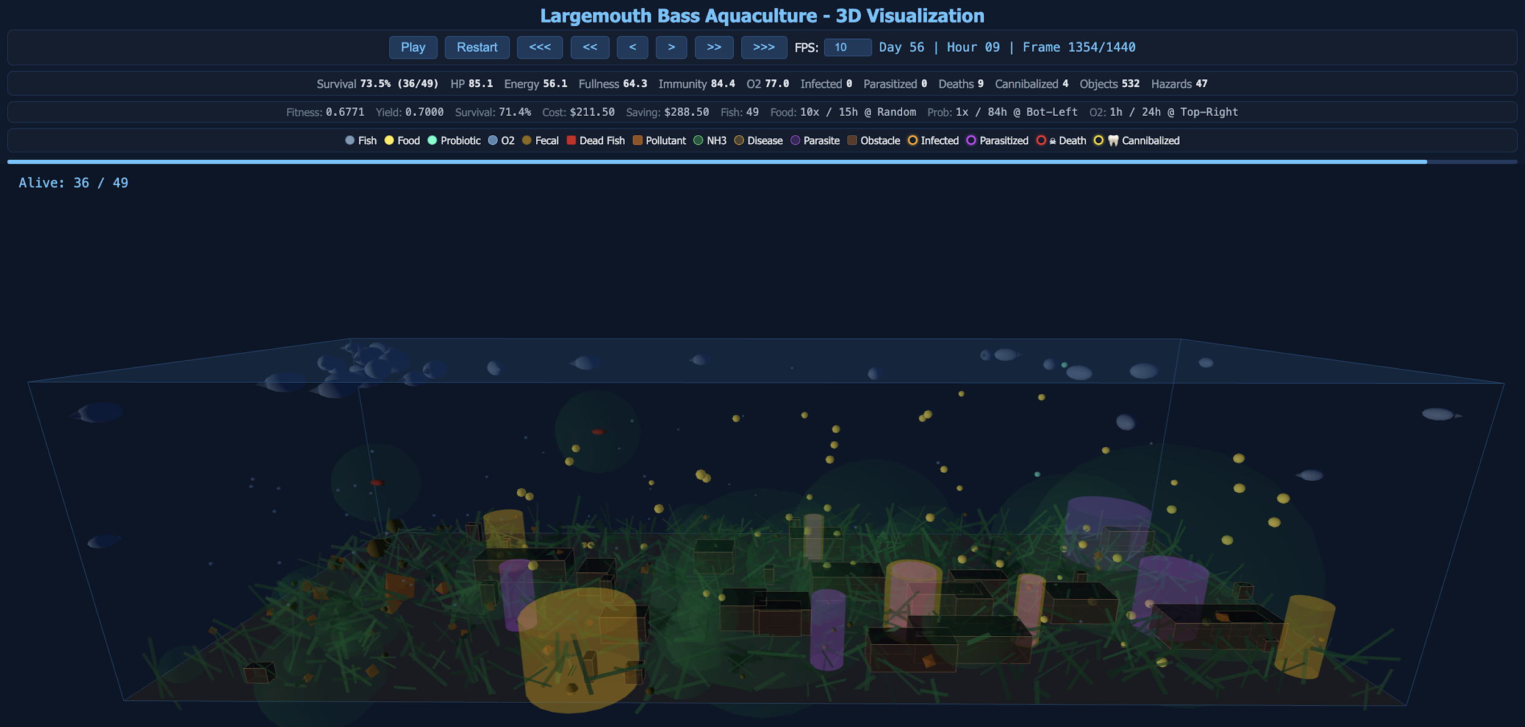
AquaOptima
Applying PSO and EA to simulate and optimize Largemouth Bass Aquaculture
Ahmed Ghazi and Leon Hoang
Background
How The PSO Works
How The EA Works
Largemouth bass aquaculture is a growing global industry [1, 4] facing environmental hurdles like poor winter survival [2] and biological threats such as external columnaris [3]. To combat disease and improve yields, farmers often use dietary supplements to boost fish immunity, metabolism, and growth [6]. A uniquely fascinating challenge in cultivating this species is its highly predatory nature, which frequently leads to intracohort cannibalism [5]. Driven by morphological constraints in young (Age-0) fish, this cannibalistic behavior requires active swarm management and optimal environmental policies to ensure population health and operational profitability [5].
Pond Genotype
Selection Method
Generic Variation
Encodes the aquacultural policy, defining maximum initial fishes, quantity, interval, and drop-location for Food, Probiotic and Oxygen.
Preserves top best using Elitism (k = 20%) unchanged. Remaining parents selected via Tournament (k = 40%) to balance diversity and selective pressure.
Introduces novelty through 50% independent Crossover and a 25% Mutation rate, randomizing genes to explore the global optimal.
Fitness Evaluation
Fitness Score Formula
Quantifies performance through weighted sum of biological yield, economic savings, and average swarm health.
Fitness = 0.55 × Yield + 0.33 × Saving_Rate + 0.12 × Healthiness
● Yield (55%): Aim to produce maximum living fish
● Saving_Rate (33%): Spend as little as possible
● Healthiness (12%): Survivors should be in good condition
Core Idea
Primary Flow Diagram
AquaOptima is an aquaculture simulation that pairs Particle Swarm Optimization to model how a swarm of Largemouth Bass survives a 3D pond, with an Evolutionary Algorithm that selects the best ponds with policy that yield the best outcome.
Stage 1
Stage 2
Stage 3
Initialization
EA Loop (G Generations)
Convergence
Input desire configurations (max_budget, pond’s size, aquaculture days, etc…
Initialize a fish swarm with random traits.
Initialize N Ponds with random genotypes
Ponds Population
PSO Simulation
Fitness
A converged pond (solution) at the last generations is chosen
Crossover and Mutation
Runs in each pond
Selection
Yield, Saving, and Healthiness
Elitism & Tournament
Plot 1
Plot 2
Plot 3
Virtual Aquatic Ecosystem
References
[1] An Environmental Impact Assessment of Largemouth Bass (Micropterus salmoides) Aquaculture in Hangzhou, China.
[2] Comparison of the survival rate of largemouth bass (Micropterus salmoides) fingerlings during the winter period in ponds and a wintering complex in the northern part of Ukraine.
[3] Controlling Mortality Caused by External Columnaris in Largemouth Bass and Bluegill with Chloramine-T or Hydrogen Peroxide.
[4] Largemouth Bass Aquaculture.
[5] Morphological Constraints on Intracohort Cannibalism in Age-0 Largemouth Bass.
[6] Multiple effects of dietary supplementation with Lactobacillus reuteri and Bacillus subtilis on the growth, immunity, and metabolism of largemouth bass (Micropterus salmoides).

