Slide 1
Precision Medicine: Integrated and Relational Database Design Concept
Lei Jiang
Liang Huang

Slide 2
Precision Medicine/ Personalized Medicine
Precision medicine delivers individually tailored therapy based on the patient’s disease subtype (Servant et al., 2014).
Select the most effective cancer treatments based on the presence of specific biomarkers in a patient’s tumor.
Genomic testing is used to identify patient’s gene expression profiles to determine the corresponding sensitive targeted therapies.

Slide 3
Precision Medicine/ Personalized Medicine
Precision medicine delivers individually tailored therapy based on the patient’s disease subtype (Servant et al., 2014).
Select the most effective cancer treatments based on the presence of specific biomarkers in a patient’s tumor.
Genomic testing is used to identify patient’s gene expression profiles to determine the corresponding sensitive targeted therapies.

Slide 4
Advantages of Precision Medicine
Avoids unnecessary treatments, reduces toxicity, and significantly improves outcome.
Actionable insights to prevent, diagnose (early detection) and treat diseases.
Potential to find cure for currently lethal diseases.
Machine learning allows predict drug response and develop diagnostics.

Slide 5
Advantages of Precision Medicine
Avoids unnecessary treatments, reduces toxicity, and significantly improves outcome.
Actionable insights to prevent, diagnose (early detection) and treat diseases.
Potential to find cure for currently lethal diseases.
Machine learning used in precision medicine allows predict drug response and develop diagnostics.

Slide 6
Clinical Use of Genomic Testing on Biomarkers
Standard in use:
Oncotype DX:
Breast cancer
Colon cancer
Prostate cancer
Chemotherapy, Radiation, Aggressive Treatment, or Surgery
Over 1 million patients tested in more than 90 countries

Slide 7
Clinical Use of Genomic Testing on Biomarkers
Standard in use:
Oncotype DX:
Breast cancer
Colon cancer
Prostate cancer
Chemotherapy, Radiation, Aggressive Treatment, or Surgery
Over 1 million patients tested in more than 90 countries

Slide 8
Clinical Use of Genomic Testing on Biomarkers
Standard in use:
Oncotype DX:
Breast cancer
Colon cancer
Prostate cancer
Chemotherapy, Radiation, Aggressive Treatment, or Surgery
Over 1 million patients tested in more than 90 countries

Slide 9
Clinical Use of Genomic Testing on Biomarkers
PD-L1 expression testing: for Lung cancer (Mascaux et al. 2018)
Biomarkers for Immunotherapies
Becoming standard:
Biomarkers for Pancreatic Cancer (Dimitrakopoulos et al. April 3rd, 2019)

Slide 10
Clinical Use of Genomic Testing on Biomarkers
PD-L1 expression testing: for Lung cancer (Mascaux et al. 2018)
Biomarkers for Immunotherapies
Becoming standard:
Biomarkers for Pancreatic Cancer (Dimitrakopoulos et al. April 3rd, 2019)

Slide 11
Motivation for Data Integration
Current Lack of Integrated Data Source
Existing Bioinformatics Databases are mostly single omics.
ENCODE, UCSC Genome Browser, Cancer Genome Atlas project (TCGA), and Ensembl.
A few integrative DB
The Multi-Omics Profiling Expression Database (MOPED)
Includes transcriptomics and proteomics information from publicly available studies on model organisms and humans
Genotype-Tissue Expression (GTEx) (on-going effort)
Includes Gene expression data(WES, RNA-sq), QTLs (mapping biomarker with phenotype), histology images (clinical).

Slide 12
Motivation for Data Integration
Current Lack of Integrated Data Source
Existing Bioinformatics Databases are mostly single omics.
ENCODE, UCSC Genome Browser, Cancer Genome Atlas project (TCGA), and Ensembl.
A few integrative DB
The Multi-Omics Profiling Expression Database (MOPED)
Includes transcriptomics and proteomics information from publicly available studies on model organisms and humans
Genotype-Tissue Expression (GTEx) (on-going effort)
Includes Gene expression data(WES, RNA-sq), QTLs (mapping biomarker with phenotype), histology images (clinical).

Slide 13
Motivation for Data Integration
Current Lack of Integrated Data Source
Existing Bioinformatics Databases are mostly single omics.
ENCODE, UCSC Genome Browser, Cancer Genome Atlas project (TCGA), and Ensembl.
A few integrative DB
The Multi-Omics Profiling Expression Database (MOPED)
Includes transcriptomics and proteomics information from publicly available studies on model organisms and humans
Genotype-Tissue Expression (GTEx) (on-going effort)
Includes Gene expression data(WES, RNA-sq), QTLs (mapping biomarker with phenotype), histology images (clinical).

Slide 14
Motivation for Data Integration
Current Lack of Integrated Data Source
Existing Bioinformatics Databases are mostly single omics.
ENCODE, UCSC Genome Browser, Cancer Genome Atlas project (TCGA), and Ensembl.
A few integrative DB
The Multi-Omics Profiling Expression Database (MOPED)
Includes transcriptomics and proteomics information from publicly available studies on model organisms and humans
Genotype-Tissue Expression (GTEx) (on-going effort)
Includes Gene expression data(WES, RNA-sq), QTLs (mapping biomarker with phenotype), histology images (clinical).

Slide 15
Motivation for Data Integration
Current Lack of Integrated Data Source
Existing Bioinformatics Databases are mostly single omics.
ENCODE, UCSC Genome Browser, Cancer Genome Atlas project (TCGA), and Ensembl.
A few integrative DB
The Multi-Omics Profiling Expression Database (MOPED)
Includes transcriptomics and proteomics information from publicly available studies on model organisms and humans
Genotype-Tissue Expression (GTEx) (on-going effort)
Includes Gene expression data(WES, RNA-sq), QTLs (mapping biomarker with phenotype), histology images (clinical).

Slide 16
Motivation for Data Integration
-Multiple data sources provide more information for more accurate clustering analysis.
Integrated the clinical, genomic, and transcriptomic data
Performed integrative clustering
Classified triple-negative breast cancers into more subtypes and suggested precision treatment strategies accordingly (Jiang et al. 2019).
-Deep learning usually requires extremely large training sample size and rich features from multiple sources.

Slide 17
Motivation for Data Integration
-Multiple data sources provide more information for more accurate clustering analysis.
Integrated the clinical, genomic, and transcriptomic data
Performed integrative clustering
Classified triple-negative breast cancers into more subtypes and suggested precision treatment strategies accordingly (Jiang et al. 2019).
-Deep learning usually requires extremely large training sample size and rich features from multiple sources.

Slide 18
Motivation for Data Integration
-Multiple data sources provide more information for more accurate clustering analysis.
Integrated the clinical, genomic, and transcriptomic data
Performed integrative clustering
Classified triple-negative breast cancers into more subtypes and suggested precision treatment strategies accordingly (Jiang et al. 2019).
-Deep learning usually requires extremely large training sample size and rich features from multiple sources.

Slide 19
Motivation for Data Integration
-Multiple data sources provide more information for more accurate clustering analysis.
Integrated the clinical, genomic, and transcriptomic data
Performed integrative clustering
Classified triple-negative breast cancers into more subtypes and suggested precision treatment strategies accordingly (Jiang et al. 2019).
-Deep learning usually requires extremely large training sample size and rich features from multiple sources.

Slide 20
Integrated Relational Database Approach
Most biological databases are in “flat files” format that are not easy to integrate with external data sources.
Relational databases allow integration of diverse types of information and efficient management of these large datasets.

Slide 21
Integrated Relational Database Approach
Most biological databases are in “flat files” format that are not easy to integrate with external data sources.
Relational databases allow integration of diverse types of information and efficient management of these large datasets.

Slide 22
Integrated Relational Database Approach
Queryable
Integrate all the related data in one query and extract or subset the data for deeper analysis.
Improve the efficiency for storing and querying the data.

Slide 23
Obstacles
Large-scale of Data
Create a smaller size database to prove the concept
Dramatic Increase in Genomics Data.
Next Generating Sequencing (NGS) technology making sequencing of human genomes cost effective. The cost falls from 10 million dollars a decade ago to 1 thousand dollars today.
Enormous amount of data generated from genomic tests.
Existing genomics database Sequence Read Archive (SRA) grows 10,000 times in the last decade.

Slide 24
Obstacles
Large-scale of Data
Create a smaller size database to prove the concept
Dramatic Increase in Genomics Data.
Next Generating Sequencing (NGS) technology making sequencing of human genomes cost effective. The cost falls from 10 million dollars a decade ago to 1 thousand dollars today.
Enormous amount of data generated from genomic tests.
Existing genomics database Sequence Read Archive (SRA) grows 10,000 times in the last decade.

Slide 25
Obstacles
Large-scale of Data
Create a smaller size database to prove the concept
Dramatic Increase in Genomics Data.
Next Generating Sequencing (NGS) technology making sequencing of human genomes cost effective. The cost falls from 10 million dollars a decade ago to 1 thousand dollars today.
Enormous amount of data generated from genomic tests.
Existing genomics database Sequence Read Archive (SRA) grows 10,000 times in the last decade.

Slide 26
Obstacles
Large-scale of Data
Create a smaller size database to prove the concept
Dramatic Increase in Genomics Data.
Next Generating Sequencing (NGS) technology making sequencing of human genomes cost effective. The cost falls from 10 million dollars from a decade ago to 1 thousand dollars today.
Enormous amount of data generated from genomic tests.
Existing genomics database Sequence Read Archive (SRA) grows 10,000 times in the last decade.

Slide 27
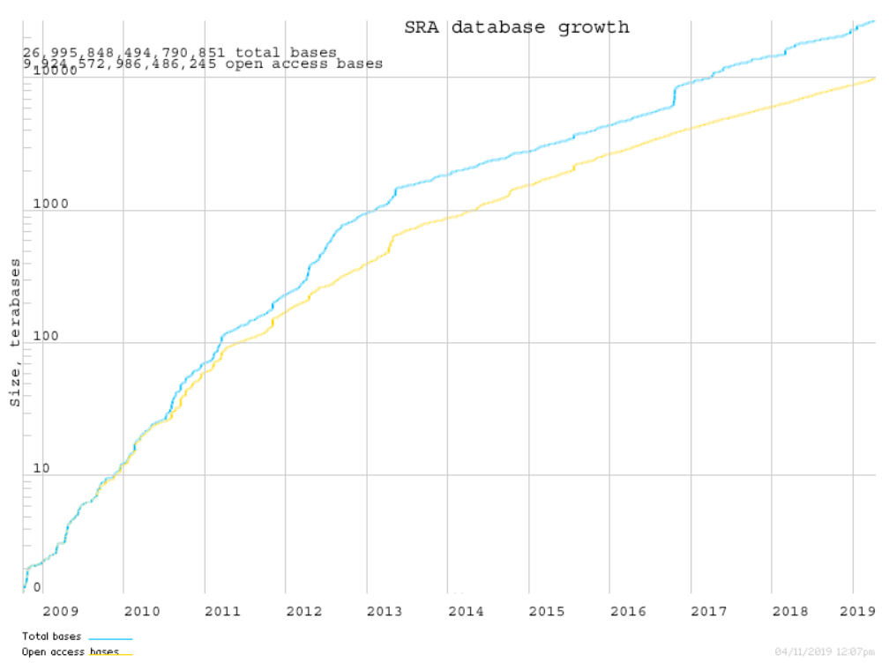
SRA growth

Slide 28
Obstacles
Hard to access patient genotyping and phenotyping data due to privacy concern
simulated data
Various non-trivial datatypes -- VCF and BAM, a lot of data munging to get data from various Datatypes, File formats.
Biological data has extremely flexible schema. Normalization for biological data is impractical.

Slide 29
Obstacles
Hard to access patient genotyping and phenotyping data due to privacy concern
simulated data
Various non-trivial datatypes -- VCF and BAM, a lot of data munging to get data from various Datatypes, File formats.
Biological data has extremely flexible schema. Normalization for biological data is impractical.

Slide 30
Methodology
Design the ER diagram
Normalization
Data Definition Language (DDL)
Data Manipulation Language(DML)
Populate patient genotyping data by simulated data (R code in Appendix).
Populate patient biopsy data from online data source.

Slide 31
Methodology
Simulate genomic test data:
569x21 matrix for patients genomic test dataset with gene expression levels range from 1-3. (All cancer patients data, so we do not have 0 value since it means no cancer. we do not know the actual underlie distribution though. so just used a normal distribution)
HER2-scores: The HER2 expression was scored using the HercepTest criteria. The HER2-score was based on a 0 to 3+ scale. 0 corresponded to tumour cells that were completely negative, 1+ corresponded to faint perceptible staining of the tumour cell membranes, 2+ corresponded to moderate staining of the entire tumour cell membranes and 3+ indicated strong circumferential staining of the entire tumour cell membranes creating a fishnet pattern.
Reference: Carlsson et al. paper in 2004. HER2 expression in breast cancer primary tumours and corresponding metastases.

Slide 32
Methodology
Simulate genomic test data:
569x21 matrix for patients genomic test dataset with gene expression levels range from 1-3. (All cancer patients data, so we do not have 0 value since it means no cancer. we do not know the actual underlie distribution though. so just used a normal distribution)
HER2-scores: The HER2 expression was scored using the HercepTest criteria. The HER2-score was based on a 0 to 3+ scale. 0 corresponded to tumour cells that were completely negative, 1+ corresponded to faint perceptible staining of the tumour cell membranes, 2+ corresponded to moderate staining of the entire tumour cell membranes and 3+ indicated strong circumferential staining of the entire tumour cell membranes creating a fishnet pattern.
Reference: Carlsson et al. paper in 2004. HER2 expression in breast cancer primary tumours and corresponding metastases.

Slide 33
Methodology
Simulate genomic test data:
569x21 matrix for patients genomic test dataset with gene expression levels range from 1-3. (All cancer patients data, so we do not have 0 value since it means no cancer. we do not know the actual underlie distribution though. so just used a normal distribution)
HER2-scores: The HER2 expression was scored using the HercepTest criteria. The HER2-score was based on a 0 to 3+ scale. 0 corresponded to tumour cells that were completely negative, 1+ corresponded to faint perceptible staining of the tumour cell membranes, 2+ corresponded to moderate staining of the entire tumour cell membranes and 3+ indicated strong circumferential staining of the entire tumour cell membranes creating a fishnet pattern.
Reference: Carlsson et al. paper in 2004. HER2 expression in breast cancer primary tumours and corresponding metastases.

Slide 34
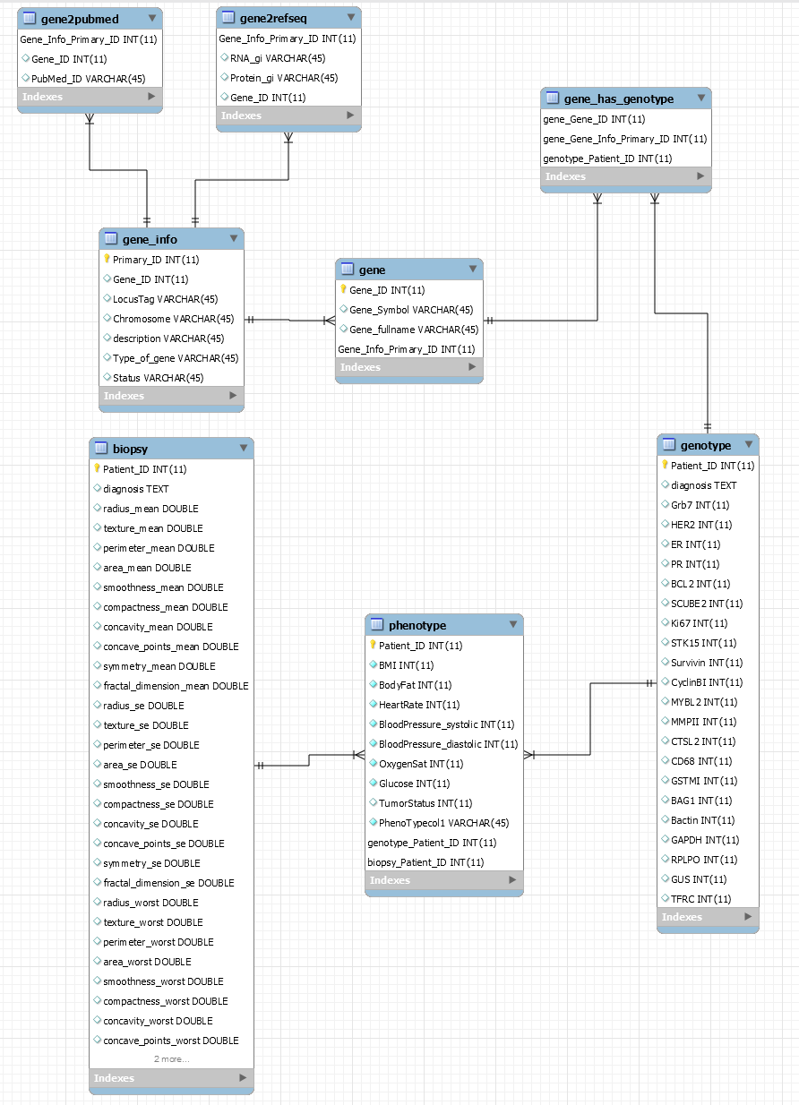
ER Diagram

Slide 35
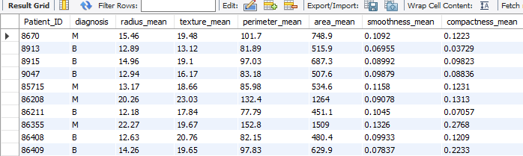
Patient_ID diagnosis

Slide 36
Demonstration
SELECT *
FROM (SELECT * FROM biopsy) b
JOIN (SELECT * FROM genotype) g
ON b.Patient_ID = g.Patient_ID
WHERE HER2=2
GROUP BY g.diagnosis
ORDER BY g.BCL2 DESC;

Slide 37
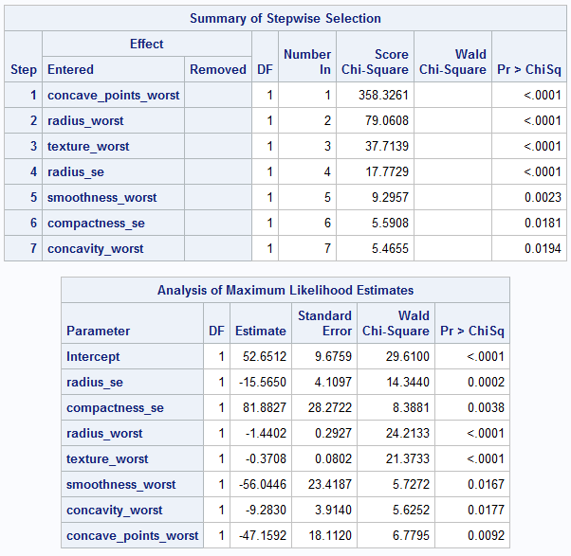
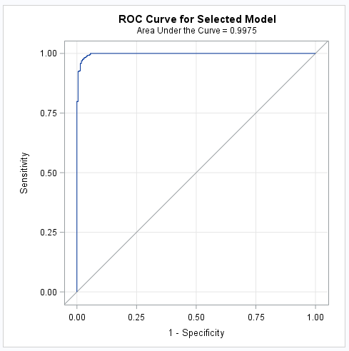
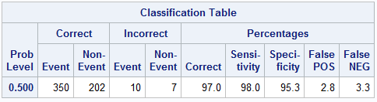
Logistic Regression Stepwise variable Selection

Slide 38
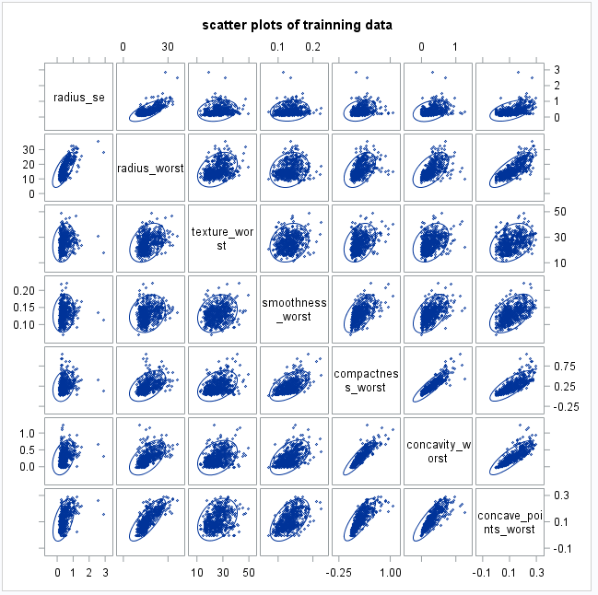
Scatter plots of selected variables

Slide 39
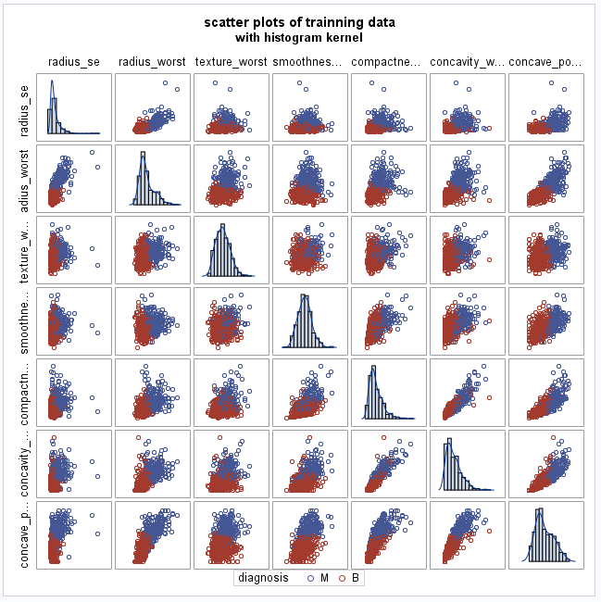
Scatter Plots of selected variables

Slide 40
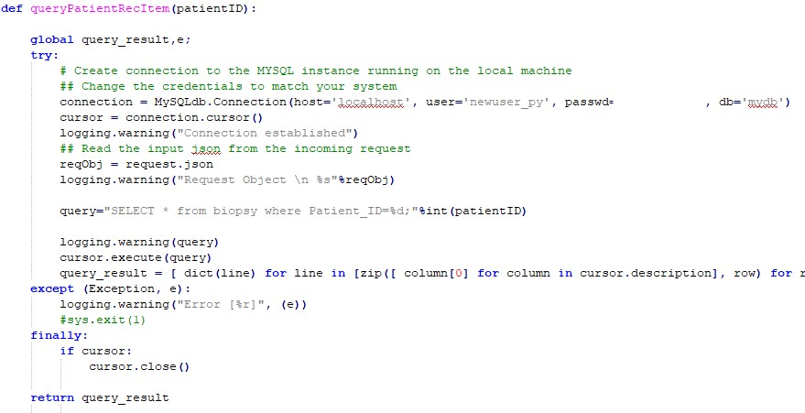
queryPatientRecItem(patientID)

Slide 41
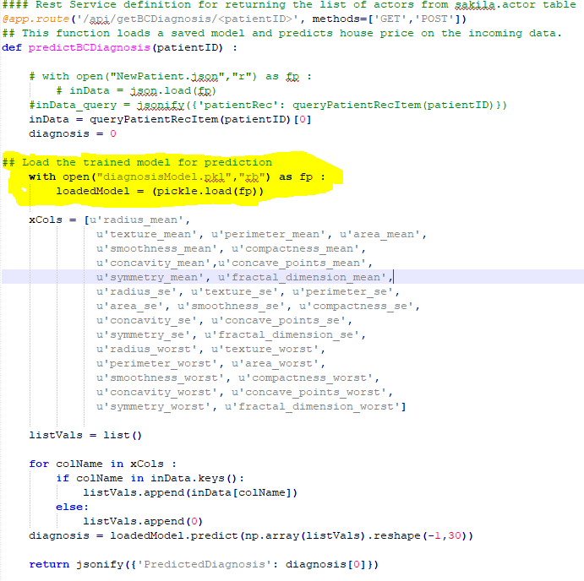
predictBCDiagnosis(patientID)

Slide 42
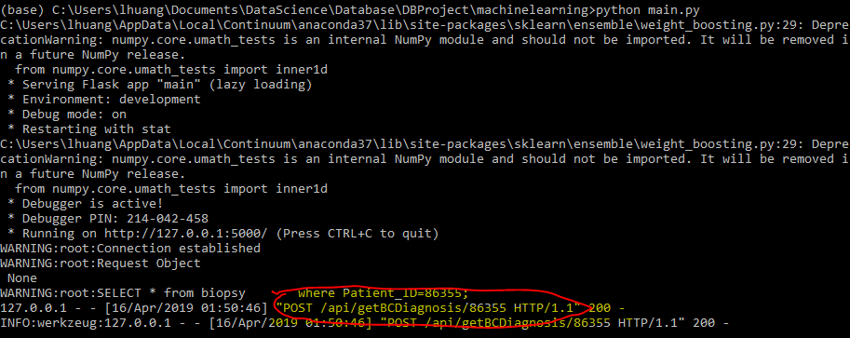
main.py "POST /api/getBCDiagnosis/86355 HTTP/1.1"

Slide 43
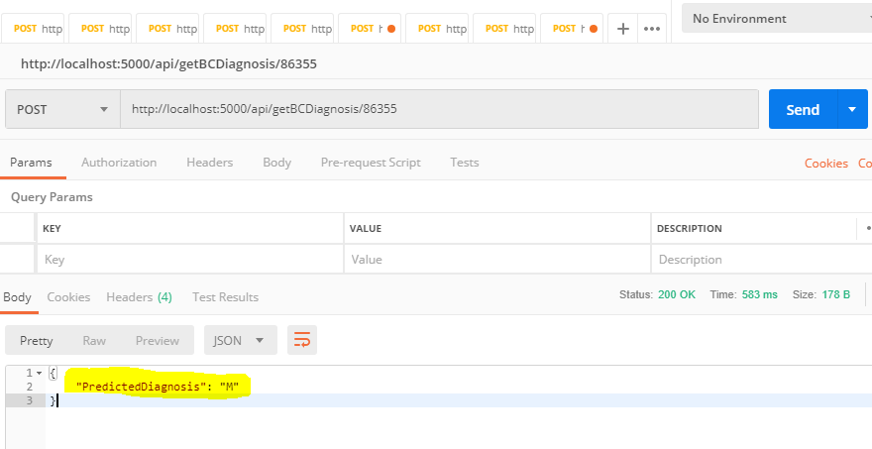
http://localhost:5000/api/getBCDiagnosis/86355

Slide 44
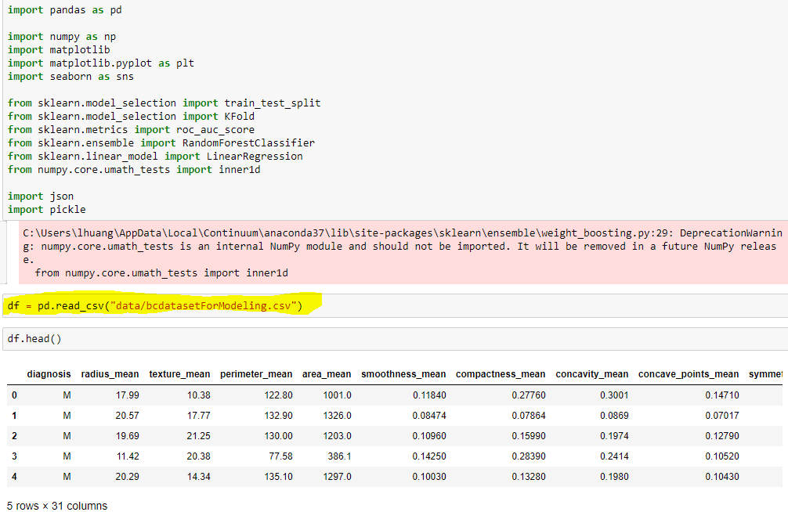
Modeling

Slide 45
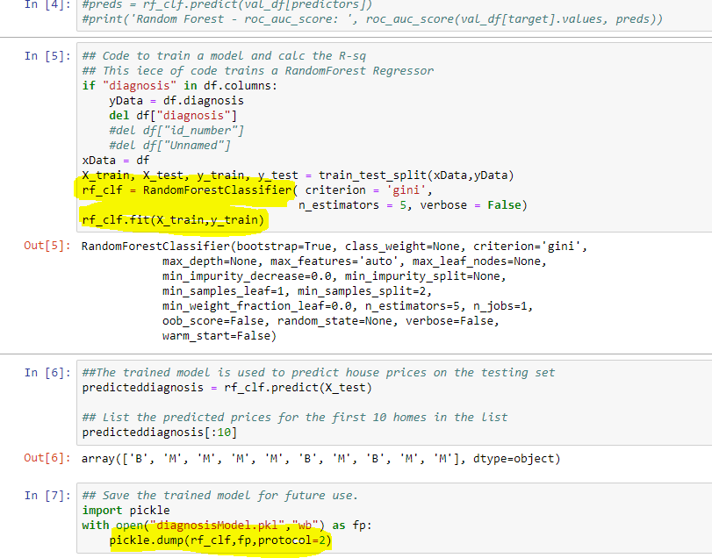
Modeling

Slide 46
CONCLUSIONS
Successfully designed the ER diagram and use normalization techniques to improve the efficiency for storing and querying the data.
Populated the database with patient genotyping data by simulation and patient biopsy data from online data source. Demonstrate the database function by writing SQL queries to extract or subset for deeper analysis.
Significance of our database :
Gain personalized biological information to diagnose and optimize treatment decisions for many types of cancers.
Potentially aid in biomarker or drug discovery. Easy to retrieve useful information for further analysis such as deep learning algorithms.

Slide 47
NEXT STEP
For real life large datasets, we need to utilize cloud computing such as AWS or Google Cloud Platform.

Slide 48
ACKNOWLEDGMENT
We would like to thank James Clay for the preliminary work.
And we are very honored to get initial guidance of this project from Dr. George Bell.
We would like to thank Dr. Engels and all the students in Database class for the semester. We help each other out and learn from each other a lot.

