Slide 1
GD 447
Game Programming III
Embedding Python scripts
into C++/opengl game
Leonid Umanskiy
Herzing University — Madison
27/05/2014

Slide 2

What is Python?
Python is general-purpose,
high-level programming language.
It was created in 1993 and it is still actively developed.

Slide 3
Why Python?
Why not?
No, seriously, why do we still use C++ for a game development?

Slide 4
Why Python?
We are still using C++ for game development because it's fast.
C++:
- Complied into native machine codes
- Executed directly by processor
Python (or JAVA, or any other language like that):
- Compiled into virtual machine bytecode
- Executed by virtual machine or interpreter

Slide 5
Why Python?
Pros and cons:
C++:
- Fast!
- Hard to learn, hard to code, hard to debug
(you can't be a professional C++ developer if you don't understand low-level stuff, such as pointers, stack, heap, processor registers, etc).
Python:
- Slower
- Easier to learn, easier to debug, easier to use

Slide 6
Why Python?
Does it really mater if it takes 10 or 20 milliseconds to display 500 000 polys?
Yes!
10 MS per frame = 100 FPS, 20 MS per frame = 50 FPS. Lower FPS — higher response time, game appears to be laggy.
That's why C++ is better for graphics/calculations

Slide 7
Why Python?
Does it really mater if it takes 10 or 20 milliseconds for NPC to answer when you click?
No! Nobody cares!
Nobody will ever see the difference between 10, 20, or even 100 MS here.
That's why it doesn't make any sense to write all your gameplay logic, dialogs, NPC code using C++.

Slide 8
Why Python?
From a studio producer perspective:
- C++ programmers are more expensive (because C++ is harder)
- If you are using C++ for gameplay logic (for example, for quests), designers should first make quest on paper and then programmers should code it.
- If you are using scripting language for quests, designers can write that code (it's much easier!). Or at least you can hire junior programmers so they can write NPC code

Slide 9
Why Python?
From a programmer perspective:
- Less code!
- Less work!
- Easier to code!

Slide 10
Why Python?
From a designer perspective:
- If you are designer who knows Python, you can just sit, write, and test your NPC code
- You are much more valuable employee than just an artist

Slide 11
Why Python?
Also,
If you split your graphics/calculations and game logic:
- No need to recompile everything to make minor change in NPC dialog
- Much easier to support Python code
- You can make user-modifiable functionality (UI plugins, addons, etc)

Slide 12
Why Python?
Why Python and not LUA?
- Python is MUCH easier to learn for non-professional programmer
- Python is general-purpose language, so if you know it, you can use it to write your own website for example, or to make some calculations when you need etc.

Slide 13
Usage — part 1
Usage - part 1:
Including Python script
into Visual Studio Project

Slide 14
Including Python script into Visual Studio Project
Right way to do it:
- Download latest python installer from https://www.python.org/
- Install to your system
- Include files from C:\Python32 (depends on version you installed), for all your projects

Slide 15
Including Python script into Visual Studio Project
Another way to do it:
- Download package I built from my github:
https://github.com/leonidumanskiy/PythonTutorial
- Put into your project folder
- Include files from it

Slide 16
Including Python script into Visual Studio Project
In your project properties:
- Switch «configuration» to «All configurations»
- Linker → General → Additional Dependencies → Add «Python32\libs\python32.lib»
(or C:\Python32\libs\python32.lib if you installed python into your system)

Slide 17
Including Python script into Visual Studio Project
If you downloaded package:
Main.cpp:
#include "Python32/include/Python.h"
If you installed to system:
Main.cpp:
#include <Python.h>
And then go to your go to your Configuration Properties → C/C++ → General → Additional Include Directories and add "C:\Python32\include"

Slide 18
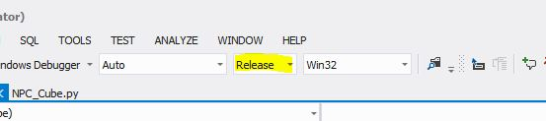
Including Python script into Visual Studio Project
You should also change your build configuration to «Release».
If you don't do it, Python will try to open debug .lib file which is missing (you can fix pyconfig.h if you really need debug build).

Slide 19
Including Python script into Visual Studio Project
If you haven’t installed Python, compress your python32/Lib contents into python32.zip archive and put it near your exe file, or use tools like freeze

Slide 20
Including Python script into Visual Studio Project
Main.cpp:
#include <iostream>
#include "Python32/include/Python.h"
int main(int argc, char *argv[])
{
Py_Initialize();
PyRun_SimpleString("from time import time,ctime\n"
"print('Today is', ctime(time()))\n");
Py_Finalize();
std::cin.get();
return 0;
}

Slide 21
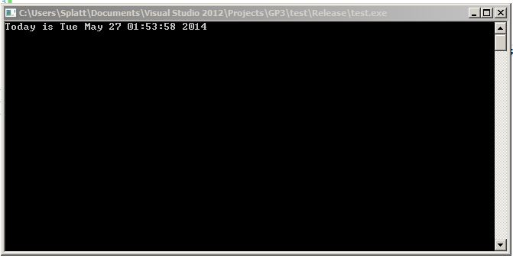
Including Python script into Visual Studio Project
Result:

Slide 22
Usage — part 2
Usage - part 2:
Combining OpenGL game and python script
(for that part, I will not go over OpenGL-related game code, because it will take a lot of time. I will only go over python-related C++ code)

Slide 23
Combining OpenGL game and python script
Main.cpp, add:
#include "Python32/include/Python.h"
Function prototypes:
void initGL();
void initPython();
void destroyGame();
void drawCube();
void cubeClick();

Slide 24
Combining OpenGL game and python script
Main.cpp, add:
Some variables we need:
unsigned char cubeText[255];
// Python variables
char pModuleName[] = "NPC_Cube";
char pClassName[] = "NPC_Cube";
char pFunctionName[] = "dialog";
// We store our python-based npc object here
PyObject *pCubeNpc;

Slide 25
Combining OpenGL game and python script
Main function, add:
After:
InitGL();
Add:
initPython();

Slide 26
Combining OpenGL game and python script
Display function, add:
// code to display
drawCube();
destroyGame() function:
void destroyGame()
{
// Clean python cube npc instance
Py_DECREF(pCubeNpc);
// Finalize python
Py_Finalize();
}

Slide 27
Combining OpenGL game and python script
Mouse function, add:
…
switch (button)
{
case GLUT_LEFT_BUTTON:
{
if(state == GLUT_UP)
cubeClick();

Slide 28
Combining OpenGL game and python script
DrawCube:
void drawCube()
{
// Draw cube NPC answer
glColor3f(1.0f, 1.0f, 1.0f);
glRasterPos3f(-70, -80, 330);
glutBitmapString(GLUT_BITMAP_HELVETICA_18, cubeText);
// Draw cube NPC object
...

Slide 29
Combining OpenGL game and python script
initPython function: (interesting part)
// Init python, load module / class, create instance
void initPython()
{
Py_Initialize(); // Initialize python
PyObject *pName = PyUnicode_FromString(pModuleName); // Module Name
PyObject *pModule = PyImport_Import(pName); // Import module NPC_Cube
if(pModule == NULL) {
cerr << "Failed to load module:" << endl;
PyErr_Print();
return;
}

Slide 30
Combining OpenGL game and python script
initPython function: (interesting part)
// Create pCubeNpc python class instance by calling it
pCubeNpc = PyObject_CallMethod(pModule, pClassName, "");
if(pCubeNpc == NULL) {
cerr << "Failed to create instance:" << endl;
PyErr_Print();
return;
}
// Clean memory
Py_DECREF(pName);
Py_DECREF(pModule);
}

Slide 31
Combining OpenGL game and python script
cubeClick function: (interesting part)
// When user clicks cube, call python npc dialog
void cubeClick()
{
// Call our "dialog" method with no args
PyObject *pValue = PyObject_CallMethod(pCubeNpc, pFunctionName, "");
if(pValue == NULL) {
cerr << "Failed to call method" << endl;
PyErr_Print();
return;
}

Slide 32
Combining OpenGL game and python script
cubeClick function: (interesting part)
// Convert python unicode object to ascii string
PyObject *pStr = PyUnicode_AsASCIIString(pValue);
// Convert python ascii string to C string
const char *c_str = PyBytes_AsString(pStr);
memcpy_s(cubeText, 255, c_str, 255);
// Clean up
Py_DECREF(pValue);
Py_DECREF(pStr);
}

Slide 33
Combining OpenGL game and python script
Add NPC_Cube.py file to your project:
class NPC_Cube:
timesAnswered = 0
def dialog(self):
if self.timesAnswered == 0:
answer = "Hi there."
elif self.timesAnswered == 1:
answer = "I am just a cube, lost in time and space."
elif self.timesAnswered == 2:
answer = "What do you want, stranger?"
else:
answer = "You clicked me " + str(self.timesAnswered) + " times. Stop!"
self.timesAnswered += 1
return answer

Slide 34
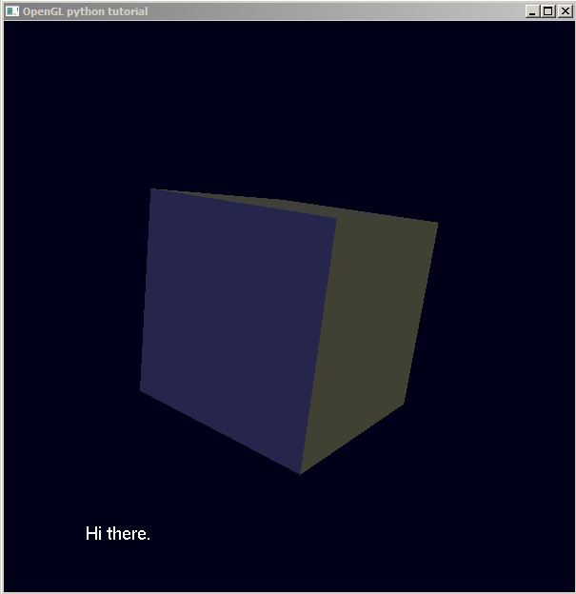
Combining OpenGL game and python script
Result:

Slide 35
Thank you!
References:
Download demo project from my github:
https://github.com/leonidumanskiy/PythonTutorial
Additional materials:
https://docs.python.org/3.2/extending/embedding.html

