Slide 1
Edge Detection
6.344 Final Project
Michael Mekonnen

Slide 2
Outline
Gradient-based method
Description
Examples
Laplacian-based method
Description
Examples
Comparison

Slide 3
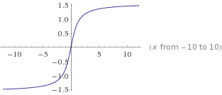
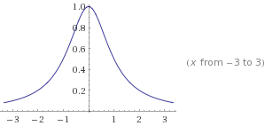
Gradient-based method Motivation
f(x)
df(x)/dx

Slide 4
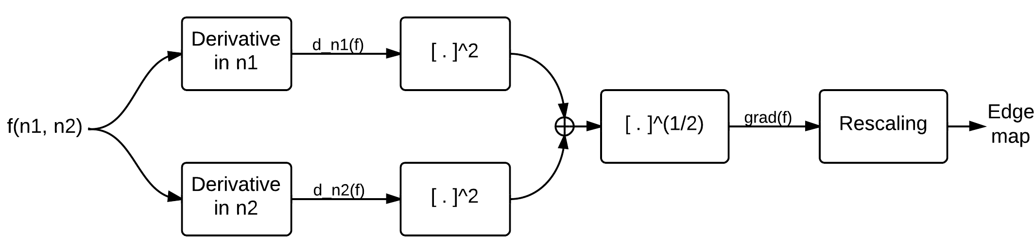
Gradient-based method Steps

Slide 5
Gradient-based method Examples

Slide 6
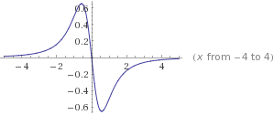
Laplacian-based method Motivation
f(x)
d²f(x)/dx²

Slide 7
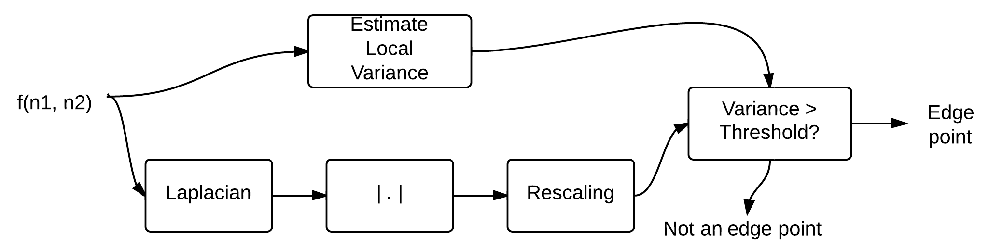
Laplacian-based method Steps

Slide 8
Laplacian-based method Examples

Slide 9
Comparison

