Slide 1
Edge Detection
6.344 Final Project
Michael Mekonnen

Slide 2
Outline
Gradient-based method
Description
Examples
Laplacian-based method
Description
Examples
Comparison

Slide 3
Gradient-based method

Slide 4
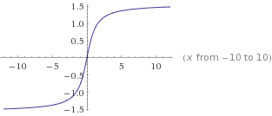
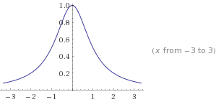
Gradient-based method Motivation
f(x)
df(x)/dx

Slide 5
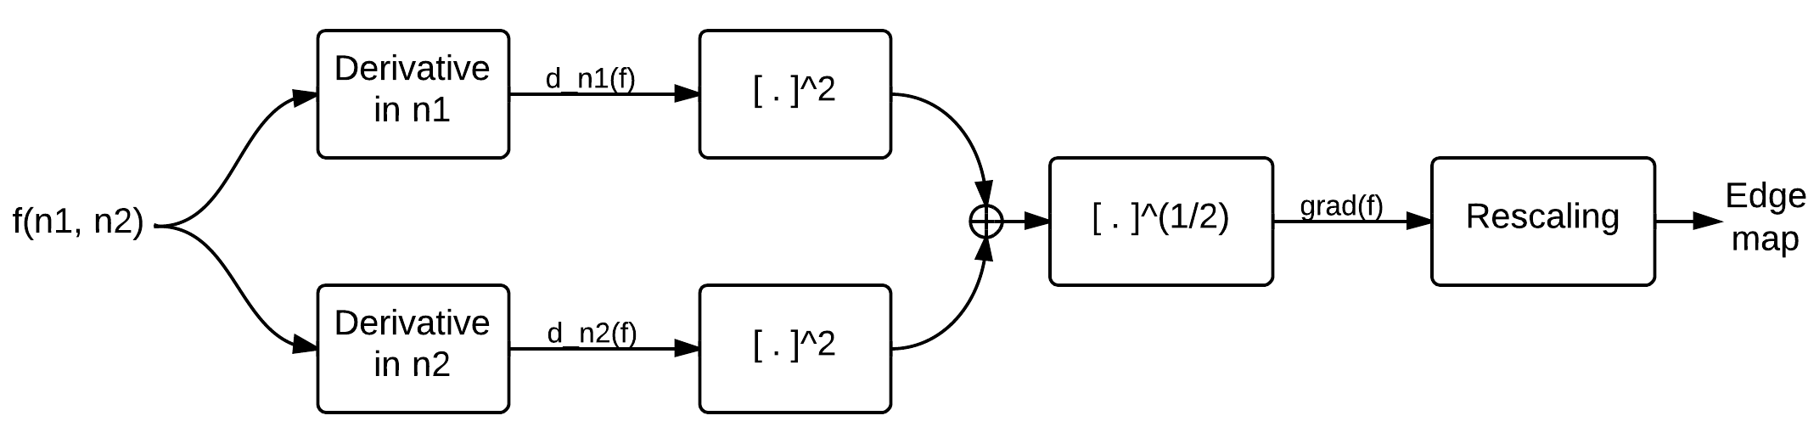
Gradient-based method Steps

Slide 6
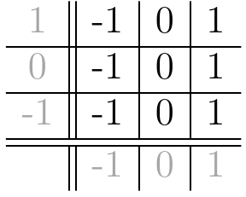
Gradient-based method Computing Derivatives

Slide 7
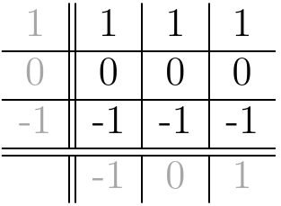
Gradient-based method Computing Derivatives

Slide 8

Gradient-based method Computing Derivatives

Slide 9
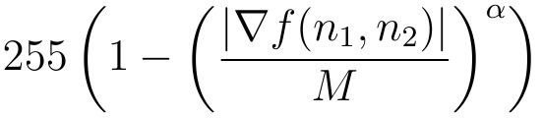

Gradient-based method Computing Derivatives

Slide 10

Gradient-based method Example 1

Slide 11

Gradient-based method Example 1

Slide 12
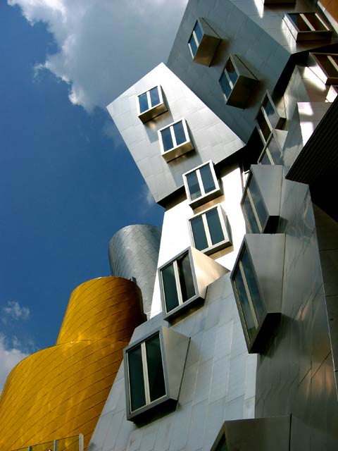
Gradient-based method Example 2

Slide 13
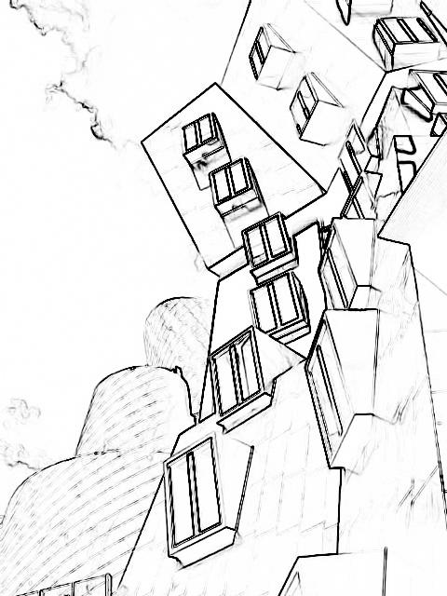
Gradient-based method Example 2

Slide 14
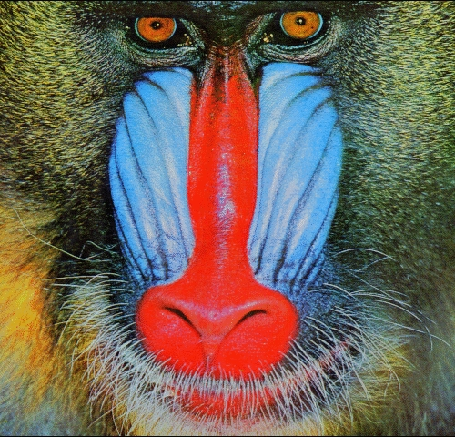
Gradient-based method Example 3

Slide 15
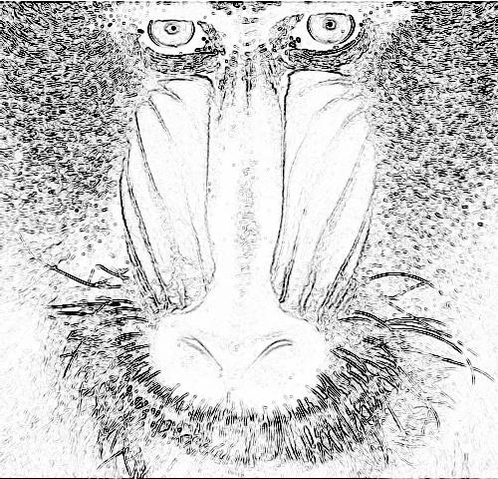
Gradient-based method Example 3

Slide 16
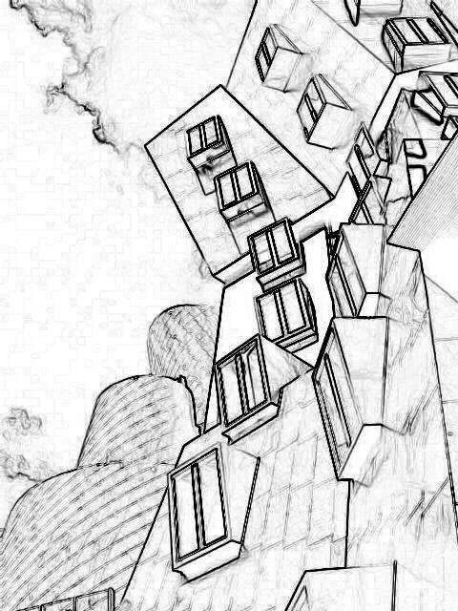
Effect of α α = 1

Slide 17
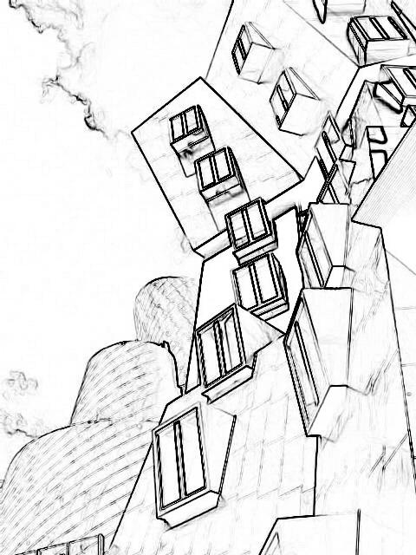
Effect of α α = 1.5

Slide 18
Effect of α α = 2

Slide 19
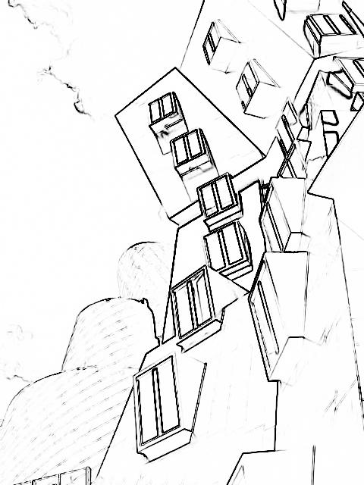
Effect of α α = 3

Slide 20
Laplacian-based method

Slide 21
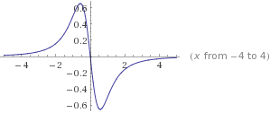
Laplacian-based method Motivation
f(x)
d²f(x)/dx²

Slide 22
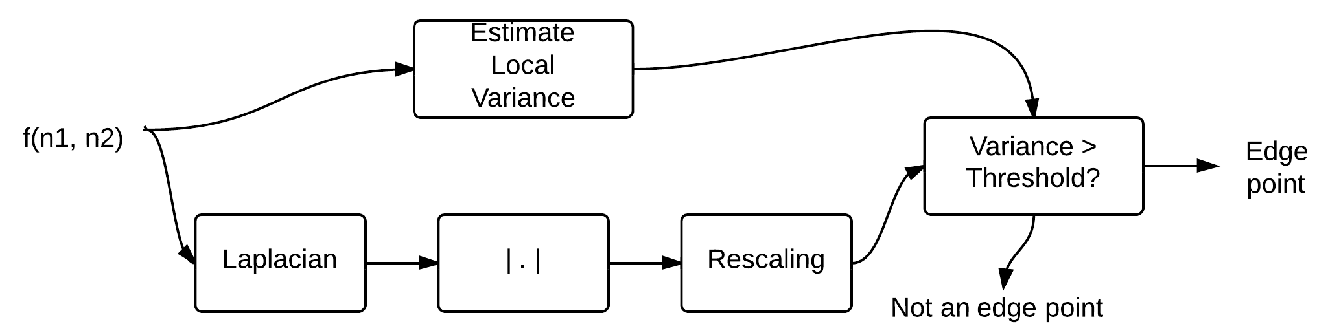
Laplacian-based method Steps

Slide 23
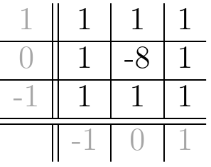
Laplacian-based method Steps

Slide 24


Laplacian-based method Steps

Slide 25
Laplacian-based method Example 1

Slide 26
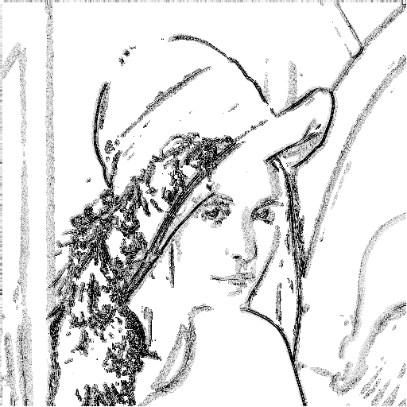
Laplacian-based method Example 1

Slide 27
Laplacian-based method Example 2

Slide 28
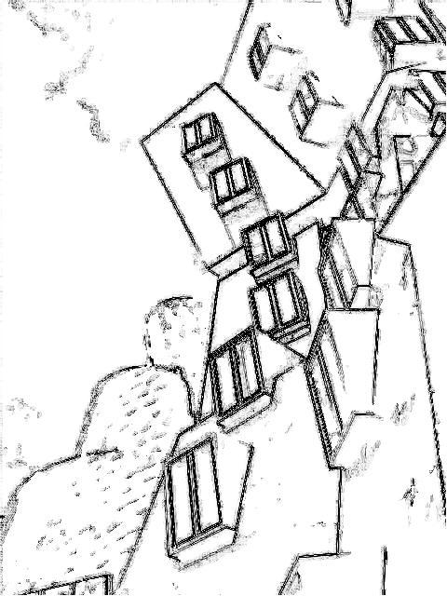
Laplacian-based method Example 2

Slide 29
Laplacian-based method Example 3

Slide 30
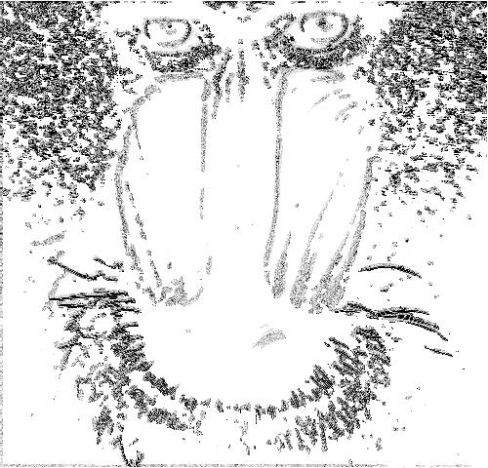
Laplacian-based method Example 3

Slide 31
Need for variance fix With variance fix

Slide 32
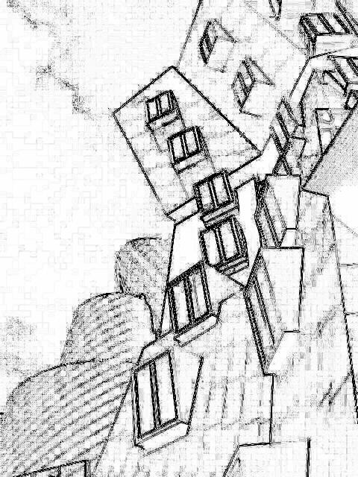
Need for variance fix Without variance fix

Slide 33
Comparison

Slide 34
Comparison Original

Slide 35
Comparison Gradient-based

Slide 36
Comparison Laplacian-based

Slide 37
Comparison Original

Slide 38
Comparison Gradient-based

Slide 39
Comparison Laplacian-based

Slide 40
Comparison Original

Slide 41
Comparison Gradient-based

Slide 42
Comparison Laplacian-based

Slide 43
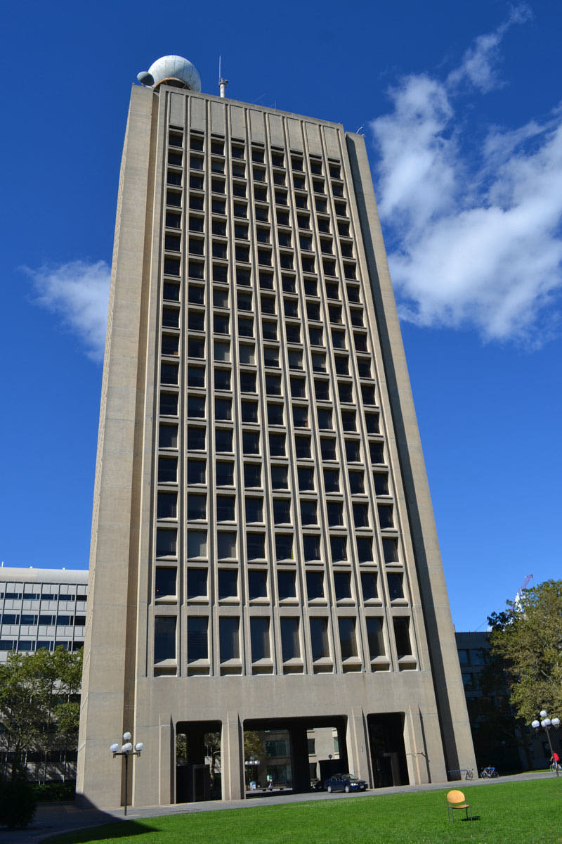
Comparison Original

Slide 44
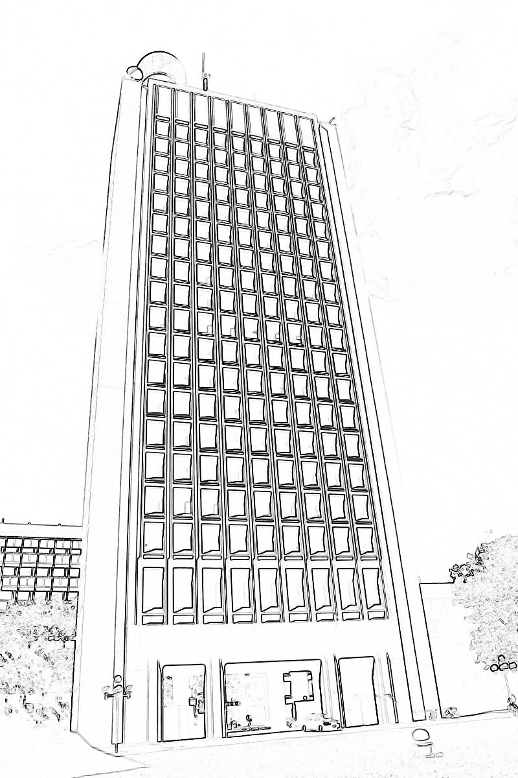
Comparison Gradient-based

Slide 45
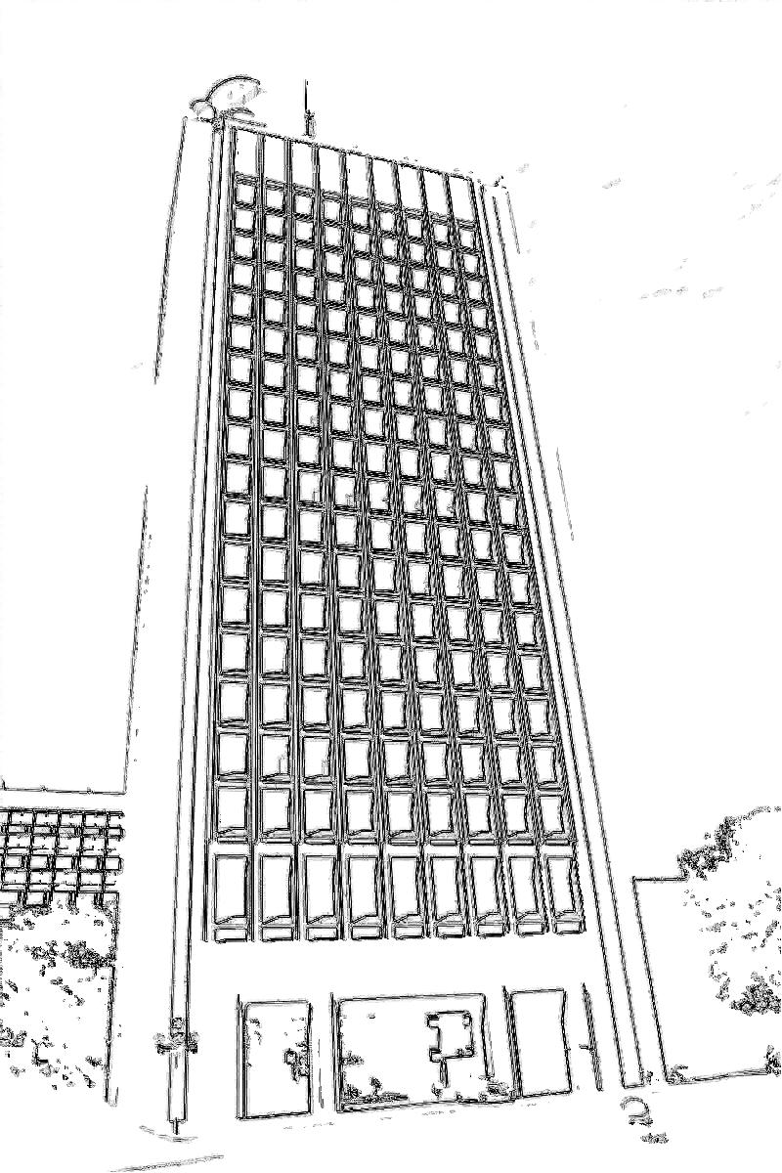
Comparison Laplacian-based

Slide 46
Source
https://github.com/mikemeko/6.344-Project

