Slide 1
Edge Detection
6.344 Final Project
Michael Mekonnen

Slide 2
Outline
Gradient-based method
Description
Examples
Laplacian-based method
Description
Examples
Comparison

Slide 3
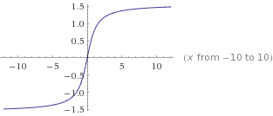
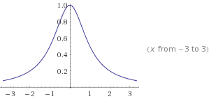
Gradient-based method Motivation
f(x)
df(x)/dx

Slide 4
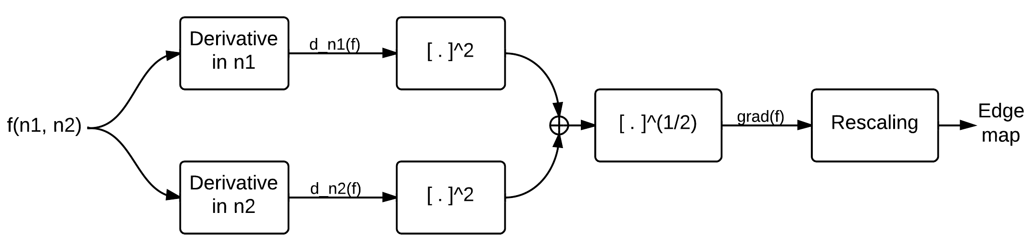
Gradient-based method Steps

Slide 5
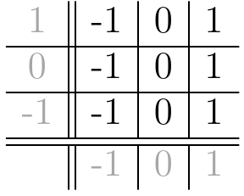
Gradient-based method Computing Derivatives

Slide 6
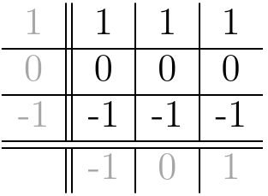
Gradient-based method Computing Derivatives

Slide 7

Gradient-based method Computing Derivatives

Slide 8
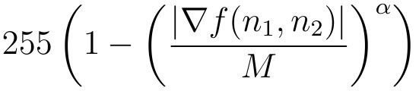

Gradient-based method Computing Derivatives

Slide 9

Gradient-based method Example 1

Slide 10

Gradient-based method Example 1

Slide 11
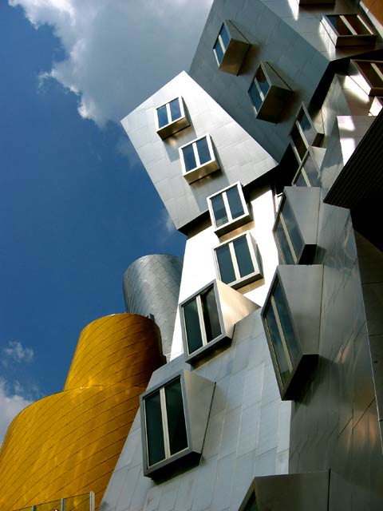
Gradient-based method Example 2

Slide 12
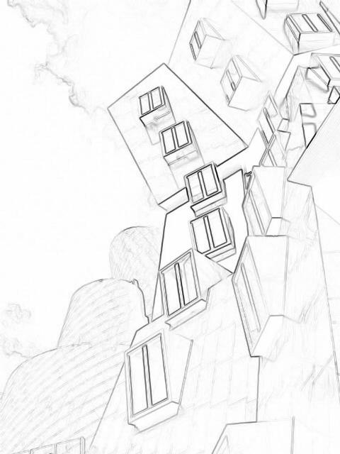
Gradient-based method Example 2

Slide 13
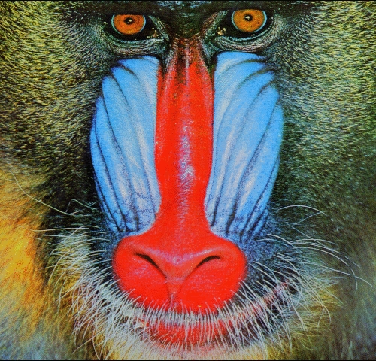
Gradient-based method Example 3

Slide 14
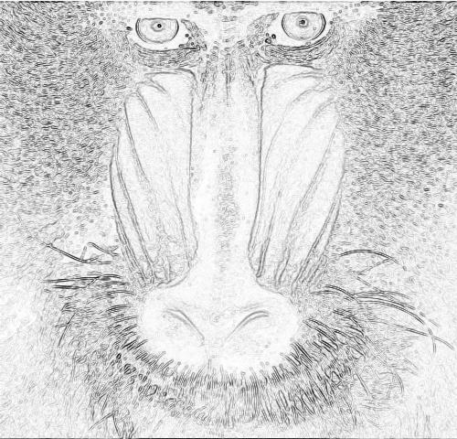
Gradient-based method Example 3

Slide 15
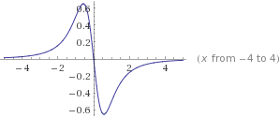
Laplacian-based method Motivation
f(x)
d²f(x)/dx²

Slide 16
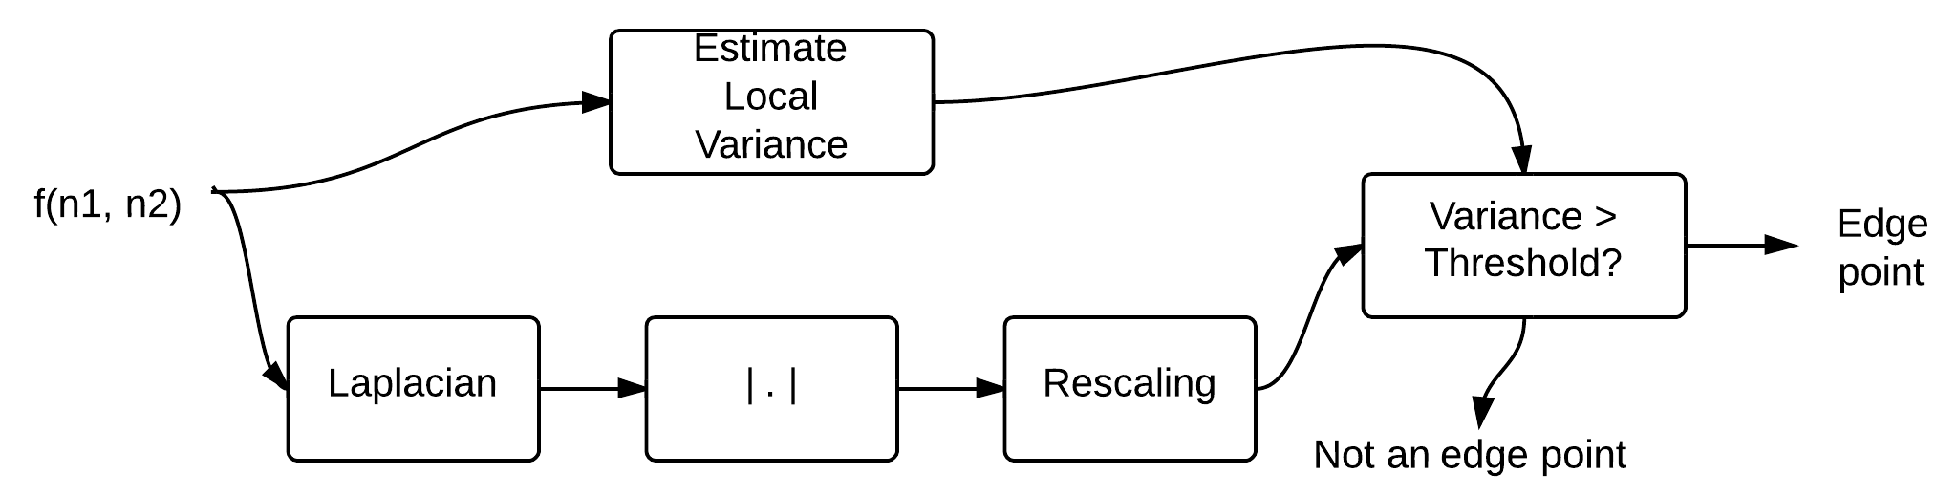
Laplacian-based method Steps

Slide 17
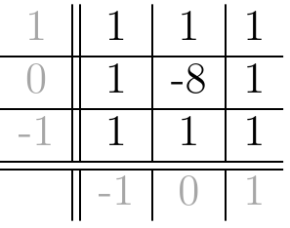
Laplacian-based method Steps

Slide 18

Laplacian-based method Steps

Slide 19
Laplacian-based method Example 1

Slide 20
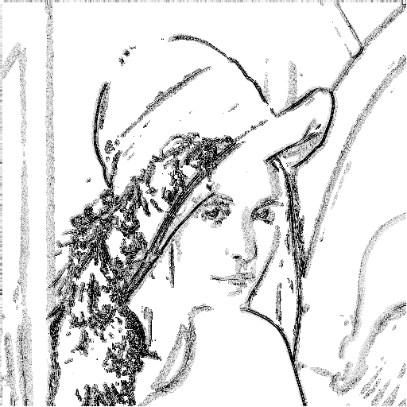
Laplacian-based method Example 1

Slide 21
Laplacian-based method Example 2

Slide 22
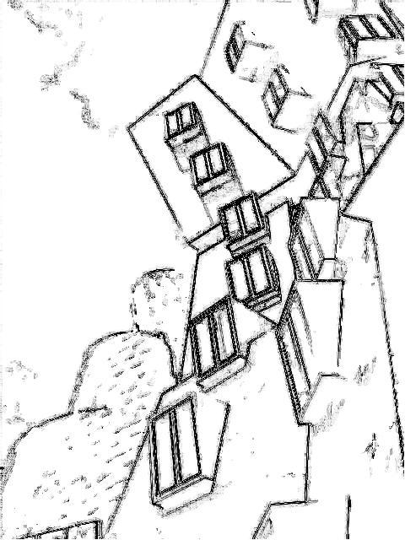
Laplacian-based method Example 2

Slide 23
Laplacian-based method Example 3

Slide 24
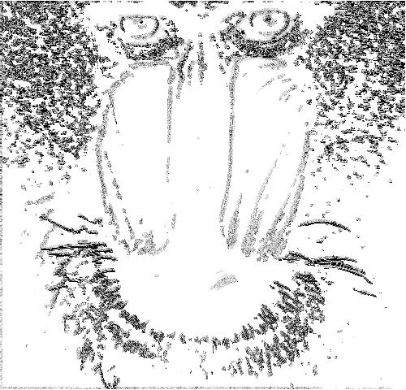
Laplacian-based method Example 3

Slide 25
Comparison Original

Slide 26
Comparison Gradient-based

Slide 27
Comparison Laplacian-based

Slide 28
Comparison Original

Slide 29
Comparison Gradient-based

Slide 30
Comparison Laplacian-based

Slide 31
Comparison Original

Slide 32
Comparison Gradient-based

Slide 33
Comparison Laplacian-based

Slide 34
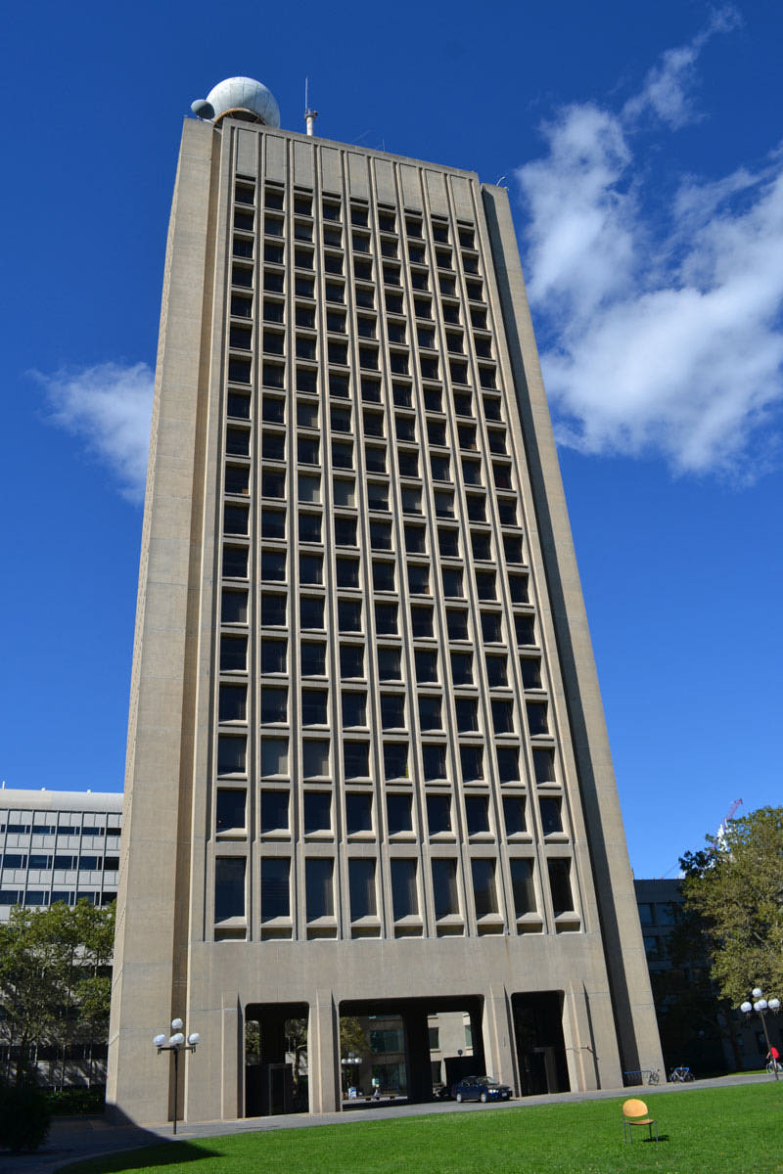
Comparison Original

Slide 35
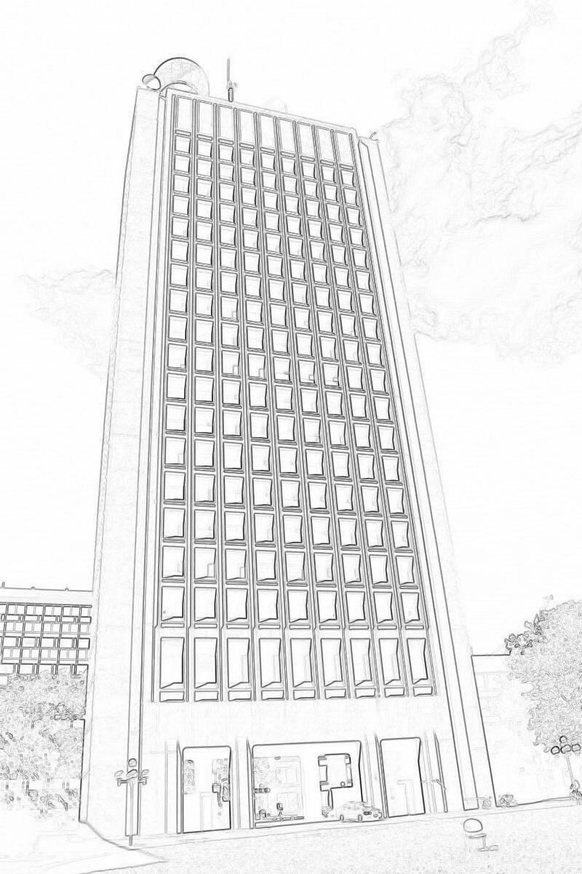
Comparison Gradient-based

Slide 36
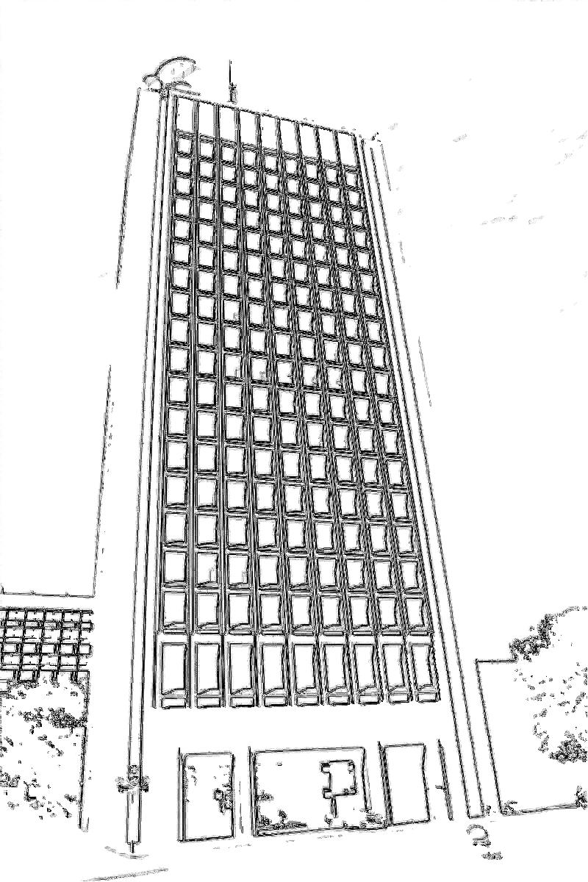
Comparison Laplacian-based

Slide 37
Source
https://github.com/mikemeko/6.344-Project

