Slide 1
Edge Detection
6.344 Final Project
Michael Mekonnen

Slide 2
Outline
Gradient-based method
Description
Examples
Laplacian-based method
Description
Examples
Comparison
Application of Edge Detection

Slide 3
Gradient-based method

Slide 4
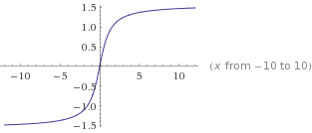
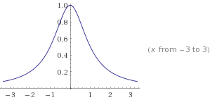
Gradient-based method Motivation
f(x)
df(x)/dx

Slide 5
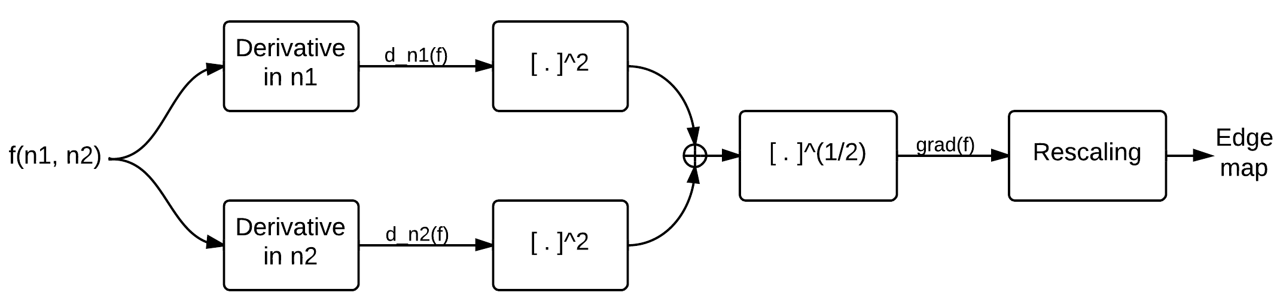
Gradient-based method Steps

Slide 6
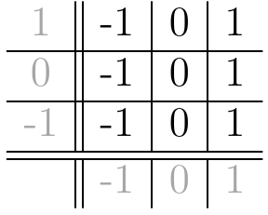
Gradient-based method Computing Derivatives

Slide 7
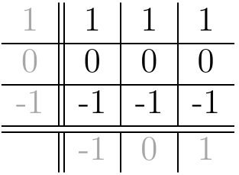
Gradient-based method Computing Derivatives

Slide 8

Gradient-based method Computing Derivatives

Slide 9
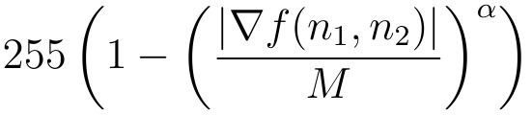

Gradient-based method Computing Derivatives

Slide 10

Gradient-based method Example 1

Slide 11
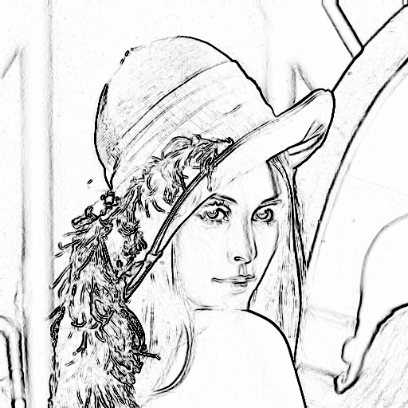
Gradient-based method Example 1

Slide 12
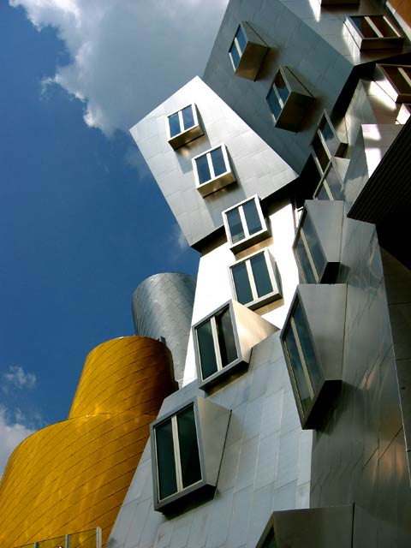
Gradient-based method Example 2

Slide 13
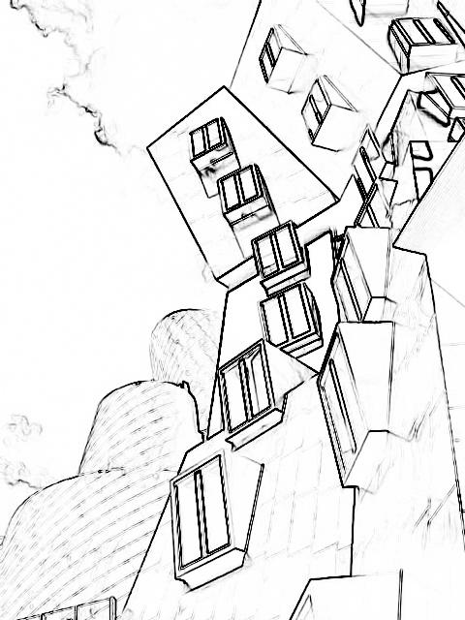
Gradient-based method Example 2

Slide 14
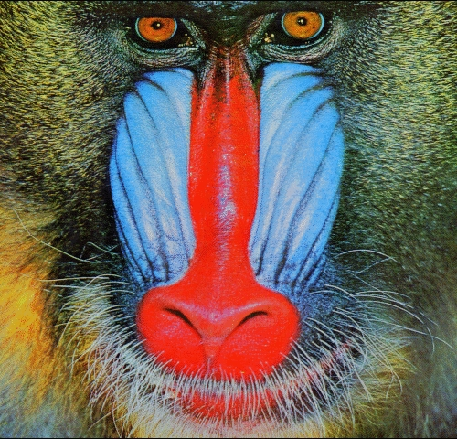
Gradient-based method Example 3

Slide 15
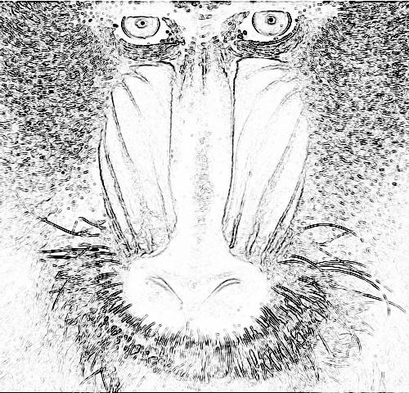
Gradient-based method Example 3

Slide 16
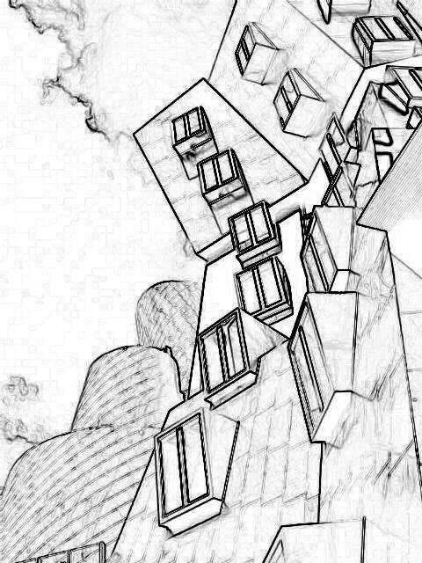
Effect of α α = 1

Slide 17
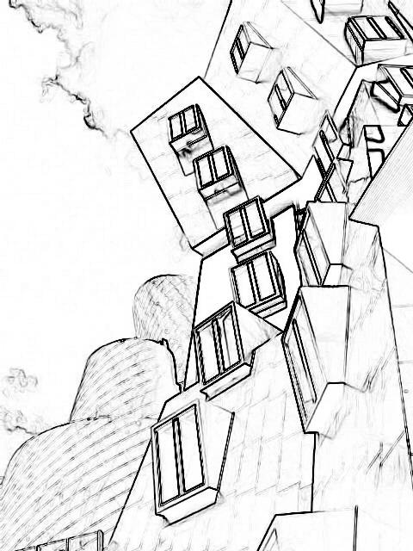
Effect of α α = 1.5

Slide 18
Effect of α α = 2

Slide 19
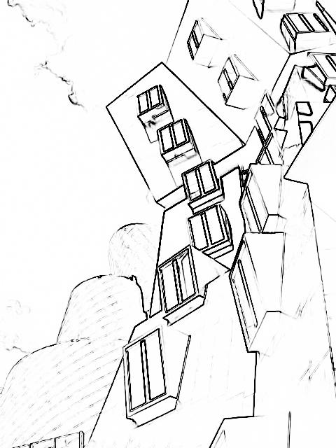
Effect of α α = 3

Slide 20
Laplacian-based method

Slide 21
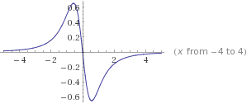
Laplacian-based method Motivation
f(x)
d²f(x)/dx²

Slide 22
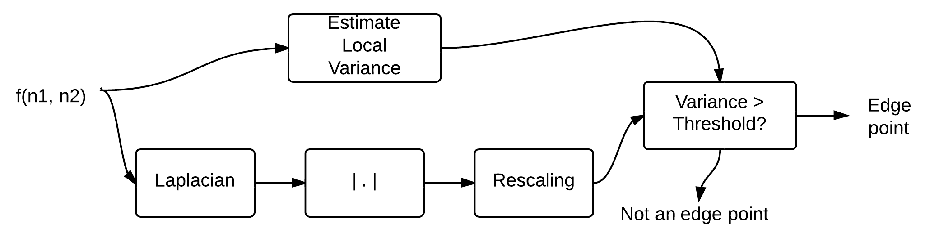
Laplacian-based method Steps

Slide 23
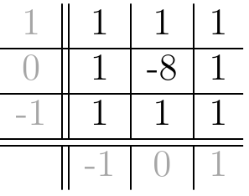
Laplacian-based method Steps

Slide 24


Laplacian-based method Steps

Slide 25
Laplacian-based method Example 1

Slide 26
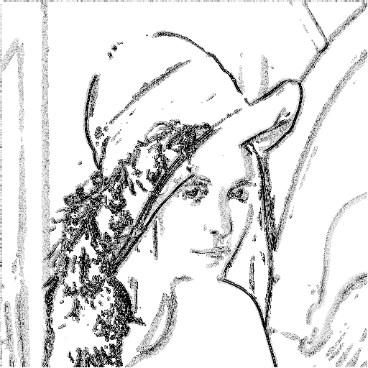
Laplacian-based method Example 1

Slide 27
Laplacian-based method Example 2

Slide 28
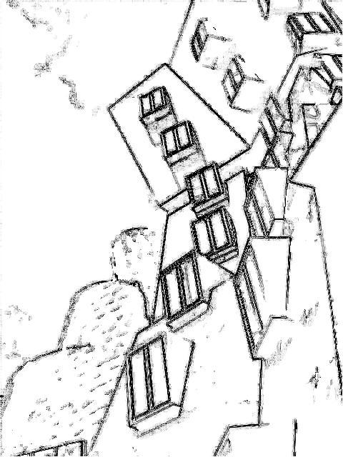
Laplacian-based method Example 2

Slide 29
Laplacian-based method Example 3

Slide 30
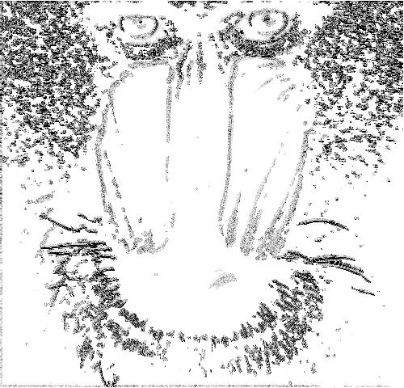
Laplacian-based method Example 3

Slide 31
Need for variance fix With variance fix

Slide 32
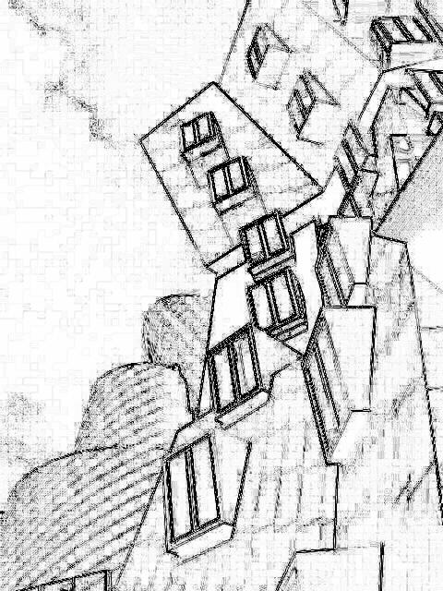
Need for variance fix Without variance fix

Slide 33
Comparison

Slide 34
Comparison Original

Slide 35
Comparison Gradient-based

Slide 36
Comparison Laplacian-based

Slide 37
Comparison Original

Slide 38
Comparison Gradient-based

Slide 39
Comparison Laplacian-based

Slide 40
Comparison Original

Slide 41
Comparison Gradient-based

Slide 42
Comparison Laplacian-based

Slide 43
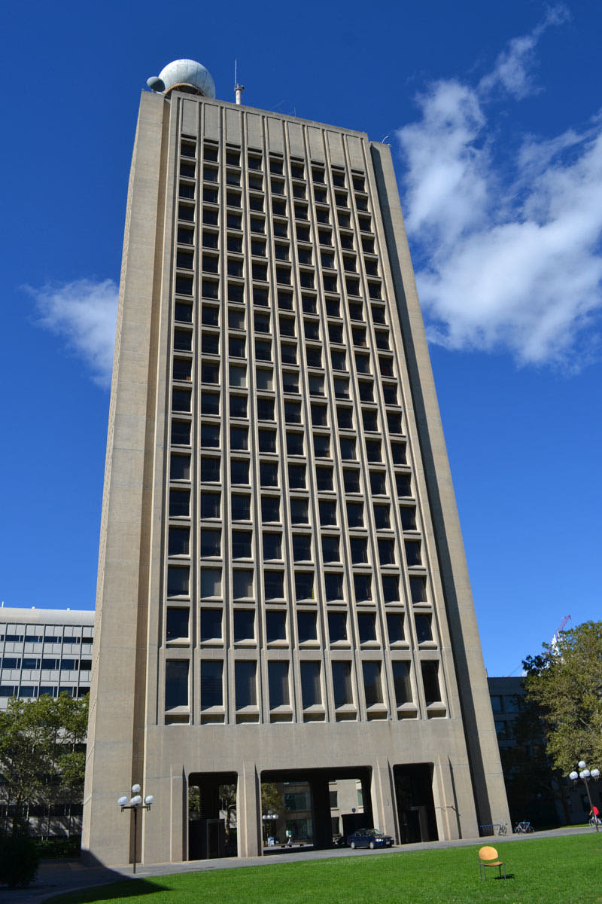
Comparison Original

Slide 44
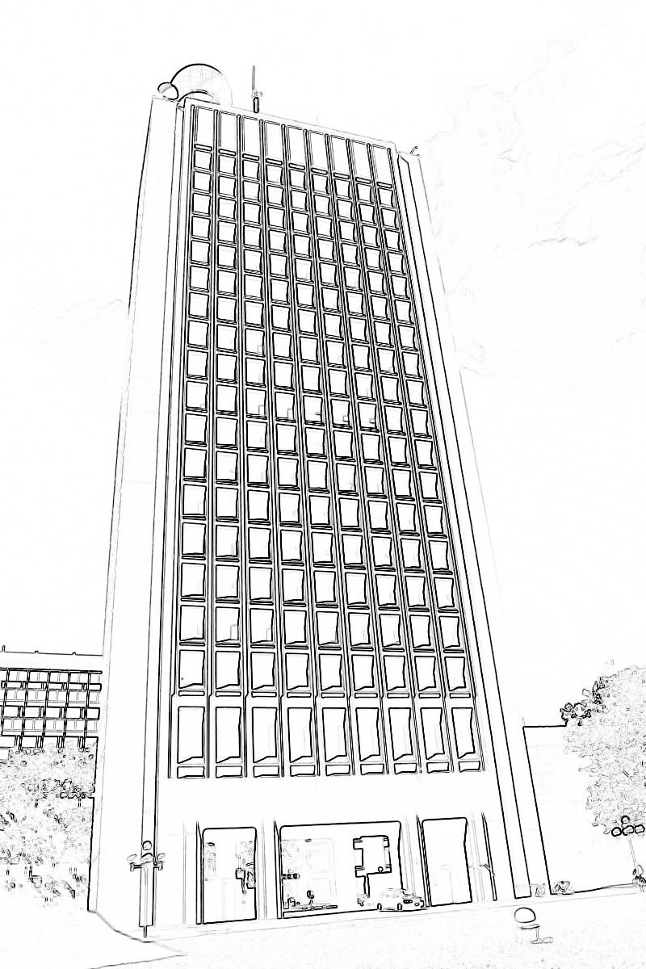
Comparison Gradient-based

Slide 45
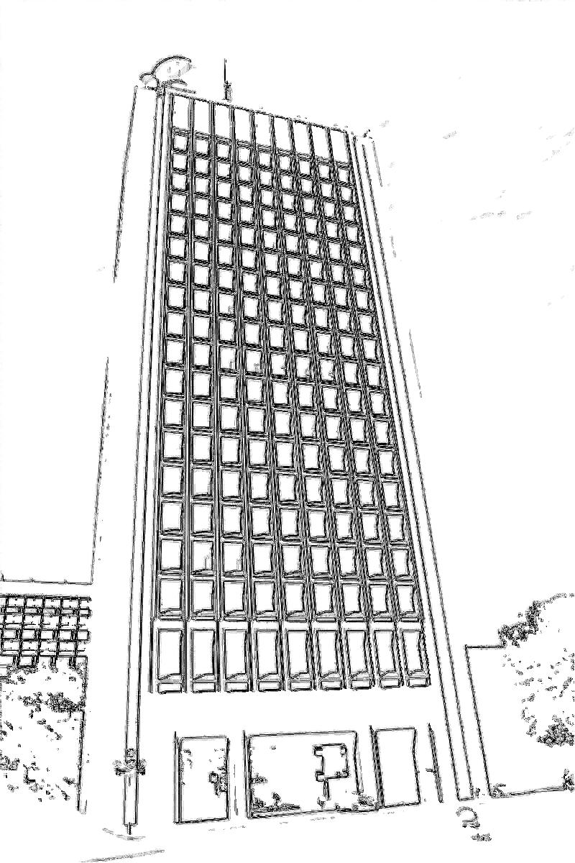
Comparison Laplacian-based

Slide 46
Application Original

Slide 47

Application Enhanced

Slide 48
Application Original

Slide 49
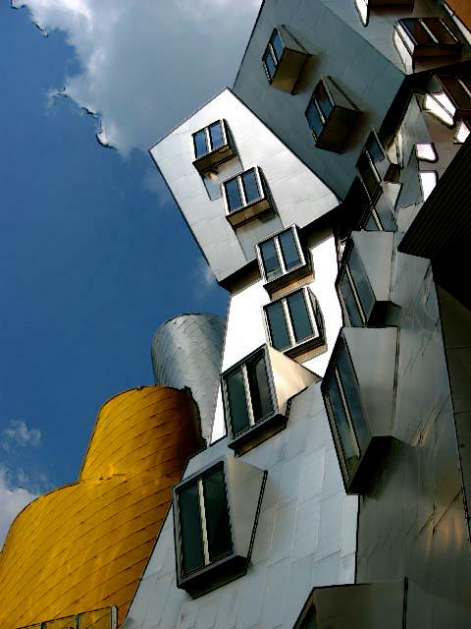
Application Enhanced

Slide 50
Application Original

Slide 51
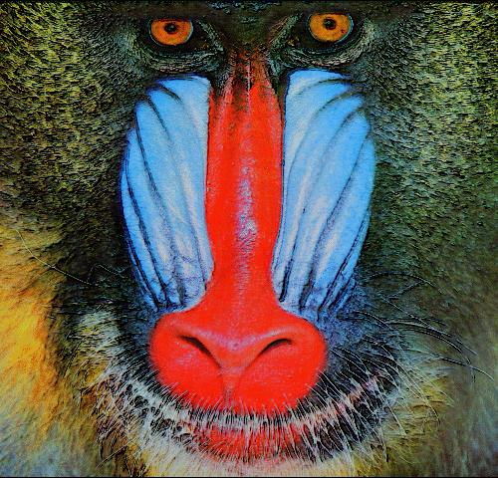
Application Enhanced

Slide 52
Application Original

Slide 53
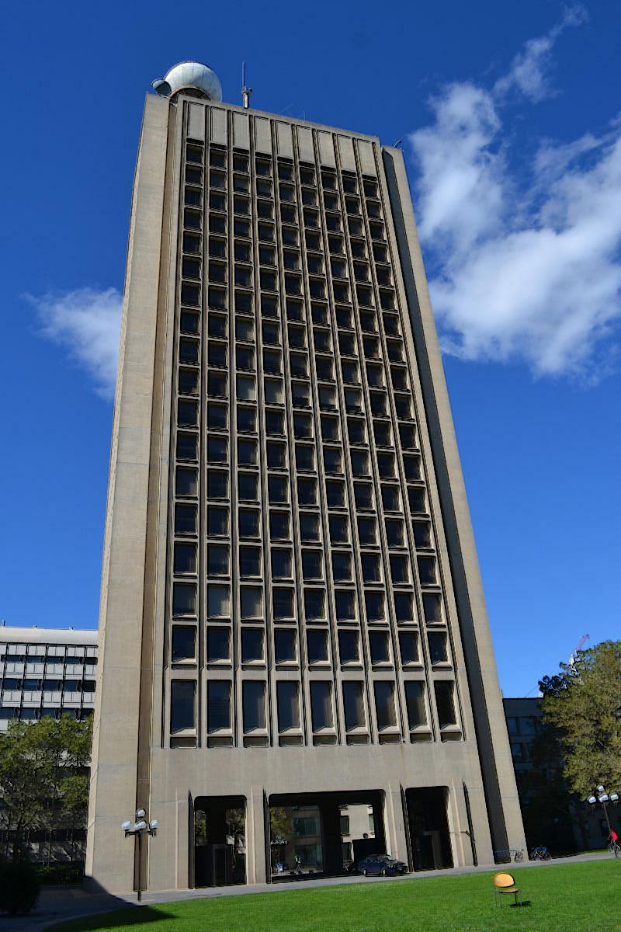
Application Enhanced

Slide 54
Source
https://github.com/mikemeko/6.344-Project

